Slide 1

AI-Powered Fake News Detection
Using Text Classification to Combat Misinformation
HARSHIL PATEL · 183320 · IICT SUMMER INTERNSHIP

Slide 2

The Misinformation Crisis
Fake news — articles intentionally fabricated to deceive — propagates rapidly across social media, often outpacing manual fact-checking. The spread of misinformation poses a severe threat to societal discourse, political stability, and public health.
The Threat
The Solution
Fake news spreads faster than truth, undermining public trust and societal stability.
Automated AI/NLP pipelines serve as a first line of defense against deceptive content.
The Goal
Classify news articles as Real (0) or Fake (1) using machine learning.

Slide 3
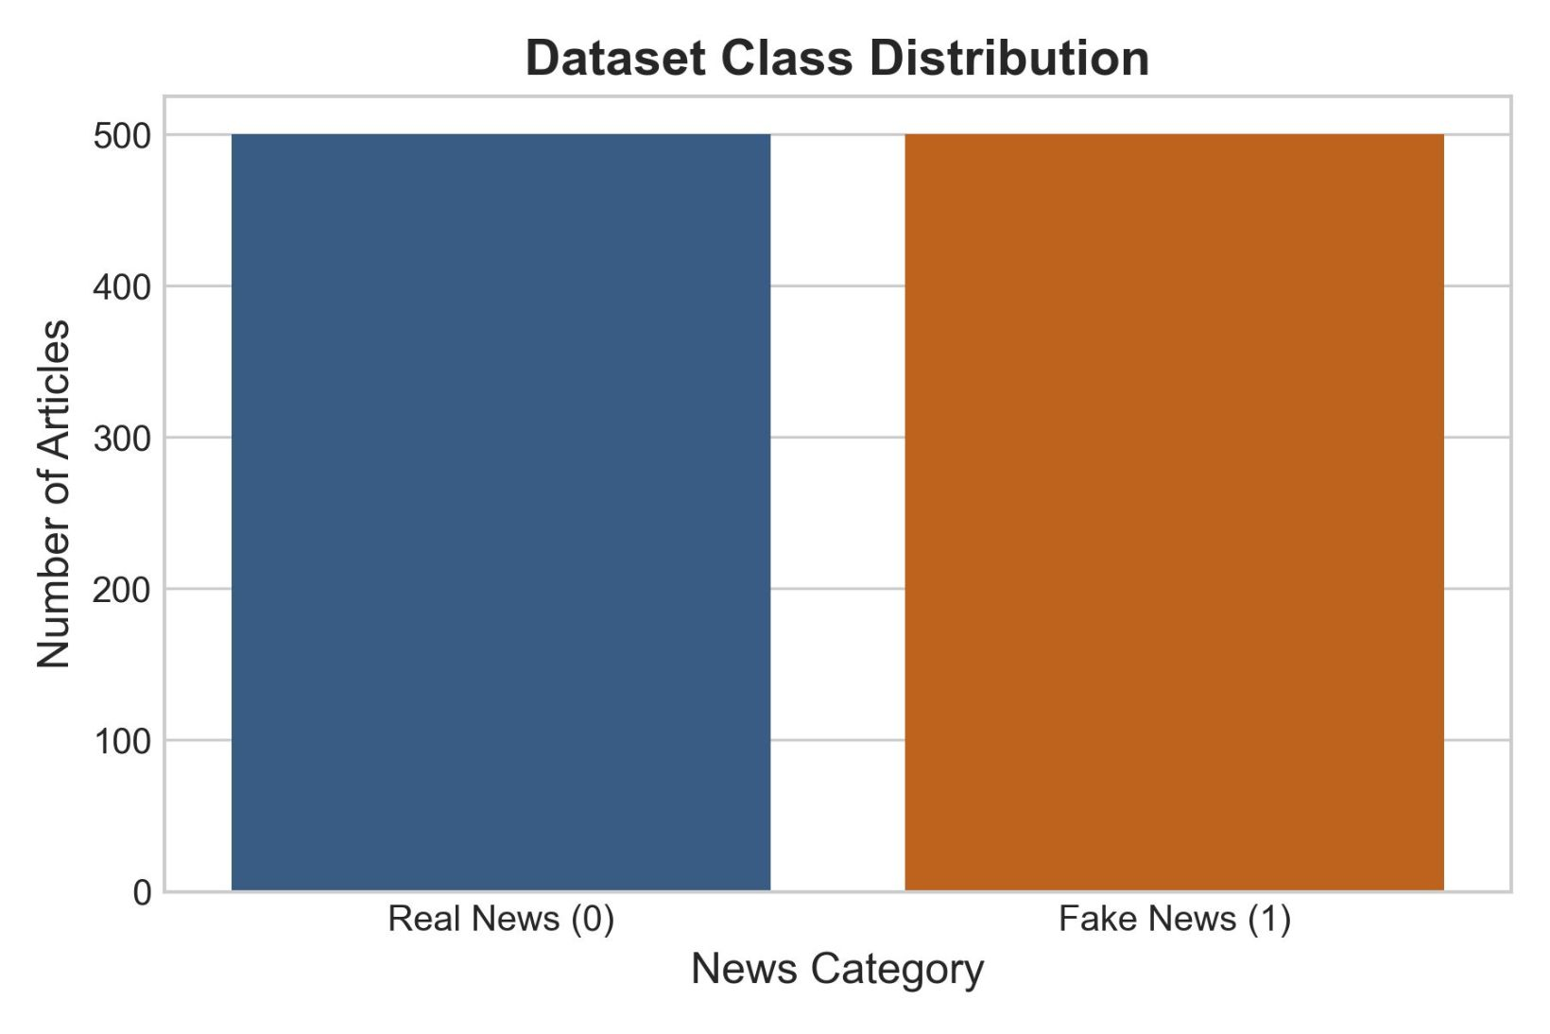
Dataset Overview
Balanced Benchmark Dataset
A synthetic benchmark dataset was generated dynamically to ensure reproducibility and realistic representation of news data.
1,000 total instances of news articles
Primary feature: raw textual content (text)
Target variable: label (Real = 0, Fake = 1)
Perfectly balanced: 500 real and 500 fake articles

Slide 4

Text Preprocessing Pipeline
Raw text undergoes rigorous cleaning before feature extraction, converting unstructured content into a format suitable for ML algorithms.
Lowercase
Remove URLs
Remove Non-Alphabetic
Tokenize
Each step progressively refines the raw text, removing noise and standardizing the input for TF-IDF vectorization and downstream classification.

Slide 5
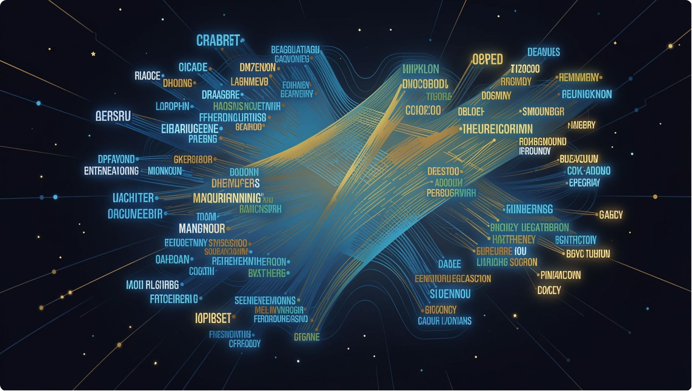

TF-IDF Feature Vectorization
Term Frequency-Inverse Document Frequency converts cleaned text into numerical representations by evaluating word importance relative to the corpus.
5,000 max features extracted
Unigrams + bigrams to capture sequential context
High discriminative power on textual structure

Slide 6
Four Classification Paradigms
KNN
1
Non-parametric, instance-based learning using Minkowski distance to classify by majority vote of k-nearest neighbors.
Logistic Regression
2
Parametric linear model estimating binary class probability via logistic function — highly interpretable.
Random Forest
3
Ensemble of decision trees using bagging and feature randomness, mitigating overfitting.
MLP Neural Network
4
Single hidden layer of 100 neurons modeling complex non-linear relationships in TF-IDF space.

Slide 7

Model Evaluation Results
Models trained on 80% of data (800 samples) and tested on 20% (200 samples). All four classifiers achieved perfect scores on the synthetic benchmark dataset.
Model
Accuracy
Precision
Recall
F1-Score
KNN
1.00
1.00
1.00
1.00
Logistic Regression
1.00
1.00
1.00
1.00
Random Forest
1.00
1.00
1.00
1.00
Neural Network (MLP)
1.00
1.00
1.00
1.00
Perfect scores reflect the discriminative power of TF-IDF features on this synthetic benchmark — confusion matrices confirmed zero false positives and zero false negatives across all models.

Slide 8
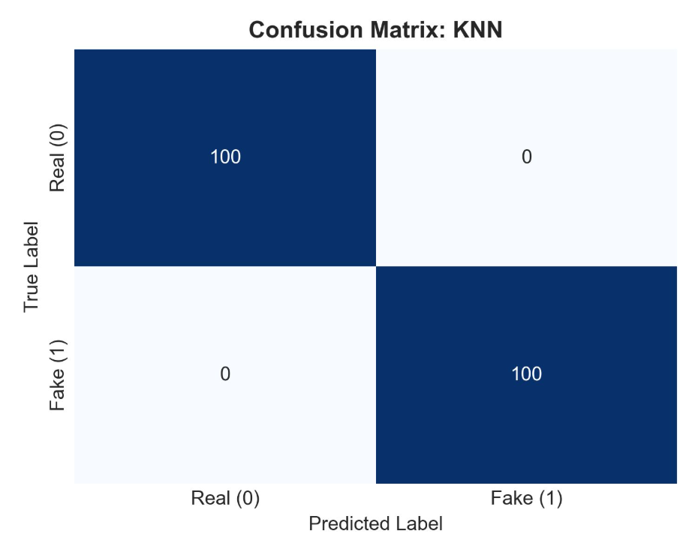
Confusion Matrices
All four models — KNN, Logistic Regression, Random Forest, and MLP — achieved identical conf
usion matrices on the 200-sample test set, with 100 true positives and 100 true negatives, and zero misclassifications.

Slide 9

Discussion: Model Behaviors
Parametric vs. Non-Parametric
Ensemble & Deep Learning
Random Forest uses bagging for robust, overfitting-resistant boundaries. MLP learns feature interactions dynamically but is computationally more intensive than linear baselines.
Logistic Regression converges quickly with interpretable coefficients. KNN makes no distributional assumptions but is sensitive to the curse of dimensionality and has slower inference.

Slide 10



Conclusion & Future Scope
This project demonstrates a complete end-to-end NLP pipeline for fake news detection, comparing four classification paradigms with TF-IDF vectorization.
Transformer Embeddings
Live Data Pipelines
Scalable Deployment
Replace TF-IDF with BERT to capture deeper semantic meanings and contextual nuances in text.
Integrate NewsAPI scraping to ingest live articles and adapt to emerging misinformation trends in real-time.
Extend the pipeline for production-grade deployment with continuous model retraining and monitoring.

