Slide 1
A PROJECT REPORT ON “FACE MASK DETECTION SYSTEM USING CONVOLUTIONAL NEURAL NETWORK” UNDER THE GUIDANCE OF
Dr. Subhashree Darshana
BY
Ajit 2006161
Ayush Raj 2006120
Happy Ranjan 2006432
Meetali Verma 2006224

Slide 2

AGENDA
PROJECT SUMMARY
PROBLEM STATEMENT
METHODS
TECHNOLOGIES USED
CNN
UI DESIGN
OUTPUT
RESULTS
FUTURE SCOPE
CONCLUSION

Slide 3
PROJECT SUMMARY
In this project , CNN model and different types of python libraries employed for face mask detection, leveraging its ability to effectively learn features from image data, ensuring accurate classification of masked and unmasked faces.
To utilize a CNN, prepared with an openly offered from a given picture dataset.
Thus, it's resolved that neural organizations will catch the shadings and surfaces of sores explicit toa few veils, that look like human dynamics

Slide 4
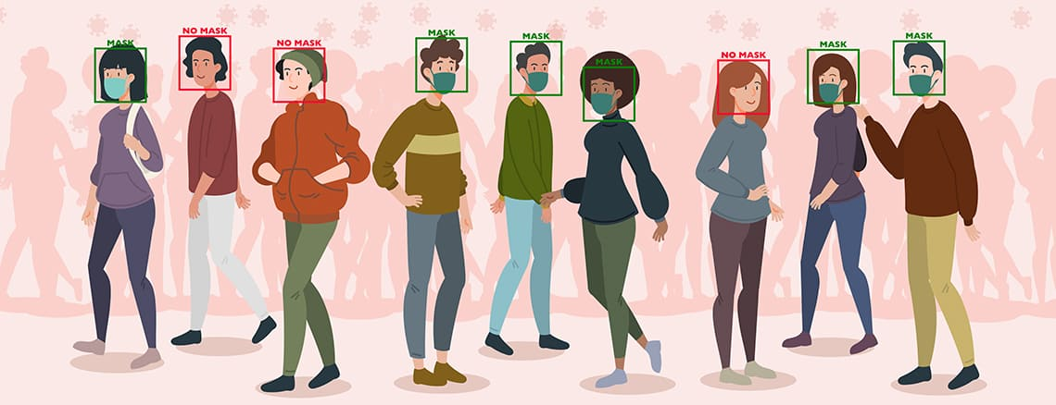
PROBLEM STATEMENT
The need for this project is the development accurate face mask detection system using Convolutional Neural Networks (CNNs), aiming to automatically identify whether individuals are wearing masks, with potential applications in public safety, healthcare, and security.

Slide 5
METHODS
Face mask detection employs computer vision and deep learning methodologies.
Initially, facial detection algorithms locate faces within images. Deep learning models, often Convolutional Neural Networks (CNNs), analyze facial features to classify whether individuals are wearing masks accurately.

Slide 6
These models undergo extensive training on annotated datasets to optimize performance. Post-training, the models are integrated into the detection system, which operates in real-time.
Continuous refinement and evaluation and also user testing ensure robustness and accuracy, contributing to effective public health compliance measures amidst the COVID-19 pandemic.

Slide 7
TECHNOLOGIES USED
Relevent Technologies:
Computer Vision: Utilized for real-time image processing and facial feature recognition.
Deep Learning: Employs convolutional neural networks (CNNs) for accurate face mask classification.
Machine Learning Algorithms: Trained models to distinguish between faces with and without masks.
IoT Sensors: Integrated with cameras for data acquisition and analysis in various environments

Slide 8
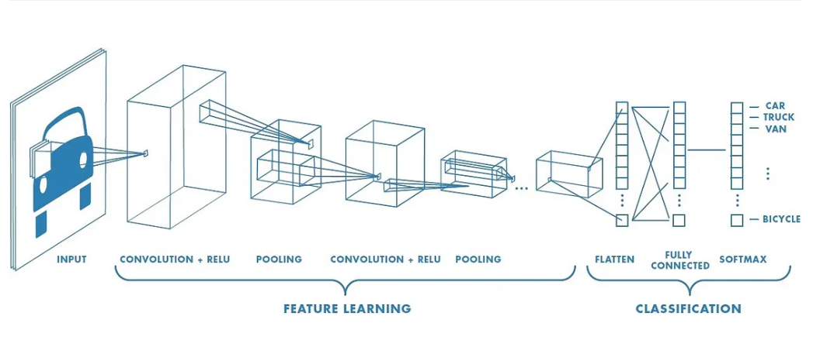
Convolutional Neural Networks(CNN)
Convolutional Neural Networks (CNNs) are a class of deep learning algorithms primarily used for image recognition and classification tasks, inspired by the organization of the animal visual cortex.
CNNs leverage convolutional layers to automatically extract hierarchical features from input images, progressively learning to recognize patterns such as edges, textures, and shapes, enabling robust and efficient image analysis.

Slide 9
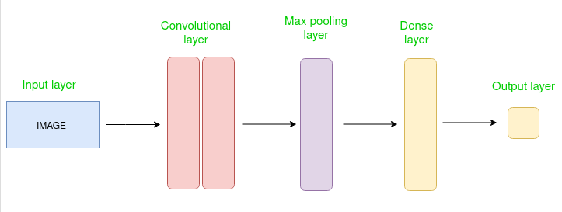
With applications ranging from object detection and facial recognition to medical imaging and autonomous vehicles,
CNNs have revolutionized computer vision tasks, achieving state-of-the-art performance in various domains through advancements in model architecture, training techniques, and dataset augmentation..

Slide 10
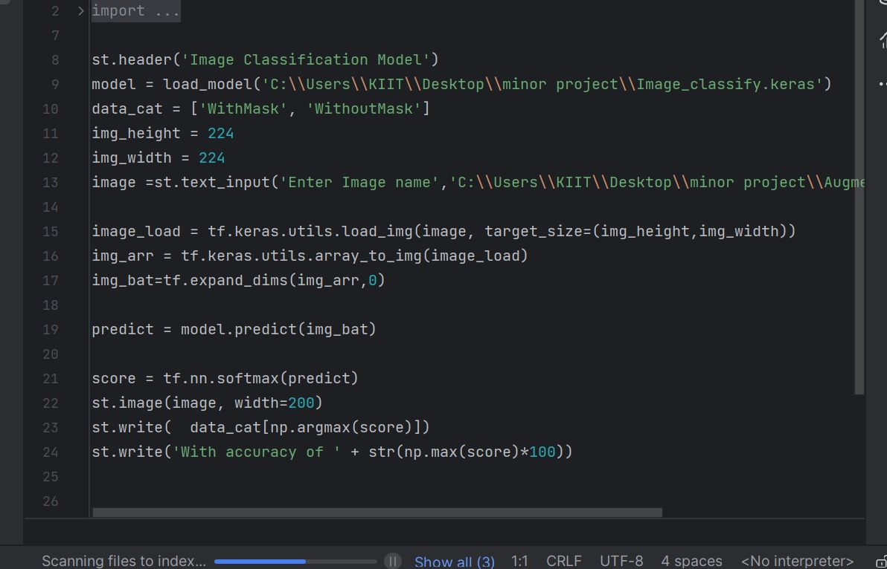
UI Design
This part of the code is a Streamlit application that uses a pre-trained image classification model to predict whether an input image contains a person wearing a mask or not

Slide 11
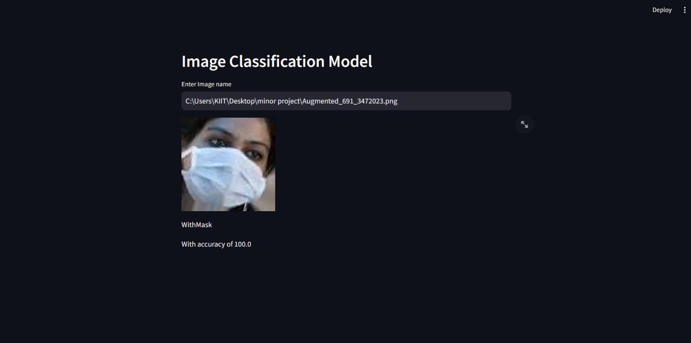
OUTPUT
Image With Mask Detected

Slide 12
RESULTS
It aims to automate the monitoring of face mask compliance in public spaces, enhancing public health measures.
The system integrates real-time image capture, deep learning model inference, and alerting mechanisms to accurately detect individuals wearing or not wearing masks.
Through comprehensive testing and validation, the system ensures reliability, scalability, and adherence to privacy standards, contributing to mitigating viral transmission and promoting community safet

Slide 13
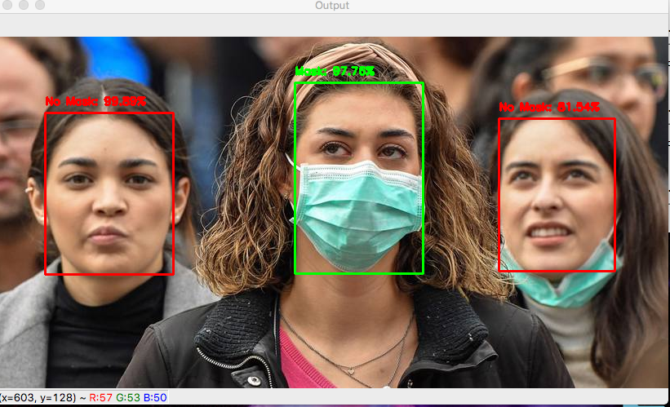
FUTURE SCOPE
Integration with Public Safety Systems: Future iterations of face mask detection systems using CNNs could be integrated with public safety infrastructure such as surveillance cameras in public spaces, transportation hubs, and workplaces to enforce mask-wearing policies and ensure compliance with health regulations
.

Slide 14

Real-time Monitoring and Alerts: Enhanced systems may incorporate real-time monitoring capabilities and automated alerting mechanisms, enabling authorities and administrators to promptly respond to instances of non-compliance and take necessary actions, such as issuing warnings or reminders.

Slide 15
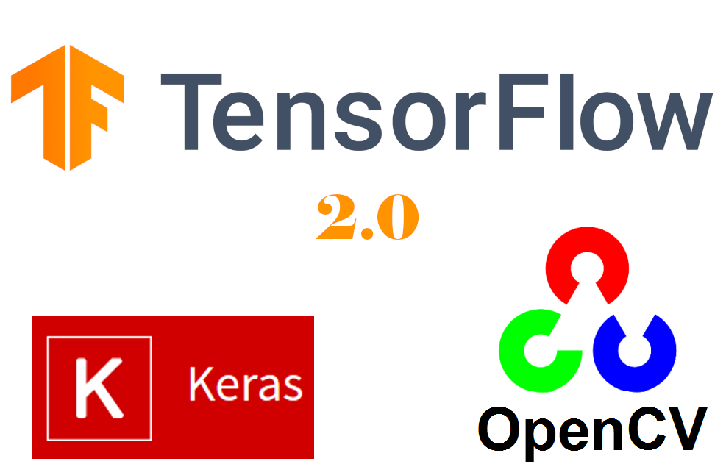
Conclusion
This manuscript proposes a face mask recognition system for static images and real-time video that automatically identifies if a person is wearing a mask. By using Keras , OpenCV, and CNN, the proposed system can detect the presence or absence of a face mask and the model gives precise and quick results.
The trained model yields an accuracy of around 98%
Trials were conducted to compare it with other premodels which demonstrate that the proposed model performs better than DenseNet-121, MobileNet-V2, VGG-19, and Inception-V3 in terms of processing time and accuracy.

