Slide 1
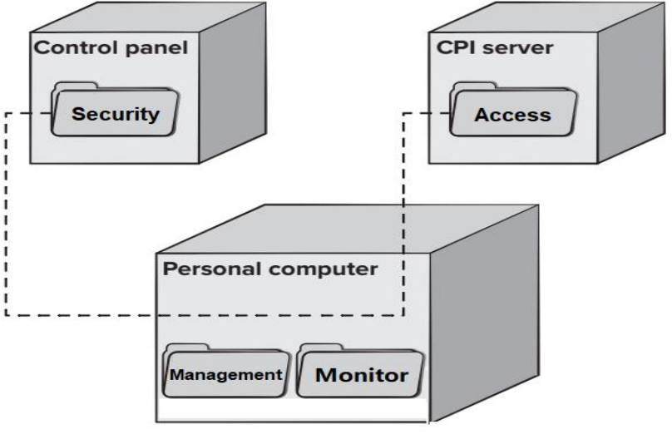
《软件工程》作业讲评
Picture Analysis
Comprehensively analyze the content in the picture.
Q: What type of UML diagram is the following diagram? Describe its meaning
A: (1’)Deployment.
(4’)Three computing environments are shown. The subsystems housed within each computing element are indicated. For example, the personal computer houses subsystems that implement security and surveillance features. In addition, an external access subsystem has been designed to manage all attempts to access the system from an external source. Each subsystem would be elaborated to indicate the components that it implements.

Slide 2
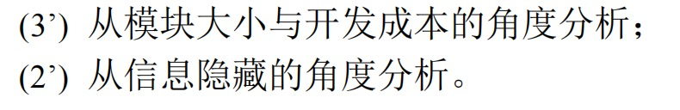
《软件工程》作业讲评
Q & A
Analyze from different angles
Q: Modularity is a basic design concept. How to decompose a software solution to obtain the best set of modules?
A:

Slide 3
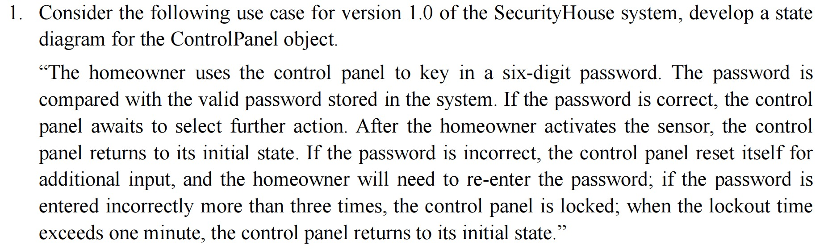
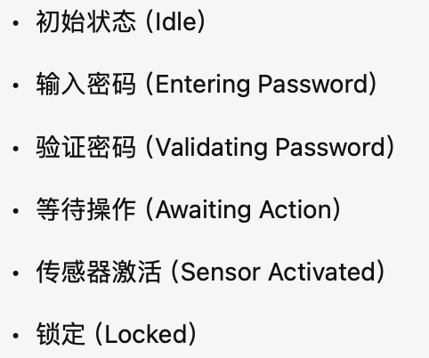
《软件工程》作业讲评
Diagram Planting
State Diagram
确定关键状态 + 状态转换条件 + 异常处理

Slide 4
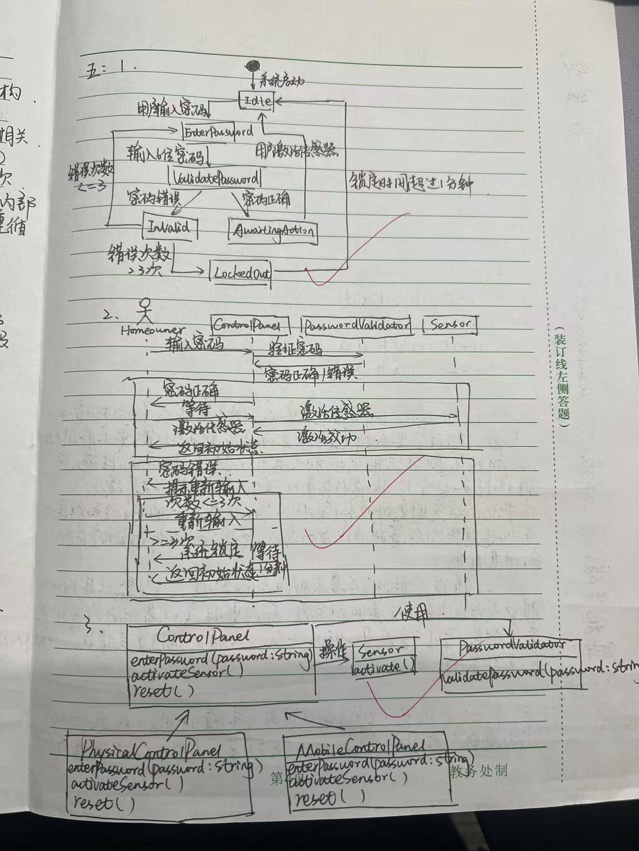
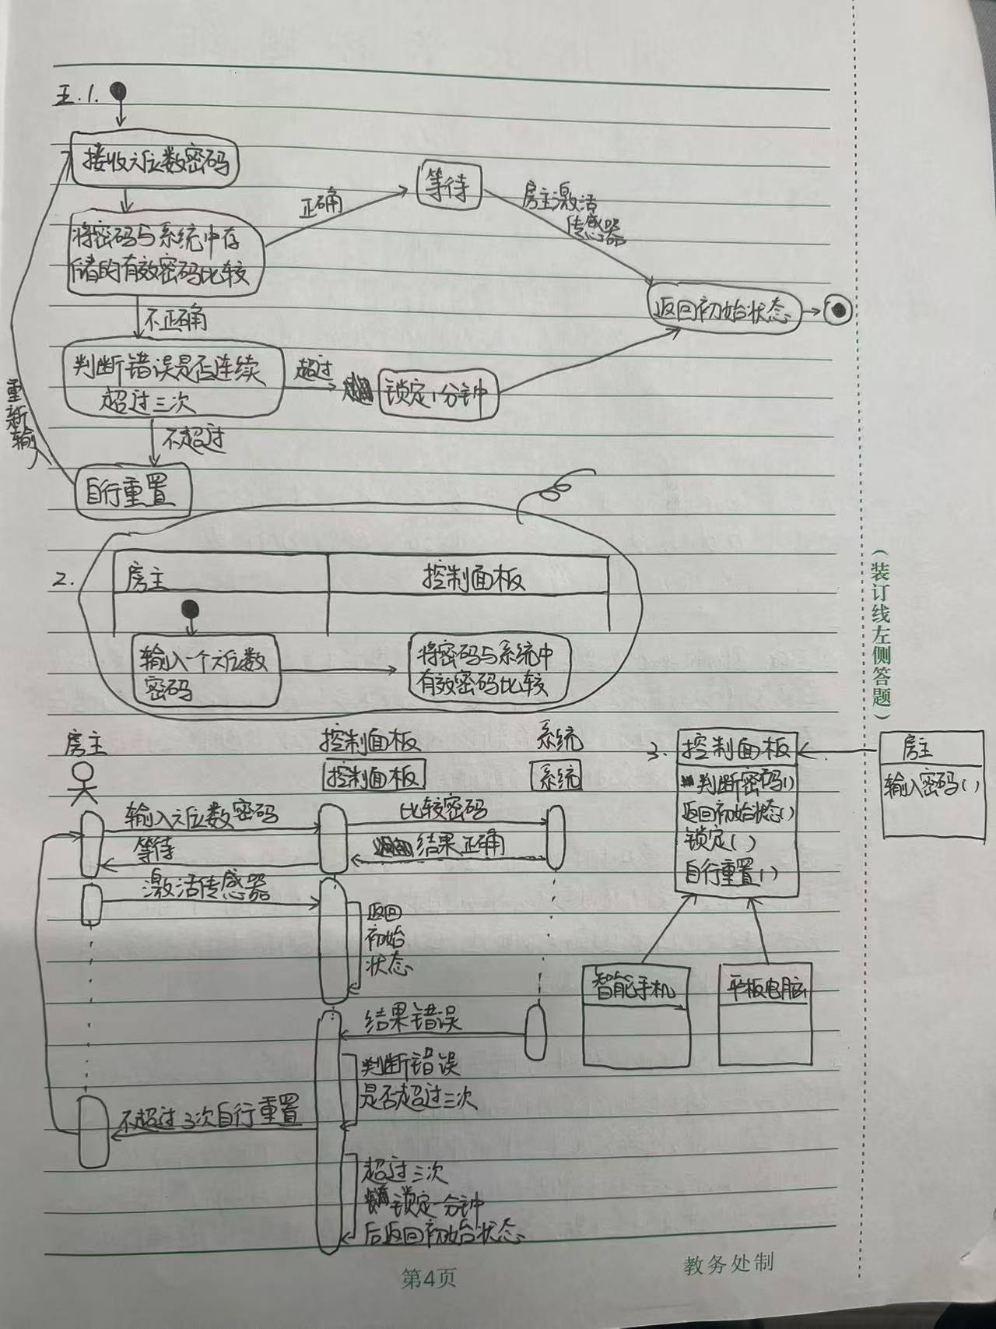
《软件工程》作业讲评
Diagram Planting
State Diagram
确定关键状态 + 状态转换条件 + 异常处理

Slide 5
《软件工程》作业讲评
Diagram Planting
Sequence Diagram
交互对象 + 时间顺序 + 操作者正确

Slide 6
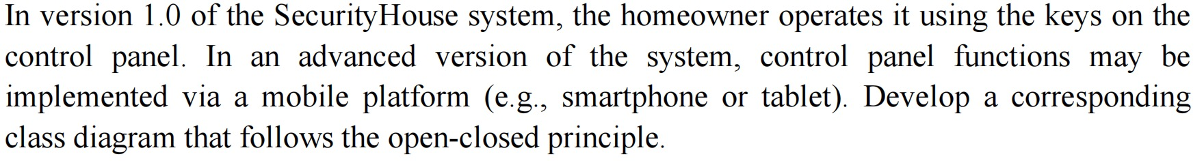
《软件工程》作业讲评
Diagram Planting
Class Diagram
核心类 + 辅助类 + 关系
核心类：
辅助类：
ControlPanel(抽象类)
PhysicalControlPanel：实现物理控制面板功能（实现类）
MobileControlPanel：实现移动平台控制功能（实现类）
AuthenticationManager
负责密码验证逻辑
SystemStateManager
负责状态跟踪（如锁定、超时）
SensorManager
负责与传感器交互

Slide 7
《软件工程》作业讲评
Diagram Planting
Class Diagram

