Slide 1

Part Two: Modeling
Part Two-1 Requirement analysis （Chapter 7-8）
What is requirements engineering, and what are the underlying concepts that lead to good requirements analysis?
How is the analysis model created, and what are its elements?
Part Two-2 Design （Chapter 9-12）
What is design engineering, and what are the underlying concepts
that lead to good design?
What concepts, models, and methods are used to create architectural,
interface, and component-level designs?
WHAT & HOW
© Sichuan University All rights reserved. | Confidential
1
Notes:
1

Slide 2
KEY Word
Requirements Engineering
Inception
Elicitation
Elaboration
Negotiation
Specification
Validation
Requirements Management
scenario
traceability Feasibility , constraint , Unambiguous
diagram， compatible, abbreviated
© Sichuan University All rights reserved. | Confidential
2
Notes:
2

Slide 3

Chapter 7 Understanding Requirements
Content
Requirements Engineering Tasks
Inception
Elicitation
Elaboration
Negotiation
Specification
Validation
Requirements Management
注意：某些需求工程任务并行发生，不完全是顺序的
© Sichuan University All rights reserved. | Confidential
3
Notes:
3

Slide 4
What do you think after construction?
理解需求是软件工程师所面临的最困难的任务之一
“I know you believe you understood
what you think I said, but I am not
sure you realise that what you heard
is not what I meant……”
© Sichuan University All rights reserved. | Confidential
4

Slide 5
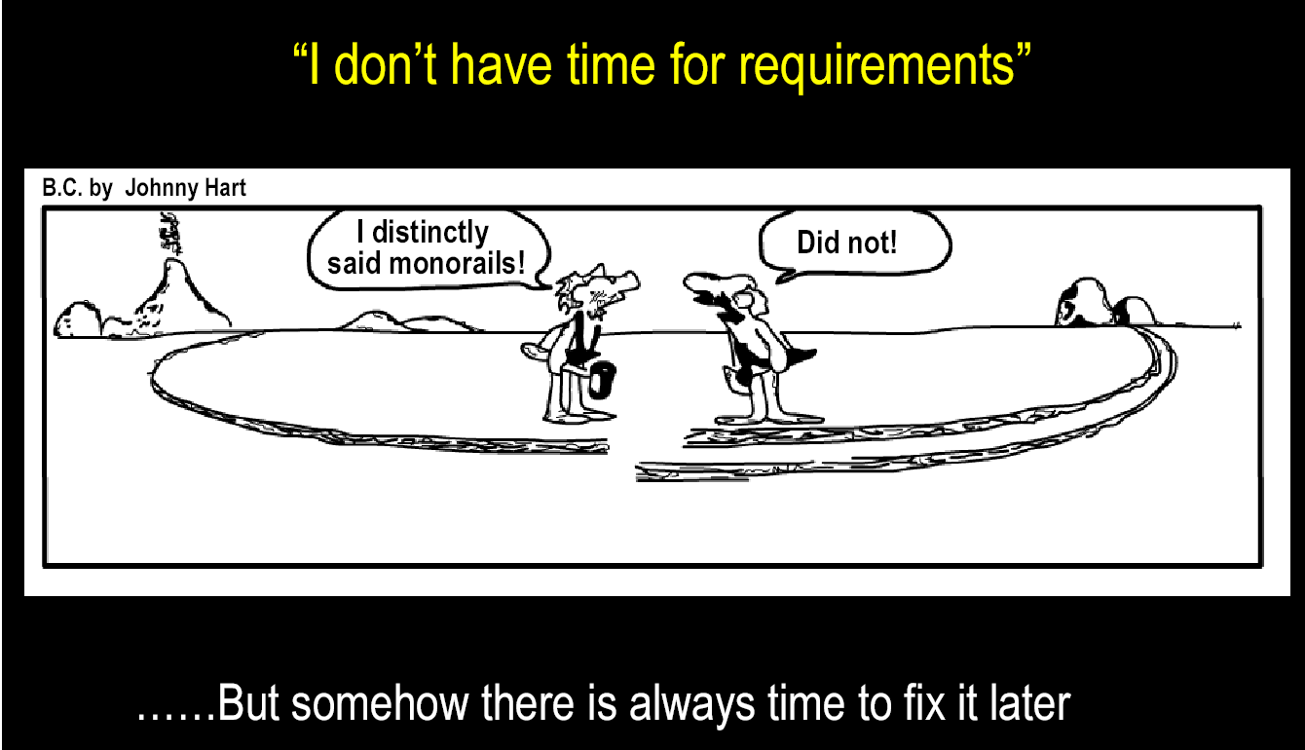
Requirement is very important

Slide 6
7.1 WHAT IS A REQUIREMENT ?
Requirement:
contractual condition and/or capability (external customer(*))
industrial constraint (system engineering group, marketing, ...)
states WHAT the system/software item must do, not HOW it does it.
Specification: a list of technical requirements
Requirement traceability, necessary to ensure development coherence一致
SwReq_1: The item shall ...
SwReq_2: ...
…..
SwReq_X: ...
© Sichuan University All rights reserved. | Confidential
6

Slide 7
TYPES OF SYSTEM REQUIREMENTS
Non-functional technical requirements
Operational security
Safety
Availability
Reliability
Maintainability
Ergonomics
Performance
Constraints
Non-technical requirements
Contractual milestones
Required methods and techniques
2
3
Functional technical requirements
Capabilities
Dynamic behaviour
Data manipulation
1
© Sichuan University All rights reserved. | Confidential
7

Slide 8
Non-functional Requirements
Non-Functional Requirement (N F R) – quality attribute, performance attribute, security attribute, or general system constraint.
A two-phase process is used to determine which N F R’s are compatible:
The first phase is to create a matrix using each N F R as a column heading and the system S E guidelines a row labels.
The second phase is for the team to prioritize each N F R using a set of decision rules to decide which to implement by classifying each N F R and guideline pair as complementary, overlapping, conflicting, or independent.

Slide 9
HOW MUST BE A REQUIREMENT ?
Easily Identifiable
by a well–determined name and a unique reference in the system.
Unambiguous['ʌnæm'bɪgjʊəs]
Only 1 possible interpretation is possible
Testable
A test case can be defined to test the requirement
© Sichuan University All rights reserved. | Confidential
9

Slide 10
HOW MUST BE A REQUIREMENT ?
杯子
基本需求：
材质
形状
大小、规格
数量
颜色
用处
价格（包括成本）
其它需求：
盖子？
耳朵？
包装
环境因素（纸杯是否可回收等）
© Sichuan University All rights reserved. | Confidential
10

Slide 11
Requirement engineering RE
Designing and building computer software is challenging, creative, and just plain fun.
Building software is so compelling that many software developers want to jump right in before they have a clear understanding of what is needed.
They argue that things will be become clear as they build, that users will be able to understand need only after examining early iterations of the software, that things change so rapidly that ant attempt to understand requirement in detail is a waste of time
某些人的观点：设计和编写软件富有挑战性……，需求理解被忽略(也浪费时间)，最终是开发出程序，其它都是次要的
（举例：口腔正畸需求分析与设计）
© Sichuan University All rights reserved. | Confidential
11

Slide 12
Requirement engineering important
RE is a major process action starting the communication activity continues into modeling activity
RE is a bridge to design and construction
RE is to understand the needs of process, project, product and people
RE is a key problem lead to a failed software project
© Sichuan University All rights reserved. | Confidential
12

Slide 13
Requirement engineering RE（定义）
需求工程是指致力于不断理解需求的大量任务和技术。
从软件过程的角度来看，需求工程是一个软件工程动作，开始于沟通活动并持续到建模活动
RE is the tasks and techniques that lead to understanding of requirements
RE builds a bridge to design and construction
RE is a major software engineering action that begins during the communication activity and continues into the modeling activity
RE=requirement analysis
© Sichuan University All rights reserved. | Confidential
13

Slide 14
Requirements Engineering Tasks
Inception（起始）—establish basic understanding of the project…
Elicitation（收集）—elicit requirements from all stakeholders
Elaboration（精化）—create an analysis model that identifies data, function and behavioral requirements
Negotiation（协商）—agree on a deliverable system that is realistic for developers and customers
Specification（规格说明）—document, combining natural language descriptions, graphic models or usage scenarios (use-cases)…
Validation（确认）—a review mechanism that looks for
Requirements management（需求管理）
理解客户需要什么、分析要求、评估可行性、协商合理方案、无歧义地详细说明方案、确认规格说明、管理需求以及将这些需求转化为可行性运行系统。
需求工程通过执行上述七个活动来收集、分析、理解需求。
© Sichuan University All rights reserved. | Confidential
14
Notes:
14

Slide 15
Requirements Engineering Tasks
Inception（起始）—ask a set of questions that …
establish basic understanding of the problem
the people who want a solution
the nature of the solution that is desired, and
the effectiveness of preliminary communication and collaboration between the customer and the developer
市场分析，粗略可行性分析(在需求之前)
Elicitation（导出、抽出）—elicit requirements from all stakeholders
系统或产品的目标是什么？想要实现什么？系统和产品如何满足业务要求？最终系统或产品如何用于日常工作？
In fact, elicit requirements is very hard because of the following problems:
Problems of scope 范围问题（系统边界不清楚）
Problems of understanding 理解问题（客户并不能完全确定需要什么）
Problems of volatility 易变问题(需求随时间变化)
In order to overcome these problems, you must approach requirements gathering in an organized manner
© Sichuan University All rights reserved. | Confidential
15
Notes:
15

Slide 16
Requirements Engineering Tasks
Elaboration（精化）—create an analysis model that identifies data, function and behavioral requirements
The information obtained from the customer during inception and elicitation is expanded and refined during elaboration
在起始和导出阶段获得的信息在精化阶段进行扩展和提炼，该任务集中于开发一个精确的需求模型（chapter6-7），用以说明软件的功能、特征等
Requirement modeling: Define classes, use-cases, various diagrams…
Negotiation（协商）—agree on a deliverable system that is realistic for developers and customers
Reconcile conflicts between the users and developers
QFD[quality function deployment] Normal /Expected/Exciting requirements
© Sichuan University All rights reserved. | Confidential
16
Notes:
16

Slide 17
Requirements Engineering Tasks
Specification（规格说明）—can be any one (or more) of the following:
A written document
A set of models
A formal mathematical
A collection of user scenarios (use-cases)
A prototype
Validation（确认）—a review mechanism that looks for
errors in content or interpretation(解释)
areas where clarification（说明、澄清） may be required
missing information
Inconsistencies不一致-矛盾 (a major problem when large products or systems are engineered)
conflicting or unrealistic (unachievable) requirements.
Requirements management（需求管理）
需求管理贯穿于系统的这个生命期
© Sichuan University All rights reserved. | Confidential
17
Notes:
17

Slide 18
SRS软件需求规格说明模板
1.导言
目的
文档约定
适用人群和阅读建议
项目范围
参考文献
2.总体描述
产品愿景
产品特性
用户类型和特征
操作环境
设计和实现约束
用户文档
假设和依赖
3.系统特征
系统特征1
系统特征2
4.外部接口需求
用户接口
硬件接口
软件接口
通讯接口
5.其他非功能需求
性能需求
安全需求
保密需求
软件质量属性
6.其他需求
附录A：术语表
附录B：分析模型
附录C：问题列表
© Sichuan University All rights reserved. | Confidential
18
Notes:
18

Slide 19
需求收集、分析建议：
1.stakeholder确定利益相关者
2.要求用户指定专门的人员协助收集需求信息
3.注意客户需求信息保密
4.了解工作流程
5.收集各种输入、输出，即：报告、报表等
6.会议（各个层次，各种场合，一定要形成会议记录）
7.评审
© Sichuan University All rights reserved. | Confidential
19
Notes:
19

Slide 20
需求收集：什么是约束条件（举例）
输入限制：
1.要求数字、字母或其他符号、汉字等
2.长度限制
3.输入次数限制
出错提示（文字、颜色、声音），光标位置
选课系统：
1.必选和可选
2.选课时间限制（开学前2个月，开学后3周）
3.重修选课限制
4.人数限制
5.学分限制（最多，最少等等）
6.退选限制（包括退款的条件，与时间等相关）
7.课程取消（如教师的问题，学生选课人数不够等）
© Sichuan University All rights reserved. | Confidential
20
Notes:
20

Slide 21
需求分析举例：
闹钟：
需求规格说明（列表说明所有需求）（不仅仅是功能）
单个还是多个
是否每天（每周）定时闹（是否去掉周末）
闹铃声（音乐？歌曲？多少可选），持续时间，间隔多久
文字提示（大小，是否闪烁）
时钟数字式显示，还是传统表针
闹钟布局，形状，大小
。。。
？如果在一个时间段内，有多个闹钟被激活，系统怎么处理
© Sichuan University All rights reserved. | Confidential
21
Notes:
21

Slide 22
7.2 establishing the groundwork-inception
7.2.1Identify stakeholders
“who else do you think I should talk to?”
业务运行管理人员、产品管理人员、市场销售人员、客户、最终用户、顾问、产品工程师、软件工程师、维护工程师
人事、财务、采购、项目经理、公司领导等等
7.2.2Recognize multiple points of view
Because many different stakeholders exist, the requirements will be explored from many different points of view
7.2.3Work toward collaboration
7.2.4Ask the first questions
© Sichuan University All rights reserved. | Confidential
22
Notes:
22

Slide 23
Ask the first questions-续前页
Ask the first questions（参考,不限于这些问题）
Who is behind the request for this work?谁提出的需求
Who will use the solution?谁使用它
What will be the economic benefit of a successful solution会有什么样的经济效益
Is there another source for the solution that you need?还需要什么资源
。。。
These questions (and others) will help to “break the ice” and initiate the communication that is essential to successful elicitation.
Q&A should be used for the first encounter only, and then
Problem solving, negotiation, specification…
© Sichuan University All rights reserved. | Confidential
23
Notes:
23

Slide 24
7.2 establishing the groundwork-inception续前
8.2.5 Nonfunctional Requirement NFR
质量属性、性能属性、安全属性，其它常规限制
可用性、可测性、安全性或可维护性等
8.2.6 Tracebility
© Sichuan University All rights reserved. | Confidential
24
Notes:
24

Slide 25
7.3 Eliciting Requirements
Requirements elicitation (=requirements gathering) combines elements of problem solving, elaboration, negotiation, and specification.
In order to encourage a collaboration, team-oriented approach to requirements gathering, stakeholders work together to identify the problem, propose elements of the solution, negotiate different approaches and specify a preliminary set of solution requirements.
由开发人员和用户共同完成：
收集需求，确认（需求）问题，提供建议，并提出初略的需求解决方案
© Sichuan University All rights reserved. | Confidential
25
Notes:
25

Slide 26
7.3.1 Collaborative Requirements Gathering
召开需求收集会议
Formal meeting:
Meetings are conducted and attended by both software engineers and customers
Rules for preparation and participation are established
An agenda is suggested
A “facilitator” (调解人)(can be a customer, a developer, or an outsider) controls the meeting
A "definition mechanism" (can be work sheets, flip charts, or wall stickers or an electronic bulletin board, chat room or virtual forum) is used
The goal is
to identify the problem 定义问题
propose elements of the solution 提出解决方案的要素
negotiate different approaches, and 协商不同的方法
specify a preliminary set of solution requirements 确定初步解决方案
© Sichuan University All rights reserved. | Confidential
26
Notes:
26

Slide 27
7.3.2Quality Function Deployment（QFD）
QFD是一种将客户要求转化成软件技术需求的技术。
Three types of requirements
Normal requirements
Expected requirements
Exciting requirements
QFD的目的是最大限度地让客户从软件工程中感到满意
（WIN-WIN？？？）
© Sichuan University All rights reserved. | Confidential
27
Notes:
27

Slide 28
Requirement of human being
What do U want?
Maslow's hierarchy of needs - "A Theory of Human Motivation".
生理需求-Physiological needs
安全需求-Safety needs
爱与归属-Love and belongingness
尊重-Esteem (Respect)
自我实现-Self-actualization
自我超越-Self-transcendence （其他人增加）
© Sichuan University All rights reserved. | Confidential
28
Notes:
28

Slide 29
Requirement of human being
What is happiness?
幸福=供给÷需求。
幸福，与人的（物质与精神上的）供给成正比，
与人的（物质与精神上的）需求成反比。
满足是快乐的密码
千里修书只为墙 让他三尺又何妨。
（张英六尺巷，安徽桐城）
© Sichuan University All rights reserved. | Confidential
29
Notes:
29

Slide 30
7.3.3 Usage scenarios
在此过程中，将系统功能开始具体化。开发人员和用户可以创建一系列场景（用例），它提供了（参与者）如何使用系统的描述，便于下一步的系统设计。
Developers and users can create a set of scenarios that identify a threads of usages for the system
Scenarios –often called use cases, provide a description of how the system will be used.
在8.4中详述
© Sichuan University All rights reserved. | Confidential
30
Notes:
30

Slide 31
7.3.4 Elicitation Work Products
A statement of need and feasibility.
A bounded statement of scope for the system or product.
A list of customers, users, and other stakeholders who participated in requirements elicitation
A description of the system’s technical environment.
A list of requirements (preferably organized by function) and the domain constraints that apply to each.
A set of usage scenarios that provide insight into the use of the system or product under different operating conditions.
Any prototypes developed to better define requirements.
Requirement Specification
© Sichuan University All rights reserved. | Confidential
31
Notes:
31

Slide 32
7.4 Elaboration: Developing Use-Cases
什么是用例 Scenario = Use Case
用例：就是场景，描述了能表达主体场景的“故事”
用例：描述最终用户（参与者）如何在一特定环境下和系统交互。
用例：它可以用文字、基于模板的说明或图形来表示，用例从最终用户的角度来描述软件
Use-case—descriptions of the interaction between an “actor” and the system
A collection of user scenarios that describe the thread of usage of a system
Each scenario is described from the point-of-view of an “actor”—a person or device that interacts with the software in some way
© Sichuan University All rights reserved. | Confidential
32
Notes:
32

Slide 33
应该由用例回答的问题
Each scenario answers the following questions:
Who is the primary actor, the secondary actor (s)?
What are the actor’s goals?
What preconditions should exist before the story begins
What main tasks or functions are performed by the actor?
What extensions might be considered as the story is described?
What variations变化 in the actor’s interaction are possible?
What system information will the actor acquire, produce, or change?
Will the actor have to inform the system about changes in the external environment?
What information does the actor desire from the system?
Does the actor wish to be informed about unexpected changes?
© Sichuan University All rights reserved. | Confidential
33

Slide 34
Actor and Use Case
Actor is something outside the system that interact with the system, actor maybe someone , machine, or other system
All the actors is the system’s environment
An use case models a dialog between one or more actor and system
An use case describes the actions system takes to deliver something of value to the actor
© Sichuan University All rights reserved. | Confidential
34

Slide 35
Actor and Use Case（举例）
© Sichuan University All rights reserved. | Confidential
35
选课Actor：学生、老师、教务处、（管理员）
use case 学生->选课 、缴费、查询。。。
use case 教务处->排课、安排教室、老师、调课。。。
use case 教师-> 登录、学生成绩。。

Slide 36
Example： SAFEHOME
actors参与者: homeowner(a user), setup manager（likely the same as person as homeowner）, sensors(devices attached to the system), the monitoring and response subsystem
Use-case用例：初始化监测 InitiateMonitoring
© Sichuan University All rights reserved. | Confidential
36

Slide 37
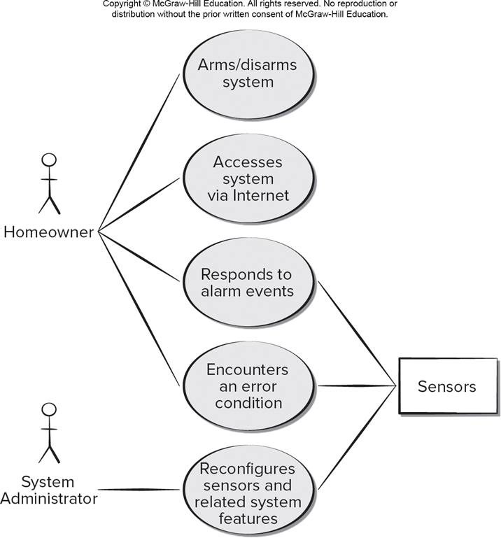
U M L Use Case Diagram
Access the text alternative for slide images.

Slide 38
Example： SAFEHOME

Slide 39
Example： SAFEHOME
Use-case：InitiateMonitoring
Primary actor: Homeowner
Goal in context: To set the system to monitor sensors when the homeowner leaves the house or remains inside
Precondition： System has been programmed for a password and to recognize various sensors
Trigger: The homeowner decides to “set” the system, i.e., to turn on the alarm functions
Scenario: 1.observes control panel; 2.enters password;3.selects “stay” or “away”; 4.observes read alarm light to indicate that the system has been armed.
Exception: 1.Control panel is not ready： homeowner checks all sensors… 2.Password is incorrect: homeowner reenters correct password; 3.Password not recognized: monitoring and response subsystem must be contacted to reprogram password; 4. Stay is selected: beep twice & stay light is lit; perimeter sensors are activated; 5. Away is selected: beep three times & away light is lit; perimeter sensors are activated;
（重点掌握如何编写场景use-case）
© Sichuan University All rights reserved. | Confidential
39

Slide 40
Example： SAFEHOME
Priority: Essential, must be implemented
When available: First increment
Frequency of use: Many times per days
Channel to actor： via control panel interface
Secondary actor: Support technician, sensors
Channels to secondary actors: support technician: phone line; Sensors: hardwired and radio frequency interfaces
Open issues: 1.Should there be a away to activate the system without the use of a password or with an abbreviated password; 2.Should the control panel display additional text messages? 3. How much time does the homeowner have to enter the password from the time the first key is pressed? 4. Is there a way to deactivate the system before it actually activates?
（其它要解决的问题，比如：away&stay用数字键代表，是否需要功能转换键，即增加一个shift键，代表是输入数字还是选择功能；按住away&stay键不松开，会是什么状况？）
© Sichuan University All rights reserved. | Confidential
40

Slide 41
7.5 Elaboration: Building the Analysis Model
需求分析建模的目的是为软件系统提供必要的信息、功能和行为域的说明(下一个章节重点介绍)
© Sichuan University All rights reserved. | Confidential
41
Notes:
41

Slide 42
7.5.1 Elements of the analysis model
Scenario-based elements
Functional—processing narratives for software functions
Use-case—descriptions of the interaction between an “actor” and the system
Class-based elements
Implied by scenarios/ Class diagram
Behavioral elements
State diagram
Flow-oriented elements（第8版取消）
Data flow diagram
© Sichuan University All rights reserved. | Confidential
42
Notes:
42

Slide 43
Elements of the analysis model(举例)
Scenario-based elements(Activity diagram)
Class-based elements(Class diagram)
Behavioral elements(State diagram)
Flow-oriented elements（Data flow diagram第8版取消）
© Sichuan University All rights reserved. | Confidential
43
Notes:
43

Slide 44
Activity Diagram eliciting requirements
© Sichuan University All rights reserved. | Confidential
44
Notes:
44

Slide 45
Class Diagram (类图)
From the SafeHome system …
© Sichuan University All rights reserved. | Confidential
45
Notes:
45

Slide 46
State Diagram（状态图）
Reading
Commands
State name
System status = “ready”
Display msg = “enter cmd”
Display status = steady
State variables
Entry/subsystems ready
Do: poll user input panel
Do: read user input
Do: interpret user input
State activities
© Sichuan University All rights reserved. | Confidential
46

Slide 47
State Diagram（状态图说明）-paper copy
System State :
Initialization-Not ready;
Reading commands-Ready;
Making copies-Copying;
Load paper-Load paper;
Program diagnose-paper jammed
Exception: paper jammed, toner low, crash…
© Sichuan University All rights reserved. | Confidential
47
Notes:
47

Slide 48
State Diagram（状态图）
（load paper放在问题诊断中最好，还比如没有墨等等故障）
© Sichuan University All rights reserved. | Confidential
48
Notes:
48

Slide 49
Data Flow Diagram
Format
for
display
Sensor
information
Configuration Information
Sensor ID
type, location
Generate
alarm
signal
Alarm
type
Configuration
data
Assess
against
setup
Alarm
data
Sensor ID,
type
Telephone
number
Read
sensor
Dial
phone
Sensor
status
Telephone
number tones
© Sichuan University All rights reserved. | Confidential
49
Notes:
49

Slide 50
7.5.2 Analysis Patterns(建立分析模式，重用)
Pattern name: A descriptor that captures the essence of the pattern.
Intent: Describes what the pattern accomplishes or represents
Motivation: A scenario that illustrates how the pattern can be used to
address the problem.
Forces and context: A description of external issues (forces) that can affect
how the pattern is used and also the external
issues that will be resolved when the pattern is applied.
Solution: A description of how the pattern is applied to solve the problem
with an emphasis on structural and behavioral issues.
Consequences: Addresses what happens when the pattern is applied and
what trade-offs exist during its application.
Design: Discusses how the analysis pattern can be achieved through
the use of known design patterns.
Known uses: Examples of uses within actual systems.
Related patterns: One or more analysis patterns that are related to
the named pattern because (1) it is commonly used with
the named pattern; (2) it is structurally similar to the named
pattern; (3) it is a variation of the named pattern.
© Sichuan University All rights reserved. | Confidential
50
Notes:
50

Slide 51
7.6 Negotiating Requirements
协商功能项、指标、时间、人手、费用等
win-win
Identify the key stakeholders
These are the people who will be involved in the negotiation
Determine each of the stakeholders “win conditions”
Win conditions are not always obvious
Negotiate
Work toward a set of requirements that lead to “win-win”
© Sichuan University All rights reserved. | Confidential
51
Notes:
51

Slide 52
Negotiating 协商的艺术
认识到这不是竞争
制定策略
主动地听
关注对方的兴趣
不要进行人身攻击
要有创新性
随时准备做出承诺
（晁错之错-汉景帝老师-七国之乱）
（自己工作、管理的经历分享，胡萝卜与大棒）
© Sichuan University All rights reserved. | Confidential
52
Notes:
52

Slide 53
Specification
描述系统功能、性能和约束的文档，可以用文字、图形、一组场景、形式化数学模型、一个原型等来表达需求
The system specification describes the
Function, performance and constraints of a computer-based system
© Sichuan University All rights reserved. | Confidential
53
Notes:
53

Slide 54
Specification
描述系统功能、环境和约束的文档，可以用文字、图形、一组场景、形式化数学模型、一个原型等来表达需求
The system specification describes the
Function, performance and constraints of a computer-based system
© Sichuan University All rights reserved. | Confidential
54
Notes:
54

Slide 55
7.7 Requirements Monitoring
Especially needes in incremental development
Distributed debugging – uncovers errors and determines their cause.
Run-time verification – determines whether software matches its specification.
Run-time validation – assesses whether evolving software meets user goals.
Business activity monitoring – evaluates whether a system satisfies business goals.
Evolution and codesign – provides information to stakeholders as the system evolves.

Slide 56
7.8 Validating Requirements-1
Is each requirement consistent with the overall objective for the system/product?
Have all requirements been specified at the proper level of abstraction? That is, do some requirements provide a level of technical detail that is inappropriate at this stage?（需求的定义和说明都是合适的）
Is the requirement really necessary or does it represent an add-on feature that may not be essential to the objective of the system?
Is each requirement bounded and unambiguous?
Does each requirement have attribution? That is, is a source (generally, a specific individual) noted for each requirement?（是否每个需求都有归属？即都有出处吗？）
Do any requirements conflict with other requirements?
© Sichuan University All rights reserved. | Confidential
56
Notes:
56

Slide 57
7.8 Validating Requirements-2
Is each requirement achievable in the technical environment that will house the system or product?（技术上是否可行）
Is each requirement testable, once implemented?
Does the requirements model properly reflect the information, function and behavior of the system to be built.
Has the requirements model been “partitioned” in a way that exposes progressively more detailed information about the system.（需求模式是否已经使用合适的方法分割，能够逐步揭示详细的系统信息）
Have requirements patterns been used to simplify the requirements model. Have all patterns been properly validated? Are all patterns consistent with customer requirements?
Ensure that the requirements model is an accurate reflection of stakeholder needs and that it provides a solid foundation for design
© Sichuan University All rights reserved. | Confidential
57
Notes:
57

Slide 58
Requirements Management
A set of activities that help the project team identify, control, and
track requirements and changes to requirements at any times.
Feature traceability table
Source traceability table
Dependency（从属、依赖） traceability table
Subsystem traceability table
Interface traceability table
© Sichuan University All rights reserved. | Confidential
58
Notes:
58

Slide 59
Requirement engineering RE（定义）
7.9 Summary
需求工程是指致力于不断理解需求的大量任务和技术。
从软件过程的角度来看，需求工程是一个软件工程动作，开始于沟通活动并持续到建模活动
RE is the tasks and techniques that lead to understanding of requirements
RE builds a bridge to design and construction
RE is a major software engineering action that begins during the communication activity and continues into the modeling activity
© Sichuan University All rights reserved. | Confidential
59

Slide 60
7.9 Summary
Requirement engineering tasks are conducted to establish a solid foundation for design and construction
It encompasses 7 distinct tasks: Inception, Elicitation, elaboration, negotiation, specification, validation, management
Inception: stakeholders establish basic problem requirements, define overriding project constraints, and address major features and functions.
Elicitation: refine and expand information from inception.
Elaboration: further expands requirements in a model – a collection of scenario-based, class-based, behavioral, and flow-oriented elements
The intent of negotiation is to develop a realistic project plan.
Each requirement and the model are validated against customer need to ensure that the right system is to be built
© Sichuan University All rights reserved. | Confidential
60
Notes:
60

Slide 61
7.9 Summary
什么是用例
用例：就是场景，描述了能表达主体场景的“故事”
用例：描述最终用户（参与者）如何在一特定环境下和系统交互。
用例：它可以用文字、基于模板的说明或图形来表示，用例从最终用户的角度来描述软件
Scenario = Use Case
© Sichuan University All rights reserved. | Confidential
61
Notes:
61

Slide 62
Exercise
Answer: 1-b 2-b
In requirements validation the requirements model is reviewed to ensure its technical feasibility.
True
False
In win-win negotiation, the customer's needs are met even though the developer's need may not be.
True
False
© Sichuan University All rights reserved. | Confidential
62
Notes:
62

Slide 63
Exercise
Answer: 3-b 4-c
3. Which of the following is not one of the relevant questions that would be used during project inception?
What will be the economic benefit from a good solution?
Who is against this project?
Who will pay for the work?
Who will use the solution?
4. The use of traceability tables helps to
debug programs following the detection of run-time errors
determine the performance of algorithm implementations
identify, control, and track requirements changes
none of the above
© Sichuan University All rights reserved. | Confidential
63
Notes:
63

Slide 64
Exercise
Answer: 5-a 6-b 7-c
5. The system specification describes the
Function, performance and constraints of a computer-based system
implementation of each allocated system
element software architecture
time required for system simulation
6. Use-case actors are always people, never system devices.
a. True
b. False
7. Which of the following is not one of the requirement classifications used in Quality Function Deployment (QFD)?
exciting b. expected
c. mandatory d. normal
© Sichuan University All rights reserved. | Confidential
64
Notes:
64

Slide 65
Exercise
8. Develop a complete use-case for one of the following activities.
Making a withdrawal at an ATM
Using your charge card for a meal at a restaurant
Searching for books (on a specific topic) using an on-line bookstore
Solution a
Use-case: withdrawal at an ATM
Primary actor: customer, bank card, ATM
Precondition: ATM is ready
Trigger: customer decides to make a withdrawal
Scenario:
Customer insert bank card into ATM
Customer input password
Customer press the withdrawal
Customer input the number of money
Customer gets the money
Customer takes out the bank card
Exception:
The bank card is not recognized – see abnormal process
Password is incorrect or not recognized – see abnormal process
Money does not get out – see abnormal process
The bank card can not be took out – see abnormal process
ATM
Withdrawal
management
bank
card
Abnormal
process
© Sichuan University All rights reserved. | Confidential
65
Notes:
65

Slide 66
Exercise
8. Develop a complete use-case for one of the following activities.
Making a withdrawal at an ATM
Using your charge card for a meal at a restaurant
Searching for books (on a specific topic) using an on-line bookstore
Solution b:
Use-case: using charge card at a restaurant
Primary actor: customer, cashier, charge card, card reader
Precondition: card reader is ready
Trigger: customer decides to pay by charge card
Scenario:
Cashier insert charge card into card reader
Customer input password
Cashier input the number of money
Card reader prints the receipt
Cashier takes out the charge card
Customer signs the receipt
Exception:
The charge card is not recognized – see abnormal process
Password is incorrect or not recognized – see abnormal process
receipt does not get out – see abnormal process
The charge card can not be took out – see abnormal process
Cannot complete the payment, Not enough money in charge card-…
Reading
charge card
Customer
Cashier
charge
card
Abnormal
process
Card
reader
© Sichuan University All rights reserved. | Confidential
66
Notes:
66

Slide 67
Exercise
8. Develop a complete use-case for one of the following activities.
Making a withdrawal at an ATM
Using your charge card for a meal at a restaurant
Searching for books (on a specific topic) using an on-line bookstore
Solution c:
Use-case: searching for books
Primary actor: customer
Precondition: customer registration starts
Trigger: customer decides to search for books
Scenario:
Customer input ID and password
Customer input specific topic
Book list is displayed
Customer checks the books
Exception:
Password is incorrect or not recognized – see abnormal process
Internet disconnect – see abnormal process
online
search
Abnormal
process
© Sichuan University All rights reserved. | Confidential
© Sichuan University All rights reserved. | Confidential
67
67
Notes:
67

Slide 68
Homework 2024-10-10
What are the steps for requirements engineering?
Describe the job of the requirements engineer with respect to stakeholder collaboration?
Why are nonfunctional requirements important to the requirements engineer?
What does win-win mean in the context of negotiation during the requirements engineering activity?
What work products result from the requirements engineering process?
Develop a complete use-case for one of the following activities.
Buying a product on a vending machine
Saving money at the bank counter
Booking a hotel on the website
Buying a stock using an on-line brokerage account
© Sichuan University All rights reserved. | Confidential
68
Notes:
68

Slide 69
Review RE
需求工程是指致力于不断理解需求的大量任务和技术。
从软件过程的角度来看，需求工程是一个软件工程动作，开始于沟通活动并持续到建模活动
Requirement engineering tasks are conducted to establish a solid foundation for design and construction
It encompasses 7 distinct tasks: Inception, Elicitation, elaboration, negotiation, specification, validation, management

Slide 70
Chapter 8 Requirements Modeling：
Scenario-based models depict requirements from the point of view of various system “actors.”
Class-oriented models represent object-oriented classes (attributes and operations) and how classes collaborate to achieve system requirements.
Behavioral models depict how the software reacts to internal or external “events.”
Data models depict the information domain for the problem.
Flow-oriented models represent functional elements of the system and how they transform data in the system.
© Sichuan University All rights reserved. | Confidential
70
Notes:
70

Slide 71
8.1 Requirements Analysis
需求分析产生软件工作特征的规格说明，即功能、接口和约束条件，最终生成待开发软件的需求规格说明和设计表示(尽可能使用图形符号表示）
Requirements analysis =》 Specification：
Specification of operational characteristics(功能、运行特征)
indicates software‘s interface with other system elements （接口）
establishes constraints that software must meet（约束条件）(功能约束，环境条件约束，合同约束，人员约束等等)
加一条：定义数据
（注意：前面的定义是performance，不是interface ）
© Sichuan University All rights reserved. | Confidential
71
Notes:
71

Slide 72
8.1 Requirements Modeling:需求建模
Requirements analysis allows the software engineer (called an analyst or modeler in this role) to: =》Modeling：
elaborate on basic requirements established during earlier requirement engineering tasks （细化在前期需求工程的起始、导出、谈判等任务中建立的基础需求）
build models that depict user scenarios, functional activities, problem classes and their relationships, system and class behavior, and the flow of data as it is transformed. （建模，包括描述场景、用例、类及关系、数据、数据流等）
注意：需求建模产生以下一种或多种模型类型
Scenario-Based Modeling场景模型
Data Modeling数据模型
Class-Oriented Modeling面向类的模型
Flow-Oriented Modeling面向流程的模型
Behavioral modeling行为模型
需求建模
左边这些模型可以转化为架构、接口和构建级的设计
（bridge）
© Sichuan University All rights reserved. | Confidential
72
Notes:
72

Slide 73
最近十几年，不常使用流和数据建模，流行使用场景和基于类的方法
本书（第8版），省略了面向流和数据建模
© Sichuan University All rights reserved. | Confidential
73
Notes:
73

Slide 74
8.1.1 Overall objectives and philosophy
Focus on what, not how
What user interaction does occur in a particular circumstance?
What objects does the system manipulate?
What functions must the system perform?
What behaviors does the system exhibit?
What interfaces are defined?
What constraints apply?
The requirements model must achieve three primary objectives:
To describe what the customer requires描述客户需要什么
To establish a basis for the creation of a software design为软件设计奠定基础
To define a set of requirements that can be validated once the software is built定义在软件完成后可以被确认的一组需求
© Sichuan University All rights reserved. | Confidential
74
Notes:
74

Slide 75
需求分析模型： Is a bridge to design and construction
系统描述：给出在软件、硬件、数据、人员和其它系统元素共同作用下的整个系统的功能描述
设计建模：给出软件的应用程序结构、用户接口以及构件级的结构
注意：需求模型的所有元素都可以直接跟踪到设计模型，需求建模和设计建模的部分工作是重叠进行的
© Sichuan University All rights reserved. | Confidential
75
Notes:
75

Slide 76
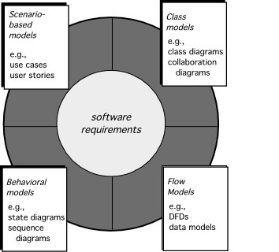
Elements of Requirements Analysis
© Sichuan University All rights reserved. | Confidential
76

Slide 77
Elements of Requirements Analysis
Scenario-base elements depict how the user interacts with the system and specific sequence of activities that occur as the software is used （用例图、活动图）
Class-based elements model the objects that the system will manipulation, relationships (some hierarchical) between the objects, and the collaborations that occur between the classes that are defined（类图、协作图）
Behavioral elements depict how external events change the state of the system or the classes that reside within it.
（状态图、顺序图）
Flow-oriented elements represent the system as an information transform, depicting描绘 how data objects are transformed as they flow through various system functions.
（数据流图）
© Sichuan University All rights reserved. | Confidential
77
Notes:
77

Slide 78
8.1.2 Rules of Thumb（需求分析建模的经验原则）
The model should focus on requirements that are visible within the problem or business domain. The level of abstraction should be relatively high. Don’t get bogged down in details(不要陷入细节)
Each element of the analysis model should add to an overall understanding of software requirements and provide insight into the information domain, function and behavior of the system. （增加对软件需求主体的理解）
Delay consideration of infrastructure and other non-functional models until design. (有些非功能的模型可以延后到设计阶段完成)
Minimize coupling throughout the system. (低耦合)
Be certain that the analysis model provides value to all stakeholders. (确认需求模型对所有利益相关者带来价值)
Keep the model as simple as it can be. （简洁）
© Sichuan University All rights reserved. | Confidential
78
Notes:
78

Slide 79
8.1.3 Requirements Modeling Principles
Principle 1. The information domain of a problem must be represented and understood.
Principle 2. The functions that the software performs must be defined.
Principle 3. The behavior of the software (as a consequence of external events) must be represented.
Principle 4. The models that depict information, function, and behavior must be partitioned in a manner that uncovers detail in a layered (or hierarchical) fashion.
Principle 5. The analysis task should move from essential information toward implementation detail.

Slide 80
8.2 Scenario-Based Modeling
“[Use-cases] are simply an aid to defining what exists outside the system (actors) and what should be performed by the system (use-cases).” Ivar Jacobson
(1) What should we write about?
(2) How much should we write about it?
(3) How detailed should we make our description?
(4) How should we organize the description?
© Sichuan University All rights reserved. | Confidential
80

Slide 81
What to Write About?
Inception and elicitation—provide you with the information you’ll need to begin writing use cases.
Requirements gathering meetings, QFD, and other requirements engineering mechanisms are used to
identify stakeholders
define the scope of the problem
specify overall operational goals
establish priorities
outline all known functional requirements, and
describe the things (objects) that will be manipulated by the system.
To begin developing a set of use cases, list the functions or activities performed by a specific actor.
© Sichuan University All rights reserved. | Confidential
81

Slide 82
How Much to Write About?
As further conversations with the stakeholders progress, the requirements gathering team develops use cases for each of the functions noted.
In general, use cases are written first in an informal narrative fashion.
If more formality is required, the same use case is rewritten using a structured format similar to the one proposed.
© Sichuan University All rights reserved. | Confidential
82

Slide 83
Writing use-case
a scenario that describes a “thread of usage” for a system
actors represent roles people or devices play as the system functions
users can play a number of different roles for a given scenario
© Sichuan University All rights reserved. | Confidential
83
Notes:
83

Slide 84
Documenting Use Cases
What are the main tasks or functions that are performed by the actor?
What system information will the actor acquire, produce or change?
Will the actor have to inform the system about changes in the external environment?
What information does the actor desire from the system?
Does the actor wish to be informed about unexpected changes?
What are the preconditions, triggers, exceptions, and open issues?

Slide 85
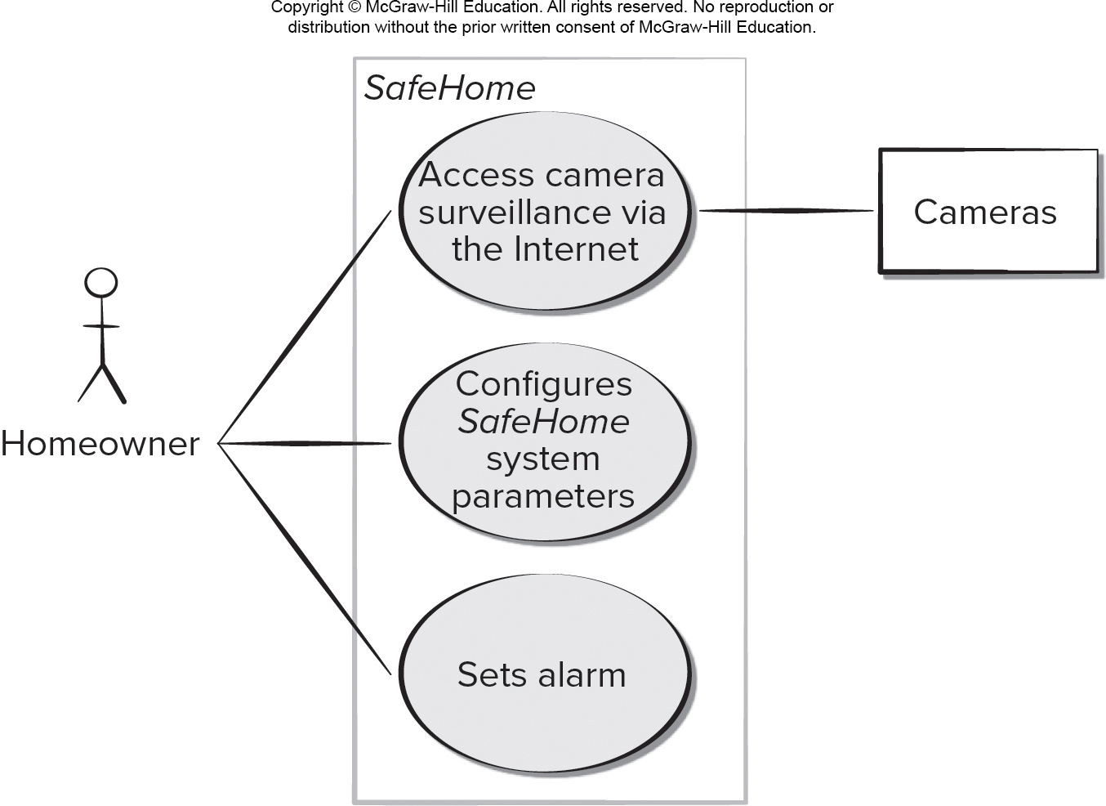
Use Case Diagram
注：configure system parameters也可以加入administrator-actor
Access the text alternative for slide images.

Slide 86
ACS-DCV Use Case
ACS-DCV: Access Camera Surveillance -Display Camera Views
通过网络访问摄像机监视设备-显示摄像机视频
Write use case
© Sichuan University All rights reserved. | Confidential
86

Slide 87
Use case Template for ACS-DCV
使用模版的用例：在此后几页
Use case Name:
Primary Actor:
Goal in context:
Precondition:
Trigger:
Scenario:
Exception
Priority:
When available :
Frequency:
Channel to actor:
Secondary actor:
Channels to secondary actors:
© Sichuan University All rights reserved. | Confidential
87

Slide 88
Use case Template for ACS-DCV
© Sichuan University All rights reserved. | Confidential
88
Use case: access camera surveillance-display (ACS-DCV)
Primary Actor: homeowner
Goal in context: To view output of camera placed throughout the house from any remote location via Internet
Precondition: System must be fully configured; Appropriate User ID and Pwd must be obtained
Trigger: The homeowner decides to take a look inside the house while away

Slide 89
Use case Template for ACS-DCV
Scenario:
1. The homeowner logs on to the Safehome Products web site
The homeowner enters his or her use ID
The homeowner enters two pwd (each at least eight char in length)
The system displays all major functions buttons
The homeowner selects the “surveillance” from the major function buttons
The homeowner selects “pick a camera”
The system displays the floor plan of the house
The homeowner selects a camera icon from the floor plan
The homeowner selects the “View” button
The system displays a viewing window that is identified by the camera ID
The system displays video output within the viewing window at one frame per second
© Sichuan University All rights reserved. | Confidential
89

Slide 90
Use case Template for ACS-DCV
Exception
1:ID or PWD are incorrect or not recognized—see use case: ”Validate ID and passwords”
2: Surveillance function not configured for this system— system displays appropriate error message; see use case : “configure surveillance function”
3: Homeowner selects “View thumbnail snapshots for all cameras” – see use case “View thumbnail snapshots for all cameras”
4: A floor plan is not available or has not been configured – displays appropriate error message and see use case “configure floor plan”
5: An alarm condition is encountered –see use case “alarm condition encountered”
© Sichuan University All rights reserved. | Confidential
90

Slide 91
Use case Template for ACS-DCV
Priority: Moderate priority , to be implemented after basic functions
When available : third increment
Frequency: Infrequent
Channel to actor: Via PC-based browser and internet connection to Safehome website
Secondary actor: System administrator, camera
Channels to secondary actors: 1. System administrator: PC-based system; 2. Camera: wireless connectivity
© Sichuan University All rights reserved. | Confidential
91

Slide 92
Use case Template for ACS-DCV
Open issues:
1. What mechanisms protects unauthorized use of this capability by employees of the company（未授权使用）
2. Is security sufficient? Hacking into this feature would represent a major invasion of privacy?（黑客侵入，隐私保护）
3. Will system response via the internet be acceptable given the bandwidth required for camera views?（在给定情况下，系统视频响应能接受吗？）
4. Will we develop a capability to protect video at a higher frames-per-second rate when high bandwidth connection are available?（显示速度提升）
© Sichuan University All rights reserved. | Confidential
92

Slide 93
补充内容
Data Modeling
Object-Oriented Concepts
© 2010 Sichuan University All rights reserved. | Confidential
93
Notes:
93

Slide 94
Data Modeling（补充）
examines data objects independently of processing
focuses attention on the data domain
creates a model at the customer’s level of abstraction
indicates how data objects relate to one another
实体关系图ERD
© 2010 Sichuan University All rights reserved. | Confidential
94
Notes:
94

Slide 95
What is a Data Object? （补充）
A data object is a representation of almost any composite information that must be understood by software.
数据对象是能被软件理解的复合信息表示。复合信息是指具有若干不同特征或属性的事物。
数据对象可能是外部实体、事物、事件、角色、组织、地点或结构等等can be an external entity (e.g., anything that produces or consumes information), a thing (e.g., a report or a display), an occurrence (e.g., a telephone call) or event (e.g., an alarm), a role (e.g., salesperson), an organizational unit (e.g., accounting department), a place (e.g., a warehouse), or a structure (e.g., a file).
数据对象描述包括数据对象及其属性The description of the data object incorporates the data object and all of its attributes.
数据对象只封装数据（没有对数据的操作）A data object encapsulates(封装) data only—there is no reference within a data object to operations that act on the data.
© 2010 Sichuan University All rights reserved. | Confidential
95

Slide 96
Typical Data Objects （补充）
external entities (printer, user, sensor)
things (e.g. reports, displays, signals)
occurrences or events (e.g. interrupt, alarm)
roles (e.g. manager, engineer, salesperson)
organizational units (e.g. division, team)
places (e.g. manufacturing floor)
structures (e.g. employee record)
© 2010 Sichuan University All rights reserved. | Confidential
96
Notes:
96

Slide 97
Data Objects and Attributes （补充）
A data object contains a set of attributes that act as an aspect, quality, characteristic, or descriptor of the object
object: automobile
attributes:
Make
Model
ID number
Body type
Color
Owner
© 2010 Sichuan University All rights reserved. | Confidential
97
Notes:
97

Slide 98
What is a Relationship? （补充）
Data objects are connected to one another in different ways.
A connection is established between person and car because the two objects are related.
A person owns a car
A person is insured to drive a car
The relationships owns and insured to drive define the relevant connections between person and car.
Several instances of a relationship can exist
Objects can be related in many different ways
owns
Person
Car
Insured to drive
© 2010 Sichuan University All rights reserved. | Confidential
98

Slide 99
ERD Notation （补充）
矩形：数据对象
连接线、菱形：关系
object
1
1
1
relationship
object
2
object
1
n
1
relationship
object
2
object
n
m
1
relationship
object
2
© 2010 Sichuan University All rights reserved. | Confidential
99
Notes:
99

Slide 100
ERD Notation （补充）
One common form:
(0, m)
object
relationship
object
1
(1, 1)
2
attribute
Another common form:
object
relationship
object
1
2
(0, m)
(1, 1)
© 2010 Sichuan University All rights reserved. | Confidential
100

Slide 101
Building an ERD （补充）
Level 1—model all data objects (entities) and their “connections” to one another
Level 2—model all entities and relationships
Level 3—model all entities, relationships, and the attributes that provide further depth
© 2010 Sichuan University All rights reserved. | Confidential
101

Slide 102
The ERD: An Example （补充）
Customer
order
Product
1
n
1
Company
consists
of
m
Parts
1
selected
from
p
k
workers
produced
by
w
© 2010 Sichuan University All rights reserved. | Confidential
102
Notes:
102

Slide 103
Object-Oriented Concepts（补充）
Must be understood to apply class-based elements of the analysis model
Key concepts:
Classes and objects
Attributes and operations
Encapsulation and instantiation
Inheritance继承、polymorphism多态
系统中一切皆为对象；对象是属性及其操作（方法）的封装体；对象可按其性质划分为类，对象成为类的实例；实例关系和继承关系是对象之间的静态关系；消息传递是对象之间动态联系的唯一形式，也是计算的唯一形式；方法是消息的序列
© 2010 Sichuan University All rights reserved. | Confidential
103
Notes:
103

Slide 104
Classes （补充）
Attributes
a collection of data values that describe a class
Class
encapsulates the data and procedural abstractions required to describe the content and behavior of some real world entity.
Objects
instances of a specific class
Operations
also called methods and services
Superclass
also called a base class, is a generalization of classes that are related to it.
Subclass
a specialization of the superclass
© 2010 Sichuan University All rights reserved. | Confidential
104
Notes:
104

Slide 105
Building a Class （补充）
© 2010 Sichuan University All rights reserved. | Confidential
105
Notes:
105

Slide 106
What is a Class? （补充）
occurrences
roles
things
organizational units
places
external entities
structures
class name
attributes:
operations:
© 2010 Sichuan University All rights reserved. | Confidential
106
Notes:
106

Slide 107
Encapsulation/Hiding （封装）
The object encapsulates
both data and the logical
procedures required to
manipulate the data
method
# 1
method
# 2
data
method
# 3
method
# 6
method
# 5
method
# 4
Achieves “information hiding”
© 2010 Sichuan University All rights reserved. | Confidential
107
Notes:
107

Slide 108
Polymorphism多态
多态性是指相同的操作或函数、过程可作用于多种类型的对象上并获得不同的结果。不同的对象，收到同一消息可以产生不同的结果，这种现象称为多态性。
多态是面向对象设计的重要特征
如：+，-等操作
© 2010 Sichuan University All rights reserved. | Confidential
108
Notes:
108

Slide 109
Class Hierarchy （类层次，继承Inheritance ）
PieceOfFurniture (superclass)
Table
Chair
Desk
Bed
subclasses of the
instances of Chair
© 2010 Sichuan University All rights reserved. | Confidential
109
Notes:
109

Slide 110
Methods (Operations) （补充）
An executable procedure that is encapsulated in a
class and is designed to operate on one or more data
attributes that are defined as part of the class.
A method is invoked via message passing.
© 2010 Sichuan University All rights reserved. | Confidential
110
Notes:
110

Slide 111
8.3 Class-Based Modeling
Class-based modeling represents:
objects that the system will manipulate.
operations (also called methods or services) that will be applied to the objects to effect the manipulation.
relationships (some hierarchical) between the objects.
collaborations that occur between the classes that are defined.
The elements of a class-based model include classes and objects, attributes, operations, C R C models, U M L class diagrams.

Slide 112
8.3Class-Based Methods
类（对象）、属性、操作，协作类CRC
Identify analysis classes by examining the problem statement
Use a “grammatical parse” to isolate potential classes
Identify the attributes of each class
Identify operations that manipulate the attributes
© 2010 Sichuan University All rights reserved. | Confidential
112
Notes:
112

Slide 113
8.3.1 Identifying Analysis Classes
External entities (e.g., other systems, devices, people) that produce or consume information to be used by a computer-based system.
Things (e.g, reports, displays, letters, signals) that are part of the information domain for the problem.
Occurrences or events (e.g., a property transfer or the completion of a series of robot movements) that occur within the context of system operation.
Roles (e.g., manager, engineer, salesperson) played by people who interact with the system.
Organizational units (e.g., division, group, team) that are relevant to an application.
Places (e.g., manufacturing floor or loading dock) that establish the context of the problem and the overall function of the system.
Structures (e.g., sensors, four-wheeled vehicles, or computers) that define a class of objects or related classes of objects.
以上数据对象都是为候选的类
分类方法很多，这只是其中方法之一
© 2010 Sichuan University All rights reserved. | Confidential
113
Notes:
113

Slide 114
8.3.1 Identifying Analysis Classes
© 2010 Sichuan University All rights reserved. | Confidential
114
Examining the usage scenarios developed as part of the requirements model and perform a “grammatical parse”语法分析 [Abb83]
Classes are determined by underlining each noun or noun phrase and entering it into a simple table.
Synonyms should be noted.
If the class (noun) is required to implement a solution, then it is part of the solution space; otherwise, if a class is necessary only to describe a solution, it is part of the problem space.
But what should we look for once all of the nouns have been isolated?

Slide 115
Selecting Classes—Criteria
例：识别分析类（课堂上阅读）
（8.3.1 p138,第9版英文）（10.1 p136,第8版中文）
（10.1 p187,第8版英文）（8.1 P148，第8版英文）
（第七版 p169 potential class/中文书p121)
© 2010 Sichuan University All rights reserved. | Confidential
115
Notes:
115

Slide 116
Potential Classes （潜在类）

Slide 117
Potential Classes （潜在类 候选准则）
Selecting Classes—Criteria （确定类主要还是开发经验）
Retained information-保留信息. The potential class will be useful during analysis only if information about it must be remembered so that the system can function.
Needed services-所需服务. The potential class must have a set of identifiable operations that can change the value of its attributes in some way.
Multiple attributes-多个属性. During requirement analysis, the focus should be on "major" information; a class with a single attribute may, in fact, be useful during design, but is probably better represented as an attribute of another class during the analysis activity.
Common attributes-公共属性. A set of attributes can be defined for the potential class and these attributes apply to all instances of the class.
Common operations-公共操作. A set of operations can be defined for the potential class and these operations apply to all instances of the class.
Essential requirements-必要需求. External entities that appear in the problem space and produce or consume information essential to the operation of any solution for the system will almost always be defined as classes in the requirements model.
© 2010 Sichuan University All rights reserved. | Confidential
117

Slide 118
Selecting Classes—Criteria
确定类主要还是开发经验，同时大量的边界类都被系统自动生成，实际开发中重点是定义实体类及其协作者（关注实体类之间的关联关系）
© 2010 Sichuan University All rights reserved. | Confidential
118
Notes:
118

Slide 119
用户提出购买的申请，根据用户选择的电影院，购买一张电影票。用户需留下电话号码。

Slide 120
用户提出购买的申请，根据用户选择的电影院，对应的电影院制造一张电影票，这张电影票拥有电影的信息，还拥有用户的信息。对于电影院，它可以安排电影场次（增删改电影），场次内包含的信息可以有：电影院、上映时间等，如果需要分不同的放映厅，在电影院类和showtimes中增加信息即可。我在图中没有画id之类的字段，如果需要用户、电影票、电影对象等更有标识性，也可以加入id字段，这个id字段可以用于查询、保存等。

Slide 121
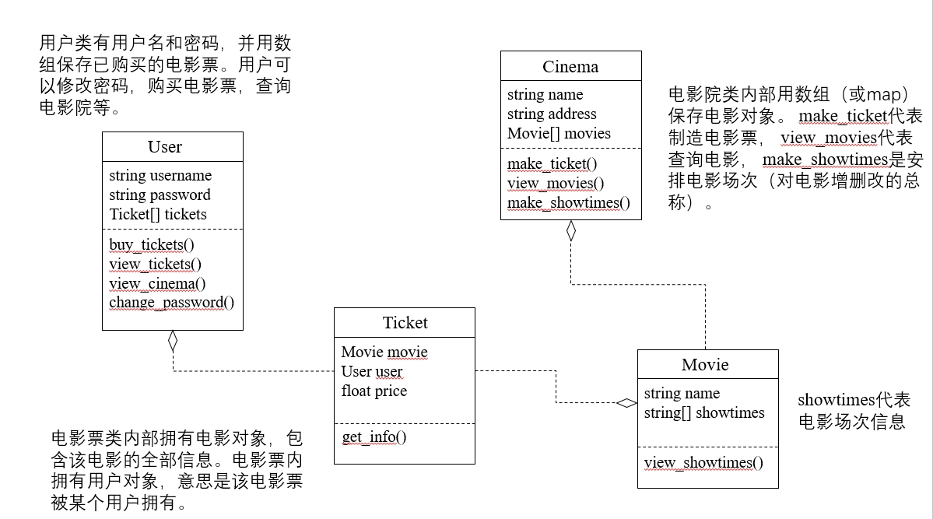

Slide 122
8.3.2 Defining Attributes
Attributes describe a class that has been selected for inclusion in the analysis model.
build two different classes for professional baseball players（举例）
For Playing Statistics software: ID, name, position, batting average, fielding percentage, years played, and games played might be relevant
For Pension Fund software: ID, name, average salary, credit toward full vesting, pension plan options chosen, mailing address, and the like.
© 2010 Sichuan University All rights reserved. | Confidential
122

Slide 123
例：system class- SafeHome
举例定义safehome系统类的属性：
A homeowner can configure the security function to reflect sensor information, alarm response information, activation/deactivation information, identification information, etc.
identification information = system ID + verification phone number + status
alarm response information= delay time + phone number
activation/deactivation=master password + number of allowable tries + temp password
其他：Sensor-class 定义为一个单独类
© 2010 Sichuan University All rights reserved. | Confidential
123
Notes:
123

Slide 124
例：system class- SafeHome
Class name
attributes
operations
Class Diagram
© 2010 Sichuan University All rights reserved. | Confidential
124
Notes:
124

Slide 125
8.3.2 Defining Operations
Do a grammatical parse of a processing narrative and look at the verbs
Operations can be divided into four broad categories:
operations that manipulate data in some way (e.g., adding, deleting, reformatting, selecting)
operations that perform a computation
operations that inquire about the state of an object, and
operations that monitor an object for the occurrence of a controlling event.
© 2010 Sichuan University All rights reserved. | Confidential
125

Slide 126
8.3.3 UML Class Models
例 FloorPlan Class
© 2010 Sichuan University All rights reserved. | Confidential
126
Notes:
126

Slide 127
8.3.4 Class-responsibility-collaborator (CRC) Models
总结：
8.3.1 识别分析类
8.3.2 类的属性和操作
本节：类的协作（识别相关的类）
CRC建模提供了一个简单的方法，来识别相关的类.
CRC模型是表示类的标准索引卡的集合。CRC卡包括三个基本部分：类、责任、协作者
© 2010 Sichuan University All rights reserved. | Confidential
127

Slide 128
8.3.4 Class-responsibility-collaborator (CRC) Models
Class-responsibility-collaborator (类-职责-协作者)
provides a simple means for identifying and organizing the classes that are relevant to system or product requirements. CRC建模提供了一个简单方法，可以识别和组织与系统或产品需求相关的类
Ambler [Amb95] describes CRC modeling in the following way:
A CRC model is really a collection of standard index cards that represent classes. The cards are divided into three sections. Along the top of the card you write the name of the class. In the body of the card you list the class responsibilities on the left and the collaborators on the right.
© 2010 Sichuan University All rights reserved. | Confidential
128

Slide 129
CRC Modeling
Analysis classes have “responsibilities”
Responsibilities are the attributes and operations encapsulated by the class（封装在类中的属性和操作）
Analysis classes collaborate with one another
Collaborators are those classes that are required to provide a class with the information needed to complete a responsibility. In general, a collaboration implies either a request for information or a request for some action.（完成某个职责的其它协作的类）
© 2010 Sichuan University All rights reserved. | Confidential
129
Notes:
129

Slide 130
CRC Modeling：举例CRC索引卡
类：住宅平面图
职责：
定义住宅平面图的名称、类型
管理住宅平面图的布局
显示住宅平面图（缩放）
（合并）墙、门和窗
显示摄像头位置
© 2010 Sichuan University All rights reserved. | Confidential
130
Notes:
130

Slide 131
Responsibilities-职责（属性和操作)的基本原则
System intelligence should be distributed across classes to best address the needs of the problem(合理分布类，高内聚，低耦合)
Each responsibility should be stated as generally as possible（每个职责的说明应尽可能具有普遍性）
Information and the behavior related to it should reside within the same class（信息和与之相关的行为应放在同一个类中）
Information about one thing should be localized with a single class, not distributed across multiple classes. （某个事物的信息应局限在一个类而不是多个类中）
Responsibilities should be shared among related classes, when appropriate.（适合时，职责应由相关类共享）
© 2010 Sichuan University All rights reserved. | Confidential
131
Notes:
131

Slide 132
Collaborations
Classes fulfill their responsibilities in one of two ways:
A class can use its own operations to manipulate its own attributes, thereby fulfilling a particular responsibility, or
A class can collaborate with other classes.
Collaborations identify relationships between classes
Collaborations are identified by determining whether a class can fulfill each responsibility itself
Three different generic relationships between classes [WIR90]:
the is-part-of relationship-聚合
the has-knowledge-of relationship-关联（常用）
the depends-upon relationship-依赖
© 2010 Sichuan University All rights reserved. | Confidential
132
Notes:
132

Slide 133
CRC Model Review Process
All participants in the review (of the CRC model) are given a subset of the CRC model index cards. （所有参加评审的人员拿到部分CRC索引卡）
Cards that collaborate should be separated (i.e., no reviewer should have two cards that collaborate).拆分有协作的卡
All use-case scenarios (and corresponding use-case diagrams) should be organized into categories.分类管理所有的用例场景
The review leader reads the use-case deliberately.细致阅读用例
As the review leader comes to a named object, she passes a token to the person holding the corresponding class index card.给令牌
When the token is passed, the holder of the class card is asked to describe the responsibilities noted on the card.当令牌传递时，卡拥有者要描述其职责
The group determines whether one (or more) of the responsibilities satisfies the use-case requirement.
If the responsibilities and collaborations noted on the index cards cannot accommodate the use-case, modifications are made to the cards.（若有问题，修改卡片）
This may include the definition of new classes (and corresponding CRC index cards) or the specification of new or revised responsibilities or collaborations on existing cards.
© 2010 Sichuan University All rights reserved. | Confidential
133
Notes:
133

Slide 134
8.4 Functional Modeling（参考）
The functional model addresses two application processing elements:
user-observable functionality that is delivered by the app to end users.
operations contained within analysis classes that implement behaviors associated with the class.
U M L activity diagrams can be used to represent processing details.
U M L activity diagram supplements a use case by providing a graphical representation of the flow of interaction within a specific scenario.

Slide 135
8.5 Behavioral Modeling
之前的建模表示主要是表达需求模型的静态元素；本节主要是动态行为的建模
© 2010 Sichuan University All rights reserved. | Confidential
135
Notes:
135

Slide 136
8.5 Behavioral Modeling
A behavioral model indicates how software will respond to internal or external events or stimuli.
This information is useful in the creation of an effective design for the system to be built.
U M L activity diagrams can be used to model how system elements respond to internal events.
U M L state diagrams can be used to model how system elements respond to external events.

Slide 137
8.5 Creating A Behavioral Model
The behavioral model indicates how software will respond to external events or stimuli-刺激. To create the model, the analyst must perform the following steps:
Evaluate all use-cases to fully understand the sequence of interaction within the system.评估所有用例，以保证完全理解系统内的交互顺序
Identify events that drive the interaction sequence and understand how these events relate to specific objects.识别驱动交互顺序的事件，并理解这些时间如何与特定的对象相互关联
Create a sequence for each use-case. 为每一个用例生成序列
Build a state diagram for the system. 创建系统状态图
Review the behavioral model to verify accuracy and consistency. 评审
© 2010 Sichuan University All rights reserved. | Confidential
137
Notes:
137

Slide 138
8.5.1 Identifying Events
A use case represents a sequence of activities that involves actors and the system.
An event occurs whenever the system and an actor exchange information.
An event is not the information that has been exchanged, but rather the fact that information has been exchanged.
A use case needs to be examined for points of information exchange.
Events are used to trigger state transitions.

Slide 139
8.5.2 UML State Diagrams
In the context of behavioral modeling, two different characterizations of states must be considered:
the state of each class as the system performs its function and
the state of the system as observed from the outside as the system performs its function
The state of a class takes on both passive and active characteristics [CHA93].
A passive state is simply the current status of all of an object’s attributes.
The active state of an object indicates the current status of the object as it undergoes a continuing transformation or processing.
These slides are designed to accompany Software Engineering: A Practitioner’s Approach, 8/e (McGraw-Hill 2014). Slides copyright 2014 by Roger Pressman.
139

Slide 140
UML State Diagrams:The States of a System
state—a set of observable circumstances that characterizes the behavior of a system at a given time
state transition—the movement from one state to another
event—an occurrence that causes the system to exhibit some predictable form of behavior
action—process that occurs as a consequence of making a transition
© 2010 Sichuan University All rights reserved. | Confidential
140

Slide 141
UML State Diagrams
make a list of the different states of a system
-- (How does the system behave?)
indicate how the system makes a transition from one state to another
-- (How does the system change state?)
indicate event
indicate action
draw a state diagram or a sequence diagram
© 2010 Sichuan University All rights reserved. | Confidential
141

Slide 142
state diagram & sequence diagram 示例
用户输入正确密码，激活系统
包括：Reading， Comparing， Locked， Selecting四个状态
© 2010 Sichuan University All rights reserved. | Confidential
142

Slide 143
State Diagram for the ControlPanel Class
© 2010 Sichuan University All rights reserved. | Confidential
143
Notes:
143

Slide 144
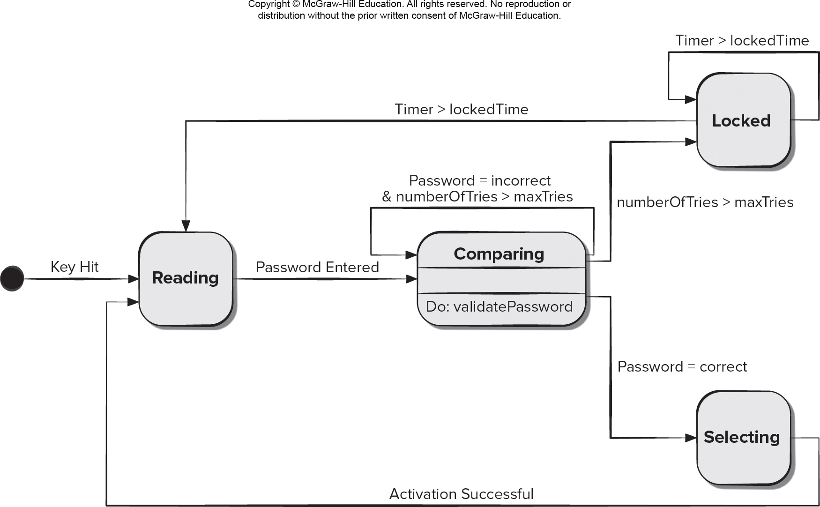
State Diagram
Access the text alternative for slide images.

Slide 145
Sequence Diagram 1
The U M L sequence diagram can be used for behavioral modeling.
Sequence diagrams can also be used to show how events cause transitions from object to object.
Once events have been identified by examining a use case, the modeler creates a sequence diagram—a representation of how events cause flow from one object to another as a function of time.
Sequence diagram is a shorthand version of a use case.

Slide 146
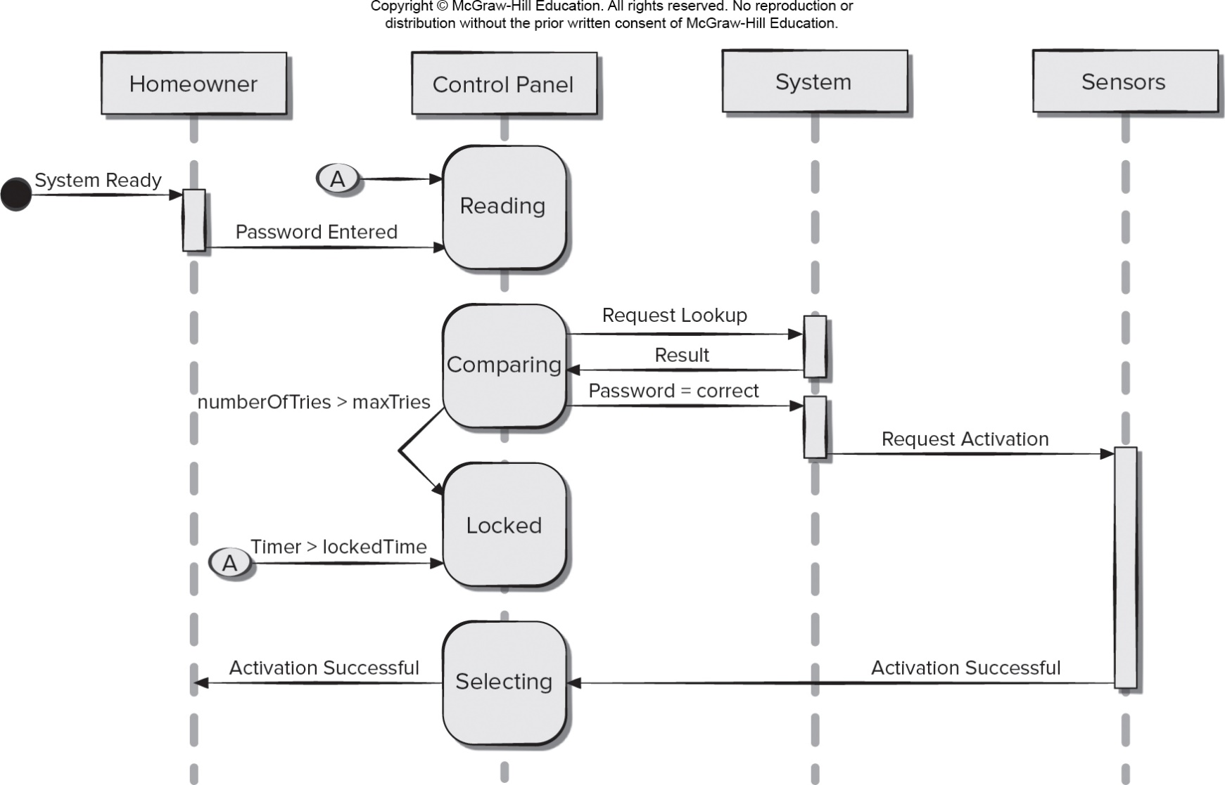
Sequence Diagram 2
序列图定义事件序列，
垂直：从上而下表示消息/调用发生的时间序列，
水平：从左到右表示消息发送到的对象实例。
Access the text alternative for slide images.

Slide 147
状态图 vs 顺序图
State diagrams depict the state of the system and show how events affect system states.
Sequence diagrams indicate how events cause transitions from object to object.

Slide 148
activity diagram
The UML activity diagram supplements the use case by providing a graphical representation of the flow of interaction within a specific scenario.
like a flowchart
Many software engineers like to describe activity diagrams as a way of representing how a system reacts to internal events.

Slide 149
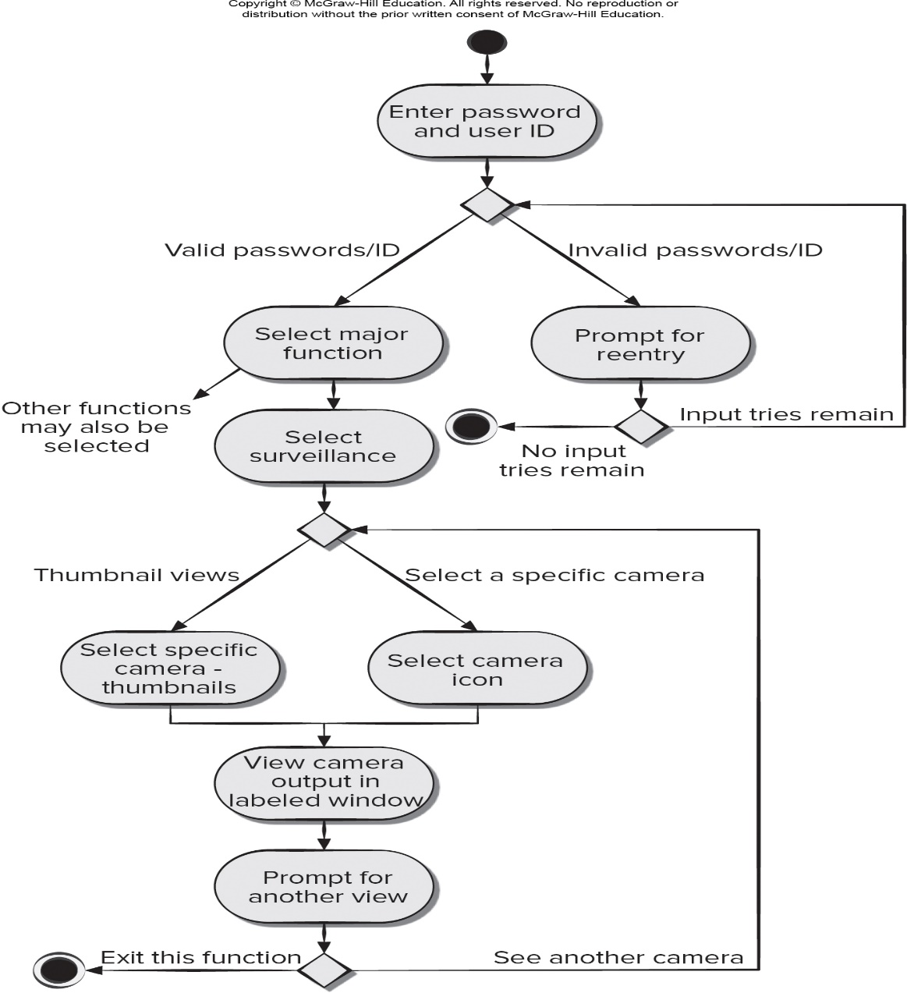
Activity Diagram 2
Access the text alternative for slide images.

Slide 150
Swimlane Diagrams
The U M L swimlane diagram is a useful variation of the activity diagram that allows you to represent the flow of activities described by the use case.
Swimlane diagrams indicate which actor (if there are multiple actors involved in a specific use case) or analysis class has responsibility for the action described by an activity rectangle.
Responsibilities are represented as parallel segments that divide the diagram vertically, like the lanes in a swimming pool.

Slide 151
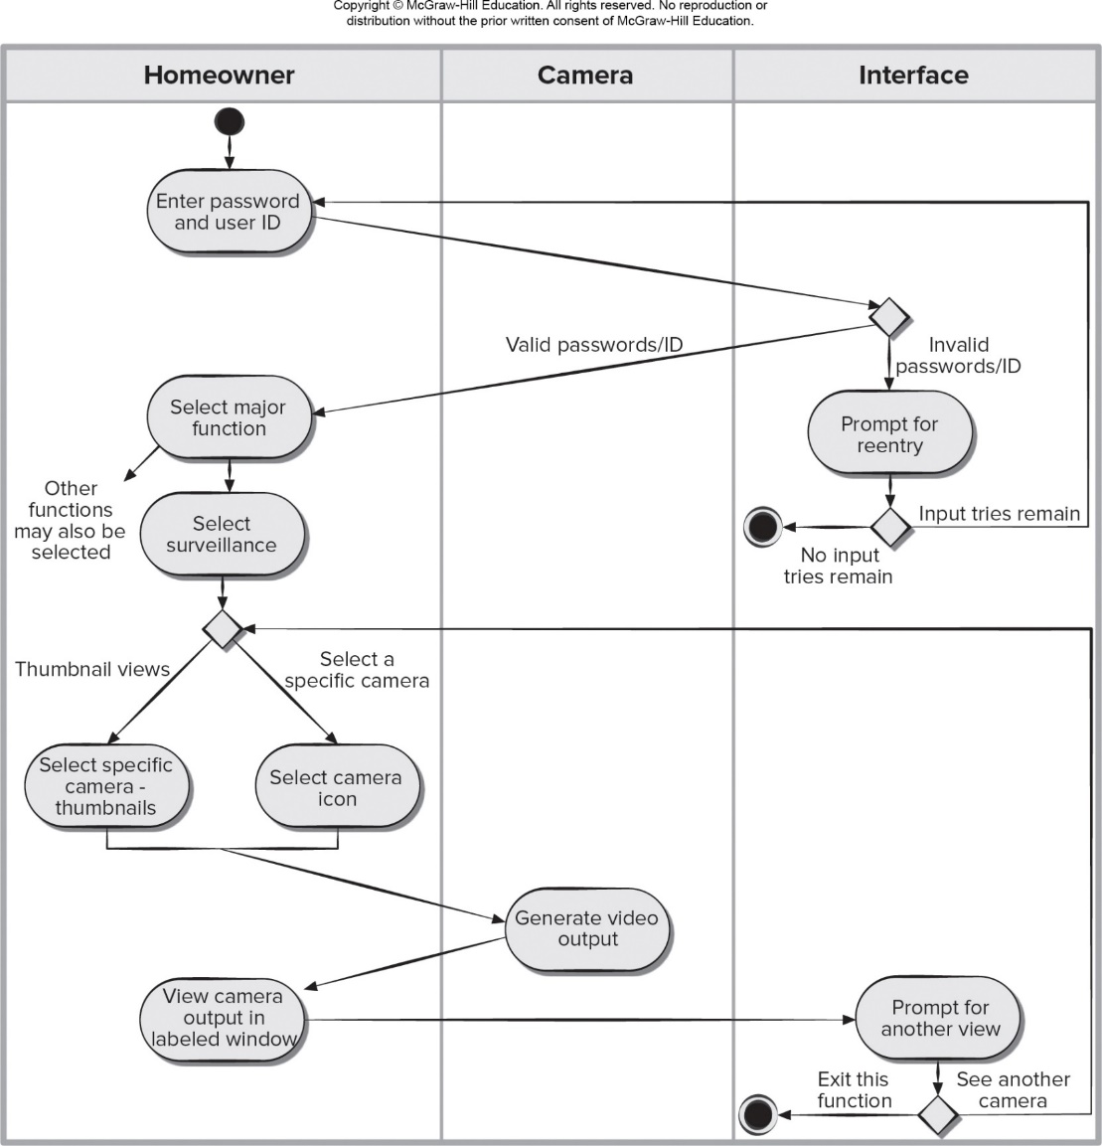
Swimlane Diagram
Access the text alternative for slide images.

Slide 152
Writing the Software Specification
Everyone knew exactly what had to be done until someone wrote it down!
© 2010 Sichuan University All rights reserved. | Confidential
152
Notes:
152

Slide 153
Specification Guidelines-参考
Always put yourself in the reader's position, "Would
I be able to understand this if I wasn't intimately
familiar with the system?”
Write in a simple, unambiguous style.
Use consistent graphical notation and apply textual
terms consistently (stay away from aliases). 统一术语和标识
When a term is explicitly defined in one place, try
substituting the definition for other occurrences of the term.
When a structure is described in words, draw a picture.
When symbolic equations are used, try expressing their
meaning in words.
When a calculation is specified, work at least two examples.
Search behind certainty statements—be sure restrictions
or limitations are realistic.
Specification：功能描述、接口、约束
© 2010 Sichuan University All rights reserved. | Confidential
153
Notes:
153

Slide 154
Summary
The requirement model bridges the gap between a system-level representation and a software design
Scenario-based depict software requirements from the user’s point of view. use-case
Data modeling is used to describe the information space that will be constructed or maintained by the software. Data object
© 2010 Sichuan University All rights reserved. | Confidential
154
Notes:
154

Slide 155
Summary
Class-based modeling uses information derived from scenario-based and data modeling elements to identify analysis classes. Class-attribute-operation
CRC-class responsibility collaboration
© 2010 Sichuan University All rights reserved. | Confidential
155
Notes:
155

Slide 156
Answer: 1-c 2-c
Exercise
Which of these is not an element of an object-oriented analysis model?
Behavioral elements
Class-based elements
Data elements
Scenario-based elements
Which of the following is not an objective for building an analysis model?
define set of software requirements that can be validated
describe customer requirements
develop an abbreviated solution for the problem
establish basis for software design
class responsibilities
© 2010 Sichuan University All rights reserved. | Confidential
156
Notes:
156

Slide 157
Answer: 3-e 4-c
Exercise
3.The data flow diagram
depicts relationships between data objects
depicts functions that transform the data flow
indicates how data are transformed by the system
indicates system reactions to external events
both b and c
4.Which of the following items does not appear on a CRC card?
class collaborators
class name
class reliability
class responsibilities
© 2010 Sichuan University All rights reserved. | Confidential
157
Notes:
157

Slide 158
Answer: 5-c 6-b
Exercise
5. For purposes of behavior modeling a state is any
consumer or producer of data.
data object hierarchy.
observable mode of behavior.
well defined process.
6. Attributes cannot be defined for a class until design has been completed.
a. True
b. False
© 2010 Sichuan University All rights reserved. | Confidential
158
Notes:
158

Slide 159
Answer: 7-a 8-d
Exercise
7. Operations are object procedures that are invoked when an object receives a message.
True
False
8. UML activity diagrams are useful in representing which analysis model elements?
a. Behavioral elements
b. Class-based elements
c. Flow-based elements
d. Scenario-based elements
© 2010 Sichuan University All rights reserved. | Confidential
159
Notes:
159

Slide 160
Exercise
Answer: 9-d
9. Which of the following should be considered as candidate objects in a problem space?
a. events b. people
c. structure d. all of the above
10. In a few sentences, try to describe the primary differences between structured analysis
and object-oriented analysis.
Answer: Structured analysis begins with a consideration of the data objects that the system must manipulate. In structured analysis the data objects are described with a data dictionary and the entity relation diagram (ERD) depicts relationships between data objects. The flow and transformation of data through a system are represented using the data flow diagram (DFD). The structured analysis also incorporates a behavioral modeling notation called the state transition diagram (STD). In the object oriented analysis model, class-based elements model the objects that the system will manipulate, the operations that will be applied to the objects to effect the manipulation, relationships (some hierarchical) between the objects, and the collaborations that occur between the classes that are defined. In addition the OO model represents the behavior of objects and the behavior of the system as a whole.
© 2010 Sichuan University All rights reserved. | Confidential
160
Notes:
160

Slide 161
Homework 2024-10-17
List the types of models that might be used in requirements modeling and explain the role of each type of model
Which UML (unified modeling language) diagrams are useful in scenario-based modeling?
What questions should be asked to help refine a preliminary use case?
List the characteristics that should be considered when considering potential classes for inclusion in an analysis model
What are the steps needed to build a behavioral model?
What types of nouns resulting from a grammatical parse should be considered as potential analysis classes?
Describe the roles of the three sections of CRC (class responsibility collaborator) cards?
There are two different types of “states” that behavioral models can represent. What are they?
How does a sequence diagram differ from a state diagram . How are they similar?
What is the fundamental difference between the structured analysis and object-oriented strategies for requirements analysis?
© 2010 Sichuan University All rights reserved. | Confidential
161
Notes:
161

