Slide 1
Modern Software Engineering
College of Computer Science
Sichuan University

Slide 2
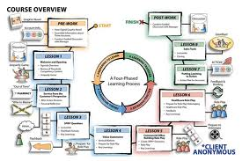
Course Overview
Goals & Content
Textbook & Reference & Language
Course outline
Evolution & Grading
© 2010 Sichuan University All rights reserved. | Confidential

Slide 3
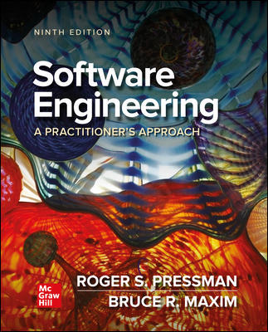
Course Overview
Textbook:
Roger S. Pressman
9th Ddition
Software Engineering
A Practitioner’s Approach
© 2010 Sichuan University All rights reserved. | Confidential

Slide 4


Course Overview （3 parts）
Goals（software process/modeling/quality management）
Understanding the role of software in systems
Understanding why software engineering practices are important
Knowing good basic software engineering practices
Possessing basic skills using software engineering tools and practices
Having applied those skills in a structured setting with realistic challenges
Software Engineer
Programmer
© 2010 Sichuan University All rights reserved. | Confidential

Slide 5
Course Overview
Textbook
Roger S. Pressman, Software Engineering
A Practitioner’s Approach
Reference
软件工程 实践者的研究方法 郑人杰 等译
L. A. Maciaszek, Practical Software Engineering: A Case Study Approach
F. P. Brooks, The Mythical Man-Month: Essays on Software Engineering
http://www.mhhe.com/engineering/pressman/
Journal of Software Engineering and Applications
Language: Chinese & English
关于教材7-8-9版都可以（中英文）
© 2010 Sichuan University All rights reserved. | Confidential

Slide 6
Course Overview
Part One – The Software Process（3~4 weeks）
(chapter 1-5 )
Part two – Modeling （4~5 weeks）
(chapter 7-12 )
Part Three – Quality Management （2~3 weeks）
(chapter 19-20 )
Web应用不讲
© 2010 Sichuan University All rights reserved. | Confidential

Slide 7
Course Overview
Course outline（会有调整）
week 2: Introduction of Software & Software Engineering
week 3-4: Part One – The Software Process
week 5-8: Part two – Modeling
week 9: midterm test
week 10-13: Part Three – Quality Management
week 14-15: Project Presentation
week 16: Final Review
week 17: Q&A
Evaluation
Attendance Record 10%
Discuss & Exercise 20%
Mid test 20%
Final test 50%
注意：强制及格线：50
© 2010 Sichuan University All rights reserved. | Confidential

Slide 8
软件工程的重要性
失败的案例远远多于成功的案例
需求控制的问题
设计的问题
团队、人力资源的问题（离职，分配不合理，管理和执行力）
进度的问题（行百里半九十）
质量的问题
风险的问题（技术风险、人力资源风险、财务风险）
© 2010 Sichuan University All rights reserved. | Confidential

Slide 9
Why & How
Why do I learn it?
软件和软件工程
软件工程的重要性
How can I get high score?
作业
选择题
© 2010 Sichuan University All rights reserved. | Confidential

Slide 10
注意事项
课堂秩序（点名）(提前请假，短信都可以，一次不到扣3分)
作业 （10次左右，可以用中文，也可以用英文），必须使用作业本！按时提交
© 2010 Sichuan University All rights reserved. | Confidential

Slide 11
Teacher
liyi 李毅 副教授
1984-1988四川大学计算机科学系本科
1988-1991四川大学计算机软件硕士
2002-2009四川大学计算机应用博士
1991-1993日本广岛KCC公司研修2年
1991-1995四川省经济信息中心（四凯公司，日本外包软件开发）
1995-1997四川省外经贸委信息中心
1997-2009川大智胜公司工作
2009-2010美国马里兰大学访问1年
1997至今川大计算机学院，图形图像研究所工作、国家空管自动化系统技术重点实验室。
计算机视觉（深度学习）、软件工程、软件测试、空管自动化系统
国家科技进步一等奖1项，省部级奖4项
Contact Information
Email: liyi_ws@scu.edu.cn
Mobile phone: 18011536477 13808068528
助教 张金成
© 2010 Sichuan University All rights reserved. | Confidential

Slide 12
Chapter 1 Key Word
Software，Software Process，Software Engineering
systematic, disciplined, quantifiable approach
Framework activities
communication/ planning/ modeling
/construction / deployment
activities, actions and tasks
Components
wear out, deteriorating, Off-the-shelf, Stakeholder
Voluminous， adequately manipulate
© 2010 Sichuan University All rights reserved. | Confidential

Slide 13

Chapter 1 The Nature of Software
Content
Software’s evolving role & Characteristics
Software Application Domain
Legacy Software
软件、软件过程、软件工程
© 2010 Sichuan University All rights reserved. | Confidential

Slide 14
1.1 The Nature of Software
Question????
Why does it take so long to get software finished
Why are development costs so high
Why can’t we find all errors before we give the software to our customers
Why do we spend so much time and effort maintaining existing programs
Why do we continue to have difficulty in measuring progress as software is being developed and maintained
© 2010 Sichuan University All rights reserved. | Confidential

Slide 15
Software Definition
What is Software?
Software is: (1) instructions (computer programs) that when executed provide desired features, function, and performance; (2) data structures that enable the programs to adequately manipulate information and (3) descriptive information in both hard copy and virtual forms that describes the operation and use of the programs.
Programs (instructions)
Data Structure (data structures )
Document (descriptive information )
© 2010 Sichuan University All rights reserved. | Confidential

Slide 16
Software vs. Hardware
Software is developed or engineered, it is not manufactured in the classical sense.
Software doesn‘t “wear out.” （最根本的不同）
Although the industry is moving toward component-based construction, most software continues to be custom-built.
软件与硬件的制造流程和管理模式既相似又不同
软件可复用程度比硬件低
© 2010 Sichuan University All rights reserved. | Confidential

Slide 17
Software doesn't "wear out."
Failure
rate
浴缸曲线
hardware
Time
idealized curve
Failure
rate
Software
Time
idealized curve
© 2010 Sichuan University All rights reserved. | Confidential

Slide 18
Software doesn't "wear out."
In fact: Software is deteriorating 退化
Most serious corporations control and constrain changes.
Most software is custom built, and customer never really knows what she/he wants
© 2010 Sichuan University All rights reserved. | Confidential

Slide 19
1.1.2 Software Application Domain
System Software: Service other programs
Compilers, editors and file management utilities
Operating system components, drivers, networking software
Application Software: standalone programs that solve a specific business need
Point-of-sale transaction processing
Flight booking system
Engineering/Scientific Software
Numerical computing in physics, chemistry, biology.
Computer-aided design, system simulation and other interactive applications
Embedded Software
keypad control for home appliances
digital functions in an automobile, e.g. fuel control, braking systems
Product-line Software: Designed to provide a specific capability for use
Word processing, spreadsheets, computer graphics
Multimedia, entertainment, database management
Web/Mobile-applications
E-commerce, B2B, B2P, Blog, Twitter
AI Software
expert system, artificial neural networks, theorem proving, game playing, etc.
© 2010 Sichuan University All rights reserved. | Confidential

Slide 20
1.1.3Legacy Software 旧软件
Why must it change?
Software must be adapted to meet the needs of new
computing environments or technology.
Software must be enhanced to implement new business
requirements.
Software must be extended to make it interoperable with
other more modern systems or databases.
Software must be re-architected to make it viable within a
network environment.
新的需求，新的环境和技术，扩展功能等
如：订座系统（命令行、DOS软件等）
© 2010 Sichuan University All rights reserved. | Confidential

Slide 21
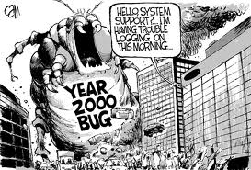
Year 2000 Problem
Y2K Bug/Millennium Bug
A problem for both digital (computer-related) and non-digital documentation and data storage situations which resulted from the practice of abbreviating a four-digit year to two digits.
http://en.wikipedia.org/wiki/Year_2000_problem
© 2010 Sichuan University All rights reserved. | Confidential

Slide 22
word
exhibit
pivotal
executed
Myths
establishment
systematic, disciplined, quantifiable
accuracy
essence of
© 2010 Sichuan University All rights reserved. | Confidential

Slide 23
1.2 Defining the Discipline
Software Engineering:
（1） The application of a systematic, disciplined, quantifiable approach to the development, operation, and maintenance of software;
that is, the application of engineering to software.
（2） The study of approaches as in (1).
（将系统化、规范化、可量化的方法应用于软件的开发、运行和维护），即：将工程化的方法应用于软件（开发）
（以及对上述方法的研究）
© 2010 Sichuan University All rights reserved. | Confidential

Slide 24
A Layered Technology 软件工程是一种层次化的技术； 软件工程的基础是过程
tools
methods
process
a “quality” focus
Software Engineering

Slide 25
Quality Focus
Is a bedrock to support SW engineering
Is a organizational commitment to software
Need a continuous process improvement
a “quality” focus
© 2010 Sichuan University All rights reserved. | Confidential

Slide 26
Process Model
Is the foundation of SW engineering to hold technology together to build software timely and rationally （及时地、合理地）
Defines a framework as a road map for software development
Forms a basis for software management control
process
© 2010 Sichuan University All rights reserved. | Confidential

Slide 27
Methods
Provide the technology : how to build software
Including many methods : communication, requirement analysis, design modeling, program construction, testing and support
Rely on a set of basic principles that govern each area of technology and include modeling activity and other descriptive techniques
methods
© 2010 Sichuan University All rights reserved. | Confidential

Slide 28
Tools( suport)
为Process过程和Method方法提供支持
Is for methods
Is for processes
Tools are integrated for stakeholder
Computer aided software engineering (CASE)计算机辅助软件工程
Tools
© 2010 Sichuan University All rights reserved. | Confidential

Slide 29
1.3 Software Process
Software Process
is a collection of activities, actions and tasks that are performed when some work product is to be created.
An activity strives to achieve a broad objective and is applied regardless of the application domain, size of the project, complexity of the effort, or degree of rigor with which SE is to be applied. (e.g. communication with stakeholders)
An action encompasses a set of tasks that produce a major work product. (e.g. an architectural design)
A task focuses on a small, but well-defined objective that produces a tangible outcome. (e.g. conducting a unit test)

Slide 30
1.3.1 A Process Framework
Process framework
Framework activities（基本框架）
work tasks
work products
milestones & deliverables
QA checkpoints
Umbrella Activities （补充）
© 2010 Sichuan University All rights reserved. | Confidential

Slide 31
Framework Activities（generic）
一个通用的软件工程（无论项目大小）过程框架包括：
Communication
Planning
Modeling
Analysis of requirements
Design
Construction
Code generation
Testing
Deployment
© 2010 Sichuan University All rights reserved. | Confidential

Slide 32
1.3.2 Umbrella Activities(普适性活动)
软件工程过程框架活动由很多普适性活动来补充，这些活动贯穿软件项目始终
Software project management
Formal technical reviews
Software quality assurance
Software configuration management
Work product preparation and production
Reusability management
Measurement
Risk management
© 2010 Sichuan University All rights reserved. | Confidential

Slide 33
Adapting a Process Model
不同项目所采用的项目过程可能有很大的不同，这些不同体现如下：
the overall flow of activities, actions, and tasks and the interdependencies among them
the degree to which actions and tasks are defined within each framework activity
the degree to which work products are identified and required
the manner which quality assurance activities are applied
the manner in which project tracking and control activities are applied
the overall degree of detail and rigor（严谨） with which the process is described
the degree to which the customer and other stakeholders are involved with the project
the level of autonomy given to the software team
the degree to which team organization and roles are prescribed
© 2010 Sichuan University All rights reserved. | Confidential

Slide 34
1.4 Software Engineering Practice
软件工程实践应用
The Essence of Practice（实践的精髓）
Hooker’s General Principles（一般原则）
© 2010 Sichuan University All rights reserved. | Confidential

Slide 35
1.4.1 The Essence of Practice 实践的精髓
© 2010 Sichuan University All rights reserved. | Confidential
Polya suggests:
Understand the problem
(communication and analysis).
Plan a solution
(modeling and software design).
Carry out the plan
(code generation).
Examine the result for accuracy
(testing and quality assurance).
(communication/planning/modeling/construction/deployment）

Slide 36
1.Understand the Problem
Who has a stake in the solution to the problem? That is, who are the stakeholders?
What are the unknowns? What data, functions, and features are required to properly solve the problem?
Can the problem be compartmentalized? Is it possible to represent smaller problems that may be easier to understand?（问题细化，区分）
Can the problem be represented graphically? Can an analysis model be created?(可视化、图形化)
© 2010 Sichuan University All rights reserved. | Confidential

Slide 37
2.Plan the Solution
Have you seen similar problems before?
Are there patterns that are recognizable in a potential solution? Is there existing software that implements the data, functions, and features that are required?
Has a similar problem been solved?
If so, are elements of the solution reusable?
Can subproblems be defined?
If so, are solutions readily apparent for the subproblems?
Can you represent a solution in a manner that leads to effective implementation?
Can a design model be created?
© 2010 Sichuan University All rights reserved. | Confidential

Slide 38
3.Carry Out the Plan
Does the solution conform to the plan? Is source code traceable to the design model?
Is each component part of the solution provably correct? Has the design and code been reviewed, or better, have correctness proofs been applied to algorithm?
© 2010 Sichuan University All rights reserved. | Confidential

Slide 39
4. Examine the Result
Is it possible to test each component part of the solution? Has a reasonable testing strategy been implemented?
Does the solution produce results that conform to the data, functions, and features that are required? Has the software been validated against all stakeholder requirements?（满足需求）
© 2010 Sichuan University All rights reserved. | Confidential

Slide 40
1.4.2 Hooker’s General Principles
1: The Reason It All Exists(软件是否存在价值)
2: KISS (Keep It Simple, Stupid!)（简单）
3: Maintain the Vision（保持愿景，目标明确）
4: What You Produce, Others Will Consume （关注使用者）
5: Be Open to the Future（面向未来）
6: Plan Ahead for Reuse（重用）
7: Think!（认真思考）
举例（ATC新系统的使用，鼠标使用，取消键盘）
© 2010 Sichuan University All rights reserved. | Confidential

Slide 41
Software Myths
Affect managers, customers (and other non-technical stakeholders) and practitionersAre believable because they often have elements of truth,
but …
Invariably lead to bad decisions,
therefore …
Insist on reality as you navigate your way through software engineering
（软件开发的神话，也是误区）
© 2010 Sichuan University All rights reserved. | Confidential

Slide 42

软件影响当今社会的方方面面
我妈常说，现在的人跟自己亲妈都没跟手机亲！
以前一起打打闹闹无话不谈的同学们，我是真没想到多年后大家再见面时的画面是这样。
© 2010 Sichuan University All rights reserved. | Confidential

Slide 43
Software Myths
Management Myths
Myth: We already have a book that’s full of standards and procedures for building software. Won’t that provide my people with everything they need to know
Reality: The book of standards may very well exist, but is it used? Are software practitioners aware of its existence? Does it reflect modern software engineering practice? Is it complete? Is it adaptable Is it focus on quality? In many cases, the answer to all of these questions is “no”
（核心问题是这些过程和标准并不能包治百病）
© 2010 Sichuan University All rights reserved. | Confidential

Slide 44
Software Myths
Management Myths
Myth: If we get behind schedule, we can add more programmers and catch up.
Reality: Software development is not a mechanistic process like manufacturing. In the words of Brooks “Adding people to a late, software project makes it later” People can be added only in a planned and well-coordinated manner. （有时候增加人手适得其反）
© 2010 Sichuan University All rights reserved. | Confidential

Slide 45
Software Myths
Management Myths
Myth: If I decide to outsource the software project to a third party, I can just relax and let that firm build.
Reality: If an organization does not understand how to manage and control software projects internally, it will invariably struggle when it outsources software project.
（外包管理）
© 2010 Sichuan University All rights reserved. | Confidential

Slide 46
Software Myths
Customer Myths
Myth: A general statement of objectives is sufficient to begin writing programs- we can fill in the details later.
Reality: Although a comprehensive and stable statement of requirements is not always possible, an ambiguous “statement of objectives” is a recipe for disaster. Unambiguous requirements are developed only through effective and continuous communications between customer and developer.
（必须一开始就明确需求，不要有模糊不清的需求存在）
但事实上很难把需求完全弄清楚了，才开始编程序
© 2010 Sichuan University All rights reserved. | Confidential

Slide 47
Software Myths
Customer Myths
Myth: Project requirements continually change, but change can be easily accommodated because software is flexible.
Reality: The impact of change varies with the time at which it is introduced. As time passes. cost impact grows rapidly. Change can cause upheaval that requires additional resources and major design modification.
（变革有代价，尤其在后期）
© 2010 Sichuan University All rights reserved. | Confidential

Slide 48
Software Myths
Practitioner’s Myths
Myth: Until I get the program running, I have no way of assessing its quality.
Reality: The formal technical review is one of most effective software quality assurance mechanisms. Software reviews are a “quality filter” that have been found to be more effective than testing for finding certain classes of software errors.
（软件质量控制贯穿在整个开发过程中，软件评审比发现某些缺陷的测试更有效）
© 2010 Sichuan University All rights reserved. | Confidential

Slide 49
Software Myths
Practitioner’s Myths
Myth: Once we write the program and get it to work, our job is done.
Reality: Someone once said that “the sooner you begin ‘writing code’, the longer it’ll take you to get done.” Industry data indicate that between 60 and 80 percent of all effort expended on software will be expended after it is delivered to the customer for the first time.
© 2010 Sichuan University All rights reserved. | Confidential

Slide 50
Software Myths
Practitioner’s Myths
Myth: The only deliverable work product for a successful project is the working program.
Reality: e.g. models, documents, plans, mannual
Myth: SE will make us creating voluminous and unnecessary documentation and will invariably slow us down.
Reality: SE is not about creating documents. It is about creating a quality product. Better quality leads to reduced rework. And reduced rework results in faster delivery times.
（文档不是为编写而编写，这些工作时间的付出反而会节省时间）
© 2010 Sichuan University All rights reserved. | Confidential

Slide 51
How It all Starts
SafeHome:
Every software project is precipitated by some business need—
the need to correct a defect in an existing application;
the need to the need to adapt a ‘legacy system’ to a changing business environment;
the need to extend the functions and features of an existing application, or
the need to create a new product, service, or system.
© 2010 Sichuan University All rights reserved. | Confidential

Slide 52
Review
Software
instructions (computer programs) that when executed provide desired features, function, and performance;
data structures that enable the programs to adequately manipulate information and
documentation that describes the operation and use of the programs.
© 2010 Sichuan University All rights reserved. | Confidential

Slide 53
Review
Software (vs hardware)
Software is developed or engineered, it is not manufactured in the classical sense.
Software doesn't "wear out."
Although the industry is moving toward component-based construction, most software continues to be custom-built.

Slide 54
Review
Software Engineering
the establishment and use of sound engineering principles in order to obtain economically software that is reliable and works efficiently on real machines.
IEEE: Software Engineering
The application of a systematic, disciplined, quantifiable approach to the development, operation, and maintenance of software; that is, the application of engineering to software. (系统化的、规范的、可量化的)
The study of approaches as in (1).

Slide 55
A Layered Technology 软件工程是一种层次化的技术； 软件工程的基础是过程
Review
tools
methods
process model
a “quality” focus
Software Engineering
© 2010 Sichuan University All rights reserved. | Confidential

Slide 56
Review
Software Process
is a collection of activities, actions and tasks that are performed when some work product is to be created.
An activity strives to achieve a broad objective and is applied regardless of the application domain, size of the project, complexity of the effort, or degree of rigor with which SE is to be applied. (e.g. communication with stakeholders)
An action encompasses a set of tasks that produce a major work product. (e.g. an architectural design)
A task focuses on a small, but well-defined objective that produces a tangible outcome. (e.g. conducting a unit test)

Slide 57
软件过程五个框架活动 Framework Activities（generic）
Review
Communication
Planning
Modeling
Analysis of requirements
Design
Construction
Code generation
Testing
Deployment
© 2010 Sichuan University All rights reserved. | Confidential

Slide 58
Review
Software is the key element in the evolution of computer-based systems and products and one of the most important technologies on the world stage. Over the past 60 years, software has evolved from a specialized problem-solving and information analysis tool to an industry in itself. Yet we still have trouble developing high-quality software on time and within budget.
Software—programs, data, and descriptive information—addresses a wide array of technology and application areas.
Legacy software continues to present special challenges to those who must maintain it.

Slide 59
Review
Software engineering encompasses process, methods, and tools that enable complex computer-based systems to be built in a timely manner with quality.
The software process incorporates five framework activities—communication, planning, modeling, construction, and deployment—that are applicable to all software projects.
Software engineering practice is a problem-solving activity that follows a set of core principles. As you learn more about software engineering, you’ll begin to understand why these principles should be considered when beginning any software project.

Slide 60
Exercise
Answer: 1-a 2-b
1. Which question no longer concerns the modern software engineering
a. Why does computer hardware cost so much?
b. Why does software take a long time to finish?
c. Why does it cost so much to develop a piece of software?
d. Why can't software errors be removed from products prior to delivery?
2. Today the increased power of the personal computer has brought about an abandonment（放弃） of the practice of team development of software.
a.True
b.False
© 2010 Sichuan University All rights reserved. | Confidential

Slide 61
Answer: 3-b 4-c
Exercise
3.Software is a product and can be manufactured using the same technologies used for other engineering artifacts.
a.True
b.False
4.Software deteriorates（恶化） rather than wears out because
a.Software suffers from exposure to hostile environments.
b.Defects are more likely to arise after software has been used often.
c.Multiple change requests introduce errors in component interactions.
d.Software spare parts（备件） become harder to order.
© 2010 Sichuan University All rights reserved. | Confidential

Slide 62
Answer: 5-d 6-d
Exercise
5. Most software continues to be custom built because
a. Component reuse is common in the software world.
b. Reusable components are too expensive to use.
c. Software is easier to build without using someone else's components.
d. Off-the-shelf software components are unavailable in many application domains.
6. The nature of software applications can be characterized by their information (?)
a. complexity
b. content
c. determinacy
d. both b and c
© 2010 Sichuan University All rights reserved. | Confidential

Slide 63
Answer: 7-a 8-b
Exercise
7. Change cannot be easily accommodated in most software systems, unless the system was designed with change in mind.
a. True
b. False
8. The functionality of most computer systems does not need to be enhanced the lifetime of the system.
a.True
b.False
© 2010 Sichuan University All rights reserved. | Confidential

Slide 64
Homework No.1 2024-9-12
How does software differ from the artifacts produced by other engineering disciplines?
How do software characteristics differ from hardware characteristics?
Explain what is wrong with the notion that computer software does not need to evolve over time.
List three areas in which process models may differ from one another
Describe how Polya’s problem solving principles describe the essence of engineering practice?
必须用作业本做练习，不收单页
建议用中文
下次上课交作业
© 2010 Sichuan University All rights reserved. | Confidential

Slide 65
Part One: The Software Process
关于教材（中文）7-8-9版都可以
关于选课（包括课程设计）
关于作业（做在作业本上）
REVIEW
Software (Software vs hardware)
SE(A Layered Technology)
Software Process
Framework Activities
Umbrella Activities
© 2010 Sichuan University All rights reserved. | Confidential

Slide 66
Part One: The Software Process
What is a software process
Prescriptive process models
Agile software development
© 2010 Sichuan University All rights reserved. | Confidential

Slide 67
Part One: The Software Process
Key Word：
Prescriptive process models
Waterfall Model (linear sequential model)
Incremental model
Evolutionary process models (Prototype/Spiral)
Unified Process
agility agile
Advocate, coordination and coherence
© 2010 Sichuan University All rights reserved. | Confidential

Slide 68
Chapter 2 Process Model
Content
A Generic Process Model
Process Assessment and improvement
Prescriptive process models
© 2010 Sichuan University All rights reserved. | Confidential

Slide 69
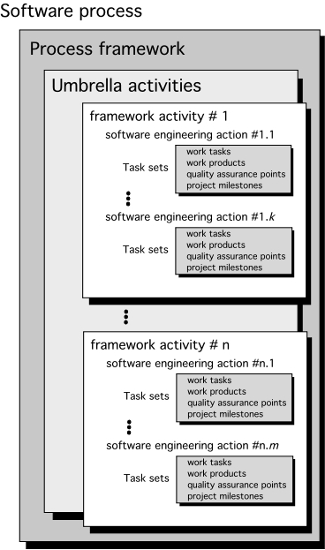
2.1 A Generic Process Model
过程：在工作产品构建中的工作活动、动作和任务的集合。
这些活动、动作、任务中的每一个都隶属于某一框架或模型，框架或模型定义了他们同过程之间或者相互之间的关系。
左图:
每一个框架活动由一系列（软件工程）动作构成；
每一个动作由任务集来定义；
每一个任务集包括：任务，产品，质量保证点，项目里程碑；
© 2010 Sichuan University All rights reserved. | Confidential

Slide 70
SW Process
A software process is a framework for the activities, actions, and tasks that are required to build high quality software
SW process defines the approach that is taken as software is engineered.
SW engineering also encompasses technologies that populate the process—technological method and automated tools。 (quality)
软件过程定义了软件工程化中采用的方法（框架活动），但软件工程还包括该过程中的应用技术（技术方法和自动化工具），软件过程包含在软件工程中。

Slide 71
Process Framework
Process framework
Framework activities
work tasks
work products
milestones & deliverables
QA checkpoints
Umbrella Activities
© 2010 Sichuan University All rights reserved. | Confidential

Slide 72
Process Framework
Umbrella Activities
Software project management
Formal technical reviews
Software quality assurance
Software configuration management
Work product preparation and production
Reusability management
Measurement
Risk management
© 2010 Sichuan University All rights reserved. | Confidential

Slide 73
Process Framework
Generic Framework Activities
Communication
Planning
Modeling
Analysis of requirements
Design
Construction
Code generation
Testing
Deployment
© 2010 Sichuan University All rights reserved. | Confidential

Slide 74
SW Process and SW Engineering
Software is a process for the tasks required to build high quality software, is to define the methods in SW develop
But Software engineering encompasses technologies populated the process—technological method and automated tools
tools
methods
process model
a “quality” focus

Slide 75
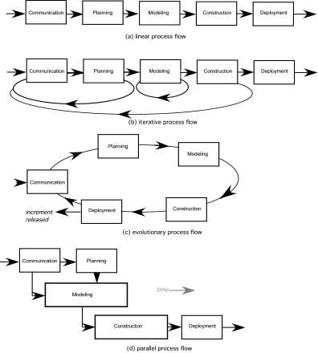
Process Flow
线性过程流：从沟通到部署顺序执行五个框架活动
迭代过程流：在执行下一个活动前，重复执行之前的一个或多个活动
演化过程流：采用循环的方式执行各个活动
parallel并行过程流：将一个或多个活动与其他活动并行执行

Slide 76
2.2 Defining Framework Activity
Although we have described five framework activities and provided a basic definition of each in Chapter 2, a software team would need significantly more information before it could properly execute any one of these activities as part of the software process. Therefore, you are faced with a key question:
What actions are appropriate for a framework activity, given the nature of the problem to be solved, the characteristics of the people doing the work, and the stakeholders who are sponsoring the project?
© 2010 Sichuan University All rights reserved. | Confidential

Slide 77
Process Framework
The Process Model: Adaptability
the framework activities will always be applied on every project ... BUT
the tasks (and degree of rigor) for each activity will vary based on:
the type of project
characteristics of the project
common sense judgment; concurrence of the project team
© 2010 Sichuan University All rights reserved. | Confidential

Slide 78
2.3 Identifying a Task Set
Activity（如：沟通）
Action （如：需求获取）
Task set（如：开会、需求列表、需求优先级…）
每一个软件工程动作action都是有若干个任务集（task set）构成，而每一个任务急都有软件工程工作任务、相关工作产品、质量保证点和项目里程碑等部分组成
（参看右图）

Slide 79
2.3 Identifying a Task Set
© 2010 Sichuan University All rights reserved. | Confidential
A task set defines the actual work to be done to accomplish the objectives of a software engineering action.（一个软件动作由若干个任务集完成）
A list of the task to be accomplished
A list of the work products to be produced
A list of the quality assurance filters to be applied

Slide 80
Process Framework
Example: Task set for Requirement gathering
in Communication activity
Make a list of stakeholders for the project
Invite all stakeholders to an informal meeting
Ask each stakeholder to make a list of features and functions required
Discuss requirements and build a final list
Prioritize requirements
Note areas of uncertainty
small, relatively simple project
© 2010 Sichuan University All rights reserved. | Confidential

Slide 81
Process Framework
Example: Task set for Requirement gathering
in Communication activity
Make a list of stakeholders for the project
Interview each stakeholder separately to determine overall wants and needs
Build a preliminary list of functions and features based on stakeholder input
Schedule a series of facilitated requirements gathering meetings
Conduct meetings
Produce informal user scenarios as part of each meeting
Reline user scenarios based on stakeholder feedback
Build a revised list of stakeholder requirements
Use quality function deployment (QFD) techniques to prioritize requirement
Package requirements so that they can be delivered incrementally
Note constraints and restrictions that will be placed on the system
Discuss methods for validating the system
large, more complex project
© 2010 Sichuan University All rights reserved. | Confidential

Slide 82
2.4 Process Assessment and Improvement
Standard CMMI Assessment Method for Process Improvement (SCAMPI)： 用于过程改进的CMMI标准评估方法.
CMM-Based Appraisal for Internal Process Improvement (CBA IPI)：用于组织内部过程改进的CMM评估
SPICE—The SPICE (ISO/IEC15504) ：软件过程改进和能力测定（software process improvement and capability determination）
ISO 9001:2000 for Software：国际标准化组织的软件开发标准
GB 国标
chapter 28 SPI（Software Process Improvement ）
© 2010 Sichuan University All rights reserved. | Confidential

Slide 83
（同前页）
Standard CMMI Assessment Method for Process Improvement (SCAMPI) — provides a five step process assessment model that incorporates five phases: initiating, diagnosing, establishing, acting and learning.
CMM-Based Appraisal for Internal Process Improvement (CBA IPI)—provides a diagnostic technique for assessing the relative maturity of a software organization; uses the SEI CMM as the basis for the assessment [Dun01]
SPICE—The SPICE (ISO/IEC15504) standard defines a set of requirements for software process assessment. The intent of the standard is to assist organizations in developing an objective evaluation of the efficacy of any defined software process. [ISO08]
ISO 9001:2000 for Software—a generic standard that applies to any organization that wants to improve the overall quality of the products, systems, or services that it provides. Therefore, the standard is directly applicable to software organizations and companies. [Ant06]

Slide 84
Software process assessment
ISO:
SEI:CMM (Capability maturity Model)
CMMI (Capability maturity Model Integration)
CMM/CMMI主要应用在两大方面：能力评估和过程改进。

Slide 85
CMM & CMMI （参考）
为了保证软件产品的质量，80年代中期，美国联邦政府提出对软件承包商的软件开发能力进行评估的要求。因此，美国卡内基-梅隆大学软件工程研究所 (CMU/SEI) 于1987年研究发布了软件过程成熟度框架，并提供了软件过程评估和软件能力评价两种评估方法和软件成熟度提问单。4年之后，SEI将软件过程成熟度框架进化为软件能力成熟度模型（Capability Maturity Model For Software，简称SW-CMM），并发布了最早的SW-CMM 1.0版。经过两年的试用，1993年SEI正式发布了SW-CMM1.1版，这是目前使用最为广泛的版本。

Slide 86
CMM & CMMI （参考）
1991年SW-CMM首次发布后，SEI又开发了其他成熟度模型，包括：系统工程、采购、人力资源管理和集成产品开发等。虽然各个模型针对的专业领域不同，但彼此之间也有一定的重叠，毕竟它们同出一辙；另外，这些模型在表现形式上又有不统一之处：系统工程模型是连续式的，而其他模型采用了分级式。当SEI开始开发新一代成熟度模型的时候，其发起人提出了新的要求：整合不同模型中的最佳实践，建立统一模型，覆盖不同领域，供企业进行整个组织的全面过程改进。所以，SEI于2001年12月正式发布了能力成熟度集成模型（CMMI）1.1版本，这次发布标志着CMMI的正式使用。（逐步取代CMM）

Slide 87
CMMI： （参考）
https://cmmiinstitute.com
据CMMI官网显示，目前通过CMMI5级别审核的全球企业共有1534家，其中2021年通过CMMI5级的全球企业共477家。国内通过CMMI5级的企业大多来自科大讯飞、平安壹账通、联想数据、百度智能云等业内知名公司。

Slide 88
CMMI： （参考）
CMMI is the successor of the capability maturity model (CMM) or Software CMM. The CMM was developed from 1987 until 1997.
Version 1.1 2002
Version 1.2 August 2006
Version 1.3 November 2010. Some of the major changes in CMMI V1.3 are the support of Agile Software Development, improvements to high maturity practices and alignment of the representation (staged and continuous).

Slide 89
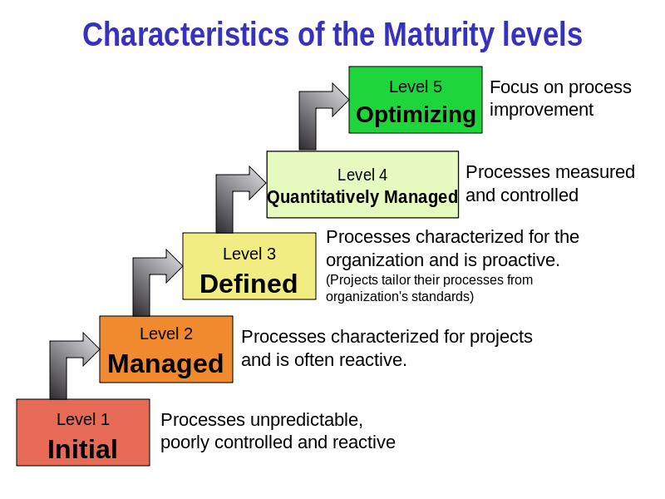
CMMI: Capability Maturity Model Integration （参考）
level 1 Performed
© 2010 Sichuan University All rights reserved. | Confidential

Slide 90
CMM vs CMMI （参考）
CMM came first but was later improved and was succeeded by CMMI.
Different sets of CMMs have problems with overlaps, contradictions, and lack of standardization. CMMI later addressed these problems.
Initially, CMM describes specifically about software engineering whereas CMMI describes integrated processes and disciplines as it applies both to software and systems engineering.
CMMI is much more useful and universal than the older CMM.

Slide 91
Criticism （参考）
CMMI and CMM are geared more toward large, bureaucratic organizations than smaller ones. Smaller organizations have to spend more time in interpreting the provisions of CMM and CMMI to their individual contexts.
CMM and CMMI largely focus on the process while not dwelling on the people and technology aspects of software development, meaning that implementing them provides no guarantee that a project will succeed.

Slide 92
Summary
SE is a discipline that integrates process,methods,and tools for the devlopment Software
Difference process models for SE proposed,all process models define a set of framework activities,a collection of tasks that conducted to accomplish each activity,work products produced as a consequence of the tasks, and a set of umbrella activivities that span the entire process
process pattern can be used to define the characteristics of a process
CMM/CMMI is a comprehensive process meta-model that describes the specfic goal,practices and capabilities that should be present in a mature software process（了解分几级，名称）
© 2010 Sichuan University All rights reserved. | Confidential

Slide 93
Summary: Process Flow
线性过程流：从沟通到部署顺序执行五个框架活动
迭代过程流：在执行下一个活动前，重复执行之前的一个或多个活动
演化过程流：采用循环的方式执行各个活动
并行过程流：将一个或多个活动与其他活动并行执行
© 2010 Sichuan University All rights reserved. | Confidential

Slide 94
Exercise
1.Which of the items listed below is not one of the software engineering layers?
a. Process
b. Manufacturing
c. Methods
d. Tools
2.Software engineering umbrella activities are only applied during the initial phases of software development projects.
a. True
b. False
Answer： 1-b 2-b
© 2010 Sichuan University All rights reserved. | Confidential

Slide 95
Exercise
Answer： 3-a 4-b
3.Which of these are the 5 generic software engineering framework activities?
a. communication, planning, modeling, construction, deployment
b. communication, risk management, measurement, production, reviewing
c. analysis, designing, programming, debugging, maintenance
d. analysis, planning, designing, programming, testing
4.Process technology tools allow software organizations to compress schedules by skipping unimportant activities.
a. True
b. False
© 2010 Sichuan University All rights reserved. | Confidential

Slide 96
Exercise
5. It is generally accepted that one cannot have weak software processes and create high quality end products.
a. True
b. False
6. The tasks for each activity are always unchanged.
a. True
b. False
Answer: 5-a 6-b
© 2010 Sichuan University All rights reserved. | Confidential

Slide 97
2.5 Prescriptive process models
Prescriptive process models
Waterfall Model
Incremental model
Prototype
Spiral
Unified Process
© 2010 Sichuan University All rights reserved. | Confidential

Slide 98
Prescriptive Process Models惯用过程模型
Prescriptive process models advocate an orderly approach to software engineering（提倡有序的工程方法）
That leads to a few questions …
If prescriptive process models strive for structure and order, are they inappropriate for a software world that thrives on change?
如果倡导过程模型（结构和有序），如何适应变化
Yet, if we reject traditional process models (and the order they imply) and replace them with something less structured, do we make it impossible to achieve coordination and coherence in software work?
如果摒弃过程模型（非结构和无序），如何协调一致地开发软件
© 2010 Sichuan University All rights reserved. | Confidential

Slide 99
软件开发
手工作坊式： 编码、测试、提交
软件工程的方法（软件生命周期，过程模型）
所有的软件过程模型都支持通用活动框架，只是每个模型对框架活动有不同侧重，并且定义不同的过程流以不同的方式执行每一个框架活动(包括动作和任务)

Slide 100
2.5.1Waterfall Model
Waterfall Model (Classic life cycle)
Communication
project initiation
requirements gathering
Planning
estimating
scheduling
tracking
Modeling
analysis
design
Construction
code
test
Deployment
delivery
Support
feedback
© 2010 Sichuan University All rights reserved. | Confidential

Slide 101
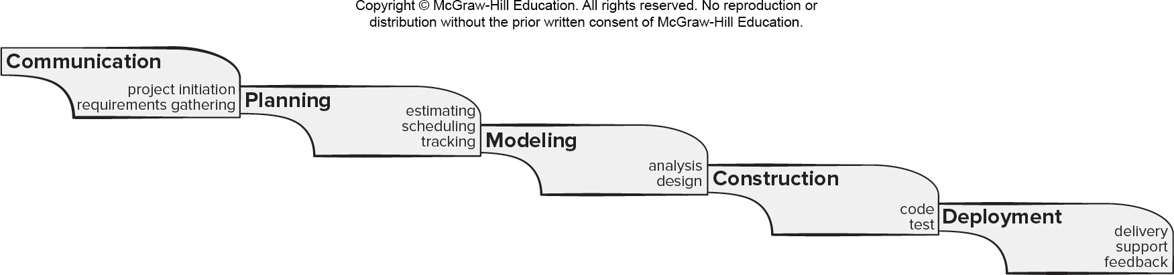
Waterfall Process Model
Pros
It is easy to understand and plan.
It works for well-understood small projects.
Analysis and testing are straightforward.
Cons
It does not accommodate change well.
Testing occurs late in the process.
Customer approval is at the end.

Slide 102
Waterfall Model: Example
Normal project，No high risk
Requirements explicit
© 2010 Sichuan University All rights reserved. | Confidential

Slide 103
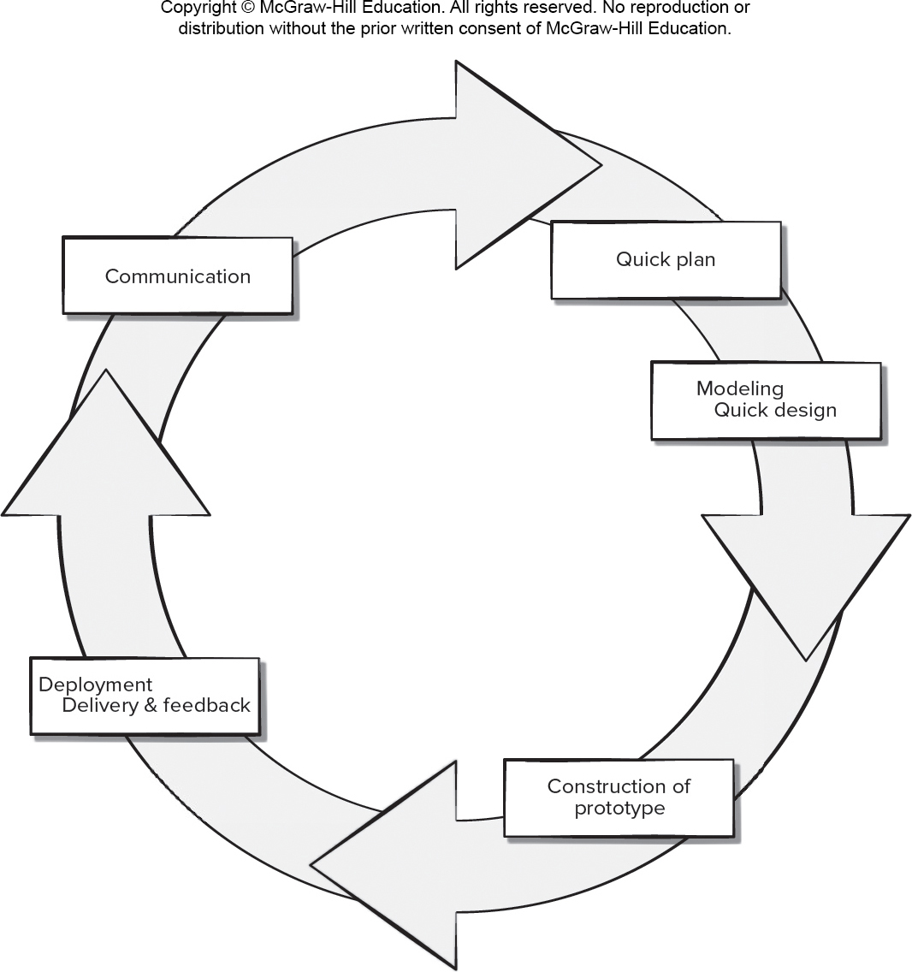
Prototyping Process Model
Pros
Reduced impact of requirement changes.
Customer is involved early and often.
Works well for small projects.
Reduced likelihood of product rejection.
Cons
Customer involvement may cause delays.
Temptation to “ship” a prototype.
Work lost in a throwaway prototype.
Hard to plan and manage.

Slide 104
Prototyping Model(参考)
Merits
Serves as a mechanism for assisting developers and customers to better understand what is to be build when requirements are fuzzy.
Useful for high risk
Demerits
Customers always ask developers to make the prototype a working product, which makes software development management relented.
(原型常常会被抛弃，而不是在其上继续开发)
增加成本
Developers often make implementation compromises in order to get a prototype working quickly. Finally, the less-than-ideal choices has now become an integral part of the system.（一些凑合的技术和算法可能会遗留在最终系统中）
© 2010 Sichuan University All rights reserved. | Confidential

Slide 105
Evolutionary Models: Spiral Model
© 2010 Sichuan University All rights reserved. | Confidential

Slide 106
Spiral Model: （风险驱动的过程模型）
螺旋模型是一种演化过程模型，它结合了原型的迭代性质和瀑布模型的系统性和可控性，注重风险控制（里程碑），适合大型项目开发
螺旋模型两个显著特点：
采用循环的方式逐步加深系统定义和实现的深度
确定一系列里程碑，确保利益相关者都支持可行的和令人满意的系统解决方案
运用螺旋模型，把软件开发为一系列演进版本，早期的迭代中，软件可能是一个理论模型或原型，后来的迭代，才会产生一系列逐渐完善的系统版本
在每一次迭代的过程中，都要考虑风险、标记里程碑
© 2010 Sichuan University All rights reserved. | Confidential

Slide 107
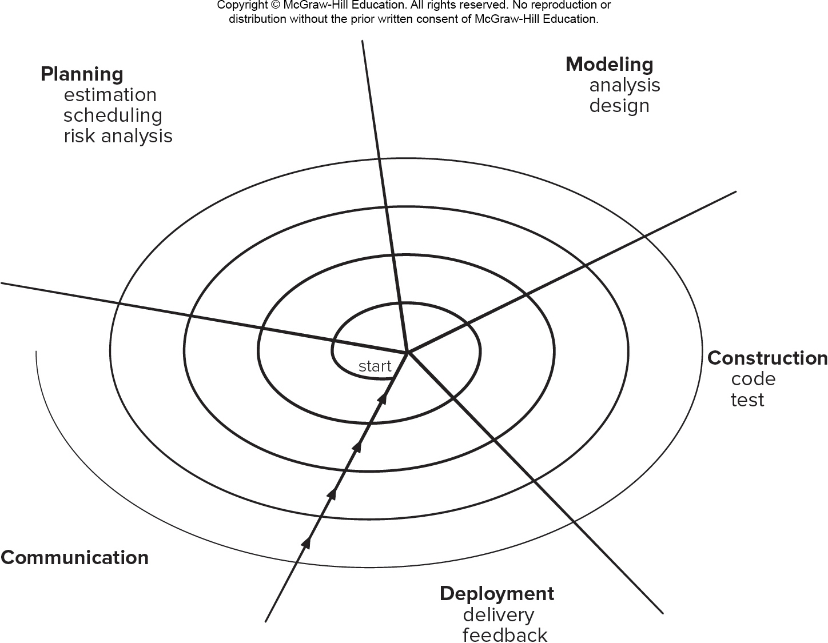
Spiral Process Model
Pros
Continuous customer involvement.
Development risks are managed.
Suitable for large, complex projects.
It works well for extensible products.
Cons
Risk analysis failures can doom the project.
Project may be hard to manage.
Requires an expert development team.

Slide 108
Unified Process迭代增量过程，用UML进行面向对象软件工程的框架和过程）
UML（附件一）
The Unified Modeling Language (UML) is “a standard language for writing software blueprints. UML may be used to visualize, specify, construct, and document the artifacts of a software-intensive system” . In other words, just as building architects create blueprints to be used by a construction company, software architects create UML diagrams to help software developers build the software. If you understand the vocabulary of UML (the diagrams’ pictorial elements and their meanings), you can much more easily understand and specify a system and explain the design of that system to others.
© 2010 Sichuan University All rights reserved. | Confidential

Slide 109
Unified Process迭代增量过程，用UML进行面向对象软件工程的框架和过程）
The Unified Process is an iterative and incremental development process. The Elaboration, Construction and Transition phases are divided into a series of time-boxed iterations. (The Inception phase may also be divided into iterations for a large project.) Each iteration results in an increment, which is a release of the system that contains added or improved functionality compared with the previous release. provides a process and methodological approach for defining, specifying, designing, and constructing aspects
use-case driven （用例驱动）
architecture-centric （软件架构为核心）
Risk Focused （关注风险）
Inception/Elaboration/Construction/Transition（/production）
© 2010 Sichuan University All rights reserved. | Confidential

Slide 110
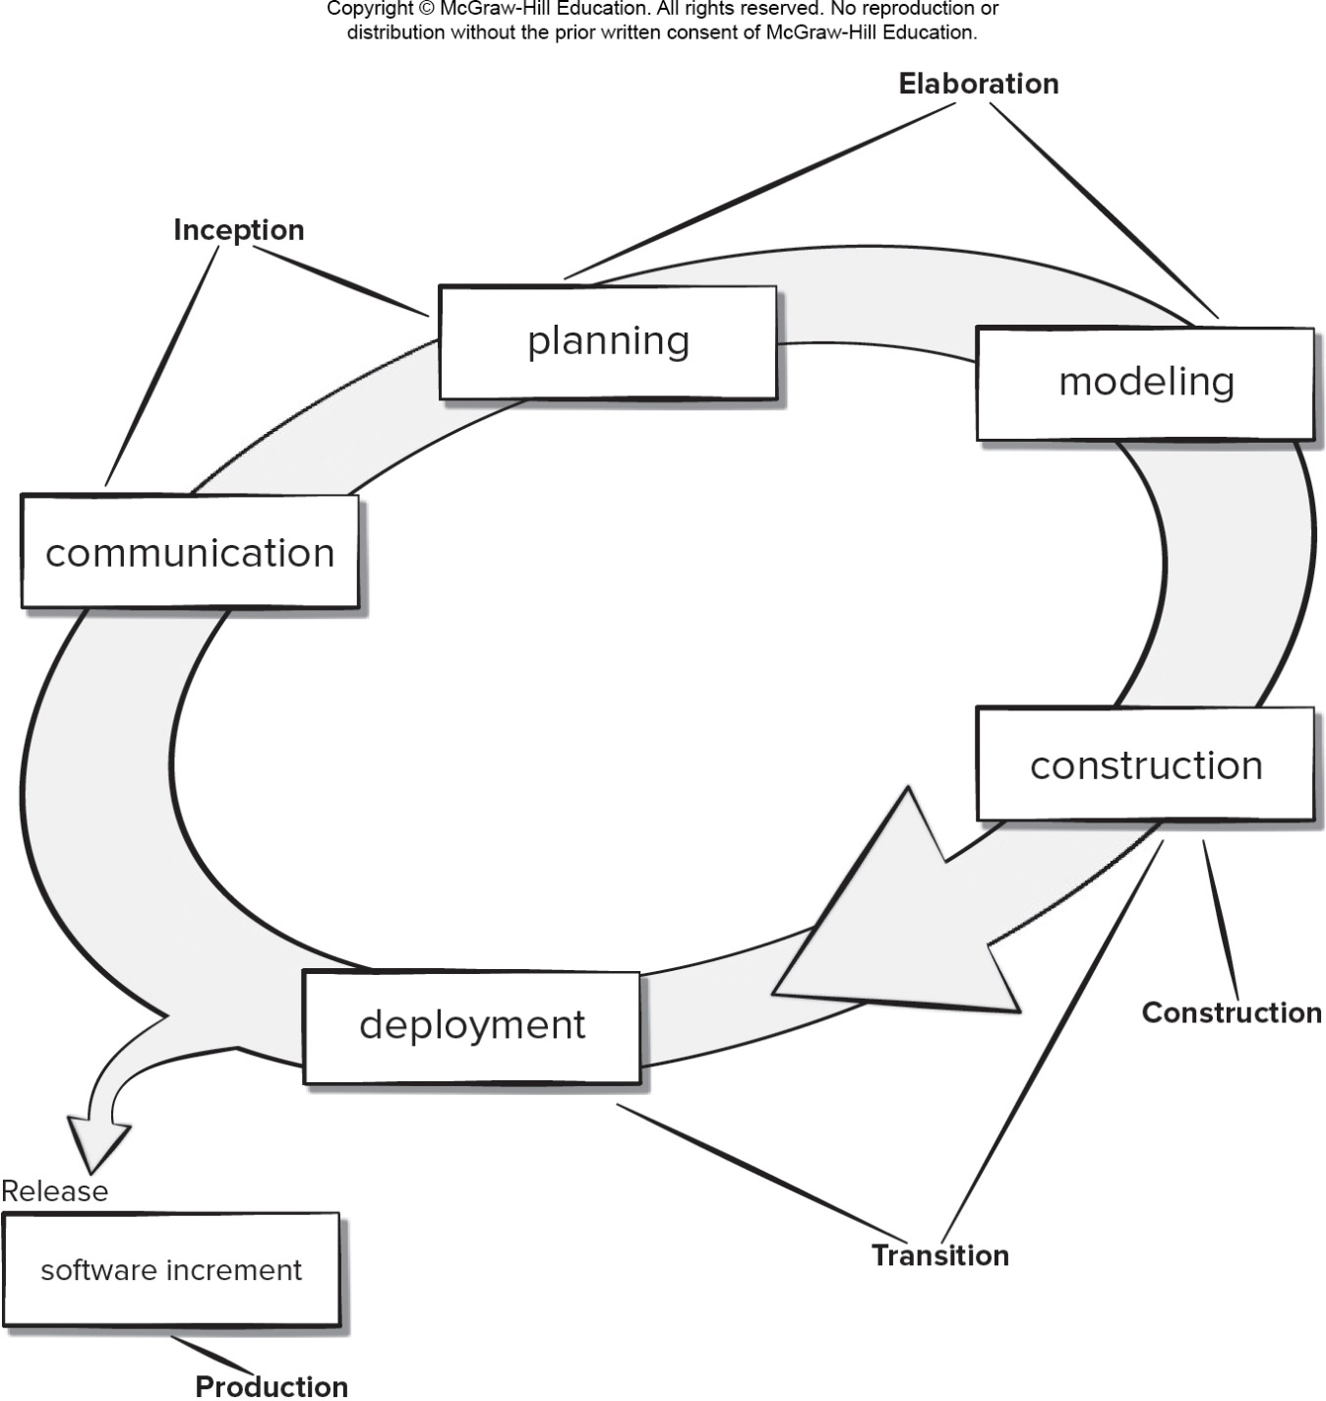
Unified Process Model
Pros
Quality documentation emphasized.
Continuous customer involvement.
Accommodates requirements changes.
Works well for maintenance projects.
Cons
Use cases are not always precise.
Tricky software increment integration.
Overlapping phases can cause problems.
Requires expert development team.

Slide 111
Incremental Model
© 2010 Sichuan University All rights reserved. | Confidential

Slide 112
Incremental Model: Example: WORD
word-processing software
First version： core product（basic file management/ editing/ document functions）
Sophisticated editing/document production capabilities
Spelling/grammar checking
Advanced Page layout
© 2010 Sichuan University All rights reserved. | Confidential

Slide 113
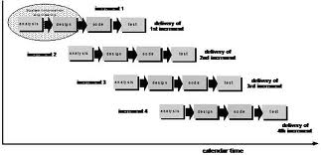
Incremental Model
Merits
Useful for unavailable staffing for complete
implementation by the business deadline.（克服人手不足）
节约时间.
线性（每个增量按照瀑布模型进行管理）+并行
每个增量都是可提交运行的版本，（第一个增量往往是核心产品core product）
Demerits（？？？）
Focus on the delivery of an operational product with each
increment. Early increments would be “ignored” easily.
© 2010 Sichuan University All rights reserved. | Confidential

Slide 114
Speed of development vs high quality
The challenge for software team is to establish a proper balance between these critical project and product parameters and customer satisfaction
In many cases, time-to-market is the most important management requirement.
If a market window is missed, the software project itself may be meaningless.
微信
Word 与 wps
管家婆（任我行）与用友和金蝶财务软件
显微图像处理与诊断报告打印
© 2010 Sichuan University All rights reserved. | Confidential

Slide 115
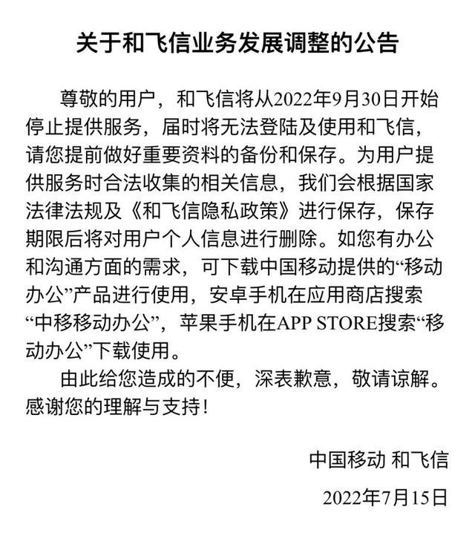
故事一：微信
微信 十年
2021年的1月19日，在新一期的微信公开课PRO上，张小龙分享了这样一组数据：每天有10.9亿用户打开微信，3.3亿用户进行了视频通话；有7.8亿用户进入朋友圈，1.2亿用户发表朋友圈，其中照片6.7亿张，短视频1亿条；有3.6亿用户读公众号文章，4亿用户使用小程序。
从2011年1月21日微信开启公测，到2021年1月21日微信迎来十岁生日，微信成为了很多人每天社交、工作中使用最频繁的APP。
背靠中国移动，飞信曾经也有着一手好牌。作为一款在国内红极一时的即时通讯软件，早在 PC 互联网时代，飞信就已然具备移动社交通讯的基因。
飞信于2007年面世，算是国内最早一批进军即时通讯软件领域的产品，比国民级软件微信还要早上4年。其“巅峰期”在2010年前后，根据当时的数据机构统计，在巅峰时期飞信的活跃用户高达9000万，注册用户更是超过了5亿。
飞信之所以会在短短几年内被微信打得丢盔弃甲，除了腾讯庞大用户基数外，更重要的是飞信自身存在不少问题。飞信的固步自封是其中一个重要原因。在一开始飞信是屏蔽了其他运营商的，非移动用户根本无法注册和使用飞信，从而白白丢失了不少潜在用户（直到2012年才开放）。
© 2010 Sichuan University All rights reserved. | Confidential

Slide 116
故事二：米聊VS微信
2010年12月，小米接连发布Android版与iOS版的米聊。与QQ的陌生人扩列模式不同，米聊是国内第一款基于本地通讯录添加好友的社交应用，其模式据说来源于加拿大的的一款通讯软件KiK。
米聊的发布会上，雷军曾这样表示：如果给他们一年时间，米聊就有50%的胜出机会，可一旦腾讯在几个月内反击，那米聊就必死无疑。
不料后半句一语成谶，仅隔一个月，腾讯就强势推出微信，导致起步不久的米聊被迫与之同台竞争。据官方数据显示，米聊上线近半年，就拥有了200万的注册用户，值得一句“表现不错”的评价。可米聊仅是表现不错，但微信却是在变态发育。2012年3月，微信官方宣布用户数突破1亿大关，且用时仅433天，刷新了彼时国内APP的发展记录，同样也意味着米聊的彻底落败。
为何起了个大早的米聊，却只能赶晚集？
阿里也曾选择与微信正面对抗，力推移动社交 " 来往 "，高调邀请十万淘女郎入驻，但多番 " 折腾 " 之后，来往也逐渐销声匿迹，转而变为钉钉，主攻在线办公市场。
电信和网易联手打造的 " 易信 " 也曾同样向微信公开叫板，但如今也同样悄无声息、泯然众人。2019 年，马桶 MT、多闪、聊天宝三款 App" 宣战 " 微信，号称三英战微信，结果均难逃失败命运。
© 2010 Sichuan University All rights reserved. | Confidential

Slide 117
Prescriptive model summary
瀑布模型、原型模型、增量模型等
e.g. ATC system， Windows（Mac）
拖拉机与坦克
智能交通投标，开发原型样机，投标经历，软件产品化和工程化的问题
© 2010 Sichuan University All rights reserved. | Confidential

Slide 118
Use Case(专题)
© 2010 Sichuan University All rights reserved. | Confidential

Slide 119
Use Case
Course Management
Course
selection
Student
Course
management
Course manager
Classroom
management
Course
Scheduling
Teacher
Grade
management
小人：参与者、角色；椭圆：用例；矩形框：系统边界
用例图：用例和用例之间关系的视图
© 2010 Sichuan University All rights reserved. | Confidential

Slide 120
Use Case
用例图定义了系统的功能需求，它是从系统的外部看系统功能，并不描述系统内部对功能的具体实现。
USE CASE图主要的作用有三个：（1）获取需求；（2）指导测试；（3）还可在整个过程中的其它工作流起到指导作用。
参与者：参与者不是特指人，是指系统以外的，在使用系统或与系统交互中所扮演的角色。因此参与者可以是人，可以是事物，也可以是时间或其他系统等等。还有一点要注意的是，参与者不是指人或事物本身，而是表示人或事物当时所扮演的角色。比如小明是图书馆的管理员，他参与图书馆管理系统的交互，这时他既可以作为管理员这个角色参与管理，也可以作为借书者向图书馆借书，在这里小明扮演了两个角色，是两个不同的参与者。参与者在画图中用简笔人物画来表示，人物下面附上参与者的名称。
© 2010 Sichuan University All rights reserved. | Confidential

Slide 121
Use Case
用例：是对包括变量在内的一组动作序列的描述，系统执行这些动作，并产生传递特定参与者的价值的可观察结果。这是UML对用例的正式定义，对我们初学者可能有点难懂。我们可以这样去理解，用例是参与者想要系统做的事情。对于对用例的命名，我们可以给用例取一个简单、描述性的名称，一般为带有动作性的词。用例在画图中用椭圆来表示，椭圆下面附上用例的名称。
系统边界：用来表示正在建模系统的边界。边界内表示系统的组成部分，边界外表示系统外部。
箭头：用来表示参与者和系统通过相互发送信号或消息进行交互的关联关系。箭头尾部用来表示启动交互的一方，箭头头部用来表示被启动的一方，其中用例总是要由参与者来启动。
© 2010 Sichuan University All rights reserved. | Confidential

Slide 122

Use Case
1. 包含
包含关系是指用例可以简单地包含其他用例具有的行为，并把它所包含的用例行为作为自身行为的一部分。

Slide 123

Use Case
2. 扩展
在一定条件下，把新的行为加入到已有的用例中，获得的新用例称为扩展用例（Extension），原有的用例称为基础用例（Base）。

Slide 124
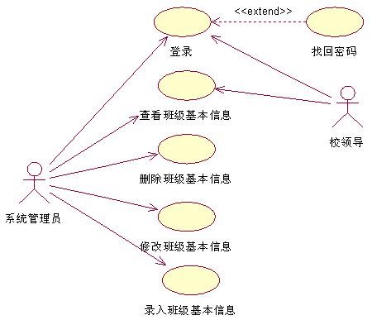
示例1：班级信息管理用例图

Slide 125
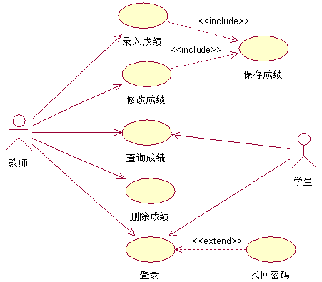
示例2： 成绩管理用例图

Slide 126
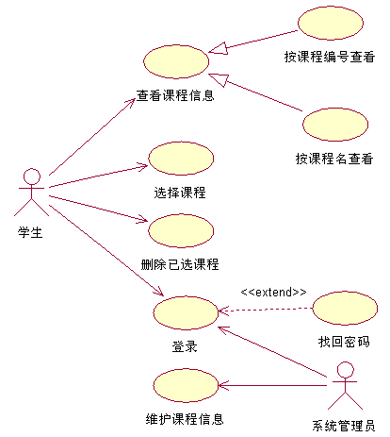
示例3： 网上选课用例图

Slide 127
Summary
Prescriptive Software process models have been applied for many years in an effort to bring order and structure to SW development
Each of these models suggests a somewhat different process flow, but all perform the same set of generic framework activities:communication,planning,modeliing,costruction and deployment
© 2010 Sichuan University All rights reserved. | Confidential

Slide 128
Summary
© 2010 Sichuan University All rights reserved. | Confidential
我们开发软件用什么过程模型？
举例：ATC开发
重点：瀑布模型、增量模型、原型模型、UP

Slide 129
Summary
The waterfall model suggests a linear progression of framework activities ,it is applicable in situations where requirement are well-defined
Incremental SW process models produce software as a series of increment releases.
Evolutionary process models recognize the iterative nature of most SE projects and are designed to accommodate change, such as prototyping, spiral model
Prototype- when requirements are fuzzy; throw-away
© 2010 Sichuan University All rights reserved. | Confidential

Slide 130
Summary
UP is a “usecase-driven, architecture-centric,iterative and incremental” software process designed as a framework for UML methods and tools,UP is an incremental model in which five phases are defined: inception,elaboration,construction, transition, production
© 2010 Sichuan University All rights reserved. | Confidential

Slide 131
Answer：1-a 2-e
Exercise
The linear sequential model of software development is
A reasonable approach when requirements are well defined.
A good approach when a working program is required quickly.
The best approach to use for projects with large development teams.
An old fashioned model that cannot be used in a modern context.
The linear sequential model of software development is also known as the
Classical life cycle model
Fountain model
Spiral model
Waterfall model
both a and d
© 2010 Sichuan University All rights reserved. | Confidential

Slide 132
Answer：3-b
Exercise
3.The incremental model of software development is
A reasonable approach when requirements are well defined.
A good approach when a working core product is required quickly.
The best approach to use for projects with large development teams.
A revolutionary model that is not used for commercial products.
© 2010 Sichuan University All rights reserved. | Confidential

Slide 133
Answer：5-d 6-b
Exercise
5. Evolutionary software process models
Are iterative in nature
Can easily accommodate product requirements changes
Do not generally produce throwaway systems
All of the above
6. The prototyping model of software development is
a. A reasonable approach when requirements are well defined.
b. A useful approach when a customer cannot define requirements clearly.
c. The best approach to use for projects with large development teams.
d. A risky model that rarely produces a meaningful product.
© 2010 Sichuan University All rights reserved. | Confidential

Slide 134
Answer：7-d 8-a
Exercise
7. Which of these is not one of the phase names defined by the Unified Process model for software development?
Inception phase
Elaboration phase
Construction phase
Validation phase
8. In the Unified Process model requirements are determined iteratively and may span more than one phase of the process.
True
False
© 2010 Sichuan University All rights reserved. | Confidential

Slide 135
Homework No.2 2024-9-12
How does software team choose the task set for a particular project?
How can process patterns assist a development team build software products efficiently?
Why it important for software processes to be agile?
Describe the phases of the prototyping model for software development?
Why are evolutionary models considered by many to be the best approach to software development in a modern context?
How are tasks, actions, and activities related to software process models?
Describe a process framework in your own words. When we say that framework activities are applicable to all projects, does this mean that the same work tasks are applied for all projects, regardless of size and complexity ? Explain
Umbrella activities occur throughout the software process. Do you think they are applied evenly across the process, or are some concentrated in one or more framework activities.
Describe the relationships among software engineering process, methods, and tools.
© 2010 Sichuan University All rights reserved. | Confidential

Slide 136
Homework No.2 2024-9-12
软件团队如何为特定项目选择任务集？
软件团队在为一个特定的项目选择任务集合时，通常会考虑项目的具体需求、可用资源、时间限制以及团队的能力。他们会根据业务目标来定义功能要求，并将其分解成可管理的任务。这些任务随后会被优先级排序，以确定先做什么以及在什么时间框架内完成。
过程模式如何帮助开发团队高效地构建软件产品？
过程模式提供了一种结构化的方法来管理和组织开发活动。它们可以帮助团队识别最佳实践、避免常见陷阱，并确保开发工作按照预定的时间表和预算进行。此外，过程模式还能促进团队成员之间的沟通，确保每个人都了解自己的职责，并有助于在整个开发周期中保持一致性和质量标准。
为什么软件过程需要具备敏捷性？
软件过程需要具备敏捷性是因为现代软件开发环境变化快速且不可预测。敏捷方法允许团队快速响应变化，及时调整计划以适应新的信息或需求变更。这有助于提高产品质量，减少浪费，并使团队能够更有效地交付价值给客户。
描述软件开发原型模型的阶段？
原型模型通常包括以下几个阶段：
需求分析：与用户讨论并确定基本需求。
快速设计：基于初步需求创建一个简单的系统设计。
构建原型：根据设计快速构建一个可以工作的系统版本。
用户反馈：让用户与原型互动，并收集他们的反馈。
修正和完善：根据用户的反馈改进原型。
重复上述步骤直到原型满足用户的需求。
为什么进化模型被认为是现代软件开发的最佳方法？
进化模型（如增量模型或螺旋模型）被认为是现代软件开发的最佳方法之一，因为它允许项目在一系列迭代中逐渐发展，每次迭代都会增加新的特性和改进现有特性。这种方法可以更好地应对需求的变化，并且可以在早期发现和解决问题，从而降低了项目失败的风险。
任务、行动和活动是如何与软件过程模型相关的？
任务、行动和活动是软件过程模型中的重要组成部分。任务是需要完成的工作单位，而行动是指执行某个任务的具体步骤。活动是一系列相关任务的组合，它们共同实现特定的目标。在软件开发过程中，活动是按顺序排列的任务集合，通常涉及多个角色和协作。
描述一个过程框架。当我们说框架活动适用于所有项目时，这是否意味着对于所有项目，无论大小和复杂程度，都应用相同的工作任务？解释一下。
一个过程框架提供了一个结构化的指南，它定义了软件开发过程中应遵循的基本活动和流程。虽然框架活动适用于所有项目，但这并不意味着所有项目都会以相同的方式执行这些任务。每个项目都有其独特的特性，因此即使使用相同的框架活动，具体的实施细节也会根据项目的规模、复杂度和其他因素而有所不同。
伞状活动在整个软件过程中发生。你认为它们在整个过程中均匀分布，还是集中在某些框架活动中？
伞状活动是指那些贯穿整个软件开发过程中的活动，如文档记录、质量管理等。这些活动的重要性可能会随着项目的不同阶段而有所变化，有些可能在项目的初始阶段更加集中，而在后期则保持较低的活跃度。因此，这些活动不一定在整个过程中均匀分布，而是根据项目的实际需求和所处的开发阶段来调整。
描述软件工程过程、方法和工具之间的关系？
软件工程过程定义了开发活动的序列，而方法则是实现这些活动的技术和策略。工具支持方法的实施，并自动化某些过程中的任务。三者之间的关系是相辅相成的：过程指导何时何地做事情，方法规定如何做，而工具则提供了实现的手段。有效的工具可以提高方法的效率，从而优化整个软件工程过程
© 2010 Sichuan University All rights reserved. | Confidential

Slide 137
Chapter 3 Agile Development
© 2010 Sichuan University All rights reserved. | Confidential

Slide 138
Competence,traits
Agile，agility

Slide 139
Chapter 3 Agile and Process
Content
The Manifesto for Agile
What is Agility?
An Agile process
Agile Process Model
Scrum
Extreme Programming (XP)
Kanban
DevOps
© 2010 Sichuan University All rights reserved. | Confidential

Slide 140

The Manifesto for Agile Software Development
“We are uncovering better ways of developing software by doing it and helping others do it. Through this work we have come to value:
Individuals and interactions over processes and tools
Working software over comprehensive documentation
Customer collaboration over contract negotiation
Responding to change over following a plan
That is, while there is value in the items on the right, we value the items on the left more.” by Kent Beck et al.
2001， Kent Beck + 16 developers/writer/consultants
Agile alliance
© 2010 Sichuan University All rights reserved. | Confidential

Slide 141
The Manifesto for Agile （同前）
4 core values:
Individuals and interaction OVER processes and tools
个人与交互 过程和工具
Working software OVER comprehensive documentation
可运行软件 繁复文档
Customer collaboration OVER contract negotiation
客户合作 合同谈判
responding to change OVER following a plan
响应变更 遵循计划

Slide 142
敏捷方法(另一个版本-参考)
Agile：轻巧、机敏、活力
Agile 其特点是对软件生产率的高度重视，主要适用于需求模糊或快速变化下的、小型项目组的开发。
Agile方法是在保证软件开发有成功产出的前提下，尽量减少开发过程中的活动和制品的方法，笼统的讲就是，"刚刚好"（Just enough），即开发中的活动及制品既不要太多也不要太少，在满足所需的软件质量要求的前提下，力求提高开发效率。

Slide 143
Why use Agility -> CHANGE
© 2010 Sichuan University All rights reserved. | Confidential
敏捷方法是克服传统软件工程中认识和实践的弱点而形成的
But changes occur every where in the software development
Requirements
Business Marketing (fluid business environment)
Peoples (human weakness) 人不是机器
technologies
SE continues to evolve. It can be adapted easily to meet the challenges posed by a demand for agility.

Slide 144
Why use Agility
© 2010 Sichuan University All rights reserved. | Confidential
Overcome perceived and actual weaknesses in conventional SE.
Can provide important benefits, but they are not applicable to all projects, all produces, all situations
Not anti thetical to solid SE practices.
(与传统SE并不对立，共存)

Slide 145
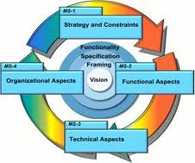
3.1What is “Agility”?
Effective (rapid and adaptive) response to change
Rapid, incremental delivery of software
最简而言之：快速、增量（迭代）
Agile/incremental/iterative
© 2010 Sichuan University All rights reserved. | Confidential

Slide 146
What is “Agility”?
Rapid deliver products (not care intermediate work products)
Effective (rapid and adaptive) response to change
Customers join the team (eliminate “us and them”), Effective communication among all stakeholders
Project plan must be flexible
Organizing a team so that it is in control of the work performed(自组织) ,communicate facilely
© 2010 Sichuan University All rights reserved. | Confidential

Slide 147
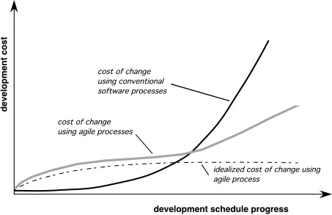
3.2 Agility and the Cost of Change
© 2010 Sichuan University All rights reserved. | Confidential

Slide 148
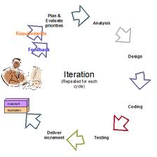
3.3 An Agile Process （迭代和增量提交）
Is driven by customer descriptions of what is required (scenarios)
Recognizes that plans are short-lived
Develops software iteratively with a heavy emphasis on construction activities
Delivers multiple ‘software increments’
Adapts as changes occur
© 2010 Sichuan University All rights reserved. | Confidential

Slide 149
3.3.1Agility Principles
Customer satisfaction is achieved by providing value through software that is delivered to the customer as rapidly as possible.
Develop recognize that requirements will change and respond (or accomedate ) changes.
Deliver software increments frequently (weeks not months) to stakeholders to ensure feedback on their deliveries is meaningful.
Agile team populated by motivated individuals using face-to-face communication to convey information.
Team process encourages technical excellence, good design, simplicity, and avoids unnecessary work.

Slide 150
3.3.1 Agility Principles
Working software that meets customer needs is the primary goal.
Pace and direction of the team’s work must be “sustainable,” enabling them to work effectively for long periods of time.
An agile team is a “self-organizing team”—one that can be trusted develop well-structured architectures that lead to solid designs and customer satisfaction.
Part of the team culture is to consider its work introspectively with the intent of improving how to become more effective its primary goal (customer satisfaction).

Slide 151
Human factor（参考）
the process molds to the needs of the people and team, not the other way around
key traits must exist among the people on an agile team and the team itself:
Competence (自信）
Common focus （共同目标）
Collaboration（精诚合作）
Decision-making ability （决策能力)
Fuzzy problem-solving agility （模糊解决问题能力，灵活性）
Mutual trust and respect （互相信任和尊重）
Self-organization （自我组织）
© 2010 Sichuan University All rights reserved. | Confidential

Slide 152
Self-organization
Self-organization
The team organizes itself for the work to be done
The team organizes the process to best accommodate its local environment
The team organizes the work schedule to best achieve delivery of the software increments
In order to Improve collaboration & boost team morale
（自己分配任务、时间，自己组织队伍完成，鼓舞士气，获得成就和满足感）
© 2010 Sichuan University All rights reserved. | Confidential

Slide 153
示例：
KCC项目开发
Group leader 下田与我要求的设计，独立开发照排系统（了解、理解、沟通与信任）
加班
© 2010 Sichuan University All rights reserved. | Confidential

Slide 154
3.4 Scrum
derived from an activity that occur during a rugby match
Originally proposed by Schwaber and Beedle
Framework activities
Requirements
Analysis
Design
Evolution
Delivery
© 2010 Sichuan University All rights reserved. | Confidential

Slide 155
Scrum （derived from an activity that occur during a rugby match）
Scrum—distinguishing features
Development work is partitioned into “packets(小包)”
Testing and documentation are on-going as the product is constructed
Work occurs in “sprints(冲刺)” and is derived from a “backlog（待定项，积压的工作）” of existing requirements
Meetings are very short and sometimes conducted without chairs
“demos（演示）” are delivered to the customer with the time-box allocated
© 2010 Sichuan University All rights reserved. | Confidential

Slide 156
Scrum （derived from an activity that occur during a rugby match）
Scrum Meetings
Are short(15m) meeting held daily by the scrum team
What did you do since the last meeting?
What obstacles are you encountering?
What do you plan to accomplish by the next team meeting?
© 2010 Sichuan University All rights reserved. | Confidential

Slide 157
Scrum
Every 24hrs
15min meeting daily
Basic questions
30days
Backlogs
demos
找一个山清水秀的地方冲刺--短暂、稳定、封闭的工作环境
© 2010 Sichuan University All rights reserved. | Confidential

Slide 158
Scrum Details（总结）
Backlog Refinement Meeting Developers work with stakeholders to create product backlog.
Sprint(冲刺) Planning Meeting Backlog partitioned into “sprints” derived from backlog and next sprint defined.
Daily Scrum Meeting Team members synchronize their activities and plan work day (15 minutes max).
Sprint Review Prototype “demos” are delivered to the stakeholders for approval or rejection.
Sprint Retrospective After sprint is complete, team considers what went well and what needs improvement.
Pros
Product owner sets priorities.
Team owns decision making.
Documentation is lightweight.
Supports frequent updating.
Cons
Difficult to control the cost of changes.
May not be suitable for large teams.
Requires expert team members.

Slide 159
3.5.1 Extreme Programming (XP) process
Uses an object-oriented approach as its preferred development paradigm（XP推荐面向对象的开发）
Four framework activities: planning/design/coding/testing
XP Planning
XP design
XP coding
XP testing
© 2010 Sichuan University All rights reserved. | Confidential

Slide 160
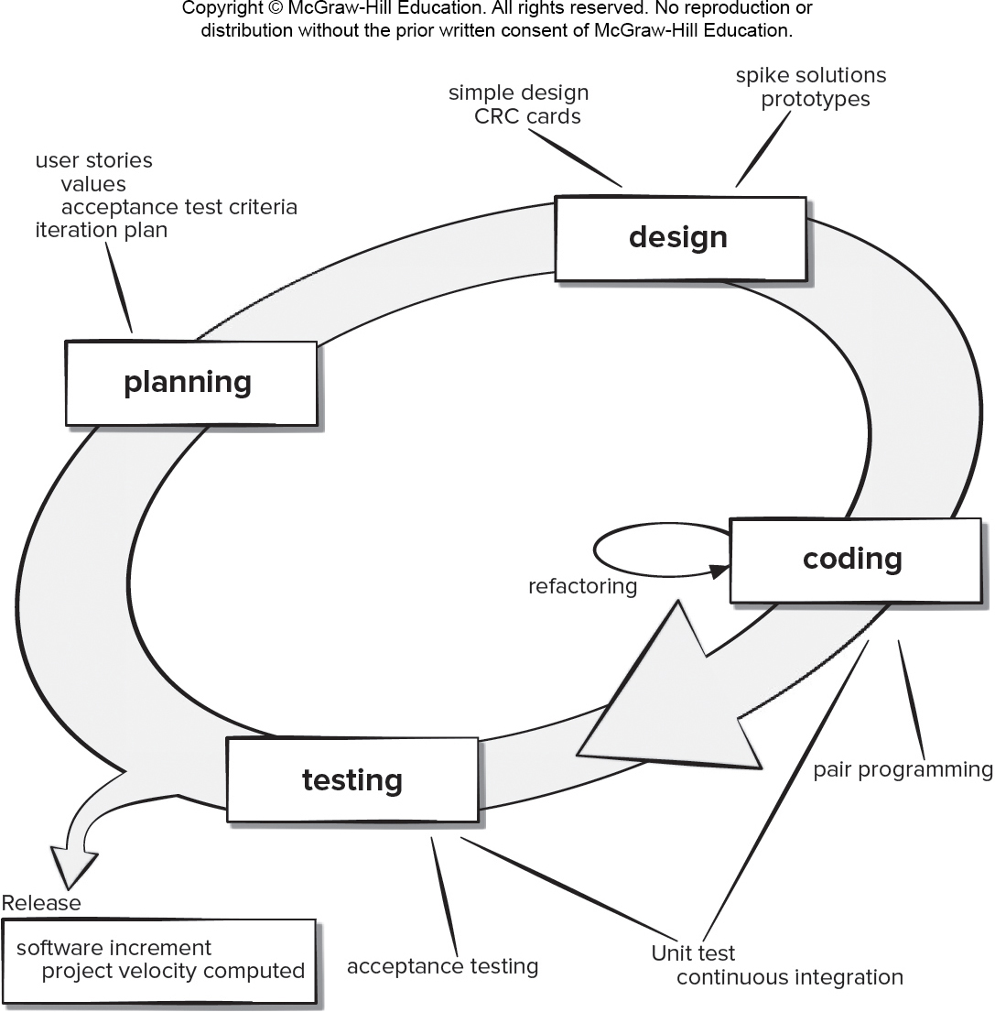
Extreme Programming (XP) Framework

Slide 161
XP Details（总结）
XP Planning – Begins with user stories, team estimates cost, stories grouped into increments, commitment made on delivery date, computer project velocity.
XP Design – Follows KIS principle, encourages use of CRC cards, design prototypes, and refactoring.
XP Coding – construct unit tests before coding, uses pair.
XP Testing – unit tests executed daily, acceptance tests define by customer.
Pros
Emphasizes customer involvement.
Establishes rational plans and schedules.
High developer commitment to the project.
Reduced likelihood of product rejection.
Cons
Temptation to “ship” a prototype.
Requires frequent meetings about increasing costs.
Allows for excessive changes.
Depends on highly skilled team members.

Slide 162
3.5.1 (XP) process-planning
XP Planning
Begins with the creation of “user stories”（ user stories：用户需求分析与分解，也就是用例）
Agile team assesses each story and assigns a cost
Stories are grouped to for a deliverable increment
A commitment is made on delivery date
After the first increment “project velocity(项目速度)” is used to help define subsequent delivery dates for other increments
© 2010 Sichuan University All rights reserved. | Confidential

Slide 163
3.5.1 (XP) process-design
XP Design
Follows the KIS (Keep It Simple) principle (不多不少，刚刚好)
Encourage the use of CRC (Class-Responsibility Collaborator 类-责任-协作者卡) cards （CRC卡以后介绍）
For difficult design problems, suggests the creation of
“Spike solutions”— a design prototype（实现并评估设计原型）
Encourages “refactoring” — an iterative refinement of the internal program design (重构：净化代码，在编码完成后改进代码设计)
© 2010 Sichuan University All rights reserved. | Confidential

Slide 164
3.5.1 (XP) process-coding, testing
XP Coding
Recommends the construction of a unit test for a store before coding commences （推荐先开发单元测试，再编码）
Encourages “pair programming”（结对编程）
XP Testing
The creation of unit tests before coding commences is a key element of XP, can be executed easily and repeated. This encourages a regression testing strategy whenever code is modified.(关注重要的、易出错的地方，进行回归测试，80%错误发生在20%代码中!!!!!!)
All unit tests are executed daily
“Acceptance tests” are defined by the customer and executed to assess customer visible functionality
© 2010 Sichuan University All rights reserved. | Confidential

Slide 165
？设计（对于一般的应用系统而言，GUI是关键）
？如何做设计（先做测试用例，先写说明书）
？如何编程序（桌上，机上）

Slide 166
3.5.2 Kanban 日语"看板"，カンバン
Kanban方法最初起源于丰田的JIT（Just In Time），是丰田生产模式中的重要概念，指为了达到准时生产方式（JIT）控制现场生产流程的工具。它可以使信息的流程缩短，并配合定量、固定装货容器等方式，使生产过程中的物料流动顺畅, 之后作为一种高效管理软件开发流程的技术和思想应用于软件开发。Kanban方法以价值流动为核心，不断发现团队中的瓶颈工序进行改进，使价值流动更加顺畅和快速。简单的说，就是保证软件的持续集成并且不让开发团队超负荷 看板也是敏捷模型的一部分
可视化工作流程。所有的工作进度会全部显示在Kanban上，每一个人都可以一目了然了解自己的工作进度以及项目进度、流程以及瓶颈，能够增加团队之间的协作，使他们能够集中精力促进流程。
限制在制工作，可以避免任务切换导致的问题，并减少不断重新确定项目优先次序的需要。WIP 限制释放了看板的全部潜力，使团队能够在更健康、更可持续的环境中以比以往更快的速度提供高质量的工作。
管理并优化流程。Kanban能够动态地展示团队工作流程的瓶颈。一旦项目管理者发现某个环节影响到团队进度，t就可以及时调配相应的资源改进这个环节，使流程得到优化。
缩短开发周期。可以更好的发现问题，解决问题，从而找到更科学的方法提高开发效率。

Slide 167
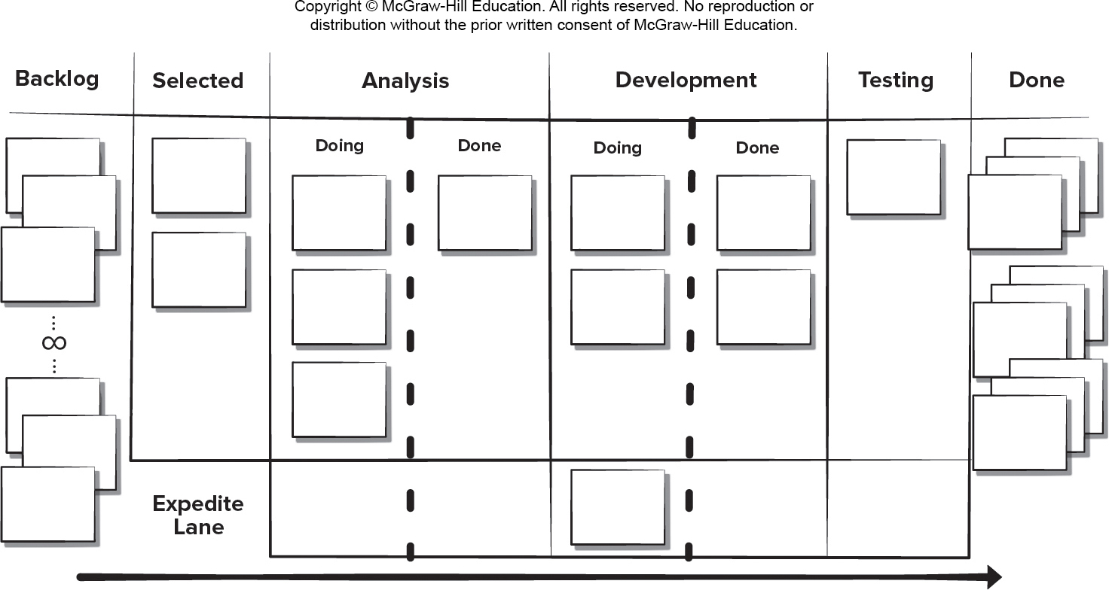
3.5.2 Kanban Framework
Kanban is focused on change management and service delivery

Slide 168
Kanban Details
Visualizing workflow using a Kanban board.
Limiting the amount of work in progress at any given time.
（Limit Work In Progress）（WIP）
Managing workflow to reduce waste by understanding the current value flow.
Making process policies explicit and the criteria used to define “done”.
Focusing on continuous improvement by creating feedback loops where changes are introduced.
Make process changes collaboratively and involve all stakeholders as needed.
Pros
Lower budget and time requirements.
Allows early product delivery.
Process policies written down.
Continuous process improvement.
Cons
Team collaboration skills determine success.
Poor business analysis can doom the project.
Flexibility can cause developers to lose focus.
Developer reluctance to use measurement.

Slide 169
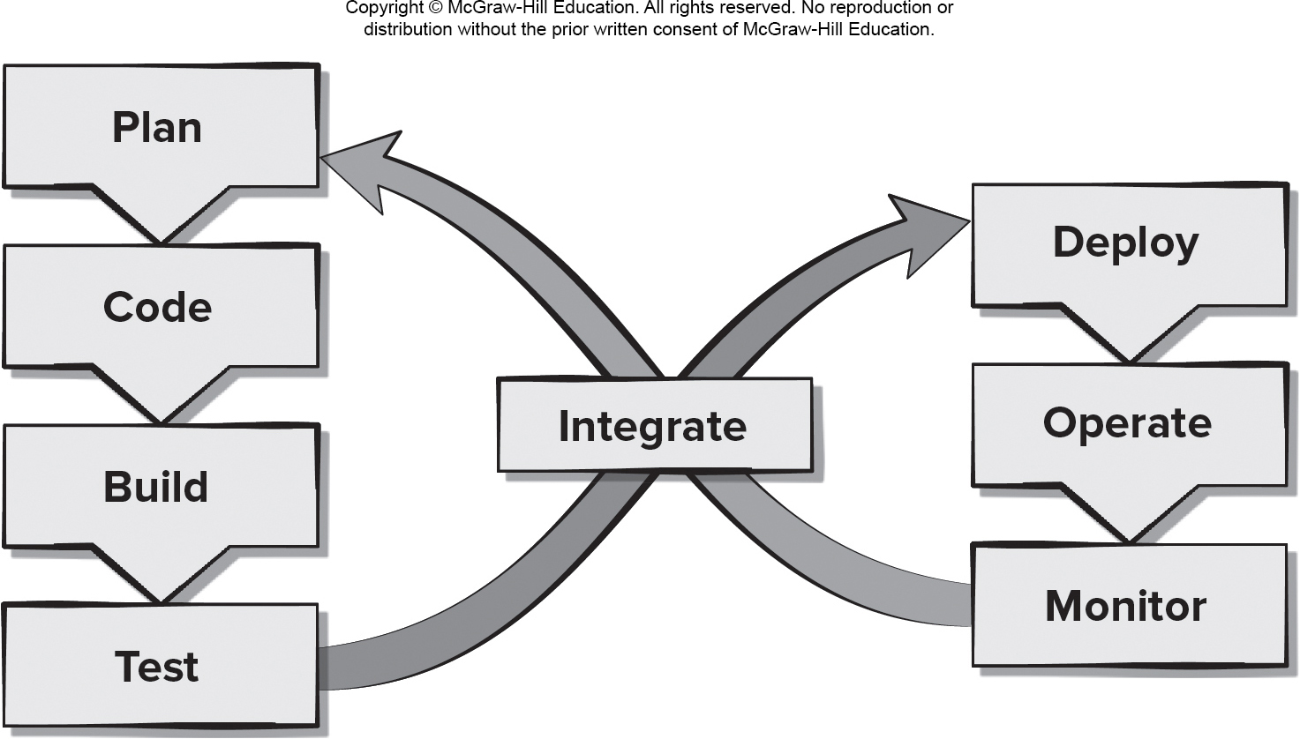
3.5.3 DevOps(Development &Operations）
DevOps enhances customers’ experiences by reacting quickly to changes in their needs or desires.
开发和运营维护的总称。强调开发部门、运维部门进行协调，使得构建、测试、发布软件能够更加地快捷、频繁和可靠，满足客户体验。

Slide 170
DevOps Details
Continuous development. Software delivered in multiple sprints.
Continuous testing. Automated testing tools used prior to integration.
Continuous integration. Code pieces with new functionality added to existing code running code.
Continuous deployment. Integrated code is deployed to the production environment.
Continuous monitoring. Team operations staff members proactively monitor software performance in the production environment.
Pros
Reduced time to code deployment.
Team has developers and operations staff.
Team has end-to-end project ownership.
Proactive monitoring of deployed product.
Cons
Pressure to work on both old and new code.
Heavy reliance on automated tools to be effective.
Deployment may affect the production environment.
Requires an expert development team.

Slide 171
Summary
The Manifesto for Agile:
Individuals and interactions over processes and tools
Working software over comprehensive documentation
Customer collaboration over contract negotiation
Responding to change over following a plan
© 2010 Sichuan University All rights reserved. | Confidential

Slide 172
Summary
© 2010 Sichuan University All rights reserved. | Confidential
Four keys stressed by Agile software engineering
Importance of self-organization that control …..
Communication and collaboration
Change recognition
Rapid software delivery satisfies customer

Slide 173
Summary
Scrum Framework activities
Requirements
Analysis
Design
Evolution
Delivery
© 2010 Sichuan University All rights reserved. | Confidential

Slide 174
Summary
Scrum—distinguishing features
Development work is partitioned into “packets(小包)”
Testing and documentation are on-going as the product is constructed
Work occurs in “sprints(冲刺)” and is derived from a “backlog（待定项）” of existing requirements
Meetings are very short and sometimes conducted without chairs
“demos（演示）” are delivered to the customer with the time-box allocated
© 2010 Sichuan University All rights reserved. | Confidential

Slide 175
Summary
© 2010 Sichuan University All rights reserved. | Confidential
XP is the most widely used agile process
Planning
Design
Coding
Testing

Slide 176
1-B 2-A
Exercise
Agility is nothing more than the ability of a project team to respond rapidly to change.
True
False
Which of the following is not necessary to apply agility to a software process?
Eliminate the use of project planning and testing
Only essential work products are produced
Process allows team to streamline tasks
Uses incremental product delivery strategy
© 2010 Sichuan University All rights reserved. | Confidential

Slide 177
3-E 4-D
Exercise
3.How do you create agile processes to manage unpredictability?
Requirements gathering must be conducted very carefully
Risk analysis must be conducted before planning takes place
Software increments must be delivered in short time periods
Software processes must adapt to changes incrementally
Both c and d
4. Which of the following traits need to exist among the members of an agile software team?
Competence
Decision-making ability
Mutual trust and respect
All of the above.
© 2010 Sichuan University All rights reserved. | Confidential

Slide 178
5-A 6-D
Exercise
5. All agile process models conform to a greater or lesser degree to the principles stated in the "Manifesto for Agile Software Development". Answer:
True
False
6. What are the four framework activities found in the Extreme Programming (XP) process model?
a. analysis, design, coding, testing
b. planning, analysis, design, coding
c. planning, analysis, coding, testing
d. planning, design, coding, testing
© 2010 Sichuan University All rights reserved. | Confidential

Slide 179
Homework No.3 2024.9.19
List the key issues stressed by an agile philosophy of software engineering.
What are the tradeoffs proposes by the “Manifesto for Agile Software Development”?
Describe the role of customers and end-users on an agile process team?
Describe the three key assumptions regarding software projects that every agile software process must address.
Describe agility (for software projects) in your own words.
Describe the XP concepts of refactoring and pair programming.
© 2010 Sichuan University All rights reserved. | Confidential

