Slide 1

雄关漫道真如铁，
而今迈步从头越。
2024.12 软工

Slide 2

Exercises
作业、半期考试
一、单项选择题20 (20*1)
二、简答题20(4*5)
三、用例分析设计UML 20 (4°5)
三、设计类20 (2*10)
五、综合、测试20
(2*10)
□

Slide 3

Final Review: Introduction
Software?
instructions (computer programs)
data structures
Documentation (descriptive information)
Software Characteristics(The differences between software and hardware)
Software is developed,not manufactured.
Software does not wear out, but it can deteriorate.
Most software is custom build, not assembled out of components.
Software is deteriorating退化(Why?)
Software process
is a framework for the activities, actions, and tasks that are
required to build high quality software
Software engineering?
The application of a systematic, disciplined, quantifiable approach to
the development, operation, and maintenance of software; that is,
the application of engineering to software（将系统化、规范化、可量
化的方法应用于软件开发
The study of approaches as inabove.
3

Slide 4


Final Review: Introduction
The Essence of Practice
Understand the problem(communication and analysis).
Plan a solution (modeling and software design).
Carry out the plan(code generation).
Examine the result for accuracy(testing and quality assurance).

Slide 5

llal NGVIGW . Software Process
Generic View
What is software process? Collection of activities, actions & tasks
Software Engineering Layers: Tools, Methods, Process, focus on quality
Generic Software Engineering Framework Activities:
Communication, Planning, Modeling, Construction, Deployment
Difference process models for SE proposed, all process models define a
set of framework activities, a collection of tasks that conducted to
accomplish each activity, work products produced as a consequence of
the tasks, and a set of umbrella activivities that span the entire process
Process Assessment and Improvement(CMM等)
Process Flow (linear process flow线性、iterative process flow迭代
evolutionary process flow演化、parallel process flow并行)
Umbrella Activities

Slide 6


IllalNGviCW. Software Process
Process Models（概念、特点）
Waterfall Model (Linear Sequential Model)
Incremental Model (core product +waterfall)
Prototyping Model (evolutionary model, requirements fuzzy, throw-away)
Spiral Model( evolutionary models + Prototyping + waterfall, Suitable for large,
complex projects.)
Unified Process Model(an iterative and incremental evelopment process, UML
use-case driven, architecture-centric, Risk Focused )
evolutionary models (the iterative nature, accomodate change)

Slide 7
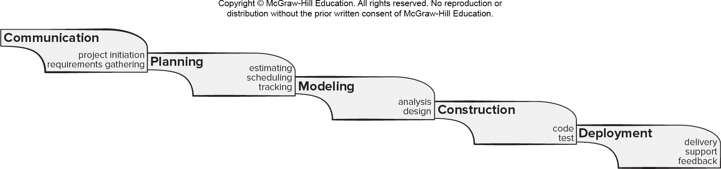
Waterfall Process Model
Pros
It is easy to understand and plan.
It works for well-understood small projects.
Analysis and testing are straightforward.
Cons
It does not accommodate change well.
Testing occurs late in the process.
Customer approval is at the end.

Slide 8
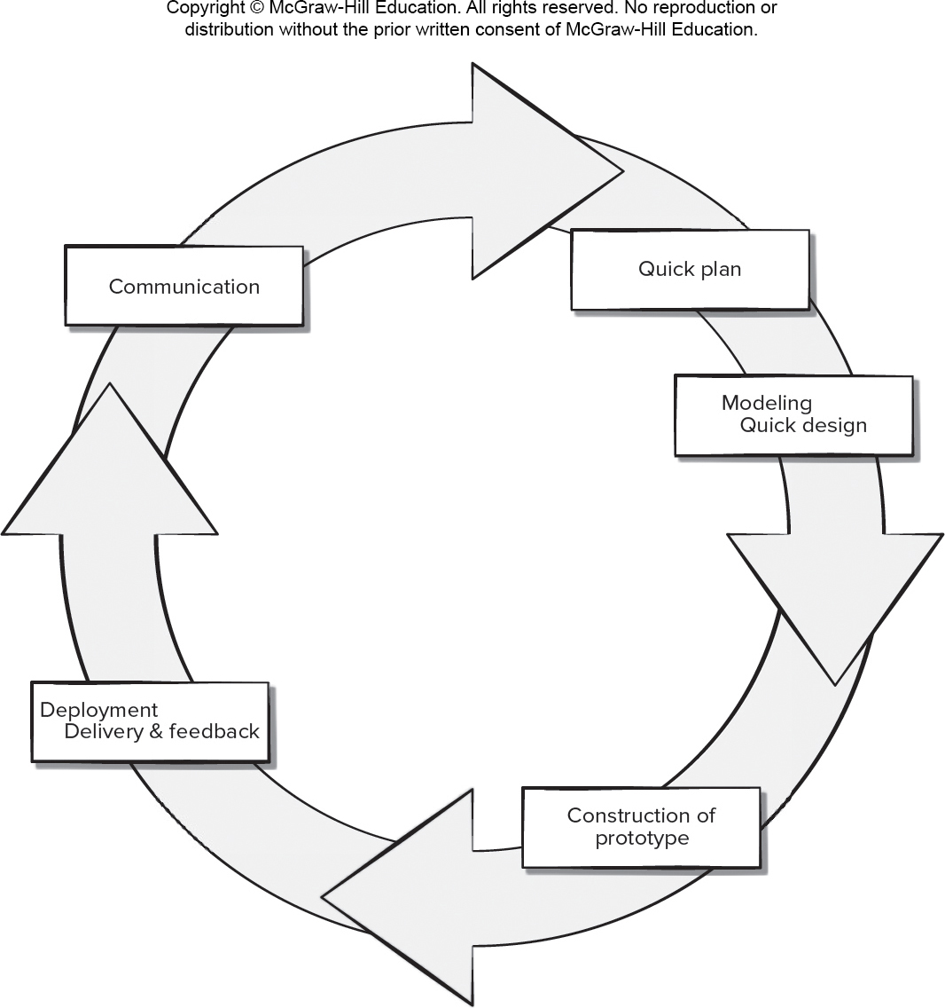
Prototyping Process Model
Pros
Reduced impact of requirement changes.
Customer is involved early and often.
Works well for small projects.
Reduced likelihood of product rejection.
Cons
Customer involvement may cause delays.
Temptation to “ship” a prototype.
Work lost in a throwaway prototype.
Hard to plan and manage.

Slide 9
Prototyping Model(参考)
Merits优点
Serves as a mechanism for assisting developers and customers to better understand what is to be build when requirements are fuzzy.
Useful for high risk
Demerits缺点
Customers always ask developers to make the prototype a working product, which makes software development management relented.
(原型常常会被抛弃，而不是在其上继续开发)
增加成本
Developers often make implementation compromises in order to get a prototype working quickly. Finally, the less-than-ideal choices has now become an integral part of the system.（一些凑合的技术和算法可能会遗留在最终系统中）
© 2010 Sichuan University All rights reserved. | Confidential

Slide 10
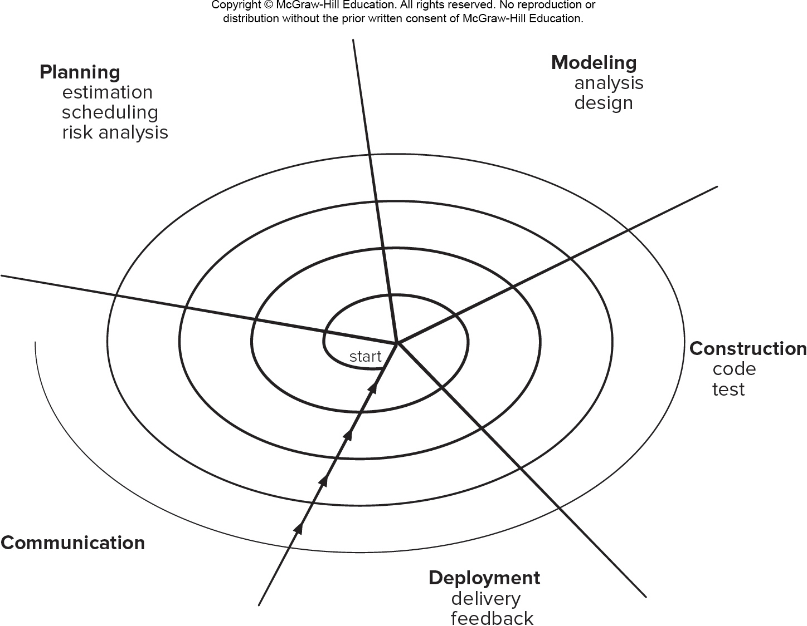
Spiral Process Model
Pros
Continuous customer involvement.
Development risks are managed.
Suitable for large, complex projects.
It works well for extensible products.
Cons
Risk analysis failures can doom the project.
Project may be hard to manage.
Requires an expert development team.

Slide 11
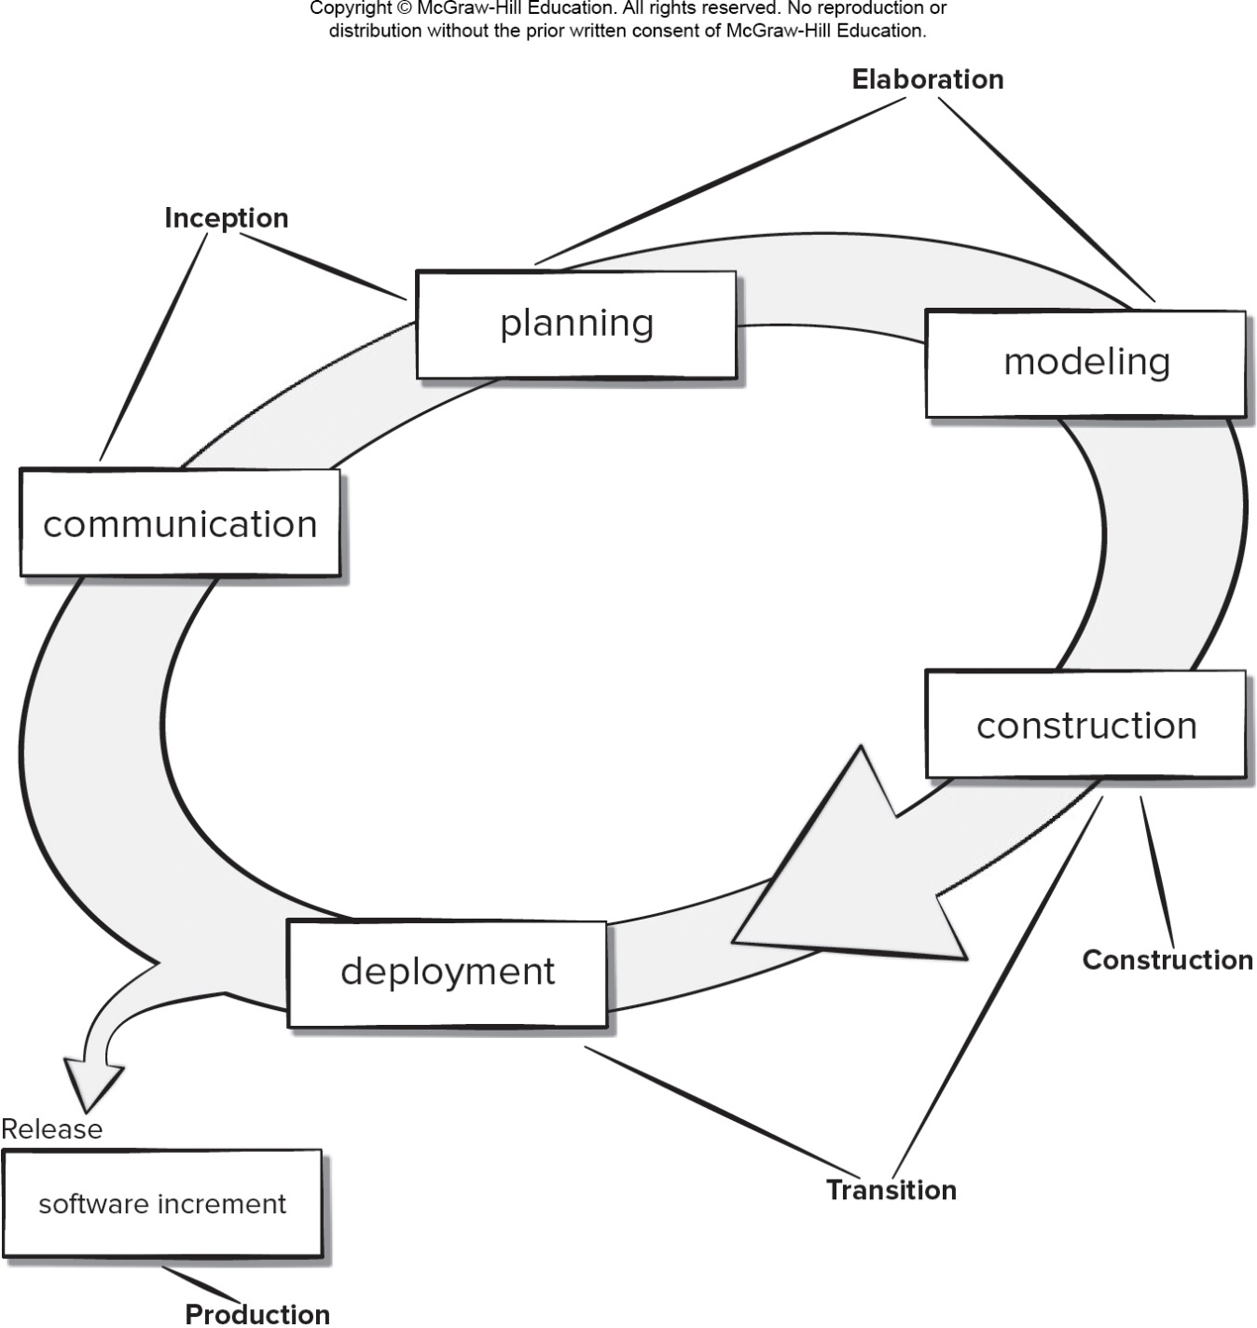
Unified Process Model
Pros
Quality documentation emphasized.
Continuous customer involvement.
Accommodates requirements changes.
Works well for maintenance projects.
Cons
Use cases are not always precise.
Tricky software increment integration.
Overlapping phases can cause problems.
Requires expert development team.

Slide 12


FihalRevieW:Software Process
Agile
What is agile? 快速、增量（迭代）
Rapid deliver products(not care intermediate work products)
Effective (rapid and adaptive) response to change
Customers join the team (eliminate “us and them”), Effective
communication among all stakeholders
Project plan must be flexible
Organizing a team so that it is in control of the work performed
（自组织)communicate facilely
The Manifesto for Agile
Individuals and interactions over processes and tools
Working software over comprehensive documentation
Customer collaboration over contract negotiation
Responding to change over following a plan

Slide 13


Final RevieW: Software Process
Agile
Extreme Programming(XP): planning, design, coding, test
Key Points of XP
User stories
KIS
Pair-programming
Refactoring
Continuous integration
Incremental delivery
Scrum (Requirements, Analysis, Design, Evolution, Delivery)
Development work is partitioned into “packets（小包）”
Testing and documentation are on-going as the product is constructed
Work occurs in “sprints（冲刺）” and is derived from a “backlog（待定项
积压的工作)"of existing requirements
Meetings are very short and sometimes conducted without chairs
“demos（演示）” are delivered to the customer with the time-box allocated
Kanban（看板）
DevOps(Development &Operations) 开发和运营维护

Slide 14


Final Review: Requirement
■The definition of requirements engineering
RE is the tasks and techniques that lead to understanding of requirements
RE builds a bridge to design and construction
Inception, Elicitation, Elaboration, Negotiation, Specification,
Validation, Requirements Management
Elicitation Work Products(specification...)
■Quality Function Deployment (QFD) : Normal /Expected/Exciting
■ERD（Example-Relationship Diagram） ER图包含实体、属性和关系。
举例（选课：老师-学生-课程；借书：图书、借阅人、管理员）

Slide 15

FihalReview: Requirement
Inception（起始） —establish basic understanding of the project..
Elicitation （收集） —elicit requirements from all stakeholders
Elaboration（精化） —create an analysis model that identifies
data, function and behavioral requirements
Negotiation （协商） —agree on a deliverable system that is
realistic for developers and customers
Specification（规格说明） —document, combining natural
language descriptions, graphic models or usage scenarios(use-cases)...
Validation （确认） —a review mechanism that looks for
Requirements management （需求管理）
理解客户需要什么、分析要求、评估可行性、协商合理方案、无歧
义地详细说明方案、确认规格说明、管理需求以及将这些需求转化
为可行性运行系统。
需求工程通过执行上述七个活动来收集、分析、理解需求。

Slide 16


FihalRevieW:Requirement
■Use-case
An use case describes the actions svstem takes to deliver something of
value to the actor（用例是对一组动作序列的抽象描述，就是系统功能描述）
Scenarios —often called use cases, provide a description of how the
system will be used
举例：编写用例图（用例图是指由参与者Actor、用例Use Case，边界以及
它们之间的关系构成的用于描述系统功能的视图，包括出错处理）
举例：编写用例场景（用例描述：包括：条件、场景、意外处理等，参考
PPT)

Slide 17
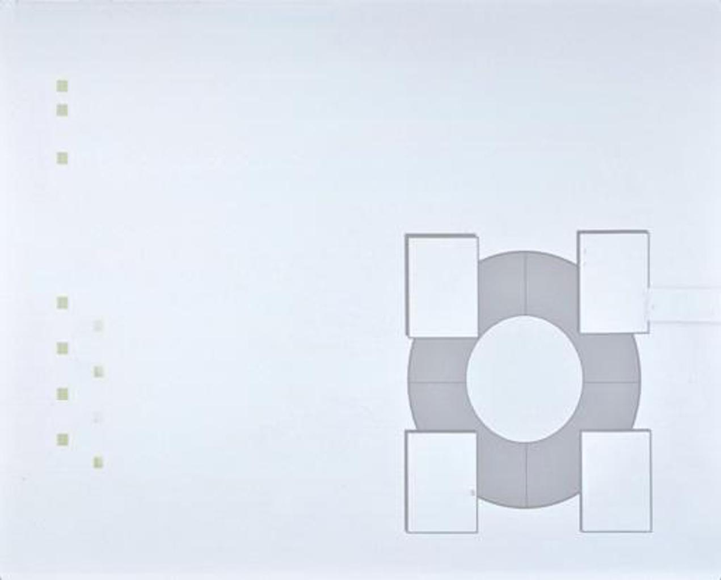
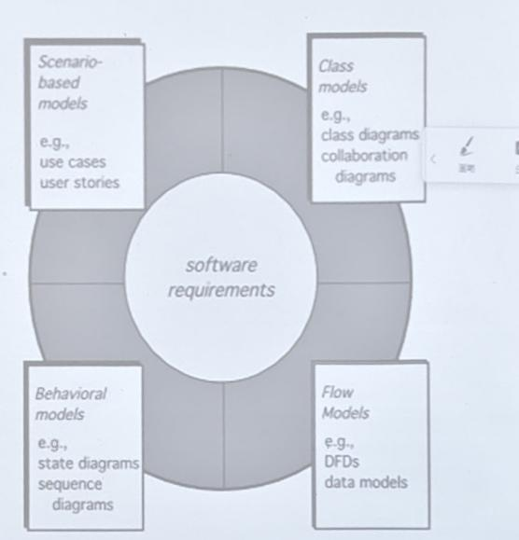
FinalReview: Requirement
■Objectives of Requirements Model
To describe what the customer requires描述客户需要什么
To establish a basis for the creation of a software design为软件设计奠
定基础
To define a set of requirements that can be validated once the
software is built定义在软件完成后可以被确认的一组需求
Rules of Thumb（需求分析建模原则）
Requirements Modeling
Scenario-based Modeling
Use case, user story
Class-Modeling(CRC)
Class diagram, collaboration diagram...
Flow-oriented Modeling
DFD, data models
Behavioral Model
State diagrams, sequence diagram

Slide 18


FinalRevieW: Requirement——The function of each model
Scenario-based models depict software requirements from the user's point of view
Class-oriented models represent object-oriented classes (attributes and operations) and
how classes collaborate to achieve system requirements.
Behavioral models depict how the software reacts to internal or external “events.”
Data models depict the information domain for the problem.
Flow-oriented models represent functional elements of the system and how they
transform data in the system.

Slide 19

FinalhevieW.Requirement（每个图怎么画都必须知道）
■What is UML
Diagrams of UML for analysis modeling
Use-case diagram: visualizes the interaction of your system with the
outside world
Activity diagram:shows the flow of events within your system
Class diagram: describes the structure of system by showing system’s
classes, their attributes, and the re!ationship between the classes
State diagram: indicates system reactions to external events ;
represents active states for each class and the events that cause changes between
these active states
Swimlane Diagrams: is a useful variation of the activity diagram。 Swimlane
diagrams indicate which actor (if there are multiple actors involved in a specif
use case) or analysis class has responsibility for the action described by an
activity rectangle.
Deployment diagram: Indicates how software functionality and
subsystems will be allocated within the physical computing environment

Slide 20
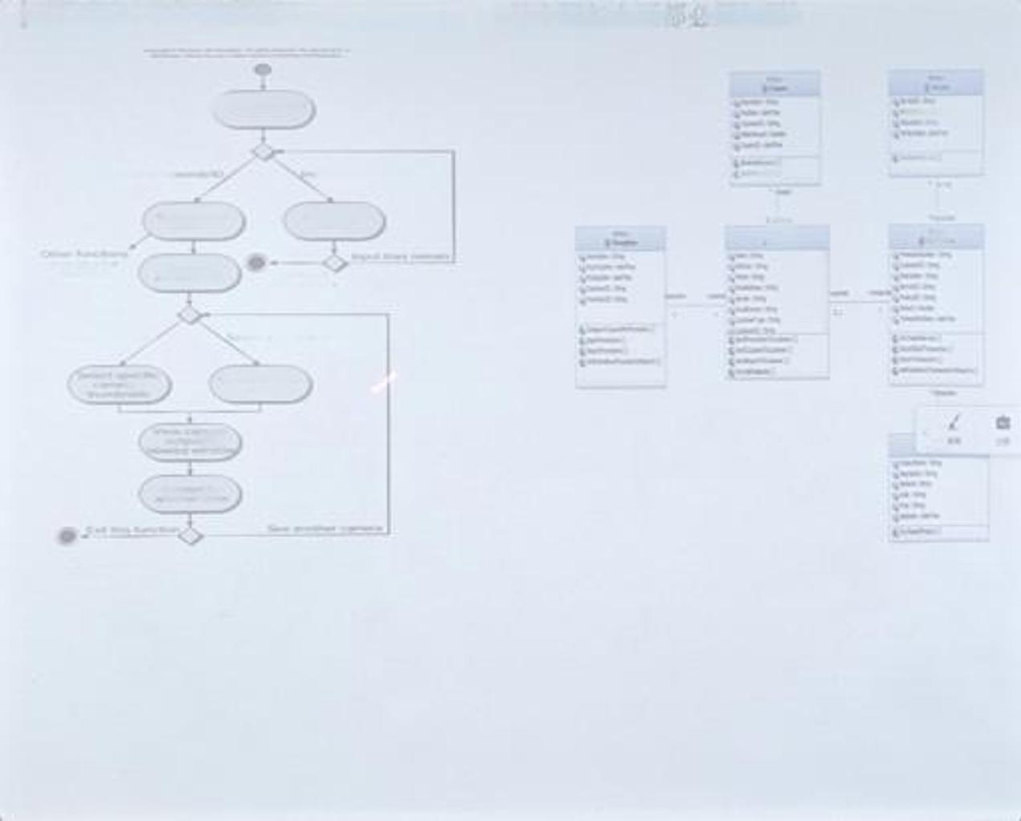
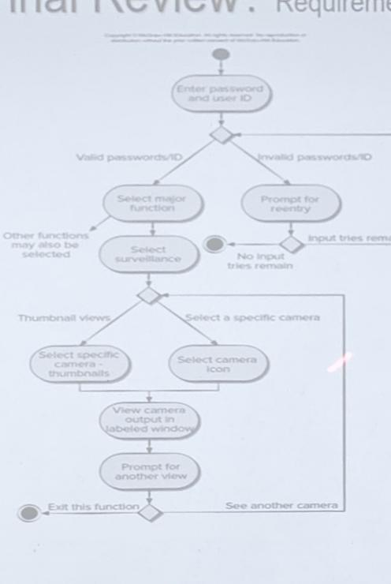
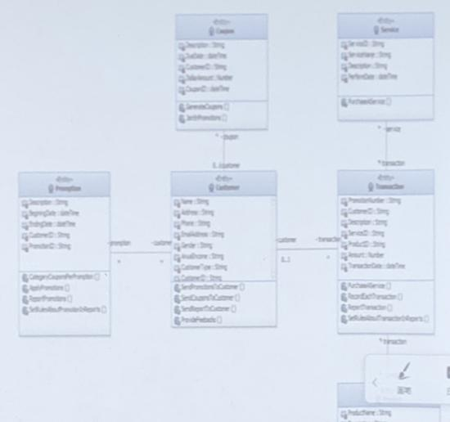

Slide 21
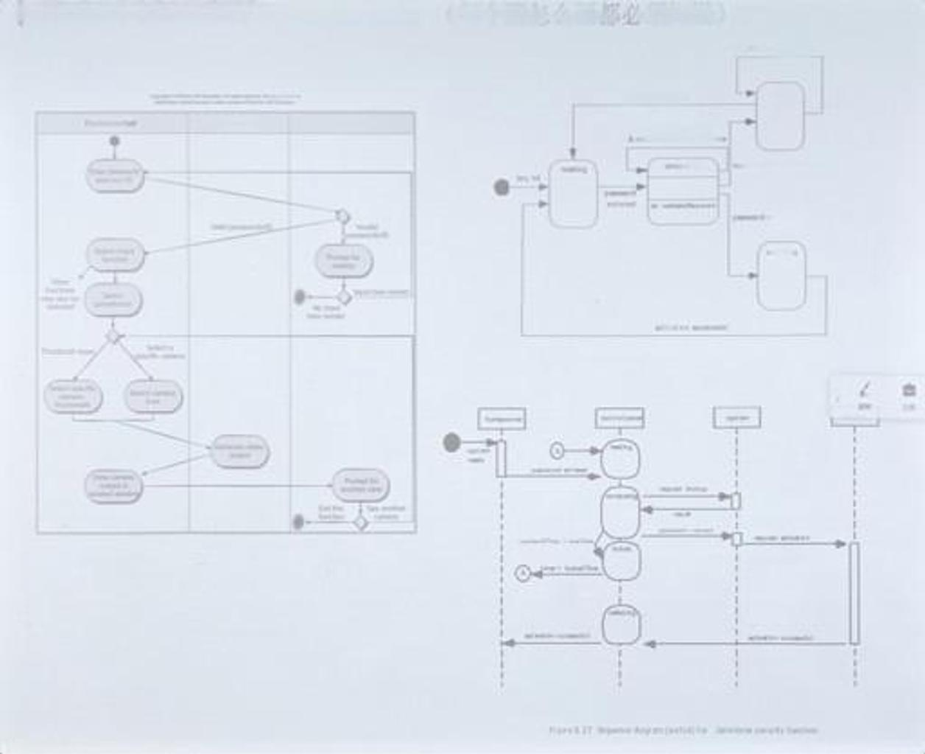
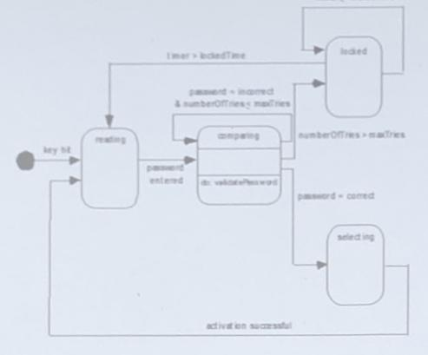
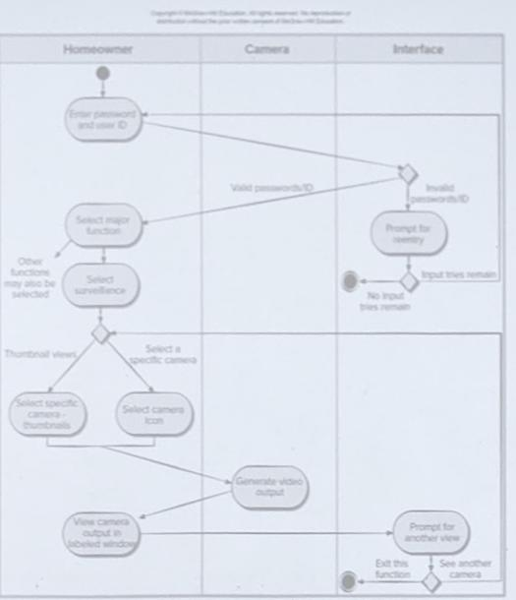
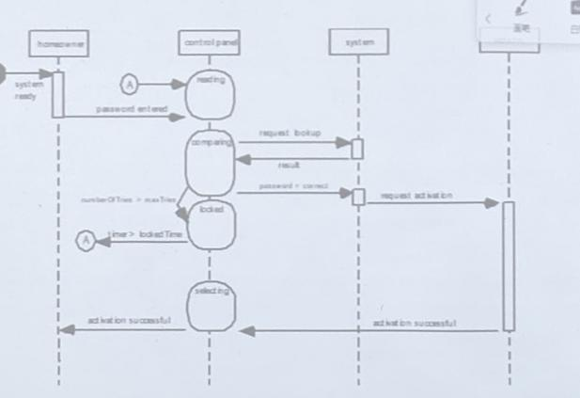
FinalRevieW. Requirement （每个图怎么画都必须知道）
lww sedat
Figure 8.27 Sequence dagr am (partia) for Saf'etome sacurity function

Slide 22


rlnalhevieW.Requirement（每个图怎么画都必须知道）
Class-Based Modeling
identifying Analysis Classes
“grammatical parse
Selecting Classes—Criteria
Class-responsibility-collaborator (CRC) Models
Responsibilities are the attributes and operations encapsulated by
the class（封装在类中的属性和操作）
Collaborators are those classes that are required to provide a class
with the information needed to complete a responsibility. In general,
a collaboration implies either a request for information or a request
for some action.（完成某个职责的其它协作的类）
Collaborations()
the is-part-of relationship-聚合
the has-knowledge-of relationship-关联（常用）
the depends-upon relationship-依赖

Slide 23
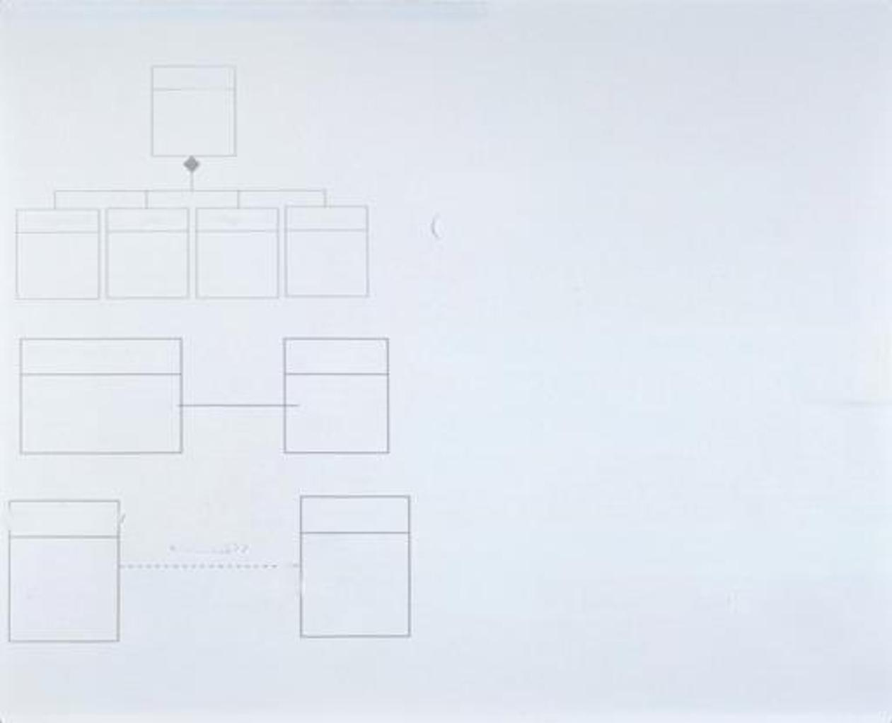
relationships between classes（聚合-关联-依赖）
Plager
Aggregate聚合(is-part-of)
（强关联）
Plageriead
PlagerBiody
PlagerArms
Pueertegs
ControlPanel
Associate关联(has-knowledge-of)
（只有控制面板和传感器协作
能确定传感器状态)
（双向）
Sensor
Determine-sensor-status()
get-status()
PisplayWindow
Camera
<<access>>
Dependency依赖(depends-upon)
（单向）
(password)

Slide 24


Final RevieW Design
Design conceptions
Information Hiding
Separation of concerns
Modularity(the number and size of modularity )
Refactoring
Cohesion(functional, layer, communicational)
Coupling(Content, Control, External)
Object-oriented Design conceptions
Class,attribute, operation
Polymorphism 多态
Encapsulation 封装
Inheritance 继承
Quality attributes-FURPS
Functionality-Usability-Reliability-Performance-Supportability

Slide 25
软件质量属性Qualityattributes-FURPS
Functionality 功能性
Usability 易用性
Reliability 可靠性
Performance-高性能processing speed/response time/
resource consumption/throughput/efficiency
Supportability- 可支持性（可维护、可测试、兼容、可配置、简易性等）
maintainability/testability/compatibility/
Configurability-the ability to organize and control elements of the software configuration
Convenient Installation
Locate problems easily
Proposed by HP, short for FURPS
FURPS quality attributes represent a target for all software design
并不是每个软件质量属性都具有相同的权重，有的应用强调功能性，特别突出安全性；有的可能要求性能，特别突出处理速度；有的强调可靠性。
必须在设计开始时就考虑这些质量属性，而不是在设计完成后和构造开始时才考虑
© 2010 Sichuan University All rights reserved. | Confidential

Slide 26


Final RevieW Design
Four Design Models
Data Design, Architectural Design, Interface Design,
Component level Design +Deployment level Design
Architectural Design
Software Architecture: the structure of the system, which comprise
software components, the externally visible properties of those
components and the relationships among them.（架构包括软件构
件，构件的属性和构件之间的相互关系)
architectural description (A D):The IEEE Standard defines an
architectural description (A D) as a “a collection of products to
document an architecture.”. An architecture description shall identify
the system stakeholders having concerns considered fundamental to the
architecture of the system-of-interest.
Architectural decision: means that the system architect considers
a variety of alternatives and ultimately decides on the specific
architectural features that best meet the concern.

Slide 27


Final Review Design
■Architectural Design
■ Why is Architecture Important?
有助于各方的交流
突出早期的设计，对其后工作很重要（打好设计的根基）
建立了一个相对小、易理解的模型，其描述了系统如何构成及构件如何
一起工作
architectural styles
Data-centered architectures
Data flow architectures
Call and return architectures
Object-oriented architectures
Layered architectures

Slide 28
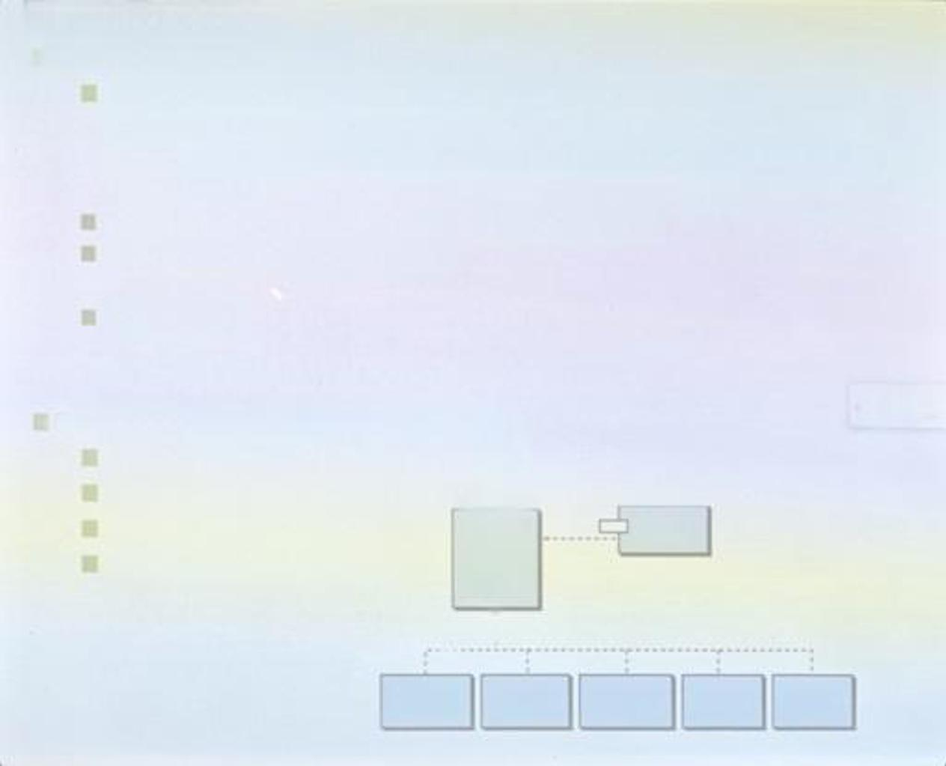

Final Review Design
Component-level Design
Component definition:a modular, deployable, and replaceable part of a
system that encapsulates implementation and exposes a set of
interfaces.”构件是:模块化的、可部署的和可替换的部件，该部件封装了操作实现和接口
What is Component? O-O View; Conventional view
The definition of Decision Table
分析设计类
Component-level Design (class-based)
The Open-Closed Principle (OCP)
The Liskov Substitution Principle (LSP)
Dependency Inversior（DIP）
The Interface Segrega（ISP）
Delactor
reod[ ]
duoble( )
Window/
dao/Sensor
SmokeSersor MotanDetactar HeaSensor CO2Sersor

Slide 29

FinalRevieWDesign
Interface Design
Interface analysis and modeling
user analysis
task analysis
Display Content analysis
work environment analysis
Interface design
Using information developed during interface analysis, define
interface objects and actions (operations).
Define events (user actions) that will cause the state of the user
interface to change. Model this behavior
Depict each interface state as it will actually look to the enc-
user.
Indicate how the user interprets the state of the system from
information provided through the interface.

Slide 30


Final RevieW Test
Test
Testing is the process of exercising a program with the specific intent of
finding errors prior to delivery to the end user
Test Strategies
To perform effective testing, you should conduct effective technical
reviews. By doing this, many errors will be eliminated before testing
commences
Testing begins at the component level and works “outward” toward the
integration of the entire computer-based system.
Different testing techniques are appropriate for different software
engineering approaches and at different points in time.
Testing is conducted by the developer of the software and (for large
projects) an independent test group.
Testing and debugging are different activities, but debugging must be
accommodated in any testing strategy.（debug调试是一个较小的task）

Slide 31

Final Review Test
Test Strateqy：（需求规格说明、设计文档，测试计划和测试用例，使用手册）
Unit Test
Integration Test(driver/stub)
Top-down Integration
Bottom-up Integration
Sandwich Testing
Validation Test
Software validation is achieved through a series of tests that demonstrate conformity with requirements.
A test plan and test cases that are designed to ensure that all functional requirements are satisfied,
all behavioral characteristics are achieved, all conteritis accurate and properly presented,all performance requirements
are attained, documentation is correct, and usability and otherrequirements are met.
Configuration Review
Acceptance testing (Alpha/Beta testing)
System Test
Recovery testing;Security testing;Stress testing;Performance Testing
Deployment Testing; Configuration testing

Slide 32


Final RevieW Test
Unit testing begins at the center of the spiral and concentrates on each unit (for
example, component, class, or content object) as they are implemented in source
code.
Testing progresses to integration testing, where the focus is on design and the
construction of the software architecture. Taking another turn outward on the
spiral.
Validation testing, is where requirements established as part of requirements
modeling are validated against the software that has been constructed.
In system testing, the software and other system clements are tested as a whole.

Slide 33

Final Review Test
Test Tactics
White-box Test
Black-box testing, also called behavioral testing, focus on the
functional requirements of the software （就是功能测试，从外部执行
测试用例，用以验证待测功能的正确性，而不考虑软件内部处理逻辑。
外部测试)
包括：Basic Path Testing, Control Structure Testing
Black-box Test
Sometimes called glass-box testing, is a test-case design philosophy
that uses the control structure described as part of component-level
desian to derive test cases（也叫玻璃盒测试，是一种测试用例设之
法。它利用作为构件层设计的一部分所描述的控制结构来生成测试用例
。白盒测试是基于过程细节的封闭测试。测试构件内部的数据结构、算
法流程与接口。内部测试)
包括：Equivalence Partitioning, Boundary value analysis
白盒也叫structural test
黑盒也叫functional test
■other
Regression testing
Smoke testing
Debug, Debugging Techniques

Slide 34

Final RevieW Test
OO Test
OO Unit testing
the concept of the unit changes, the smallest testable unit is the
encapsulated class, a single operation can no longer be tested in
isolation (the conventional view of unit testing) but rather, as part
of a class
OO Integration Testing
Cluster testing is one step in the integration testing of OO
software.defines a cluster of collaborating classes (determined hv
examining the CRC and object-relationship model) is exercised
designing test cases that attempt to uncover errors in the
collaborations.
集成策略：（两种）
Thread-based testing integrates the set of classes required to
respond to one input or event for the system
Use-based testing begins the construction of the system by testing
those classes (called independent classes) that use very few (if
any) of server classes.After the independent classes are tested.
the next layer of classes, called dependent classes

Slide 35


Final Review Test
Cyclomatic Complexity 环复杂度
V(G)=E-N+2
V(G)=P+1

Slide 36
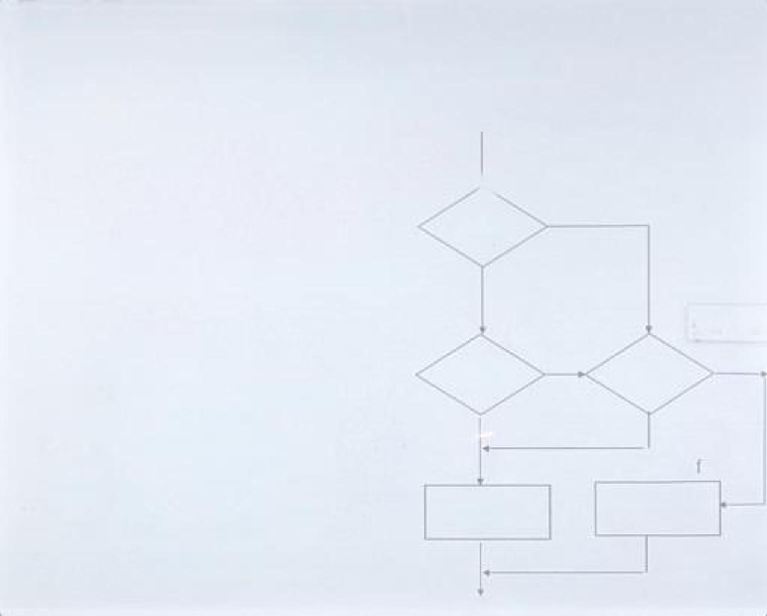
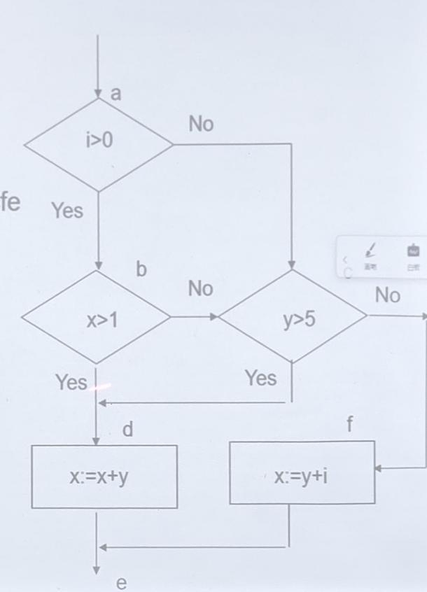
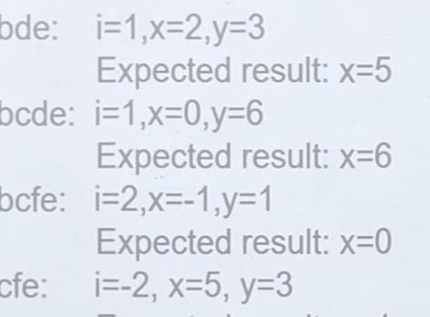
FinalReview Test 基本路径测试
圈复杂度Cyclomatic Complexity:V(G)=P+1
if(i>0&&x>1| y>5) X:=x+y
else
x:=y+i;
V(G)=4
Basic Path(4条):abde, abcde, abcfe, acfe

