Slide 1
Apache Performance Tuning
Part 2: Scaling Out
Sander Temme <sander@temme.net>

Slide 2
Agenda
Introduction
Redundancy in Hardware
Building Out: Separate Tiers
Building Out: Load Balancing
Caching Content
Conclusion

Slide 3
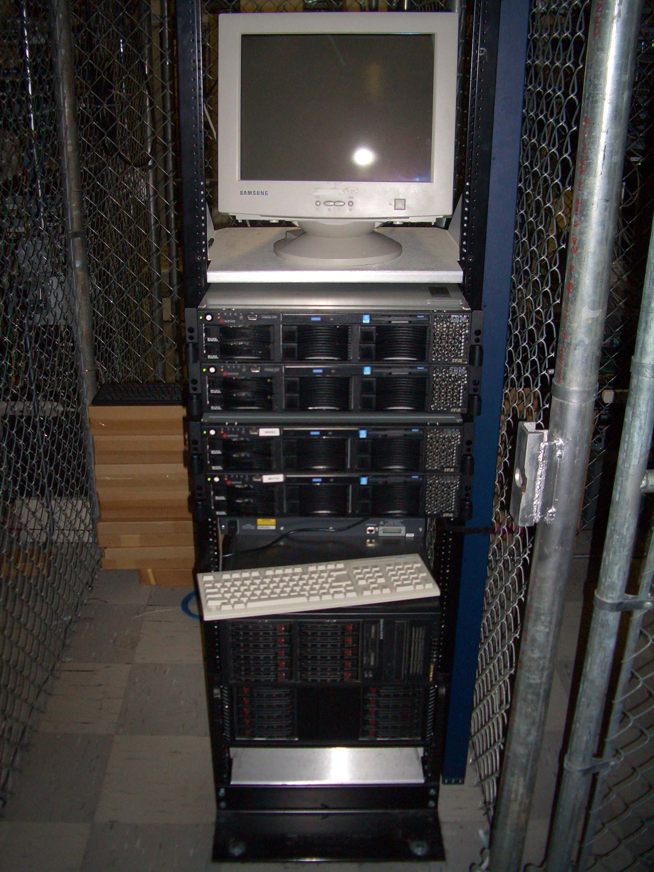
Introduction
Why do This?
Scalability (Oh my gosh, I’m so popular!)
Reliability (We need five nines!)
Why NOT do This?
It costs money

Slide 4
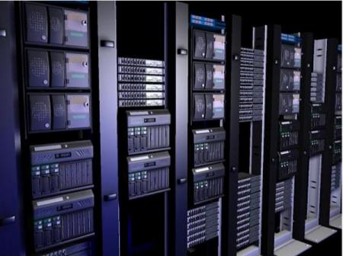
Redundancy in Hardware
Moving Parts Break
Hard Disks
Power Supplies
Hard Disks
Fans
Hard Disks
Buy High Quality Disks
Refurbished, OEM, Brand Name
Which has longer warranty?
Which is more reliable?

Slide 5
Server Configuration
Mirror those Disks
Install the RAID utility
Have it warn you
RAID is no good if you don’t learn of failures!
Redundant Power Supplies
On different circuits

