Slide 1
Apache Performance Tuning
Part 2: Scaling Out
Sander Temme <sander@temme.net>

Slide 2
Agenda
Introduction
Redundancy in Hardware
Building Out: Separate Tiers
Building Out: Load Balancing
Caching Content
Conclusion

Slide 3
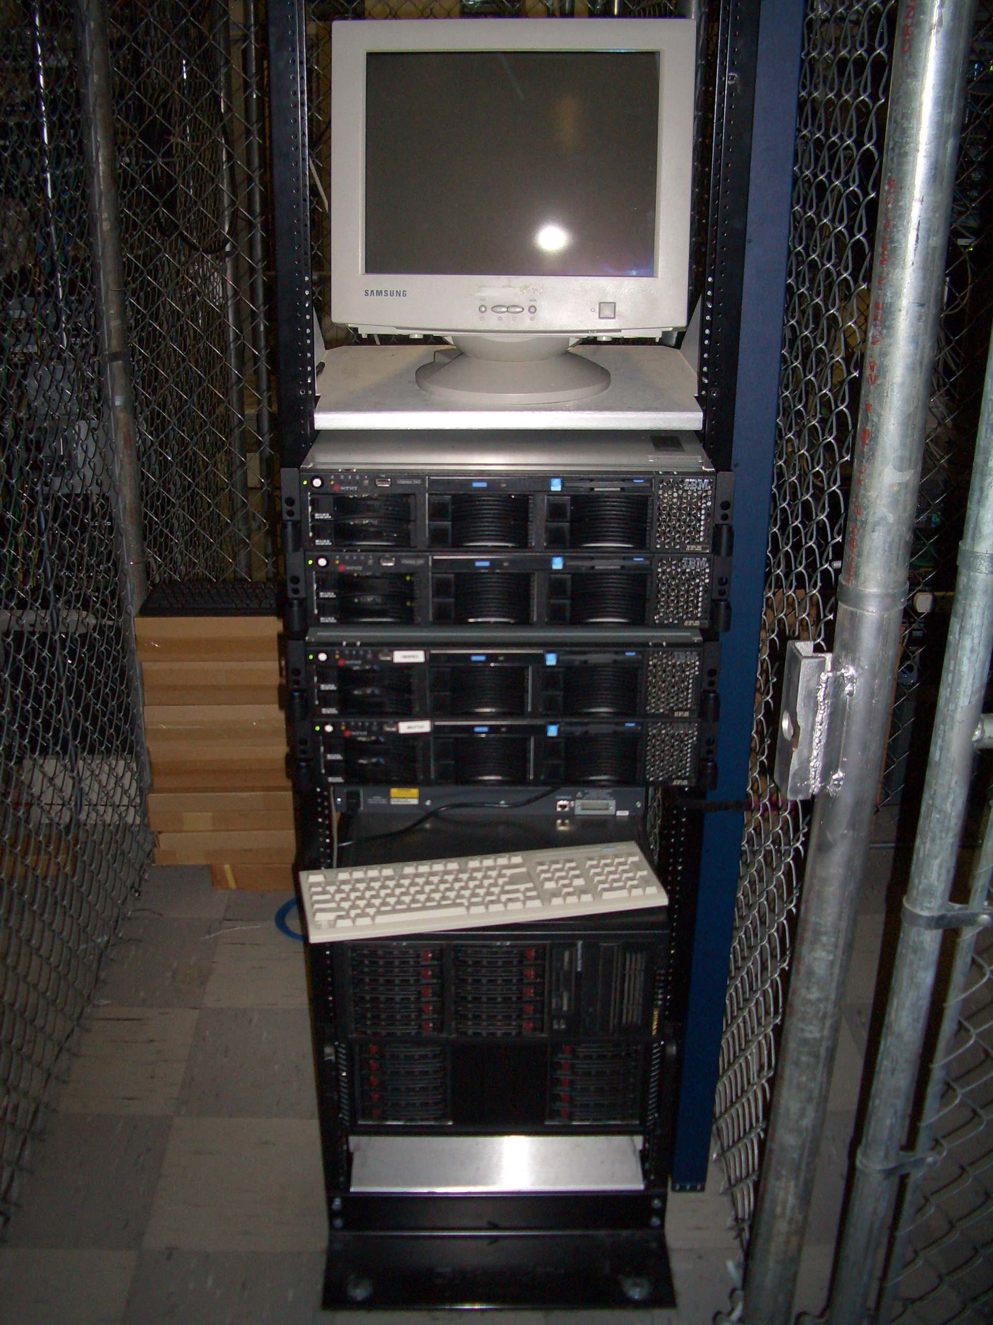
Introduction
Why do This?
Scalability (Oh my gosh, I’m so popular!)
Reliability (We need five nines!)
Why NOT do This?
It costs money

Slide 4

Redundancy in Hardware
Moving Parts Break
Hard Disks
Power Supplies
Hard Disks
Fans
Hard Disks
Buy High Quality Disks
Refurbished, OEM, Brand Name
Which has longer warranty?
Which is more reliable?

Slide 5
Server Configuration
Mirror those Disks
Install the RAID utility
Have it warn you
RAID is no good if you don’t learn of failures!
Redundant Power Supplies
On different circuits

Slide 6
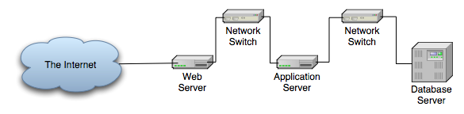
Scaling Vertically

Slide 7
Scaling Vertically
Move Services to Other Hosts
Pros:
Less resource contention
Specialized hardware
Scale out tiers individually
Cons:
Development/Deployment harder
More hosts to manage

Slide 8
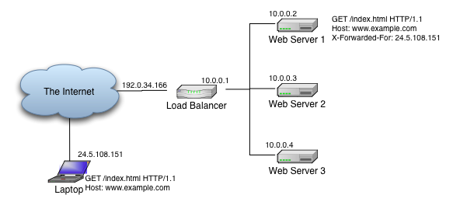
Scaling Horizontally

Slide 9
Scaling Horizontally
Multiple servers per tier
All receive requests
All serve same content
Some arbitration scheme

Slide 10
Load Balancing Schemes
DNS Tricks
Peer Server Pools
Network Load Balancing (Win2k3)
Wackamole
Load Balancing Appliance
Box from F5, Juniper, Cisco, Foundry, …
Linux Virtual Server

Slide 11
DNS Round-Robin
Easy!
Multiple A Records in DNS Zone File
Not Smart:
DNS Lookups are cached
Load on Server
Server Outage

Slide 12
Example Zone File
scalingout.org. 86400 IN SOA ns.scalingout.org. sctemme.scalingout.org. (
2006051401 ; Serial
86400 ; refresh (1 day)
7200 ; retry (2 hours)
8640000 ; expire (10 days)
86400 ) ; minimum (1 day)
scalingout.org. IN NS bagheera.scalingout.org.
gw IN A 10.11.0.1
bagheera IN A 10.11.0.2
; ...
mail IN CNAME bagheera
ns IN CNAME bagheera
www IN A 10.11.0.113
IN A 10.11.0.114
IN A 10.11.0.115

Slide 13
Peer-based: NLB
Windows 2000 Server Enterprise Ed., Windows Server 2003
Up to 32 hosts in cluster
All hosts assume cluster IP, MAC
NLB makes LB decision
Only one host gets to answer TCP handshake
Should be application independent

Slide 14
Peer-based: Wackamole
High Availability Solution
When Host Fails
Other hosts take over its IP addresses
Distribute IP addresses among cluster
Every IP address reliably available
No Load Balancing!
Use with RR DNS (or something)
http://www.backhand.org/wackamole/

Slide 15



Load Balancing Device
Client
Internet

Slide 16
Load Balancing
One Load Balancer
Many Web Servers
Choice of Balancing Schemes
Round-robin, Least Used, …
Reliability
Heartbeats, unavailable servers don’t receive requests
Feature War

Slide 17

Linux Virtual Server
Free, Open Source, etc.
IP Virtual Server module in kernel
Lots of auxiliary modules
Like a box of Legos
May come with Your Distribution
Do It Yourself
http://www.linuxvirtualserver.org/

Slide 18
Example: mod_proxy_balancer
New in Apache HTTP Server 2.2
Part of mod_proxy
Two Load Balancing Methods
By number of requests
By number of bytes
Detects failed backends

Slide 19
Apache Configuration
Listen 80
LogLevel debug
TransferLog logs/access_log
LoadModule proxy_module modules/mod_proxy.so
LoadModule proxy_http_module modules/mod_proxy_http.so
LoadModule proxy_balancer_module modules/mod_proxy_balancer.so
ProxyPass / balancer://mycluster/
ProxyPassReverse / http://1.2.3.4:80
ProxyPassReverse / http://1.2.3.5:80
<Proxy balancer://mycluster>
BalancerMember http://1.2.3.4:80
BalancerMember http://1.2.3.5:80
</Proxy>

Slide 20
Example: Tomcat, mod_jk
Apache + mod_jk
Multiple Tomcat servers
Balancer Worker

