Slide 1
Apache Performance Tuning
Part 2: Scaling Out
Sander Temme <sander@temme.net>

Slide 2
Agenda
Introduction
Redundancy in Hardware
Building Out: Separate Tiers
Building Out: Load Balancing
Caching Content
Conclusion

Slide 3
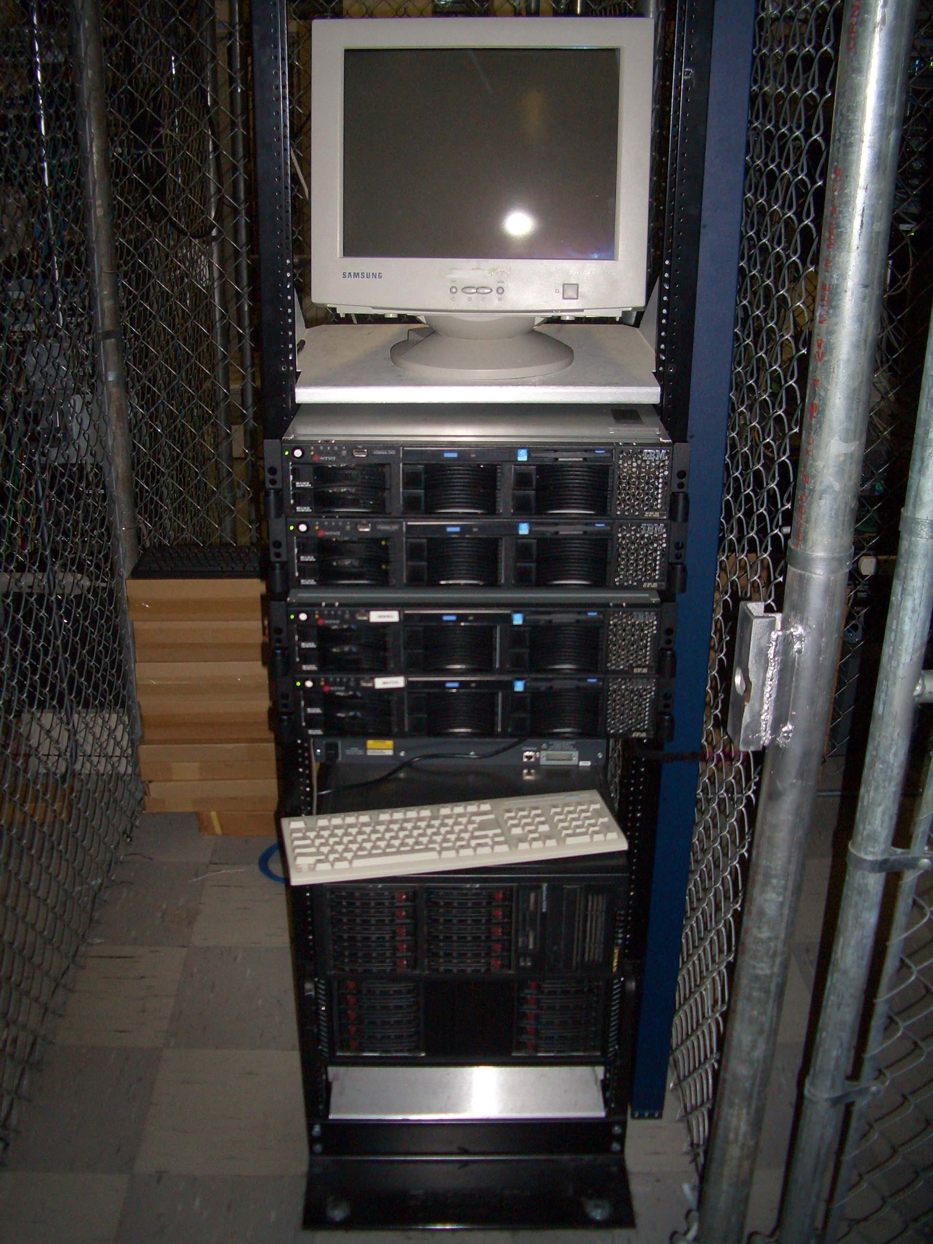
Introduction
Why do This?
Scalability (Oh my gosh, I’m so popular!)
Reliability (We need five nines!)
Why NOT do This?
It costs money

Slide 4

Redundancy in Hardware
Moving Parts Break
Hard Disks
Power Supplies
Hard Disks
Fans
Hard Disks
Buy High Quality Disks
Refurbished, OEM, Brand Name
Which has longer warranty?
Which is more reliable?

Slide 5
Server Configuration
Mirror those Disks
Install the RAID utility
Have it warn you
RAID is no good if you don’t learn of failures!
Redundant Power Supplies
On different circuits

Slide 6
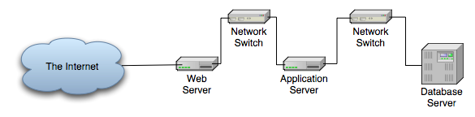
Scaling Vertically

Slide 7
Scaling Vertically
Move Services to Other Hosts
Pros:
Less resource contention
Specialized hardware
Scale out tiers individually
Cons:
Development/Deployment harder
More hosts to manage

Slide 8
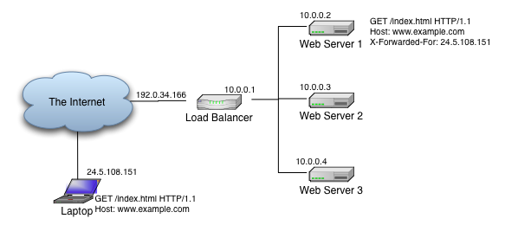
Scaling Horizontally

Slide 9
Scaling Horizontally
Multiple servers per tier
All receive requests
All serve same content
Some arbitration scheme

Slide 10
Load Balancing Schemes
DNS Tricks
Peer Server Pools
Network Load Balancing (Win2k3)
Wackamole
Load Balancing Appliance
Box from F5, Juniper, Cisco, Foundry, …
Linux Virtual Server

Slide 11
DNS Round-Robin
Easy!
Multiple A Records in DNS Zone File
Not Smart:
DNS Lookups are cached
Load on Server
Server Outage

Slide 12
Example Zone File
scalingout.org. 86400 IN SOA ns.scalingout.org. sctemme.scalingout.org. (
2006051401 ; Serial
86400 ; refresh (1 day)
7200 ; retry (2 hours)
8640000 ; expire (10 days)
86400 ) ; minimum (1 day)
scalingout.org. IN NS bagheera.scalingout.org.
gw IN A 10.11.0.1
bagheera IN A 10.11.0.2
; ...
mail IN CNAME bagheera
ns IN CNAME bagheera
www IN A 10.11.0.113
IN A 10.11.0.114
IN A 10.11.0.115

Slide 13
Peer-based: NLB
Windows 2000 Server Enterprise Ed., Windows Server 2003
Up to 32 hosts in cluster
All hosts assume cluster IP, MAC
NLB makes LB decision
Only one host gets to answer TCP handshake
Should be application independent

Slide 14
Peer-based: Wackamole
High Availability Solution
When Host Fails
Other hosts take over its IP addresses
Distribute IP addresses among cluster
Every IP address reliably available
No Load Balancing!
Use with RR DNS (or something)
http://www.backhand.org/wackamole/

Slide 15



Load Balancing Device
Client
Internet

Slide 16
Load Balancing
One Load Balancer
Many Web Servers
Choice of Balancing Schemes
Round-robin, Least Used, …
Reliability
Heartbeats, unavailable servers don’t receive requests
Feature War

Slide 17

Linux Virtual Server
Free, Open Source, etc.
IP Virtual Server module in kernel
Lots of auxiliary modules
Like a box of Legos
May come with Your Distribution
Do It Yourself
http://www.linuxvirtualserver.org/

Slide 18
Example: mod_proxy_balancer
New in Apache HTTP Server 2.2
Part of mod_proxy
Two Load Balancing Methods
By number of requests
By number of bytes
Detects failed backends

Slide 19
Apache Configuration
Listen 80
LogLevel debug
TransferLog logs/access_log
LoadModule proxy_module modules/mod_proxy.so
LoadModule proxy_http_module modules/mod_proxy_http.so
LoadModule proxy_balancer_module modules/mod_proxy_balancer.so
ProxyPass / balancer://mycluster/
ProxyPassReverse / http://1.2.3.4:80
ProxyPassReverse / http://1.2.3.5:80
<Proxy balancer://mycluster>
BalancerMember http://1.2.3.4:80
BalancerMember http://1.2.3.5:80
</Proxy>

Slide 20
Example: Tomcat, mod_jk
Apache + mod_jk
Multiple Tomcat servers
Balancer Worker

Slide 21
Apache Performance Tuning
Part 2: Scaling Out
Sander Temme <sander@temme.net>

Slide 22
Agenda
Introduction
Redundancy in Hardware
Building Out: Separate Tiers
Building Out: Load Balancing
Caching Content
Conclusion

Slide 23
Introduction
Why do This?
Scalability (Oh my gosh, I’m so popular!)
Reliability (We need five nines!)
Why NOT do This?
It costs money

Slide 24
Redundancy in Hardware
Moving Parts Break
Hard Disks
Power Supplies
Hard Disks
Fans
Hard Disks
Buy High Quality Disks
Refurbished, OEM, Brand Name
Which has longer warranty?
Which is more reliable?

Slide 25
Server Configuration
Mirror those Disks
Install the RAID utility
Have it warn you
RAID is no good if you don’t learn of failures!
Redundant Power Supplies
On different circuits

Slide 26
Scaling Vertically

Slide 27
Scaling Vertically
Move Services to Other Hosts
Pros:
Less resource contention
Specialized hardware
Scale out tiers individually
Cons:
Development/Deployment harder
More hosts to manage

Slide 28
Scaling Horizontally

Slide 29
Scaling Horizontally
Multiple servers per tier
All receive requests
All serve same content
Some arbitration scheme

Slide 30
Load Balancing Schemes
DNS Tricks
Peer Server Pools
Network Load Balancing (Win2k3)
Wackamole
Load Balancing Appliance
Box from F5, Juniper, Cisco, Foundry, …
Linux Virtual Server

Slide 31
DNS Round-Robin
Easy!
Multiple A Records in DNS Zone File
Not Smart:
DNS Lookups are cached
Load on Server
Server Outage

Slide 32
Example Zone File
scalingout.org. 86400 IN SOA ns.scalingout.org. sctemme.scalingout.org. (
2006051401 ; Serial
86400 ; refresh (1 day)
7200 ; retry (2 hours)
8640000 ; expire (10 days)
86400 ) ; minimum (1 day)
scalingout.org. IN NS bagheera.scalingout.org.
gw IN A 10.11.0.1
bagheera IN A 10.11.0.2
; ...
mail IN CNAME bagheera
ns IN CNAME bagheera
www IN A 10.11.0.113
IN A 10.11.0.114
IN A 10.11.0.115

Slide 33
Peer-based: NLB
Windows 2000 Server Enterprise Ed., Windows Server 2003
Up to 32 hosts in cluster
All hosts assume cluster IP, MAC
NLB makes LB decision
Only one host gets to answer TCP handshake
Should be application independent

Slide 34
Peer-based: Wackamole
High Availability Solution
When Host Fails
Other hosts take over its IP addresses
Distribute IP addresses among cluster
Every IP address reliably available
No Load Balancing!
Use with RR DNS (or something)
http://www.backhand.org/wackamole/

Slide 35
Load Balancing Device
Client
Internet

Slide 36
Load Balancing
One Load Balancer
Many Web Servers
Choice of Balancing Schemes
Round-robin, Least Used, …
Reliability
Heartbeats, unavailable servers don’t receive requests
Feature War

Slide 37
Linux Virtual Server
Free, Open Source, etc.
IP Virtual Server module in kernel
Lots of auxiliary modules
Like a box of Legos
May come with Your Distribution
Do It Yourself
http://www.linuxvirtualserver.org/

Slide 38
Example: mod_proxy_balancer
New in Apache HTTP Server 2.2
Part of mod_proxy
Two Load Balancing Methods
By number of requests
By number of bytes
Detects failed backends

Slide 39
Apache Configuration
Listen 80
LogLevel debug
TransferLog logs/access_log
LoadModule proxy_module modules/mod_proxy.so
LoadModule proxy_http_module modules/mod_proxy_http.so
LoadModule proxy_balancer_module modules/mod_proxy_balancer.so
ProxyPass / balancer://mycluster/
ProxyPassReverse / http://1.2.3.4:80
ProxyPassReverse / http://1.2.3.5:80
<Proxy balancer://mycluster>
BalancerMember http://1.2.3.4:80
BalancerMember http://1.2.3.5:80
</Proxy>

Slide 40
Example: Tomcat, mod_jk
Apache + mod_jk
Multiple Tomcat servers
Balancer Worker

Slide 41
Apache Performance Tuning
Part 2: Scaling Out
Sander Temme <sander@temme.net>

Slide 42
Agenda
Introduction
Redundancy in Hardware
Building Out: Separate Tiers
Building Out: Load Balancing
Caching Content
Conclusion

Slide 43
Introduction
Why do This?
Scalability (Oh my gosh, I’m so popular!)
Reliability (We need five nines!)
Why NOT do This?
It costs money

Slide 44
Redundancy in Hardware
Moving Parts Break
Hard Disks
Power Supplies
Hard Disks
Fans
Hard Disks
Buy High Quality Disks
Refurbished, OEM, Brand Name
Which has longer warranty?
Which is more reliable?

Slide 45
Server Configuration
Mirror those Disks
Install the RAID utility
Have it warn you
RAID is no good if you don’t learn of failures!
Redundant Power Supplies
On different circuits

Slide 46
Scaling Vertically

Slide 47
Scaling Vertically
Move Services to Other Hosts
Pros:
Less resource contention
Specialized hardware
Scale out tiers individually
Cons:
Development/Deployment harder
More hosts to manage

Slide 48
Scaling Horizontally

Slide 49
Scaling Horizontally
Multiple servers per tier
All receive requests
All serve same content
Some arbitration scheme

Slide 50
Load Balancing Schemes
DNS Tricks
Peer Server Pools
Network Load Balancing (Win2k3)
Wackamole
Load Balancing Appliance
Box from F5, Juniper, Cisco, Foundry, …
Linux Virtual Server

Slide 51
DNS Round-Robin
Easy!
Multiple A Records in DNS Zone File
Not Smart:
DNS Lookups are cached
Load on Server
Server Outage

Slide 52
Example Zone File
scalingout.org. 86400 IN SOA ns.scalingout.org. sctemme.scalingout.org. (
2006051401 ; Serial
86400 ; refresh (1 day)
7200 ; retry (2 hours)
8640000 ; expire (10 days)
86400 ) ; minimum (1 day)
scalingout.org. IN NS bagheera.scalingout.org.
gw IN A 10.11.0.1
bagheera IN A 10.11.0.2
; ...
mail IN CNAME bagheera
ns IN CNAME bagheera
www IN A 10.11.0.113
IN A 10.11.0.114
IN A 10.11.0.115

Slide 53
Peer-based: NLB
Windows 2000 Server Enterprise Ed., Windows Server 2003
Up to 32 hosts in cluster
All hosts assume cluster IP, MAC
NLB makes LB decision
Only one host gets to answer TCP handshake
Should be application independent

Slide 54
Peer-based: Wackamole
High Availability Solution
When Host Fails
Other hosts take over its IP addresses
Distribute IP addresses among cluster
Every IP address reliably available
No Load Balancing!
Use with RR DNS (or something)
http://www.backhand.org/wackamole/

Slide 55
Load Balancing Device
Client
Internet

Slide 56
Load Balancing
One Load Balancer
Many Web Servers
Choice of Balancing Schemes
Round-robin, Least Used, …
Reliability
Heartbeats, unavailable servers don’t receive requests
Feature War

Slide 57
Linux Virtual Server
Free, Open Source, etc.
IP Virtual Server module in kernel
Lots of auxiliary modules
Like a box of Legos
May come with Your Distribution
Do It Yourself
http://www.linuxvirtualserver.org/

Slide 58
Example: mod_proxy_balancer
New in Apache HTTP Server 2.2
Part of mod_proxy
Two Load Balancing Methods
By number of requests
By number of bytes
Detects failed backends

Slide 59
Apache Configuration
Listen 80
LogLevel debug
TransferLog logs/access_log
LoadModule proxy_module modules/mod_proxy.so
LoadModule proxy_http_module modules/mod_proxy_http.so
LoadModule proxy_balancer_module modules/mod_proxy_balancer.so
ProxyPass / balancer://mycluster/
ProxyPassReverse / http://1.2.3.4:80
ProxyPassReverse / http://1.2.3.5:80
<Proxy balancer://mycluster>
BalancerMember http://1.2.3.4:80
BalancerMember http://1.2.3.5:80
</Proxy>

Slide 60
Example: Tomcat, mod_jk
Apache + mod_jk
Multiple Tomcat servers
Balancer Worker

Slide 61
Apache Performance Tuning
Part 2: Scaling Out
Sander Temme <sander@temme.net>

Slide 62
Agenda
Introduction
Redundancy in Hardware
Building Out: Separate Tiers
Building Out: Load Balancing
Caching Content
Conclusion

Slide 63
Introduction
Why do This?
Scalability (Oh my gosh, I’m so popular!)
Reliability (We need five nines!)
Why NOT do This?
It costs money

Slide 64
Redundancy in Hardware
Moving Parts Break
Hard Disks
Power Supplies
Hard Disks
Fans
Hard Disks
Buy High Quality Disks
Refurbished, OEM, Brand Name
Which has longer warranty?
Which is more reliable?

Slide 65
Server Configuration
Mirror those Disks
Install the RAID utility
Have it warn you
RAID is no good if you don’t learn of failures!
Redundant Power Supplies
On different circuits

Slide 66
Scaling Vertically

Slide 67
Scaling Vertically
Move Services to Other Hosts
Pros:
Less resource contention
Specialized hardware
Scale out tiers individually
Cons:
Development/Deployment harder
More hosts to manage

Slide 68
Scaling Horizontally

Slide 69
Scaling Horizontally
Multiple servers per tier
All receive requests
All serve same content
Some arbitration scheme

Slide 70
Load Balancing Schemes
DNS Tricks
Peer Server Pools
Network Load Balancing (Win2k3)
Wackamole
Load Balancing Appliance
Box from F5, Juniper, Cisco, Foundry, …
Linux Virtual Server

Slide 71
DNS Round-Robin
Easy!
Multiple A Records in DNS Zone File
Not Smart:
DNS Lookups are cached
Load on Server
Server Outage

Slide 72
Example Zone File
scalingout.org. 86400 IN SOA ns.scalingout.org. sctemme.scalingout.org. (
2006051401 ; Serial
86400 ; refresh (1 day)
7200 ; retry (2 hours)
8640000 ; expire (10 days)
86400 ) ; minimum (1 day)
scalingout.org. IN NS bagheera.scalingout.org.
gw IN A 10.11.0.1
bagheera IN A 10.11.0.2
; ...
mail IN CNAME bagheera
ns IN CNAME bagheera
www IN A 10.11.0.113
IN A 10.11.0.114
IN A 10.11.0.115

Slide 73
Peer-based: NLB
Windows 2000 Server Enterprise Ed., Windows Server 2003
Up to 32 hosts in cluster
All hosts assume cluster IP, MAC
NLB makes LB decision
Only one host gets to answer TCP handshake
Should be application independent

Slide 74
Peer-based: Wackamole
High Availability Solution
When Host Fails
Other hosts take over its IP addresses
Distribute IP addresses among cluster
Every IP address reliably available
No Load Balancing!
Use with RR DNS (or something)
http://www.backhand.org/wackamole/

Slide 75
Load Balancing Device
Client
Internet

Slide 76
Load Balancing
One Load Balancer
Many Web Servers
Choice of Balancing Schemes
Round-robin, Least Used, …
Reliability
Heartbeats, unavailable servers don’t receive requests
Feature War

Slide 77
Linux Virtual Server
Free, Open Source, etc.
IP Virtual Server module in kernel
Lots of auxiliary modules
Like a box of Legos
May come with Your Distribution
Do It Yourself
http://www.linuxvirtualserver.org/

Slide 78
Example: mod_proxy_balancer
New in Apache HTTP Server 2.2
Part of mod_proxy
Two Load Balancing Methods
By number of requests
By number of bytes
Detects failed backends

Slide 79
Apache Configuration
Listen 80
LogLevel debug
TransferLog logs/access_log
LoadModule proxy_module modules/mod_proxy.so
LoadModule proxy_http_module modules/mod_proxy_http.so
LoadModule proxy_balancer_module modules/mod_proxy_balancer.so
ProxyPass / balancer://mycluster/
ProxyPassReverse / http://1.2.3.4:80
ProxyPassReverse / http://1.2.3.5:80
<Proxy balancer://mycluster>
BalancerMember http://1.2.3.4:80
BalancerMember http://1.2.3.5:80
</Proxy>

Slide 80
Example: Tomcat, mod_jk
Apache + mod_jk
Multiple Tomcat servers
Balancer Worker

Slide 81
Apache Performance Tuning
Part 2: Scaling Out
Sander Temme <sander@temme.net>

Slide 82
Agenda
Introduction
Redundancy in Hardware
Building Out: Separate Tiers
Building Out: Load Balancing
Caching Content
Conclusion

Slide 83
Introduction
Why do This?
Scalability (Oh my gosh, I’m so popular!)
Reliability (We need five nines!)
Why NOT do This?
It costs money

Slide 84
Redundancy in Hardware
Moving Parts Break
Hard Disks
Power Supplies
Hard Disks
Fans
Hard Disks
Buy High Quality Disks
Refurbished, OEM, Brand Name
Which has longer warranty?
Which is more reliable?

Slide 85
Server Configuration
Mirror those Disks
Install the RAID utility
Have it warn you
RAID is no good if you don’t learn of failures!
Redundant Power Supplies
On different circuits

Slide 86
Scaling Vertically

Slide 87
Scaling Vertically
Move Services to Other Hosts
Pros:
Less resource contention
Specialized hardware
Scale out tiers individually
Cons:
Development/Deployment harder
More hosts to manage

Slide 88
Scaling Horizontally

Slide 89
Scaling Horizontally
Multiple servers per tier
All receive requests
All serve same content
Some arbitration scheme

Slide 90
Load Balancing Schemes
DNS Tricks
Peer Server Pools
Network Load Balancing (Win2k3)
Wackamole
Load Balancing Appliance
Box from F5, Juniper, Cisco, Foundry, …
Linux Virtual Server

Slide 91
DNS Round-Robin
Easy!
Multiple A Records in DNS Zone File
Not Smart:
DNS Lookups are cached
Load on Server
Server Outage

Slide 92
Example Zone File
scalingout.org. 86400 IN SOA ns.scalingout.org. sctemme.scalingout.org. (
2006051401 ; Serial
86400 ; refresh (1 day)
7200 ; retry (2 hours)
8640000 ; expire (10 days)
86400 ) ; minimum (1 day)
scalingout.org. IN NS bagheera.scalingout.org.
gw IN A 10.11.0.1
bagheera IN A 10.11.0.2
; ...
mail IN CNAME bagheera
ns IN CNAME bagheera
www IN A 10.11.0.113
IN A 10.11.0.114
IN A 10.11.0.115

Slide 93
Peer-based: NLB
Windows 2000 Server Enterprise Ed., Windows Server 2003
Up to 32 hosts in cluster
All hosts assume cluster IP, MAC
NLB makes LB decision
Only one host gets to answer TCP handshake
Should be application independent

Slide 94
Peer-based: Wackamole
High Availability Solution
When Host Fails
Other hosts take over its IP addresses
Distribute IP addresses among cluster
Every IP address reliably available
No Load Balancing!
Use with RR DNS (or something)
http://www.backhand.org/wackamole/

Slide 95
Load Balancing Device
Client
Internet

Slide 96
Load Balancing
One Load Balancer
Many Web Servers
Choice of Balancing Schemes
Round-robin, Least Used, …
Reliability
Heartbeats, unavailable servers don’t receive requests
Feature War

Slide 97
Linux Virtual Server
Free, Open Source, etc.
IP Virtual Server module in kernel
Lots of auxiliary modules
Like a box of Legos
May come with Your Distribution
Do It Yourself
http://www.linuxvirtualserver.org/

Slide 98
Example: mod_proxy_balancer
New in Apache HTTP Server 2.2
Part of mod_proxy
Two Load Balancing Methods
By number of requests
By number of bytes
Detects failed backends

Slide 99
Apache Configuration
Listen 80
LogLevel debug
TransferLog logs/access_log
LoadModule proxy_module modules/mod_proxy.so
LoadModule proxy_http_module modules/mod_proxy_http.so
LoadModule proxy_balancer_module modules/mod_proxy_balancer.so
ProxyPass / balancer://mycluster/
ProxyPassReverse / http://1.2.3.4:80
ProxyPassReverse / http://1.2.3.5:80
<Proxy balancer://mycluster>
BalancerMember http://1.2.3.4:80
BalancerMember http://1.2.3.5:80
</Proxy>

Slide 100
Example: Tomcat, mod_jk
Apache + mod_jk
Multiple Tomcat servers
Balancer Worker

