Slide 1

ASSESS
COMPARE
DECIDE
Brand Scorecard
A practical tool for brand assessment and portfolio decisions
One shared scoring method
One persistent data source
Project presentation
September 2026
Notes:
Today I will present the Brand Scorecard. It gives the commercial team one place to assess brands, compare results, and support portfolio decisions. The tool combines a clear scoring method with a database, dashboards, and export options. I will show the full user journey and explain how the data stays available between sessions.
Source: Brand Scorecard application v2.5.

Slide 2
BUSINESS NEED
Why the project was needed
The starting point
The project response
Brand information was spread across files and personal notes.
Teams needed a consistent way to compare very different brands.
Manual updates made follow-up slow and difficult to trace.
Management needed a clear view of priorities and risks.
01
Structured assessment
The same questions and scales for every brand.
02
Persistent data
Every saved assessment returns in the next session.
03
Decision views
Scores, recommendations, comparisons, and exports.
02
Notes:
The project started with a simple business problem. Brand information was stored in different files, and it was hard to compare brands in the same way. The new application creates one structured process. It keeps the data, calculates the scores, and gives management a clear view of each brand. This reduces manual work and makes discussions more consistent.
Source: project workflow and Brand Scorecard application.

Slide 3
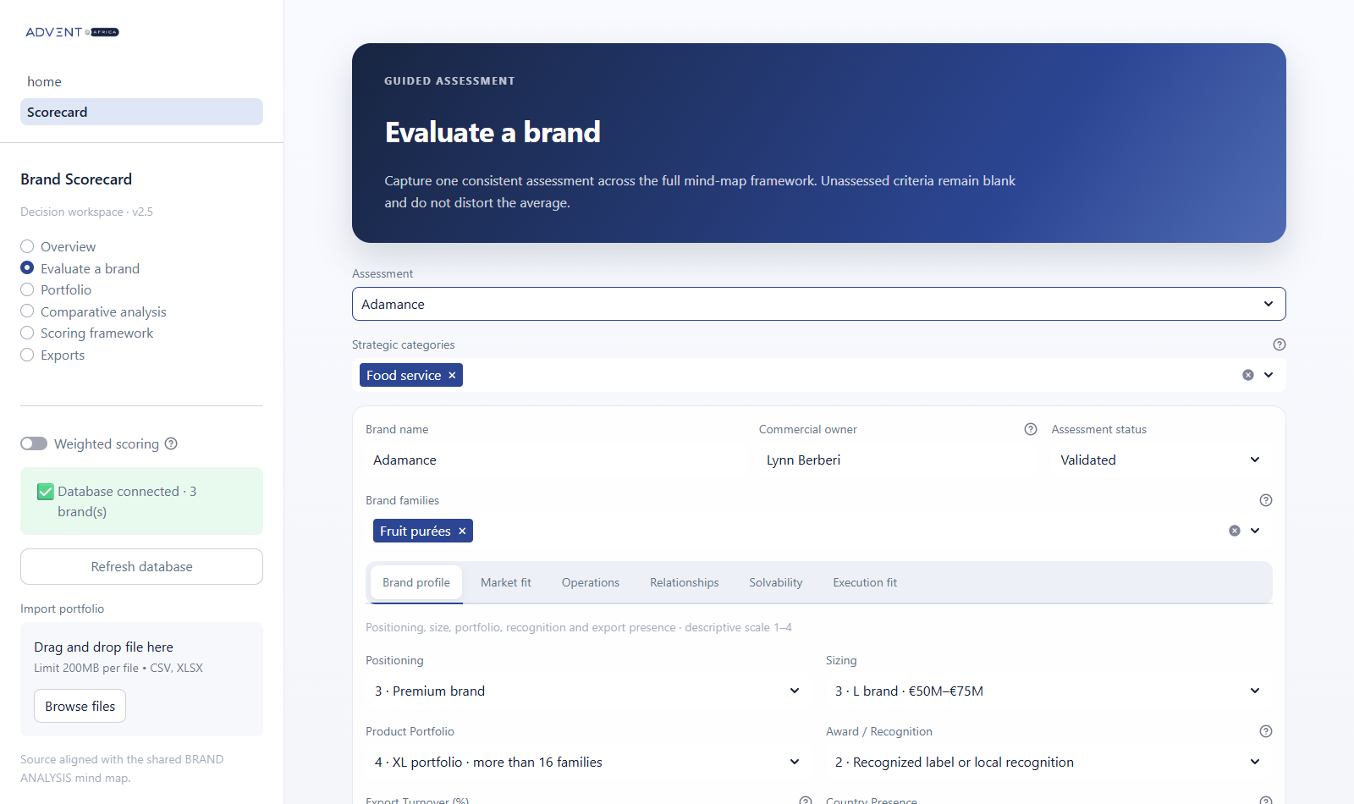
DATA CAPTURE
Guided brand assessment
One form covers the full assessment
Select one or more strategic categories and brand families.
Assign a commercial owner and an assessment status.
Complete descriptive and strategic criteria in clear sections.
Add comments and evidence before saving the assessment.
The same screen supports new brands and later updates.
03
Notes:
This is the main assessment screen. The user first selects the categories and brand families. A brand can belong to more than one category or family. The commercial owner and status make responsibility clear. The assessment is divided into sections, so the user can work through the criteria in a logical order. When the user saves, the complete record goes to the database.
Source: Brand Scorecard application v2.5.

Slide 4
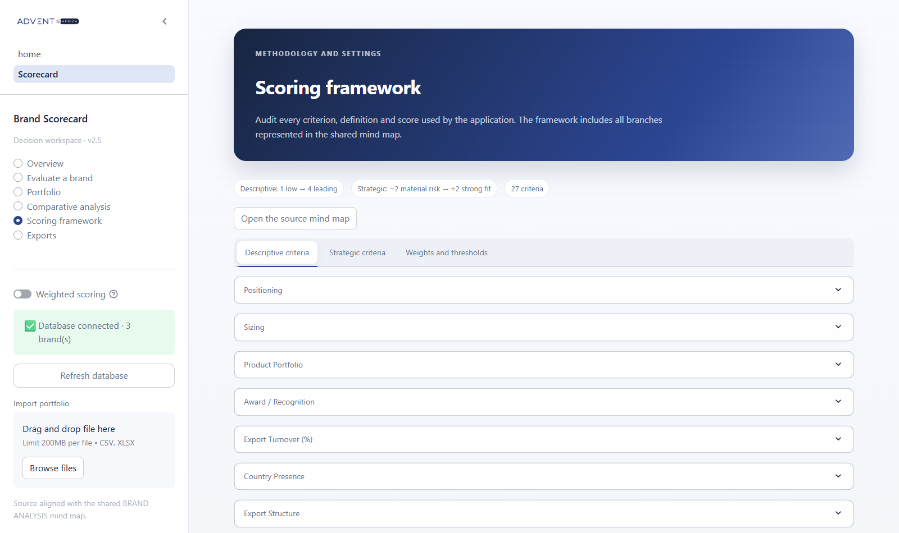
METHOD
Transparent scoring framework
27
criteria in total
7 descriptive criteria
Scores from 1 to 4
20 strategic criteria
Scores from -2 to +2
Missing answers stay blank and do not change the average.
04
Notes:
The scoring method stays visible inside the application. There are seven descriptive criteria and twenty strategic criteria. The descriptive scale runs from one to four. The strategic scale runs from minus two to plus two. Each definition can be reviewed in the Scoring Framework page. If a criterion is not assessed, it remains blank and does not reduce or increase the average.
Source: Brand Scorecard scoring framework.

Slide 5
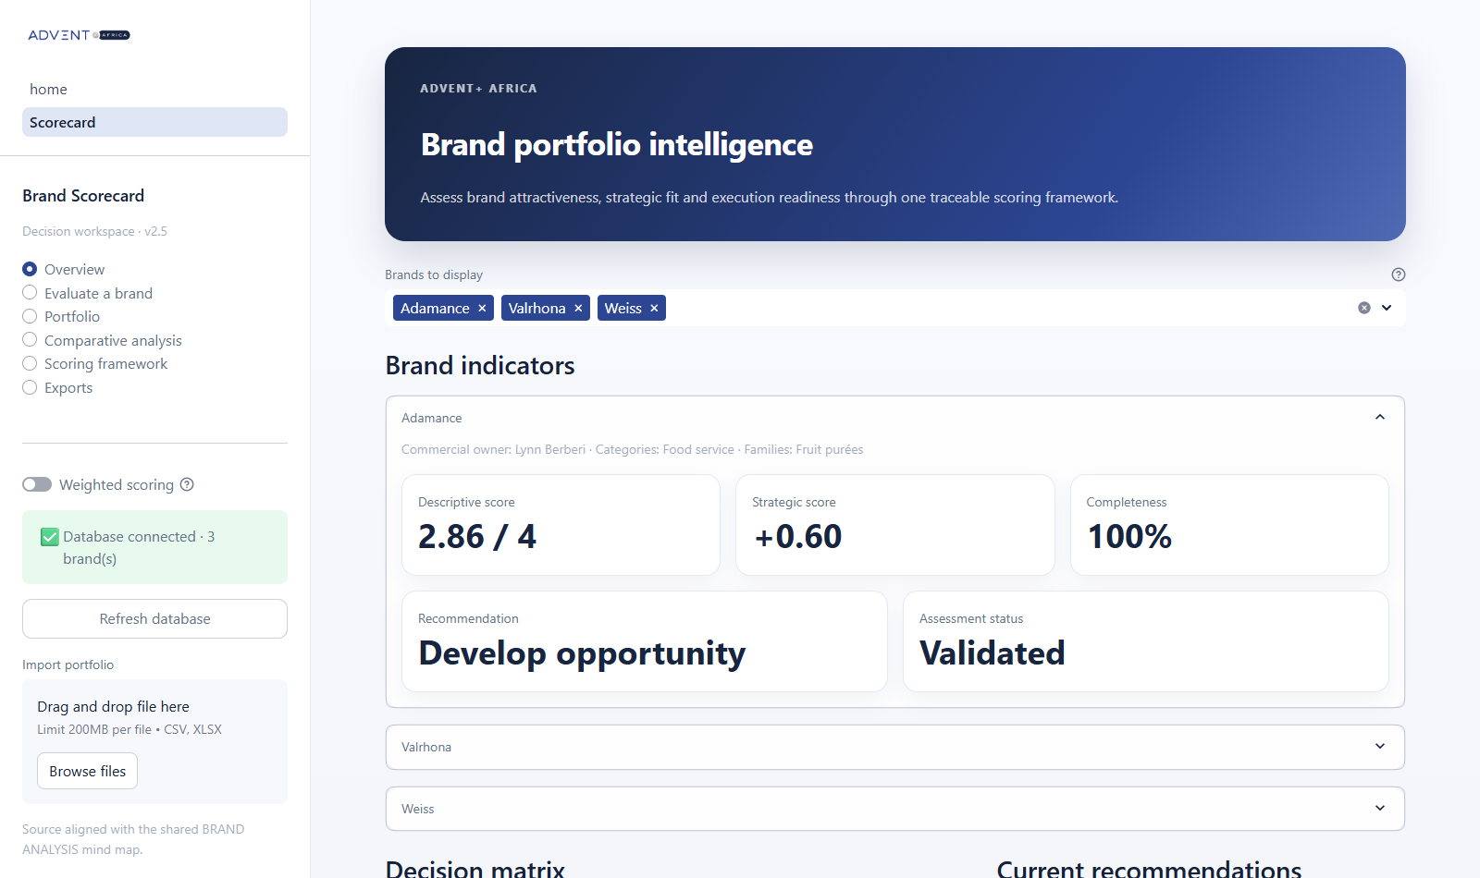
DASHBOARD
Brand level overview
The selector controls the indicators, decision matrix, recommendations, and table.
05
Notes:
The Overview now works at brand level. The user can select one or several brands. Each selected brand has its own expandable section with descriptive score, strategic score, completeness, recommendation, and status. The same filter also updates the charts and the recommendation table. This makes the page useful for both a focused brand review and a wider portfolio discussion.
Source: Brand Scorecard Overview.

Slide 6
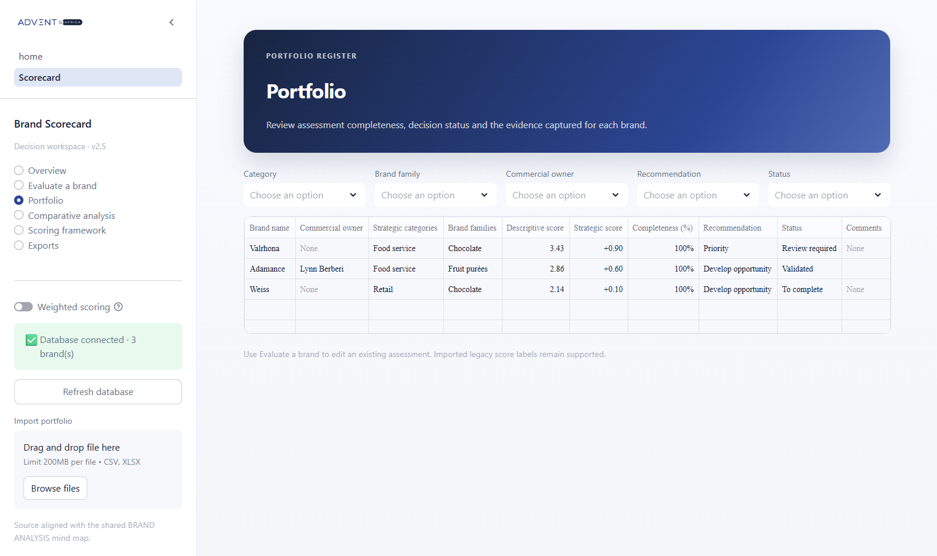
PORTFOLIO CONTROL
Portfolio register
A shared view of all active brands
Filter by category, family, commercial owner, recommendation, or status.
Compare completeness before a review meeting.
See the main scores and comments in one table.
Open the assessment page to update a record.
This screen creates a simple operating list for the commercial team.
06
Notes:
The Portfolio page gives the team one operating list. Users can filter by category, brand family, commercial owner, recommendation, and status. This helps the team prepare review meetings and focus on the records that need action. The table also shows completeness, which makes missing work easy to see. Users return to the assessment page when they need to update a brand.
Source: Brand Scorecard Portfolio page.

Slide 7
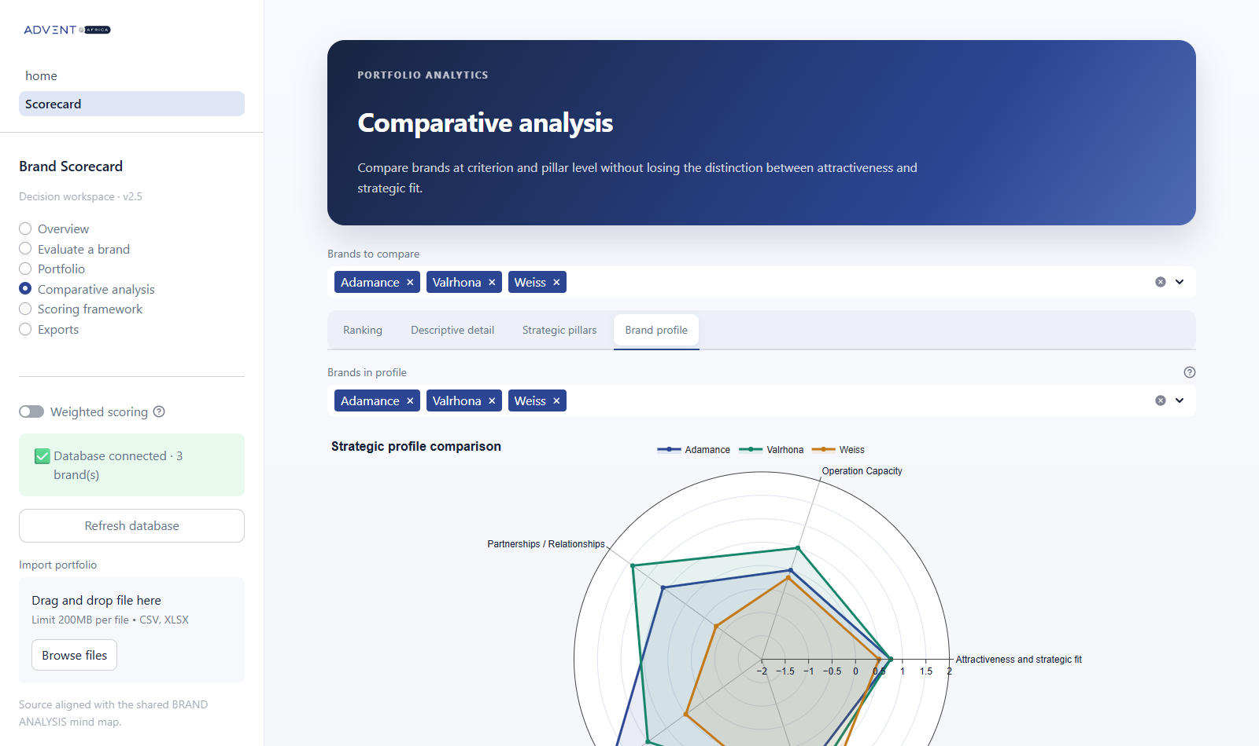
ANALYSIS
Multi-brand comparison
One chart, several brands
Select up to eight brands.
Each brand uses a different color.
Compare five strategic pillars on one radar.
Use the other tabs for ranking and heatmaps.
The legend and hover details make each profile easy to identify.
07
Notes:
The Comparative Analysis page supports several views. This example shows the strategic profile radar. The user can select several brands, and each brand receives a different color. The chart compares attractiveness, operations, relationships, solvability, and execution fit. The other tabs provide a ranking, detailed descriptive scores, and strategic pillar heatmaps.
Source: Brand Scorecard Comparative Analysis page.

Slide 8
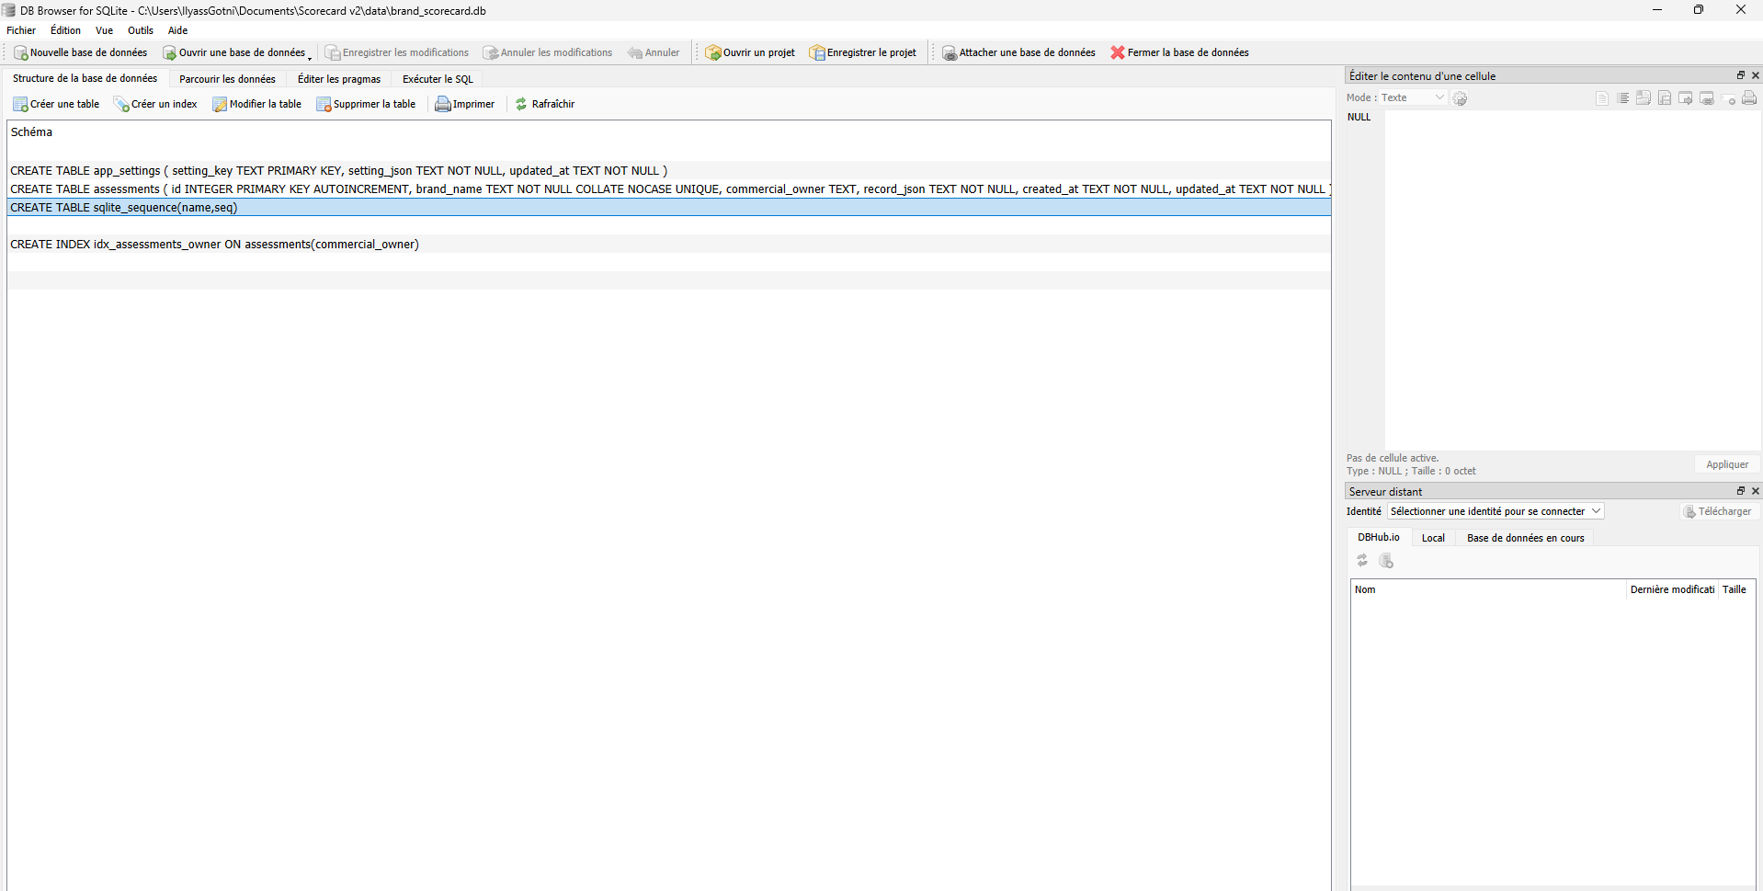
DATA STORAGE
Persistent SQLite database
The database starts automatically with the app
Every save or update writes the complete assessment.
Brand names stay unique in the database.
The app stores scoring settings as well as brand records.
DB Browser for SQLite provides a direct read-only view.
Default file
data/brand_scorecard.db
08
Notes:
The application uses SQLite for persistent storage. There is no separate database server to start. The database file opens automatically when the app starts. Each save writes the full brand assessment, and the settings are stored in a separate table. DB Browser can open the file for inspection. Normal changes should still be made through the application, because the app protects the expected data structure.
Source: database.py and local DB Browser view.

Slide 9
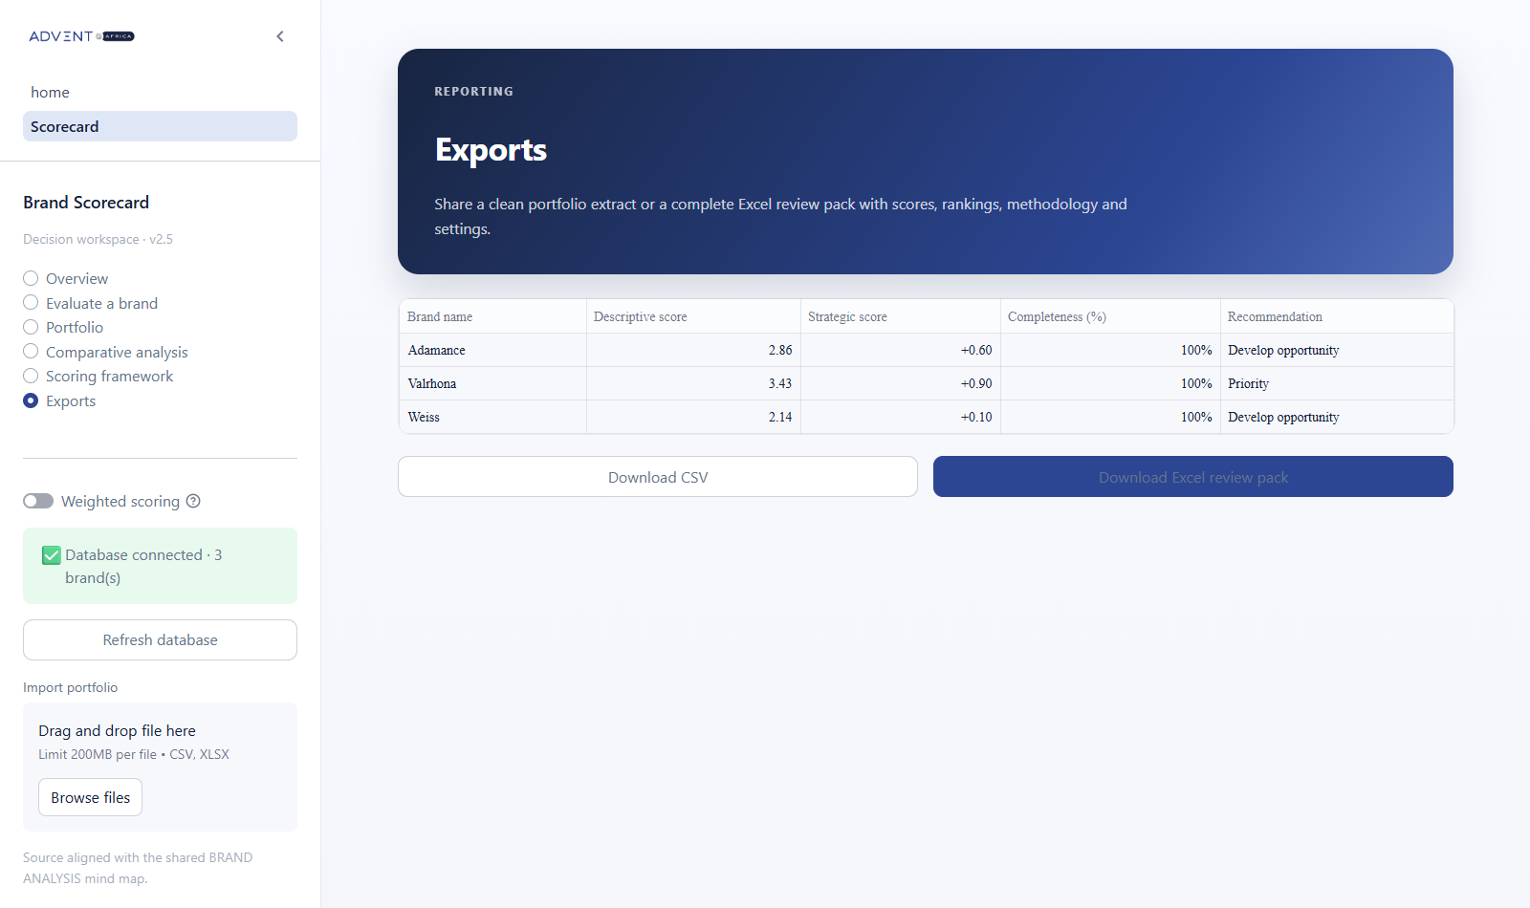
DATA EXCHANGE
Import and export
A flexible daily workflow
1
Import
Load historical or batch data from CSV or Excel.
2
Work
Review and update brands in the application.
3
Export
Create a CSV extract or a complete Excel review pack.
The database remains the main source between imports and exports.
09
Notes:
Import and export remain available around the database. Import is useful for historical data or larger updates. The application then becomes the main place for daily work. Export creates a simple CSV file or a complete Excel review pack with scores, rankings, settings, and methodology. This gives the team flexibility without losing the persistent database.
Source: Brand Scorecard Exports page and import workflow.

Slide 10
GOVERNANCE
Controls and data safety
SAVE
UPDATE
Automatic persistence
Controlled changes
Saved assessments remain available after the application closes.
Existing brands can be edited without creating duplicate records.
DELETE
BACKUP
Explicit confirmation
Portable outputs
The delete button stays disabled until the user confirms the action.
CSV and Excel exports support reviews and backup routines.
Recommended rule: use the application for changes and DB Browser for inspection.
10
Notes:
The project includes basic controls for safe daily use. Saving is automatic, and updates reuse the same brand record. Deleting a brand requires an explicit confirmation. Export files can support review meetings and backup routines. The recommended rule is simple: users should make changes in the application and use DB Browser only to inspect the database.
Source: Brand Scorecard database and delete workflow.

Slide 11
Business value and next steps
Business value
Suggested next steps
Faster preparation for brand review meetings.
Comparable scores across the full portfolio.
Clear ownership and visible assessment status.
Reusable data for analysis and reporting.
Confirm the users and their access needs.
Choose a shared deployment for the commercial team.
Agree on a regular review and backup cycle.
Train users with a small set of real brands.
The result is one consistent process from assessment to decision.
Notes:
The main value is a faster and more consistent review process. The team can compare brands using the same method, see who owns each assessment, and reuse the data for reporting. The next step is to agree on the users, choose the shared deployment, define a review and backup cycle, and train the team with a small group of real brands. This will turn the tool into a regular commercial process.
Source: project scope and recommended implementation steps.

