Slide 1

ASSESS
COMPARE
DECIDE
Brand Scorecard
A practical tool for brand assessment and portfolio decisions
One shared scoring method
One persistent data source
Project presentation
September 2026
Notes:
This project is the Brand Scorecard. The commercial team uses one application to assess brands, compare results, and support portfolio decisions. The application gives every brand the same questions, scoring rules, and data structure. It also keeps the information in one database. I will explain the full journey from data entry to the final recommendation.
Source: Brand Scorecard application v2.7.

Slide 2
BUSINESS NEED
Why the project was needed
The starting point
The project response
Brand information was spread across files and personal notes.
Teams needed a consistent way to compare very different brands.
Manual updates made follow-up slow and difficult to trace.
Management needed a clear view of priorities and risks.
01
Structured assessment
The same questions and scales for every brand.
02
Persistent data
Every saved assessment returns in the next session.
03
Decision views
Scores, recommendations, comparisons, and exports.
02
Notes:
The project started because brand information was spread across files and personal notes. That made comparisons difficult and follow-up slow. The Brand Scorecard creates one structured process. The team answers the same questions for every brand, the application keeps the records, and management receives clear scores and recommendations. This makes review meetings faster and easier to prepare.
Source: project workflow and Brand Scorecard application.

Slide 3
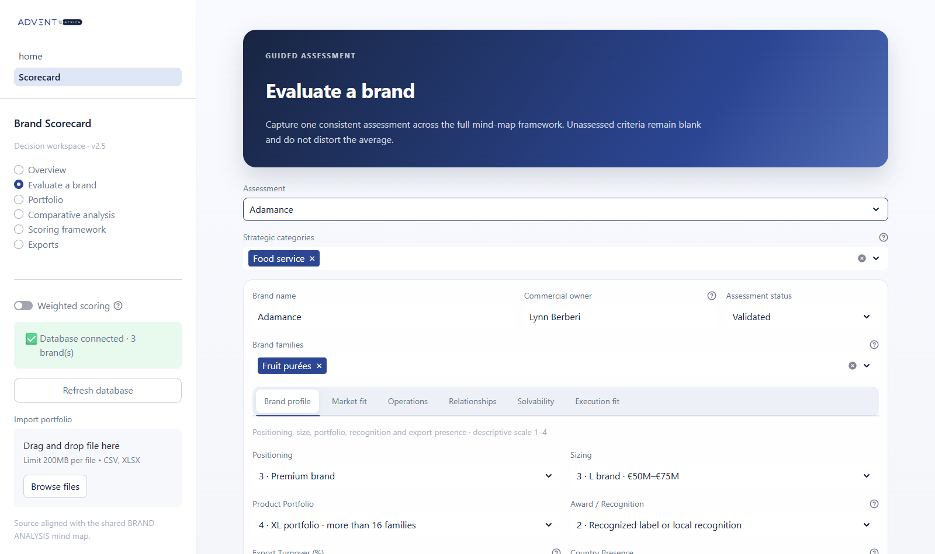
DATA CAPTURE
Guided brand assessment
One form covers the full assessment
Select one or more strategic categories and brand families.
Assign a commercial owner and an assessment status.
Complete descriptive and strategic criteria in clear sections.
Add comments and evidence before saving the assessment.
The same screen supports new brands and later updates.
03
Notes:
This is the main assessment screen. The user selects one or more strategic categories and brand families because a brand can operate in several areas. The commercial owner shows who is responsible for the record. The tabs separate the descriptive and strategic criteria into clear sections. Comments and evidence apply to the complete brand assessment. When the user saves, the application writes the full record to the SQLite database. The same page also updates an existing brand.
Source: Brand Scorecard application v2.7.

Slide 4
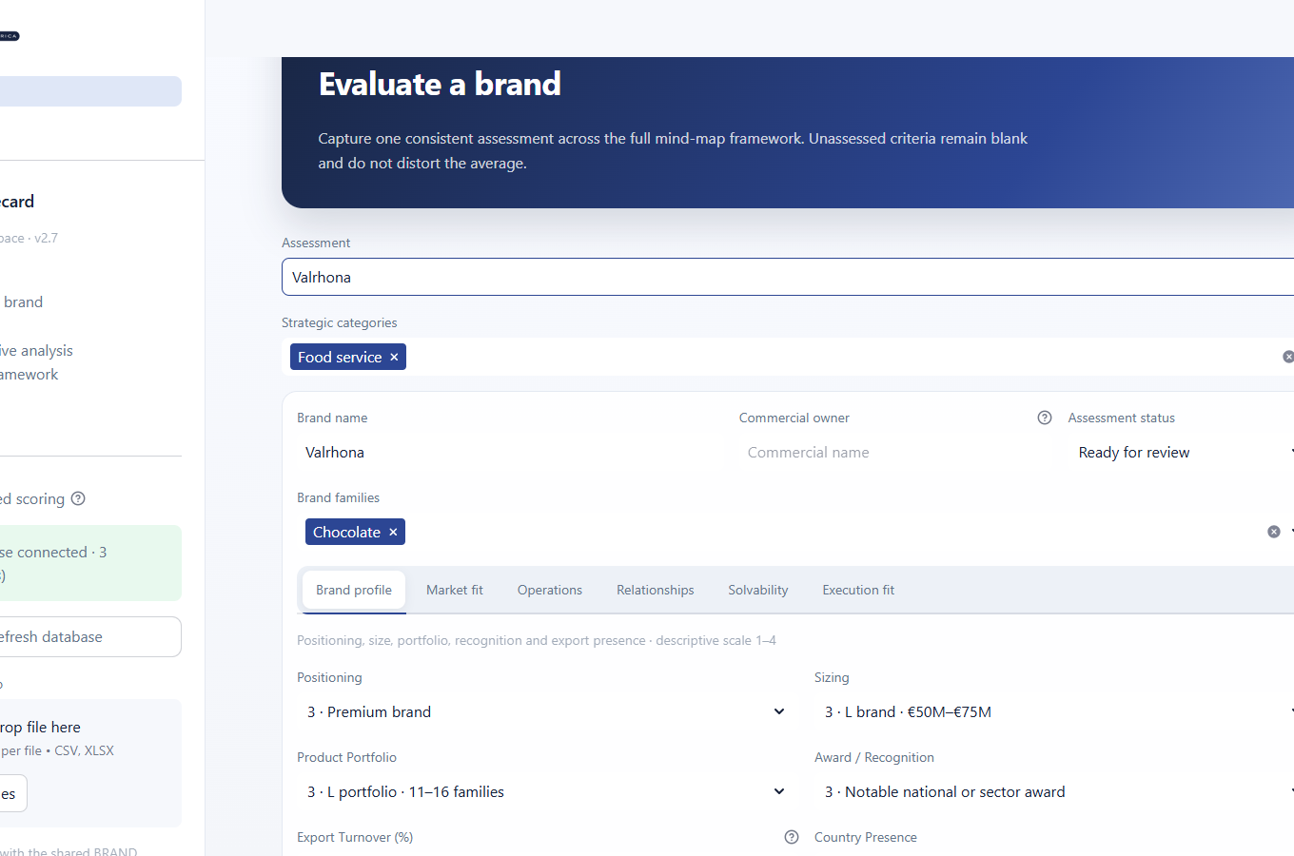
WORKFLOW
Assessment status
Four manual stages
To complete
The record exists, but the assessment has not started or still needs key inputs.
In progress
The commercial owner has started the assessment and is still working on it.
Ready for review
The inputs are complete and the assessment is waiting for a business review.
Validated
The reviewer has accepted the assessment as the current agreed view.
The user selects the status. It does not change automatically.
04
Notes:
Assessment status is a manual workflow label. To complete means that the record exists but the work has not started, or important answers are still missing. In progress means that the commercial owner is working on the assessment. Ready for review means that the inputs are complete and the assessment is waiting for a manager or team review. Validated means that the review is complete and the team accepts the assessment. The status does not change automatically. It is also not linked only to the comments field. Comments and evidence support the full brand assessment.
Source: Brand Scorecard application v2.7.

Slide 5
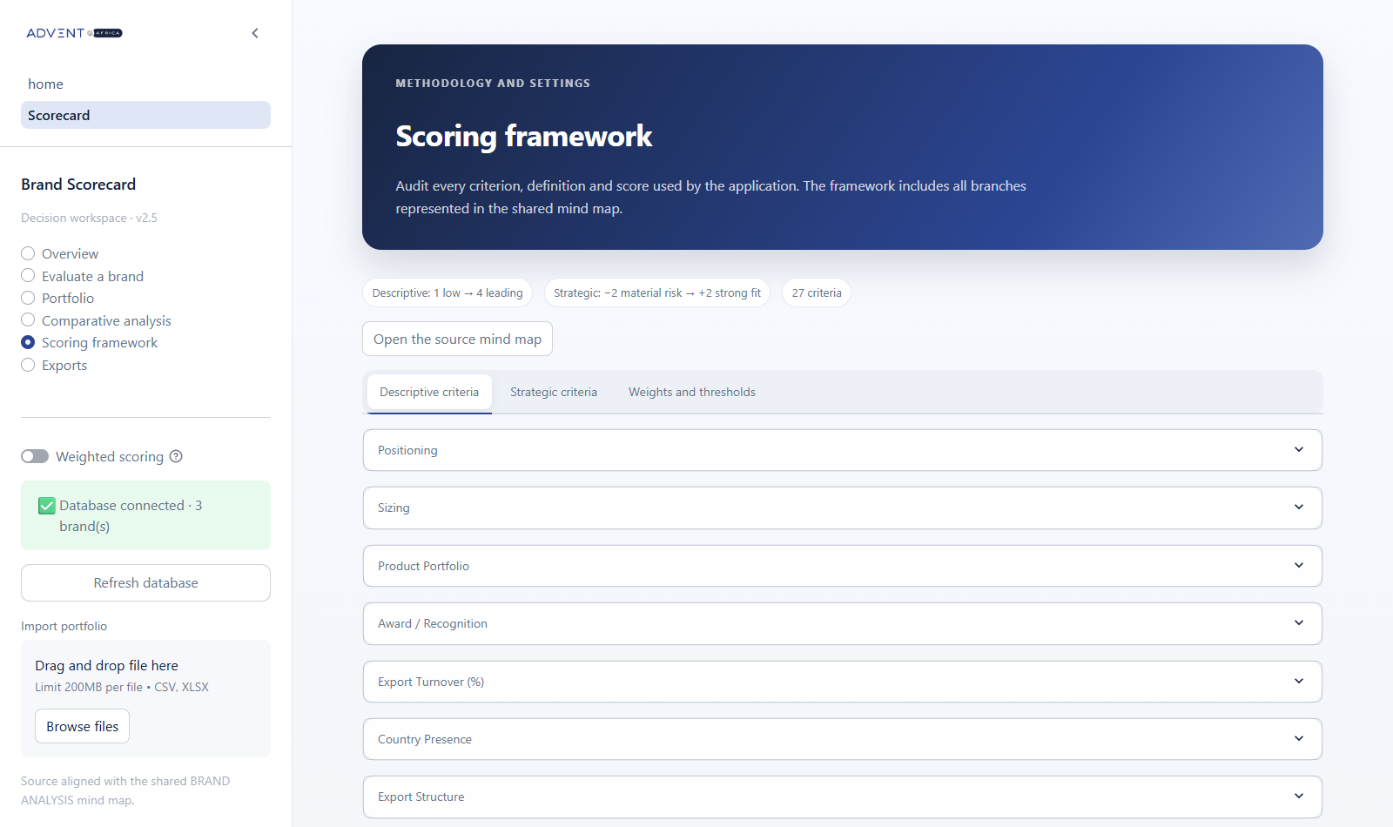
METHOD
Transparent scoring framework
27
criteria in total
7 descriptive criteria
Scores from 1 to 4
20 strategic criteria
Scores from -2 to +2
Missing answers stay blank and do not change the average.
05
Notes:
The scoring framework makes the method visible. There are seven descriptive criteria with scores from one to four. There are twenty strategic criteria with scores from minus two to plus two. Each criterion has a written definition for every possible score. Missing answers remain blank, so they do not increase or reduce the average. This page helps users understand why a score has a specific value.
Source: Brand Scorecard scoring framework v2.7.

Slide 6
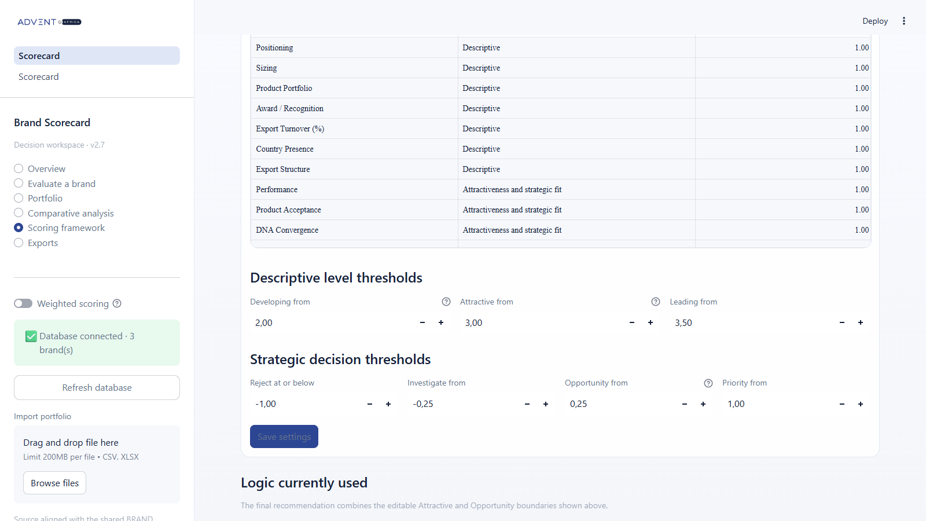
METHOD
Editable scoring settings
Weights
A weight of 1 gives every criterion the same importance. Weights apply only when Weighted scoring is enabled.
Descriptive thresholds
Developing from also controls the upper limit of Low. Attractive and Leading have their own editable boundaries.
Strategic thresholds
Reject, Investigate, Opportunity, and Priority boundaries can all be changed and saved.
Saved settings recalculate every brand.
06
Notes:
This page controls how the scores are calculated and interpreted. All weights are currently set to one, so every criterion has the same importance. When Weighted scoring is off, the application ignores the weights. When it is on and every weight is one, the result is still the same as a simple average. A weight of two gives a criterion twice the influence, while zero removes it from the weighted calculation. The descriptive boundaries define Low, Developing, Attractive, and Leading. Low has no separate input because it covers every score below Developing from. The strategic boundaries define Reject, Investigate, Opportunity, and Priority. The application saves these settings in the database and recalculates the portfolio.
Source: Brand Scorecard application v2.7.

Slide 7
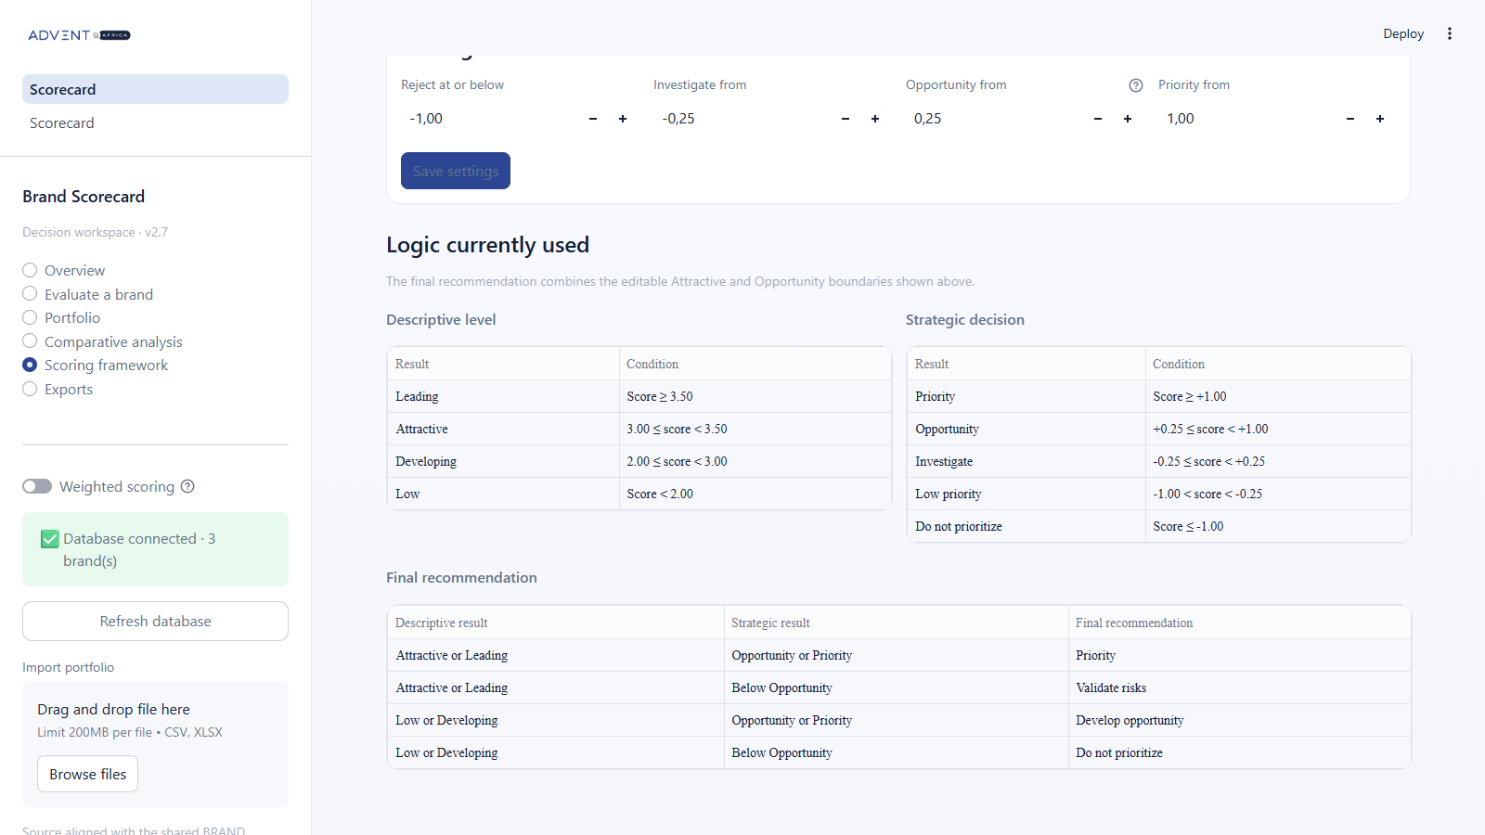
DECISION LOGIC
How the recommendation is built
Descriptive level
The first table converts the 1 to 4 score into Low, Developing, Attractive, or Leading.
Strategic decision
The second table converts the -2 to +2 score into five decision levels.
Final recommendation
The last table combines the descriptive result with the strategic result.
Attractive + Opportunity = Priority
07
Notes:
These tables show the exact logic used by the application. The first table interprets the descriptive score. Below two is Low, two to below three is Developing, three to below three point five is Attractive, and three point five or more is Leading. The second table interprets the strategic score. A score below Opportunity does not qualify as an opportunity. The third table combines the two results. Valrhona has a descriptive score of 3.43, so it is Attractive. Its strategic score is 0.90, so it is an Opportunity. Together, these results give a final recommendation of Priority. Weiss has 2.14 and 0.10, so it is Developing and Investigate. Its final recommendation is Do not prioritize.
Source: Brand Scorecard application v2.7.

Slide 8
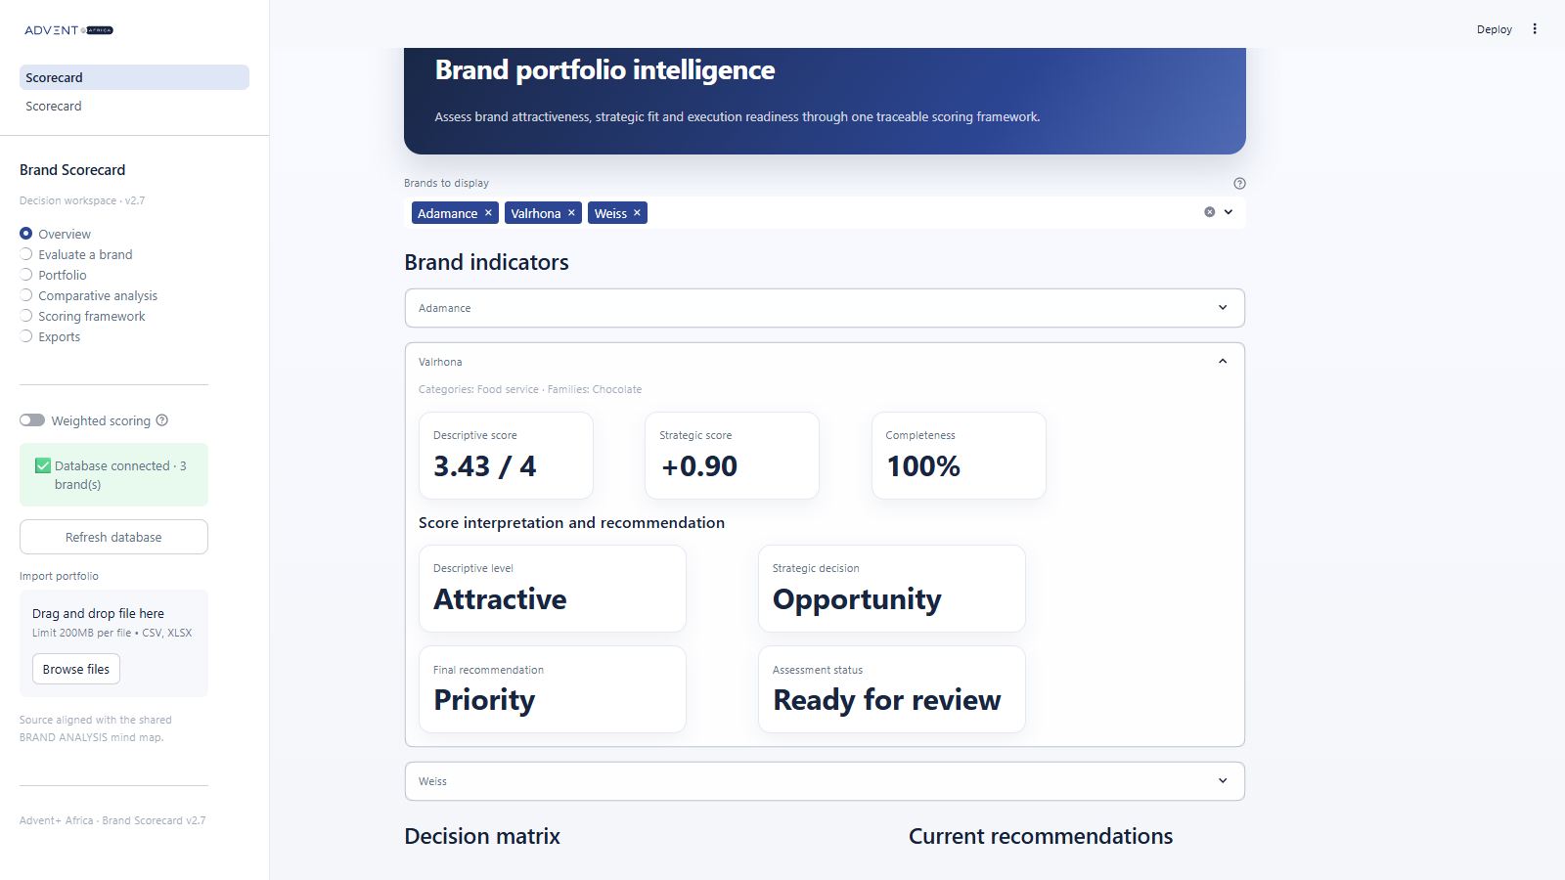
DASHBOARD
Brand level overview
Each brand shows its score interpretation, final recommendation, and status.
08
Notes:
The Overview works at brand level. The user can select one or several brands and open each brand in an expander. The first row shows the descriptive score, strategic score, and completeness. The next section explains the scores. For Valrhona, 3.43 is Attractive and 0.90 is Opportunity. The application then combines those results into the final recommendation, Priority. The assessment status remains a separate workflow field. The charts and tables use the same selected brands.
Source: Brand Scorecard Overview v2.7.

Slide 9

PORTFOLIO CONTROL
Portfolio register
A shared view of all active brands
Filter by category, family, commercial owner, recommendation, or status.
Compare completeness before a review meeting.
See the main scores and comments in one table.
Open the assessment page to update a record.
This screen creates a simple operating list for the commercial team.
09
Notes:
The Portfolio page gives the commercial team one operating list. Users can filter the table by category, family, commercial owner, recommendation, or assessment status. The table now shows the current values: Valrhona is Ready for review, Adamance is Validated, and Weiss is To complete. It also shows completeness and the final recommendation. Users return to the assessment page when they need to change a record.
Source: Brand Scorecard Portfolio page v2.7.

Slide 10
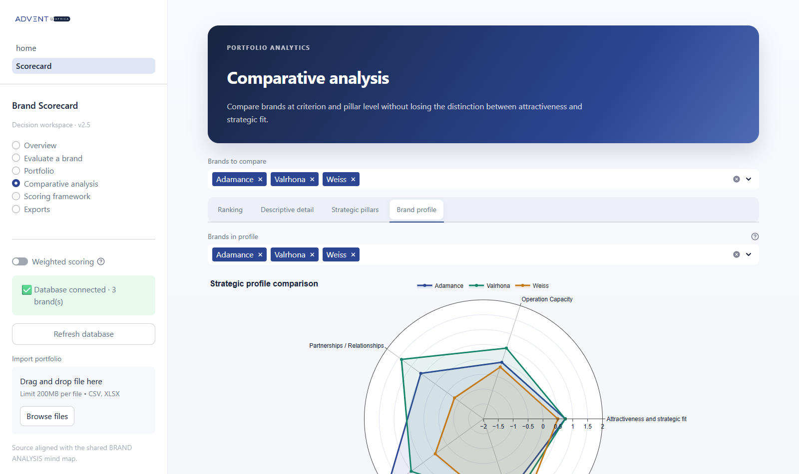
ANALYSIS
Multi-brand comparison
One chart, several brands
Select up to eight brands.
Each brand uses a different color.
Compare five strategic pillars on one radar.
Use the other tabs for ranking and heatmaps.
The legend and hover details make each profile easy to identify.
10
Notes:
The Comparative Analysis page helps the team compare several brands. Each selected brand receives a different color. This radar compares the five strategic pillars: attractiveness and strategic fit, operation capacity, partnerships and relationships, solvability, and execution fit. The other tabs provide ranking, descriptive detail, and strategic heatmaps. The purpose is to see where brands differ, not only which total score is higher.
Source: Brand Scorecard Comparative Analysis page.

Slide 11
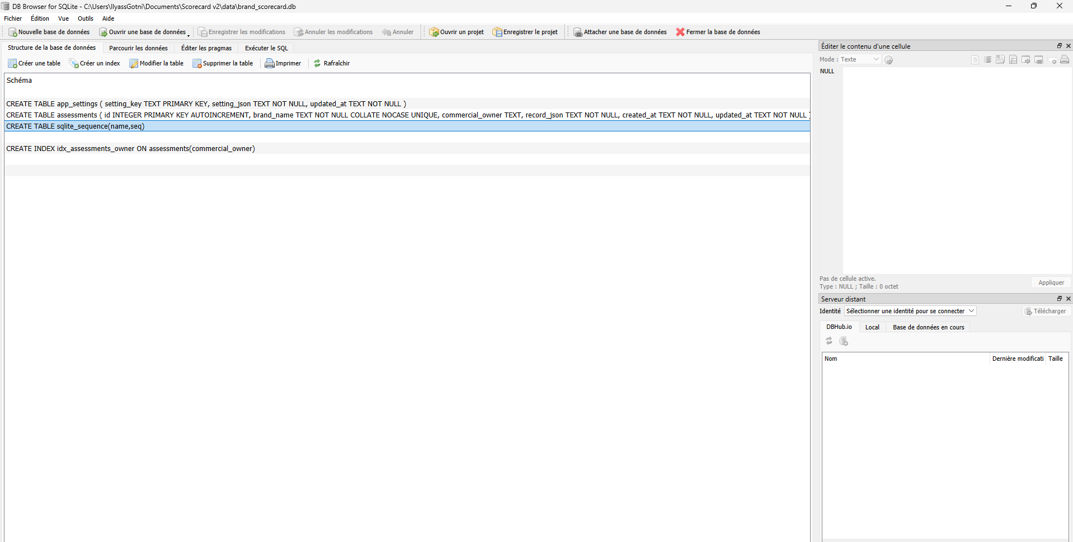
DATA STORAGE
Persistent SQLite database
The database starts automatically with the app
Every save or update writes the complete assessment.
Brand names stay unique in the database.
The app stores scoring settings as well as brand records.
DB Browser for SQLite provides a direct read-only view.
Default file
data/brand_scorecard.db
11
Notes:
The application uses SQLite for persistent storage. There is no separate database server to start. The database opens automatically with the application. Every save or update writes the full assessment, and the application also stores the scoring settings. DB Browser for SQLite can open the file for inspection. Users should make normal changes through the application because it protects the expected data structure.
Source: database.py and the local DB Browser view.

Slide 12

DATA EXCHANGE
Import and export
A flexible daily workflow
1
Import
Load historical or batch data from CSV or Excel.
2
Work
Review and update brands in the application.
3
Export
Create a CSV extract or a complete Excel review pack.
The database remains the main source between imports and exports.
12
Notes:
Import and export remain available together with the database. Import is useful for historical files or a batch of records. After import, the database becomes the main source for daily work. The Export page shows the descriptive level, strategic decision, final recommendation, and completeness. Users can download a simple CSV file or a complete Excel review pack with rankings, methodology, and settings.
Source: Brand Scorecard Exports page v2.7.

Slide 13
GOVERNANCE
Controls and data safety
SAVE
UPDATE
Automatic persistence
Controlled changes
Saved assessments remain available after the application closes.
Existing brands can be edited without creating duplicate records.
DELETE
BACKUP
Explicit confirmation
Portable outputs
The delete button stays disabled until the user confirms the action.
CSV and Excel exports support reviews and backup routines.
Recommended rule: use the application for changes and DB Browser for inspection.
13
Notes:
The project includes controls for safe daily use. Saving keeps the data after the application closes. Updating a brand reuses the same record instead of creating a duplicate. Deleting a brand requires explicit confirmation. CSV and Excel files support review meetings and backup routines. The recommended rule is to make changes in the application and use DB Browser only for inspection.
Source: Brand Scorecard database and delete workflow.

Slide 14
Business value and next steps
Business value
Suggested next steps
Faster preparation for brand review meetings.
Comparable scores across the full portfolio.
Clear ownership and visible assessment status.
Reusable data for analysis and reporting.
Confirm the users and their access needs.
Choose a shared deployment for the commercial team.
Agree on a regular review and backup cycle.
Train users with a small set of real brands.
The result is one consistent process from assessment to decision.
Notes:
The business value is a faster and more consistent review process. The team can compare brands with the same method, see who owns each assessment, and understand how the recommendation was produced. The next step is to agree on users and access, choose a shared deployment, define a review and backup cycle, and train the team with a small group of real brands. This turns the application into a regular commercial process.
Source: project scope and recommended implementation steps.

