Slide 1
MM633 Session 3
Contingency Theory, Resource Dependence, and the External Environment
16 Sept, 2025
Yi TANG, Yulong DU, Yuhang LONG

Slide 2
Outline
Section 1: The Arise of Modern Business Enterprises
The transition from entrepreneurial to managerial enterprises
Section 2: Organisations and Environment
Fit between organisational structure and the external environment
Contingency Theory
Organizations in action
Manage external environment
Adapt to external environment
Orchestrate internal interdependence
Interdependence among organisations
Resource Dependence Theory

Slide 3

The Arise of Modern Business Enterprises
Two themes for early 20th century
Technology
Advance in
Assembly line
Electricity
Communication
Transportation
Mass production of steel
…
Uncertainty
Uncertainties about
War
Recession
Demand
Employment
Tech
Léon Walras
General equilibrium!
(Source: Wikipedia)

Slide 4
The Arise of Modern Business Enterprises
Perfecting the structure
Post-war recession
Sudden and long lingering drop in demand
Increased production capabilities
Weakness in top managements
Struggled for day-to-day operations
Failed to adjust to demand
Bad at long-term planning and allocation of resources
The existing business structure was no longer efficient
Needs to change
in structure

Slide 5
The Arise of Modern Business Enterprises
Perfecting the structure
Multidivisional structure
(e.g. in General Motors, Du Pont)
General Office
Monitor and plan
Coordination, allocation, direction
Autonomous divisions
Responsible for specific product line/region
Discretion to integrate production and distribution
Functional departments
Technical parts for production, sales, R&D, purchasing ...

Slide 6
The Arise of Modern Business Enterprises
Perfecting the structure
Separation of ownership and operation
Transition from entrepreneurial to managerial enterprises
Efficiency and Growth
Similar reorganisation spread across the country
Diversification
Search for new products & markets, and develop by-products

Slide 7
The Arise of Modern Business Enterprises
Conclusions
Technological advances, material sufficiency, and fluctuation in demand →
More complex processes of production and distribution →
Weakness of existing management to coordinate →
A need for a new form of administrative coordination →
Multidivisional business enterprises and professional managers →
Dominance of managerial enterprises in contemporary business world

Slide 8
The Management of Contingencies
Introduction
Q: How is an organisation “organised”?
A: It depends and there is no a best way
Q: ...Then depends on what?
A: external environmental factors as major sources of uncertainty
Organisations are organised in reaction to the environment

Slide 9
The Management of Contingencies
Introduction
[def.] Technical rationality is a system of cause/effect relationships which lead to a desired result
but the situation is not that simple…
[def.] Organisational rationality involves three major component activities: input, technology, and output
[prop. 2.1] Organisations seek to seal off their core tech from environmental influences -> reduce uncertainty
[def.] Contingency: factors that may or may not vary but are not subject to arbitrary control
Q: (Bohong Ma) When gave assumption of organization in norms of rationality, author sometimes use "Under norms of rationality" (Propositions 3.1, 3.3, 4.1, 5.1, 5.3, and 5.4), sometimes use "Subject to rationality norms" (Propositions 3.2, 3.4, 4.1a, 4.1b, 4.1c, 4.2, 5.1b, 5.1c, and 5.2). Is this just a difference in expression, or a difference in assumption or context?

Slide 10
The Management of Contingencies
Outline
(Chap. 3) Domains of Organised Action
How to manage external environment?
(Chap. 4) Organisational Design
How to adjust myself to them?
(Chap. 5) Technology and Structure
How to coordinate internal structure?

Slide 11
The Management of Contingencies
Domains of Organised Action
[def.] Task environment:
parts of the environment relevant or potentially relevant to goal setting and goal attainment
customers
suppliers
competitors
regulatory groups
[def.] Domain:
Range of products
Population served
Services rendered
Domain
Task environment
Environment

Slide 12
The Management of Contingencies
Domains of Organised Action
[prop. 3.1] Organisations seek to minimise the power of task-environment elements over them by maintaining alternatives
If that won’t work ...
[prop. 3.3] Organisations seek power relative to those on whom they are dependent
But how?
[def.] Cooperation: demonstration of capacity to reduce uncertainty and make a commitment to exchange

Slide 13
The Management of Contingencies
Domains of Organised Action
Cooperative strategies
[def.] Contracting: negotiation of an agreement for the exchange of performances in the future
e.g. contract on supply with suppliers
[def.] Coopting: absorption of new elements into the leadership or policy-making structure
e.g. a position in company's advisory board for a local bank
[def.] Coalesce: a combination or joint venture with another organisation
e.g. a joint venture with potential competitors
Demonstration of capability, sincerity, and commitment

Slide 14
The Management of Contingencies
Domains of Organised Action
[prop. 3.4] The more sectors in which the organisation is constrained, the more power it will seek over remaining sectors of its task environment
e.g. uniqueness to local consumers
[prop. 3.5] The organisation facing many constraints and unable to achieve power in other sectors of its task environment will seek to enlarge the task environment
e.g. an orange juice factory in the adjacent city
Increasing constraints from 3.1-3.5
Q: (Mingruoxin Yan) Thompson’s framework assumes organizations can effectively buffer uncertainty, but what happens when external changes are too rapid or unpredictable? Are there limits to buffering strategies?

Slide 15
The Management of Contingencies
Outline
(Chap. 3) Domains of Organised Action
How to manage external environment?
(Chap. 4) Organisational Design
How to adjust myself to them?
(Chap. 5) Technology and Structure
How to coordinate internal structure?

Slide 16
The Management of Contingencies
Organisational Design
The compromises and maneuvering in defense of domains are disruptive and costly, so they will seek to design themselves so as to minimise the necessity of external change
[prop. 4.1] organisations seek to place their boundaries around those activities which if left to the task environment would be crucial contingencies
Expansion of domains to adapt to the environment and reduce uncertainty

Slide 17
The Management of Contingencies
Organisational Design
Integration: Smart phones
Each step is sequential, tightly coupled, and breakdowns at one stage stop the whole line:
chips → mainboard → OS & software → assembly → distribution
Expansion: Bank and branches
Service for larger population
Incorporation: Inpatient ward
For a patient who survived a car accident:
emergence treatment → quick medical check → expert consultation → operation → … (Ad hoc process)
Each case is unique and relies on quick, customized responses
Q: (Shunyi Lai) The author mentioned that vertical integration became difficult due to rapid fan-out. What can be the criteria for selecting strategic or crucial support activities for vertical integration? Besides, as technological iterations accelerate, how can organizations adjust the "strategic support activities" of their vertical integration to avoid resource misallocation?
Q: (Tongyue Fang) How do different technologies (long-linked, mediating, intensive) influence organizational domain expansion strategies, according to Thompson? Could you give some examples of industries or enterprises based on the current situation?

Slide 18
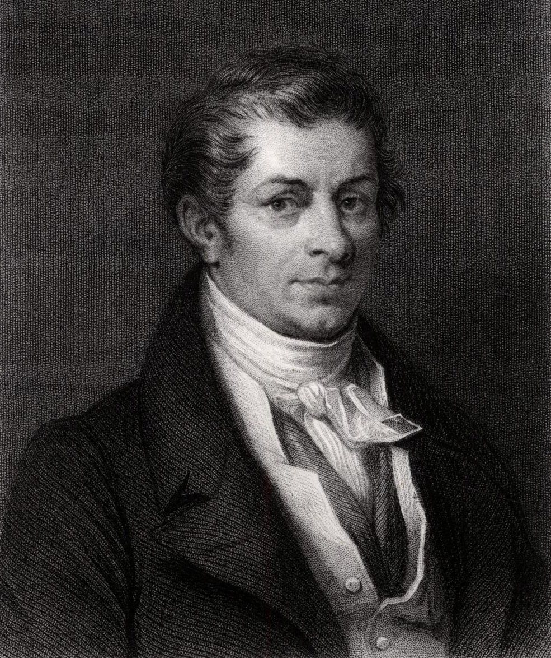
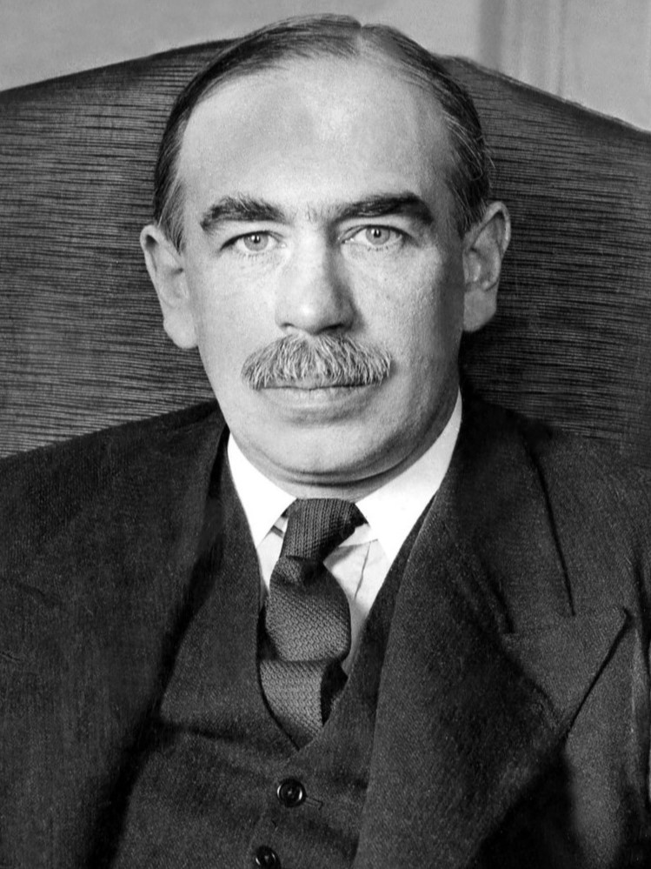
The Management of Contingencies
Organisational Design
Jean-Baptiste Say
[def.] Problem of balance: the organisation that extends its boundaries often finds that it has acquired capacity in excess of that called for by its major mission
[prop. 4.2] multi-component organisation will seek to grow until the least-reducible component is approximately fully occupied
Increased production → Excess supply!
No worries. Supply creates demand
John Maynard Keynes
(Source: Wikipedia)
Nah…Demand creates supply!
(Source: Wikipedia)

Slide 19
The Management of Contingencies
Organisational Design
[prop. 4.3] organisations with capacity in excess of what the task environment supports will seek to enlarge their domains
Amazon Web Services (AWS)
Amazon built massive IT infrastructure to handle peak retail demand, which was in excess of what its retail mission required most of the year
To balance the excess, Amazon extended into cloud services, which is the AWS, now a major business line
Spiral development of organisations

Slide 20
The Management of Contingencies
Outline
(Chap. 3) Domains of Organised Action
How to manage external environment?
(Chap. 4) Organisational Design
How to adjust myself to them?
(Chap. 5) Technology and Structure
How to coordinate internal structure?

Slide 21
The Management of Contingencies
Technology and Structure
The major components of a complex organisation are determined by the general design
Divisions and departments are “organisations” nested in organisations
Connections are established within and between departments
[def.] Structure: internal differentiation and patterning of relationships
Why? Instrumental and economic consideration
Difference kind of interaction among elements
Coordination among those interdependent elements
Coordination entails costs

Slide 22
The Management of Contingencies
Technology and Structure
[def.] Pooled interdependence: each part renders a discrete contribution to the whole and each is supported by the whole
e.g. university canteens → standardise
[def.] Sequential interdependence: a pooled interdependence in which direct connections can be pinpointed between them and the order can be specified
e.g. Dept. of Chemistry and Dept. of Material Science → plan
[def.] Reciprocal interdependence: a sequential interdependence in which the outputs of each become inputs for the others
e.g. School of Medicine and Affiliated Hospital → mutual adjustment
[prop. 5.1] organisations group positions to minimise coordination costs

Slide 23
The Management of Contingencies
Technology and Structure
Q: (Yingying Liu) How do different coordination mechanisms (mutual adjustment, standardization of work, standardization of outputs, standardization of skills, plan) map onto organizational structures in modern firms (e.g., platform firms, startups, manufacturing multinationals)?
Medical School
Business School
Dept. of Management
Affiliated Hospital
Dept. of Finance
Dept. of Chemistry
Dept. of Marketing
Dept. of Material Science

Slide 24
The Management of Contingencies
Technology and Structure
Medical School
Business School
School of Social Science
(文学部)
Dept. of Management
School of
Science
(理学部)
Dept. of Sociology
Affiliated Hospital
Dept. of Sociology
Dept. of Finance
Dept. of History
……
Dept. of Marketing
Dept. of Chemistry
Dept. of Material Science
Hierarchy

Slide 25
The Management of Contingencies
Summary
Management of external environment
Design of domains to fit
Orchestration of intra-organizational structure to fit
Next for contingency theory
Evaluation of performance based on current fit
Loss and regain of fit

Slide 26
Donaldson, L. (2001). The contingency theory of organizations. Sage.
1. Core Paradigm and Theoretical Integration
Contingency theory paradigm: organizational effectiveness results from fitting characteristics of the organization, such as its structure, to contingencies that reflect the situation of the organization (Burns and Stalker 1961; Lawrence and Lorsch 1967; Pennings 1992; Woodward 1965).
fitting --> high performance; misfitting --> low performance
What kind of contingencies we are concerning about?
Structural contingency theory: involve the three contingencies of the environment, organizational size, and strategy.
How will these contingencies function?

Slide 27
(1) The environmental stability contingency affects mechanistic structure (Pennings 1992).
The rate of technological and market change in the environment of an organization affects whether its structure is mechanistic (i.e., hierarchical) or organic (i.e., participatory; Burns and Stalker 1961).
mechanistic structure: stable environment; routine operations; upper levels make decisions; centralized control fosters efficiency
organic structure: unstable environment; innovation; decentralized decision making fosters innovation
An organization that has the misfitting, mechanistic structure in an unstable environment is unable to innovate and so becomes ineffective (Burns and Stalker 1961).
(2) The size contingency affects bureaucratic structure.
The size of an organization, that is, the number of its employees, affects the degree to which its structure is bureaucratic, for example, rule-governed, and is decentralized (Pugh and Hickson 1976; Pugh and Hinings 1976).
bureaucratic structure: large size; repetitive operations and administration; decision making by rules; inexpensive and efficient decision making;
unbureaucratic structure: small organization; not rule-governed; centralized control; top management make almost all the decisions;
A large organization that seeks to use the misfitting, simple structure will find top management overwhelmed by the number of decisions it needs to make, so that the organization becomes ineffective.

Slide 28
(3) The strategy contingency affects divisional structure.
functional structure: undiversified strategy; all its activities are focused on a single product or service; specialization by function (e.g., departments of production, marketing, etc).
divisional structure: diversified strategy; diverse activities serving various product-markets; coordinating each product or service in its own division
An organization with a diversified strategy that seeks to use the misfitting, functional structure will find top management overwhelmed by the number of decisions and also suffer lack of responsiveness to markets, so that the organization becomes ineffective.
Contingency theory is to be distinguished from universalistic theories of organization.
Universalistic theories: there is “one best way” to organize, meaning that maximum organizational performance comes from the maximum level of a structural variable.
Classical management: maximum organizational performance results from maximum formalization and specialization (Brech 1957)
neo-human relations: organizational performance is maximized by maximizing participation (Likert 1961)
Contingency theory: maximum performance as resulting from adopting, not the maximum, but rather the appropriate level of the structural variable that fits the contingency.

Slide 29
Questions
In Chapter 1 of The Contingency Theory of Organizations, is “fit” meant to be a descriptive label we give to organizations that happen to work well, or is it a causal property that actively produces higher performance? More concretely: when he says a structure “fits” a contingency, does he mean (a) the structure simply looks appropriate after the fact, (b) the structure contains specific mechanisms that generate better outcomes, or (c) some mixture of both? | Jinnan Hou
Donaldson allows that different organizations might reach effectiveness in different ways (what others call equifinality). Still, Chapter 1 sometimes reads as if there are clear structural answers to clear contingencies. How does he set limits on the idea that “many different structures can be equally good”? | Jinnan Hou

Slide 30
2. A Formal Definition of Contingency Theory
W
The contingency theory of organizations is a subset of the contingency approach in science.
In the contingency theory of organizations, the relationship is between some characteristic of the organization and effectiveness. Thus the contingency factor determines which characteristic produces high levels of effectiveness of the organization.
Organizational effectiveness can have a broad meaning that includes efficiency, profitability (Child 1975), employee satisfaction (Dewar and Werbel 1979), innovation rate (Hage and Dewar 1973), or patient well-being (Alexander and Randolph 1985; see also Pennings 1992).
Organizational effectiveness can be defined as the ability of the organization to attain the goals set by itself (Parsons 1961), or by its ability to function well as a system (Yuchtman and Seashore 1967), or by its ability to satisfy its stakeholders (Pfeffer and Salancik 1978; Pickle and Friedlander 1967).
X
Y

Slide 31
3. The Core Contingency Theory Paradigm
Structural contingency theory contains three core elements that together form its core paradigm.
First, there is an association between contingency and the organizational structure.
Second, contingency determines the organizational structure, because an organization that changes its contingency then, in consequence, changes its structure.
Third, there is a fit of some level of the organizational structural variable to each level of the contingency, which leads to higher performance, whereas misfit leads to lower performance. (core)
(1) Association Between Contingency and Organizational Structure
Often these bivariate relationships are linear
associations may be curvilinear: as the technology contingency increases, the span of control of the first-line supervisor first increases and then decreases (Woodward 1965).

Slide 32
(2) Contingency Change Causes Organizational Structural Change
Structural contingency theory deals with organizational change (dynamic)
Contingency causes structure in that change in contingency leads to change in structure (e.g., Burns and Stalker 1961; Chandler 1962): The changes in contingency lead the organization out of fit with the old structure, which lowers performance. Eventually the organization resolves this by adopting a new and better structure that fits the new level of the contingency, thereby restoring performance.
(3) Fit Affects Performance
Contingency theories hold that there is a fit between the organizational structure and contingency that has a positive effect on performance.
Each contingency theory specifies the structures that fit its contingency, so that the fits and misfits are unique to that theory (e.g., divisional structure fits diversification, bureaucratic structure fits large size).

Slide 33
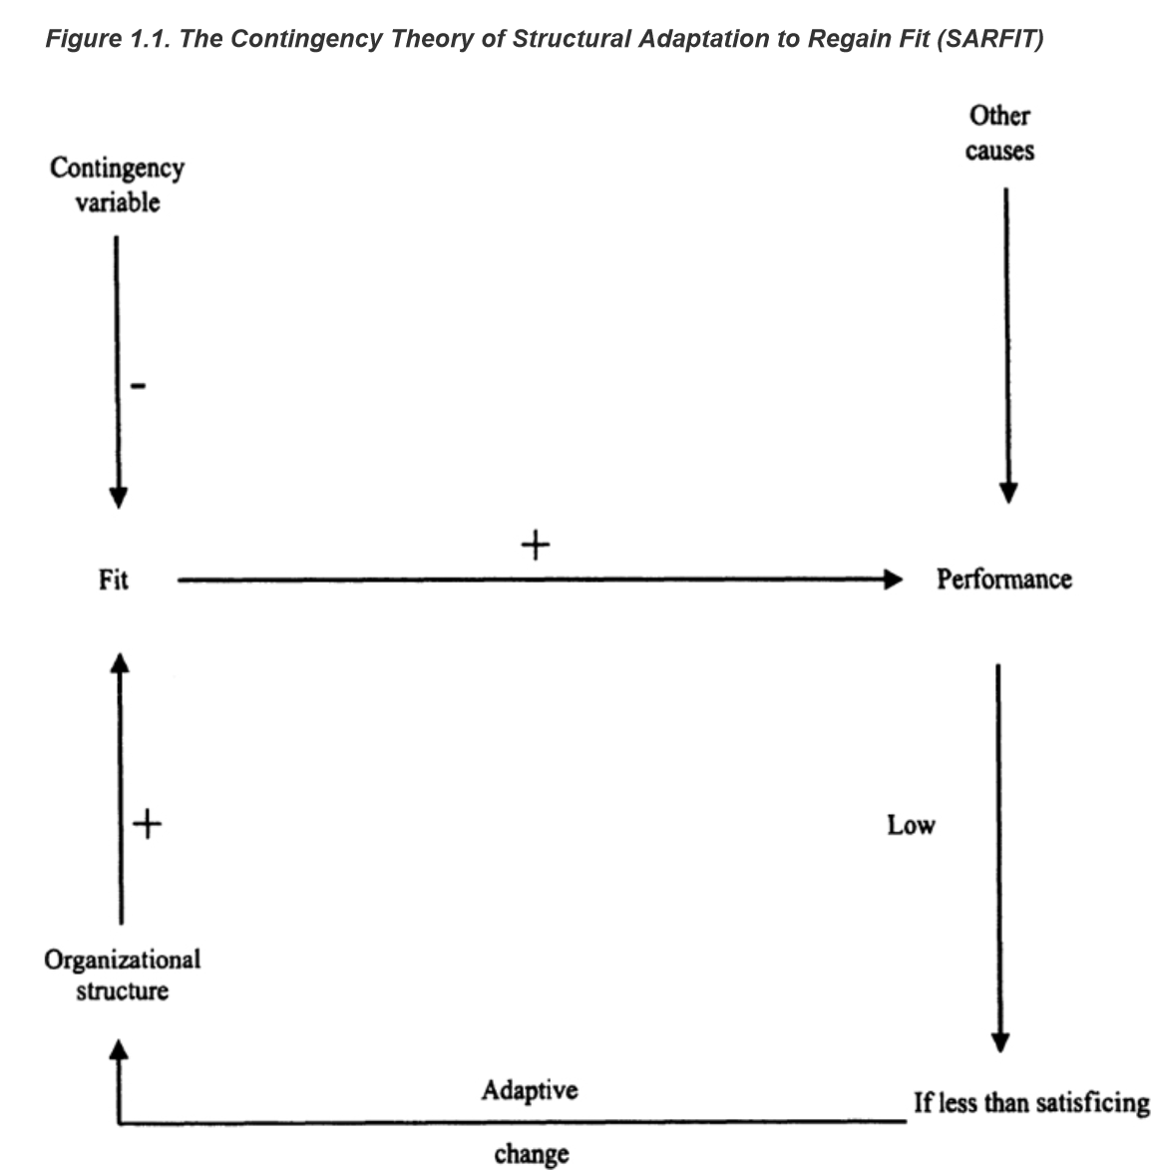
4. Structural Adaptation to Regain Fit (SARFIT)
An organization is initially in fit, having a structure that fits its existing level of the contingency variable. Fit positively affects performance.
However, the organization then changes its level of the contingency variable while retaining its existing structure, which thereby becomes a misfit with its new contingency level (thus the effect of the contingency variable on fit is shown as negative). In turn, the misfit leads to lower performance (reversing the positive effect of fit on performance shown).
When performance becomes so low that it becomes less than the satisficing (i.e., satisfactory) level, the organization then makes an adaptive change. The adaptive change is to adopt a new organizational structure that fits its new contingency level (shown as a positive effect of organizational structure on fit).
The new fit restores performance.

Slide 34
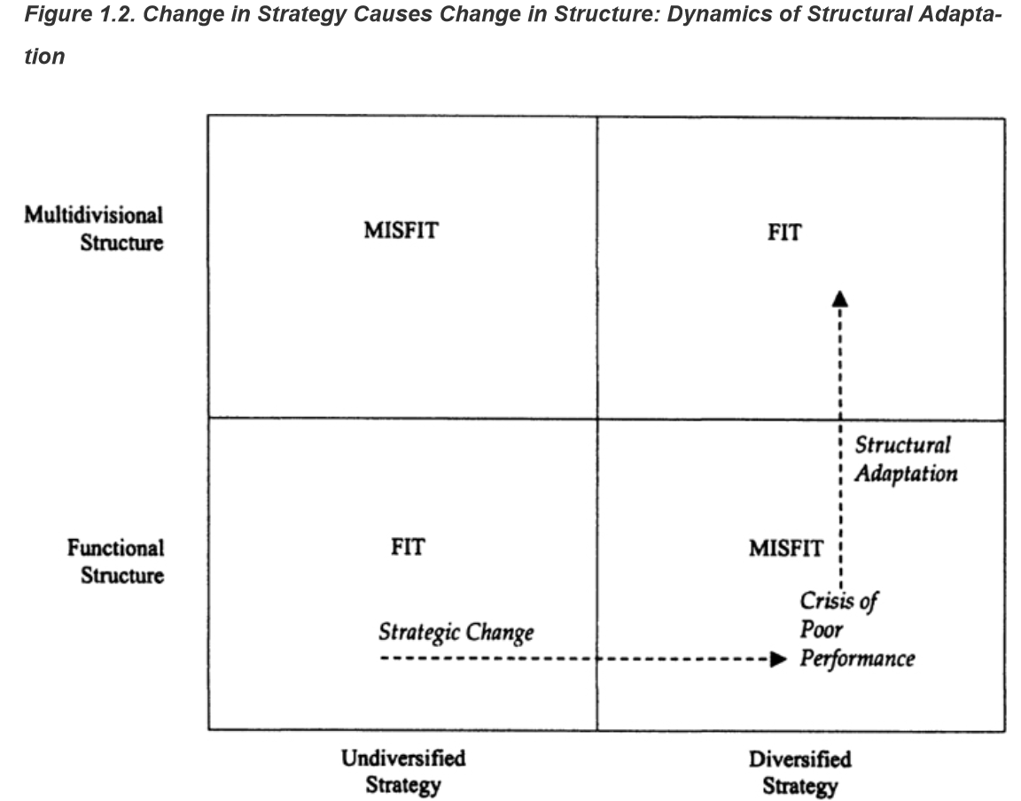
To investigate whether the SARFIT theoretical model holds for the phenomena of strategy and structure, we must first operationalize fit.
Initially, firms are undiversified and tended to have a functional structure, so that empirically most of them were in fit (Donaldson 1987).
Movement away from this initial position was overwhelmingly through strategic change, by diversification, while retaining their functional structure, so entering misfit.
Once in misfit of structure to strategy, the firms would consequently experience reduced performance.
Then, when financial performance became low, firms moved from misfit into fit by adopting a new, divisional structure that fitted their diversified strategy, so making a structural adaptation.

Slide 35
To investigate whether the SARFIT theoretical model holds for the phenomena of strategy and structure, we must first operationalize fit.
Firms in misfit were more than four times more likely to change only their structure (Donaldson 1987, p. 14), showing that misfit led to structural change.
Of firms that changed only their structure, 72 percent moved from misfit to fit and only 5 percent moved from fit to misfit (Donaldson 1987, p. 14), showing that when firms made structural change it was overwhelmingly a move from misfit into fit, that is, structural adaptation.
Of the firms that moved from misfit to fit by changing only their structure, 90 percent did so by adopting the divisional structure (Donaldson 1987, p. 15). Thus firms moved from misfit to fit by divisionalizing. The fit would be beneficial for their performance.

Slide 36
The adaptation of structure to strategy is subject to time lags：
There was no pattern of firms that diversified in one decade being more likely to change their structures in the subsequent decade, so that, on average, structural change did not follow strategic change within ten years (Donaldson 1987, p. 13).
Performance mediates structural change, so that it occurs only when performance becomes low.
Poor performance and failure to satisfy powerful stakeholders (i.e., owners) trigger structural adaptation.
Performance has to drop to a low level before the organization's management takes the corrective action needed.

Slide 37
Questions
The SARFIT model posits that structural change is primarily triggered by performance decline and is oriented toward regaining fit. However, in practice, organizational restructuring is often influenced by institutional pressures, managerial fashions, or executive self-interest, which are not strictly performance-driven. How does the SARFIT model rule out alternative explanations when explaining organizational restructuring? | Xueying Lin
In structural adaptation to regain fit model of contingency theory, normally organization need signals like performance decrease to detect misfit. Does this mean that structural adaptation model is meaningless in many situations? For instance, for companies that are experiencing continuous performance growth but requiring organizational re-design or restructuring. | Bohong Ma
Is there clear causality and inevitability in SARFIT? Donaldson’s SARFIT posits a progression—initial fit → contingency change → misfit → low performance → adaptive structural change that restores fit—with performance explicitly mediating structural change. While the model is elegant, two worries remain: (a) endogeneity/selection—the same political or governance forces that depress performance may simultaneously impel structural change, confounding the “misfit → low performance → change” chain; sample only includes firms that announced changes after a downturn, while omitting equally misfitting firms that quietly self-corrected—emerging the selection bias problems; (b) inevitability—the empirical record that firms can remain in misfit for a decade challenges the presumption of timely adaptation. Organizations can settle into stable but inferior steady states, where structure does not revert to a high-fit configuration. So how to determine whether a firm should change its structure when faced with declining performance? | Jiabing Xu

Slide 38
5. Conceptual and Theoretical Integration of Structural Contingency Theory---Underlying concepts
The contingency theory of organizational structure may be integrated by stating that there are two main contingencies, task and size, with the task contingency being composed of task uncertainty and task interdependence.
There are two main contingency theories of organizational structure: organic theory and bureaucracy theory.
Task uncertainty is the main contingency of the organic theory, with task interdependence playing the role of a minor contingency.
Size is the main contingency of bureaucracy theory with task interdependence, once again, playing the minor role.
Why only consider contingency within organization?

Slide 39
Contingencies of organizational structure include some that are within the organization and some that are outside it.
External contingencies affect the internal contingencies, which in turn shape other internal organizational characteristics, for example, organizational structure.
Contingencies
The set of contingencies made up of task uncertainty, technology, technological change, innovation, and environmental instability have an underlying concept of uncertainty. Environmental and technological change lead to uncertainty for the organization and its managers, creating uncertainty in the tasks conducted inside the organization.
Task interdependence classifies in what way activities in an organization are connected with each other: including aspects of strategy, clusters around the underlying contingency of task interdependence.
The size contingency is the number of organizational members who are to be organized (Blau 1970), determining the structure that is required.

Slide 40
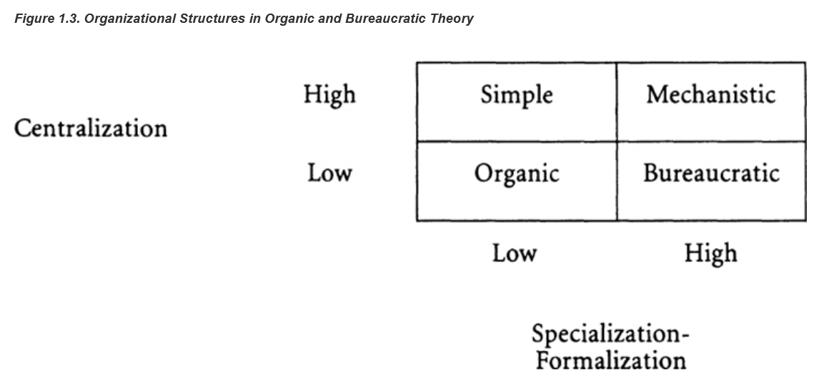
Organic and Bureaucracy Theories
Organic Theory
task uncertainty
mechanistic structure:
top-down; centralized in decision making; specialized in roles and formalized (much use of rules and documents; Hage 1965; Pennings 1992).
organic structure:
bottom up; decentralized and low on both functional specialization and formalization (Hage 1965; Pennings 1992).
Bureaucracy Theory
size
unbureaucratic (simple) structure:
centralized;
being low on functional specialization and formalization (Mintzberg 1979).
bureaucratic structure:
decentralized;
being high on functional specialization and formalization (Child 1972a; Weber 1968).

Slide 41
Difference in concept definition
1. Decentralization:
Bureaucracy theory sees increased decentralization as being mainly delegation of authority down to middle managers, with some occasional delegation to workers (Chandler 1962; Child 1973a).
Organic theory includes managerial delegation, but also autonomy and participation in decision making by technical experts at low levels in the hierarchy (Hage 1980) and even by shop-floor workers (Wall, Corbett, Martin, Clegg, and Jackson 1990).
Thus the real extent of decentralization is greater under organic theory than under bureaucracy theory.
2. Humanistic values:
Organic theory also driven by the need to fit the human needs and aspirations of organizational members (Lorsch and Morse 1974).
Bureaucratization theory tends to argue the need for bureaucratization according to a Weberian logic of subjugation of the organizational member in pursuit of effectiveness (Weber 1968).
3. Developing direction:
Organic theory sees the trend as being for task uncertainty to increase, because of increases in scientific knowledge and innovation rates, so that organizations increase over time the degree to which their structures are organic (Burns and Stalker 1961; Hage 1988).
Bureaucracy theory sees a tendency toward increasing levels of bureaucratization, because of increasing concentration in fewer, larger organizations of global reach, facilitated by modern communications technologies (Weber 1968).

Slide 42
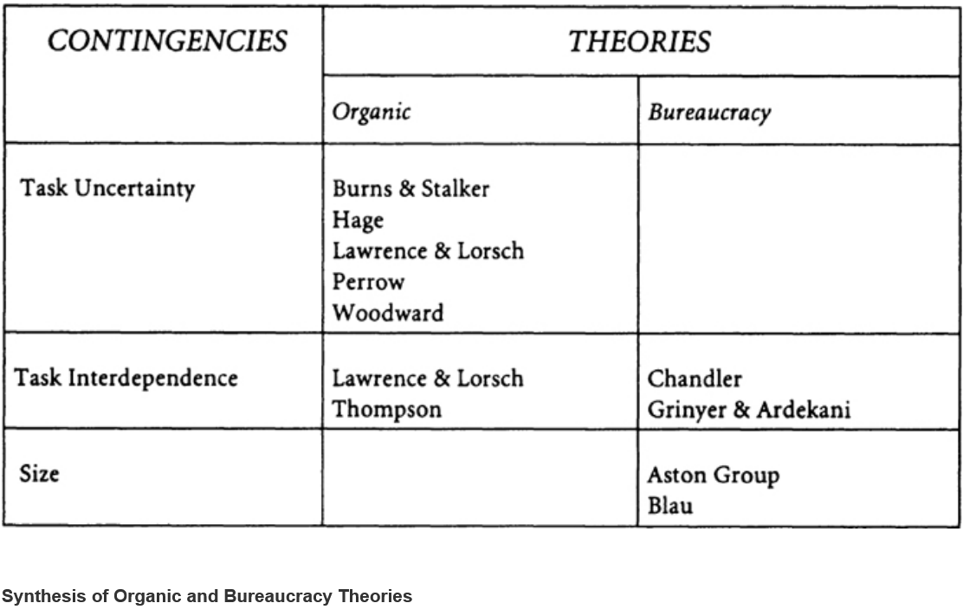
Task interdependence is a minor contingency of both the organic and the bureaucratic structures.
organic structures:
task interdependence is pooled, then the fit is standardization, that is, rules and procedures set by the hierarchy, that is, a mechanistic coordination mechanism.
task interdependence is sequential, then the fit is planning by the hierarchy, that is, another mechanistic coordination mechanism.
task interdependence is reciprocal, then the fit is mutual adjustment between organizational members, that is, an organic coordination mechanism (Thompson 1967).
bureaucratic structures
increasing task interdependence leads from divisions coordinated mechanistically to functions coordinated organically.

Slide 43
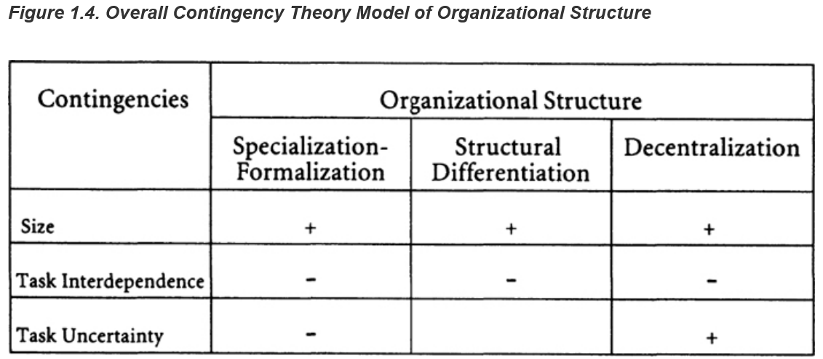
As organizations grow in size they increase specialization-formalization, structural differentiation, and decentralization.
As task interdependence decreases because of diversification, this causes divisionalization, so that decentralization increases, as does specialization-formalization (e.g., creation of profit reporting) and structural differentiation (e.g., the number of levels), beyond that which would exist for its size alone. Conversely, increasing task interdependence leads to a functional structure, which implies less specialization-formalization, structural differentiation, and decentralization
As task uncertainty increases, for example, through increased innovation in products or services, there is a reduction in formalization and an increase in decentralization.

Slide 44
Questions
Is it possible that bureaucratic change of large firms may not be purely for fitting, but for preventing potential opportunistic behaviors of individuals within them? Besides, in the structural contingency model, the organic theory emphasizes the initiative and decisions of employees, as well as their high task uncertainty. Can these circumstances be the fuel of opportunism? | Shunyi Lai

Slide 45
Pfeffer and Salancik (1978)

Slide 46
Introduction
Central Premise: Organizational activities/outcomes are shaped by external context and how organizations perceive it.
Chapter 3: Explores social control of organizations—driven by interdependence and resource dependence.
Chapter 4: Examines organizational environment—not objective, but "enacted" (constructed) by the organization.

Slide 47
Chapter 3 Core: Interdependence (Foundation of Control)
What is Interdependence?
When an actor cannot fully control all conditions for desired outcomes (e.g., a café depends on farmers for coffee beans).
Key Types
Type | Definition | Example
Outcome Interdependence | One’s results are jointly determined by others | Competitive: Competitors (zero-sum: Pepsi vs. Coke) Symbiotic: suppliers (mutual: bakery vs. flour mill)
Behavioral Interdependence | One’s activities rely on others’ actions | coordinating a joint project

Slide 48
Chapter 3: Interdependence and Uncertainty
The Problem: Interdependence creates uncertainty for organizations.
The Solution: Organizations often increase behavioral interdependence (mutual control) to improve coordination and reduce uncertainty.

Slide 49
Chapter 3: External Influence—Conditions & Determinants
Main Idea: An organization's dependence on its environment for resources makes it vulnerable to external control and influence. This is the core premise of the external perspective on organizations.
Key Points:
External Demands: External groups and organizations can demand certain actions in return for providing needed resources.
Conditions for Influence

Slide 50
Chapter 3: Key Conditions for External Control
Conditions for Influence: The likelihood of external control increases when:
1. The focal organization is aware of the demands.
2. The focal organization obtains some resources from the social actor making the demands.
3. The resource is a critical or important part of the focal organization’s operation
4. The social actor controls the allocation, access, or use of the resource; alternative sources for the resource are not available to the focal organization
5. The focal organization does not control the allocation, access, or use of other resources critical to the social actor's operation and survival.
6. The actions or outputs of the focal organization are visible and can be assessed by the social actor to judge whether the actions comply with its demands.
7. The focal organization's satisfaction of the social actor's requests are not in conflict with the satisfaction of demands from other components of the environment with which it is interdependent.
8. The focal organization does not control the determination, formulation, or expression of the social actor's demands.
9. The focal organization is capable of developing actions or outcomes that will satisfy the external demands.
10. The organization desires to survive.

Slide 51
Chapter 3: Key Conditions for External Control
Conditions for Influence: The likelihood of external control increases when:
1. The focal organization is aware of the demands.
2. The focal organization obtains some resources from the social actor making the demands.
3. The resource is a critical or important part of the focal organization’s operation
4. The social actor controls the allocation, access, or use of the resource; alternative sources for the resource are not available to the focal organization
5. The focal organization does not control the allocation, access, or use of other resources critical to the social actor's operation and survival.
6. The actions or outputs of the focal organization are visible and can be assessed by the social actor to judge whether the actions comply with its demands.
7. The focal organization's satisfaction of the social actor's requests are not in conflict with the satisfaction of demands from other components of the environment with which it is interdependent.
8. The focal organization does not control the determination, formulation, or expression of the social actor's demands.
9. The focal organization is capable of developing actions or outcomes that will satisfy the external demands.
10. The organization desires to survive.
Summary: Understanding these conditions helps to explain why organizations comply with or resist external influence attempts.

Slide 52
Questions
Ten conditions for compliance: necessary, sufficient, or just suggestive? Pfeffer & Salancik (1978) present ten conditions that raise the probability of external control; they explicitly say not all must be present. In practice, what combinations of conditions maximize the impact and which conditions substitute for (or amplify) others (e.g., visibility vs. lack of alternatives)? (From Jiabing Xu)

Slide 53
Chapter 3: Three Determinants of Dependence
Resource Importance
Relative Magnitude (share of inputs/outputs) + Criticality (ability to function without it).
Discretion over Resource Allocation and Use
Control via possession (knowledge/ownership), access, use, or rules (laws).
Concentration of Resource Control
Resource control by few actors (e.g., Intel dominating computer chips).

Slide 54
Countervailing Power & Asymmetric Dependence
Main Idea: The power one organization holds over another is often a result of asymmetric dependence in their relationship, where one party is more reliant than the other.
Key Points:
Asymmetry: A relationship is asymmetric when an exchange is not equally important to both organizations.
Countervailing Power: The concentration of power in one area can lead to a concentrated, countervailing opposition.
Summary: Organizations with a power advantage are more likely to dominate interorganizational influence attempts.

Slide 55
Questions
How should we account for situations where asymmetry exists, but power is not exercised? For example, a dominant technology company could impose stricter fees on app developers but refrains from doing so to preserve goodwill. Should dependence theory treat this as latent power, or does it reveal limits in the framework? (From Bohong Ma )

Slide 56
Chapter 4: Environment Structure: Three-Tier Model
Tier | Definition | Key Feature & Example
Macro System Layer | The overall network of interconnected individuals and organizations | Indirectly affects outcomes
Direct Transaction Layer | Individuals/organizations interacting directly with the focal organization | Directly experienced by the organization
Enacted Environment Layer | The environment constructed through organizational attention, perception, and representation | Directly influences organizational actions (subjective interpretation of objective context)

Slide 57
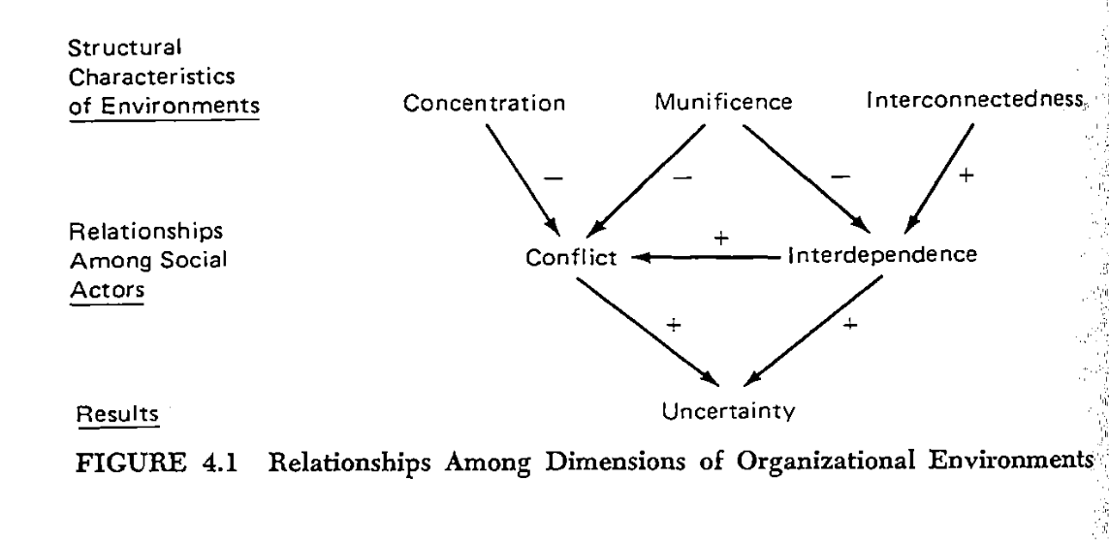
Chapter 4: Dimensions of the Environment
The degree of power/resource control held by a few entities
The scarcity/abundance of critical resources
The number and pattern of links between organizations

Slide 58
Chapter 4: The Enacted Environment
Central Idea (Weick, 1969)
the human creates the environment ot which the system then adapts. The human actor does not react to an environment, he enacts it
The Enactment Process: Environments are "enacted" by organizations through active perception, observation, and attention to various aspects. Organizations create the environment they then adapt to.
Determinants of Enactment: Influenced by how organizations attend to objective features, including organizational structure, information processing systems, and decision-makers' attention.
Takeaway: A firm's "environment" is less about what objectively exists and more about what its decision-makers choose to see and believe.

Slide 59
Chapter 4: Problems in Environmental Enactment
Misreading Interdependence: Incorrectly perceiving the importance or influence of external groups.
Misreading Demands: Failing to adequately assess external requirements, leading to inappropriate responses.
Commitment to the Past: Past beliefs and procedures hinder adaptation to new demands.
Conflicting Demands: Facing contradictory requests from various external groups.

Slide 60
Chapter 4: Assessment of Demands
Assessing External Demands: Organizations systematically evaluate external demands to ensure effective responses. This involves:
Determining Interest Groups: Identifying all relevant external groups.
Weighting Interest Groups: Assessing the relative importance and influence of these groups.
Criteria of Groups: Understanding the values each group uses to judge organizational actions.
Impact of Actions on Criteria: Evaluating how organizational actions affect these criteria.

Slide 61
Questions
If environments are “enacted,” does that mean organizational reality exists only in what members notice and pay attention to? How, then, should the theory deal with external events—like new laws or technologies—that organizations do not notice but that still shape their outcomes? Does this mean we need to think about two kinds of environments: one that is enacted and one that exists outside the organization? (From Jinnan Hou)

Slide 62
Questions
On page 72, the authors cite Weick’s quotes: “The human creates the environment to which the system then adapts. The human actor does not react to an environment; he enacts it” (Weick, 1969: 64). If each organization lives in its own “enacted” subjective reality, does it mean that there is a lack of objective evaluation of the organization’s environment? Does this mean that there is no such thing as "wrong cognition", only different but equally valid "cognitions"? (From Shunyi Lai)

