Slide 1
Highlights
No local files to run the game
Anything that has an html5 browser can run it

Slide 2
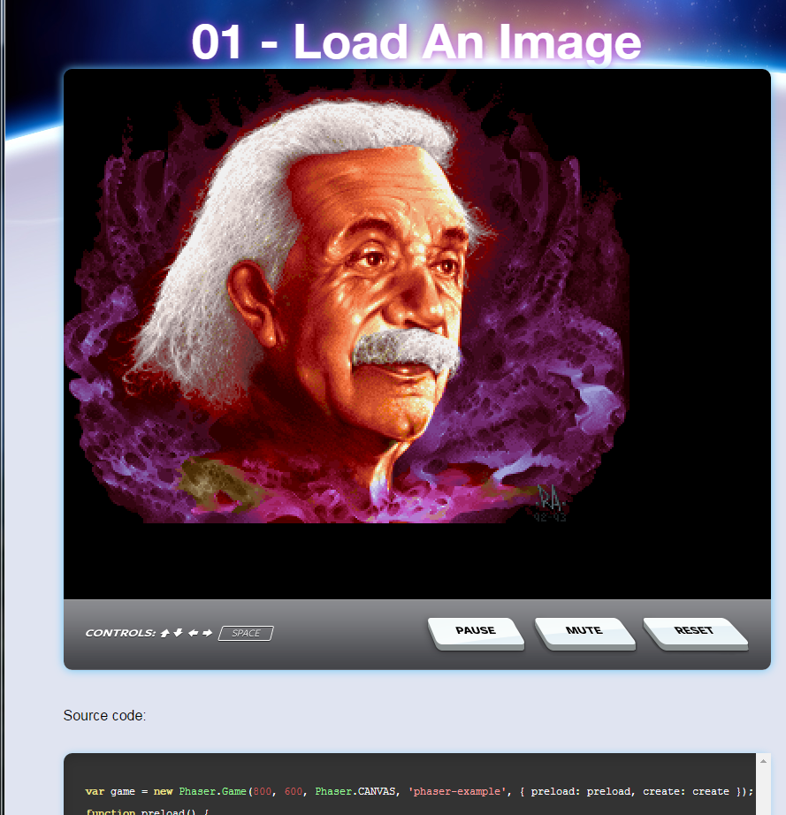
Phaser Example
var game = new Phaser.Game(800, 600, Phaser.CANVAS, 'phaser-example', { preload: preload, create: create });
//Game object as per JavaScript
function preload() {
// You can fill the preloader with as many assets as your game requires
// Here we are loading an image. The first parameter is the unique
// string by which we'll identify the image later in our code.
// The second parameter is the URL of the image (relative)
game.load.image('einstein', 'assets/pics/ra_einstein.png');
} //Called before the game is loaded
function create() {
// This creates a simple sprite that is using our loaded image and
// displays it on-screen
game.add.sprite(0, 0, 'einstein');
} //Called to create the game

Slide 3
Questions
How does one save game progress?
How do you scale the game to other screen sizes?

