Slide 1
HTML5 and Phaser
The Brogrammers
Benefits
Open Source!
Documented
Designed for desktop and mobile browsers
Low hardware requirements
Touch screen capable
Built in physics engine
Supports plugins
Important to Know
JavaScript
Server Client Relationships
Server location
Hardware differences
Inputs outputs
Screen size

Slide 2
Main Components
preload() -> loads assets
create() -> sets up game
update() -> main loop (onTick)

Slide 3
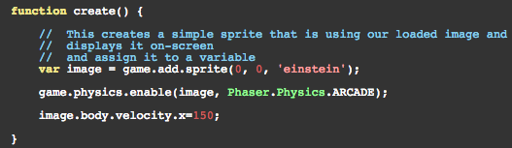
Example
Moving an Image
Breakdown
Create a game object by instantiating Phaser.Game.
Before the game begins load an image. This is accomplished inside the preload() function.
Create a Sprite to display the image and enable game.physics. Give the Sprite an x velocity.

Slide 4
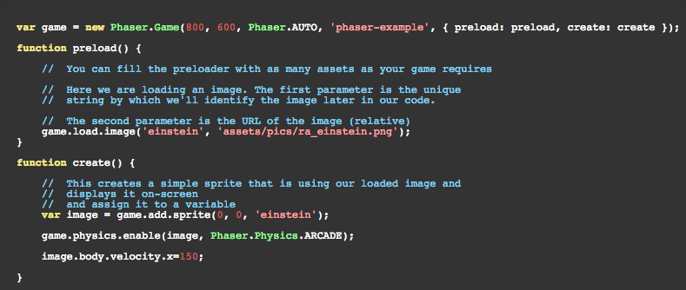
Example
Moving an Image
This example moves an image across the screen from left to right.

Slide 5
Questions
Server
Can we use UD to host the web server?
Will we be responsible for keeping the server running?
For how long?
Performance
Can we get suitable stable performance on the variety of hardware we are developing for?
Ease of Use
Am I going to be able to learn Phaser + HTML5 in one semester.

