Slide 1
HTML5 and Phaser
Ben Gotthold
Benefits
Open Source!
Documented
Designed for desktop and mobile browsers with a key focus on mobile performance.
Relies on JavaScript, a well documented language.
Important to Know
JavaScript
TypeScript
Server Client Relationships
Phaser specific components.

Slide 2
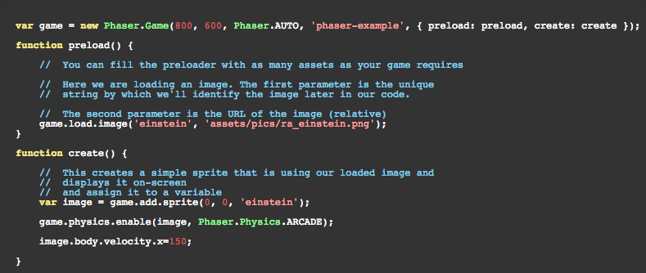
Example
Moving an Image
This example moves an image across the screen from left to right.

Slide 3
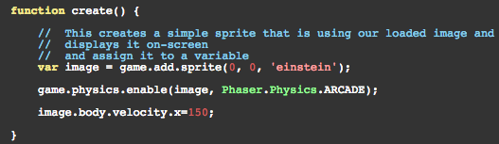
Example
Moving an Image
Breakdown
Create a game object by instantiating Phaser.Game.
Before the game begins load an image. This is accomplished inside the preload function.
Create a Sprite to display the image and enable game.physics. Give the Sprite an x velocity.

Slide 4
Questions
Concerns
Server
To use Phaser and HTML5 we would need a server?
Will we be responsible for keeping the server running?
For how long?
Performance
Can we get suitable stable performance on the variety of hardware we are developing for?
Ease of Use
Am I going to be able to learn Phaser + HTML5 in one semester.

