Slide 1

About Phaser
Steve Noyes
CISC374
Phaser is an open source framework that is used to make mobile and browser games.
It is primarily used with Javascript and Typescript.
It uses HTML5.
It is fast, powerful and the code is generally concise to write.
It is designed like eclipse in the sense that there is a dedicated plug-in system, so that developers can add plug-ins and even create/share their own.

Slide 2
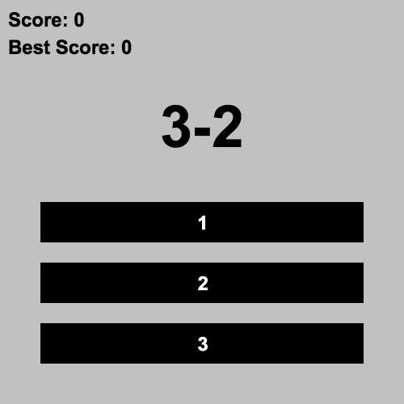
Example: 1, 2, 3
Description from the phaser website: “This is a very simple math game which all the questions and answers are combined by 1, 2, 3, plus and minus. You just have to tell the result of some simple sums like 1+1, 2+1, 3-2 and so on. You will always be using only 1, 2 and 3.”
This game, while basic looking, only took about 100 lines of code, which shows that phaser can create somewhat complex games with little code.

Slide 3
Additional Questions
How is phaser different/better than the multitude of other game design frameworks out there already?
Does the game behave any differently when using type script as opposed to javascript?
What features of HTML5 does phaser take advantage of, and which are most useful?

