Slide 1
Using Mobile Phone as the Mouse of Your PC
小组成员：苟铭浩 周潘正 李江彤 刘睿豪 张沛晗
2018年5月
Notes:
此页可以删除

Slide 2
目录 Contents
1
Motivation
2
Related Work
3
Technical Issues & Our Contributions

Slide 3
目录 Contents
1
Motivation
2
Related Work
3
Technical Issues & Our Contributions

Slide 4
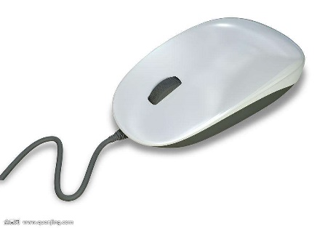
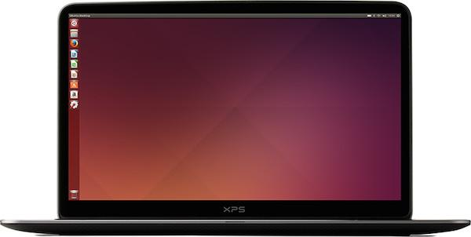

Motivation
If forget?
Awkward touchpad

Slide 5
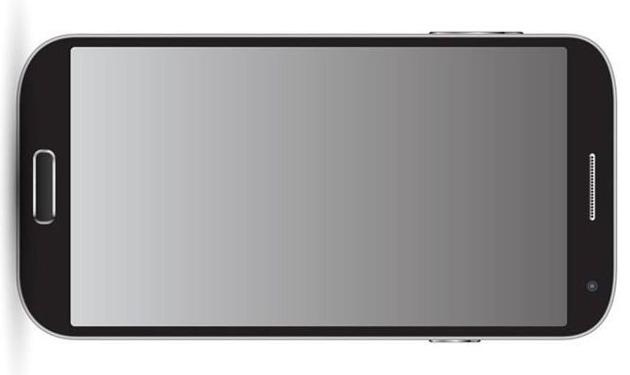
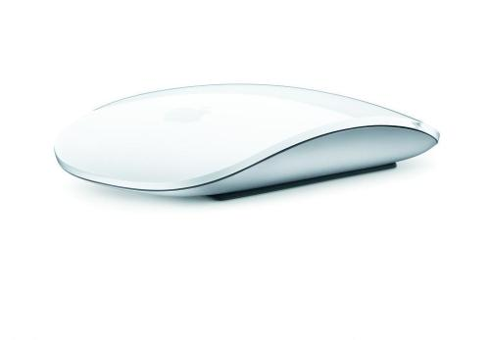
Motivation
the bluetooth module
the touch screen
the accelerometer
What if ?
A mouse everywhere
A mouse much more powerful

Slide 6
目录 Contents
1
Motivation
2
Related Work
3
Technical Issues & Our Contributions
4
Conclusion

Slide 7
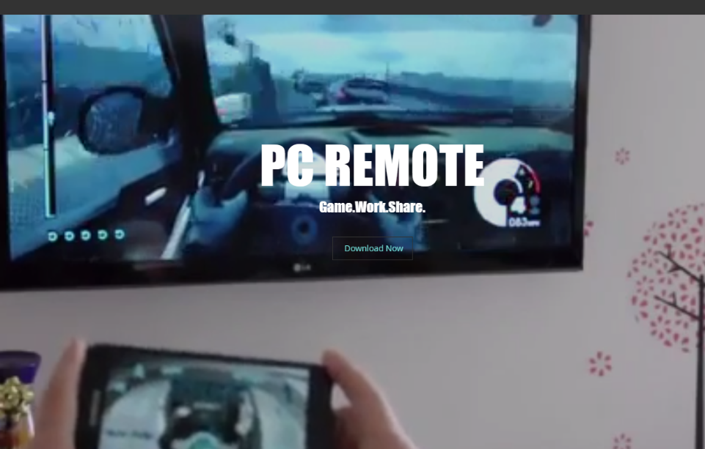
Related Work
Example：Monect
Common features:
1) The apps are heavily weighted
2) The phone mimics the function of a laptop
touchpad rather than moving around
3) Not reliable
Requirements:
the Android app and the desktop server
Wi-Fi or Bluetooth
Our goal:
Develop a light-weighted, reliable-connected app, which turns a phone exactly into a mouse through
Bluetooth.

Slide 8
目录 Contents
1
Motivation
2
Related Work
3
Technical Issues & Our Contributions
4
Conclusion

Slide 9
Technical Issues & Our Contributions
Calculating Velocity of the Mouse
Problem:
Some bias and error with the sensor
Some error caused by discrete sampling
Solution：
In order to solve the problem above, we proposed several solutions:
Kalman filter is applied on the acceleration data.
Calibration is applied before using the system to decrease caused by the sensor bias.
Attenuation of velocity is exerted to avoid divergence of velocity.
Activation function is used to alleviate the backlash.

Slide 10
Technical Issues & Our Contributions
Kalman filter
Dealing with inertial sensor data to remove noise:
ax, xVar = kalmanFilter(ax,xPreData,xVar,Q,R)
ay, yVar = kalmanFilter(ay,yPreData,yVar,Q,R)

Slide 11
Technical Issues & Our Contributions
Calibration
Before using the system, the user should put the mobile phone in the working surface. Then the system set the zero of acceleration to the mean value of static sensor data. After this step, the effect of inclination of the surface and the sensor bias is compensated.
ax = x0int / 32.0 * 9.8 - axave
ay = y0int / 32.0 * 9.8 – ayave

Slide 12
Technical Issues & Our Contributions
Attenuation of Velocity
We let the velocity damps with a constant rate so that the velocity will convergent even the integration of acceleration divergent.
# damp the speed
vx = vx * dampRate
vy = vy * dampRate
Activation function
dvx = np.exp(-abs(vx)) * ax * v
dvy = np.exp(-abs(vy)) * ay * v

Slide 13
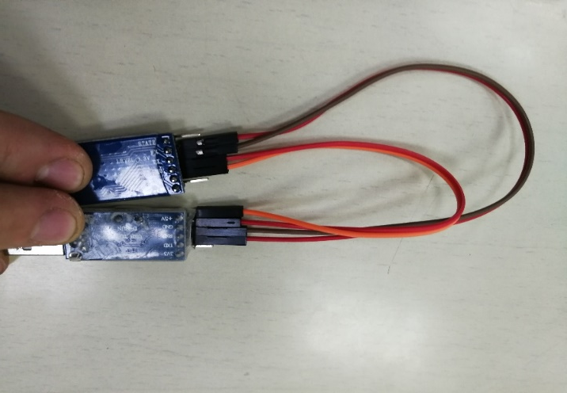
Technical Issues & Our Contributions
Communication Protocol
Hardware:
The phone establishes a Bluetooth with the HC-05 Bluetooth chip.
The chip is connected to USBtoTTL converter while 4 wires.
The USBtoTTL converter is inserted into the USB port in the computer.
As a result, the data is converted to serial communication byte in the computer.

Slide 14
Technical Issues & Our Contributions
Communication Protocol
Encoding: The data to be transmitted can be divided into Three groups.
Acceleration data.
Mouse click data.
Begin, stop and check byte.
We established the following encoding method for these data.
X Axis Acceleration Data High Byte(XH)
X Axis Acceleration Data Low Byte(XL)
Y Axis Acceleration Data High Byte(YH)
Y Axis Acceleration Data Low Byte(YL)
Left Button Down(LD)
Left Button Up(LU)
Right Button Down(RD)
Right Button Up(RU)
Begin Acceleration Data Transmission(BT)
Finish X Axis Data Transmission(FX)
Finish Y Axis Data Transmission(FY)

Slide 15
Technical Issues & Our Contributions
Communication Protocol
Encoding Method with Check:
There might be error in transmission. So, we apply Check byte to minimize the error. The Byte sequence is shown below.
Acceleration Data | BT | XH | XL | FX | YH | YL | FY | ZH | ZL | FZ |
Left Button Down | LD | LD |
Left Button Up | LU | LU |
Right Button Down | RD | RD |
Right Button Up | RU | RU |
For acceleration data transmission, we can check the FX, FY and FZ to check if the sequence is complete.

Slide 16
Technical Issues & Our Contributions
Communication Protocol
Encoding Method without Check: The encoding method with check minimize the possibility of occurrence of error. But it consumes to much time, either. This reduces the transmission rate and leads to bad performance of the system, we also introduce an encoding method without check.
Acceleration Data | BT | XH | YH |
Left Button Down | LD |
Left Button Up | LU |
Right Button Down | RD |
Right Button Up | RU |
This is the fewest bytes to be transmitted or the data will be incomplete. You can see that we do not transmit the z axis data because we don't quiet need it.
This increases the transmission speed while decreases the accuracy. In our test, the decrease of accuracy doesn’t lead to a major problem.

Slide 17
Technical Issues & Our Contributions
Running Requirement
Mobile Phone:
Phone with Android OS is required. (tested on EMUI 8.0.0(Huawei))
Phone with Bluetooth 4 is required, or it cannot communicate with computer
Computer:
PC with Windows OS is required. (tested on Windows 10 Pro)
PC with python environment is required. (tested on python 3.5)
Python package NumPy, Serial, win32api and win32con are required. (tested using Anaconda 5.1.0(Python 3.5))

Slide 18
Technical Issues & Our Contributions
Setup
Mobile Phone:
Install the csNetworkNewbeta.apk APP on your Android phone and open the Bluetooth on system setting.
Computer:
Insert an external Bluetooth in your USB port. In the test, we use HC-05 Bluetooth module and a ttl serial port to usb converter. The connection is shown in the picture below.
HC-05---------TTL to USB converter
5V ----------------------- 5V
GND --------------------- GND
TX ----------------------- RX
RX ----------------------- TX
Set the path to the root folder that contains driver.py

Slide 19
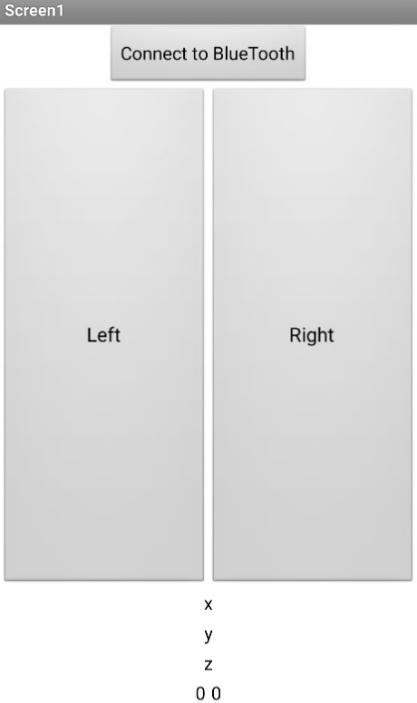
Technical Issues & Our Contributions
Test and Run
On the phone side：
1) Open the "Xiao" APP
2) Click the "Connect to BlueTooth" button
3) Choose the Bluetooth device connected to your PC.
Note that this step must be done before running the python written driver program.

Slide 20
Technical Issues & Our Contributions
Test and Run
On the computer side：
Run the command as follows:
python driver.py (serial port number) [(cursor move speed)] [(threshhold for moving)] [(damp rate)] [(Q)] [(R)]
We can just give the first few parameters that is included in '[' and ']' and the parameters will be set the default value. Some of the few examples are given below:
python driver.py COM3 20
python driver.py COM3 20 0.4
python driver.py COM3 20 0.4 0.8
python driver.py COM3 20 0.4 0.8 0.1
python driver.py COM3 20 0.4 0.8 0.1 0.25
These values are also the default value and as a result, these commands have the same effect.

Slide 21
Demo
See Demo.mp4

Slide 22
Technical Issues & Our Contributions
Future Work
Improve the accuracy of the mouse
Rewrite a Android using Java so that we can do the calculation on the mobile phone and no driver needed to be installed on computer
Try to adapt the communication protocol to the HID standard so that we don’t need an external Bluetooth receiver

Slide 23
谢 谢！

