Slide 1
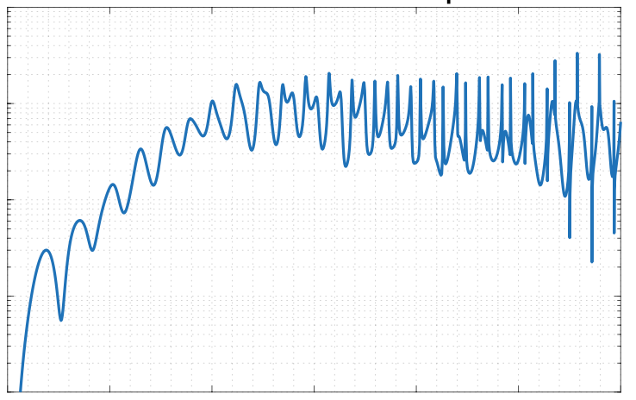
Waveport Scattering Library
Version 1.0
Mark S. Haynes
% alpha_{lm,n+1,m}, m ~= +/-n for n=1:(for l=0:(L3-n-1),
lim = min(l,n-1); for m=-lim:lim,
lm = lm2ind(l,m,str);
np1m = lm2ind(n+1,m,str);
c0 = sqrt((n+m+1)*(n-m+1)/(2*n+1)/(2*n+3)); c1 = sqrt((n+m)*(n-m)/(2*n+1)/(2*n-1));
if abs(m) <= l-1
c2 = sqrt((l+m)*(l-m)/(2*l+1)/(2*l-1));
c2 = c2*alpha(indAlphazFill(l-1,n,m,L,Lp)); else
c2 = 0; end
c3 = sqrt((l+m+1)*(l-m+1)/(2*l+3)/(2*l+1)); inds = indAlphazFill(l,n+1,m,L,Lp); row(inds) = lm;

