Slide 1
F(θ,φ)
Source region
Observation region
r’
r’ - r
X
r_{s}
r_{o}
r
d
E(r)
Number of required expansion degree L ~ O(kd)
F(θ,φ)
Source region
Observation region
r’
r’ - r
X
r_{s}
r_{o}
r
E(r)

Slide 2
θ = 0
2M + 1
θ
2
p
1
Array Index
Δθ
M points
M points
M + 2p
M + p
θ = π

Slide 3
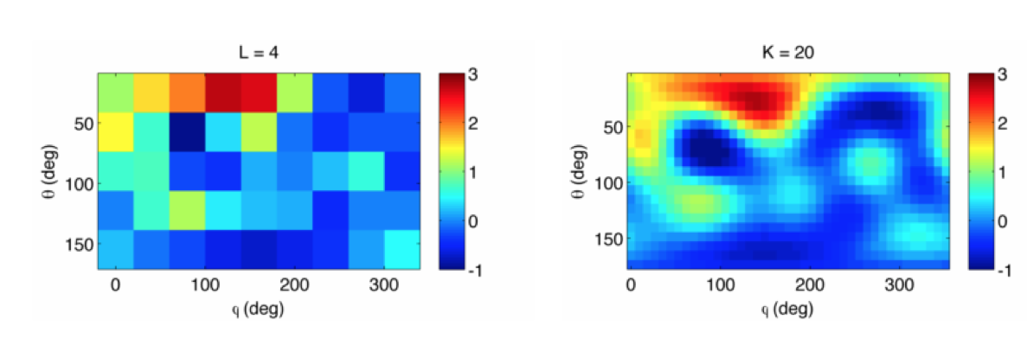
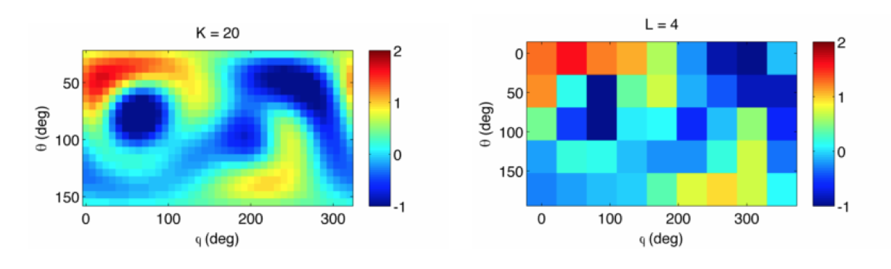
Scatterers organized in an Octree
Aggregation
Disaggregation
Far pattern for a box at level l+1 requires L harmonics
Far pattern for a box at level l requires K harmonics
Translation
Far pattern for a box at level l requires K harmonics
Translated patterns for a box at level l-1 requires K harmonics
Interpolate the outgoing far field patterns of boxes from level l+1 to l
Filter the incoming far field pattern from level l to l+1

