Slide 1
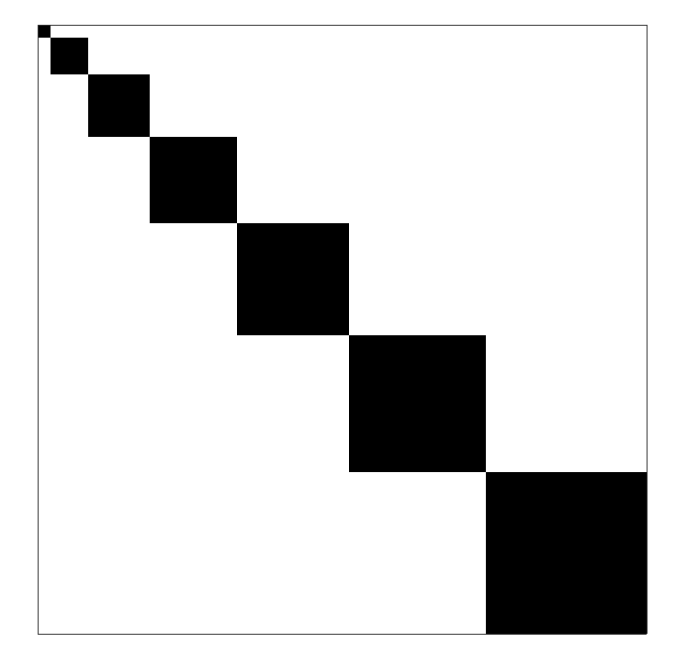
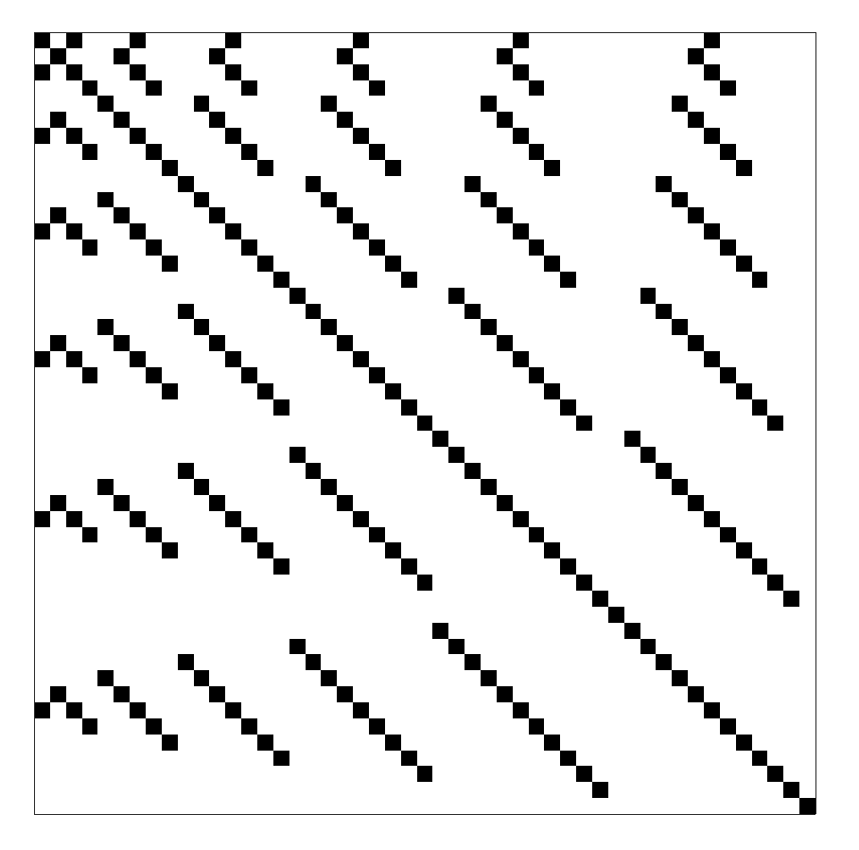
=

Slide 2
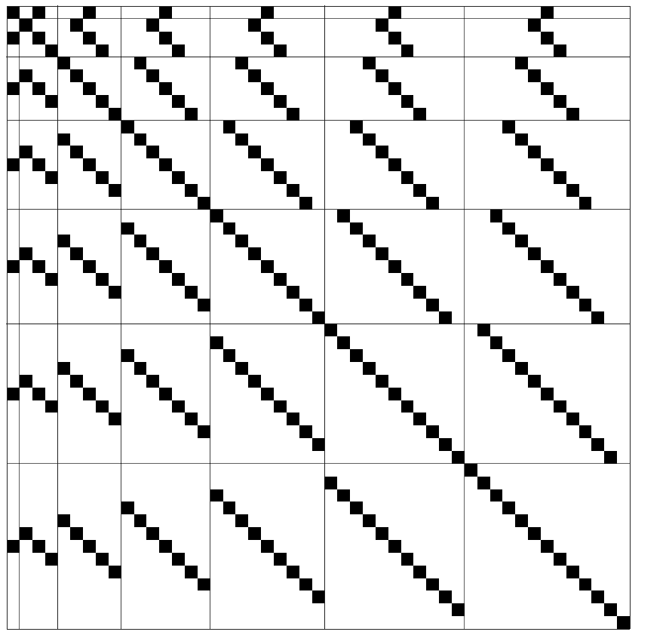

Slide 3
l’ = 0
…
l’
…
l’ = L’
l = 0
…
Linear index counted along diagonals, top down, left right
l
Linear index, I(l,l’,m,L’)
…
l = L
Total number of elements in the matrix, N(L,L’)

Slide 4
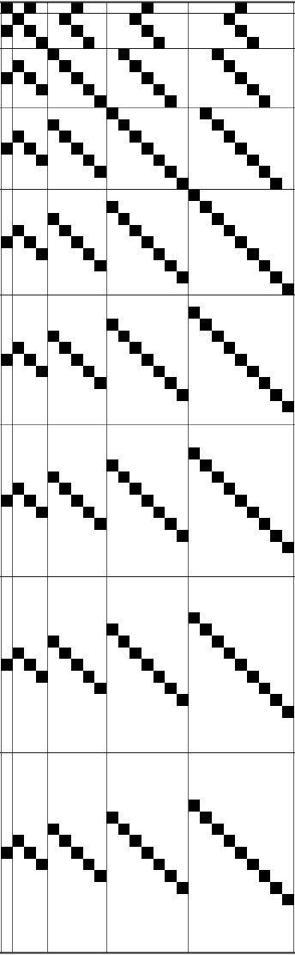
l’ = 0
l’ = L’
l = 0
l = L
Triangular fill region
Linear index in fill region, I_{fill}(l,l’,m,L’)
l = L+L’
Total number of elements in fill region, N_{fill}(L,L’)

Slide 5
r_{j}
r_{i}
j
θ_{ji}
r_{ji}
i
φ_{ji}

