Slide 1

Seminar on “DATA MINING”
Guided by
Dr. Priyanka Mehta
Submitted by
Gouda Dipak Bhagavan - 30

Slide 2
Agenda :
What is Data Mining ?
Why Data Mining?
Data Mining Process
Common Techniques
Applications of Data Mining
Tools and Software
Advantages of Data Mining
Disadvantages of Data Mining
Conclusion
References

Slide 3

What is Data Mining ?
Data mining is the process of extracting meaningful patterns and insights from large datasets. It involves applying statistical and machine learning techniques to extract meaningful information that would otherwise be hidden within the data.
Knowledge: The ultimate goal of data mining is to transform raw data into actionable knowledge.
Patterns and Trends: Data mining seeks to identify recurring patterns, trends, and associations within the data.
Large Datasets: The term "data mining" often implies working with massive amounts of data, such as those generated by businesses, scientific experiments, or social media.

Slide 4

Why Data Mining ?
Improved Decision Making: Uncovers hidden patterns and trends for better informed choices.
Competitive Advantage: Gains insights to identify opportunities and stay ahead of competitors.
Risk Mitigation: Helps identify and manage risks like fraud and credit defaults.
Increased Efficiency: Automates tasks and optimizes processes for cost savings.
Personalized Experiences: Enables tailored offers and services to individual customers.
Market Trend Identification: Helps businesses anticipate and capitalize on emerging market trends.

Slide 5
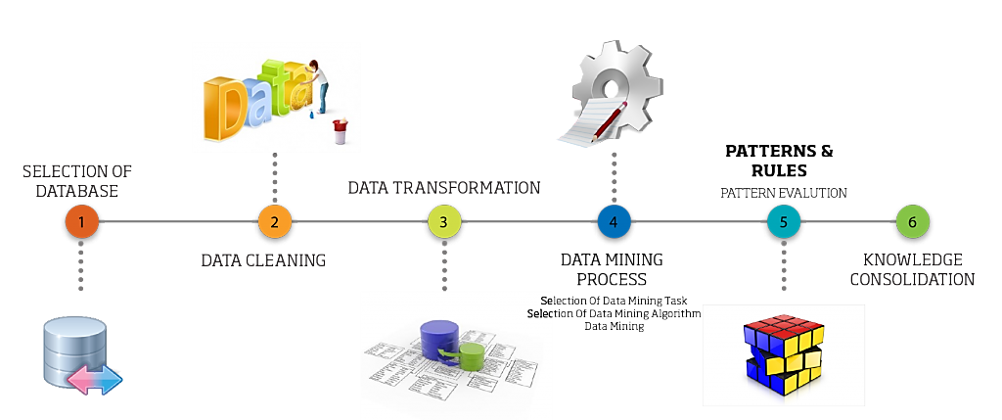
Data Mining Process

Slide 6
Data Mining Process Cont…
Selection of Database: Choosing relevant datasets for analysis based on objectives.
Data Cleaning: Removing inconsistencies, handling missing values, and ensuring data quality.
Data Transformation: Converting raw data into a format suitable for analysis, including normalization or aggregation.
Data Mining Process: Applying algorithms to discover patterns, relationships, or trends from the data.
Patterns and Evaluation: Identifying meaningful patterns and validating their significance through statistical or heuristic methods.
Knowledge Consolidation: Integrating patterns and insights into actionable knowledge for decision-making.

Slide 7
Common Techniques
Classification: Sorting data into categories (e.g., email spam vs. not spam).
Clustering: Grouping similar data points together (e.g., customer segmentation).
Association Rule Mining: Discovering relationships between items (e.g., "If bread, then butter").
Regression: Predicting continuous values (e.g., predicting house prices).
Anomaly Detection: Identifying unusual data points (e.g., fraud detection).

Slide 8
Applications of Data Mining
Business: CRM, marketing, finance (fraud detection, risk assessment).
Healthcare: Disease diagnosis, drug discovery, personalized medicine.
Science: Climate modeling, genomics, astronomy.
Social Media: Sentiment analysis, trend analysis, recommendation systems.
Web: Web usage mining.

Slide 9
Tools and software
RapidMiner: User-friendly platform with drag-and-drop functionality for predictive analytics and machine learning.
WEKA: Open-source tool with various algorithms for classification, regression, and clustering.
Orange: Interactive and visual data mining tool, ideal for beginners and education.
KNIME: Workflow-based platform for analytics, integrating with Python, R, and big data tools.
Apache Mahout: Scalable library for machine learning and distributed data mining on big data.

Slide 10
Advantages of Data Mining
Enhanced Decision-Making
Improved Customer Relationships
Fraud Detection and Risk Management
Cost Reduction and Efficiency Improvement
Discovery of New Opportunities
Personalized User Experiences
Detection of Hidden Patterns
Competitive Advantage

Slide 11
Disadvantages of Data Mining
Privacy Issues
Expensive to Set Up
Risk of Hacking
Complicated to Use
Wrong Conclusions
Needs Good Data
Hard to Handle Big Data
Too Much Focus on Patterns

Slide 12
Conclusion
Data mining is a powerful tool that helps organizations uncover patterns, trends, and valuable insights from large datasets. It plays a crucial role in decision-making, improving efficiency, and gaining a competitive edge in various industries like healthcare, finance, retail, and more.
However, while it offers significant benefits, data mining also comes with challenges such as privacy concerns, security risks, and the need for high-quality data and skilled professionals. To maximize its potential, organizations must address these challenges by implementing ethical practices, ensuring data security, and complying with legal regulations.
When used responsibly and effectively, data mining can transform raw data into actionable knowledge, driving innovation and progress in a data-driven world.

Slide 13
References
https://www.ibm.com/think/topics/data-mining
https://www.simplilearn.com/what-is-data-mining-article
https://www.tableau.com/learn/articles/what-is-data-mining
www.youtube/datamining/.com
https://www.investopedia.com/terms/d/datamining.asp

Slide 14


Thank You!
I hope you understand well

