Slide 1

Forecast of App Rating
Members : Bonbon Lin, Freddy Wen
Date : 20200422
Notes:
Hi everyone we are team 16, my name is…

Slide 2

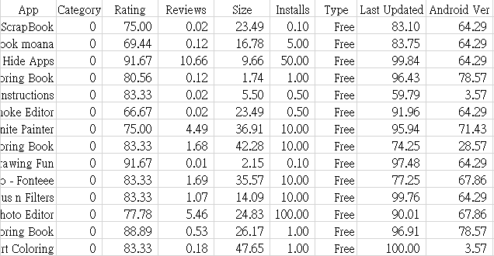
Our Data
Source : Kaggle
Type : CSV
Each row represents one App
Each column represents different attributes
Total rows : 5063(Free)+320(Paid)
Notes:
In our data, each row represents one Android App.
Each column of attributes against Rating to make App rating prediction.

Slide 3

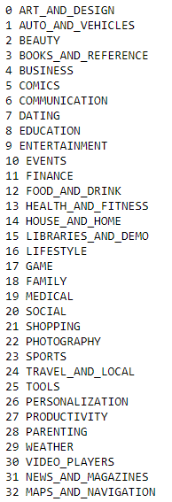
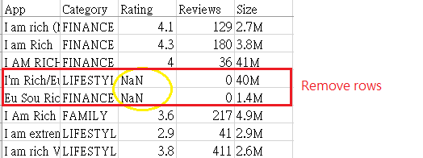
Pre-processing
Delete unessary column (App name and Genre)
keep data that can be used for meaningful analysis
Drop NAN data
Delete extreme values data (5% outliers in both ends)
Consider most of the conditions and reduce statistic impact on outliers
Normalization
all the input variables have the same treatment in the model
Feature Encoding
Easier to deal with discrete values and to do further analysis
If the categories repeat then assign the same number of value
Split data in to Free and Paid tables
Clear distinction in price related data
Notes:
In preprocessing we …

Slide 4
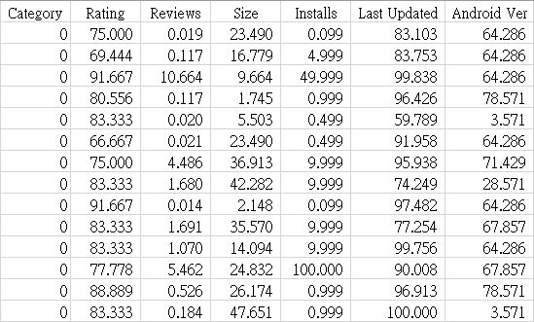
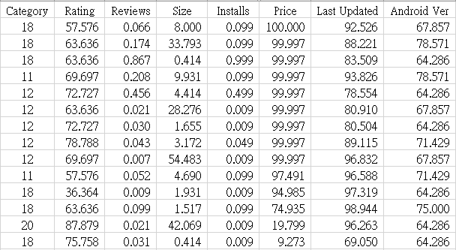
All columns analyzed against rating
Free table
Paid table
Notes:
For both free and paid table, all the columns analyzed against rating

Slide 5
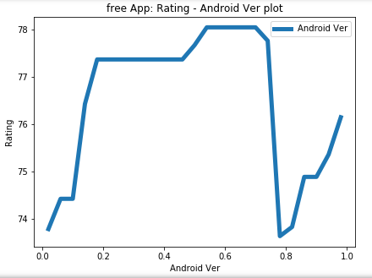
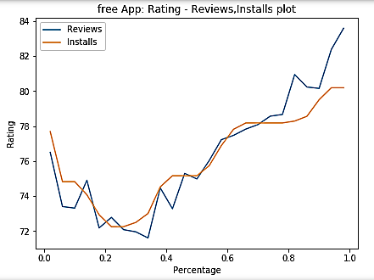
Removed Features ( Android Version, Install )
Android version is low relevance to Rating.
Install has high correlation with reviews.
Notes:
We found that Android version and install are less relevant to rating.

Slide 6
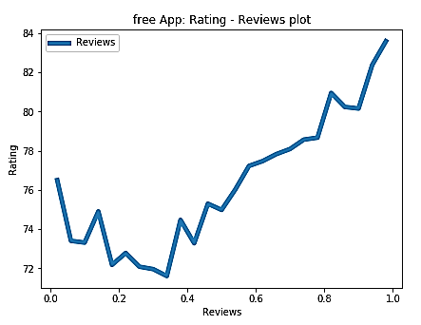
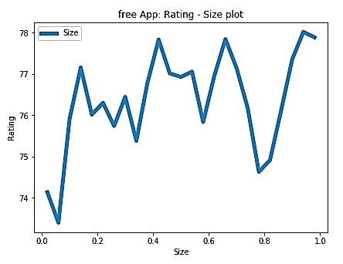
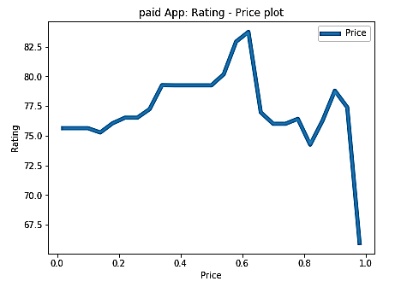
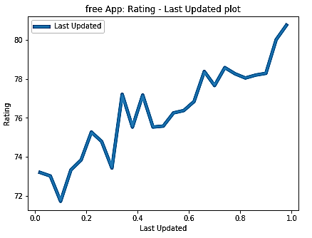
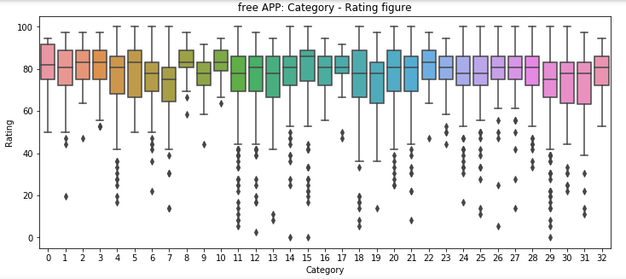
Selected Features (Reviews, Size, Price, last updated, Category)
Notes:
However Reviews, Size, Price, last updated, Category are relevant to Rating, thus we will used for further analysis.
For category, it is not enough data to make conclusion, so we still want to keep it for further analysis
Each column divide into intervals, each interval represent mean of Rating.

Slide 7
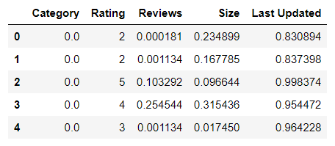
Data Processing
Divide continuous ‘Rating’ into 5 parts by number of occurrences with label [ 0, 1, 2, 3, 4 ]
Divide the dataset into training data and testing data , 70% and 30% respectively
Notes:
First, because we want to do classification problem, so we divide the continuous data rating into 5 parts by number of its occurrences, and its labels is 0, 1, 2, 3, 4
Then, we divide the dataset into training data and testing data, which are 70% and 30%.

Slide 8
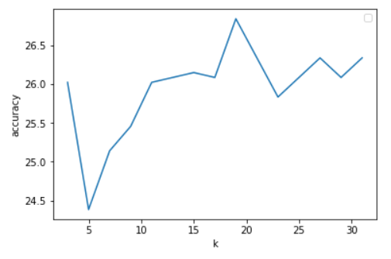
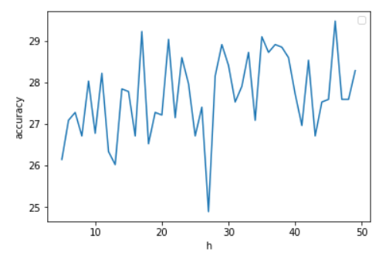
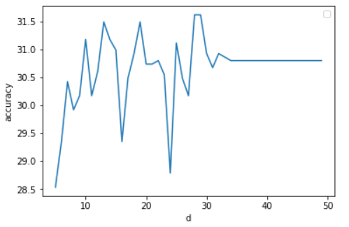
KNN
MLP
RF
K = 19
H = 46
D = 28
Acc. = 26.02 %
Acc. = 27.40 %
Acc. = 29.11 %
Notes:
We use 3 classification approaches, KNN, MLP, and Random forest.
The figure’s x axis is parameter, y axis is accuracy.
So we choose K = 19 for KNN, hidden layer = 46 for MLP, and depth = 28 for Random forest
And we can see the random forest’s accuracy is the highest

Slide 9
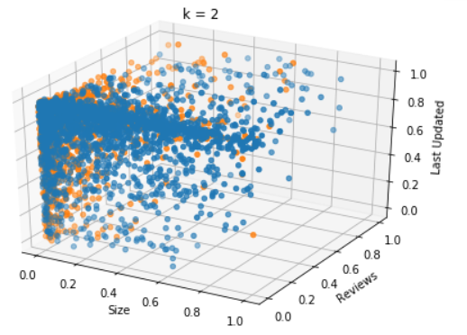
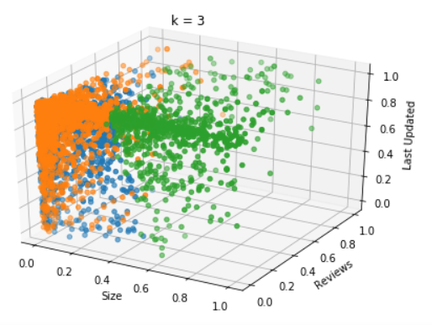
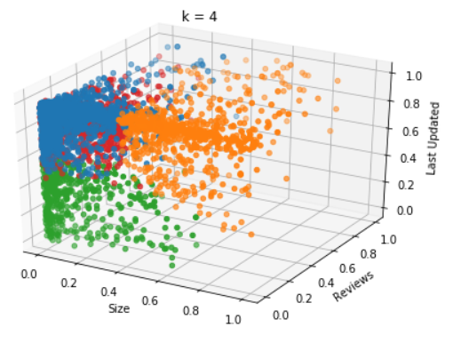
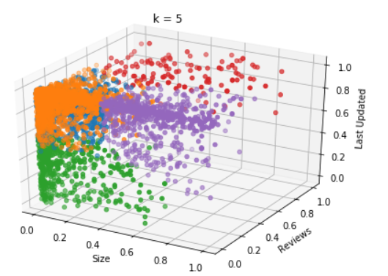
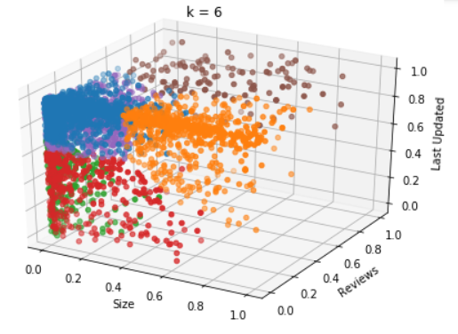
K - Means
K = 5
Notes:
Then we cluster the data to see if there any correlation in each cluster.
This is K-Means with different k, we choose the k = 5, but there are some data overlapping, so this approach not very good.

Slide 10
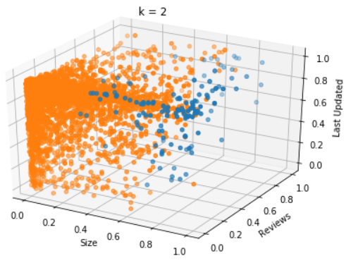
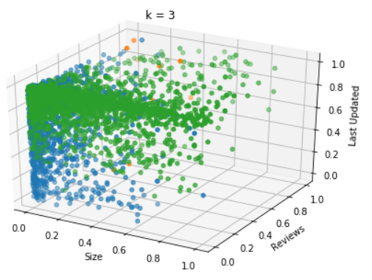
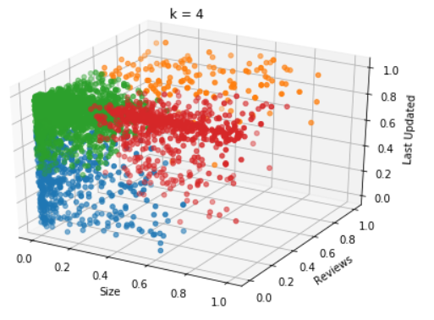
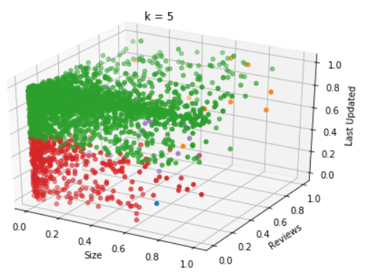
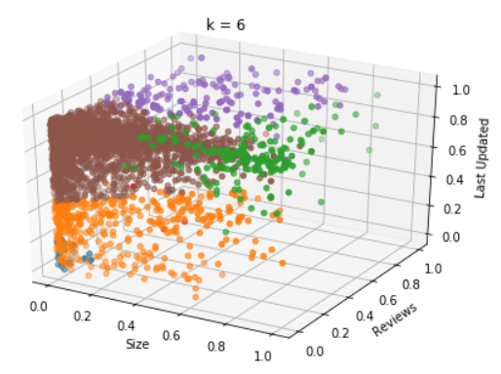
SOM
K = 4
Notes:
This is SOM, we can see k = 4 is better than others, so we choose k = 4 for SOM

Slide 11
Approach | Accuracy
KNN | 26.83 %
MLP | 27.40 %
RF | 29.85 %
K – Means + KNN | 27.95 %
K – Means + MLP | 29.66 %
K – Means + RF | 31.90 %
SOM + KNN | 29.11 %
SOM + MLP | 33.11 %
SOM + RF | 32.28 %
Notes:
This is the accuracy table for each approach, we can see best approach is SOM + MLP

Slide 12
Result
SOM > K – Means > No cluster
MLP = RF > KNN
Final Model : SOM ( 4 cluster ) + MLP ( hidden layer = 46)
KNN use the data next to it, so cluster has little impact on it.
As this is tabular data, we compare MLP and RF to decide which is better.
Conclusion
Notes:
The best cluster approach is SOM, then K-Means, and if we didn’t use cluster, the result is the worst
And in classification approach, MLP and RF is very close, they are all better than KNN
So our final model is SOM with 4 clusters and MLP with 46 hidden layer

