Slide 1

BTC/INR daily price prediction
Gourab Pal

Slide 2

Objective
Exploratory data analysis
Prediction using ML
Trading back testing

Slide 3
Python packages
Objective | Package
Data fetching | requests
Data handling and manipulation | pandas, numpy
Visualization | mplfinance, Matplotlib
Split and tuning | GridSearchCV, TimeSeriesSplit from sklearn
ML algorithm | DecisionTreeRegressor, RandomForestRegressor, XGBRegressor from sklearn, xgboost
Metrics | root_means_squared_error, r2_score from sklearn

Slide 4
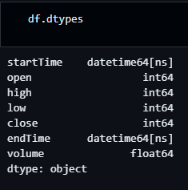
Data overview
Pair → BTC/INR
Chosen interval → 1m
Execution date → 07th October 2024
Fetched data type → json
Converted into pandas dataframe object for easy manipulation

Slide 5
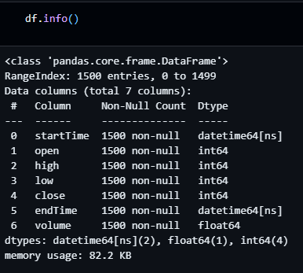
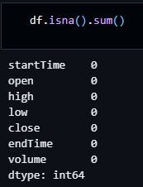
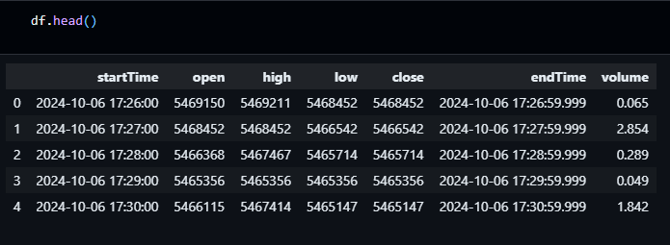
Data overview
There are 1500 rows
No Null values
First 5 rows

Slide 6
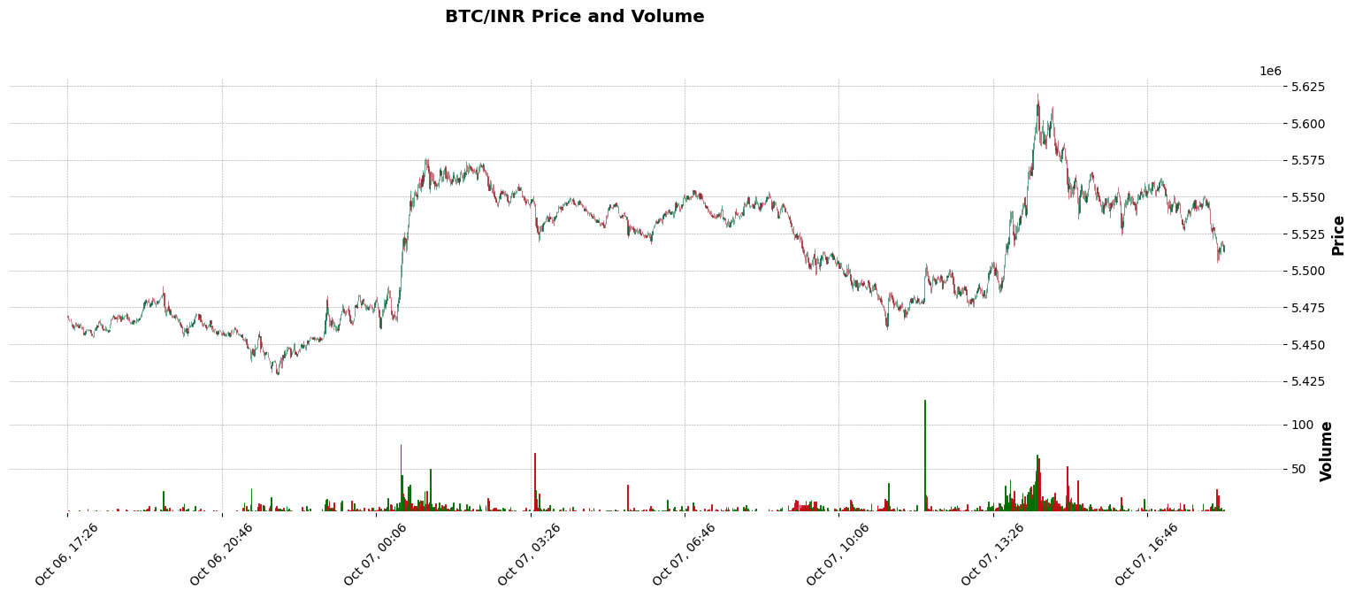
Exploratory data analysis
There is an overall increase of price in Oct 06, 17:26 to Oct 07, 16:45. When the volume of BTC was high and also there was an upward trend in price. This indicates bullish market. High volume means a large number of people are buying and selling indicating high interest and reliability in BTC. So, the sustainability and strength increase

Slide 7
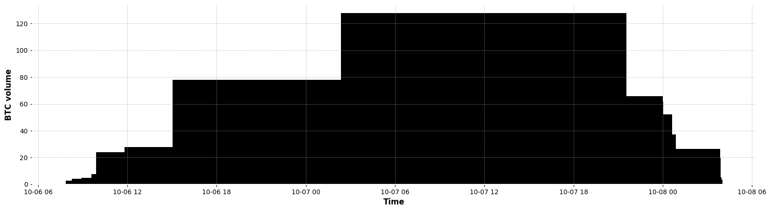
Exploratory data analysis
BTC volume traded over this day

Slide 8
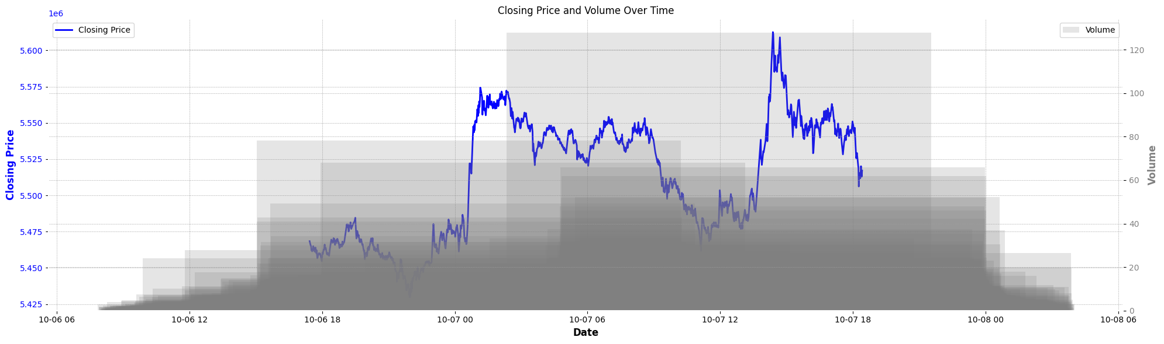
Exploratory data analysis
small steps of price increment is seen, however, a reversal may be started gradually.

Slide 9
Without feature engineering
Our objective is to predict the “close” column in the dataset.
The “startTime” column is used as index of dataframe
When I have used the columns “low”, “high”, “open” and “volume” as features in ML models, the model was too simple to understand the hidden pattern
Then I have added 7 more features in the dataset utilizing the existing columns

Slide 10
Engineered features
Feature Name | Description
RSI | Relative Strength Index → It measures the speed and change of price movement
close_lag1 | Using previous time stamp value as predictor
stoch_k | Momentum indicator that compares closing price with a range of previous prices
EMA12 | Exponential moving average of last 12 prices
EMA26 | Exponential moving average of last 26 prices
MACD | Moving Average Convergence Divergence → Indicates momentum of market
MACD_signal | Exponential moving average of MACD for say past 9 MACD.

Slide 11
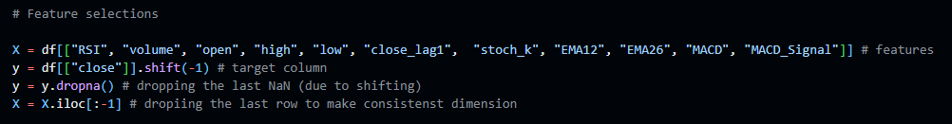
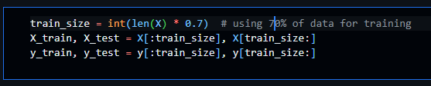
Selection and splitting
We can not simple use train_test_split for this dataset as it is a time series data.
First 70% of data is used for training and validation. Remaining 30% is used for testing

Slide 12
Hyper parameter tuning
I have used single untuned decision tree, tuned decision tree, tuned random forest and tuned xgboost regressor for price prediction
The 5 fold cross-validation is performed using the library TimeSeriesSplit method from sklearn. It takes care of the data sequence
The GridSearchCV method tunes and validate and gives most optimized parameter that reduces mean_squared_error

Slide 13
Forecasting performance
Model | RMS error (INR) | R² score
Un-tuned Decision Tree Regressor | 10056 | 0.92
Tuned Decision Tree Regressor | 10182 | 0.92
Tuned Random Forest Regressor | 8698 | 0.94
Tuned XGBoost Regressor | 8824 | 0.94
Both tuned random forest and tuned XGBoost regressor perform well. I have chosen XGBoost as final model

Slide 14
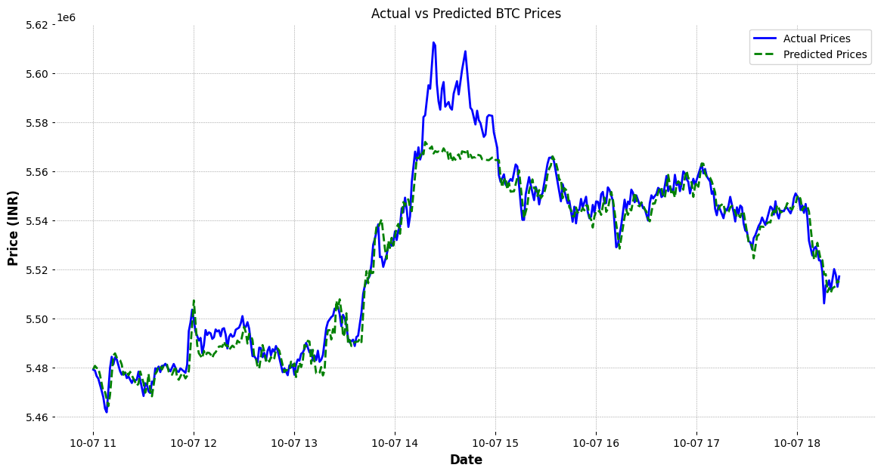
Forecasting
Tuned XGBoost model with RMS error INR 8824 with R² score 0.94

Slide 15
Back testing
Trading strategy
Start with say 100000 INR
Start with 0 BTC holding
At every predicted BTC price, if predicted is more than actual, then buy BTC with all cash
Otherwise sell all BTC to get cash in INR
Track the portfolio at every transactions

Slide 16
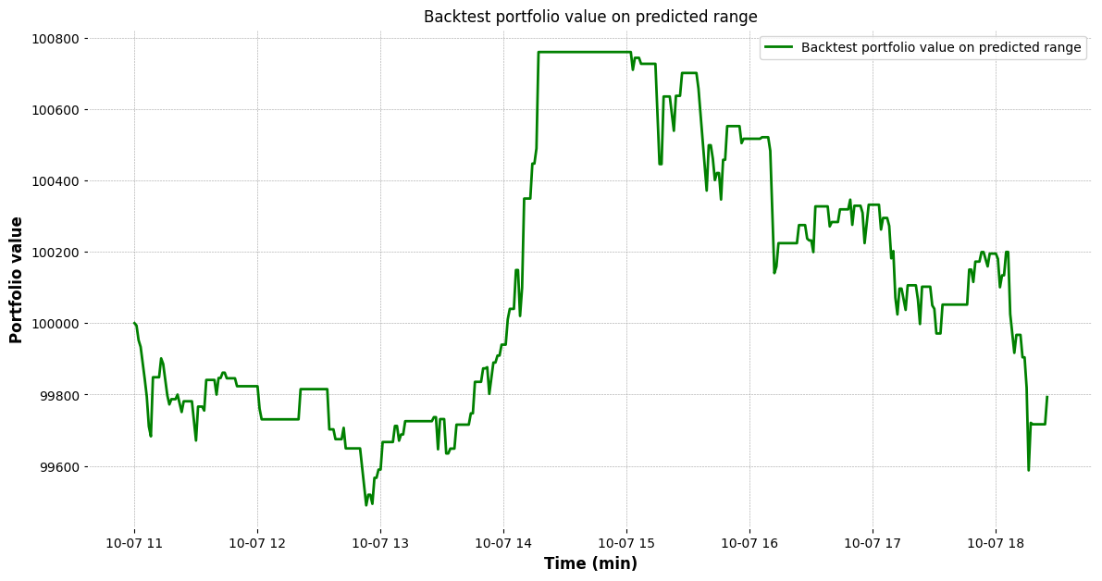
Back testing simulation

Slide 17

Thank you
Email → gourab.pal.gpal@gmail.com
Contact → +91 7076444783
LinkedIn → www.linkedin.com/in/gourab-pal-0327801a4
GitHub → https://github.com/Gourab-Pal
Portfolio → https://sites.google.com/view/gourab-pal/home

