Slide 1
Trip Advisor customer review
Sentiment analysis using python
By- Gourab pal
Check my LinkedIn profile

Slide 2
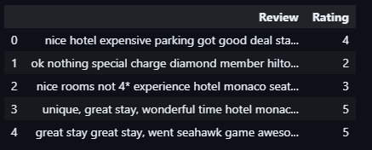
Data overview
There are 20491 customer review with rating value from 1 to 5

Slide 3
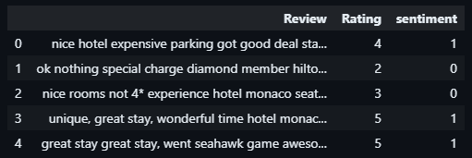
Data overview
To create a binary classification problem, Rating from 1 to 3 is
labelled as 0 and 4 to 5 is labelled as 1

Slide 4
Method -1
Lexicon based VADER analysis

Slide 5
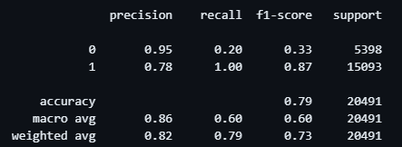
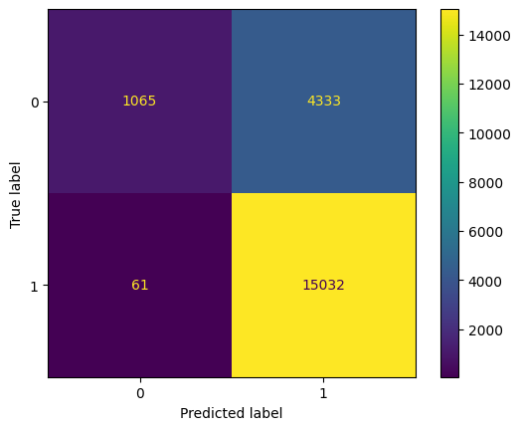
VADER ANALYSIS
Model performance is good.

Slide 6
Method -2
Machine Learning based approaches

Slide 7
Tf-idf transformation
We need to convert this text data into a numeric representation so that it can be ingested into the ML model. We will do this with the help of scikit-learn’s TF-IDF Vectorizer package.
TF → Term Frequency
IDF → Inverse Document Frequency

Slide 8
ML model
Logistic Regression

Slide 9
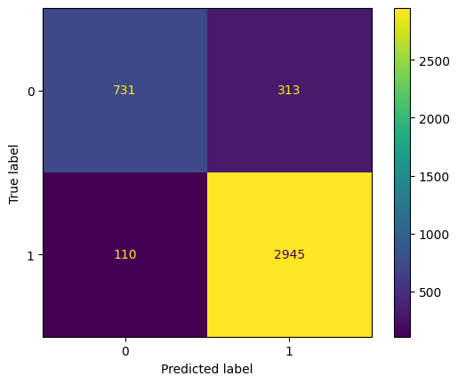
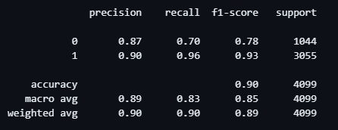
Logistic regression
Model performance

Slide 10
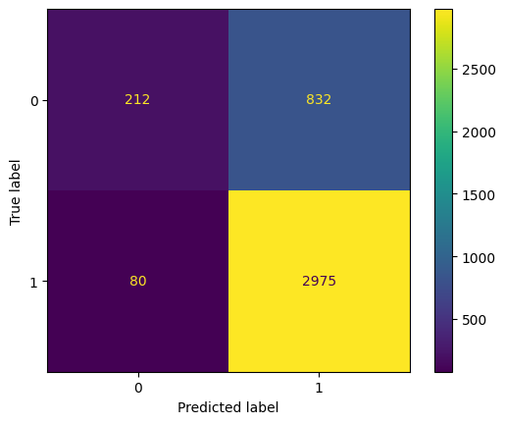
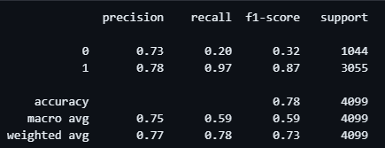
Decision tree
Model performance

Slide 11
CONCLUSION
Binary Logistic Regression outperforms VADER model and
Decision Tree Classifier

