Slide 1

Seminar Presentation
On
Railgun
Submitted By
Gourab dey
Department of Computer Science & Engineering
Semester VI
Roll No: 11900115023
email: gourabdey759@gmail.com
Y E A R : 2 0 1 8
S I L I G U R I I N S T I T U T E O F T E C H N O L O G Y
S I L I G U R I, W E S T B E N G A L
I N D I A

Slide 2
Railgun

Slide 3
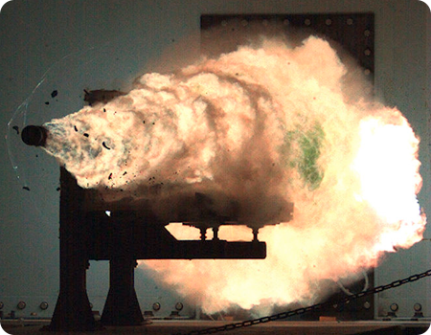
Variations of Armature Type
Solid armature
Plasma armature
Series Augmented rail
Parallel Augmented rail

Slide 4
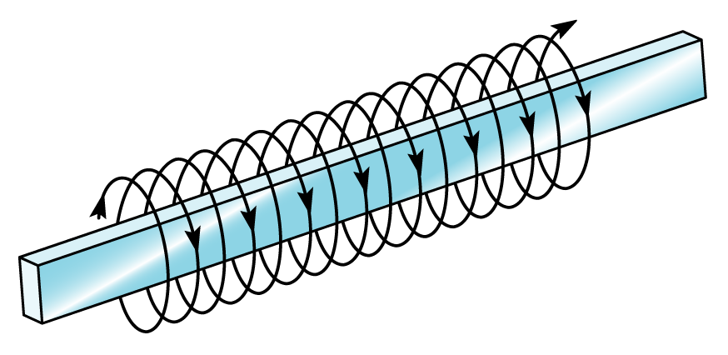
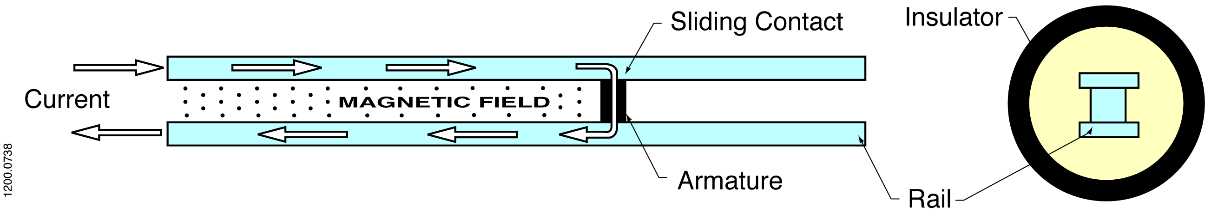
The Physics is simple- Electromagnetic Railguns convert Electric to Kinetic Energy
An electric current in a conductor creates a magnetic field around the conductor.
Force
A magnetic field fills the region between two parallel rails
The interactions of the magnetic field and the current in the conductor creates an electromagnetic force F = Current times magnetic field

Slide 5
Electromagnetic Railguns also Provide Unprecedented Gun Ranges
160
0
40
80
120
160
200
240
280
320
360
400
440
480
USMC Future Assault Range Requirement
80
140
70
120
60
)
100
EML Projectile
m
V_{MUZ} = 2,500 m/s
50
k
(
e
80
d
u
40
t
i
t
l
A
60
30
40
20
V_{Term} = 1,500 m/s
20
155 mm / LRLAP
10
5” / ERGM
0
0
20
40
60
80
100
120
140
160
180
200
220
240
0
G
r
o
u
n
d
R
a
n
g
e
(
N
M
)

Slide 6
Advantages
The railgun has a much larger possible power than a powder gun
Currently, we have been able to reach velocities around 9 km/s with the railgun; whereas, the maximum velocity a powder gun can reach is less than 8.5 km/s.It is believed that the railgun can reach up to 140 km/s.
Since the railgun depends entirely on a massive current, there is no need for fuel or explosives. This is more efficient in three ways:
The risk is greatly reduced for the sailors handling the weapon systems.
The weight of the entire system is reduced.
The smaller size frees up a lot of space, which is crucial on cramped battleships.

Slide 7
Disadvantages/Limitations
One of the biggest problems is with maintaining the structural integrity of the rails as they undergo such stressful conditions.
The thermal management of the entire system, especially as the rails increase in size needs to improve.
The pulsed power unit and supply could be compacted and decreased in size, as it encompasses most of the system.

Slide 8
Short term goals
Increase the fire rate of the current prototype up to ten rounds per minute.
Find a more efficient combination of metal conductors for the rails and for the armature.

Slide 9
Long term goals
Fully electric destroyers and battleships.
Modified electromagnetic railguns outfitted for aircraft.
Small battery packs that are powerful enough to power handheld railguns.
Launch assist system for space craft.

Slide 10

Demo of Railgun

