Slide 1

NATIONAL INSTITUTE OF TECHNOLOGY JAMSHEDPUR
INDUSTRIAL APPLICATIONS
ON
COPY-MOVE FORGERY DETECTION
Team Members : Guided by :
Gourab Dutta (2020UGCS016) Dr. Jitesh Pradhan
Amisha Bairagi (2020UGCS005) CSE Department
Sahil Kumar (2020UGCS097) NIT Jamshedpur

Slide 2
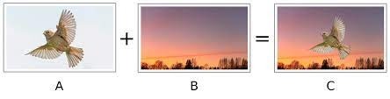
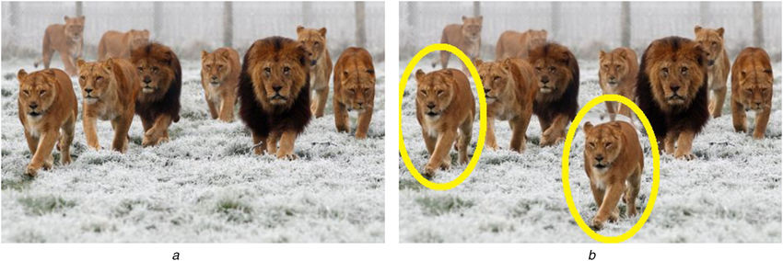
Introduction To Image Forgery
Primarily there are two kinds of forgery techniques, namely Image Splicing, and Copy-move.
In Image Splicing, different images are used to formulate forged images .
In the Copy-Move forgery technique, segments of the image are copied and pasted over the same image.
Image Splicing Forgery
Copy-Move Forgery

Slide 3
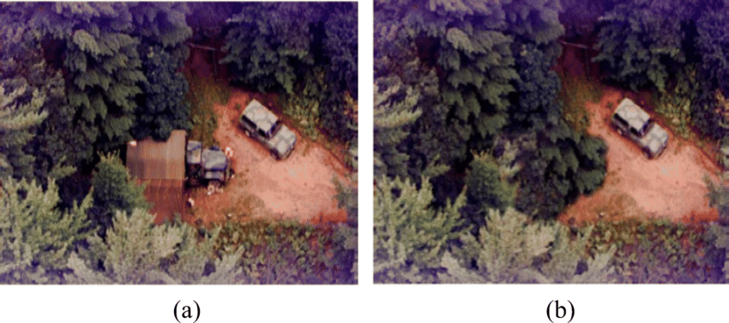
Problem Statement
To develop an algorithm or technique that can accurately identify Forged parts of the image.
The challenge is to detect copied regions despite with very slight variations .
The algorithm needs to be able to tell more than one forged region if exists.
Original Image
Forged Image

Slide 4


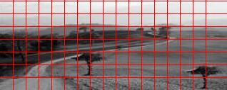
PROPOSED METHODOLOGY
Input (Host image)
Pre processing
Preprocessed image
Overlapping block segmentation
Image Blocks
Block Feature Extraction

Slide 5
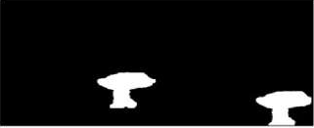
PROPOSED METHODOLOGY
Lexicographical Sorting
Feature Matching
Forged region extraction
Output:
Forged image Detected

Slide 6
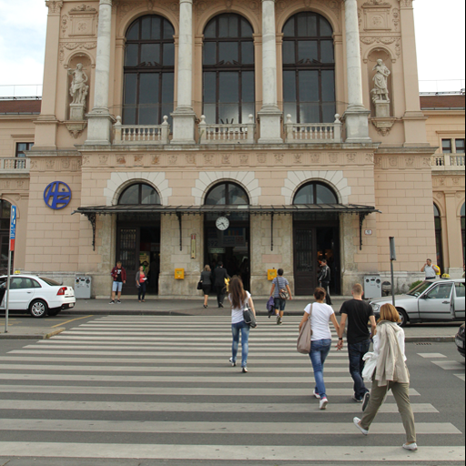
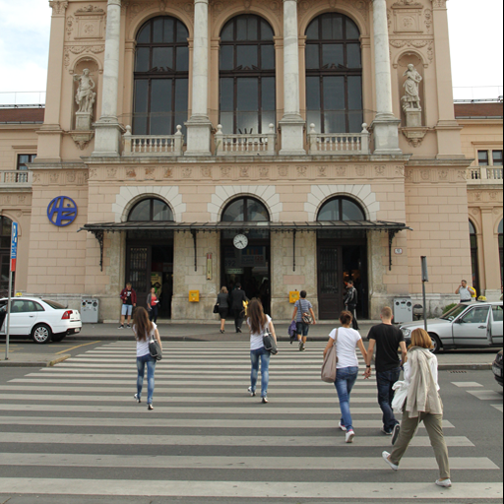
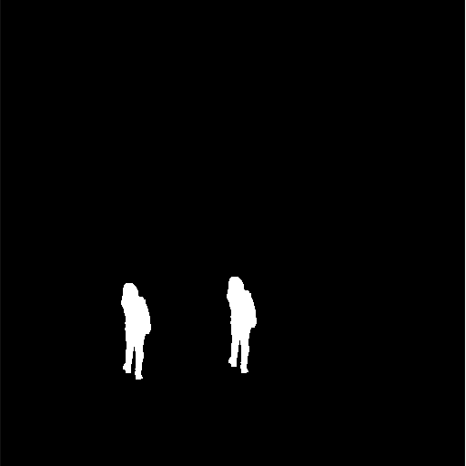

Some Experimental Outcomes
Original Image
Forged Image
Mask
Experimental result

Slide 7
INDUSTRIAL APPLICATION
1. Forensics
Copy-move forgery detection is commonly used in digital forensics to identify tampered images in criminal investigations, civil litigations, and other legal proceedings.
By detecting duplicated regions in images, forensic analysts can identify and authenticate original and altered images to ensure that justice is served.

Slide 8
INDUSTRIAL APPLICATION
2. Intellectual Property Protection
Copy-move forgery detection can be used by companies to protect their intellectual property, such as patents, trademarks, and copyrights.
By detecting unauthorized use of their copyrighted images, companies can take legal action against infringers and protect their intellectual property.

Slide 9
INDUSTRIAL APPLICATION
3. Banking and Finance
Copy-move forgery detection can be used by banks and financial institutions to detect fraudulent activities, such as counterfeiting and money laundering.
By detecting manipulated images, banks can prevent fraudsters from opening fake accounts and conducting illegal transactions.

Slide 10
INDUSTRIAL APPLICATION
4. Health Care
Copy-move forgery detection can be used in health care to detect medical image manipulation, such as altering MRI or X-ray images.
By detecting tampered medical images, doctors and clinicians can ensure that they are making accurate diagnoses and prescribing appropriate treatments.

Slide 11
Future Work
Incorporating deep learning architectures
Addressing challenges in real-world applications
Deep learning-based methods for copy-move forgery detection.
This could potentially improve the accuracy and efficiency of copy-move forgery detection.
Real-world applications, such as forensics and authentication brings many new challenges.
variations in image quality, compression artifacts, and different types of forgeries.
Addressing these challenges to make method more practical and effective in real-world settings.

Slide 12
Thank You

