Slide 1
Numerical Solution for 1D and 2D Diffusion Equation
Gourab Koley
251010016

Slide 2
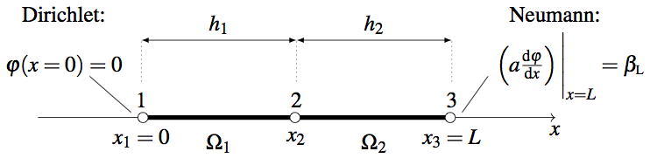
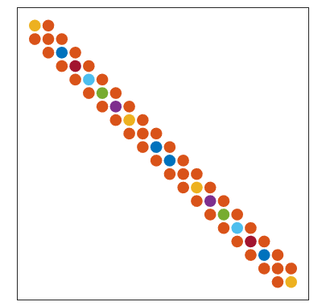
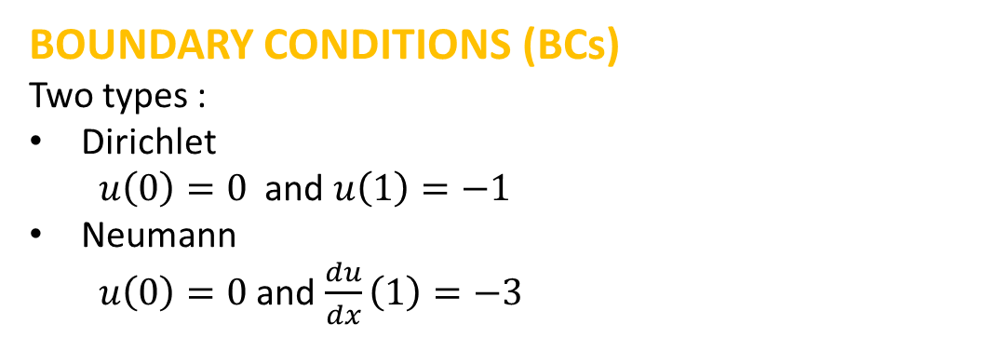
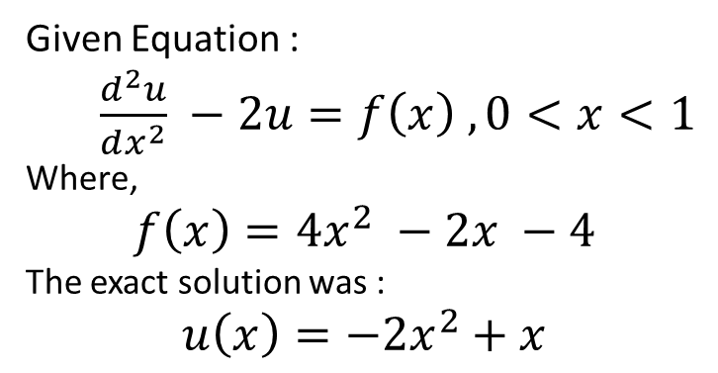

1D Diffusion: Mathematical Formulation
Problem statement (solving the 1D diffusion equation)
Given Equation :
$\frac{d^{2}u}{dx^{2}} −2u=f\left(x\right) , 0<x<1$
Where,
$$f\left(x\right)=4x^{2} −2x −4$$
The exact solution was :
$$u\left(x\right)=−2x^{2}+x$$
BOUNDARY CONDITIONS (BCs)
Two types :
Dirichlet
$u\left(0\right)=0$ and $u\left(1\right)=−1$
Neumann
$u\left(0\right)=0$ and $\frac{du}{dx}\left(1\right)=−3$
$$\}$$
Solved By:
FDM
FEM
FVM

Slide 3
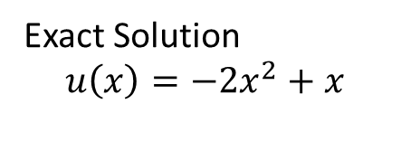
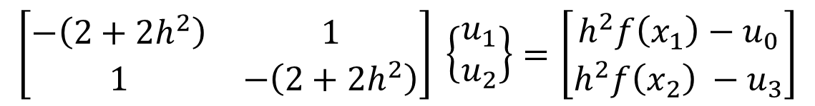

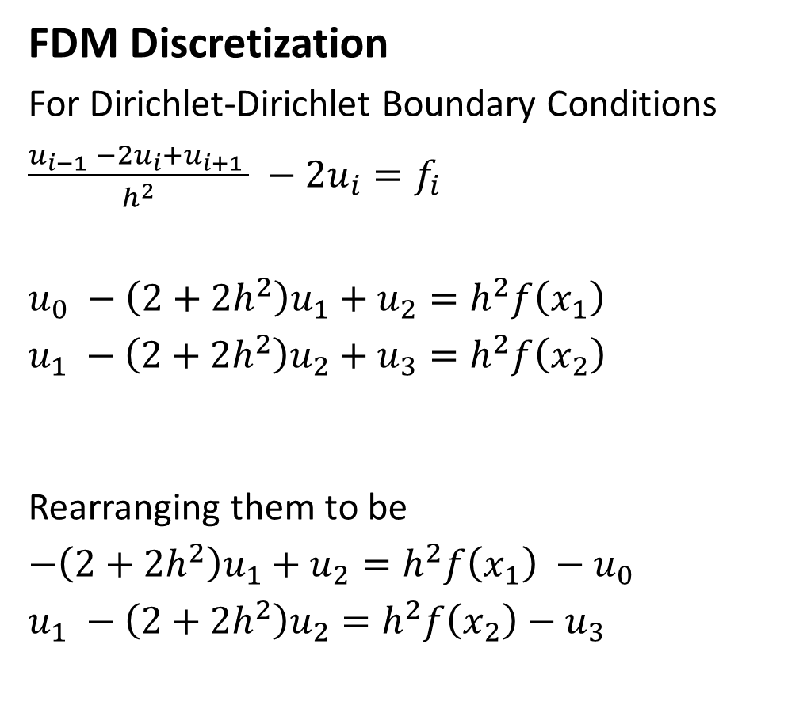


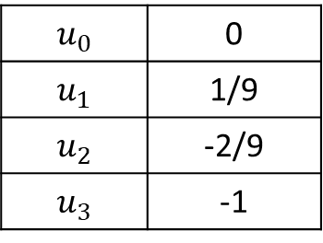

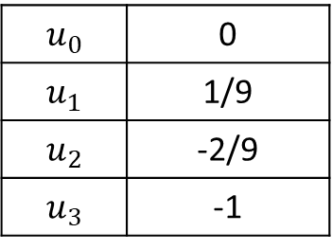
1D Diffusion: Numerical Method
FDM Discretization
For Dirichlet-Dirichlet Boundary Conditions
$\frac{u_{i−1} −2u_{i}+u_{i+1 }}{h^{2}} −2u_{i}=f_{i}$
$u_{0} −\left(2+2h^{2}\right)u_{1}+u_{2}=h^{2}f\left(x_{1}\right)$
$u_{1} −\left(2+2h^{2}\right)u_{2}+u_{3}=h^{2}f\left(x_{2}\right)$
Rearranging them to be
$−\left(2+2h^{2}\right)u_{1}+u_{2}=h^{2}f\left(x_{1}\right) −u_{0}$
$u_{1} −\left(2+2h^{2}\right)u_{2}=h^{2}f\left(x_{2}\right)−u_{3}$
$$u_{0}=0$$
$$u_{3}=−1$$
$$u_{1}$$
$$u_{2}$$
$$\left[\begin{matrix}−\left(2+2h^{2}\right) & 1 \\ 1 & −\left(2+2h^{2}\right)\end{matrix}\right] \left\{\begin{matrix}u_{1} \\ u_{2}\end{matrix}\right\}=\left[\begin{matrix}h^{2}f\left(x_{1}\right)−u_{0} \\ h^{2}f\left(x_{2}\right) −u_{3}\end{matrix}\right]$$
Exact Solution
$$u\left(x\right)=−2x^{2}+x$$
FDM Solution
$$u_{0}$$ | 0
$$u_{1}$$ | 1/9
$$u_{2}$$ | -2/9
$$u_{3}$$ | -1
$$u_{0}$$ | 0
$$u_{1}$$ | 1/9
$$u_{2}$$ | -2/9
$$u_{3}$$ | -1

Slide 4
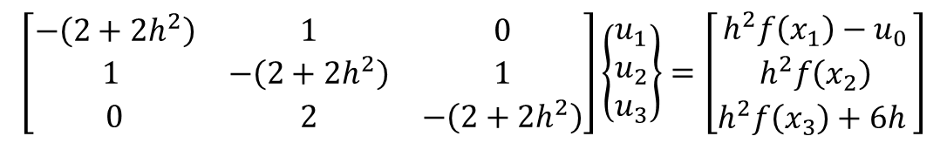
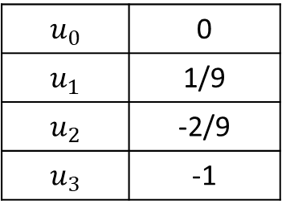
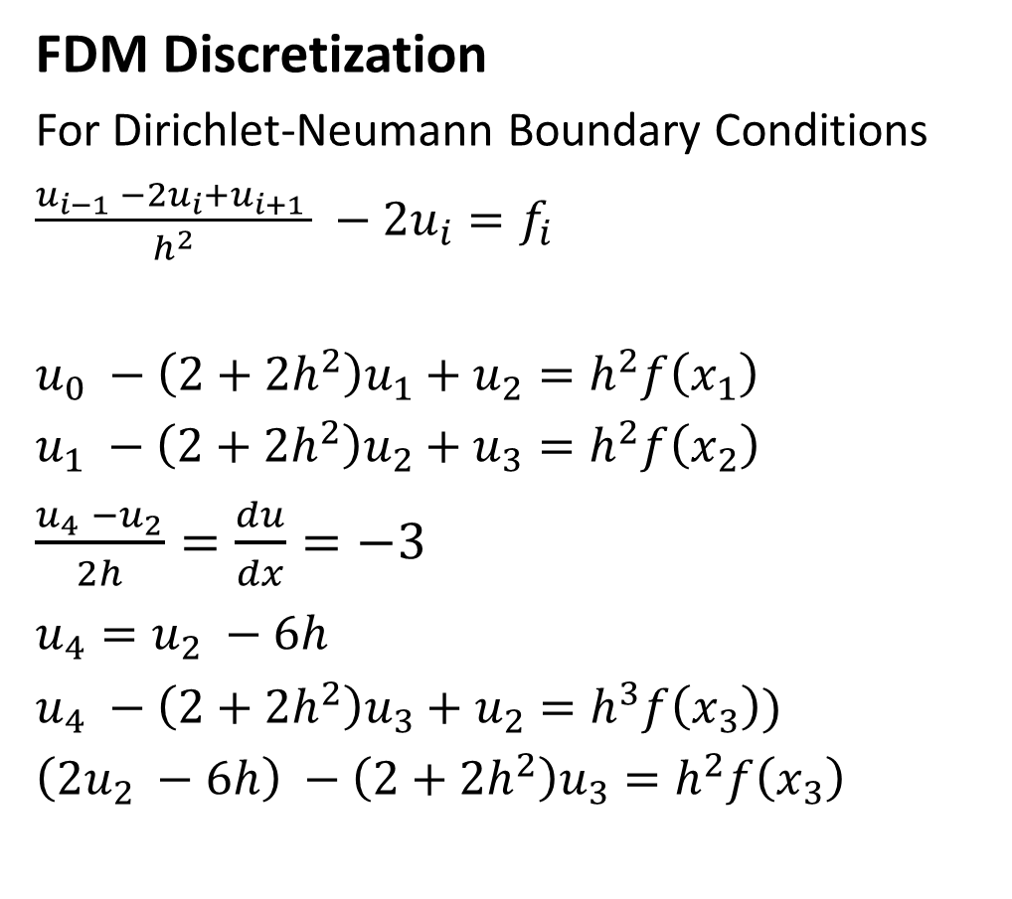
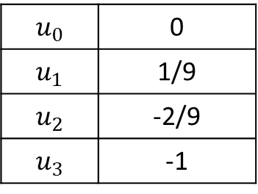
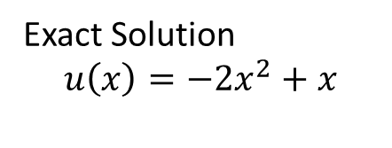
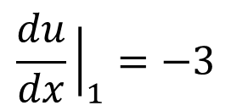

1D Diffusion: Numerical Method
$$\frac{du}{dx}{\left.​\right|}_{1}=−3$$
FDM Discretization
For Dirichlet-Neumann Boundary Conditions
$\frac{u_{i−1} −2u_{i}+u_{i+1 }}{h^{2}} −2u_{i}=f_{i}$
$u_{0} −\left(2+2h^{2}\right)u_{1}+u_{2}=h^{2}f\left(x_{1}\right)$
$u_{1} −\left(2+2h^{2}\right)u_{2}+u_{3}=h^{2}f\left(x_{2}\right)$
$\frac{u_{4} −u_{2}}{2h}=\frac{du}{dx}=−3$
$u_{4}=u_{2} −6h$
$u_{4} −\left(2+2h^{2}\right)u_{3}+u_{2}=h^{3}f\left(x_{3}\right))$
$\left(2u_{2} −6h\right) −\left(2+2h^{2}\right)u_{3}=h^{2}f\left(x_{3}\right)$
$$u_{0}=0$$
$$u_{1}$$
$$u_{2}$$
$$u_{3}$$
$$\left[\begin{matrix}−\left(2+2h^{2}\right) & 1 & 0 \\ 1 & −\left(2+2h^{2}\right) & 1 \\ 0 & 2 & −\left(2+2h^{2}\right)\end{matrix}\right]\left\{\begin{matrix}u_{1} \\ u_{2} \\ u_{3}\end{matrix}\right\}=\left[\begin{matrix}h^{2}f\left(x_{1}\right)−u_{0} \\ h^{2}f\left(x_{2}\right) \\ h^{2}f\left(x_{3}\right)+6h \end{matrix}\right]$$
Exact Solution
$$u\left(x\right)=−2x^{2}+x$$
FDM Solution
$$u_{0}$$ | 0
$$u_{1}$$ | 1/9
$$u_{2}$$ | -2/9
$$u_{3}$$ | -1
$$u_{0}$$ | 0
$$u_{1}$$ | 1/9
$$u_{2}$$ | -2/9
$$u_{3}$$ | -1

Slide 5
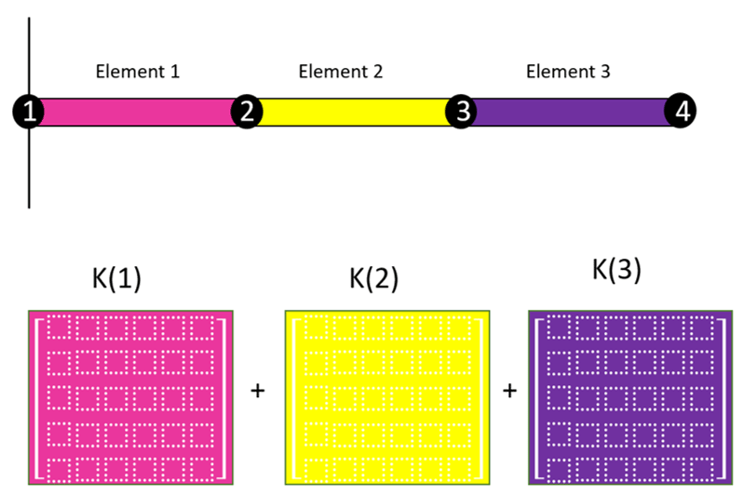
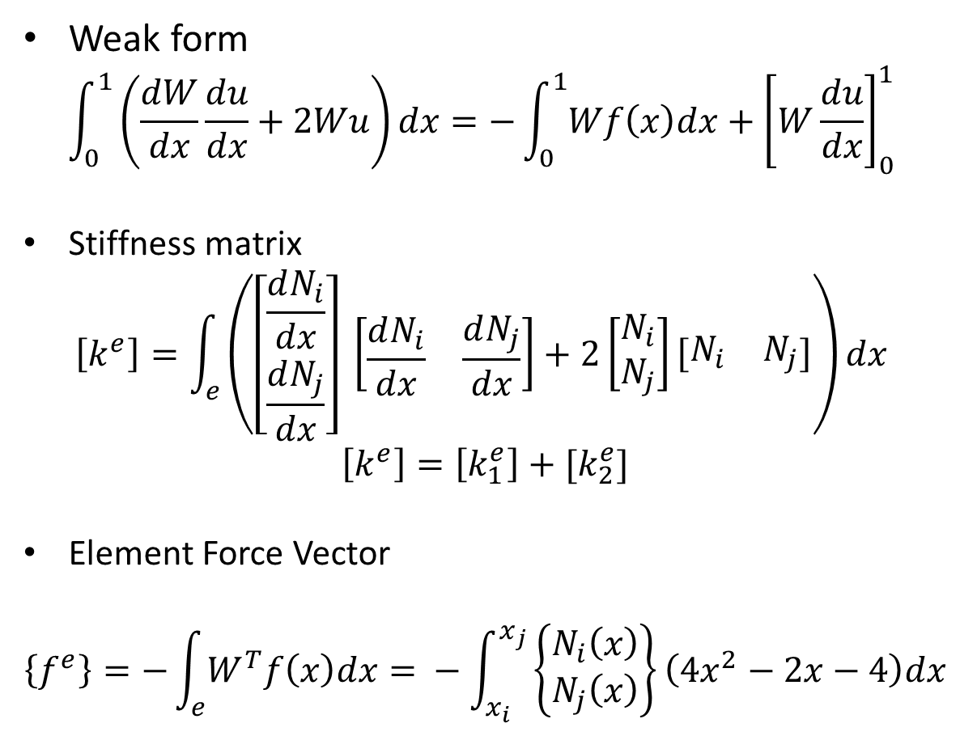
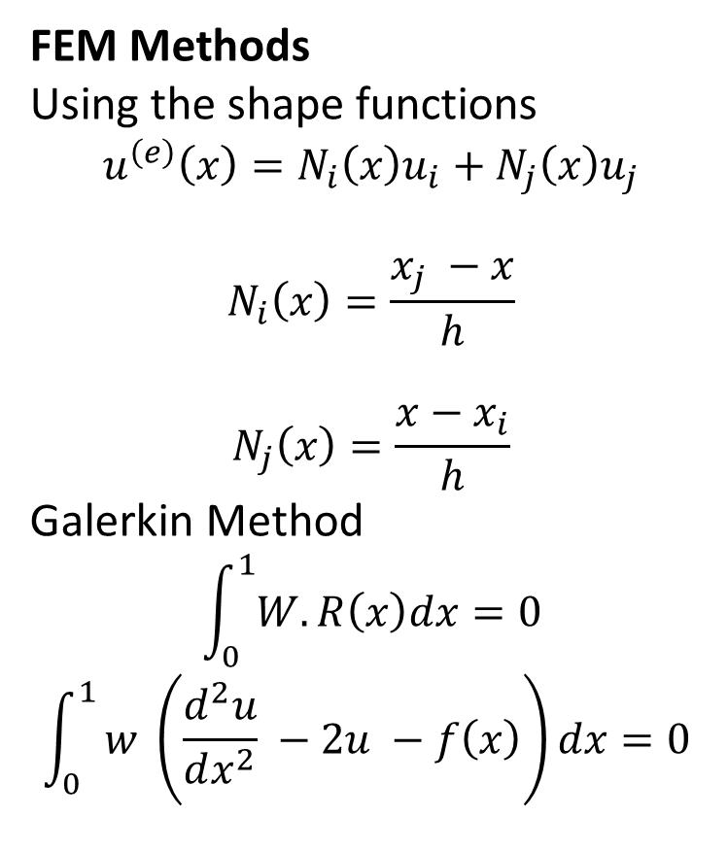
1D Diffusion: Numerical Method
FEM Methods
Using the shape functions
$$u^{\left(e\right)}\left(x\right)=N_{i}\left(x\right)u_{i}+N_{j}\left(x\right)u_{j}$$
$$N_{i}\left(x\right)=\frac{x_{j} −x}{h}$$
$$N_{j}\left(x\right)=\frac{x−x_{i}}{h}$$
Galerkin Method
$$\int_{0}^{1}{W.R\left(x\right)dx=0}$$
$$\int_{0}^{1}{w \left(\frac{d^{2}u}{dx^{2}} −2u −f\left(x\right)\right)dx=0 }$$
Weak form
$$\int_{0}^{1}{\left(\frac{dW}{dx}\frac{du}{dx}+2Wu\right)dx=−\int_{0}^{1}{Wf\left(x\right)dx}+{\left[W\frac{du}{dx}\right]}_{0}^{1} }$$
Stiffness matrix
$$\left[k^{e}\right]=\int_{e}{\left(\left[\begin{matrix}\frac{dN_{i}}{dx} \\ \frac{dN_{j}}{dx}\end{matrix}\right] \left[\begin{matrix}\frac{dN_{i}}{dx} & \frac{dN_{j}}{dx}\end{matrix}\right]+2\left[\begin{matrix}N_{i} \\ N_{j}\end{matrix}\right]\left[\begin{matrix}N_{i} & N_{j}\end{matrix}\right]\right)dx }$$
$$\left[k^{e}\right]=\left[k_{1}^{e}\right]+[k_{2}^{e}]$$
Element Force Vector
$$\left\{f^{e}\right\}=−\int_{e}{W^{T}f\left(x\right)dx= }−\int_{x_{i}}^{x_{j}}{\left\{\begin{matrix}N_{i}\left(x\right) \\ N_{j}\left(x\right)\end{matrix}\right\}\left(4x^{2}−2x−4\right)dx}$$

Slide 6
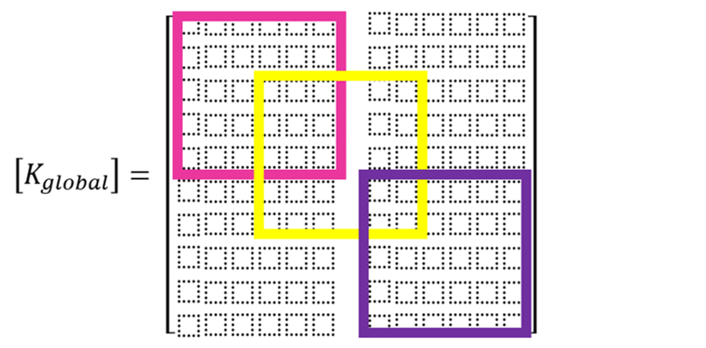


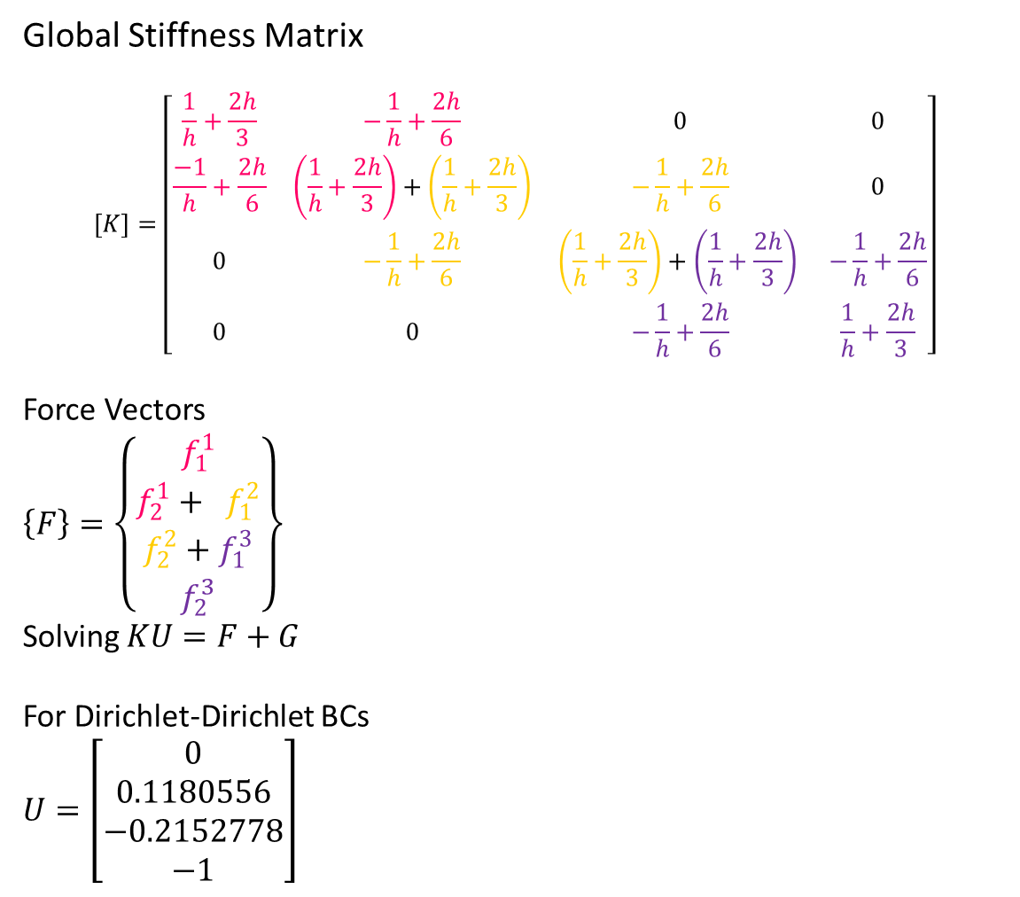
1D Diffusion: Numerical Method
Global Stiffness Matrix
$$\left[K\right]=\left[\begin{matrix}\frac{1}{h}+\frac{2h}{3} & −\frac{1}{h}+\frac{2h}{6} & 0 & 0 \\ \frac{−1}{h}+\frac{2h}{6} & \left(\frac{1}{h}+\frac{2h}{3}\right)+\left(\frac{1}{h}+\frac{2h}{3}\right) & −\frac{1}{h}+\frac{2h}{6} & 0 \\ 0 & −\frac{1}{h}+\frac{2h}{6} & \left(\frac{1}{h}+\frac{2h}{3}\right)+\left(\frac{1}{h}+\frac{2h}{3}\right) & −\frac{1}{h}+\frac{2h}{6} \\ 0 & 0 & −\frac{1}{h}+\frac{2h}{6} & \frac{1}{h}+\frac{2h}{3}\end{matrix}\right]$$
Force Vectors
$\left\{F\right\}=\left\{\begin{matrix}f_{1}^{1} \\ f_{2}^{1}+ f_{1}^{2} \\ f_{2}^{2}+f_{1}^{3} \\ f_{2}^{3}\end{matrix}\right\}$
Solving $KU=F+G$
For Dirichlet-Dirichlet BCs
$U=\left[\begin{matrix}0 \\ 0.1180556 \\ −0.2152778 \\ −1\end{matrix}\right]$
$$G=\left[\begin{matrix}G_{1}^{1} \\ \begin{aligned}G_{2}^{1}+G_{1}^{2} \\ G_{2}^{2}+G_{1}^{3}\end{aligned} \\ \\ G_{2}^{3}\end{matrix}\right]=\left[\begin{matrix}0 \\ 0 \\ 0 \\ 0\end{matrix}\right]or \left[\begin{matrix}0 \\ 0 \\ 0 \\ −3\end{matrix}\right]$$
For Dirichlet-Neumann BCs
$$U=\left[\begin{matrix}0 \\ 0.12314452 \\ −0.20392548 \\ −0.97976461\end{matrix}\right]$$

Slide 7
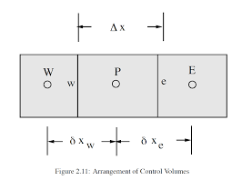
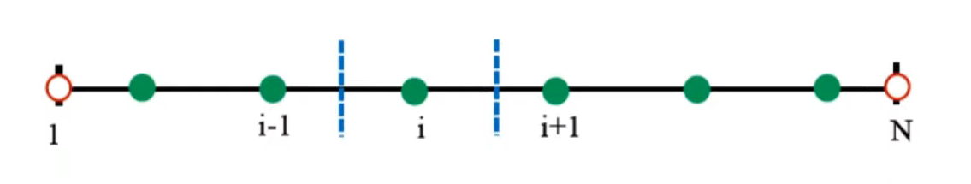
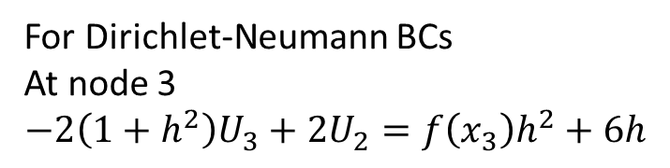
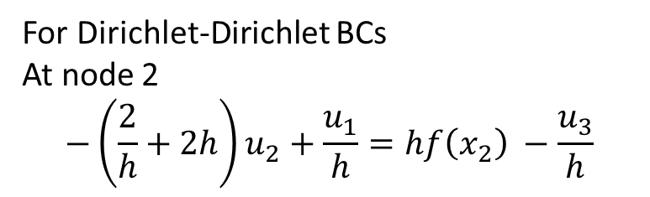
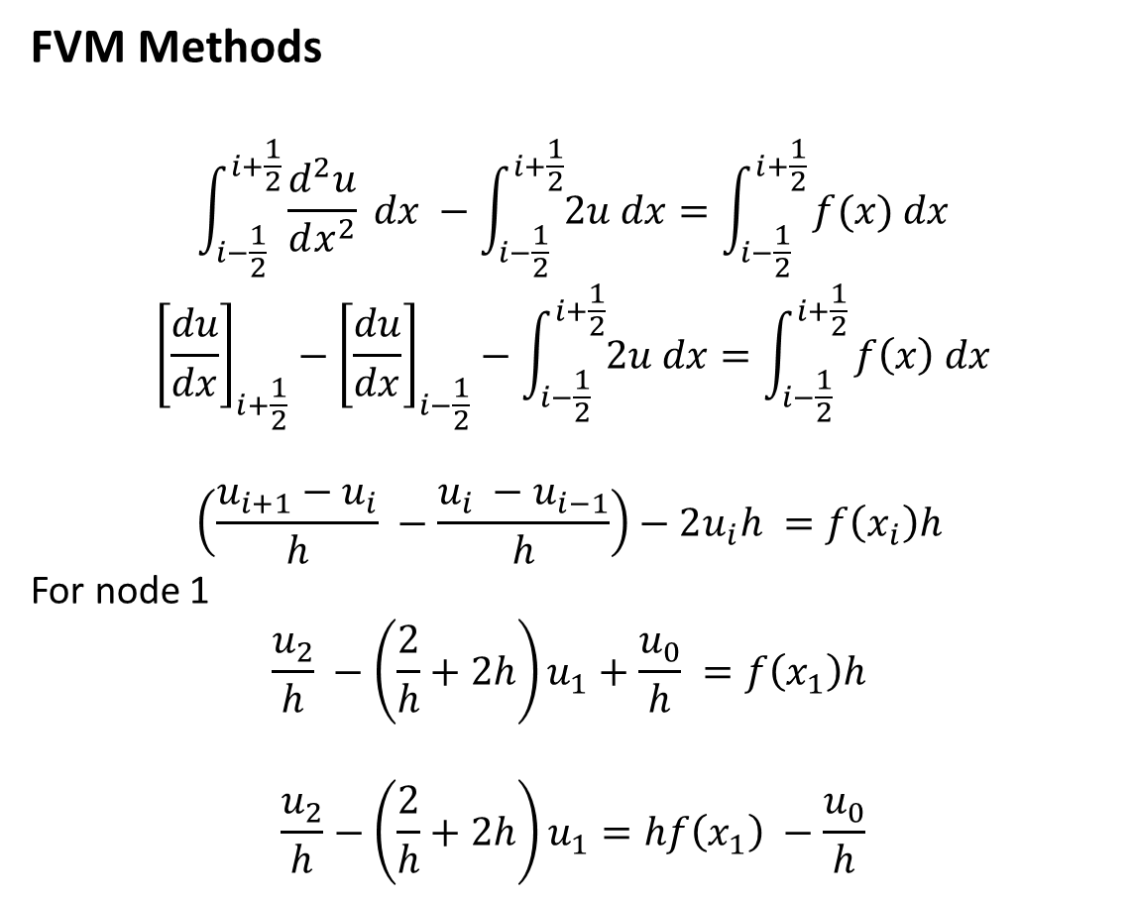
1D Diffusion: Numerical Method
FVM Methods
$$\int_{i−\frac{1}{2}}^{i+\frac{1}{2}}{\frac{d^{2}u}{dx^{2}} dx} −\int_{i−\frac{1}{2}}^{i+\frac{1}{2}}{2u dx}=\int_{i−\frac{1}{2}}^{i+\frac{1}{2}}{f(x) dx}$$
$${\left[\frac{du}{dx}\right]}_{i+\frac{1}{2}}−{\left[\frac{du}{dx}\right]}_{i−\frac{1}{2}}−\int_{i−\frac{1}{2}}^{i+\frac{1}{2}}{2u dx}=\int_{i−\frac{1}{2}}^{i+\frac{1}{2}}{f\left(x\right) dx}$$
$$\left(\frac{u_{i+1}−u_{i}}{h} −\frac{u_{i} −u_{i−1}}{h}\right)−2u_{i}h =f\left(x_{i}\right)h$$
For node 1
$$\frac{u_{2}}{h} −\left(\frac{2}{h}+2h\right)u_{1}+\frac{u_{0}}{h} =f\left(x_{1}\right)h$$
$$\frac{u_{2}}{h}−\left(\frac{2}{h}+2h\right)u_{1}=hf\left(x_{1}\right) −\frac{u_{0}}{h}$$
For Dirichlet-Dirichlet BCs
At node 2
$$−\left(\frac{2}{h}+2h\right)u_{2}+\frac{u_{1}}{h}=hf\left(x_{2}\right) −\frac{u_{3}}{h}$$
For Dirichlet-Neumann BCs
At node 3
$$−2\left(1+h^{2}\right)U_{3}+2U_{2}=f\left(x_{3}\right)h^{2}+6h$$

Slide 8
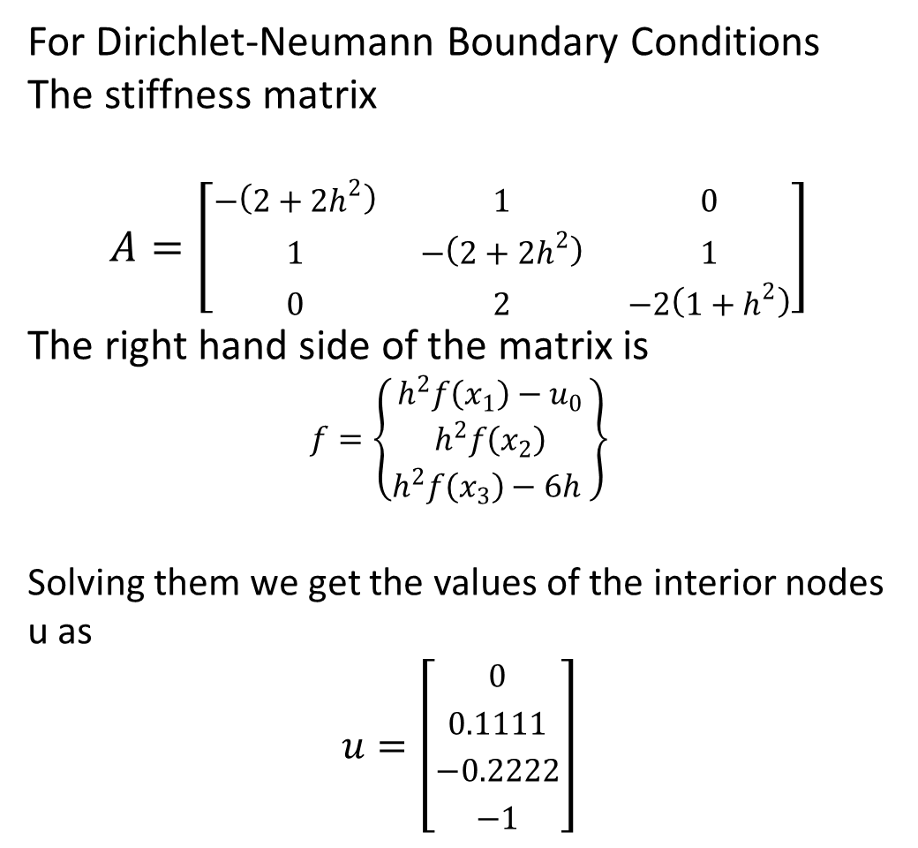
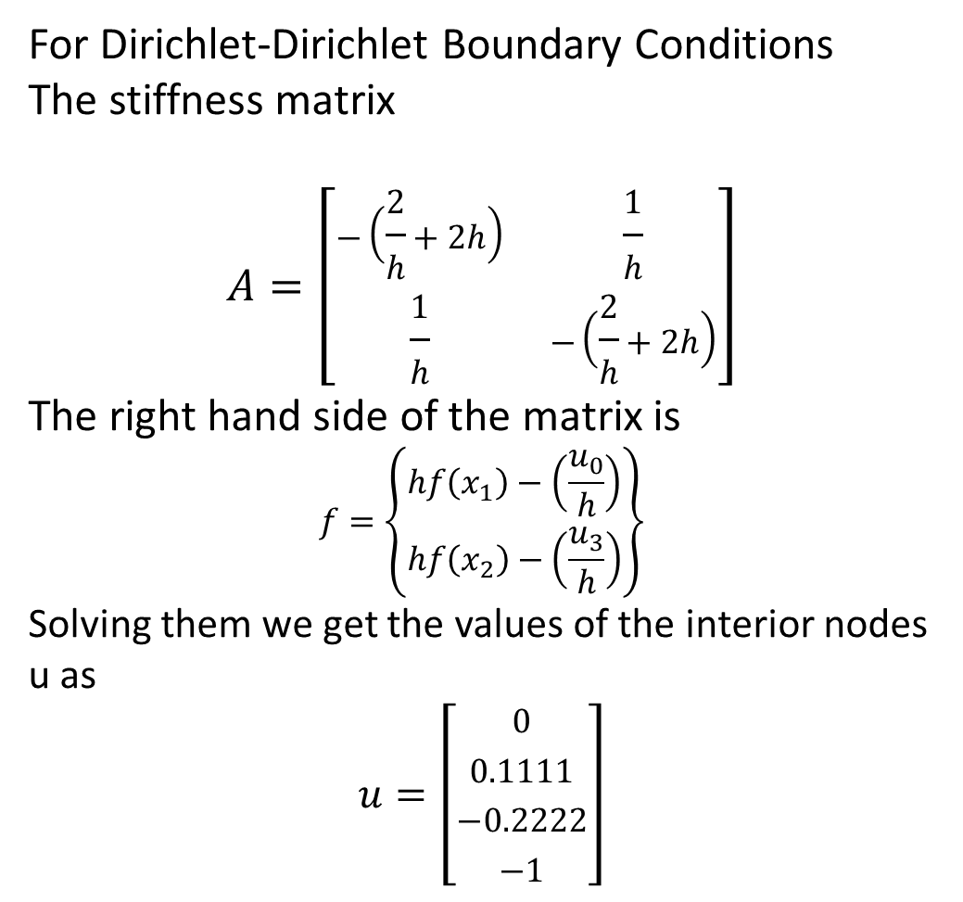
1D Diffusion: Numerical Method
For Dirichlet-Dirichlet Boundary Conditions
The stiffness matrix
$$A=\left[\begin{matrix}−\left(\frac{2}{h}+2h\right) & \frac{1}{h} \\ \frac{1}{h} & −\left(\frac{2}{h}+2h\right)\end{matrix}\right]$$
The right hand side of the matrix is
$$f=\left\{\begin{matrix}hf\left(x_{1}\right)−\left(\frac{u_{0}}{h}\right) \\ hf\left(x_{2}\right)−\left(\frac{u_{3}}{h}\right)\end{matrix}\right\}$$
Solving them we get the values of the interior nodes u as
$$u=\left[\begin{matrix}0 \\ 0.1111 \\ −0.2222 \\ −1\end{matrix}\right]$$
For Dirichlet-Neumann Boundary Conditions
The stiffness matrix
$$A=\left[\begin{matrix}−\left(2+2h^{2}\right) & 1 & 0 \\ 1 & −\left(2+2h^{2}\right) & 1 \\ 0 & 2 & −2\left(1+h^{2}\right)\end{matrix}\right]$$
The right hand side of the matrix is
$$f=\left\{\begin{matrix}h^{2}f\left(x_{1}\right)−u_{0} \\ h^{2}f\left(x_{2}\right) \\ h^{2}f\left(x_{3}\right)−6h \end{matrix}\right\}$$
Solving them we get the values of the interior nodes u as
$$u=\left[\begin{matrix}0 \\ 0.1111 \\ −0.2222 \\ −1\end{matrix}\right]$$

Slide 9
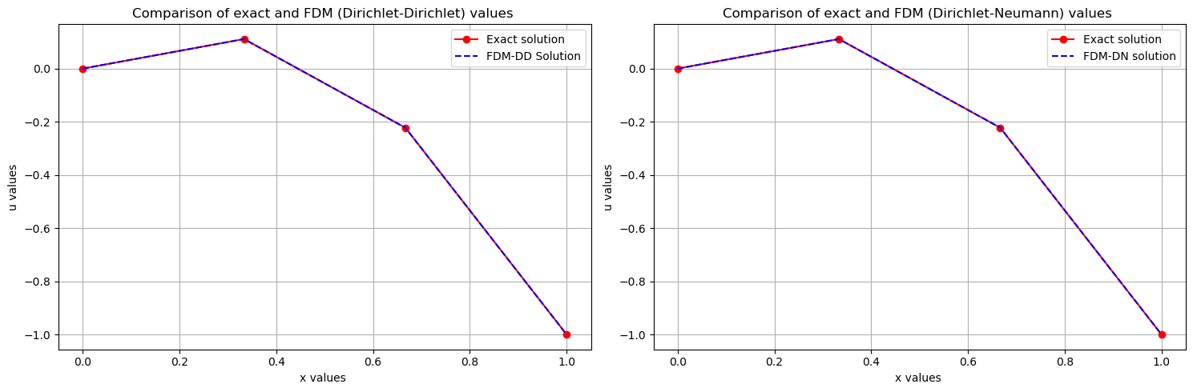
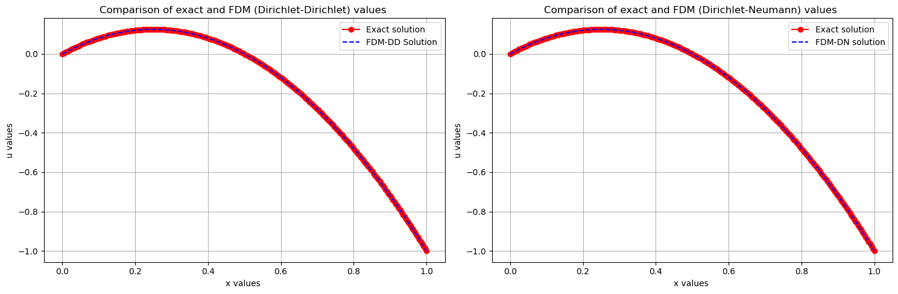
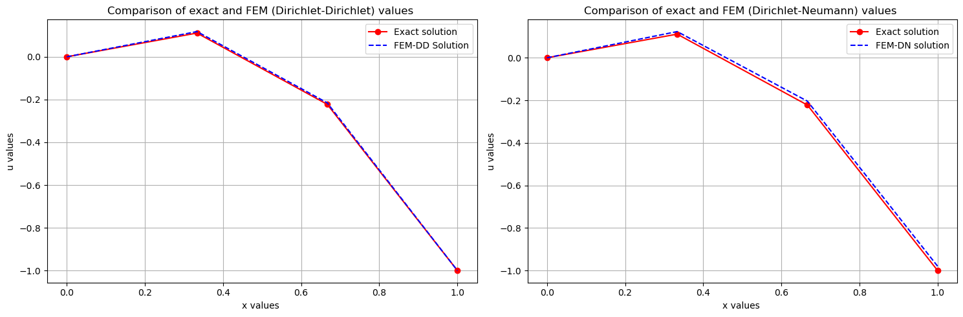
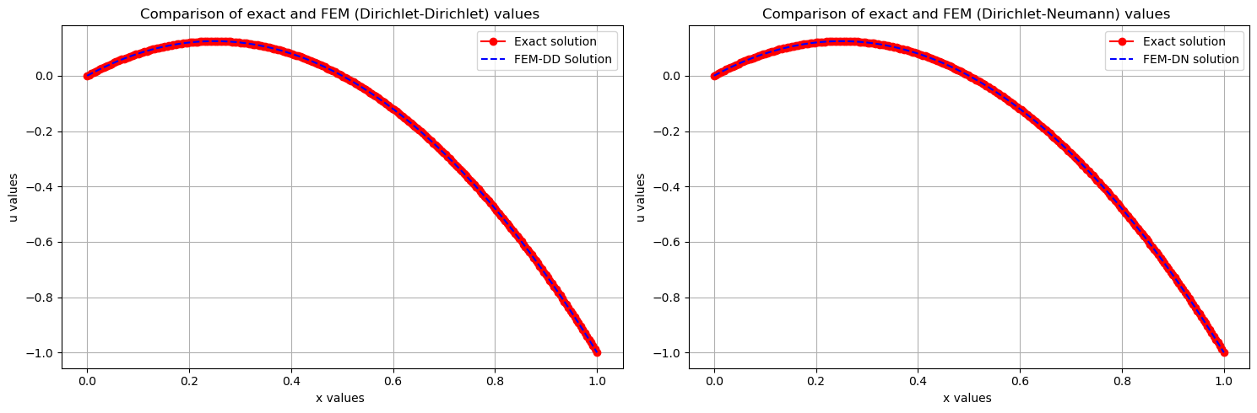



Slide 10
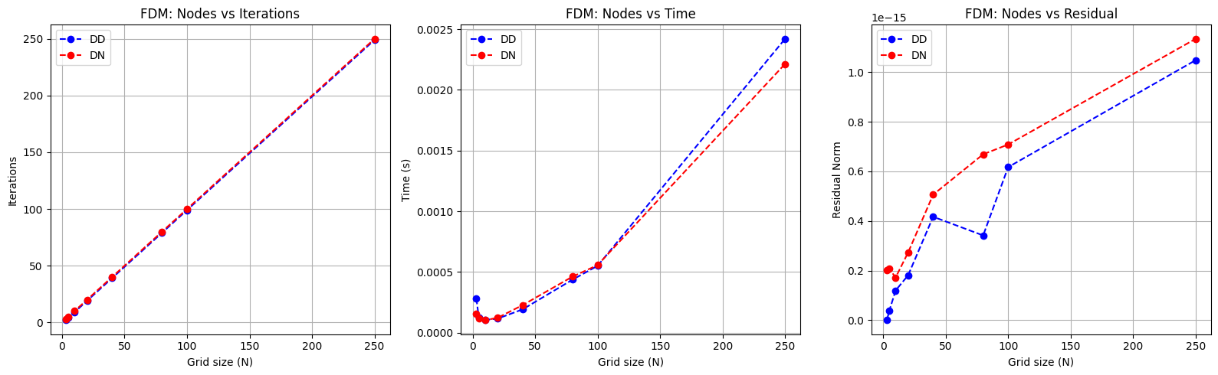
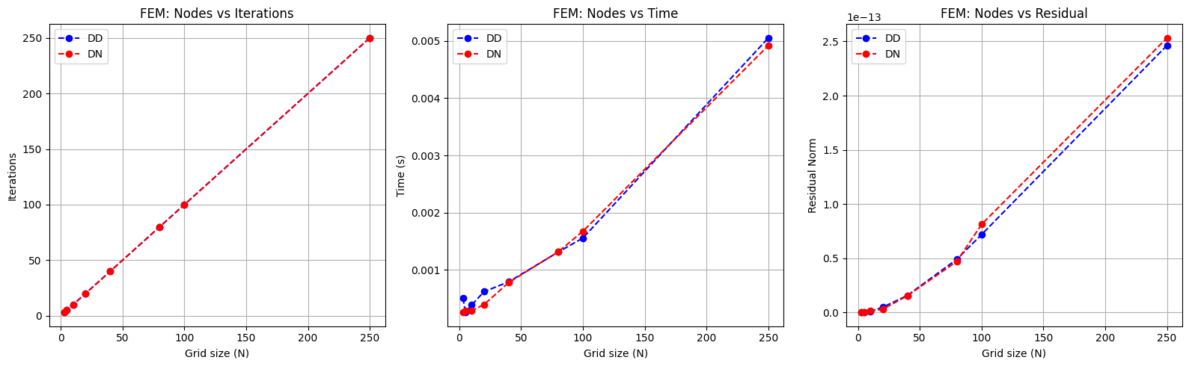
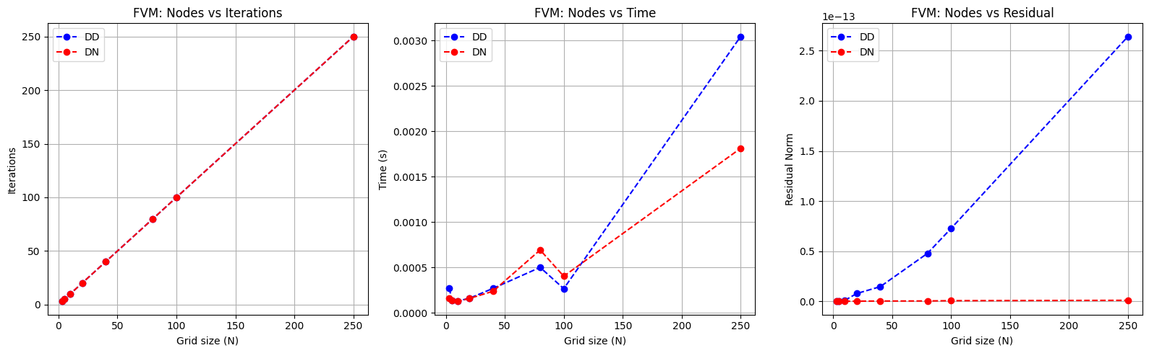
1D Diffusion: Results & Discussion

Slide 11
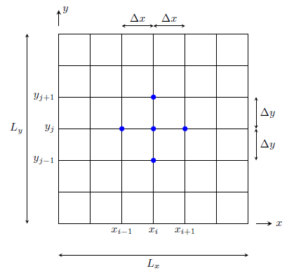
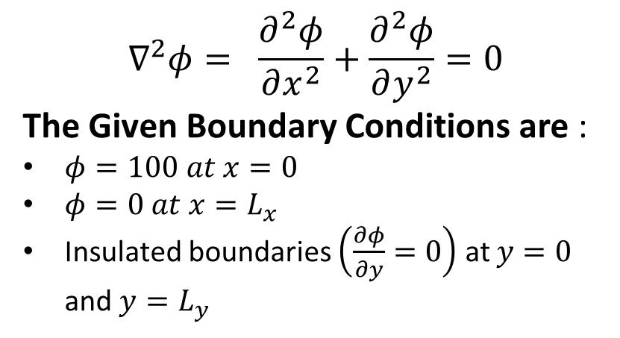




2D Diffusion: Mathematical Formulation
$\frac{∂φ}{∂y }=0$ (insulated)
Solving the 2D-diffusion equation
$$∇^{2}φ= \frac{∂^{2}φ}{∂x^{2}}+\frac{∂^{2}φ}{∂y^{2}}=0$$
The Given Boundary Conditions are :
$φ=100 at x=0$
$φ=0 at x=L_{x}$
Insulated boundaries $\left(\frac{∂φ}{∂y}=0\right)$ at $y=0$ and $y=L_{y}$
$$φ_{N_{x},j}=0$$
$$φ_{0,j}=100$$
Objectives:
To formulate using the Finite Difference Method.
To implement the iterative numerical solvers in PETSc to compare performance .
To analyse the effects of different grid resolutions on numerical solutions
TO visualize the steady-state results using contours and surface plots
$\frac{∂φ}{∂y }=0$ (insulated)

Slide 12
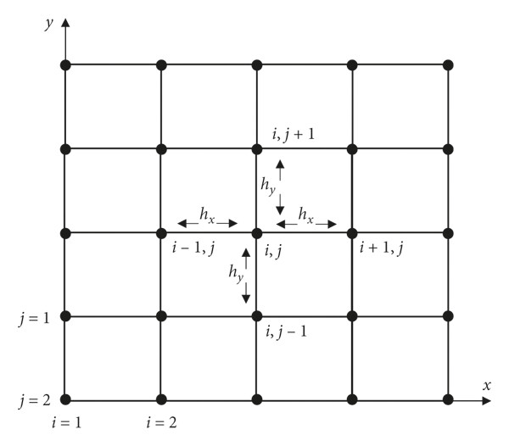
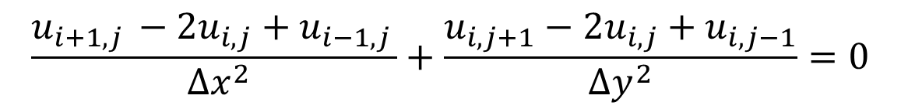
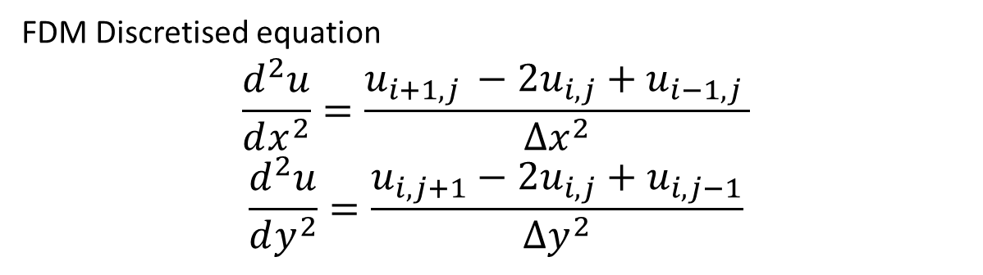
2D Diffusion: Numerical Method
FDM Discretised equation
$$\frac{d^{2}u}{dx^{2}}=\frac{u_{i+1, j }−2u_{i,j}+u_{i−1,j }}{{∆x}^{2}}$$
$$\frac{d^{2}u}{dy^{2}}=\frac{u_{i,j+1}−2u_{i,j}+u_{i,j−1}}{∆y^{2}}$$
Combining them leads to 5 point stencils of this expression
$$\frac{u_{i+1, j }−2u_{i,j}+u_{i−1,j }}{ ∆x^{2}}+\frac{u_{i,j+1}−2u_{i,j}+u_{i,j−1}}{∆y^{2}}=0$$
For 5X5 grid points , we have :
External grid or nodes are knows
Unknown internal grids
16 know grid points
9 unknows grid points
9 equations to be formed
$$u_{i+1,j}+u_{i−1,j}+β^{2}\left(u_{i,j+1}+u_{i, j−1}\right)−2\left(1+β^{2}\right)u_{i,j}=0$$

Slide 13
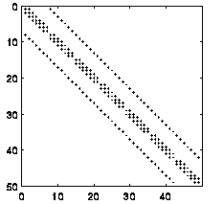
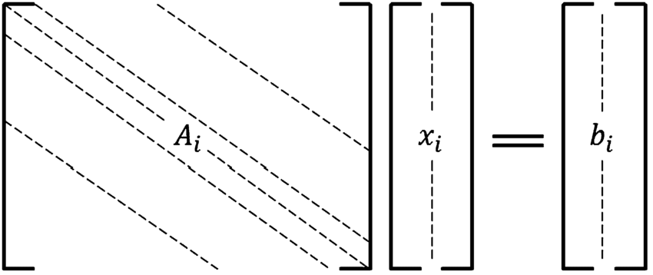
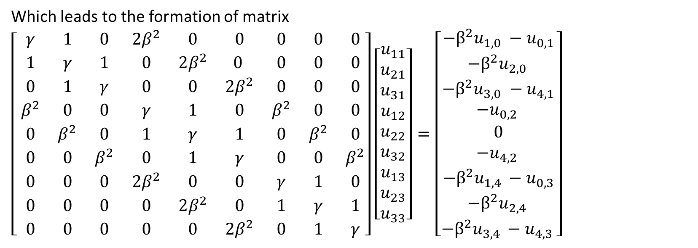

2D Diffusion: Numerical Method
Which leads to the formation of matrix
$\left[ \begin{matrix}γ & 1 & 0 & 2β^{2} & 0 & 0 & 0 & 0 & 0 \\ 1 & γ & 1 & 0 & 2β^{2} & 0 & 0 & 0 & 0 \\ 0 & 1 & γ & 0 & 0 & 2β^{2} & 0 & 0 & 0 \\ β^{2} & 0 & 0 & γ & 1 & 0 & β^{2} & 0 & 0 \\ 0 & β^{2} & 0 & 1 & γ & 1 & 0 & β^{2} & 0 \\ 0 & 0 & β^{2} & 0 & 1 & γ & 0 & 0 & β^{2} \\ 0 & 0 & 0 & 2β^{2} & 0 & 0 & γ & 1 & 0 \\ 0 & 0 & 0 & 0 & 2β^{2} & 0 & 1 & γ & 1 \\ 0 & 0 & 0 & 0 & 0 & 2β^{2} & 0 & 1 & γ\end{matrix}\right]\left[\begin{matrix}u_{11} \\ u_{21} \\ u_{31} \\ u_{12} \\ u_{22} \\ u_{32} \\ u_{13} \\ u_{23} \\ u_{33}\end{matrix}\right]=\left[\begin{matrix}−β^{2}u_{1,0} −u_{0,1} \\ −β^{2}u_{2,0 } \\ −β^{2}u_{3,0} −u_{4,1} \\ −u_{0,2 } \\ 0 \\ −u_{4,2 } \\ −β^{2}u_{1,4 }−u_{0,3} \\ −β^{2}u_{2,4 } \\ −β^{2}u_{3,4 }−u_{4,3 }\end{matrix}\right]$
Where
$$γ=−2\left(1+β^{2}\right)$$
And
$β=\frac{∆x }{∆y}$

Slide 14
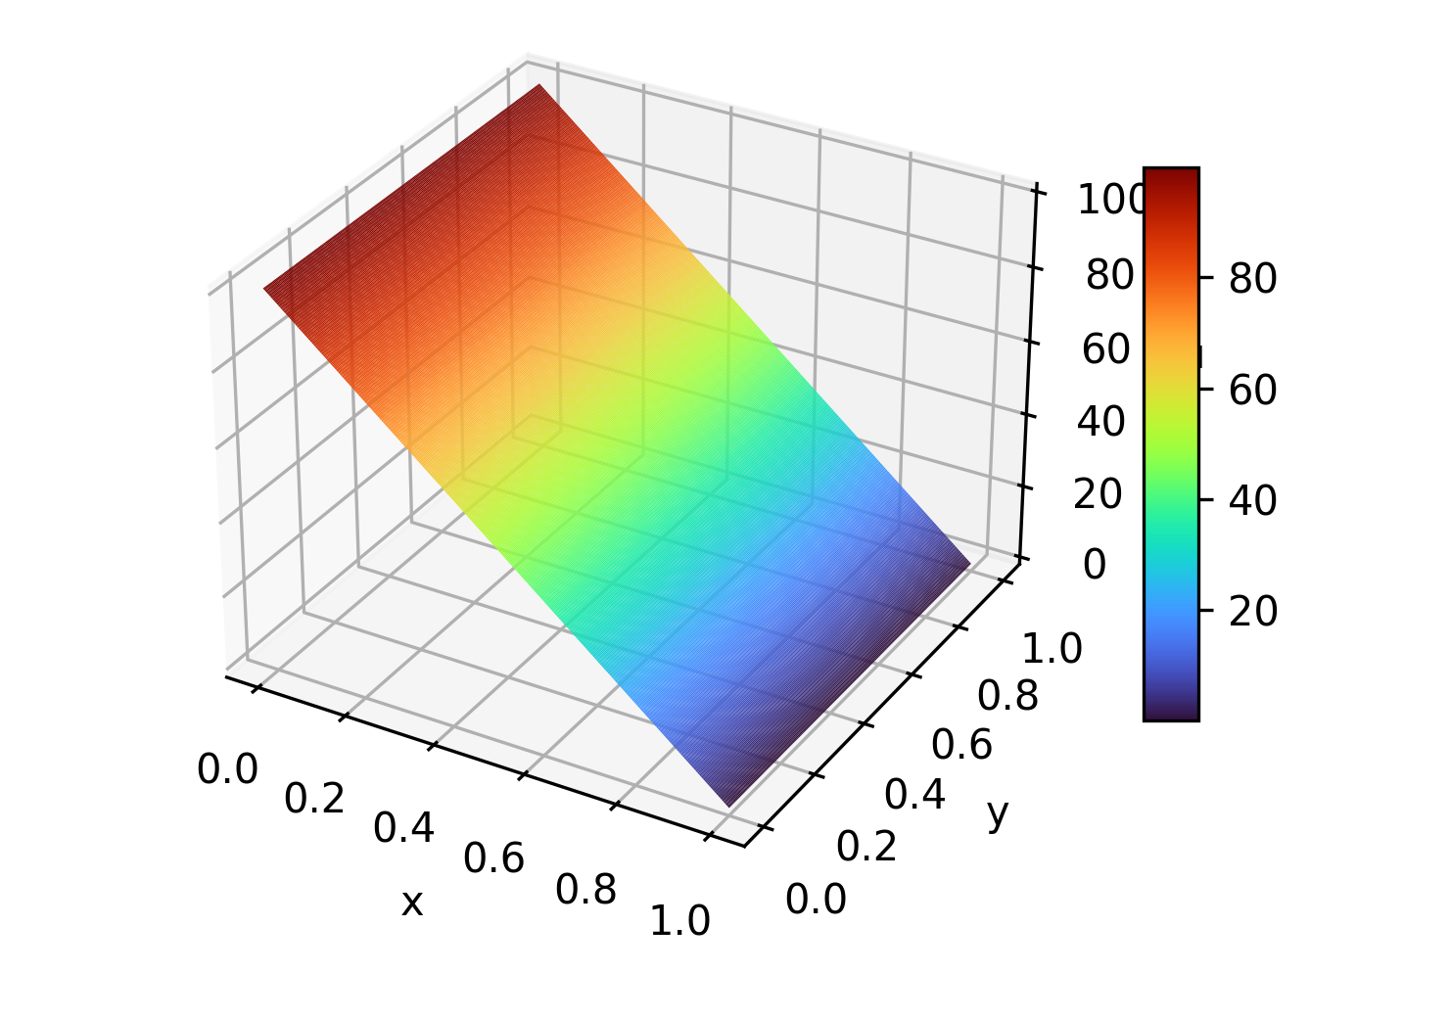
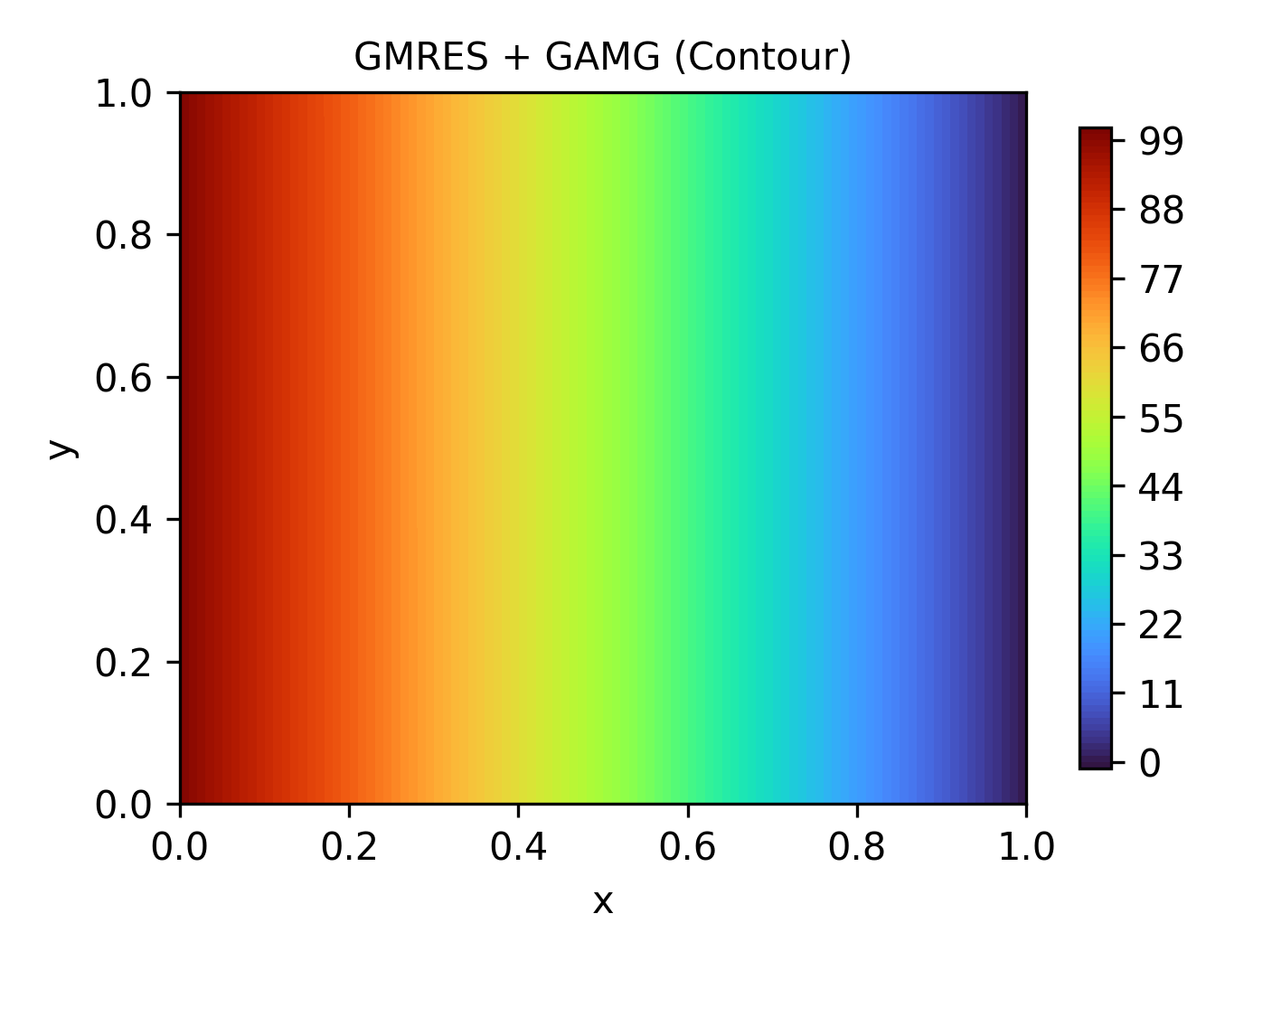
PETSc Workflow
petsc.cpp
Visualization
Bash script
1. Setup Grid
Perfromance.log
2. Assemble Matrix (A)
Result_5X5.txt
mpirun –np 20 ./petsc
Nx = [5, 10, 20, 40, 80, 100, 250 ]
Nx = Ny
3. Assemble Vectors (b)
… … .
4. Set KSP solver and Preconditioner
5. Solve and save file
Result_250X250.txt

Slide 15
Solvers and Preconditioners used
Solver | Preconditioner
CG | None
 | Bjacobi
 | ASM
 | GAMG
GMRES | None
 | Bjacobi
 | ASM
 | GAMG
MINRES | None
 | GAMG
FCG | None
 | Bjacobi
Chebyshev | None
 | Jacobi

Slide 16
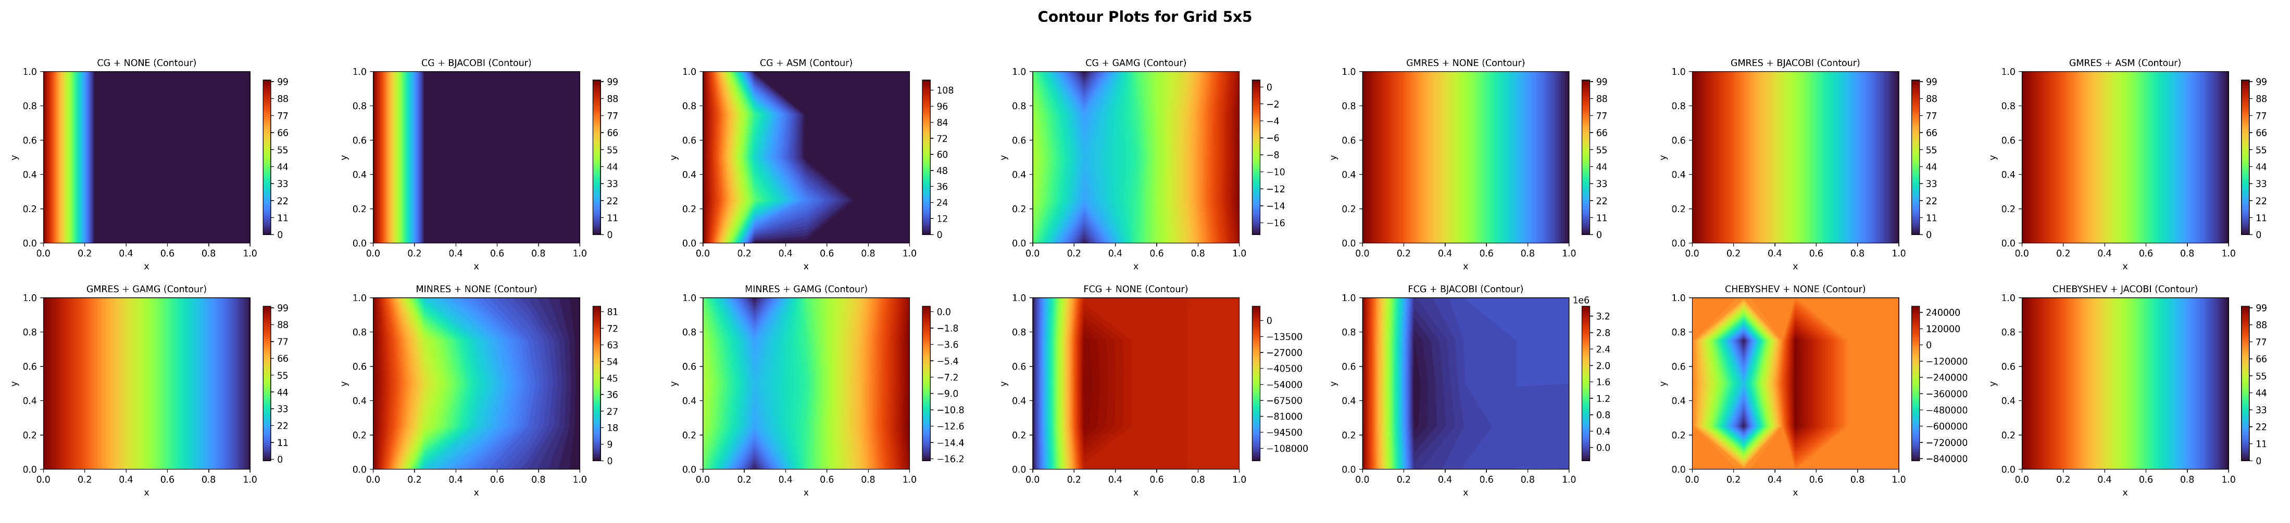
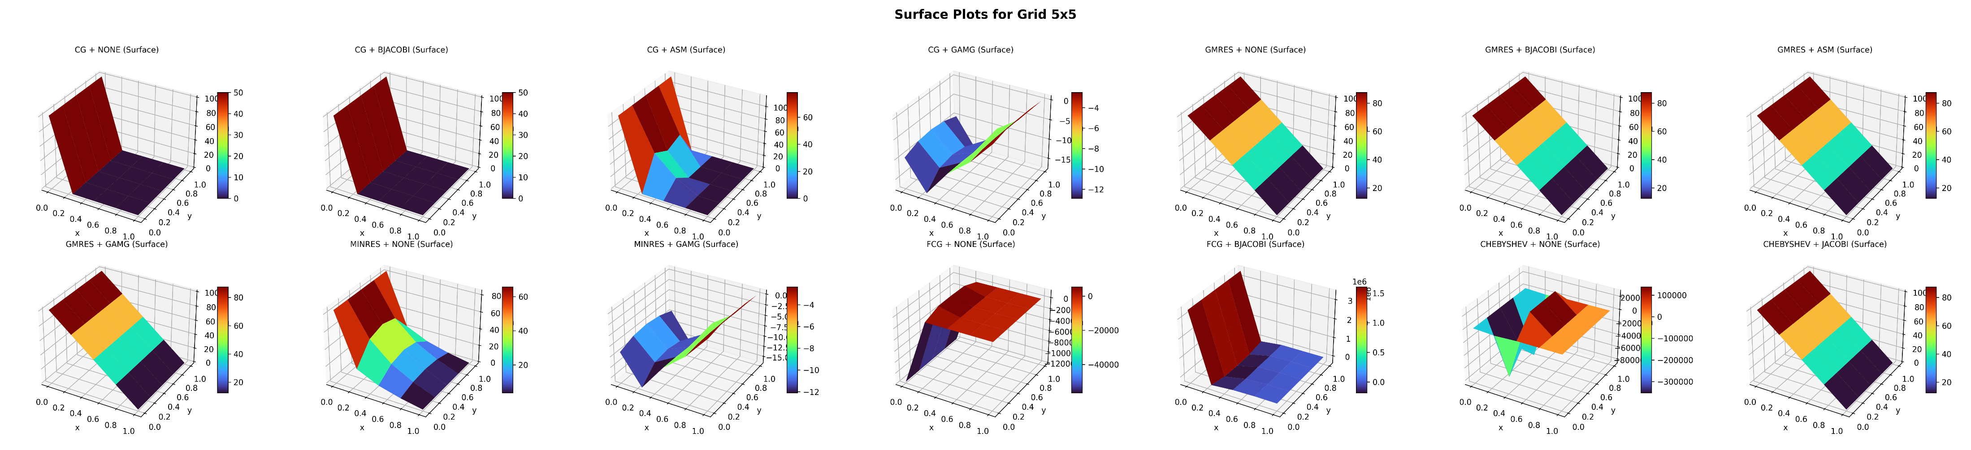
2D Diffusion: Results & Discussion

Slide 17
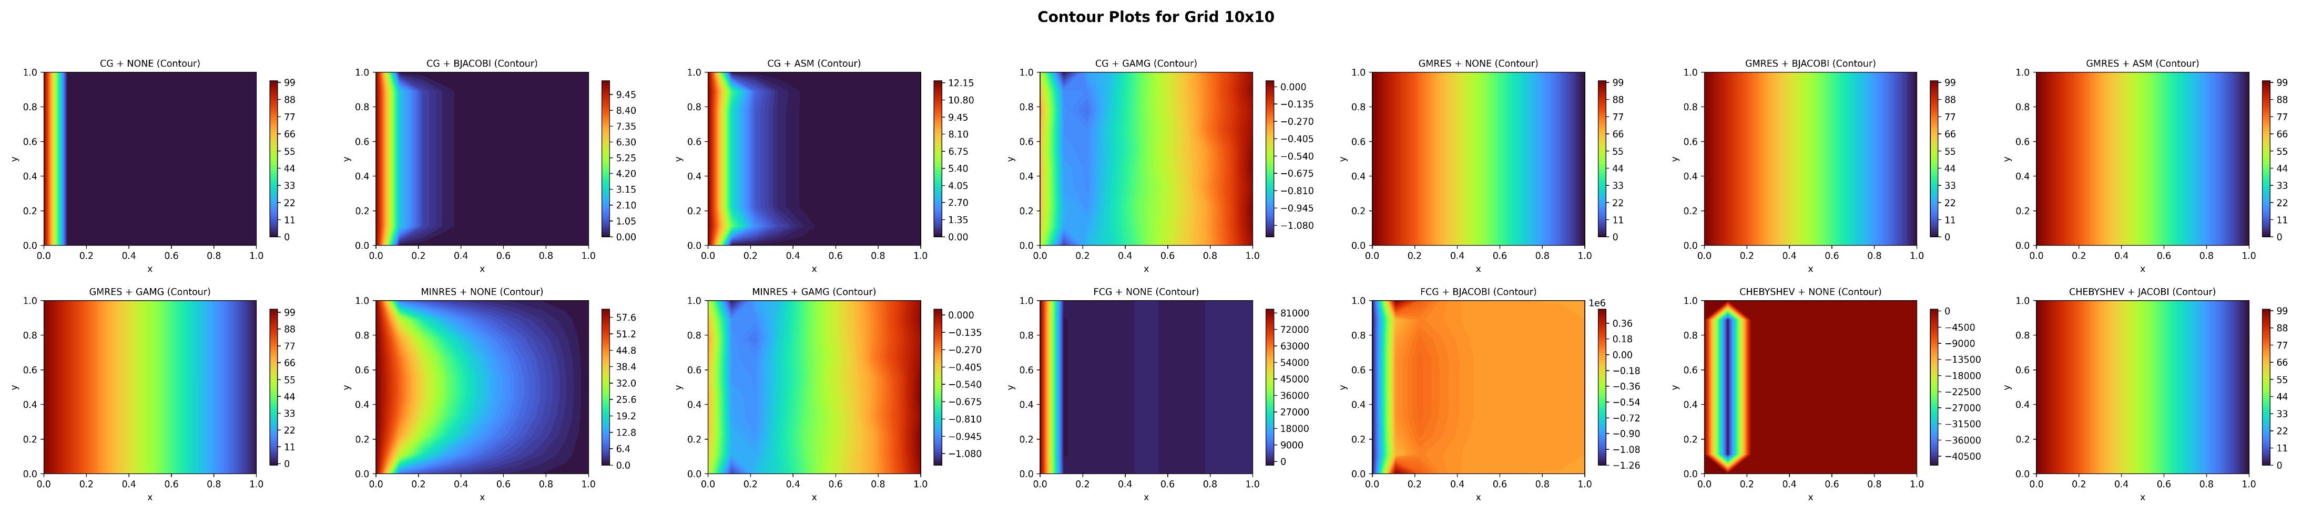

2D Diffusion: Results & Discussion

Slide 18


2D Diffusion: Results & Discussion

Slide 19


2D Diffusion: Results & Discussion

Slide 20


2D Diffusion: Results & Discussion

Slide 21


2D Diffusion: Results & Discussion

Slide 22


2D Diffusion: Results & Discussion

Slide 23
Performance Analysis

Slide 24


Performance Analysis

Slide 25

Conclusion & Learning Outcomes
FDM, FEM and FVM results closely match the exact solution across all grid sizes.
Residuals remains very low ($<{10}^{−12}$) which shows good solver convergence
Minor residual rise at finer grids is due to accumulated round-off errors.
GMRES: Most accurate and robust solver; converged consistently across all gris sizes with ASM or GAMG preconditioners .
CG: Fast for course grid but unstable and inaccurate for finer meshes
MINRES: shows false convergence-low residuals but physically incorrect solution
Chebyshev: Stable only for small grids; diverged for higher resolution
FCG: Poor convergence and high residuals across all cases; not suitable for this problem.

Slide 26
Questions! & THANK YOU

