Slide 1
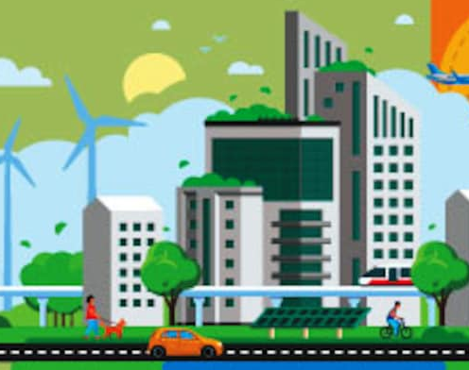
Sustainable Development

Slide 2

OUTLINE
Introduction
Sustainable Development
Importance

Slide 3
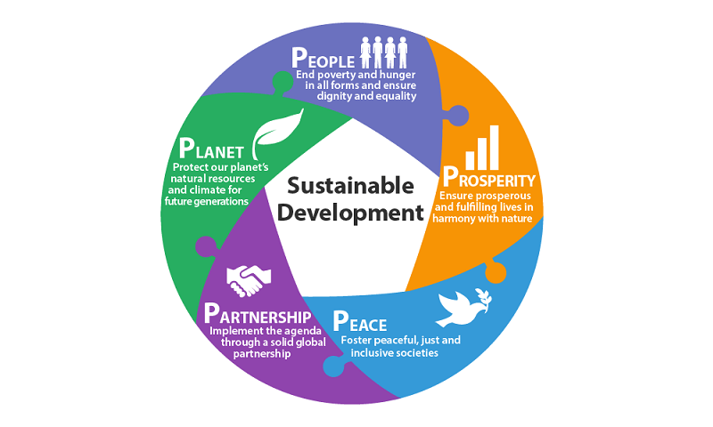
Introduction
Everything around us forms our environment and our lives depend on the natural world around us
We must ensure that we :
Plan the use of resources in a sustainable way
Choose a way that future generation can enjoy the good environment

Slide 4
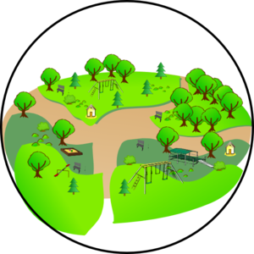
Sustainable Development
Sustainable Development is the development that satisfies the needs of the present without compromising with capacity of the future generations to fulfill their needs.

Slide 5
Importance Of Sustainable Development
If Sustainable development in not given priority then our future generations will face and serious threat on their ability to fulfil their needs.
Population is increasing and consumption is increasing day by day.
Thus various sustainable methods must be adopted to prevent the destruction of the environment.
This can only happen if initiative is taken at the individual level.

Slide 6
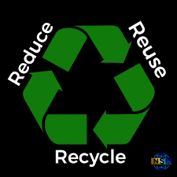
Problems related to sustainable Development
The Major problems are :
Food
Water
Fuel
Environment Friendly Methods:
Use Of Solar Energy
Eg: Charanka – Gujarat Solar Park
Reducing excessive use of resources
3Rs Of sustainable Development
Planting Trees

Slide 7

Sustainable Development Goals
They mainly focus on:
Action to end Poverty
Protect the Planet
All people enjoy peace and prosperity
Launched at the United Nations Sustainable Development Summit in New York in 2015 September, Forming the 2030 Agenda For Sustainable Development.
Core Skills Required :
Environmental Awareness
Willingness to learn about sustainable development

Slide 8
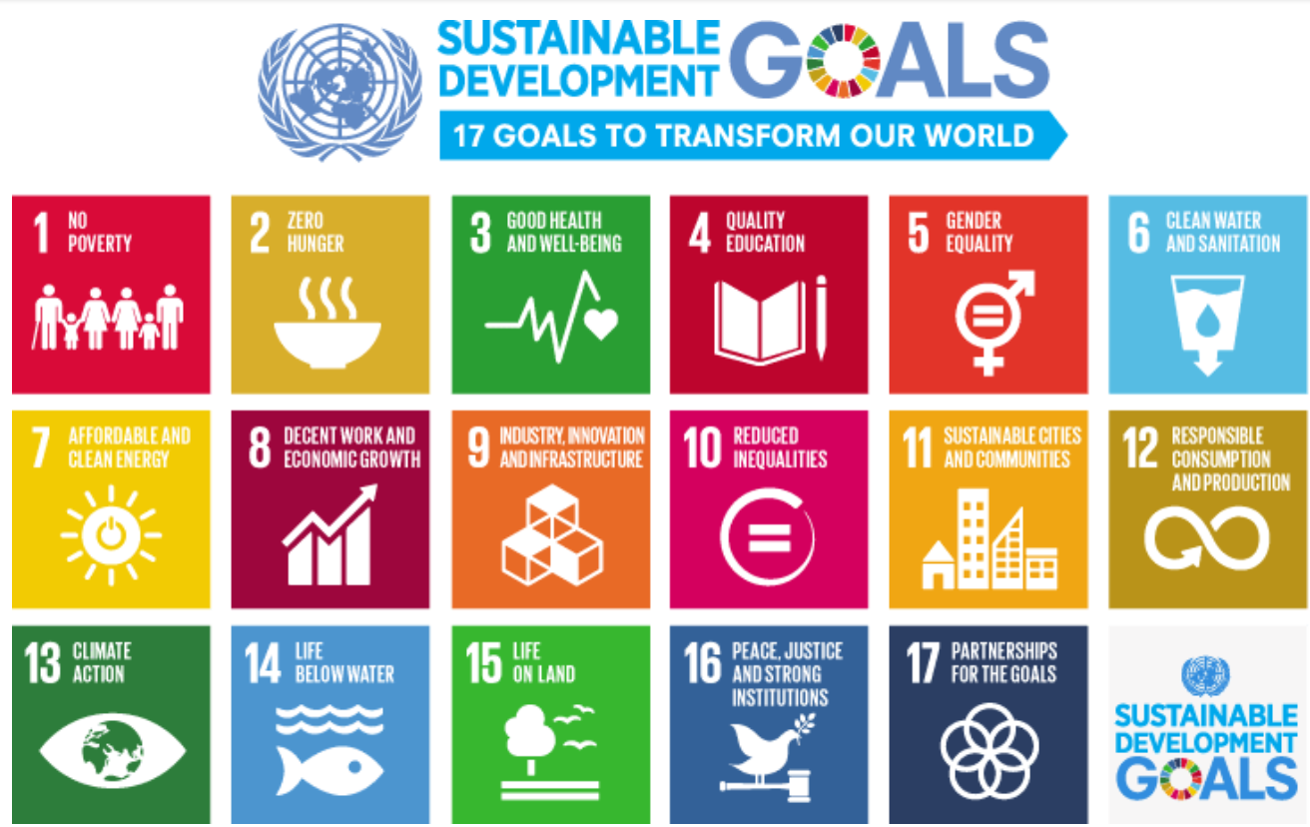
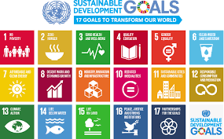

Slide 9


Sustainable Development Initiatives
Whenever steps are taken by the Government initiatives must be taken by different members of the society to make it a success.
For example:
Mr Avasth made a 100 % bio degradable bag which could dissolve in hot water and decompose in natural environment.
Narayana Peesapaty made edible cutlery out of grain.

Slide 10
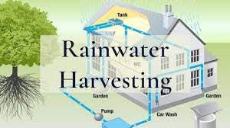
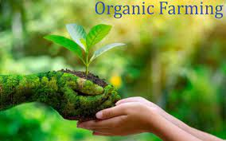
Sustainable Processes
It includes practices such as :
Vermicomposting
Rainwater Harvesting
Organic Farming

