Slide 1


BTech Final Project Handwriting Analysis
Gourav Kumar Shaw (2020CSB010)
Soumyadeep Sinha (2020CSB044)
Mentor: Dr. Samit Biswas

Slide 2

Objective
Author recognition from the handwritten text.
Using Convolutional Neural Network and train using a Softmax Classification loss function .
Instead of traditional way to establish features like curvature of letters, spacing between letters, and feed them into a strong classifier like SVM to distinguish between the writers.

Slide 3

Solution

Slide 4
Preprocessing of the data set
Previous Work…
Segmented the handwritten image first line wise then word wise.
Grayscale Conversion
Thresholding (Otsu's Method)
Dilation
Contour Detection
Bounding Box Filtering
Bounding Box Visualization
Word Extraction

Slide 5


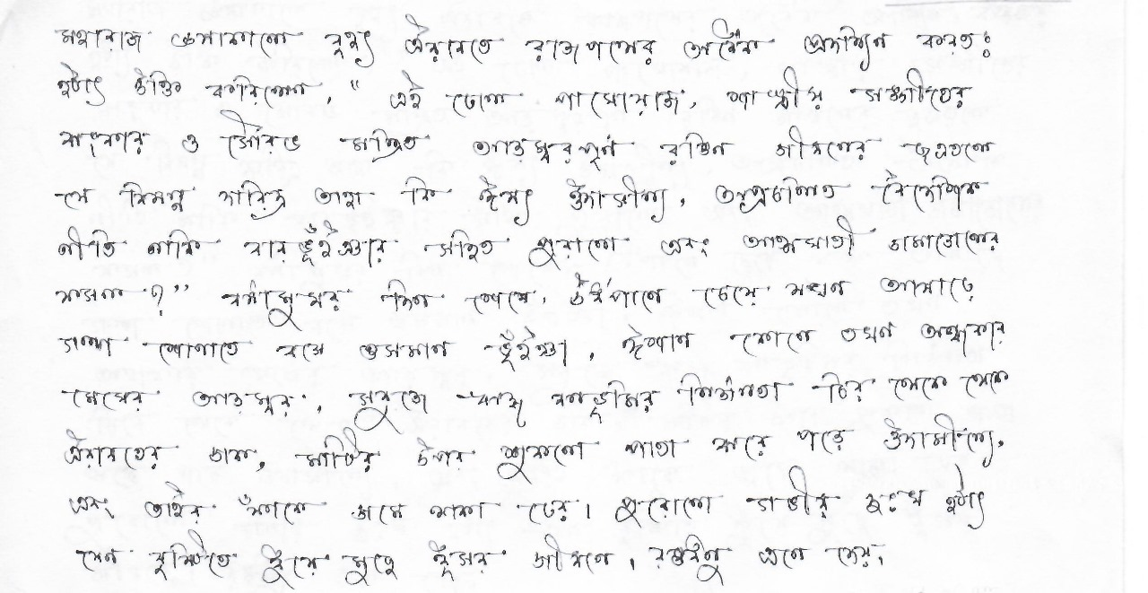










Input image and the output (Bangla)

Slide 6
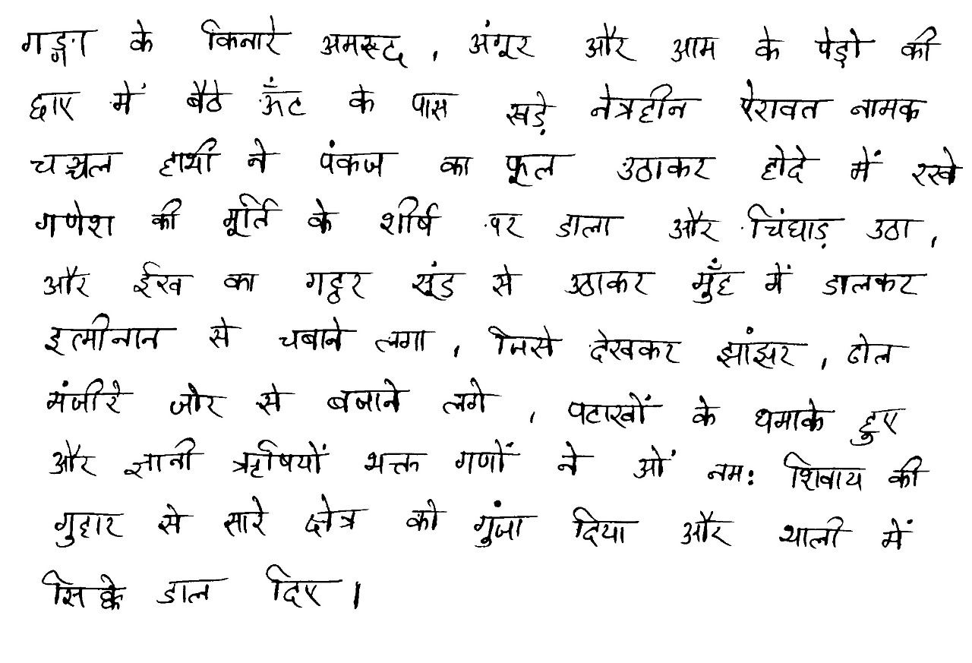















Input image and the output (Hindi)

Slide 7
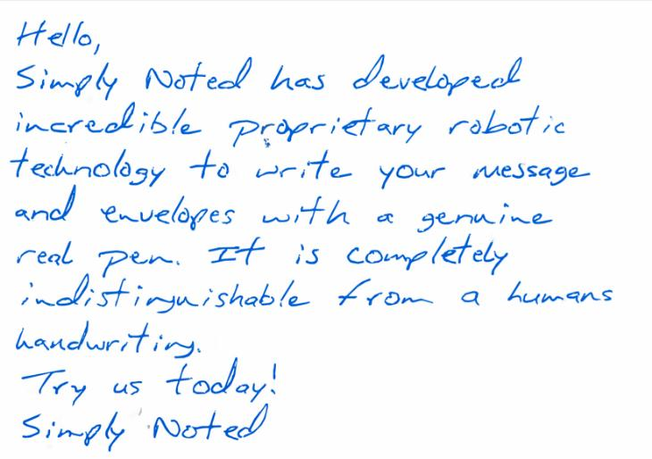










Input image and the output (English)

Slide 8
The dataset used contains 1539 pages of scanned text sentences written by 600+ writers.
Data Gathering (current work..)
This project uses the top 50 writers with most amount of data. Data is grouped by writers having written a collection of sentences

Slide 9
Preprocessing
For our CNN to understand the writing style, language is not a restriction, so we pass patches of text having image size 113x113 pixels from each sentence.
We didn't break them w.r.t. sentences or words, but we break them down into smaller image sets.
For serving the purpose, a generator function is implemented to scan through each sentence and generate random patches with same patch size.
Data-set is shuffled.

Slide 10
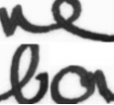
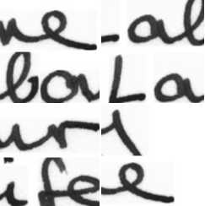
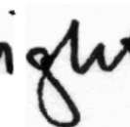
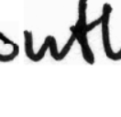
Input to the model

Slide 11
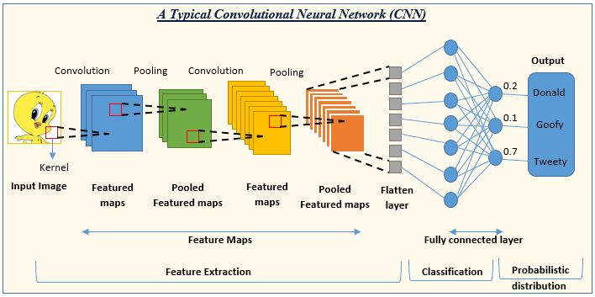
Convolutional Neural Network

Slide 12
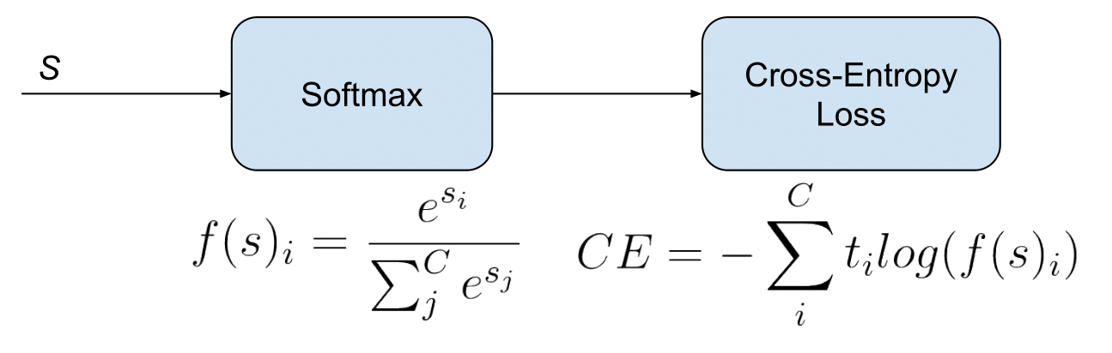
Softmax Function
Here, si​: The i-th element of the input vector.
e: Euler's number (approximately 2.71828).
t: is the actual label (0 or 1 in binary classification, a one-hot vector in multi-class classification).
f(s)i: predicted probability
SoftMax function is a mathematical function that takes a vector of real numbers as input and transforms it into a probability distribution.
Used in machine learning, particularly in multiclass classification problems
Cross-Entropy Loss is used for classification tasks.

Slide 13
Self-designed CNN Model
We’ve used Keras with TensorFlow backend.
A standard CNN Model is designed with multiple convolution and maxpool layers, a few dense layers and a final output layer is the softmax activation.
ReLU activation was also used between the convolution and dense layers.
The resultant model was optimized using Adam Optimizer.

Slide 14
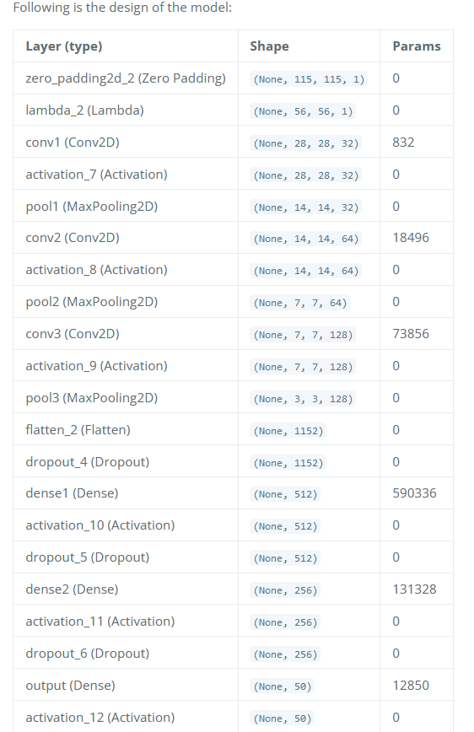
Design of the model

Slide 15
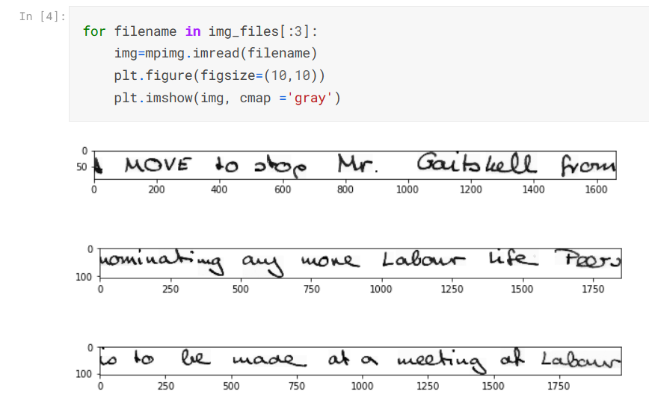
Visualize the image data.

Slide 16
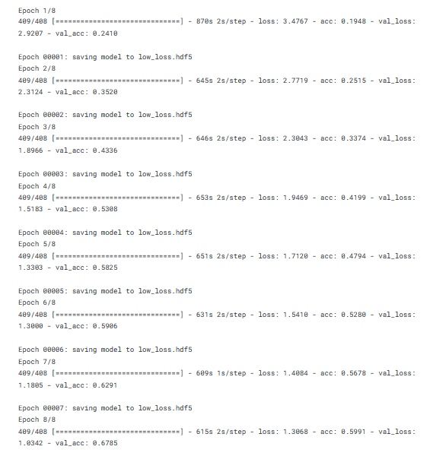
Taking 8 epoch

Slide 17
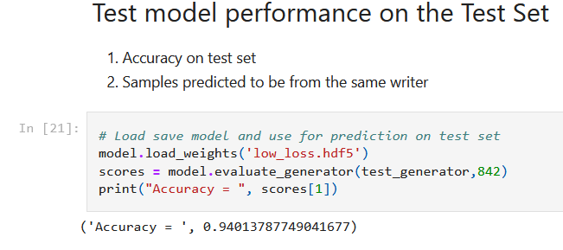
Accuracy of the Model
Link to Code: https://www.kaggle.com/code/gkshaw/handwriting-recognition-cnn/edit

Slide 18
Future Work
Accuracy
Accuracy can be improved by applying other advanced techniques like LSTM.

Slide 19
https://github.com/Gourav1695/BTech_Final_Project
Link to the Github repository code.

Slide 20
References
https://towardsdatascience.com/handwriting-recognition-using-tensorflow-and-keras-819b36148fe5
https://www.tensorflow.org/api_docs
https://keras.io/
https://www.linkedin.com/pulse/handwritten-text-recognition-using-deep-learning-cnn-rnn-dikhit/

Slide 21

Thank You!
Feel free to ask any further questions. ☺

