Slide 1


BTech Final Project Handwriting Analysis
Gourav Kumar Shaw (2020CSB010)
Soumyadeep Sinha (2020CSB044)
Mentor: Dr. Samit Biswas

Slide 2
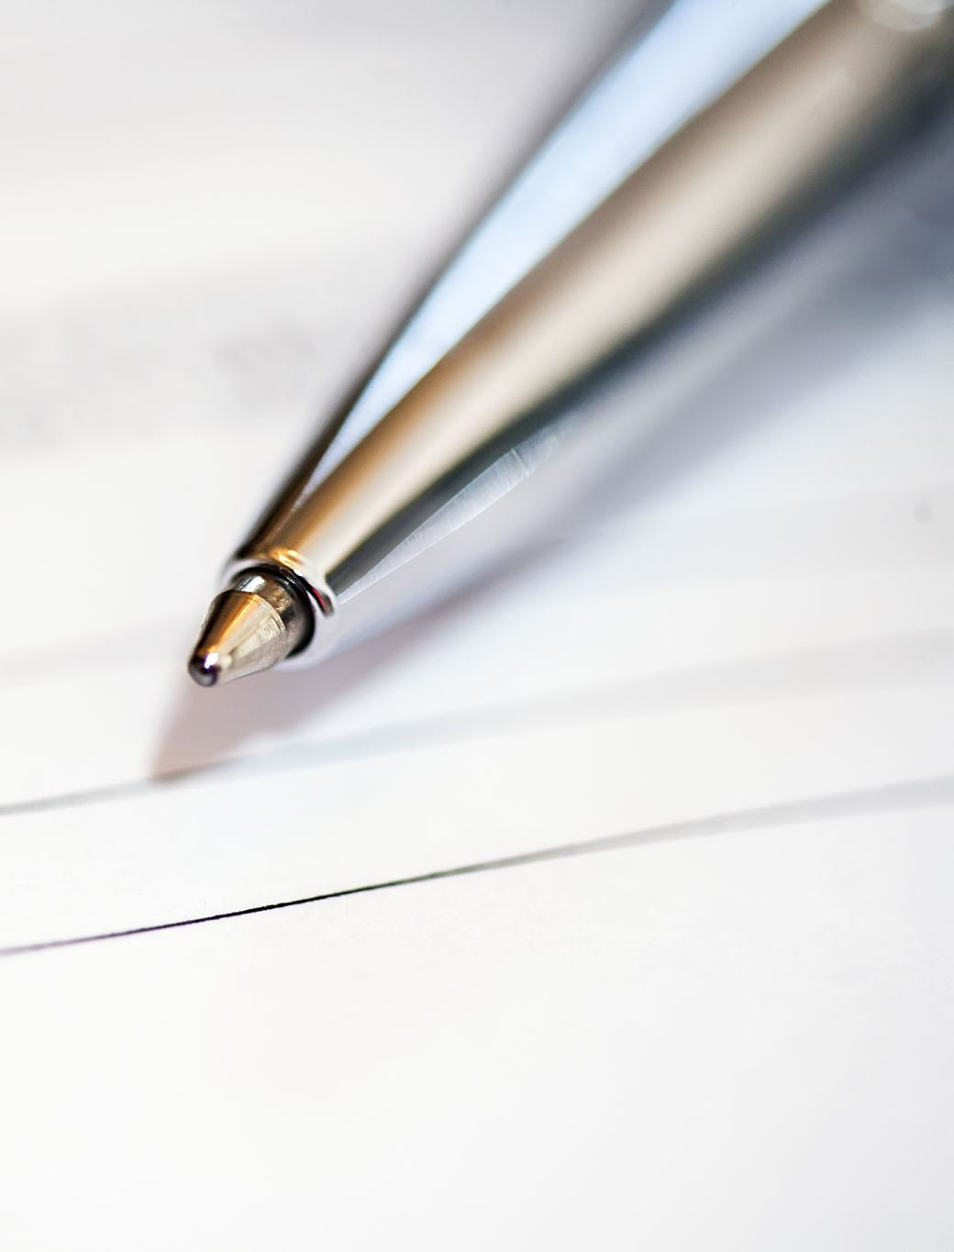
Objective
Author recognition from the handwritten text.
Using Convolutional Neural Network and train using a softmax classification loss function .
Instead of traditional way to establish features like curvature of letters, spacing between letters. And feed them into a strong classifier like SVM to distinguish between the writers.

Slide 3

Solution

Slide 4
The database used contains 1539 pages of scanned text sentences written by 600+ writers.
Data Gathering
This project uses the top 50 writers with most amount of data. Data is grouped by writers having written a collection of sentences

Slide 5
Preprocessing
For our CNN to understand the writing style, language is not a restriction, so we pass patches of text having image size 113x113 from each sentence.
We don't break them w.r.t. sentences or words, but we break them down into smaller image sets.
For serving the purpose, a generator function is implemented to scan through each sentence and generate random patches with same patch size.
CNN doesn’t even need to take the full data, so we’ve limited the number of patches to be 30% of the total patches.
Data-set is shuffled.

Slide 6
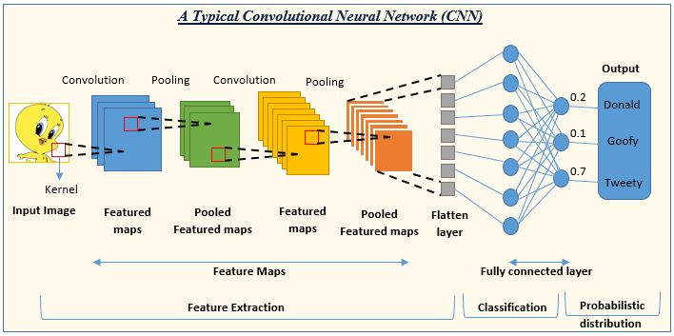
Convolutional Neural Network

Slide 7
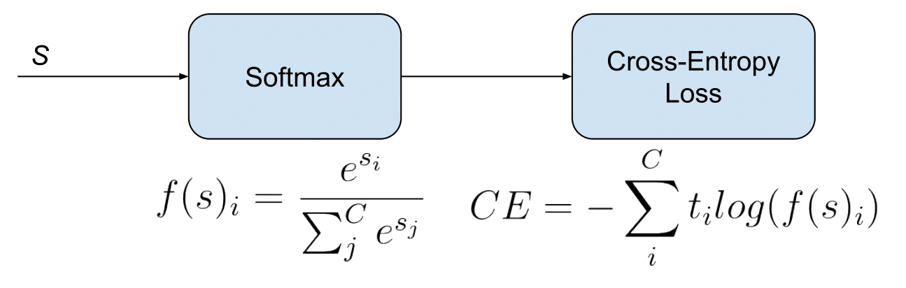
Softmax Function
Here, si​: The i-th element of the input vector.
e: Euler's number (approximately 2.71828).
t: is the actual label (0 or 1 in binary classification, a one-hot vector in multi-class classification).
f(s)i: predicted probability
SoftMax function is a mathematical function that takes a vector of real numbers as input and transforms it into a probability distribution.
Used in machine learning, particularly in multiclass classification problems
Cross-Entropy Loss is used for classification tasks.

Slide 8
Self-designed CNN Model
We’ve used Keras with TensorFlow backend.
A standard CNN Model is designed with multiple convolution and maxpool layers, a few dense layers and a final output layer is the softmax activation.
ReLU activation was also used between the convolution and dense layers.
The resultant model was optimized using Adam Optimizer.

Slide 9
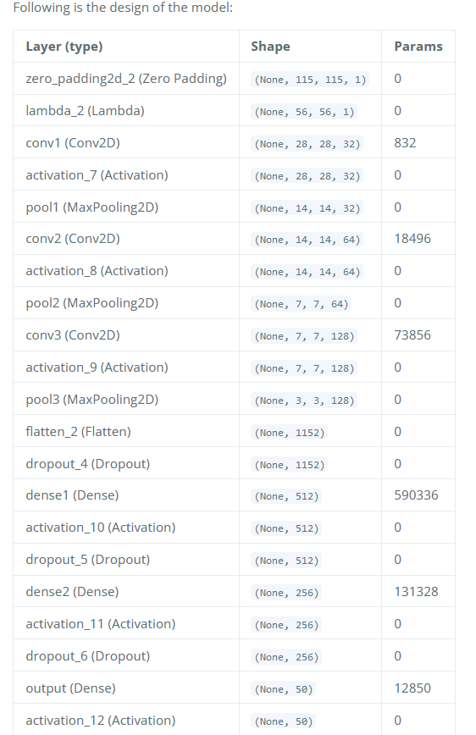
Design of the model

Slide 10
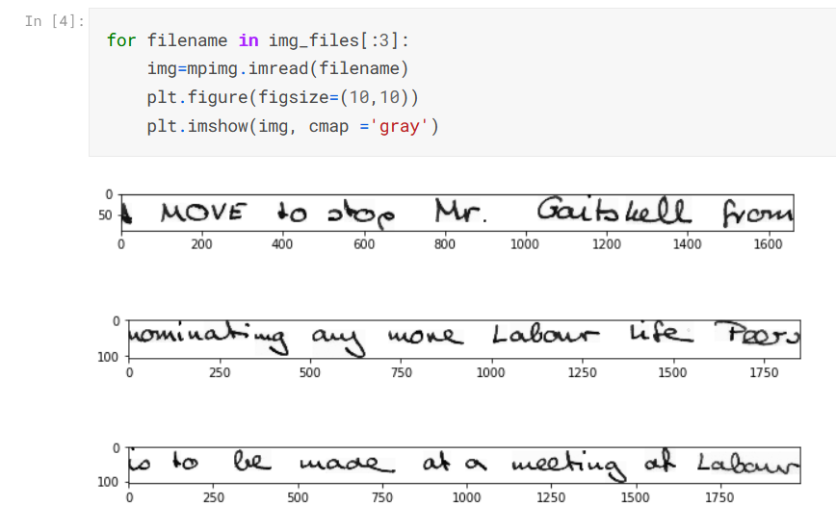
Visualize the image data.

Slide 11
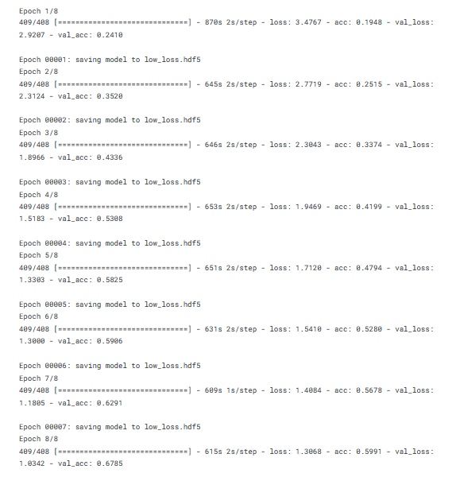
Taking 8 epoch

Slide 12
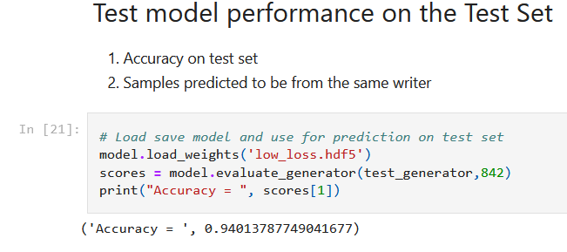
Accuracy of the Model
Link to Code: https://www.kaggle.com/code/gkshaw/handwriting-recognition-cnn/edit

Slide 13
Future Work
More Languages Support
Currently we test this model with only English dataset. Will test this model with regional languages like Bengali and Hindi.
Accuracy
Will try to improve the accuracy by applying other advanced techniques like LSTM.

Slide 14
References
https://towardsdatascience.com/handwriting-recognition-using-tensorflow-and-keras-819b36148fe5
https://www.tensorflow.org/api_docs
https://keras.io/
https://www.linkedin.com/pulse/handwritten-text-recognition-using-deep-learning-cnn-rnn-dikhit/

Slide 15

Thank You!
Feel free to ask any further questions. ☺

