Slide 1


Slide 2
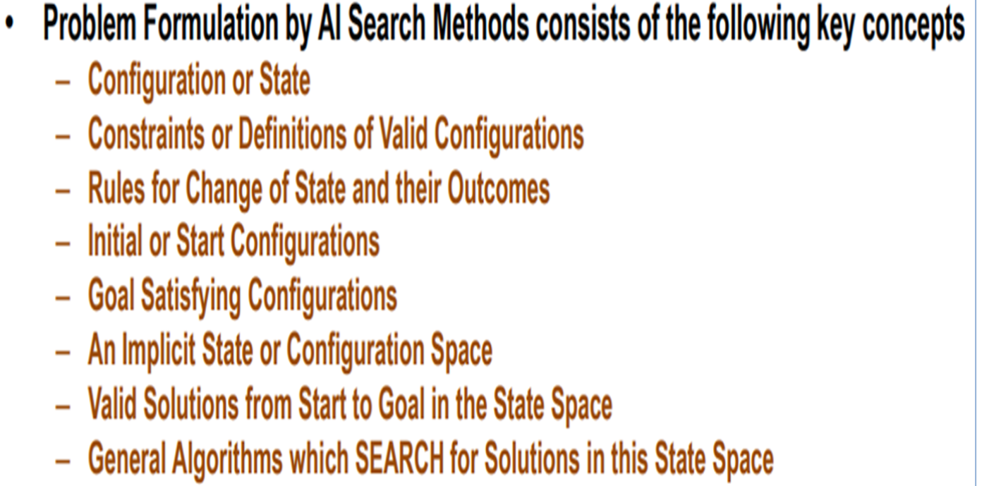


Slide 3

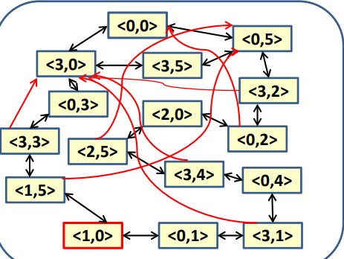

Slide 4
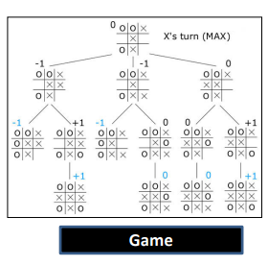

Slide 5
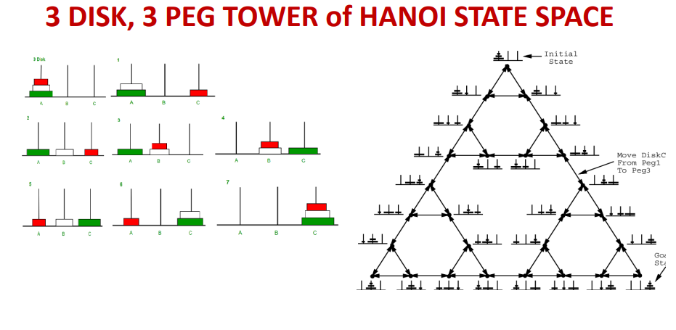

Slide 6

The SEARCH TREE represents possible action sequences starting at the initial state i.e. the root node.
Expand an unexpanded node
  test whether this is a goal state.
The current state is expanded by applying each legal action to the current state, thereby generating a new set of states.
Now we choose which of these states considered further to expand.
Follow one option now and putting the others aside for later, in case the first choice does not lead to a solution.

Slide 7

Uninformed search strategies use only the information available in the problem definition
Breadth-first search
Uniform-cost search
Depth-first search
Depth-limited search
Iterative deepening search

Slide 8



Slide 9


Expand shallowest unexpanded node
Nodes that have been expanded are shaded;
Nodes that have been generated but not yet expanded are outlined in bold;
Nodes that have not yet been generated are shown in faint dashed lines.

Slide 10


Slide 11


Slide 12
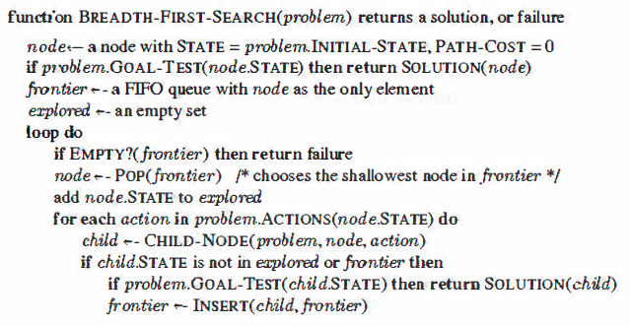

Slide 13
In some cases, redundant paths are unavoidable where
the actions are reversible, such as route-finding problems and sliding-block puzzles.
In some cases actions are irreversible.

Slide 14
The way to avoid exploring redundant paths is to remember where one has been.
Augment the TREE-SEARCH algorithm with a data structure called the explored set (also known as the closed list), which remembers every expanded node.
Newly generated nodes that match previously generated nodes—ones in the explored set—can be discarded instead of being added to the frontier (The set of all leaf nodes available for expansion at any given point is called the frontier.)
In Graph Search Algorithm the frontier separates the
state-space graph into the explored region and the unexplored region.

Slide 15
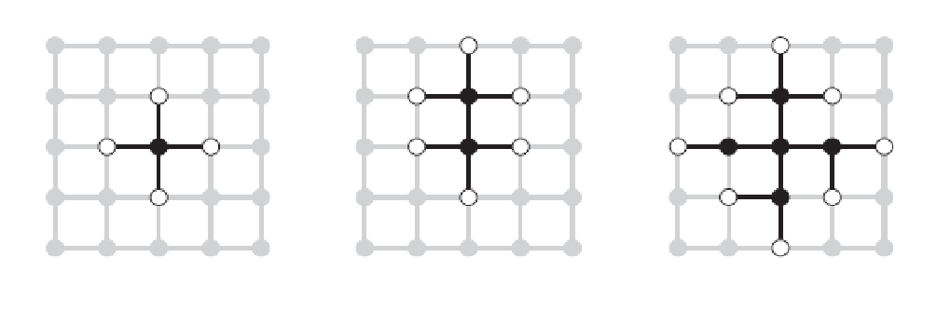
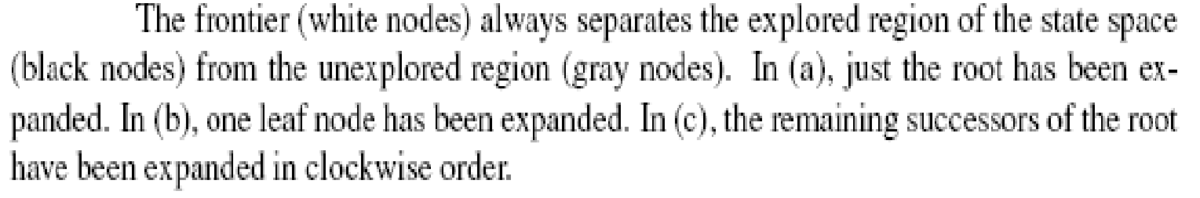
As every step moves a state from the frontier into the explored region while moving some states from the unexplored region into the frontier, we see that the algorithm is systematically examining the states in the state space, one by one, until it finds a solution.

Slide 16
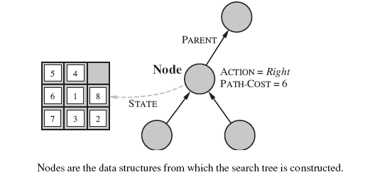

Slide 17
Infrastructure for search algorithms
For each node n of the tree, we have a structure that contains four components:
• n.STATE: the state in the state space to which the node corresponds;
• n.PARENT: the node in the search tree that generated this node;
• n.ACTION: the action that was applied to the parent to generate the node;
• n.PATH-COST: the cost denoted by g(n), of the path from the initial state to the node, as indicated by the parent pointers.

Slide 18
In AI, the graph is often represented implicitly by the initial state, actions, and transition model and is frequently infinite.
Complexity is expressed in terms of : b, the branching
factor or maximum number of successors of any node;
d, the depth of the shallowest goal node (i.e., the number of steps along the path from the root); and m, the maximum length of any path in the state space.
Time is often measured in terms of the number of nodes generated during the search, and space in terms of the maximum number of nodes stored in memory.
For the most part, we describe time and space complexity for search on a tree; for a graph, the answer depends on how “redundant” the paths in the state space are.

Slide 19
For breadth-first graph search in particular, every node generated remains in memory.
There will be O(b^{d−1}) nodes in the explored set and O(b^{d}) nodes in the frontier, so the space complexity is O(b^{d}).
First, the memory requirements are a bigger problem for breadth-first search than is the execution time.
If your problem has a solution at a depth d with large value, then it will take huge time for breadth-first search (or indeed any uninformed search) to find it.

Slide 20

Complete? Yes (if b is finite)
Time? 1+b+b²+b³+… +b^{d} + b(b^{d}-1) = O(b^{d+1})
Space? O(b^{d}) (keeps every node in memory)
Optimal? Yes, when all step costs are equal, breadth-first search is optimal because it always expands the
shallowest unexpanded node.
Space is the bigger problem (more than time).

Slide 21

Instead of expanding the shallowest node, uniform-cost search expands the node n with the lowest path cost g(n).
Whenever uniform-cost search selects a node n for expansion, the optimal path to that node has been found because whenever uniform-cost search selects a node n for expansion, the optimal path to that node n has been found.
Because step costs are nonnegative, paths never get shorter as nodes are added.
Uniform-cost search expands nodes in order of their optimal path cost.
Uniform-cost search does not care about the number of steps a path has, but only about their total cost.

Slide 22
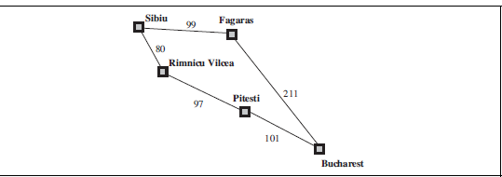
The problem is to get from Sibiu to Bucharest. The successors of Sibiu are Rimnicu Vilcea and Fagaras, with costs 80 and 99, respectively.
The least-cost node, Rimnicu Vilcea, expanded next, adding Pitesti with cost
80 +97=177.
The least-cost node is now Fagaras, so it is expanded, adding Bucharest with cost 99+211=310.
Now a goal node has been generated, but uniform-cost search keeps going, choosing Pitesti for expansion and adding a second path to Bucharest with cost 80+97+101= 278.
Now the algorithm checks to see if this new path is better than the old one; it is, so the old one is discarded. Bucharest, now with g-cost 278, is selected for expansion and the solution is returned.

Slide 23
Uniform-cost search is guided by path costs rather than depths, so its complexity is not easily characterized in terms of b and d.
Instead, let C∗ be the cost of the optimal solution, and assume that every action costs at least ε
The algorithm’s worst-case time and space complexity is
which can be much greater than b^{d}.
This is because uniform cost search can explore large trees of small steps before exploring paths involving large and perhaps useful steps.
When all step costs are equal, is just b^{d+1}.
When all step costs are the same, uniform-cost search is similar to breadth-first search, except that the latter stops as soon as it generates a goal, whereas uniform-cost search examines all the nodes at the goal’s depth to see if one has a lower cost; thus uniform-cost search does strictly more work by expanding nodes at depth d unnecessarily.

Slide 24

fringe ← MAKE-EMPTY-QUEUE()
fringe ← INSERT( root_node ) // with g=0
loop {
  if fringe is empty then return false // finished without goal
  node ← REMOVE-SMALLEST-COST(fringe)
  if node is a goal
    print node and g
    return true // that found a goal
  L_{g} ← EXPAND(node)
  // L_{g} is set of neighbours with their g costs // NOTE: do not check L_{g} for goals here!!
  fringe ← INSERT-IF-NEW(L_{g}, fringe )
    // ignore revisited nodes
    // unless with a new and better g
}

Slide 25
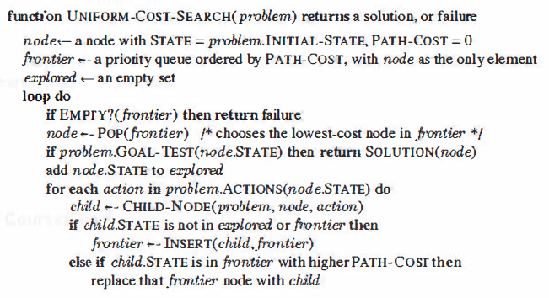

Slide 26
Consider the following problem…
A
1
10
5
5
S
B
G
15
5
C
We wish to find the shortest route from node S to node
In terms of path cost, we can clearly see that the route SBG is the cheapest route.
However, if we let breadth-first search loose on the problem it will find the non-optimal path SAG, assuming that A is the first node to be expanded at level 1.

Slide 27
We start with our initial state and expand it…
A
A
1
10
5
5
S
S
B
B
G
G
G
G
G
G
15
The goal state is achieved and the path S-B-G is returned. In relation to path cost, UCS has found the optimal route.
C

Slide 28
Expand least-cost unexpanded node
Implementation:
  fringe = queue ordered by path cost
Equivalent to breadth-first if step costs all equal
Complete? Yes, if step cost ≥ ε
Time? O(b^{ceiling(C*/ ε)}) where C* is the cost of the optimal solution
Space? O(b^{ceiling(C*/ ε)})
Optimal? Yes – given the condition of completeness – you always expand the node with lowest cost
  O(b^{ceiling(C*/ ε)}) can be greater than O^{b/d}

Slide 29


Expand deepest unexpanded node

Slide 30

Expand deepest unexpanded node

Slide 31


Expand deepest unexpanded node

Slide 32

Expand deepest unexpanded node

Slide 33

Expand deepest unexpanded node

Slide 34


Expand deepest unexpanded node

Slide 35

Expand deepest unexpanded node

Slide 36

Complete? No: fails in infinite-depth spaces, spaces with loops
  Complete in finite spaces
Time? O(b^{m}): terrible if m is much larger than d
  But if solutions are dense, may be much faster than breadth-first
Space? O(bm), i.e., linear space!
Optimal? No

Slide 37

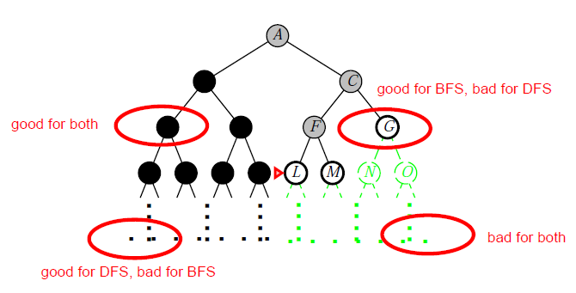

Slide 38

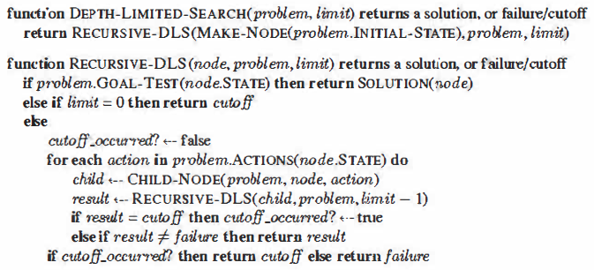
Depth-first search with depth limit l, i.e., nodes at depth l have no successors, knowledge is available.
Recursive implementation:

Slide 39

Complete? NO. Why? (l < d OR l > d)
Time? O(b^{l})
Space? O(bl)
Depth-first search is a special case of depth-limited with l being infinite.
Depth-limited search can solve the drawback of the infinite path in the Depth-first search.
In this algorithm, the node at the depth limit will treat as it has no successor nodes further.

Slide 40

Iterative deepening search gradually increasing the limit—first 0, then 1, then 2, and so on—until a goal is found.
Iterative deepening combines the benefits of depth-first
and breadth-first search.
Like depth-first search, its memory requirements are modest: O(bd)
Like breadth-first search, it is complete when the branching factor is finite and optimal when the path cost is a nondecreasing function of the depth of the node.

Slide 41



Slide 42



Slide 43



Slide 44



Slide 45

Number of nodes generated in a depth-limited search to depth d with branching factor b:
N_{DLS} = b⁰ + b¹ + b² + … + b^{d-2} + b^{d-1} + b^{d}
N_{IDS} = (d+1)b⁰ + d b¹ + (d-1)b² + … + 3b^{d-2} +2b^{d-1} + 1b^{d}
For b = 10, d = 5,
  N_{DLS} = 1 + 10 + 100 + 1,000 + 10,000 + 100,000 = 111,111
  N_{IDS} = 6 + 50 + 400 + 3,000 + 20,000 + 100,000 = 123,456
Number of nodes generated in an iterative deepening search to depth d with branching factor b:
  Overhead = (123,456 - 111,111)/111,111 = 11% more nodes than BFS

Slide 46

Complete? Yes
Time? (d+1)b⁰ + d b¹ + (d-1)b² + … + b^{d} = O(b^{d})
Space? O(bd)
Optimal? Yes, if step cost = 1

Slide 47



