Slide 1


Slide 2

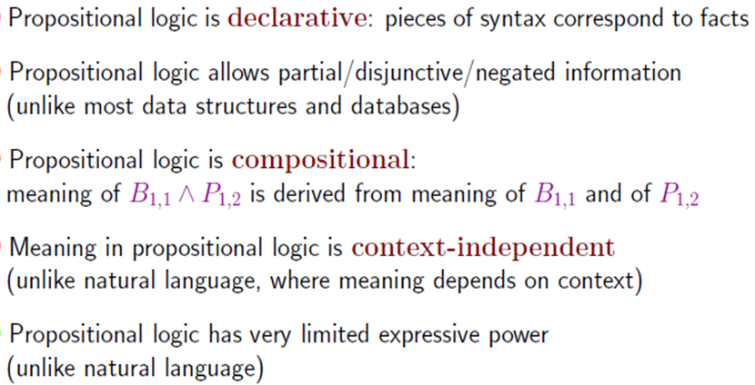

Slide 3

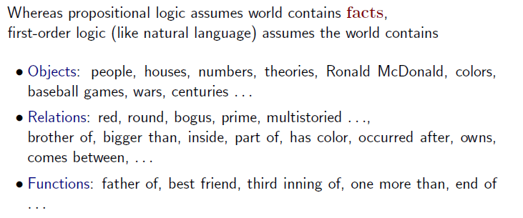
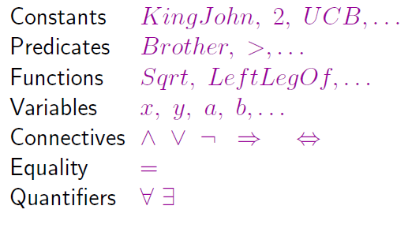
Syntax:

Slide 4

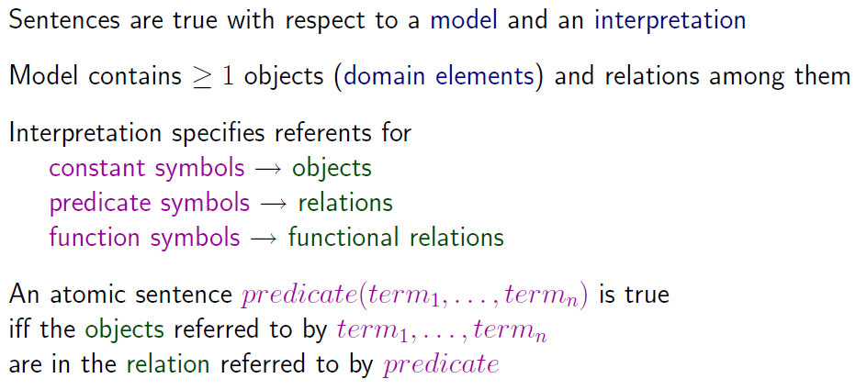

Slide 5

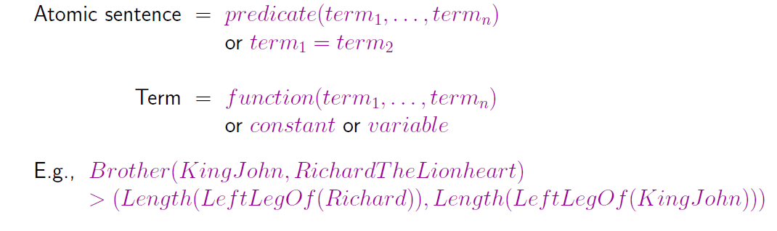
E(x, y) denote "x = y"
Multiple Quantifiers
∃x ∀ y p(x,y) means "There exists some x such that p (x, y) is true for every y."

Slide 6

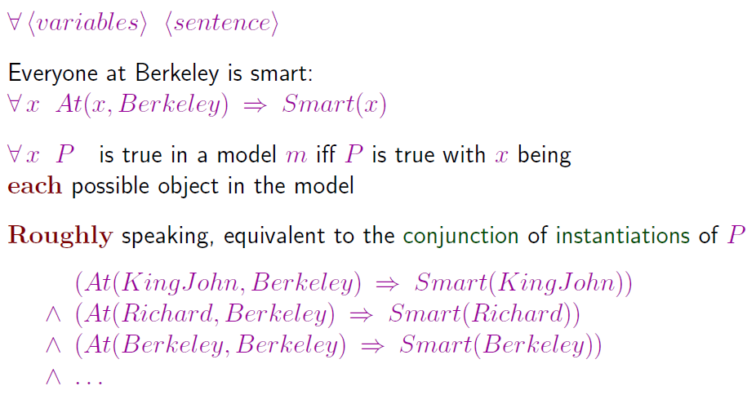

Slide 7

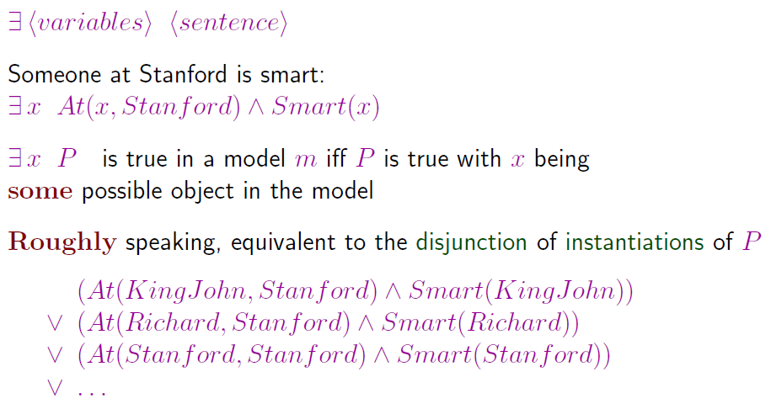

Slide 8

∀x p(x) ∧ ∃ y q(y)
~.(∀x p(x) ∧ ∃ y q(y))
≅~∀ x p(x)∨∼∃yq (y) (∴∼(p∧q)=∼p ∨∼q)
≅ ∃ x ~p(x)∨∀y∼q(y)
Negation of a universally quantified proposition results an existentially quantified proposition, and negation of an existentially quantified proposition results a universally quantified proposition.

Slide 9

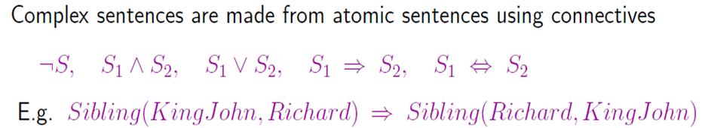
Well Formed Formula (wff) is a predicate holding any of the following −
All propositional constants and propositional variables are wffs
If x is a variable and Y is a wff, ∀xY and ∃xY are also wff
Truth value and false values are wffs
Each atomic formula is a wff
All connectives connecting wffs are wffs

Slide 10

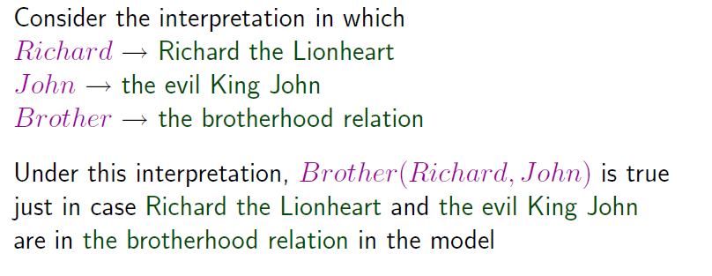

Slide 11

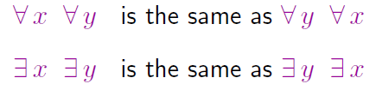
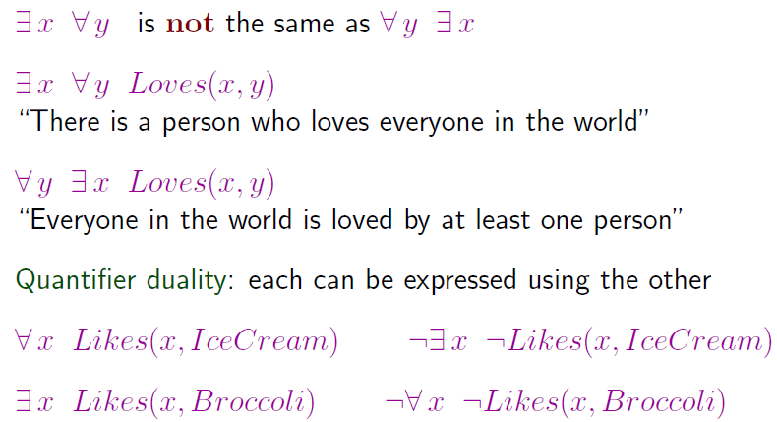

Slide 12

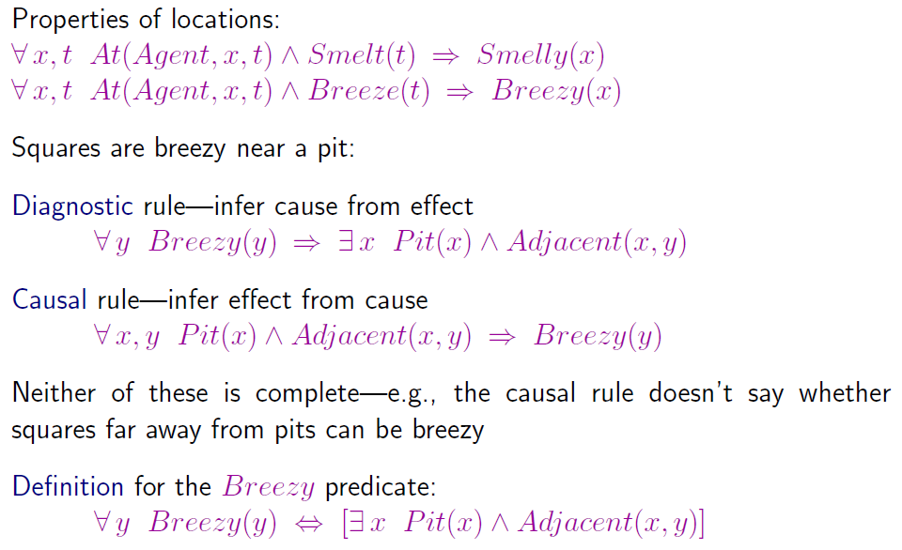

Slide 13
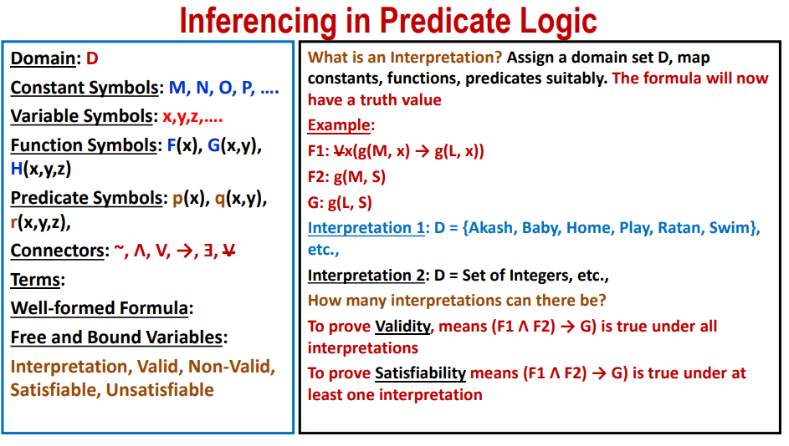

Slide 14
Resolution in FOL
Resolution is a theorem proving technique that proceeds by building refutation proofs, i.e., proofs by contradictions.
Resolution is used, if there are various statements are given, and we need to prove a conclusion of those statements.
Resolution is a single inference rule which can efficiently operate on the conjunctive normal form or clausal form.
Clause: Disjunction of literals (an atomic sentence) is called a clause.
Conjunctive Normal Form: A sentence represented as a conjunction of clauses is said to be conjunctive normal form or CNF

Slide 15

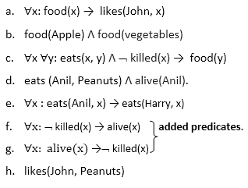
(i) John likes all kind of food.
(ii) Apple and vegetable are food
(iii) Anything anyone eats and not killed is food.
(iv) Anil eats peanuts and still alive
(v) Harry eats everything that Anil eats.
Prove by resolution:
John likes peanuts.
1.Conversion of facts into first-order logic.
2. Convert FOL statements into CNF
3. Negate the statement which needs to prove
(proof by contradiction)
4. Draw resolution graph (unification).
Step 1:

Slide 16
Eliminate all implication (→) and rewrite
  ∀x ¬ food(x) V likes(John, x)
  food(Apple) Λ food(vegetables)
  ∀x ∀y ¬ [eats(x, y) Λ ¬ killed(x)] V food(y)
  eats (Anil, Peanuts) Λ alive(Anil)
  ∀x ¬ eats(Anil, x) V eats(Harry, x)
  ∀x¬ [¬ killed(x) ] V alive(x)
  ∀x ¬ alive(x) V ¬ killed(x)
  likes(John, Peanuts).
Move negation (¬)inwards and rewrite
  ∀x ¬ food(x) V likes(John, x)
  food(Apple) Λ food(vegetables)
  ∀x ∀y ¬ eats(x, y) V killed(x) V food(y)
  eats (Anil, Peanuts) Λ alive(Anil)
  ∀x ¬ eats(Anil, x) V eats(Harry, x)
  ∀x ¬killed(x) ] V alive(x)
  ∀x ¬ alive(x) V ¬ killed(x)
  likes(John, Peanuts).
Step-2: Conversion of FOL into CNF
In First order logic resolution, it is required to convert the FOL into CNF

Slide 17
Rename variables or standardize variables
  ∀x ¬ food(x) V likes(John, x)
  food(Apple) Λ food(vegetables)
  ∀y ∀z ¬ eats(y, z) V killed(y) V food(z)
  eats (Anil, Peanuts) Λ alive(Anil)
  ∀w¬ eats(Anil, w) V eats(Harry, w)
  ∀g ¬killed(g) V alive(g)
  ∀k ¬ alive(k) V ¬ killed(k)
  likes(John, Peanuts).
Eliminate existential instantiation quantifier by elimination.
In this step, we will eliminate existential quantifier ∃, and this process is known as Skolemization.
Here there is no existential quantifier so all the statements will remain same in this step.

Slide 18
Drop Universal quantifiers.
In this step we will drop all universal quantifier since all the statements are not implicitly quantified so we don't need it.
  ¬ food(x) V likes(John, x)
  food(Apple)
  food(vegetables)
  ¬ eats(y, z) V killed(y) V food(z)
  eats (Anil, Peanuts)
  alive(Anil)
  ¬ eats(Anil, w) V eats(Harry, w)
  killed(g) V alive(g)
  ¬ alive(k) V ¬ killed(k)
  likes(John, Peanuts).

Slide 19
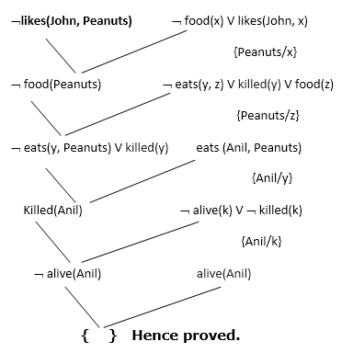
Distribute conjunction ∧ over disjunction ¬.
Step-3: Negate the statement to be proved
In this statement, we will apply negation to the conclusion statements, which will be written as ¬likes(John, Peanuts)
Step-4: Draw Resolution graph:

Slide 20
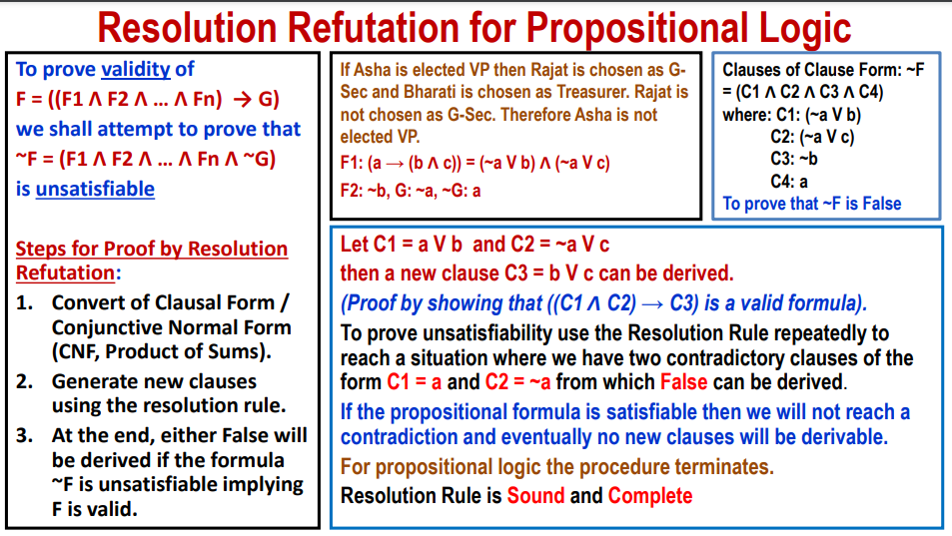

Slide 21
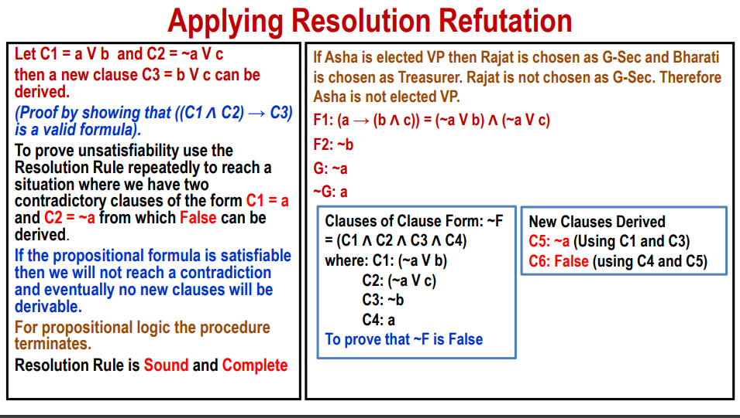

Slide 22
