Slide 1
Belief Measures

Slide 2
Properties of Belief Measures
Say, the sets A₁, A₂,…. A_{n} in X are pair wise disjoint, i.e. A_{i}∩A_{j} = φ for all i, j∈{1,2,…,n}, i ≠ j
Subadditivity: Bel(A₁∪A₂) ∪…. ∪A_{n}) ≥ Bel(A₁)+Bel(A₂)+……+Bel(A_{n})
For n=2; A₁≡A and A₂ ≡~A, Bel(A₁∪A₂)=Bel(A ∪~A)
So, Bel(A ∪~A) ≥ Bel(A) + Bel(~A) − Bel(A ∩ ~A)
A ∪~A=X and A ∩ ~A = φ, so Bel(X) ≥ Bel(A) + Bel(~A)
So Bel(A)+Bel(~A) ≤ 1 as Bel(X)=1
Lack of belief in x∈A does not imply a strong belief in x∈~A
Plausibility measure Pl is defined as Pl(A)=1− Bel(~A)
Bel(A) = 1− Pl(~A); Pl(A) ≥ Bel(A)
Bel and Pl measures are mutually dual

Slide 3
Basic Probability Assignment
A Plausibility measure is a function Pl: ℜ→[0,1] satisfy axioms of fuzzy measures and subadditivity axiom.
Pl(A)+Pl(~A) ≥1 when n=2 and A∩~A=φ
Belief and Plausibility are expressed in terms of a set function m, called a basic probability assignment.
m:P(X)→[0,1] such that m(φ) = 0 and ∑m(A)=1
A∈P(X)
m(A) is interpreted as the degree of evidence indicating that a specific element of X belongs to the set A
Any additional evidence of the subsets of A, i.e. B⊆A, expressed by m(B).

Slide 4
Relationship: m(A), Bel(A) and Pl(A)
m(A) measures the belief that one commits to the set A exactly.
To obtain total belief that one commits to A, one must add to m(A) the quantities m(B) for all proper subsets B of A.
Given a m, belief and plausibility measures are determined by
Bel(A) = ∑ m(B) and Pl(A) = ∑ m(B); for all sets A∈P(X)
B⊆A B∩A≠φ
m(A) = ∑ (-1)^{⏐A−B⏐}Bel(B) ; ⏐A−B⏐ cardinality of the set difference
B⊆A of A and B

Slide 5
Relationship: m(A), Bel(A) and Pl(A)
m(A) measures the belief that the element (x∈A) in question belongs to the set alone, not the total belief that the element commits to A.
Bel(A) indicates the total evidence that the element belongs to the set A and to the various special subset of A.
Pl(A) represents the total evidence or belief that the element belongs to the set A or to any of the various special subsets of A plus the additional evidence or belief associated with sets that overlap with A.
Pl(A) ≥ Bel(A) ≥ m(A) for ∀A∈P(X)

Slide 6
Focal Elements
For every set A for which m(A)>0 is called a focal element of m
Focal elements are subsets of X on which the available elements focuses
When X is finite, m can be fully characterized by a list of focal elements A and corresponding values of m(A)
Total ignorance is expressed in terms of the basic assignment by m(X)=1 and m(A)=0 for all A≠X
Ignorance states that we know that the element is in the universal set, but we have no evidence about its location in any subset of X

Slide 7
Single Source based Measurement
Assume a doctor is trying to diagnose a disease by determining whether the patient belongs to one of the sets of people with pneumonia (P), bronchitis (B) or emphysema (E).
Universal set X denote the set of all possible diseases and say, X=P∪B∪E
The doctor after examining the patient, provide the basic assignments to the focal elements such that sum of those equal to 1:
P, B, E, P∪B, P∪E, B∪E, P ∪B ∪E

Slide 8
Uncertainty and Ignorance
Bayesian Theory is only concerned on Single evidence.
Bayesian theory is not able to distinguish between uncertainty and ignorance owing to incomplete information.
When we do not have any evidence about X, we assign Bel(X) = 0 as well as Bel(¬X) = 0
It is customary in Dempster-Shafer theory to think about the degree of belief in evidence as analogous to the mass of a physical object. That is, the mass of evidence supports a belief.
The reason for the analogy with an object of mass is to consider belief as a quantity that can move around, be split up, and combined.

Slide 9
A fundamental difference between Dempster-Shafer theory and probability theory is the treatment of ignorance.
Probability theory must distribute an equal amount of probability even in ignorance.
If you have no prior knowledge, then you must assume the probability p of each possibility is
p =1/N where N is the number of possibilities
The Dempster-Shafer theory does not force belief to be assigned to ignorance or refutation of a hypothesis.
The mass is assigned only to those subsets of the environment to which you wish to assign belief.
Consider a set of propositions as a whole
Assign a set of propositions an interval [belief, plausibility] to constraint the degree of belief for each individual propositions in the set

Slide 10
Rules of Combination
Combine multiple basic assignments in order to get a joint basic probability assignment which is equivalent to a group decision from various experts based on the evidence or belief from each of them independently.
Conjunction operation (AND, ∩): All sources are reliable
Disjunctive operation (OR, ∪): Only one reliable source among many

Slide 11
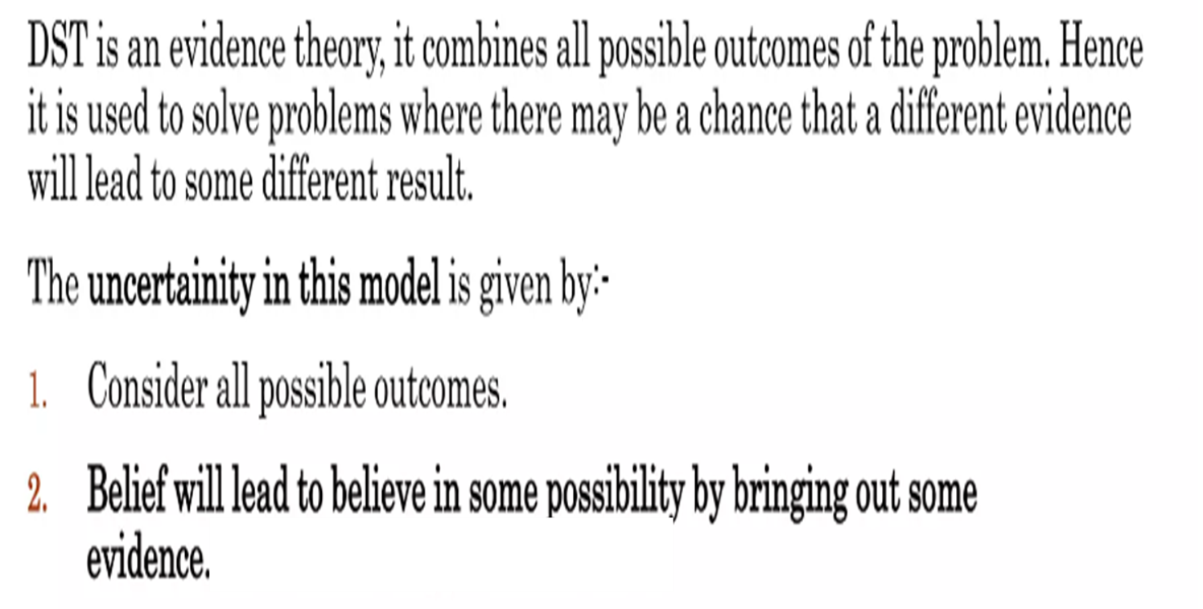

Slide 12
Dempster's Rule Of Combinations
In 1976, Dempster proposed a standard way of combining evidence from two independent sources (B ad C), termed as Dempster's rule of combination
Q – an exhaustive set of mutually exclusive hypotheses
A – a subset of Q
Given two basic assignments m₁ and m₂ on ℘(X), from two independent sources.
Total mass in support of A: ∑ m₁(B) * m₂(C)
B∩C=A
Mass of Conflict: ∑ m₁(B) * m₂(C)
B∩C= φ

Slide 13
Dempster’s Rule
The combined value of evidence m_{1,2}(A) according to this rule is given by:
∑B∩C=A m₁(B) * m₂(C)
m₁₂(A) =
1 − K
Conflict is normalized out by dividing 1− K, where K is the conflict

Slide 14
source 1 source 2
A
B
C
Source 1: m₁₍A) = 0.99 (component A)
Source 1: m₁(B) = 0.01(component B)
Source 2: m₂(B) = 0.01 (component B)
Source 2: m₂(C) = 0.99 (component C)
Dempster ‘s Rule: Support: m₁(B) * m₂(B)=0.0001
Conflict: m₁(A)m₂(B)+m₁(A)m₂(C)+m₁(B)m₂(C)=0.99*0.01+0.99*0.01+0.99*0.99= 0.9999
Answer: m₁₂(B)=0.01*0.01/1-0.9999=1

Slide 15
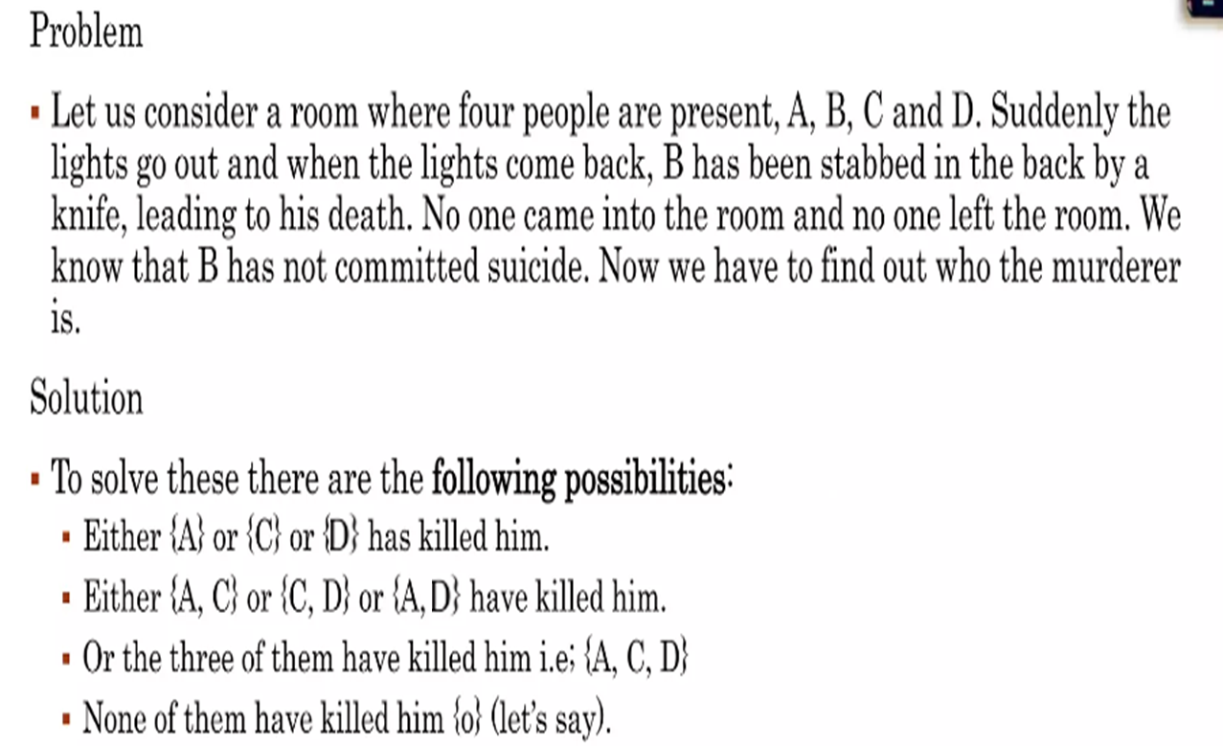

Slide 16
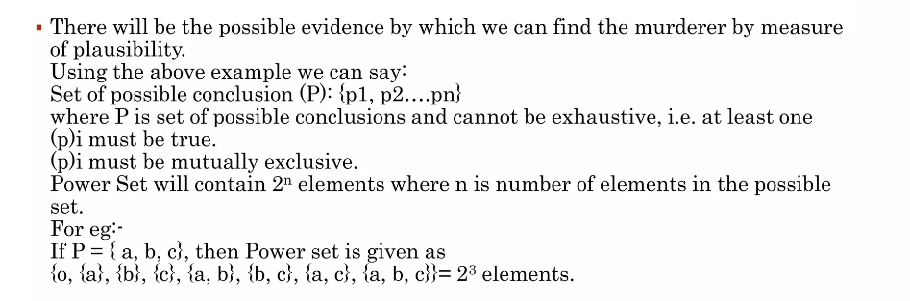

Slide 17
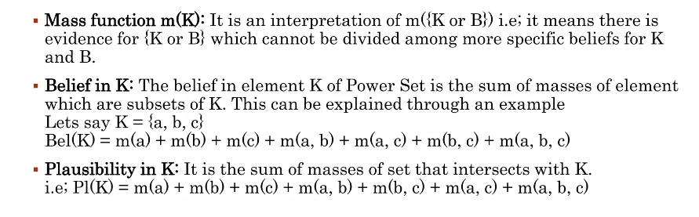
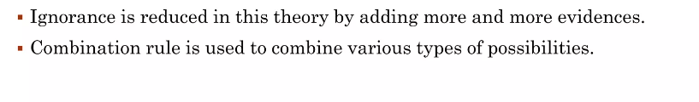

Slide 18
Diagnose Diseases
Due to the combined effect of dearth of experts and diversity of symptoms in diseases, an increasing need of knowledge based decision making system has been felt in the health care domain.
The existing knowledge-based query-oriented systems consist of static set of queries which are manually affixed.
When the patients come with subjective symptoms, a large number of questions are asked to diagnose the underlying disease properly.
During each stage of questioning, the doctor in a systematic way utilizes knowledge to differentiate particular disease(s) from a broader domain of possible diseases.
In reality, based on the response of a patient to a particular query, the doctor asks the next query, most relevant to the previous response.

Slide 19
Framework that arranges queries hierarchically to facilitate selection of most suitable query dynamically, based on the patient’s response.
The sets of queries selected in hierarchy with enough differentiating factors, eventually lead to a fair provisional diagnosis with promising degree of accuracy.
Fuzzy measures for each possible option relevant to a particular query are calculated using b. p. a.
Multiple experts’ opinions are fused using Dempster’s rule of combination to obtain fuzzy measures used for selecting the most suitable next query.

Slide 20
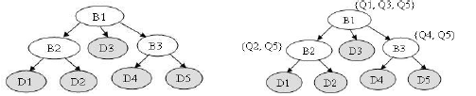
The B_{i} node represents the broader domains of diseases which can be subdivided while the D_{i} node denotes the fields representing final diagnosis of disease.

Slide 21
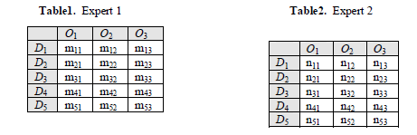
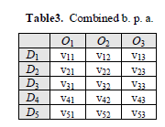
Suppose, for a query Q₁, the b. p. a. values are provided by two experts, given in Table 1 and Table 2.
Each O_{j} (1≤ j ≤ 3) represents all possible options for query Q₁ and each D_{i} (1≤ i ≤5) is a representative disease.
Now combined b. p. a. is calculated and Table 3 shows final b. p. a. for query Q₁.

