Slide 1
Planning

Slide 2
Introduction
Planning is required to reach a particular destination.
It is necessary to find the best route in Planning, but the tasks to be done at a particular time and why they are done also very important.
Planning is considered the logical side of acting.
In other words, Planning is about deciding the tasks to be performed by the artificial intelligence system and the system's functioning under domain-independent conditions.
We require domain description, task specification, and goal description for any planning system.
A plan is considered a sequence of actions, and each action has its preconditions that must be satisfied before it can act and some effects that can be positive or negative.

Slide 3
FSSP
Forward State Space Planning (FSSP) and Backward State Space Planning (BSSP) at the basic level.
FSSP behaves in the same way as forwarding state-space search.
It says that given an initial state S in any domain, we perform some necessary actions and obtain a new state S', called a progression.
It continues until we reach the target position.
Disadvantage: Large branching factor
Advantage: The algorithm is Sound

Slide 4
BSSP
BSSP behaves similarly to backward state-space search.
Move from the target state g to the sub-goal of g, tracing the previous action to achieve that goal.
This process is called regression.
These sub-goals should also be checked for consistency. The action should be relevant in this case.
Disadvantages: not sound algorithm (sometimes inconsistency can be found)
Advantage: Small branching factor (much smaller than FSSP)
So for an efficient planning system, we need to combine the features of FSSP and BSSP, which gives rise to target stack planning which will be discussed in the next article.

Slide 5
Components of the planning system
Choose the best rule to apply the next rule based on the best available guess.
Apply the chosen rule to calculate the new problem condition.
Find out when a solution has been found.
Detect dead ends so they can be discarded and direct system effort in more useful directions.
Find out when a near-perfect solution is found.

Slide 6
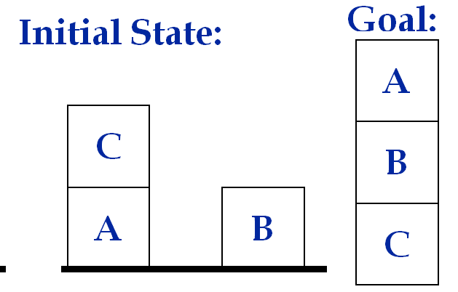
Example Problem Instance:
Sussman Anomaly
The Sussman Anomaly shows the limitations of non-interleaved planning methods.
The anomaly will show that naively pursuing one subgoal X after you satisfy the other subgoal Y, may not work because steps required to accomplish X may undo steps of subgoal Y.
Initial State: (on-table A) (on C A) (on-table B)
(clear B) (clear C) Goal: (on A B) (on B C)

Slide 7
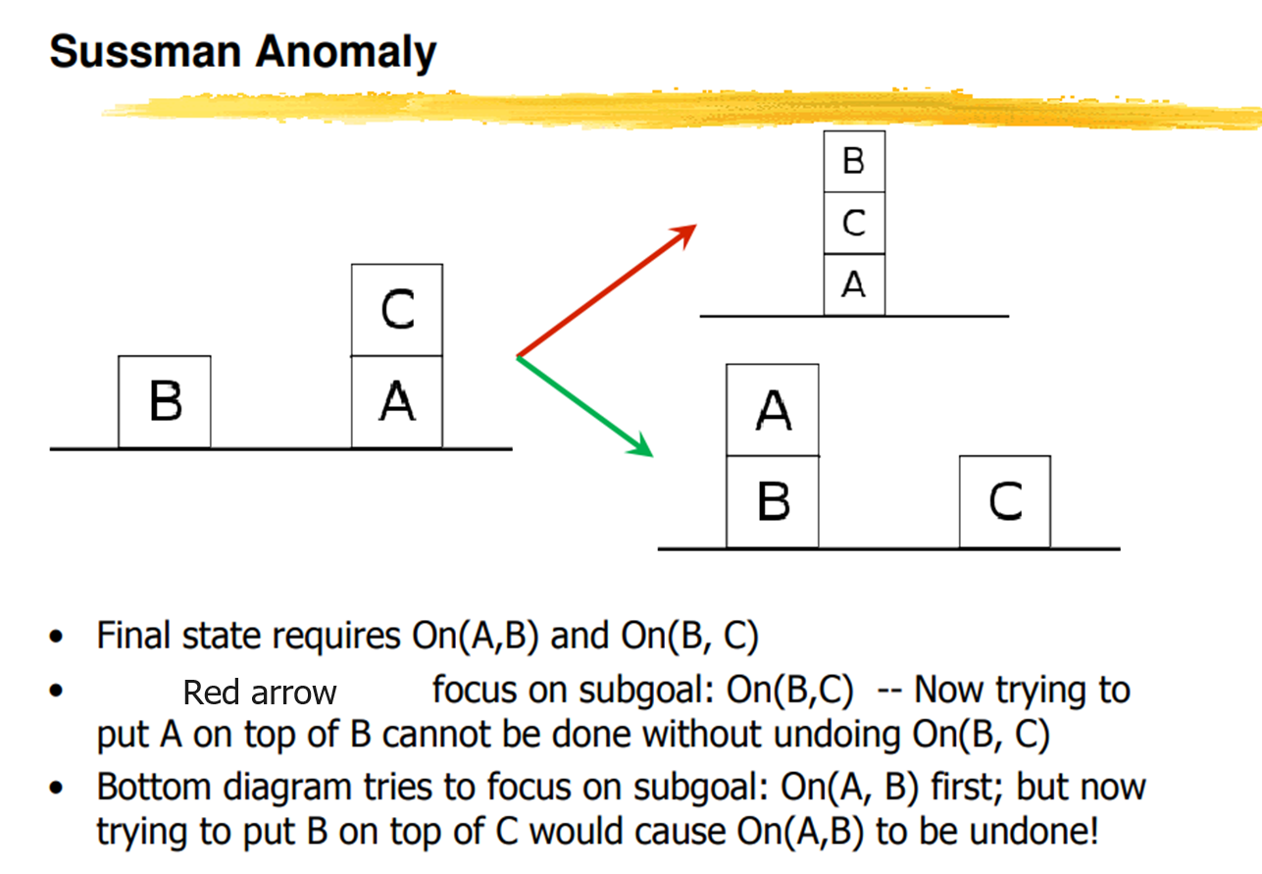

Slide 8
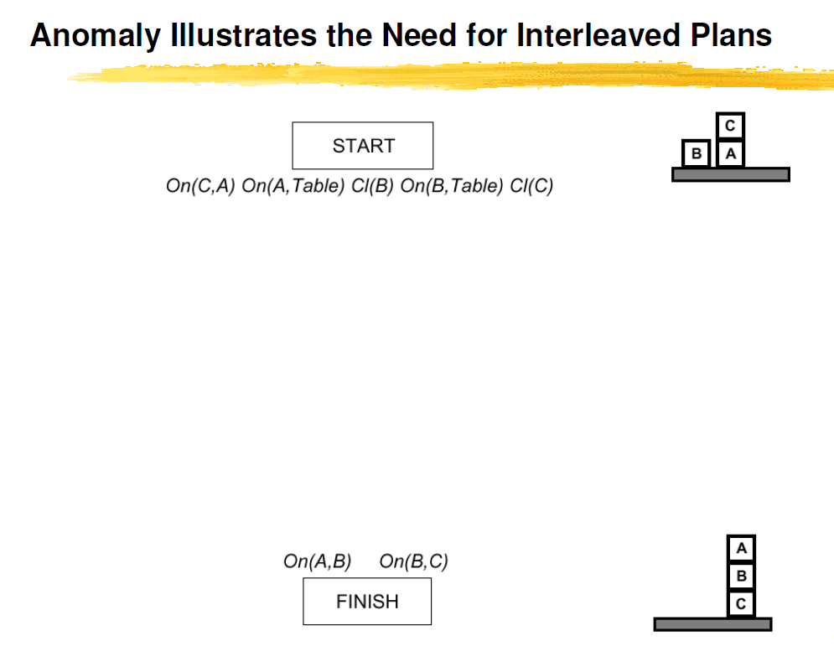

Slide 9
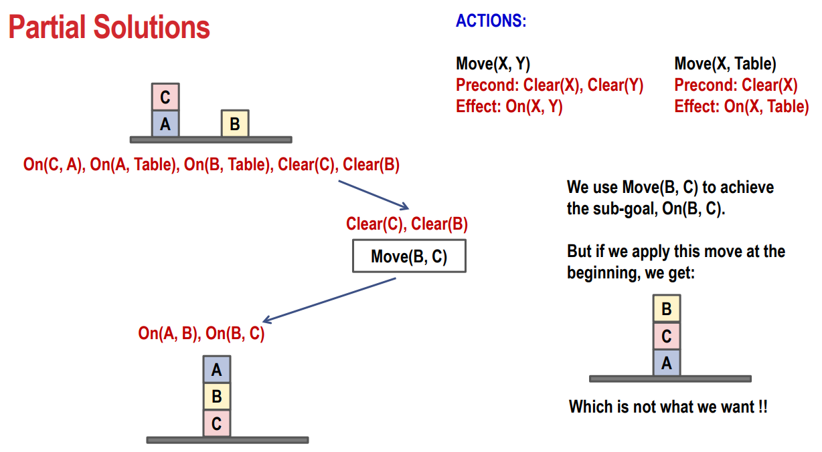

Slide 10
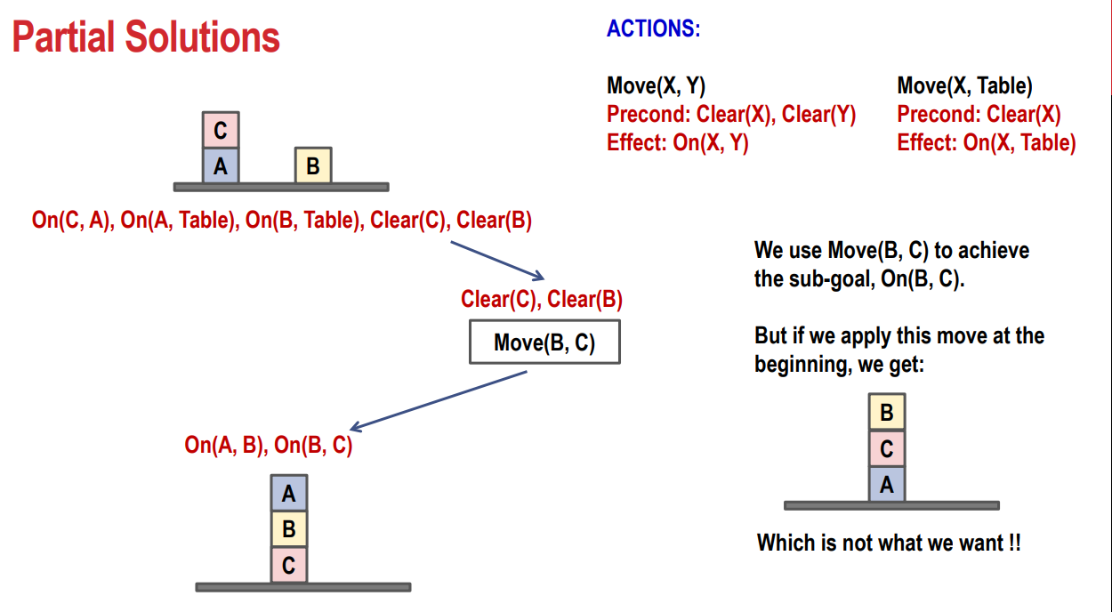

Slide 11
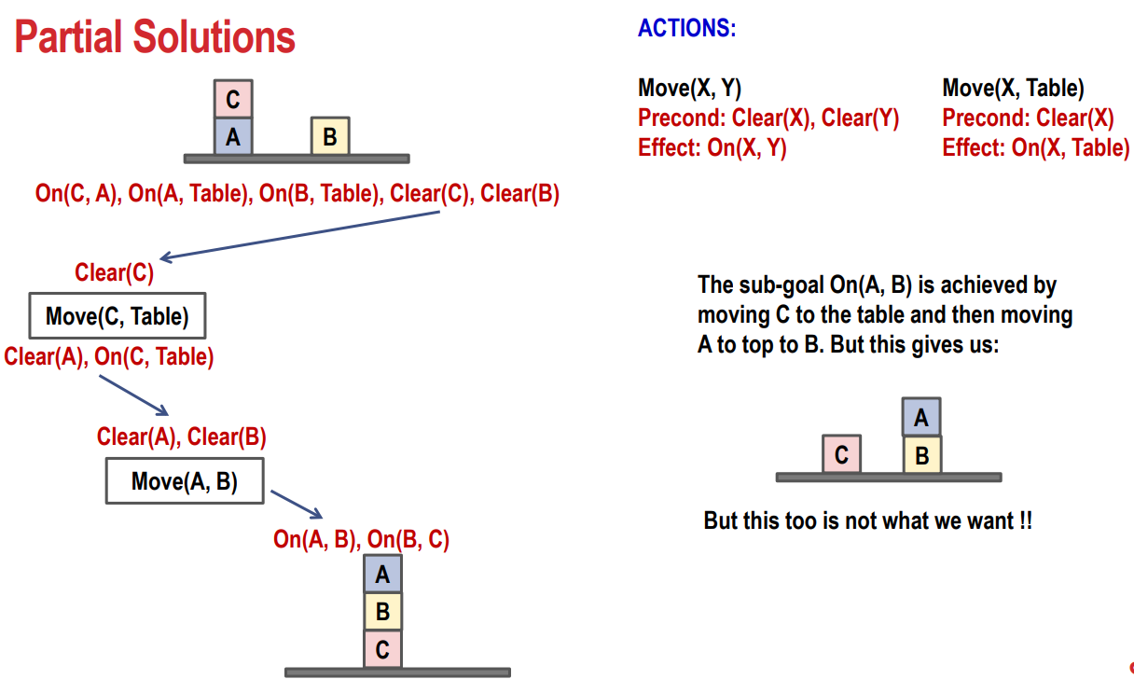

Slide 12
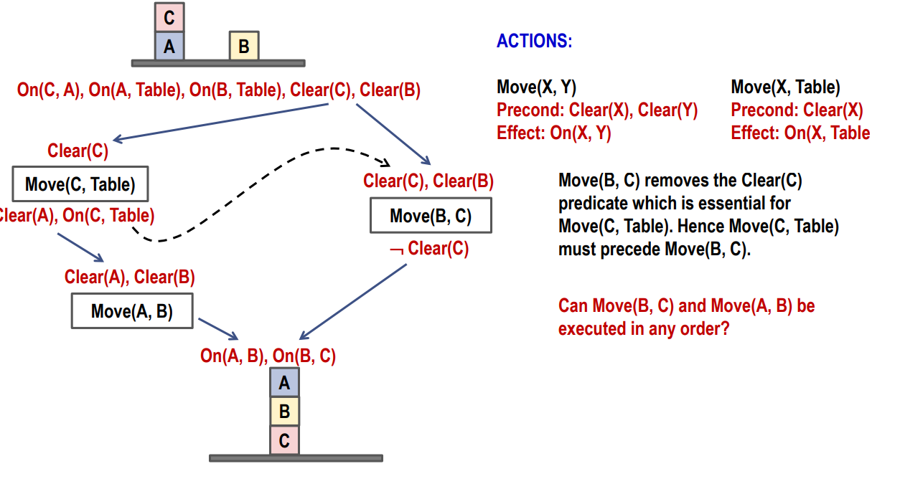

Slide 13
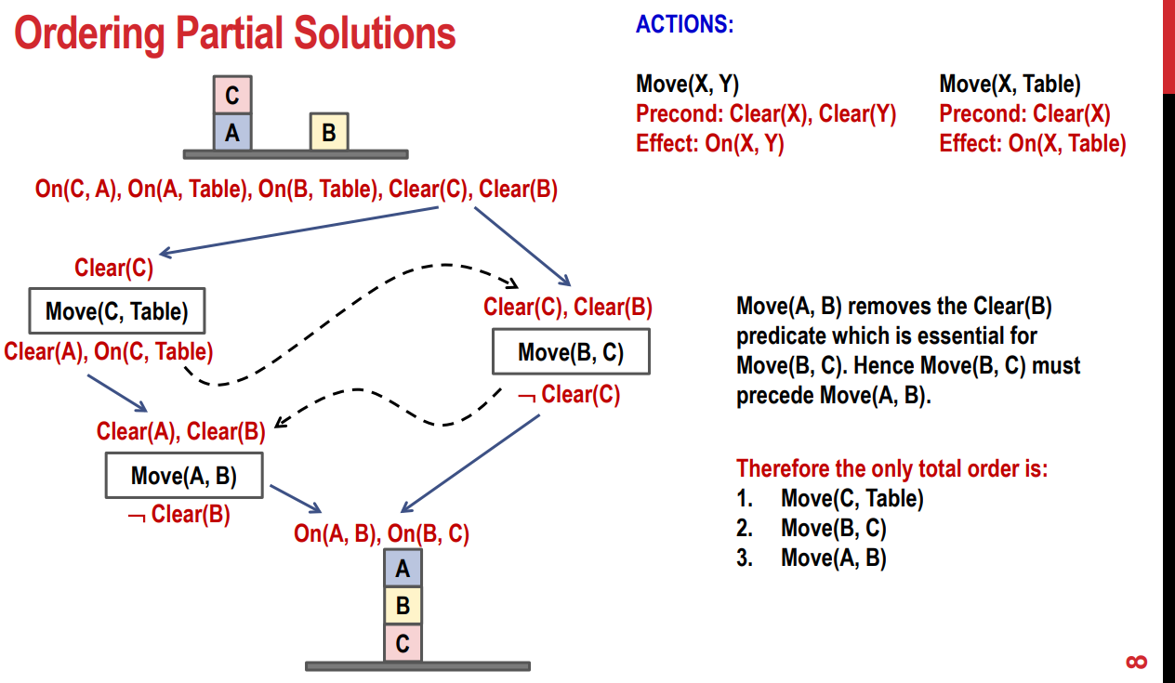

Slide 14
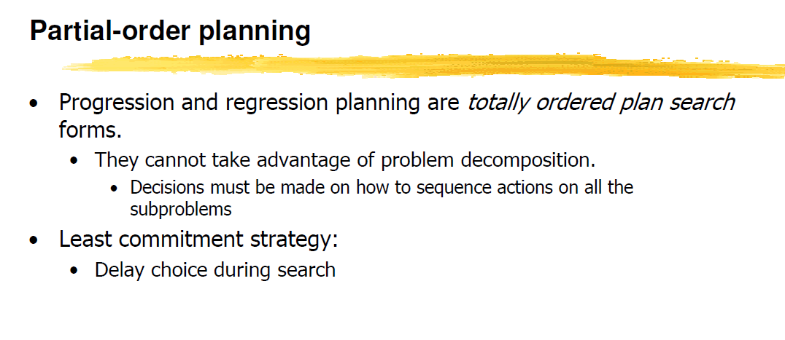

Slide 15

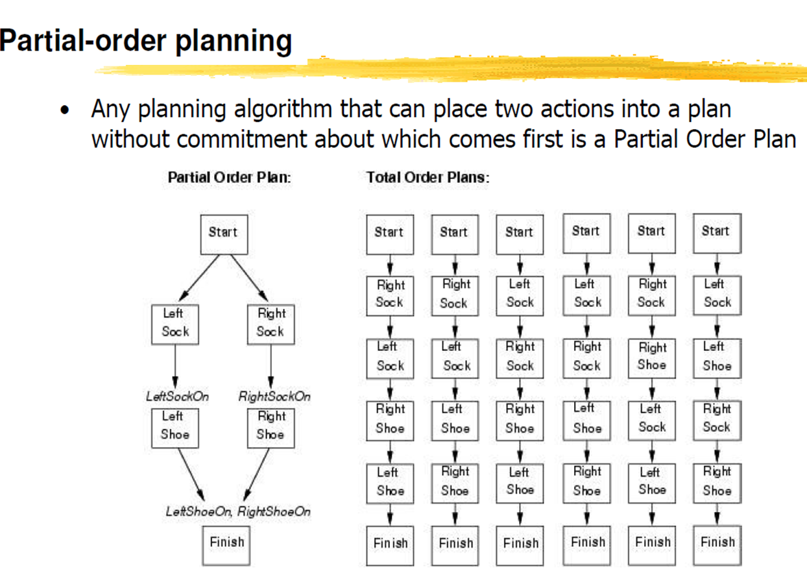
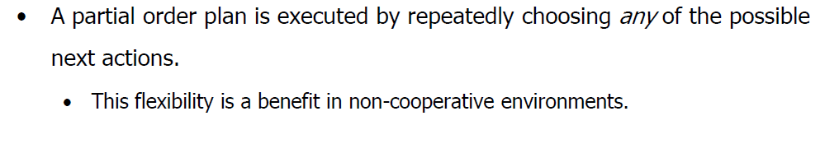

Slide 16
Target stack plan
It is one of the most important planning algorithms used by STRIPS.
Stacks are used in algorithms to capture the action and complete the target.
A knowledge base is used to hold the current situation and actions.
A target stack is similar to a node in a search tree, where branches are created with a choice of action.

Slide 17
Plan Generation:
Search space of world states
Planning as a (graph) search problem
Nodes: world states
Arcs: actions
Solution: path from the initial state to one state that satisfies the goal
  Initial state is fully specified
  There are many goal states

Slide 18
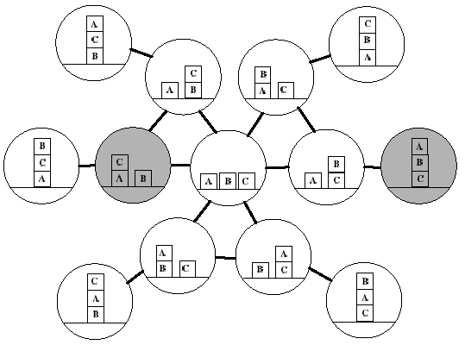
Search Space: Blocks World

Slide 19
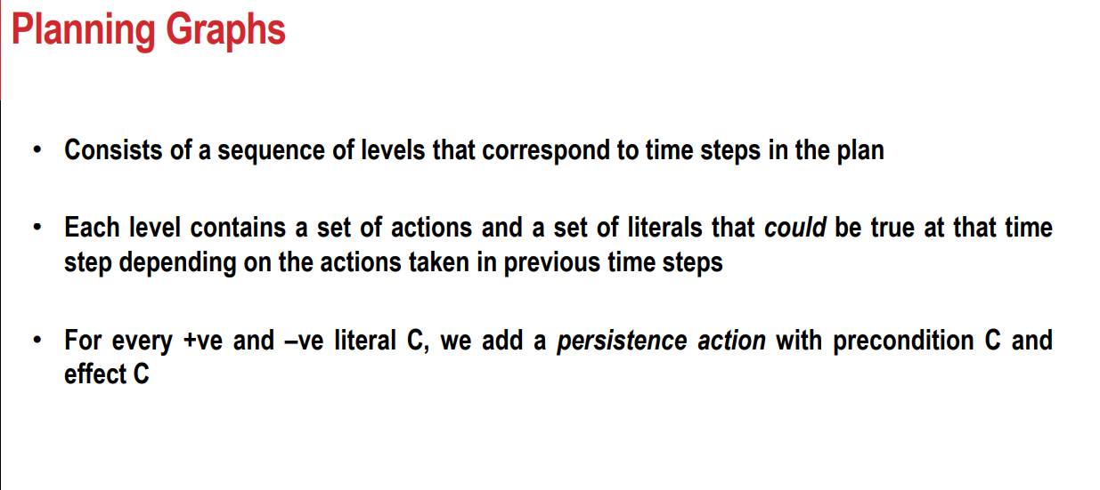

Slide 20
The End

Slide 21
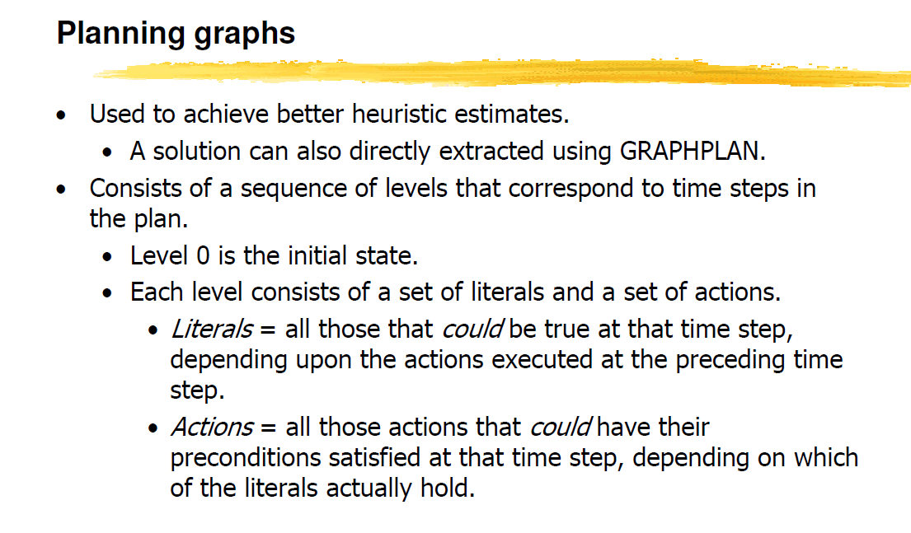

Slide 22
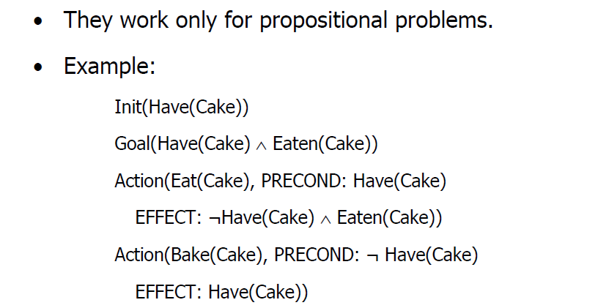
Cake Example

Slide 23
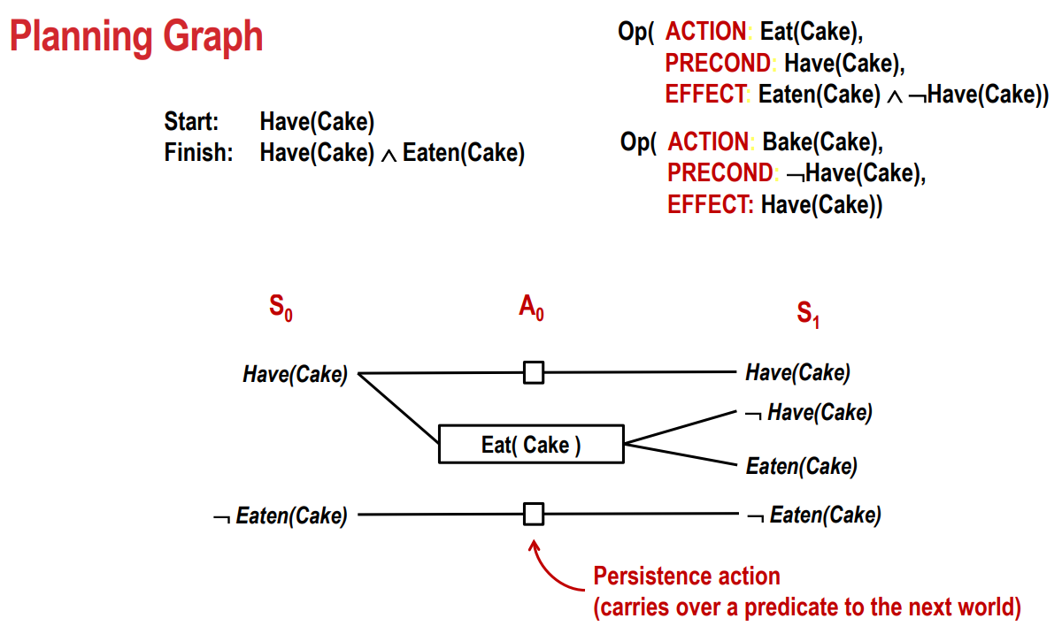

Slide 24
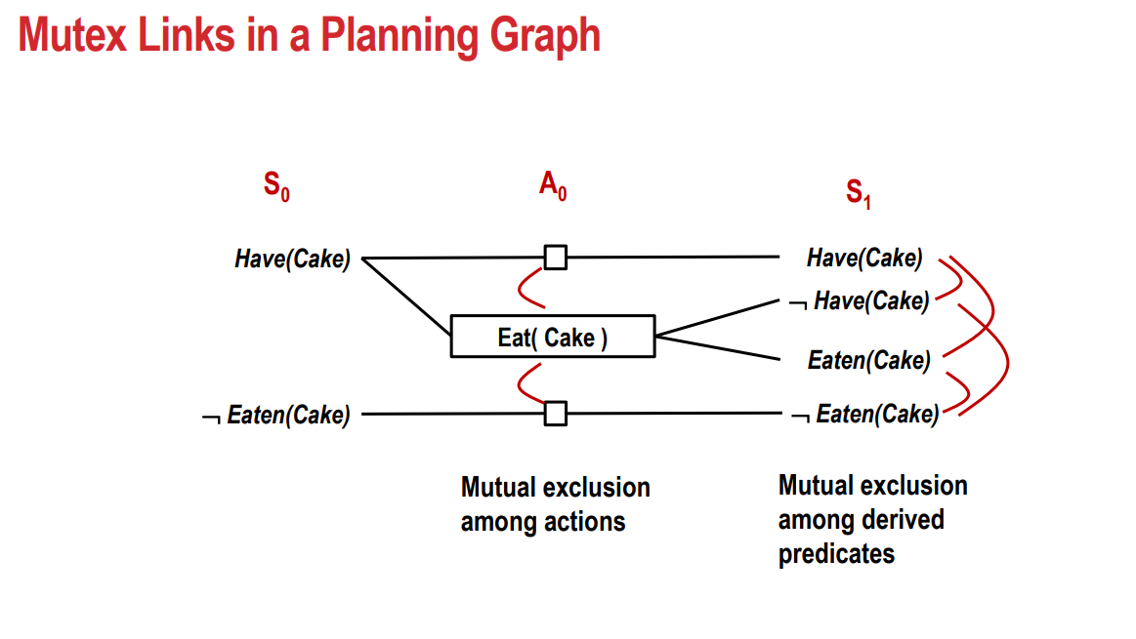

Slide 25
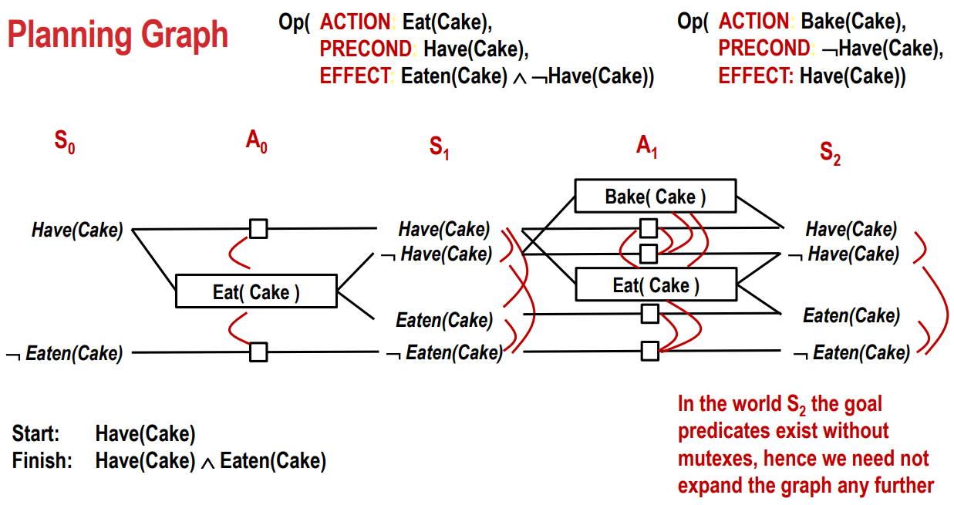

Slide 26
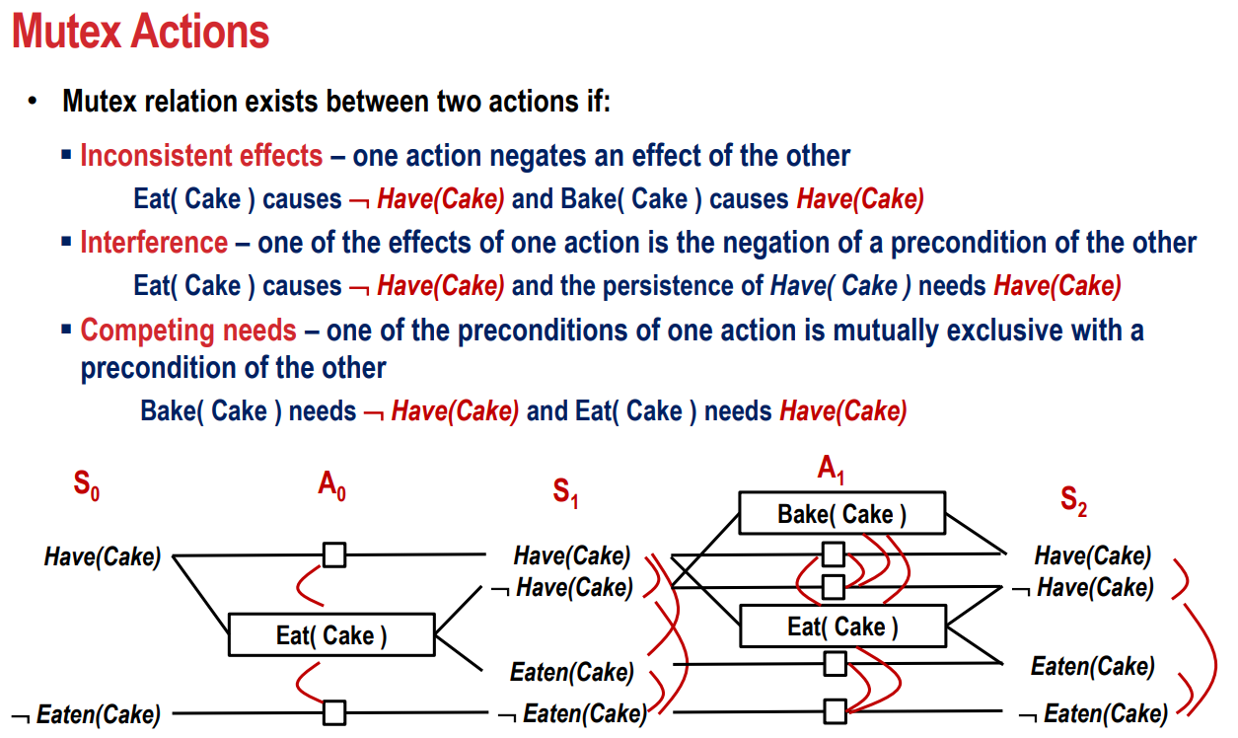

Slide 27
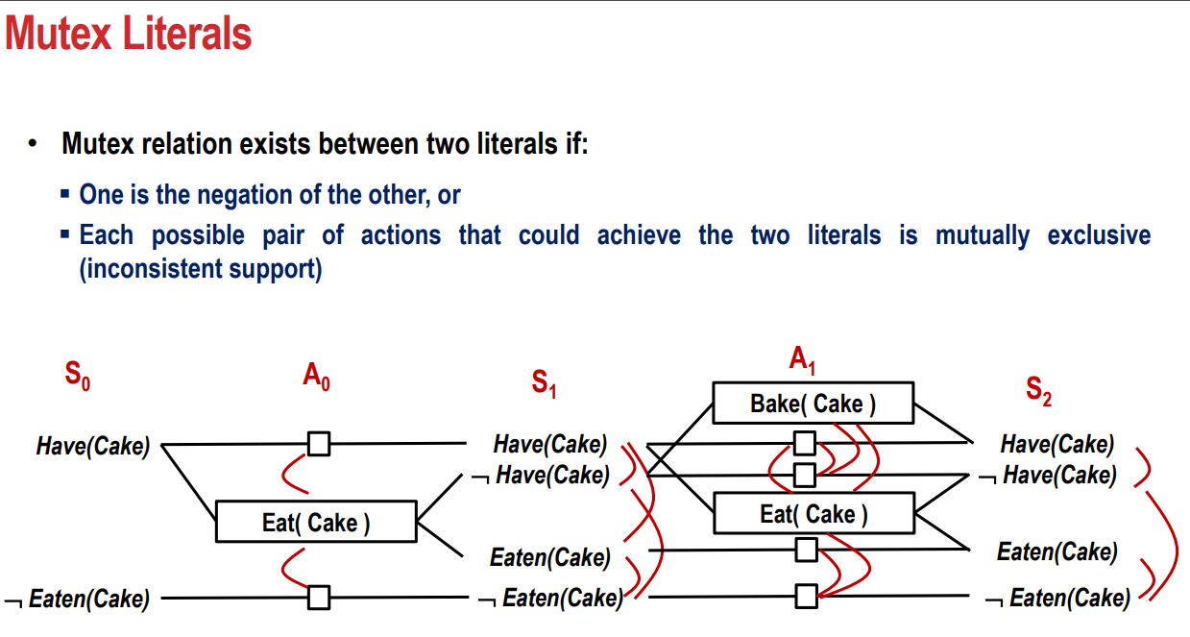

Slide 28
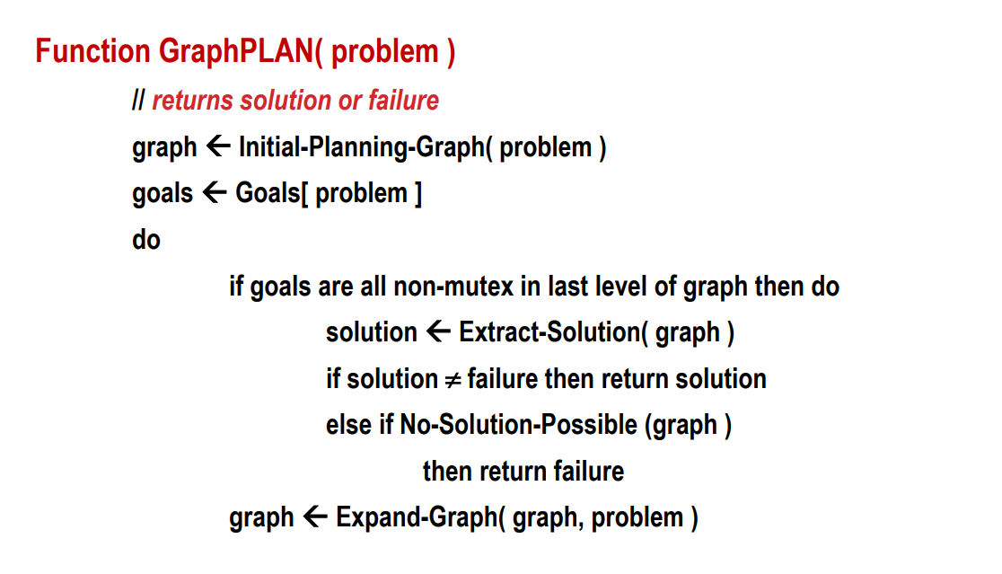

Slide 30
