Slide 1
Operations Management
What is operations?
The part of a business organization that is responsible for producing goods or services
How can we define operations management?
The management of systems or processes that create goods and/or provide services

Slide 2
Basic Functions of the Business Organization
Organization
Marketing
Operations
Finance

Slide 3
The Transformation Process
Value-Added
Inputs
Land
Labor
Capital
Information
Transformation/
Conversion
Process
Outputs
Goods
Services
Measurement
and Feedback
Measurement
and Feedback
Measurement
and Feedback
Control
Feedback = measurements taken at various points in the transformation process
Control = The comparison of feedback against previously established standards to determine if corrective action is needed.

Slide 4
Scope of Operations Management
The scope of operations management ranges across the organization.
The operations function includes many interrelated activities such as:
Forecasting
Capacity planning
Facilities and layout
Scheduling
Managing inventories
Assuring quality
Motivating employees
Deciding where to locate facilities
And more . . .
1-4

Slide 5
Supply & Demand
Operations &
Supply Chains
Sales & Marketing
Supply
>
Demand
Wasteful
Costly
Supply
<
Demand
Opportunity Loss
Customer Dissatisfaction
Supply
=
Demand
Ideal
1-5

Slide 6
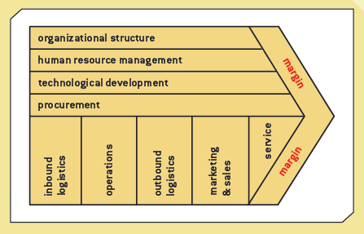
Michael Porter’s Value Chain

Slide 7
The Value Chain and E-Commerce (cont’d.)
Primary activities:
Inbound logistics
Operations
Outbound logistics
Marketing and sales
Service
The Internet
Increases the speed and accuracy of communication between suppliers, distributors, and customers
Low cost means companies of any size can participate in value chain integration

Slide 8
Using Information Technologies for a Competitive Advantage
Michael Porter
Professor at Harvard Business School
Identified three strategies for competing in the marketplace successfully
Overall cost leadership
Differentiation
Focus

Slide 9
Using Information Technologies for a Competitive Advantage (cont’d.)
Information systems
Help organizations reduce the cost of products and services
Assist with differentiation and focus strategies
Can help bottom-line and top-line strategies
Enterprise systems
Supply chain management (SCM)
Customer relationship management (CRM)
Enterprise resource planning (ERP)
Collaboration software

Slide 10
Using Information Technologies for a Competitive Advantage (cont'd.)
Differentiation strategies
Make products and services different from competitors
Examples: Apple, Amazon.com
Focus strategies
Concentrate on a specific market segment
Attempt to achieve a cost or differentiation advantage
Examples: Apple, Abercrombie & Fitch, Nordstrom

Slide 11
The Role of Distribution Operations in SCM
Balancing supply and demand.
Protecting against uncertainty.
Allowing quantity purchase discounts.
Supporting production requirements.
Promoting transportation economies.

Slide 12
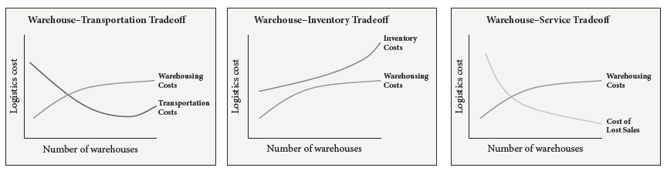
Functional Tradeoffs

Slide 13
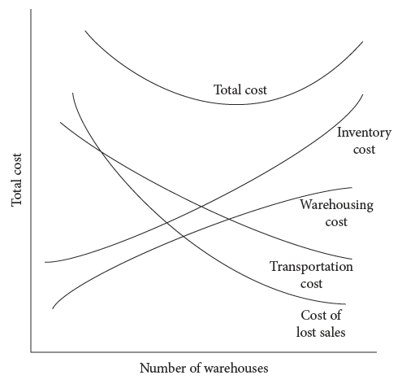
Distribution Cost Tradeoffs
Source: Edward J. Bardi, Ph.D.

Slide 14
Resource Management: Strategies

Slide 15
Aggregate Planning
Sales and Operations Planning (S&OP) is an aggregate planning process that determines the resource capacity of the firm so as to meet the demand over an intermediate time horizon of 6-12 months.
Determine the resource capacity needed to meet demand over an intermediate time horizon
Aggregate refers to product lines or families
Aggregate planning matches supply and demand
Objectives
Establish a company wide game plan for allocating resources
Develop an economic strategy for meeting demand

Slide 16
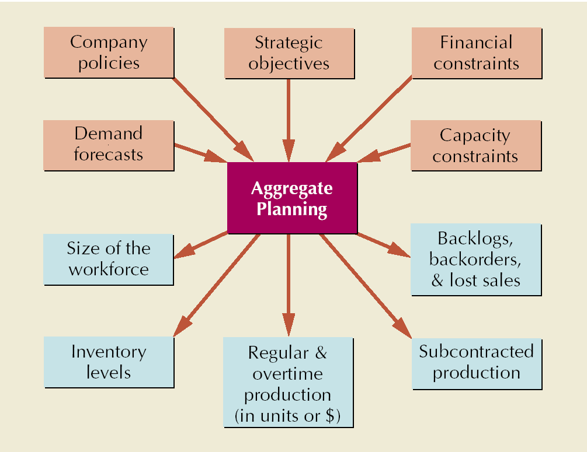
Aggregate Planning Process

Slide 17
Meeting Demand Strategies
Adjusting capacity
Resources necessary to meet demand are acquired and maintained over the time horizon of the plan
Minor variations in demand are handled with overtime or under-time
Managing demand
Proactive demand management

Slide 18
Strategies for Adjusting Capacity
Overtime and under-time
Increasing or decreasing working hours
Subcontracting
Let outside companies complete the work
Part-time workers
Hiring part time workers to complete the work
Backordering
Providing the service or product at a later time period
Level production
Producing at a constant rate and using inventory to absorb fluctuations in demand
Chase demand
Hiring and firing workers to match demand
Peak demand
Maintaining resources for high-demand levels

Slide 19
Level Production
Demand
Production
Units
Time

Slide 20
Chase Demand
Demand
Production
Units
Time

Slide 21
Strategies for Managing Demand
Shifting demand into other time periods
Incentives
Sales promotions
Advertising campaigns
Offering products or services with counter-cyclical demand patterns
Partnering with suppliers to reduce information distortion along the supply chain

Slide 22
Pure Strategies
Example:
QUARTER SALES FORECAST (LB)
Spring 80,000
Summer 50,000
Fall 120,000
Winter 150,000
Hiring cost = $100 per worker
Firing cost = $500 per worker
Regular production cost per pound = $2.00
Inventory carrying cost = $0.50 pound per quarter
Production per employee = 1,000 pounds per quarter
Beginning work force = 100 workers

Slide 23
Level Production Strategy
Level production
(50,000 + 120,000 + 150,000 + 80,000)
4
= 100,000 pounds
SALES PRODUCTION
QUARTER FORECAST PLAN INVENTORY
Spring 80,000 100,000 20,000
Summer 50,000 100,000 70,000
Fall 120,000 100,000 50,000
Winter 150,000 100,000 0
400,000 140,000
Cost of Level Production Strategy
(400,000 X $2.00) + (140,00 X $.50) = $870,000

Slide 24
Chase Demand Strategy
SALES PRODUCTION WORKERS WORKERS WORKERS
QUARTER FORECAST PLAN NEEDED HIRED FIRED
Spring 80,000 80,000 80 0 20
Summer 50,000 50,000 50 0 30
Fall 120,000 120,000 120 70 0
Winter 150,000 150,000 150 30 0
100 50
Cost of Chase Demand Strategy
(400,000 X $2.00) + (100 x $100) + (50 x $500) = $835,000

Slide 25
Five Basic Elements of Operational Excellence:
Just-in-time (JIT)
Total Quality Management
Total productive maintenance
Employee involvement
Simplicity

Slide 26
Materials Management
Inventory Control Techniques:
Shortage of Inventory: This gives rise to stock-out cost. This includes cost of customer dissatisfaction; downtime cost; changeover cost; and opportunity cost.
Excess Inventory Carrying Cost: If large inventories are carried as an insurance against stock-outs, a large amount of capital is blocked. This results in high inventory carrying cost.
Always better control (ABC)
Vital, essential and desirable (VED)
Economic order quantity (EOQ)
JIT

Slide 27
Excellence model
ENABLERS
RESULTS
People
People
Results
Key
Performance
Results
Leadership
Policy & Strategy
Processes
Customer Results
Partnerships
& Resources
Society
Results
INNOVATION AND LEARNING
EFQM, 1999. The Model is a registered trademark of the EFQM

