Slide 1
Subject : Software Engineering
Subject Code : CS3273
Section: Gx
Topic : Requirement analysis and specification of software development
Assignment - 5
Enrollment no. | Name
2020CSB007 | ARATRIKA PAL
2020CSB009 | MAYANK MANAVENDRA KUMAR
2020CSB010 | GOURAV KUMAR SHAW
2020CSB011 | TAMOGHNA ROY
2020CSB013 | ABDUL KHAZMUDDIN
2020CSB014 | SIDDARTHA JANA

Slide 2
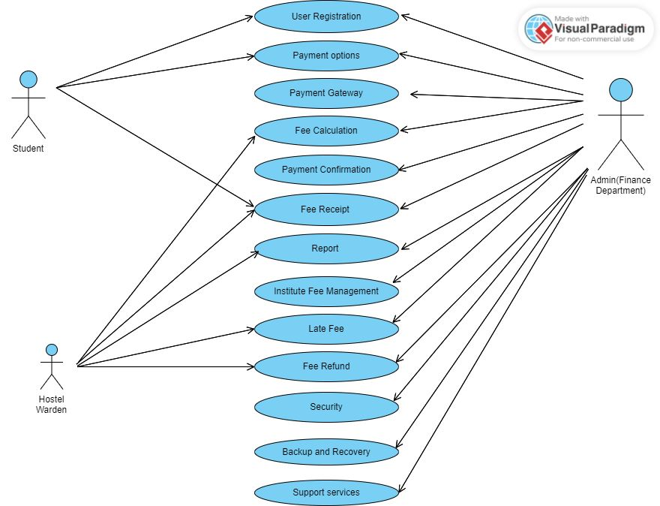
Use case diagram

Slide 3
functional requirements for automating the process of institute fee collection:
User Registration:
The user registration functionality should allow students to create their accounts by entering their personal information, including name, email, phone number, and address.
The system should validate the entered data and ensure that the email and phone number are unique.
The registration process should be secure and should not allow duplicate or invalid registrations.

Slide 4
Payment Options:
The system should support multiple payment options, including credit/debit cards, net banking, and mobile wallets.
The system should integrate with different payment gateways to facilitate the payment process for students.
The system should allow students to select their preferred payment method and should provide real-time information about the transaction status.

Slide 5
Payment Gateway Integration:
The payment gateway integration should be seamless and secure.
The system should ensure that payment information is encrypted and stored securely.
The payment gateway should also provide real-time transaction status updates to the system.
The payment gateway should be reliable, and the system should provide a backup gateway in case of failure.

Slide 6
Fee Calculation:
The system should calculate the fees based on the student's course, semester, and other relevant factors.
The system should also consider any scholarships or discounts available to the student.
The system should ensure that the fee calculation is accurate, and any changes to the fee structure should be updated in real-time.

Slide 7
Payment Confirmation:
Once the payment is successful, the system should send a confirmation to the student's email and SMS.
The confirmation should include the payment details, including the amount paid, payment date, and transaction ID.
The confirmation should also include a link to download the fee receipt.

Slide 8
Fee Receipt Generation:
The system should generate a fee receipt that the student can download and print.
The receipt should include details such as the student's name, fee amount, payment date, transaction ID, and payment method.
The system should ensure that the fee receipt is generated accurately and is available for download immediately after the payment confirmation.

Slide 9
Reports Generation:
The system should generate reports for the finance department, including transaction reports, student-wise fee collection reports, and overdue fee reports.
The reports should be available in different formats, including PDF and Excel.
The system should ensure that the reports are generated accurately and are available on demand.

Slide 10
Hostel Fee Management:
The system should allow hostel wardens to view the payment information of the students staying in their respective hostels.
The system should ensure that the hostel warden has access only to the payment information of the students in their respective hostels.
The system should provide real-time information about the payment status of the students and should allow the warden to send payment reminders to students who have not paid their fees.

Slide 11
Late Fee Calculation:
The system should automatically calculate late fees for students who fail to pay on time.
The system should apply the late fee policy based on the institute's rules and regulations.
The system should ensure that the late fee calculation is accurate and that the late fees are added to the student's account immediately after the due date.

Slide 12
Fee Refund Management:
The system should handle fee refunds for students who withdraw from the institute.
The system should ensure that the refund process is seamless and that the refund amount is calculated accurately.
The system should also ensure that the refund process is initiated as per the institute's rules and regulations.

Slide 13
Security User Authentication and Authorization:
The system should ensure that only authorized users can access the system.
The system should authenticate users using secure login credentials, such as a username and password.
The system should also ensure that each user has the appropriate level of authorization to perform their assigned tasks.

Slide 14
Encryption and Data Protection:
The system should ensure that all sensitive data, including payment information, is encrypted and stored securely.
The system should follow industry-standard encryption protocols and security practices to protect user data from unauthorized access.

Slide 15
Firewall and Network Security:
The system should implement firewalls and other network security measures to protect against external attacks.
The system should also ensure that all communication between the system and external payment gateways is secure and protected from external threats.

Slide 16
Backup and Recovery Data Backup:
The system should automatically backup all data on a regular basis to prevent data loss.
The system should also ensure that backups are stored securely and can be easily restored in case of data loss.

Slide 17
Disaster Recovery:
The system should have a disaster recovery plan in place to minimize downtime in case of system failures or disasters.
The system should also ensure that data can be recovered quickly and efficiently in case of a disaster.

Slide 18
Support Services Help Desk Support:
The system should provide a help desk support service to assist users with any queries or complaints they may have.
The help desk should be staffed by knowledgeable support staff who can provide timely and effective assistance to users.

Slide 19
Online User Support:
The system should provide online user support services, such as a knowledge base or user forums, to help users find answers to their questions or issues.
The system should also ensure that user support services are available 24/7.

Slide 20
Training and User Guides:
The system should provide comprehensive training materials and user guides to help users understand how to use the system effectively.
The system should also ensure that training materials are updated regularly to reflect any changes to the system.

Slide 21
Feedback Mechanisms:
The system should provide feedback mechanisms to allow users to provide feedback on the system's performance and suggest improvements.
The system should ensure that feedback mechanisms are easy to use and that user feedback is taken into consideration when making system improvements.

