Slide 1
Periodix
Smart Timetable Generation System
Generate Once. Get It Right.

Slide 2
Periodix
Abstract
Project overview
Periodix automates timetable planning across departments, batches, sections, and semesters.
It removes manual conflicts using faculty load, slot, and subject-type constraints.
A rule-based engine generates versioned timetables with warning transparency.
Outputs are instantly viewable and exportable as institutional PDF documents.
Generate Once. Get It Right.

Slide 3
Periodix
Introduction
Problem context and objective
Academic timetable planning is a repetitive and error-prone operational process.
Spreadsheet-based workflows struggle with conflict resolution and consistency.
Periodix provides a centralized, secure, and role-driven scheduling platform.
The goal is faster planning with fewer clashes and better academic coordination.
Generate Once. Get It Right.

Slide 4
Periodix
Existing System vs Proposed System
Direct comparison
Existing System
Proposed System
Manual spreadsheet planning
Late clash detection
No robust version history
Coordination overhead
Centralized web workflow
Constraint-aware generation
Versioned active timetables
Instant view + PDF export
Generate Once. Get It Right.

Slide 5
Periodix Design
System Architecture & UML
Design structure and behavioral flow

Slide 6
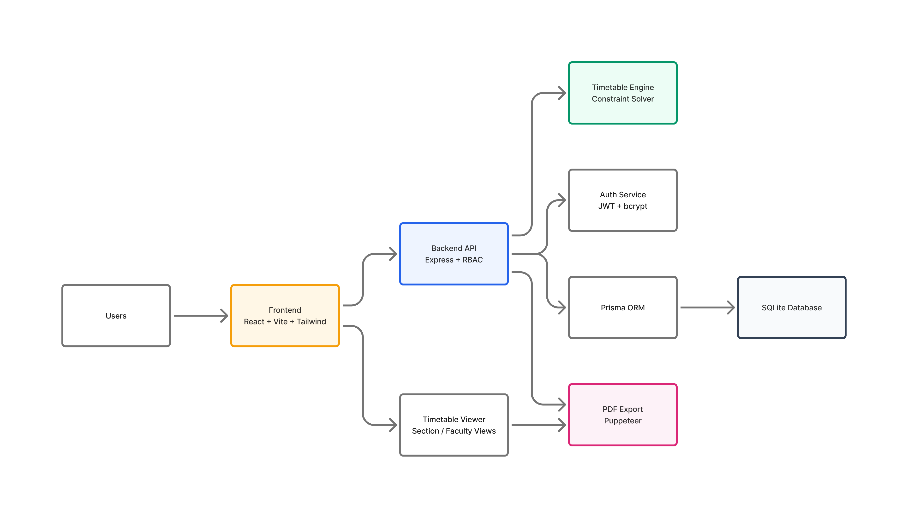
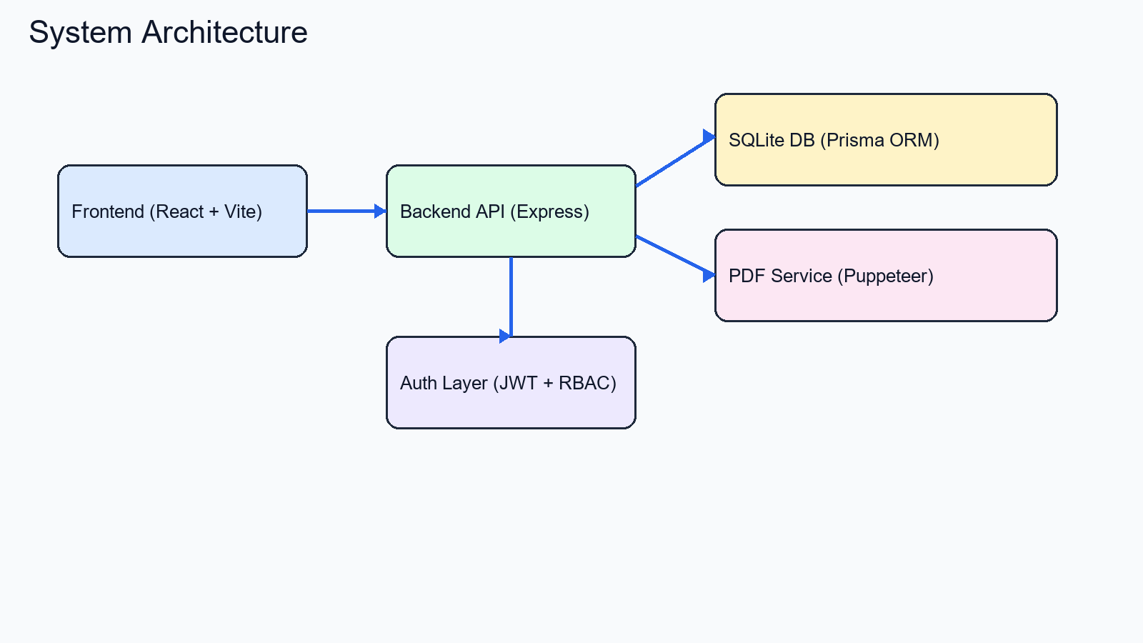
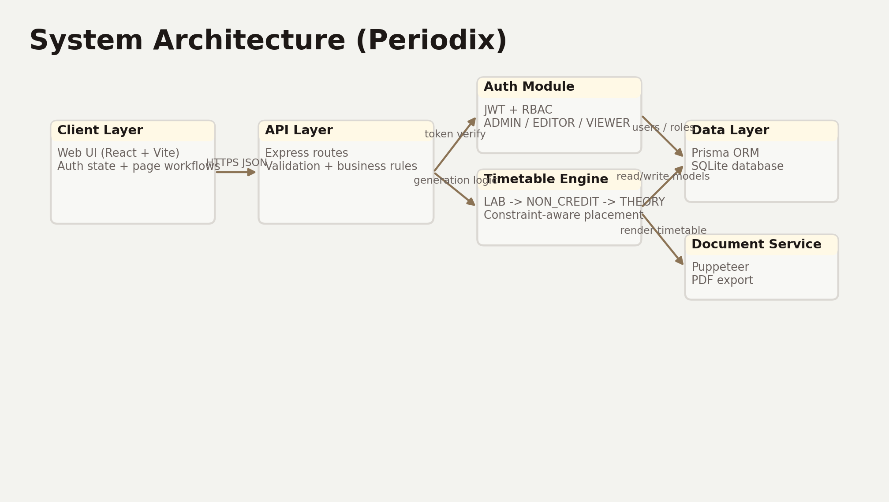
Periodix
System Architecture
Application-layer overview
Generate Once. Get It Right.

Slide 7
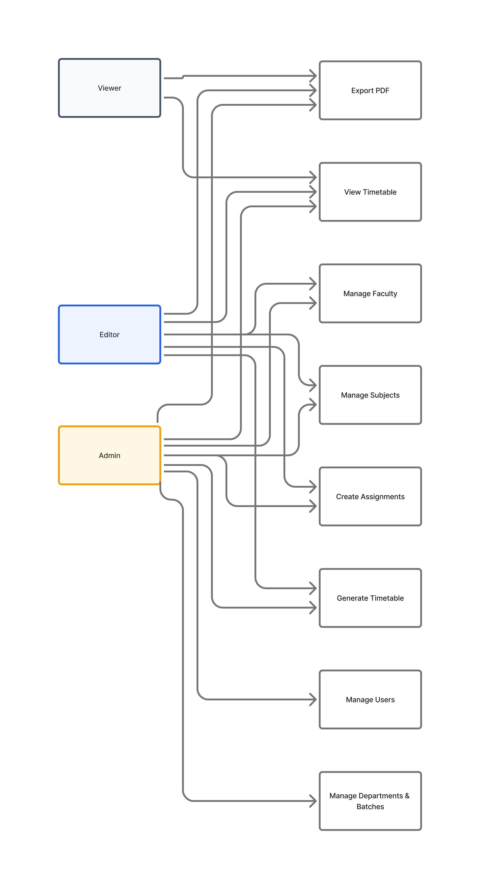
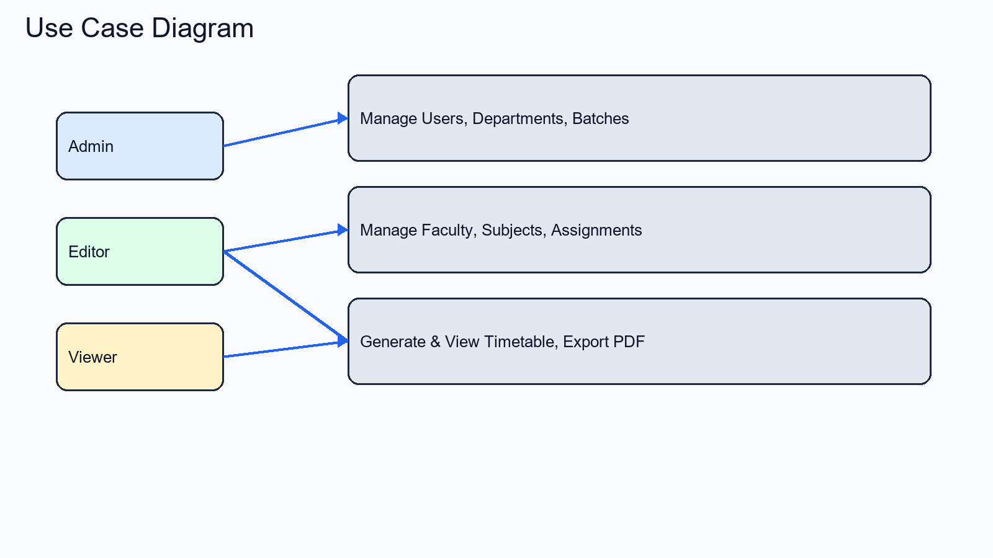
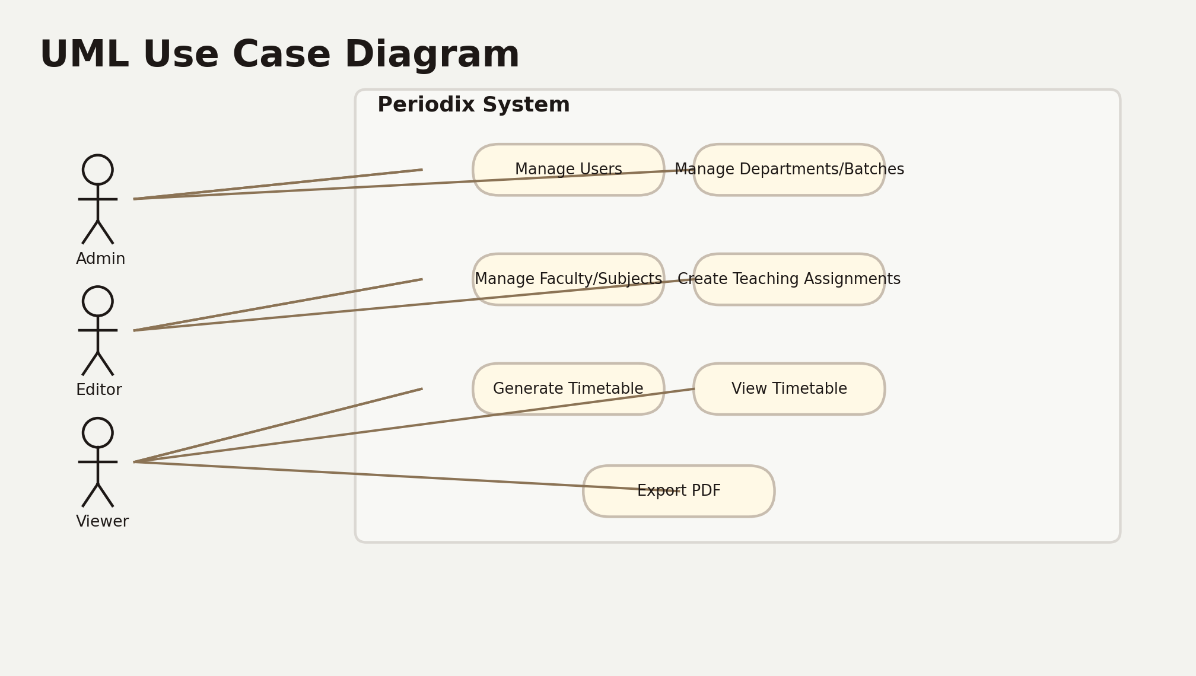
Periodix
UML: Use Case Diagram
Actors and responsibilities
Generate Once. Get It Right.

Slide 8
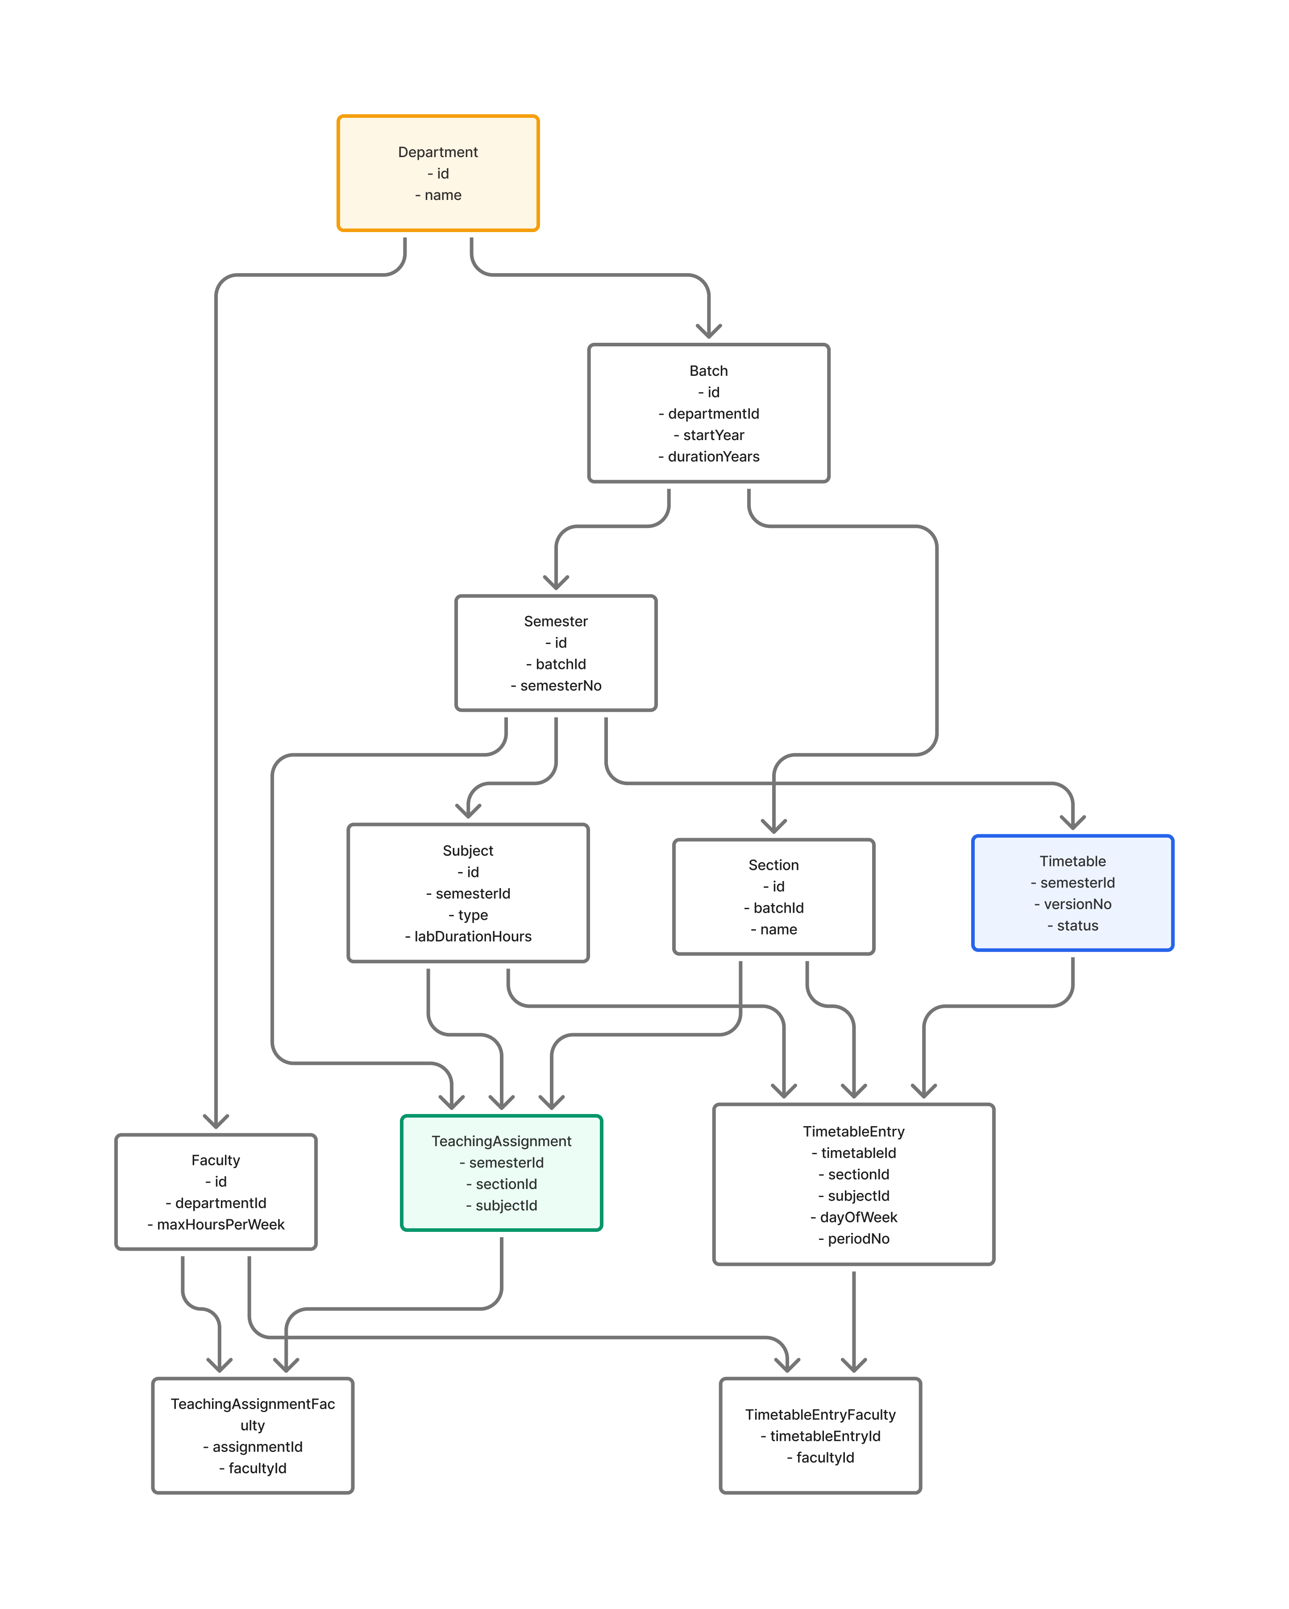
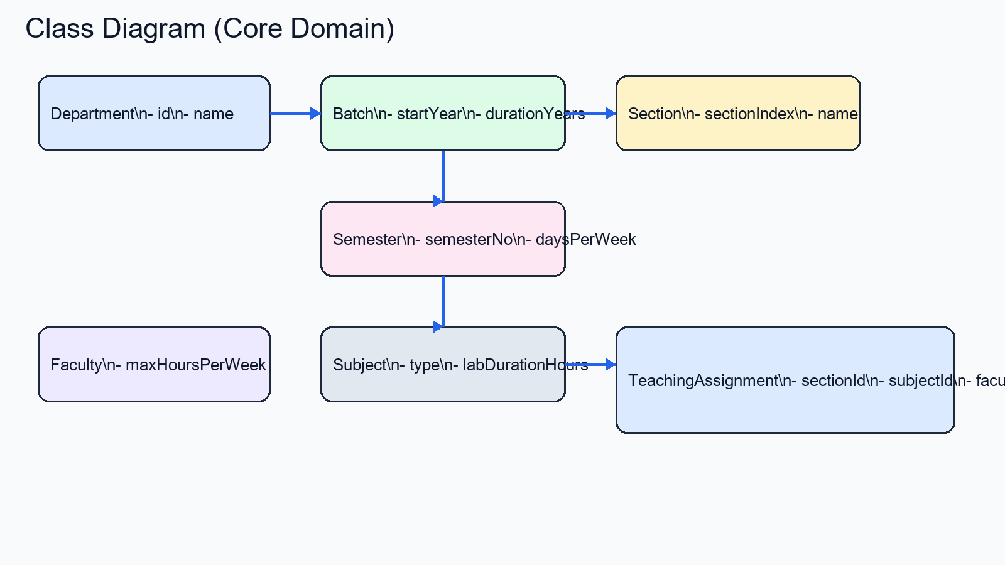
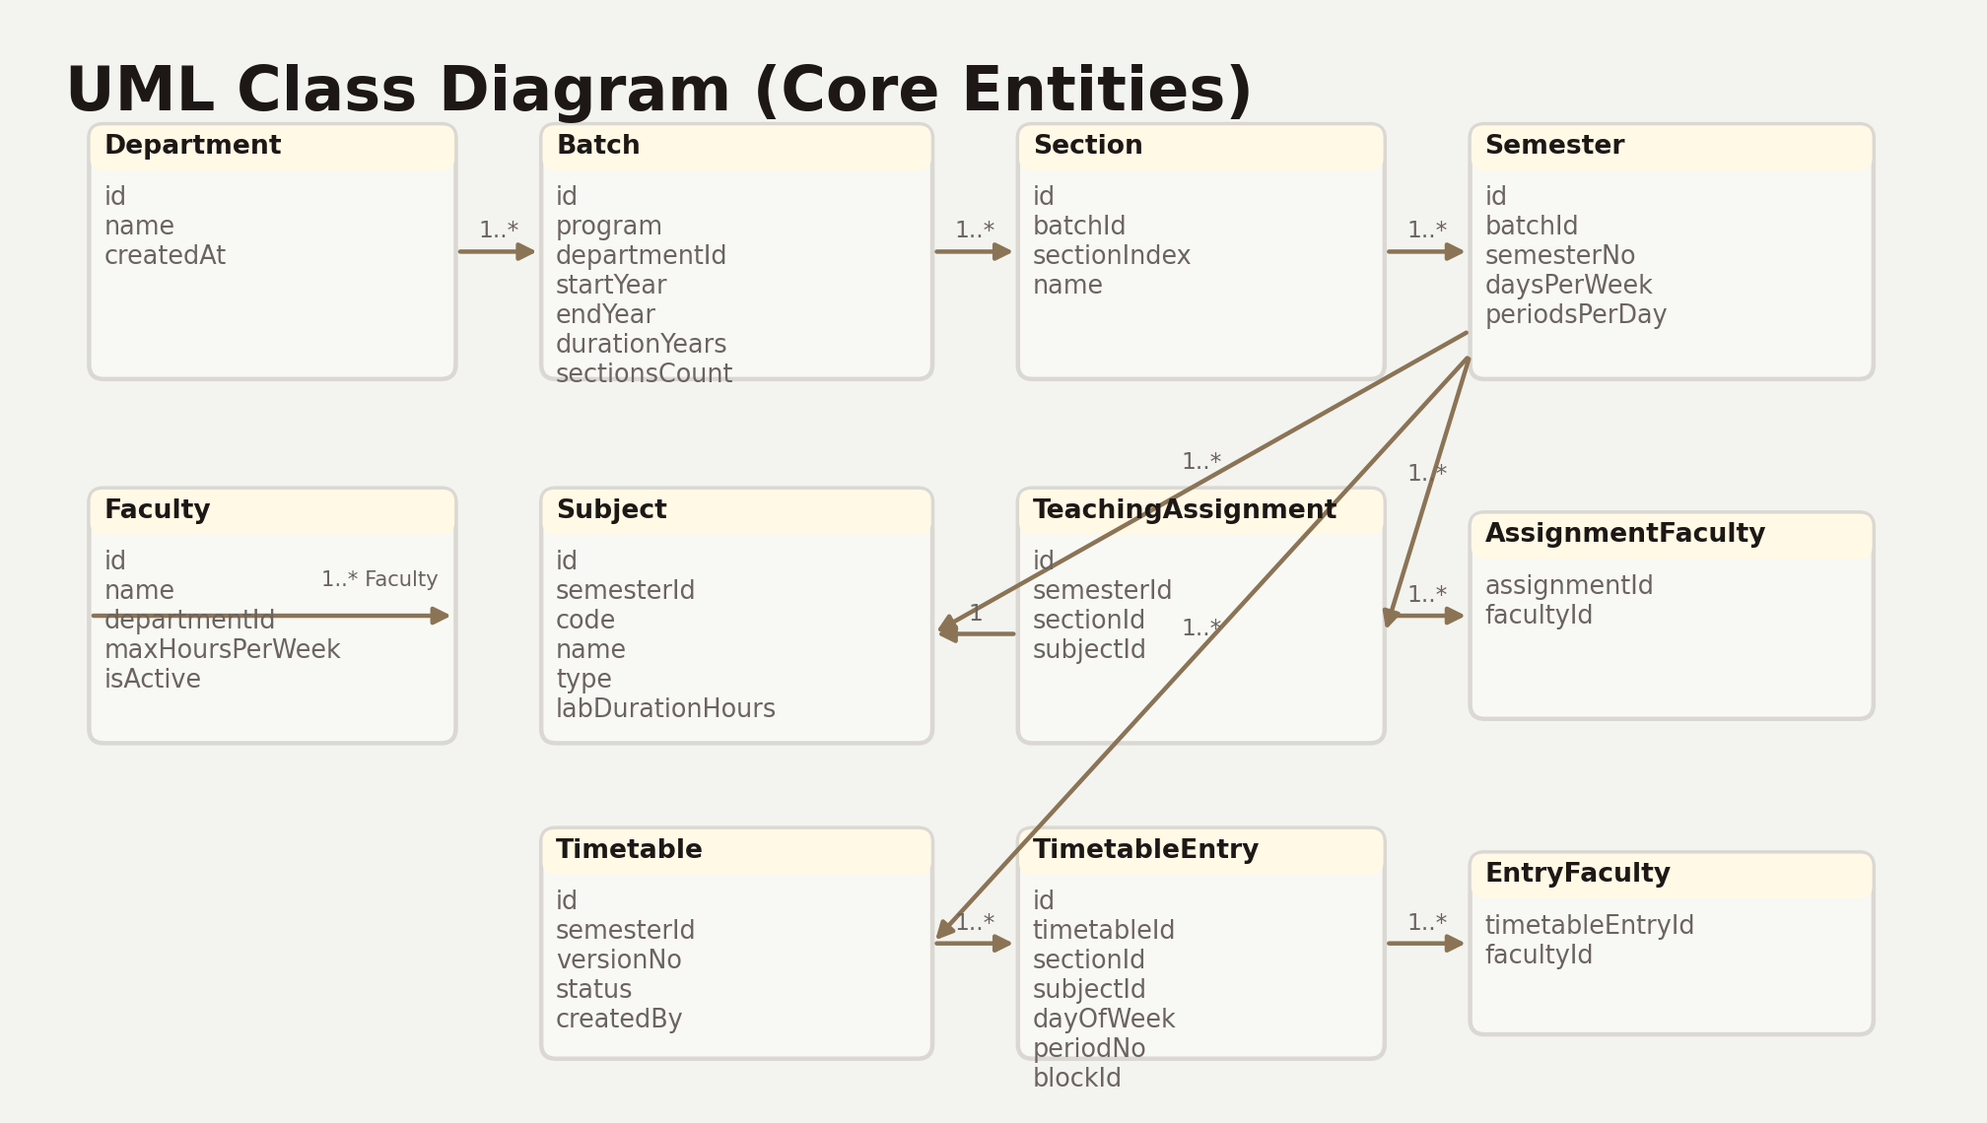
Periodix
UML: Class Diagram
Core domain model
Generate Once. Get It Right.

Slide 9
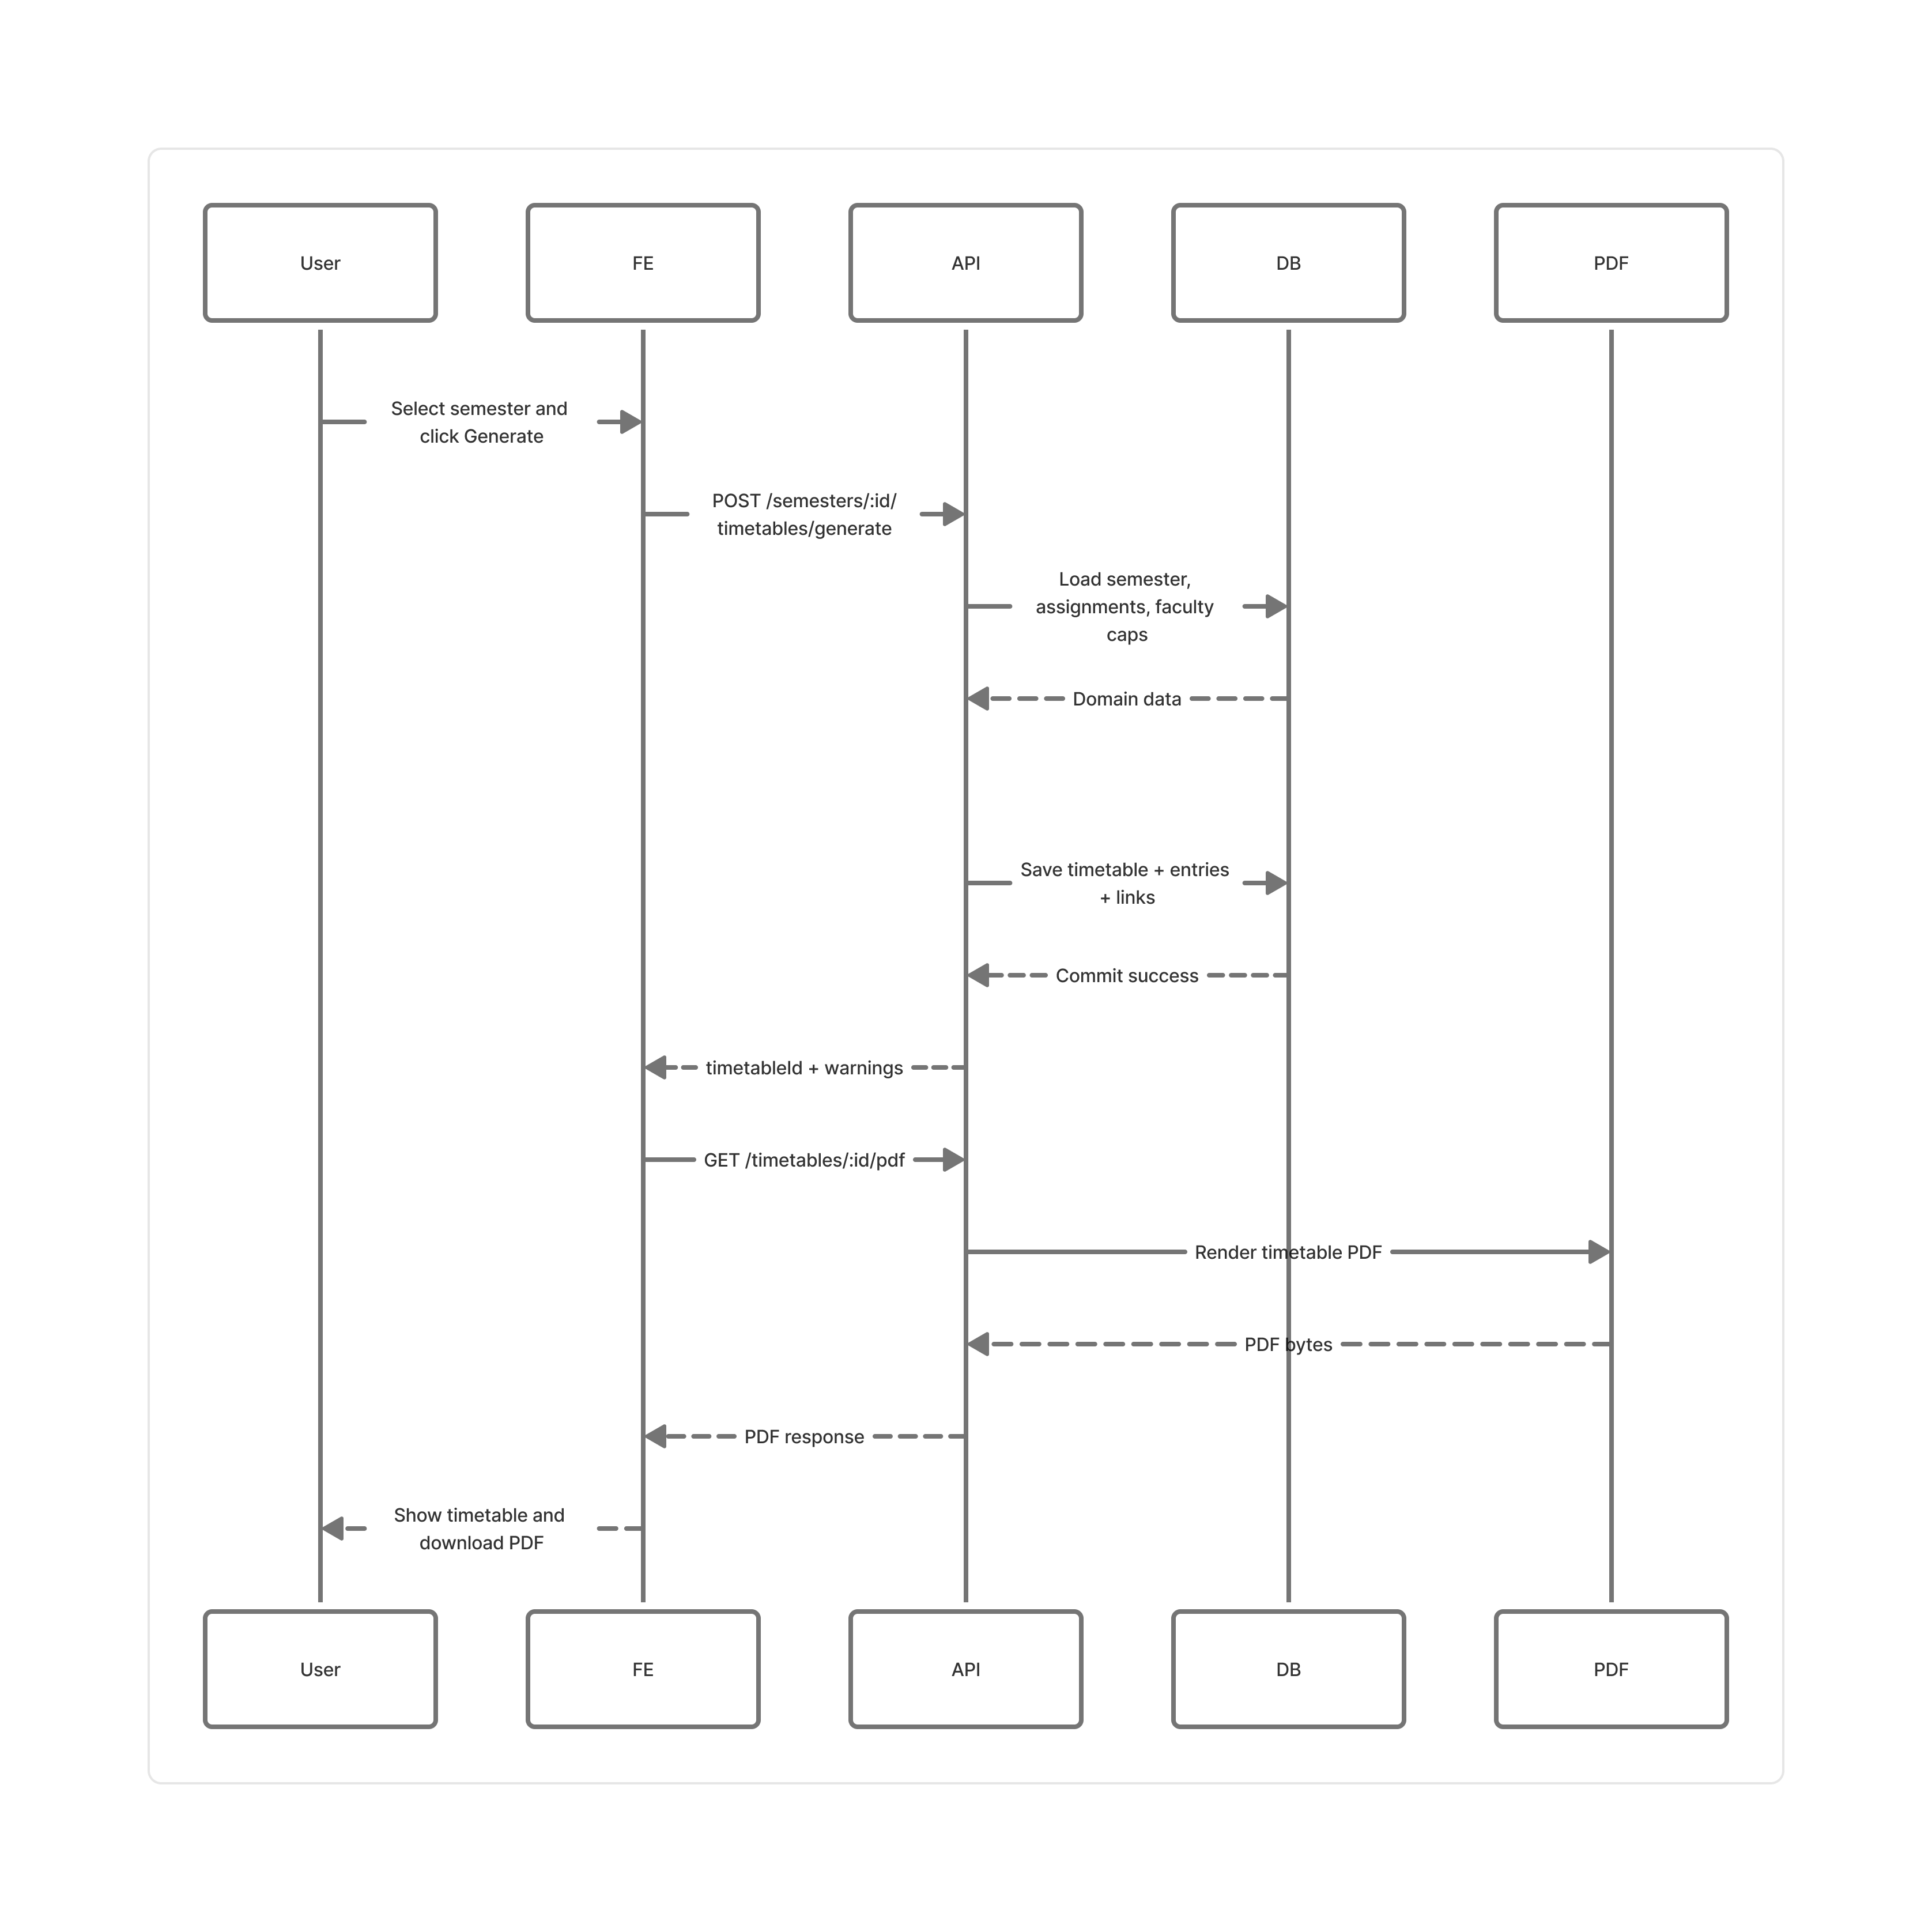
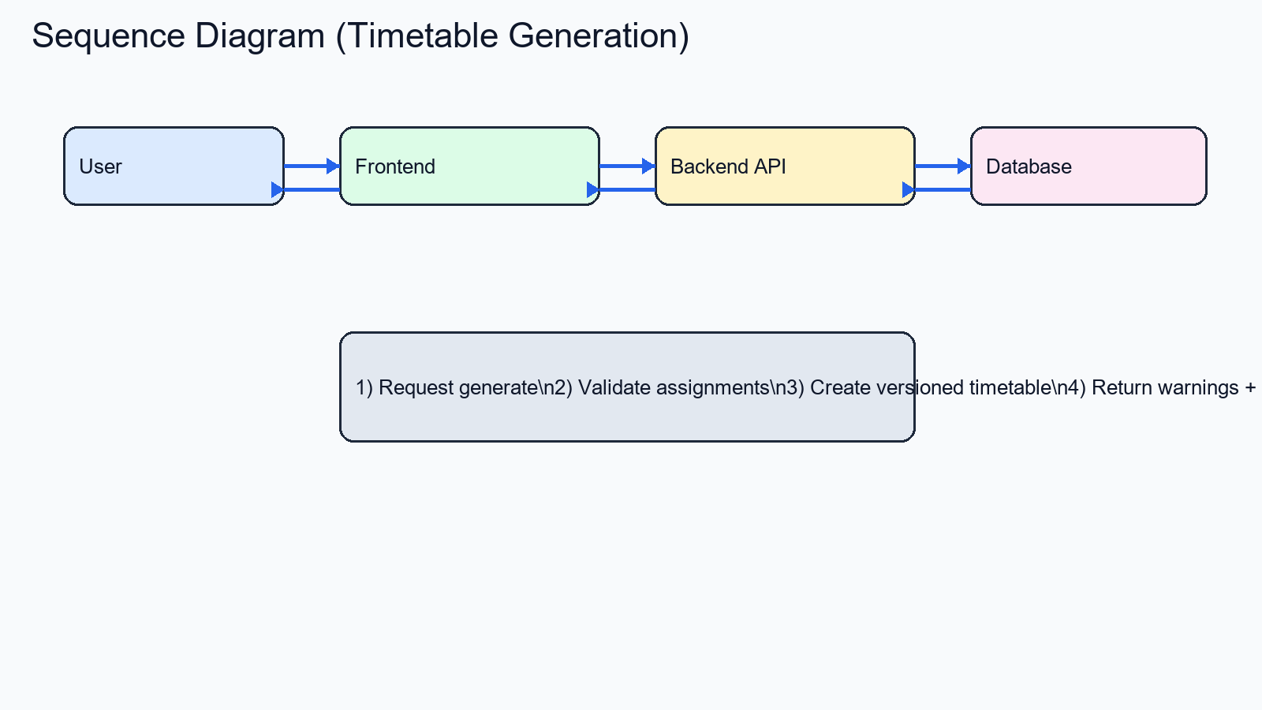
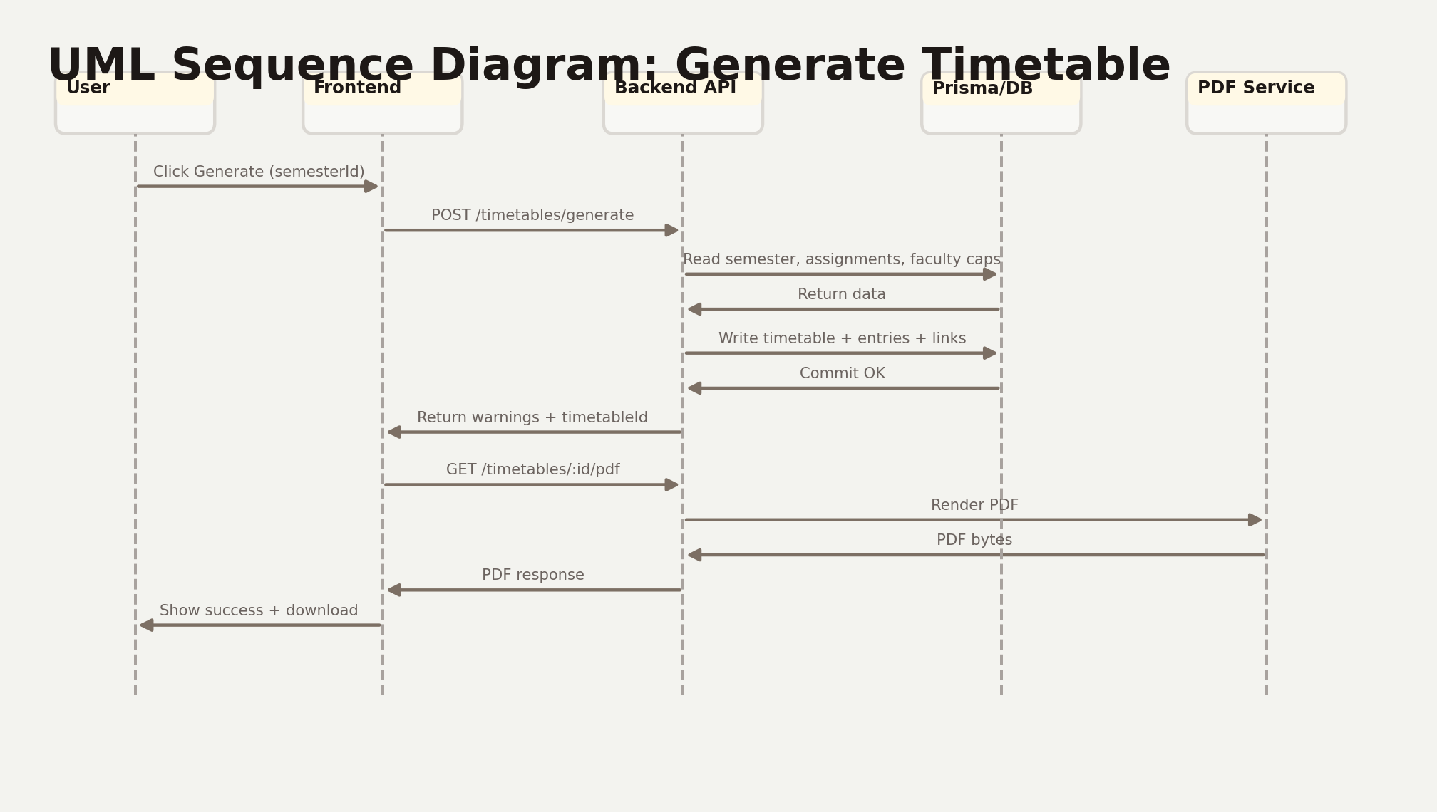
Periodix
UML: Sequence Diagram
Generation request flow
Generate Once. Get It Right.

Slide 10
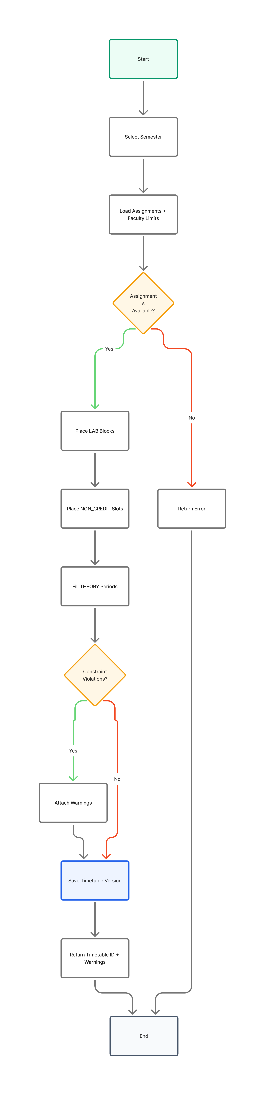
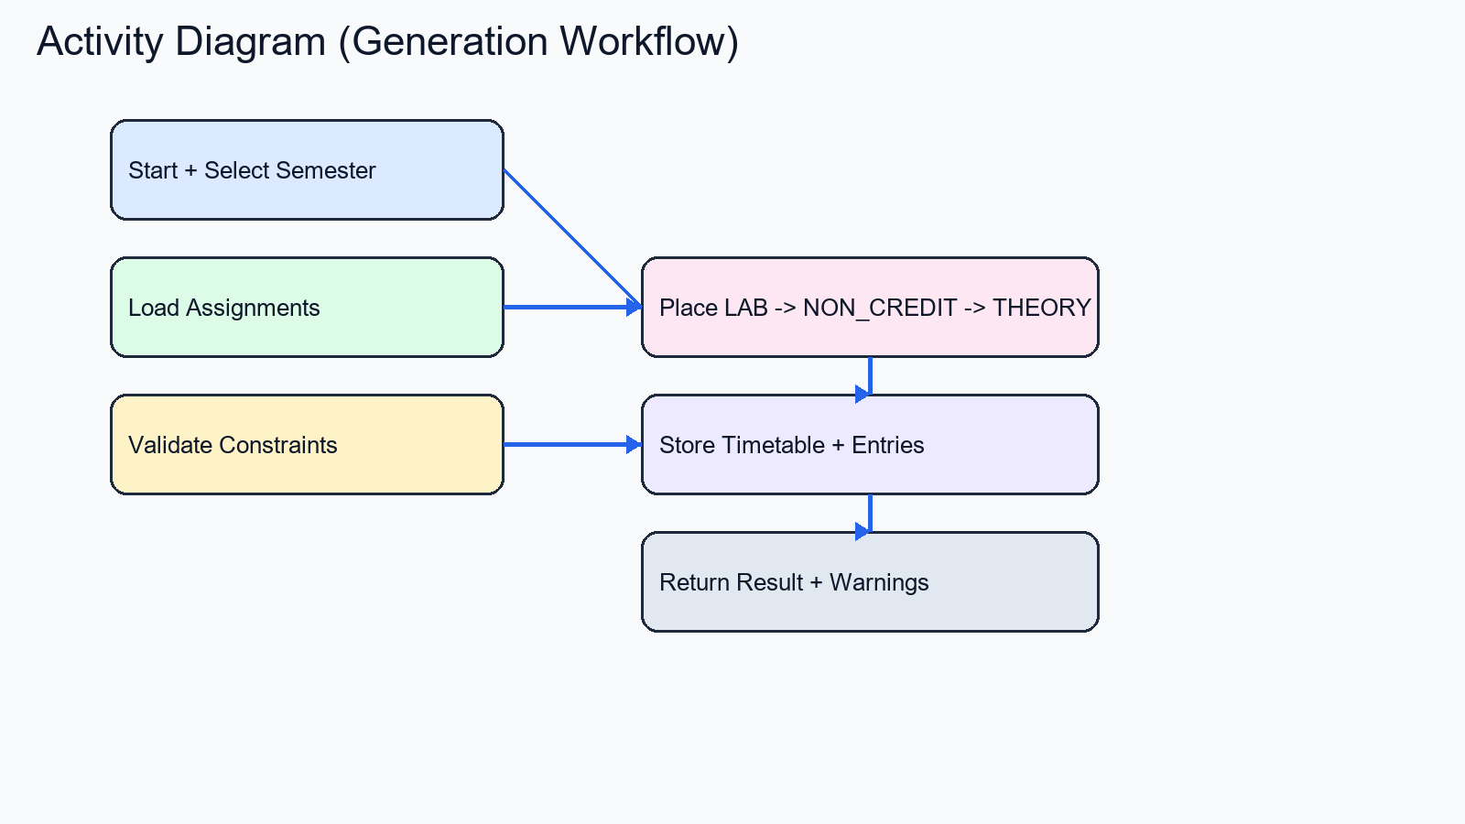
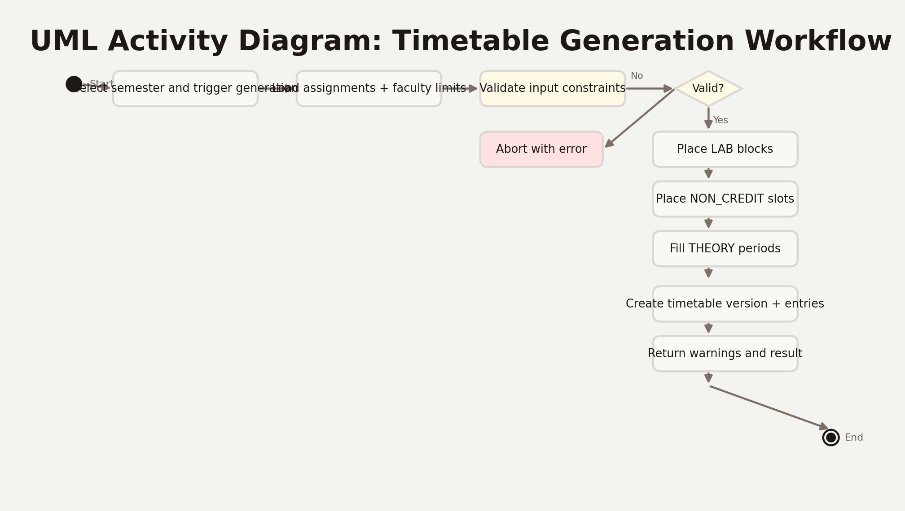
Periodix
UML: Activity Diagram
Scheduling workflow
Generate Once. Get It Right.

Slide 11
Periodix Design
System Specifications
Requirements, technologies, and module map

Slide 12
Periodix
System Specifications
Hardware and software requirements
Hardware
Software
CPU: Intel i3 / Ryzen 3 or higher
RAM: 8 GB minimum (16 GB recommended)
Storage: 5 GB free disk
Display: 1366 x 768 minimum
OS: Windows 10/11, Linux, macOS
Runtime: Node.js 18+ and npm
DB Layer: Prisma + SQLite
Browser: Chrome/Edge/Firefox latest
Generate Once. Get It Right.

Slide 13
Periodix
Technologies Used
Development stack
Frontend: TypeScript, React, Vite, Tailwind CSS, Zustand
Backend: JavaScript (Node.js), Express.js
Database: SQLite with Prisma ORM
Security: JWT authentication and bcrypt hashing
Reporting: Puppeteer-based PDF export
Tooling: ESLint, Vitest, npm
Generate Once. Get It Right.

Slide 14
Periodix
Modules
Core components and responsibilities
Authentication Module - Handles secure login, token validation, and role authorization.
Department & Batch Module - Manages departments, batches, sections, and semesters.
Faculty Module - Maintains faculty profiles, department mapping, and weekly load caps.
Subject Module - Configures semester-wise subject metadata and lab duration.
Assignment Module - Maps subjects and sections to one or more faculty members.
Timetable Engine Module - Generates conflict-aware, versioned timetable outputs.
Viewer & Export Module - Presents section/faculty views and exports official PDF.
Generate Once. Get It Right.

Slide 15
Thank You
Questions & Discussion

