Slide 1

MCA Major Project Mid Term Evaluation
Hospitality Revenue Intelligence Dashboard
Under the guidance of
Dr. Chandrashekhar Patel
Department of Computer Applications
Faculty of Science, Technology and Architecture
Manipal University Jaipur
By
GOURAV KUMAR GARG
Reg No. 23FS20MCA00112
2023-25

Slide 2
Outline
Introduction
Motivation
Process Model
Software Requirement Specification (SRS)
Data Flow Diagram (DFD)
Output
Conclusion
Future Scope

Slide 3
Introduction
A Hospitality Revenue Intelligence Dashboard is a data visualization tool designed to help hotels, resorts, and other hospitality businesses optimize their revenue management.
AtliQ Grands owns multiple five-star hotels across India. They have been in the hospitality industry for the past 20 years. Due to strategic moves from other competitors and ineffective decision-making in management, AtliQ Grands is losing its market share and revenue in the luxury/business hotels category. As a strategic move, the managing director of AtliQ Grands wanted to incorporate “Business and Data Intelligence” to regain their market share and revenue. However, they do not have an in-house data analytics team to provide them with these insights.

Slide 4
Motivation
Enables hotels to make informed pricing, marketing, and operational decisions.
Identifies optimal pricing strategies based on demand trends.
Helps in management by balancing occupancy and room rates.
Analyzes pricing strategies relative to competing hotels.
Uses historical data and trends to predict future demand.
Analyzes guest behavior, booking patterns, and preferences.
Detects underperforming revenue channels and segments.
Ensures quick corrective actions to prevent revenue losses.

Slide 5
Process Model
Process Model for AtliQ Grands’
1. Business Understanding
Identify the key business problem: Revenue decline and market share loss
Define objectives: Leverage data-driven insights for strategic decision-making
Engage stakeholders to gather specific requirements
2. Data Understanding
Identify relevant data sources
Collect data using Python web scraping from relevant websites
Perform initial exploratory data analysis (EDA) to understand trends

Slide 6
Process Model
Process Model for AtliQ Grands’
3. Data Preparation
Clean and preprocess data (handling missing values, formatting inconsistencies)
Store data in a structured format using MySQL (Data Warehousing)
Model the data using ER diagrams
4. Data Modeling
Design the relational database schema in MySQL
Create dimension and fact tables for efficient querying
Optimize data retrieval for dashboard performance

Slide 7
Process Model
Process Model for AtliQ Grands’
5. Data Analysis & Visualization
Extract meaningful insights using Power BI dashboards
Perform segmentation based on revenue, occupancy, and customer ratings
Identify patterns (e.g., weekend vs. weekday bookings, room category revenue)
6. Deployment & Decision Support
Deploy the Power BI dashboard for real-time business decision-making
Train revenue management teams on interpreting insights
Implement strategic recommendations (e.g., dynamic pricing, customer engagement strategies)

Slide 8
Software Requirement Specification
Software Requirements
•Operating System: Windows
•User Interface: Power BI, Python
•Database: MySQL
•Backend: Python (for data processing)
Hardware Requirements
•Processor: Pentium-based systems with a minimum of P4
•RAM 256MB (minimum)
•Hard Disk: 10GB Hard Disk Space

Slide 9
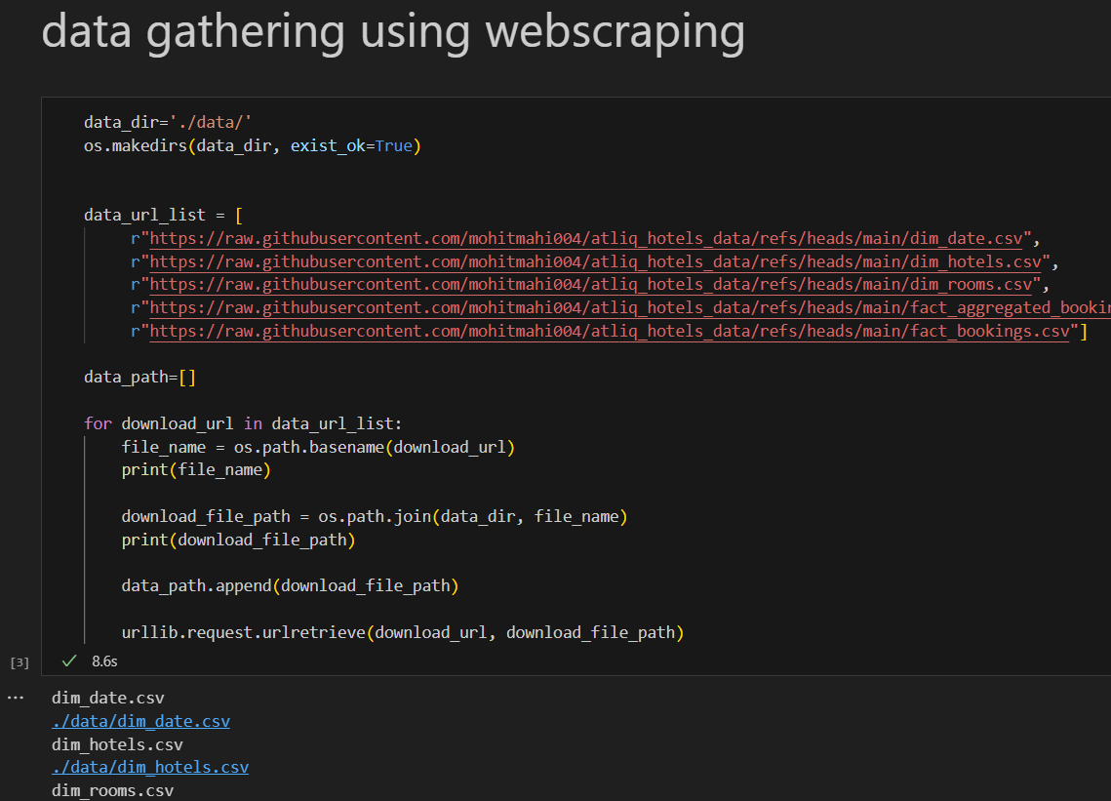
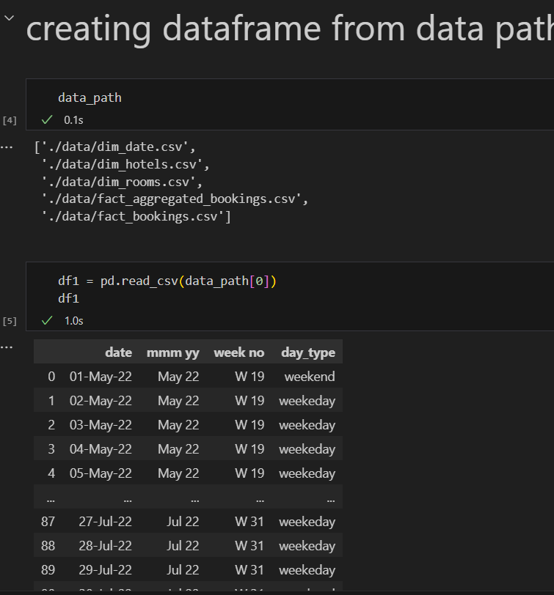
Output
The datasets used for this analysis was collected from website using python technique (web scraping)
The Data Warehousing is done using Python and MySQL database for future use.

Slide 10
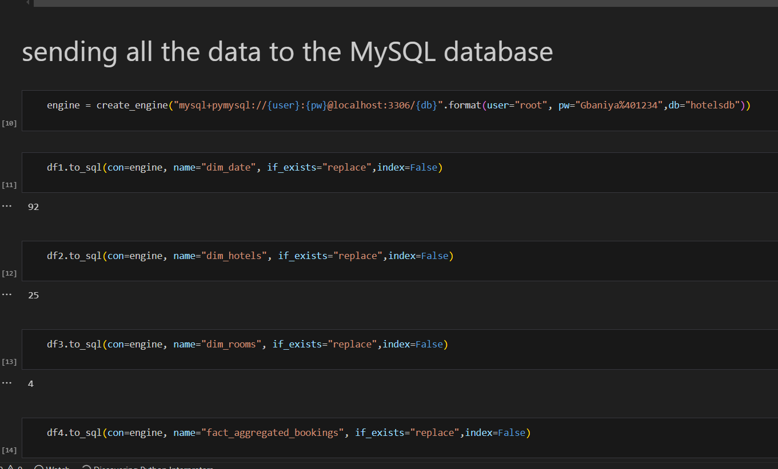
Output
The dateset comprises five CSV files, 3-dimension tables, and 2 fact tables.
dim_date: data includes day type (weekend or weekday), month, and week number (W19 —W32)
➢dim_hotels : Includes property id, property name, category (luxury/business) and the city.
➢dim_rooms : Includes room id and room class.
➢fact_aggregated_bookings : Stores information about bookings including booking dates, booking platforms, number of guests, revenue, check-in, and checkout dates.
➢fact_bookings : Includes successful bookings, hotel id, and capacity.

Slide 11
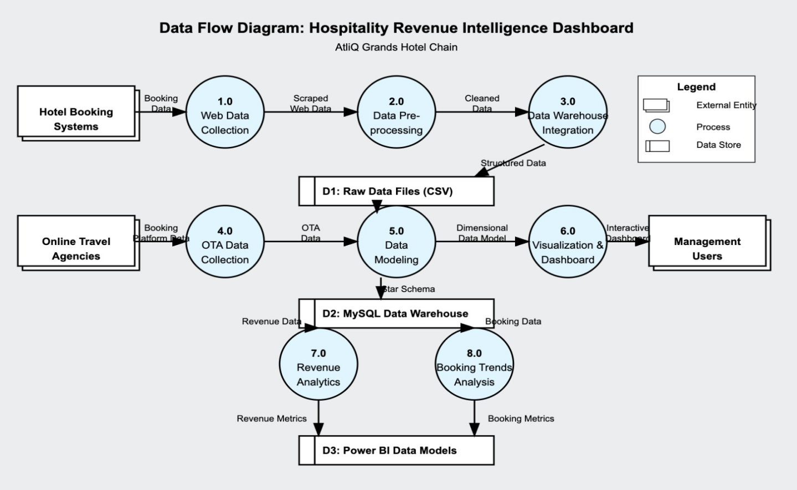
Data Flow Diagram

Slide 12
Conclusion
Helps hotel management make informed choices based on real-time data and analytics
Improves pricing strategies, demand forecasting, and yield management for higher profitability.
Provides benchmarking insights against competitors, ensuring market relevance.
Reduces manual effort, minimizes errors, and streamlines revenue management processes.
Detects underperforming revenue streams and optimizes distribution channels.
Offers predictive analytics for future planning, mitigating risks and maximizing returns.
Helps in quick decision-making by identifying revenue fluctuations and anomalies.
Aligns revenue strategies with long-term business objectives, ensuring financial stability.

Slide 13
Future Scope
1. Predictive Analytics & AI Integration
Implement machine learning models to forecast demand, pricing trends, and customer preferences.
Use AI-powered sentiment analysis to analyze customer reviews and improve service quality.
2. Real-time Data Processing
Transition from batch processing to real-time data streaming using tools like Apache Kafka or AWS Kinesis.
Enable live updates on the Power BI dashboard for instant decision-making.
3. Advanced Customer Personalization
Leverage customer segmentation techniques to offer personalized promotions.
Implement a recommendation engine for room upgrades and customized travel experiences.

Slide 14
Future Scope
4. Mobile & Web App Integration
Develop a mobile-friendly dashboard for real-time monitoring by management.
Enable direct bookings via a dedicated hotel booking platform, reducing reliance on third-party platforms.
5. Expansion of Data Sources
Integrate data from social media, IoT-enabled smart hotel systems, and customer feedback surveys.
Use external economic indicators (e.g., tourism trends, flight bookings) to enhance forecasting accuracy.
6. Cloud-Based Infrastructure
Migrate to a cloud-based data warehouse (AWS Redshift, Google BigQuery) for scalability.
Ensure high availability and security with cloud-based solutions.
7. Automated Decision Support System
Implement an AI-driven decision support system (DSS) to provide automated recommendations for pricing, inventory, and marketing strategies.

