Slide 1
Which solar charging hub should Warwick build
when e-bike demand is uncertain?
Size a hub for average demand and it strands bikes on busy days. Oversize it and capital sits idle.
Our prototype asks a sharper question: which design still works when demand, grid limits and growth change?
Theme 3 - solar charging station
Theme 2 - charge/discharge profiles
Live in-browser prototype
Team SolarCycle - Gourav Singh, Neelesh Raj, Priti Burud (Newcastle University)
Sustainable e-Micromobility Stakeholder Engagement Workshop - WMG, University of Warwick - 6 July 2026
Notes:
[Slide 1] Good morning. Instead of asking how large a charger should be for average demand, our prototype asks what design still works when demand, grid limits and future growth change. A hub sized for the average strands bikes on busy days; an oversized one wastes capital. We answer this with robust optimisation on open data - and in three minutes you will see it run live.

Slide 2
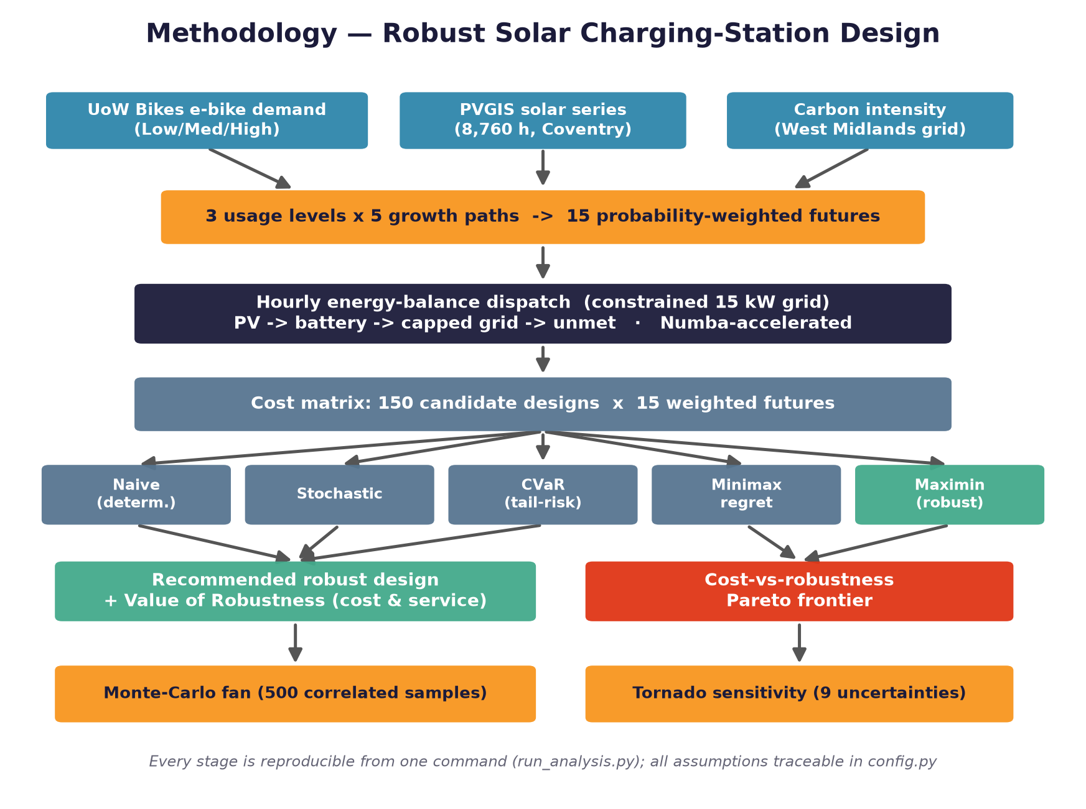
Method: open data, one full year, every design, five decision rules
The model chooses the design that still performs well when the future is worse than expected.
UoW e-bike demand > Coventry solar (PVGIS) > West Midlands carbon (ESO) > 8,760-hour simulation > 150 designs > 5 decision rules > robust recommendation
Notes:
[Slide 2] The method in one breath. Demand is calibrated to the UoW Bikes use case from open shared-micromobility evidence; solar comes from PVGIS for Coventry and grid carbon from National Grid ESO. Every candidate hub is simulated over all eight thousand seven hundred and sixty hours of a year. One hundred and fifty designs are scored across fifteen futures under five decision rules - and we recommend the one that still performs well when the future is worse than expected.

Slide 3
The recommendation: 15 kWp solar - 0 kWh battery - 8 smart bays
15 kWp
solar PV array
0 kWh
battery - smart charging replaces it here
8 bays
smart-managed 3 kW charging bays
GBP 29,400
GBP 0.253/kWh
3.7 tCO2/yr
capital cost - off-the-shelf PV and AC bays
levelised cost of delivered energy
avoided vs grid-only charging (15%, marginal basis)
99.6%
GBP 19,232/yr
Smart charging schedules flexible charging into sunny, cheap off-peak hours - the load stays under the 15 kW connection without storage.
fleet service guaranteed in the worst future
worst-case annual cost, all futures
Notes:
[Slide 3] The recommended design is 15 kilowatt-peak of solar, zero kilowatt-hours of battery, and 8 smart-managed bays. Twenty-nine thousand four hundred pounds of capital, twenty-five pence per kilowatt-hour delivered, and three point seven tonnes of CO2 avoided each year. The reason there is no battery: a returned bike only needs to be ready by morning, so smart charging schedules the energy into sunny and off-peak hours and the load never breaks the fifteen-kilowatt connection.

Slide 4
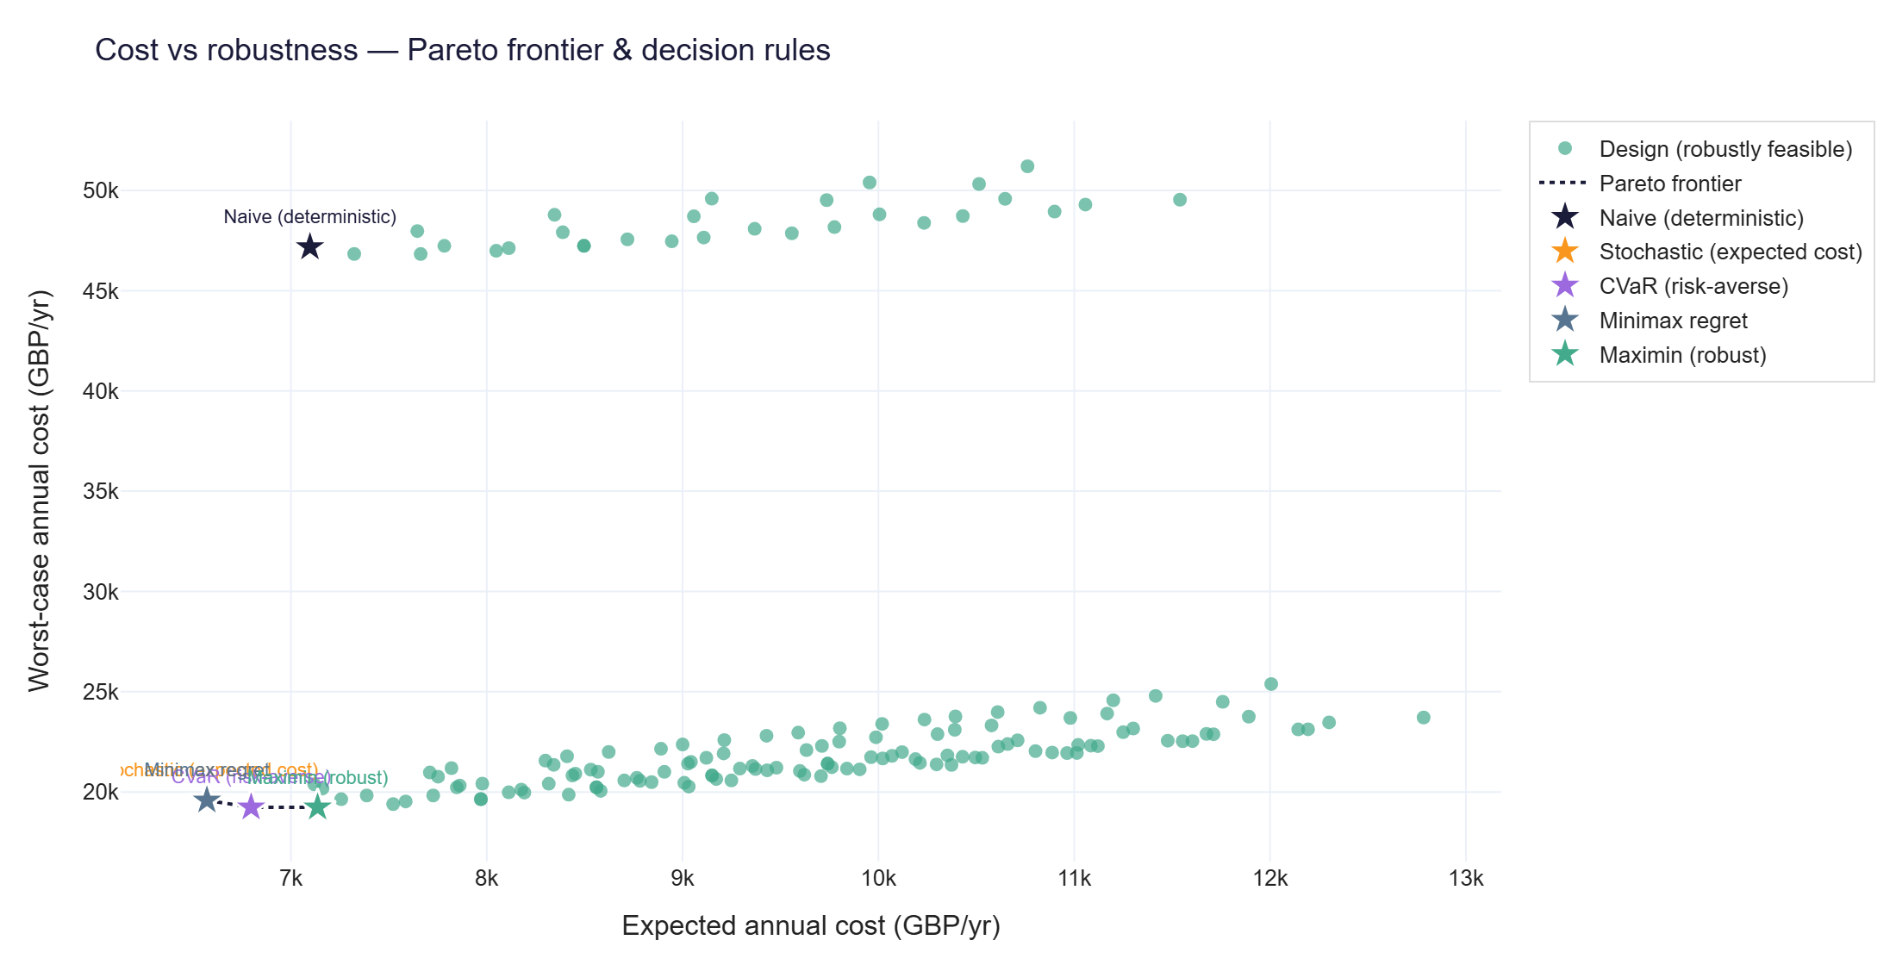
Robust vs average-demand design - what uncertainty costs
-59.2%
worst-case annual cost vs the average-demand design
95.3% -> 99.6%
guaranteed fleet service in the worst future
100% of 35
stress-test combinations in which the conclusion held
Same 500-run Monte-Carlo, Sobol sensitivity and penalty x grid x horizon sweep behind every number.
Notes:
[Slide 4] What does robustness buy? The average-demand design looks cheapest on a normal day, but in the worst demand future its cost reaches forty-seven thousand pounds a year and it strands one bike in twenty-one. The robust design cuts that worst case by nearly sixty percent and lifts guaranteed service from ninety-five point three to ninety-nine point six percent. And we stress-tested the conclusion itself: it held in one hundred percent of thirty-five assumption combinations.

Slide 5
When does a battery pay? Only when the grid is weak
Battery enters the optimal design at <= 8 kW and is gone by 10 kW.
Not an anti-battery result. For a connected campus hub, smart charging gives the required robustness without battery cost, degradation or material impact.
Conditional storage. When the connection weakens to roughly 8-10 kW, the model starts recommending storage.
LFP where needed. Cobalt- and nickel-free chemistry, long cycle life; second-life reuse and recycling planned for weak-grid sites.
Avoided impact. Skipping an unnecessary pack avoids its materials and manufacturing footprint entirely.
50.0
50.0
50.0
4.0
6.0
8.0
10.0
12.0
15.0
18.0
20.0
grid connection limit (kW) - bars show battery kWh in the robust design
“The most sustainable battery is sometimes the one you do not need to install.”
Notes:
[Slide 5] This result is not anti-battery. It shows that for a connected Warwick campus hub, smart charging gives the required robustness without extra battery cost, degradation or material impact. We swept the grid connection to find exactly where that changes: at roughly eight to ten kilowatts, storage starts entering the optimal design - and there we specify LFP chemistry with second-life reuse. The most sustainable battery is sometimes the one you do not need to install.

Slide 6

Now - the prototype itself, live
1
The recommendation, computed in front of you
the browser re-runs the full 150-design optimisation in about a second
2
Break it, then fix it
the average-demand design goes red at peaks; the robust design holds at 99.6%
3
The battery threshold, proven live
weaken the grid to 8 kW and storage enters the optimal design
scan to open on your phone
4
Validated and reproducible
gourav88502.github.io/emicromobility-robust-charging
9/9 checks in published ranges; browser matches the Python pipeline; one command rebuilds everything
The prototype turns uncertain e-bike demand into a clear infrastructure decision:
how much solar, whether a battery is needed, and how many smart bays to install.
Notes:
[Slide 6] That is the argument - now the prototype makes it live: the full model runs in the browser, checks itself against our Python pipeline, and works offline. Watch four things: the recommendation recomputed in front of you; the average-demand design failing where the robust one holds; a battery entering the design when the grid weakens to eight kilowatts; and the validation behind every number. Over to the demo.

