Slide 1
Capstone Project
Cease & Desist Automation
Gourav Anand

Slide 2
Cease & Desist Automation
Problem & Business Context:
Customers send scanned PDFs asking to stop communication
Today, agents manually read and classify each request
Manual process is slow, inconsistent, and hard to scale
Need clear separation of Cease, Uncertain, and Irrelevant
The proposed solution automates document intake, classification, routing, storage and audit logging while preserving human oversight.

Slide 3
Design & Architecture
Multi-agent pipeline built using LangGraph
PDF text extraction with OCR fallback for scans
LLM classifier outputs label, confidence, reasoning, signals
Reviewer agent optionally validates classifier output
Routing: Cease → Datastore
Irrelevant → Archive file
Uncertain → Human Review Queue
Streamlit UI for upload, review, dashboards, audit

Slide 4
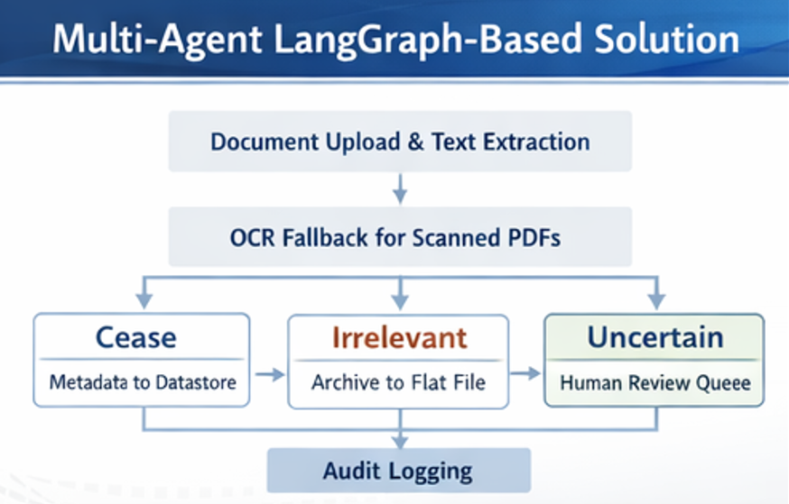
Agentic Flow

Slide 5
Edge Case Scenario Coverage
Scanned PDFs → OCR fallback when text is weak
Conditional cease language → marked Uncertain
Legal inquiries (records, authority, guardianship) → not auto-Cease
Temporary / partial suspension → flagged for human review
Low confidence / Model errors → routed to manual review
Optional multilingual support via OCR + LLM

Slide 6
Scalability & Extensibility
Modular Agents: Extractor, Classifier, Reviewer, Cease, Archive, Audit, Human Review
Storage abstraction: SQLite/CSV now, can swap to enterprise DB/queues
LangGraph routing supports new nodes and tools without redesign
Async processing & retries
Model/provider switching for token optimization
Metrics and monitoring

Slide 7
NFRs: Beyond Functionality
Auditability: Every decision logged with reasoning & confidence
Explainability: Key phrases + signal analysis for each document
Reliability: Ambiguous/failed cases go to human review
Maintainability: Clear separation of agents, tools, and UI
Scalability: Graph-based, pluggable components
Usability: Streamlit app for upload, review, dashboards, audit
Resilience: OCR fallback + configurable LLM providers

