Slide 1

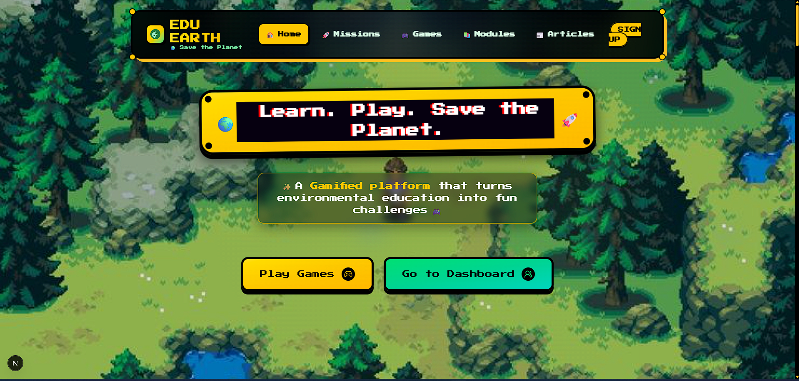

EduEarth
PROJECT PRESENTATION
EDU
EARTH
Where learning meets action for a sustainable future.
A gamified environmental education platform for students, teachers and institutions.
31
3
REST
LEARNING MODULES
GAME MODES
API + REALTIME
Project Title: EduEarth - Gamified Environmental Education Platform
Project Team
Gourav
12203224
T R Swayam
12218740
Kuldeep Gautam
12213805
Devansh Baliyan
12207844
Gamified learning | Role-aware dashboards | Realtime games | Environmental data
Notes:
Introduce EduEarth as a full-stack platform that turns environmental education into a practical learning, gaming and tracking experience.

Slide 2

EduEarth | Project Presentation
Problem & Solution
02 / 16
Problem Statement & Proposed Solution
Moving environmental education from passive awareness to measurable action.
THE PROBLEM
PROPOSED SOLUTION
01
LOW ENGAGEMENT
01
GAMIFIED LEARNING
Environmental learning is often passive and hard to connect with daily behavior.
Modules, quizzes, missions, badges, streaks and eco-points.
WEAK ACTION LOOP
ROLE-AWARE DASHBOARDS
02
Students need feedback, missions and motivation beyond static lessons.
02
Separate student and teacher journeys with automatic routing.
LIMITED VISIBILITY
03
Teachers need visibility into progress, participation and class performance.
03
REALTIME GAME LAYER
Socket.io powered quiz races and multiplayer learning moments.
04
RAW INFORMATION
04
DATA-ENRICHED ARTICLES
Current climate news is useful, but rarely converted into classroom-ready material.
Airflow ingestion turns RSS and climate data into curriculum-aligned content.
Gamified learning | Role-aware dashboards | Realtime games | Environmental data
Notes:
Frame the problem as engagement, teacher visibility and data readiness. Then show EduEarth as a loop of learn, play, act and track.

Slide 3
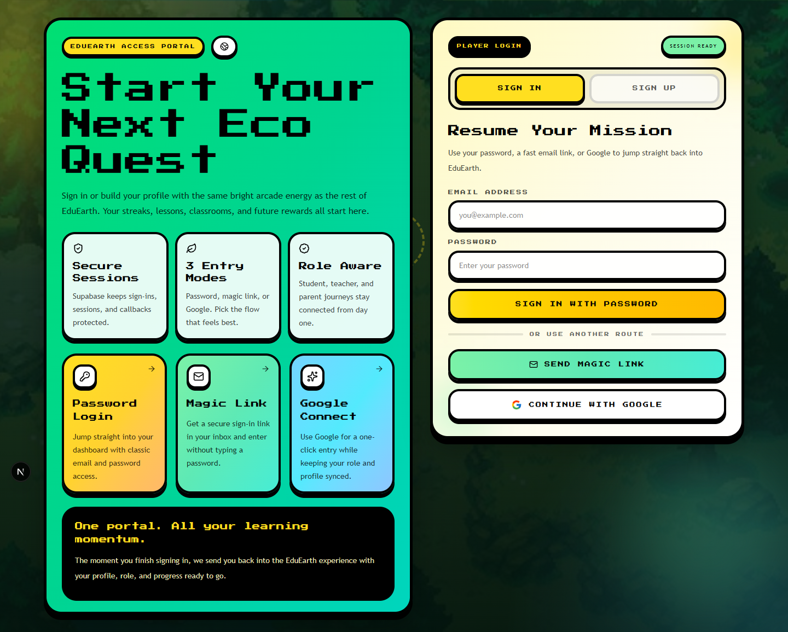
EduEarth | Project Presentation
Introduction
03 / 16
A Learning Ecosystem For Environmental Action
Designed around the people who create, guide and experience sustainable learning.
S
STUDENTS
T
TEACHERS
Explore modules, play games, complete missions and earn eco-points.
Monitor classes, review progress and guide assignments.
I
INSTITUTIONS
C
CONTENT FLOW
Manage classes, teachers, students and leaderboards.
Articles and climate signals refresh learning material over time.
Core product loop
LEARN
PLAY
ACT
TRACK
Gamified learning | Role-aware dashboards | Realtime games | Environmental data
Notes:
Explain the project around its stakeholders and the recurring product loop that keeps learners engaged.

Slide 4

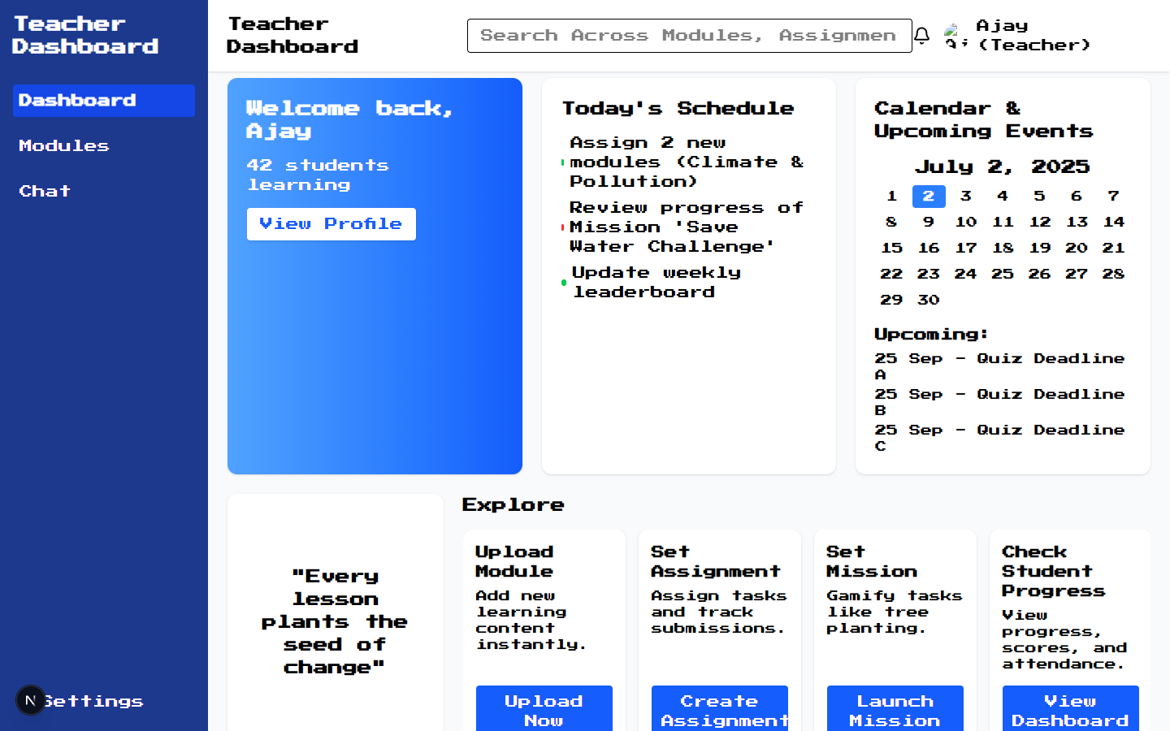
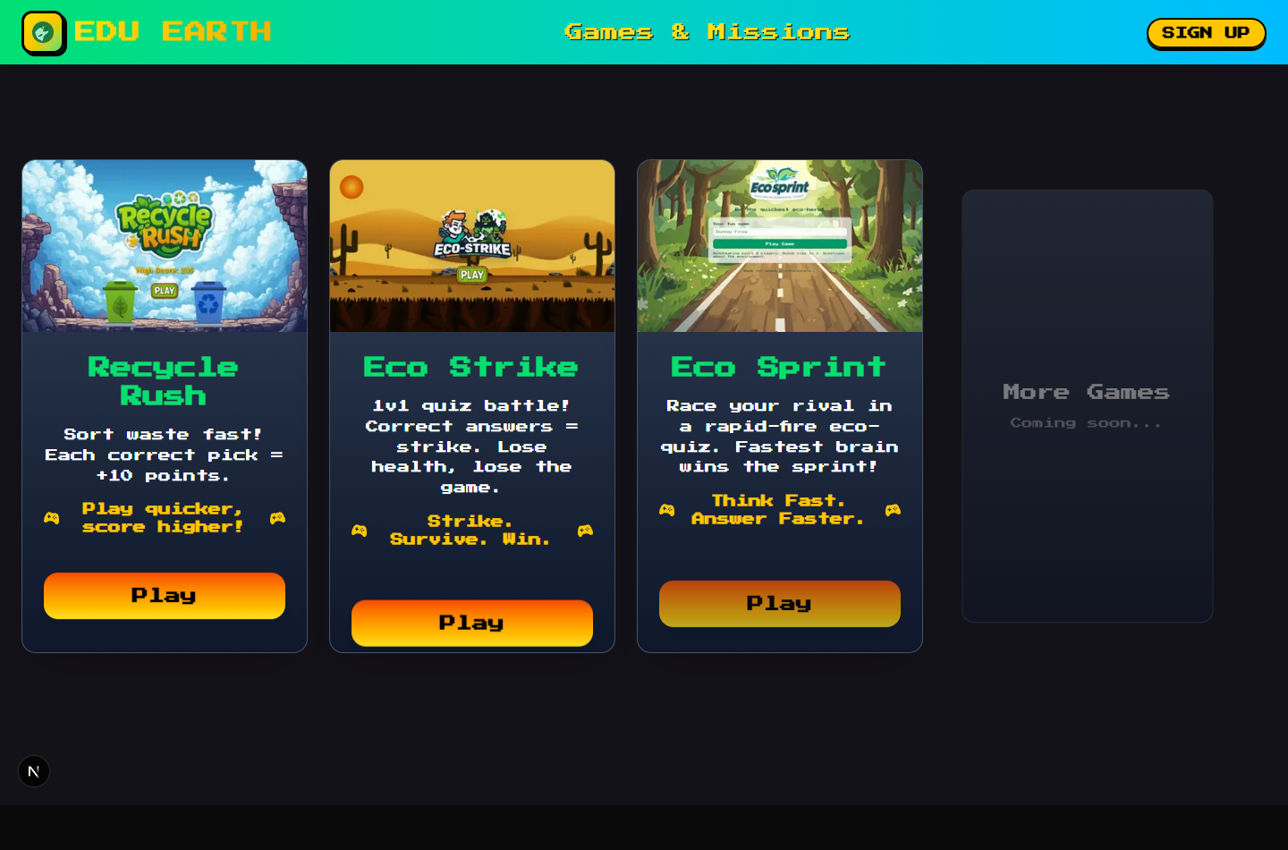
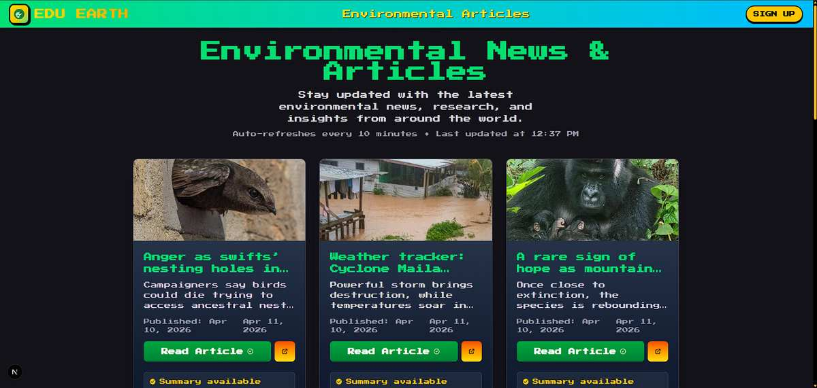
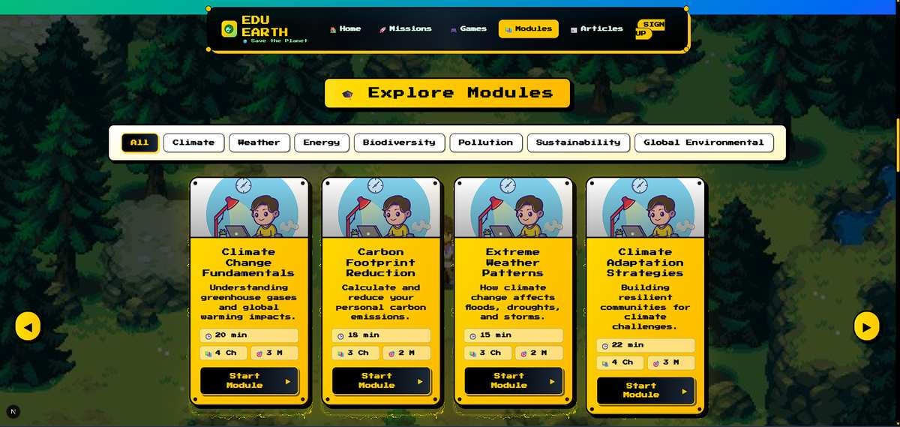
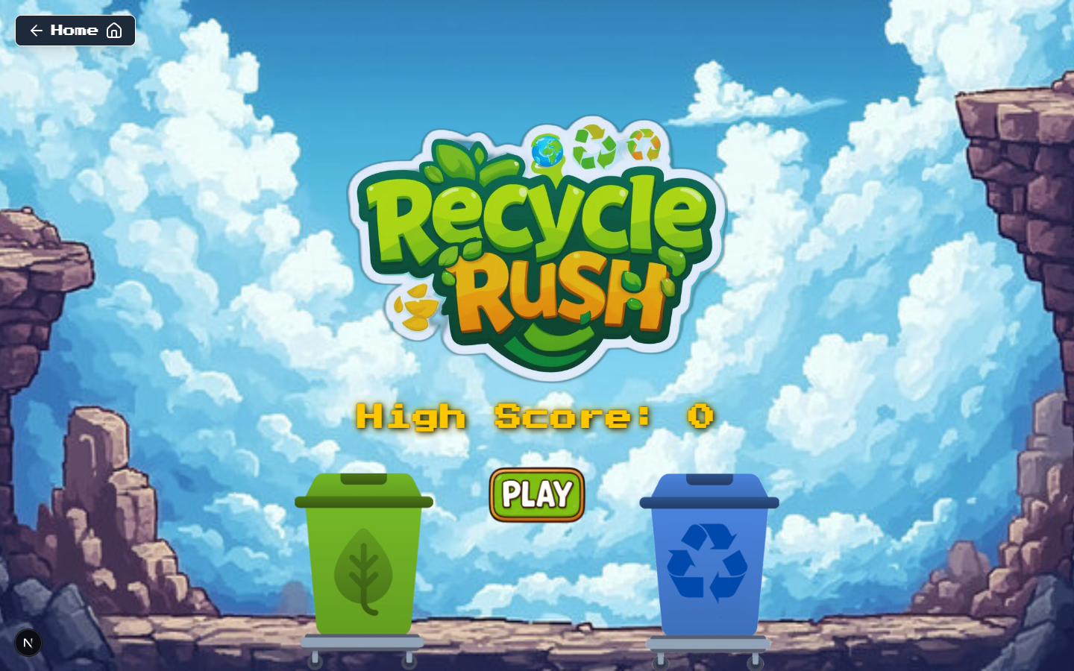
EduEarth | Project Presentation
Product Snapshot
04 / 16
Product Experience Snapshot
Screens captured from the implemented EduEarth app.
HOME
TEACHER
GAMES
ARTICLES
MODULES
RECYCLE RUSH
Gamified learning | Role-aware dashboards | Realtime games | Environmental data
Notes:
Use this slide as a quick product tour: home, dashboards, articles, modules and game experiences are all implemented and connected.

Slide 5
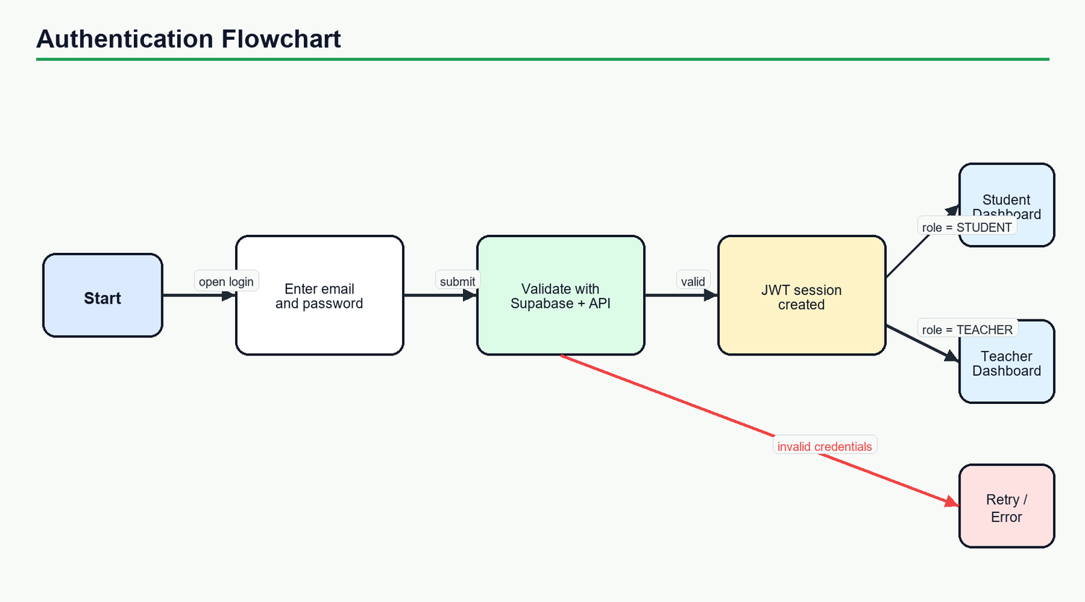
EduEarth | Project Presentation
UI/UX Flow
05 / 16
User Journey & Navigation Flow
From sign-in to action: the app keeps the learner path short and role-aware.
01
LANDING
Brand-led entry point introduces EduEarth and routes users toward auth or dashboards.
02
ROLE SELECTION
Auth model supports student and teacher flows with Supabase callback handling.
03
DASHBOARD
Users land on the right workspace: learning progress or class oversight.
04
EXPLORE
Modules, articles and games create multiple ways to engage with the same topic.
Reference flow diagram
05
ACTION LOOP
Authentication and automatic routing are backed by client-side Supabase session checks plus server token validation on protected mutations.
Missions, assignments, quizzes and badges convert lessons into practice.
Gamified learning | Role-aware dashboards | Realtime games | Environmental data
Notes:
Walk through the user journey step by step, emphasizing that role-aware routing keeps the UX clean for students and teachers.

Slide 6

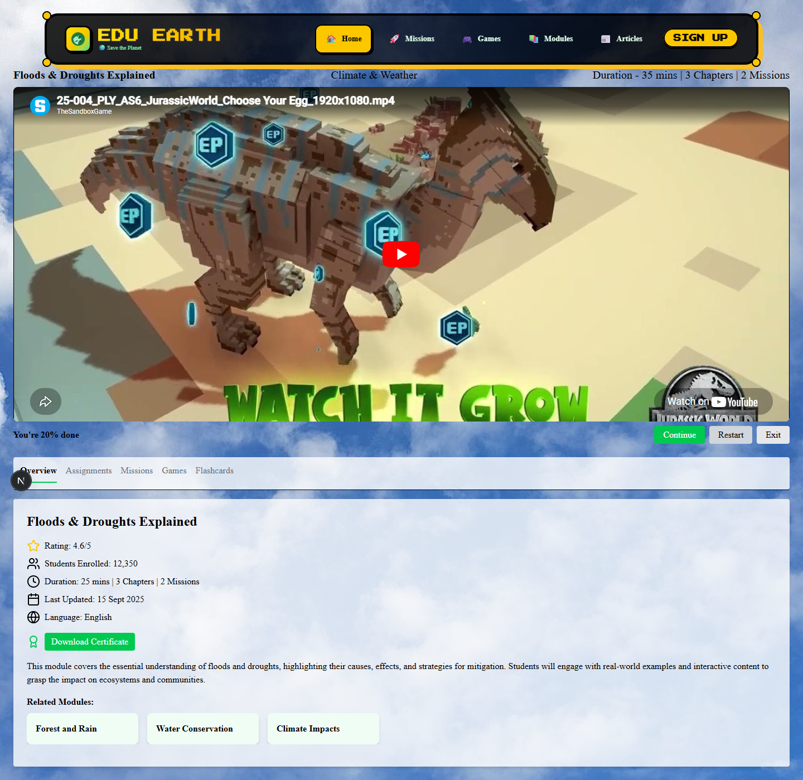
EduEarth | Project Presentation
Frontend
06 / 16
Frontend | Layered Architecture
Next.js app router, reusable components and motion-focused product screens.
PAGES
App Router routes: home, auth, dashboards, modules, games, articles
Next.js 15
React 19
COMPONENTS
Navbar, hero, dashboards, cards, game UIs, auth provider
Tailwind CSS 4
Framer Motion
CLIENT LIB
API wrapper, Supabase browser client, typed module data
Lucide / React Icons
TypeScript
VISUAL ASSETS
Screenshots, game sprites, logos, backgrounds and icons
Course detail and module UI reuse the same content model.
Gamified learning | Role-aware dashboards | Realtime games | Environmental data
Notes:
Present the frontend as a clear set of layers: routes, components, API/auth helpers and assets.

Slide 7
EduEarth | Project Presentation
Frontend Flow
07 / 16
Frontend | Navigation Flow
Modules
Student Dashboard
Session-aware routing connects users to the correct product area.
Games
Open App
Check Supabase Session
Role?
Teacher Dashboard
Articles
Classes
Auth Model
STUDENT
TEACHER
GAMES
Gamified learning | Role-aware dashboards | Realtime games | Environmental data
Notes:
Explain how auth state controls routing and how users move into modules, games, articles and class tooling.

Slide 8
EduEarth | Project Presentation
Learning
08 / 16
Learning Modules & Gamification
Curriculum breadth plus visible rewards keeps environmental topics actionable.
31
428K
4.76
MODULE CATALOG
SAMPLE ENROLLMENTS
AVERAGE RATING
Module categories
Sustainability
7
Global Environmental
6
Energy
5
Assignments
Missions
Pollution
5
Due dates, status and grading flow
Community actions and XP rewards
Biodiversity
4
Badges
Leaderboards
Climate
3
Achievement model for consistency
Institution and class motivation
Weather
1
Gamified learning | Role-aware dashboards | Realtime games | Environmental data
Notes:
Use the chart to show breadth, then explain how assignments, missions, badges and leaderboards reinforce learning outcomes.

Slide 9
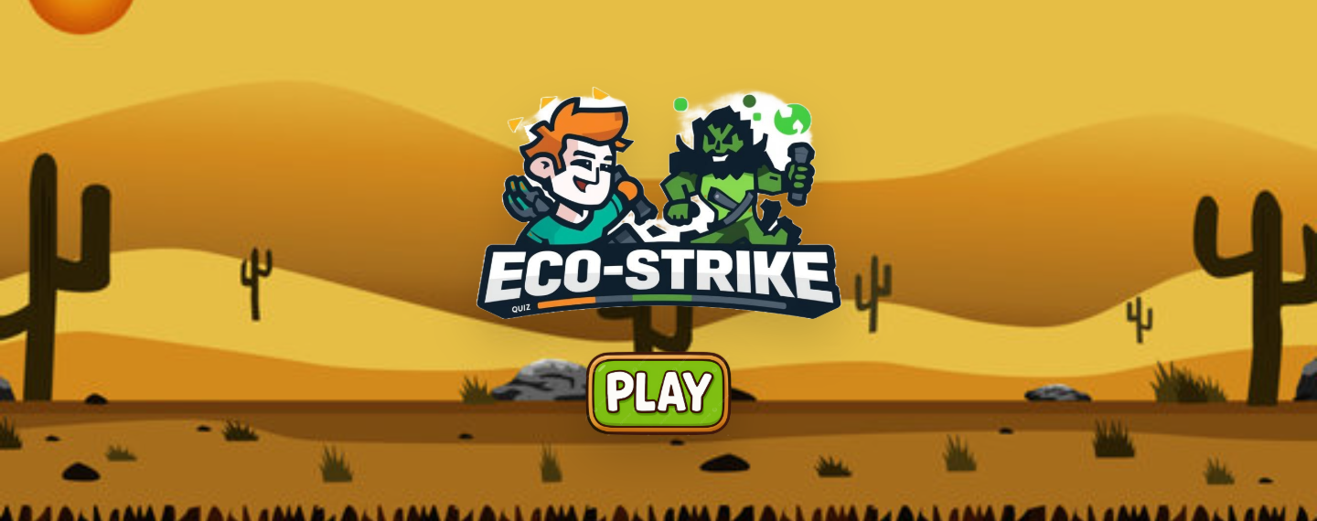
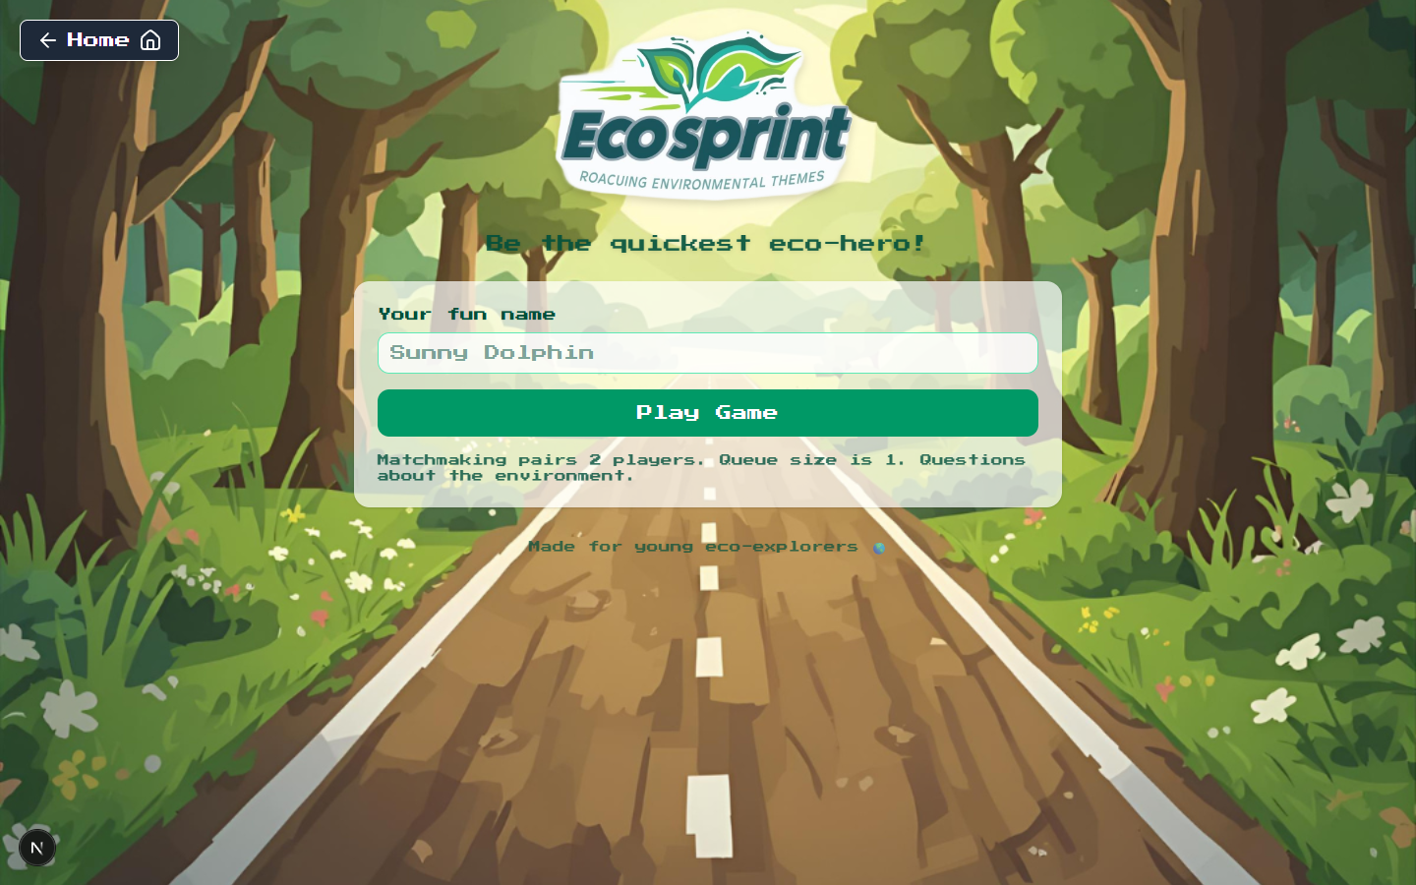
EduEarth | Project Presentation
Realtime Games
09 / 16
Games | Interactive Environmental Learning
Three game experiences turn quiz content and waste sorting into active recall.
Recycle Rush
Eco Strike
Eco Sprint
Waste sorting with custom bin and item assets.
Quiz battle where answers trigger attacks.
Realtime race powered by Socket.io matching.
Realtime game loop
Join queue
Match players
5 questions
15s timer
Score + winner
Socket.io keeps queue state, question events, scoring and disconnect handling responsive during multiplayer sessions.
Gamified learning | Role-aware dashboards | Realtime games | Environmental data
Notes:
Highlight each game briefly, then explain the realtime game loop from queue to match to scoring.

Slide 10

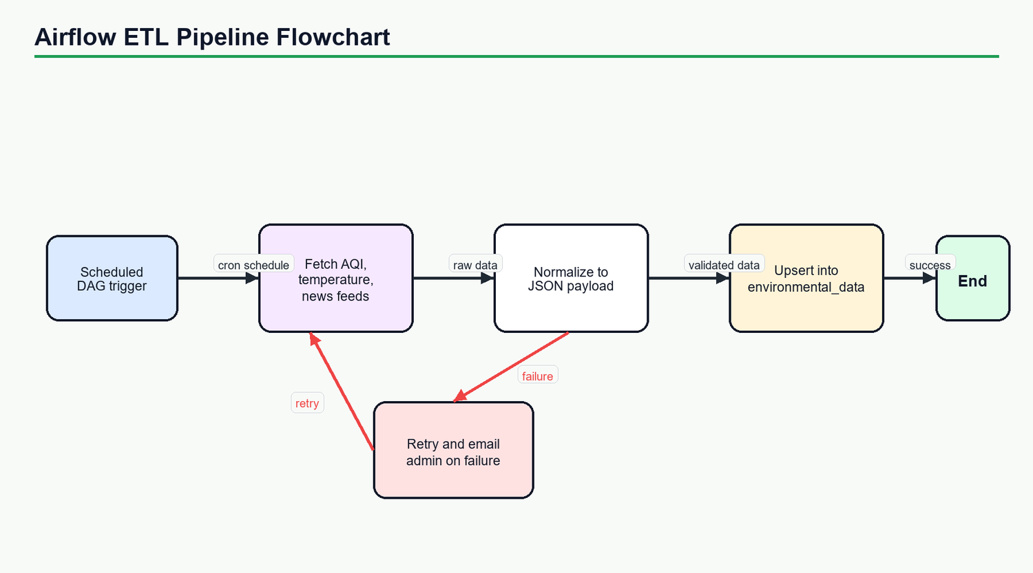
EduEarth | Project Presentation
Environmental Data
10 / 16
Articles & Environmental Data Pipeline
External climate and RSS data becomes classroom-ready learning material.
01
SOURCES
02
AIRFLOW DAG
03
ENRICHMENT
04
OUTBOX
Open-Meteo climate API plus Guardian, UNEP and NASA Earth RSS feeds.
Scheduled scraping, retries, data quality and freshness checks.
Topic, grade band, difficulty, learning objective, tags and relevance score.
Reliable websocket events publish deltas without re-scraping.
Result: teachers and learners can consume timely environmental stories as structured, searchable educational content.
Gamified learning | Role-aware dashboards | Realtime games | Environmental data
Notes:
Explain how the Python and Airflow workspace decouples external fetching from the Express API and enriches content for curriculum use.

Slide 11
EduEarth | Project Presentation
Backend
11 / 16
Backend | API, Auth & Realtime Core
Express serves domain APIs while Socket.io handles interactive game and outbox events.
Node + Express + Socket.io, modular by route and responsibility.
Primary API surface
REST API
Auth Boundary
Auth, institutions, classes, lessons, quizzes, articles, metrics and flow routes.
Supabase bearer tokens validated on protected create/update/delete flows.
GET /health
GET /metrics
/auth/user
Prisma Data Layer
Realtime Server
/institutions
Typed access to users, institutions, lessons, quizzes, badges and articles.
Socket.io queue, matchmaking, question events and winner calculation.
/classes
/lessons
Observability
Outbox Publisher
/quizzes
Pino request logging, request IDs and Prometheus metrics endpoint.
Polls unsent events and emits reliable websocket updates.
/articles
/game/health + /stats
Gamified learning | Role-aware dashboards | Realtime games | Environmental data
Notes:
Summarize the backend as REST plus realtime. Mention the observability and outbox publisher because those show production thinking.

Slide 12
EduEarth | Project Presentation
Backend Flow
12 / 16
Backend | Request Lifecycle & Services
A predictable path from browser request to database response and realtime event fan-out.
REQUEST LIFECYCLE
Client fetch
CORS + JSON
Auth token
NEXT_PUBLIC_SERVER_URL
Express middleware
validToken middleware
Controller
Service/Repo
Prisma
Route-specific handler
Domain logic
PostgreSQL read/write
RELIABLE REALTIME PATH
Ingestion write
websocket_outbox
Publisher poll
FOR UPDATE SKIP LOCKED
Socket emit
channel + event
Client update
fresh UI state
Gamified learning | Role-aware dashboards | Realtime games | Environmental data
Notes:
Walk through two flows: standard REST request handling and reliable websocket fan-out through the outbox table.

Slide 13
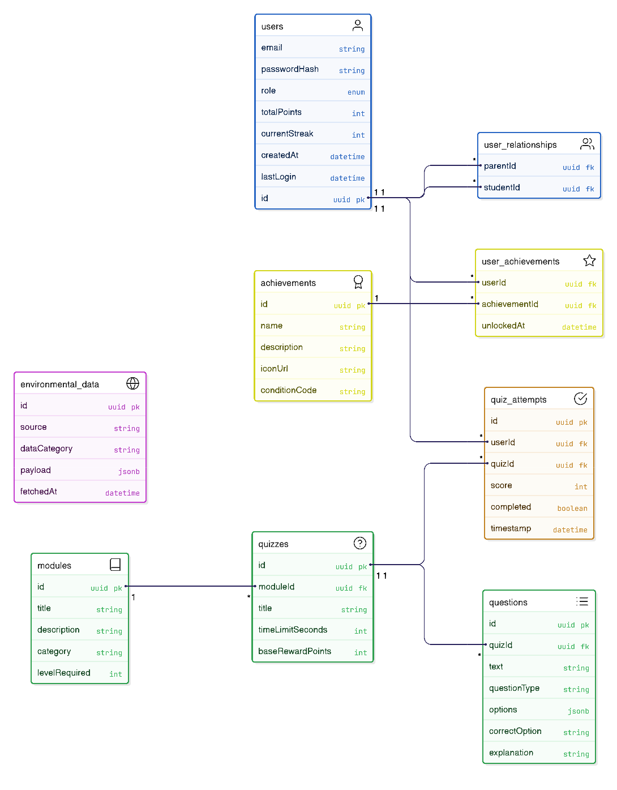
EduEarth | Project Presentation
Data Model
13 / 16
Database | Core Domain Model
Prisma models connect users, schools, learning content, activities and environmental articles.
Identity
User, RefreshToken, OTP, role metadata
Institution
Institution, Class, Student, Teacher, class membership
Learning
LessonModule, Lesson, Quiz, QuizQuestion, attempts
Motivation
Challenge, EcoActivity, Badge, Achievement, Leaderboard
Content
Article plus ingestion tables for news, climate and outbox
Gamified learning | Role-aware dashboards | Realtime games | Environmental data
Notes:
Explain the data model by families instead of reading every table. The diagram gives depth while the left side keeps the story clear.

Slide 14
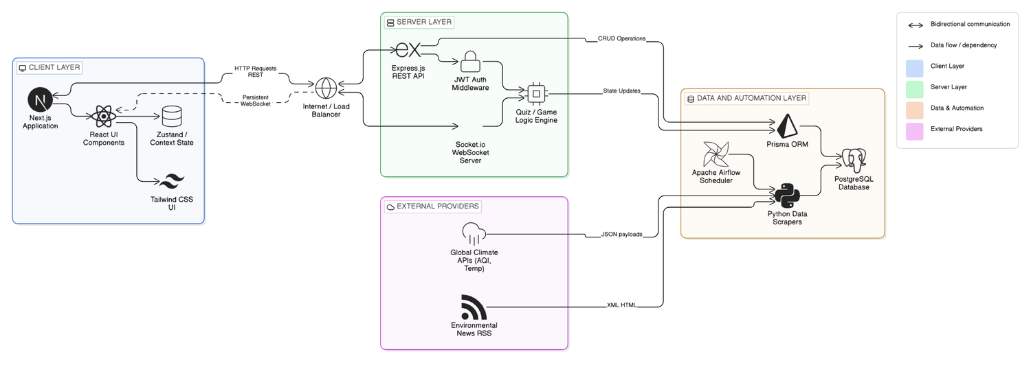
EduEarth | Project Presentation
Project Architecture
14 / 16
Project Architecture
Client, API, realtime services, PostgreSQL and Airflow ingestion working as one learning platform.
CLIENT
API
DATA
INGESTION
Next.js UI, dashboards, games, articles
Express routes, auth, metrics and flow views
PostgreSQL, Prisma models and outbox
Airflow DAGs, Python scrapers and enrichment
Gamified learning | Role-aware dashboards | Realtime games | Environmental data
Notes:
Use this slide as the main architecture explanation: the user-facing Next.js app talks to the Express API, realtime Socket.io services support games and updates, PostgreSQL stores domain data, and Airflow enriches external environmental feeds.

Slide 15
EduEarth | Project Presentation
Readiness
15 / 16
Security, Scalability & Future Scope
The current implementation already separates concerns and leaves a clear path to production hardening.
Current safeguards
Future scope
01
TOKEN VALIDATION
01
TEACHER ANALYTICS
Supabase bearer token checks protect mutations.
Deeper classroom trends, intervention signals and exports.
02
REQUEST DISCIPLINE
02
CONTENT INTELLIGENCE
CORS, JSON limits, request IDs and centralized helpers.
AI summaries and adaptive recommendations by grade band.
03
OBSERVABILITY
03
PRODUCTION INFRA
Pino logging plus Prometheus request duration metrics.
CI/CD, managed database, cache, alerts and backup policy.
04
RELIABLE FAN-OUT
04
IMPACT TRACKING
Outbox rows retry websocket delivery safely.
Verified eco-activities mapped to school and community goals.
Gamified learning | Role-aware dashboards | Realtime games | Environmental data
Notes:
Close the technical story by showing what is already designed for safety and what can be expanded next.

Slide 16
EduEarth | Project Presentation
Closing
16 / 16
EduEarth
Project Presentation
Thank
you.
Questions, feedback and collaboration are welcome.
Built as a full-stack environmental learning platform with gamified modules, realtime games, dashboards, API services and an Airflow ingestion layer.
LEARN
PLAY
ACT
TRACK
Gamified learning | Role-aware dashboards | Realtime games | Environmental data
Notes:
Thank the audience and invite questions. Be ready to demo the dashboards, games and architecture diagrams.

