Slide 1
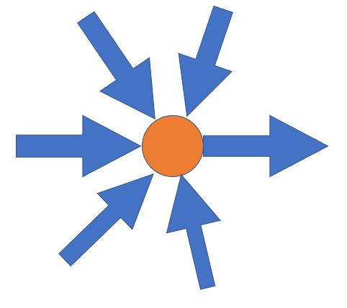
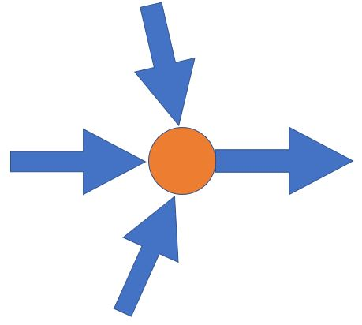
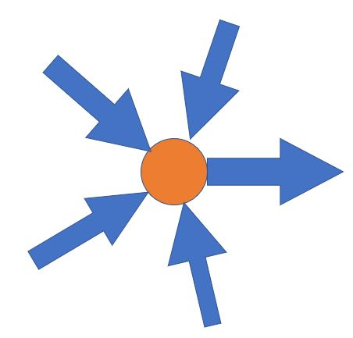
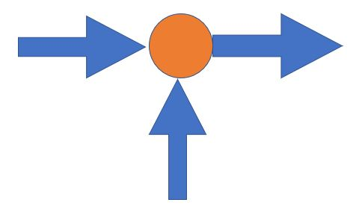
In2
In1
All Control Signals generated
Control_signal
In3
Out
Controller
Cy_wr
Reg_write
In4
In5
MEM_wr
MEM_rd
IR_15_0
ALU_a_src
Cy_out
Cy
carry
PC_next
PC_out
T1_out
IR_10_8
‘110’
Acc_out
MEM_D
A1
D1
MEM_D
ALU_Ctrl
ACC_src
ACC_write
PC
Memory
Instruction Register
Register Files
RF_D1
T1
T1_out
PC_out
ALU_a
a
RF_D1
MEM_D
IR_7_0
IR_wr
IR_2_0
T1_src
ALU_out
Accumulator
T2_out
DW
A2
ALU_out
b
T1_out
PC_write
T1_write
T2
Mem_dw_src
‘110’
T1_write
ALU
IR_7_0
T1_out
IR_7_0
D2
IR_7_0
Zr
Acc_out
RF_D2_src
ALU_b
Acc_out
IR_7_0
ALU_out
‘FF’
Zr_out
PC_src
ALU_b_src
+1
ALU_out
PC_out
Acc_out
RF_D1

Slide 2

In2
In1
All Control Signals generated
Input Clock
(50MHz)
PLL
IP Block
Output Clock
(12.5MHz)
Control_signal
Controller
ACC_src
In3
RF_D1
DM_data
ACC_write
In4
In5
alu2_out
Accumulator
Alu3_out
IM_data_7_0
Acc_out
IM_data_15_0
Reg_write
PC_out
‘110’
PC_out
Alu2_src_a
PC_next
ALU_1
IM_data_10_8
A1
Carry (Sign extended)
PC
a
Instruction Memory
RF_src_a1
D1
b
IM_data_2_0
Register Files
ALU_2
RF_D3
RF_D1
a
Acc_out
ALU_3
+1
A3
D3
alu1_out
a
Alu3_out
PC_write
alu1_out
b
IM_data_10_8
A2
‘FF’
b
Alu2_zero
write
RF_src_a2
read
PC_src
alu1_out
D2
DM_src_a
RF_D1
‘110’
Alu2_src_b
IM_data_7_0
Data Memory
RF_src_D2
IM_data_7_0
+1
A
DM_D_out
RF_D1
IM_data_7_0
RF_D1
RF_D3
alu2_out
alu1_out
DW
Alu2_out
DM_src_d
IM_data_7_0
Acc_out
Acc_out
DM_D_out
RF_D1

Slide 3
Select lines from Hazard Control
Accumulator
ACC_out
DM_d, RF_D1, ALU3_out, IM_d and others
Data Forwarding MUX _1
ACC_out_new
‘0’
ALU_3
PC_out
Here, all inputs are taken from EX_MEM stage
a
ALU3_out
read
write
out
ALU_1
RF_D1
b
Z
a
Instruction Memory
IM_d
IF_ID
ID_EX
PC
b
Acc_out and other inputs
Data Forwarding MUX _2
RF_D1_new
C_in
IM_7_0
A
D
‘110’
ALU1_out
EX_MEM
MEM_WB
ALU3_zero
IF_ID_IM_d[10:8]
A1
D1
RF_D1_new
a
ALU_2
RF_D3
DATA MEMORY
MEM_WB_IM_d[10:8]
+1
RF_D1
Cy
Register Files
ACC_out_new
out
IF_ID_IM_d[2:0]
Select lines from Hazard Control
b
Z
Branch Prediction Table
‘FF’
DW
MEM_WB_RF_src_a2
RF_A2
A3
D3
IF_ID_IM_d_7_0
ALU2_out
A2
IM_d_7_0
+1
BT_out
IM_7_0
ACC_out
“110”
D2
RF_D1
RF_D1
Alu1_out
Alu2_out
ID_EX_output
PC_src
Here, all inputs are taken from EX_MEM stage
IM_d[7:0]
RF_d2
EX_MEM_output
DM_d
IF_ID_output
Hazard Control
MEM_WB_output
RF_d1
ACC_out
Cy_new
MEM_WB_RF_src_D2
Here, all inputs are taken from MEM_WB stage
Controller
Z_new
In2
In1
ALU3_zero
Zero
All control signals
Control_signal
MEM_WB_ALU2_zero
In3
‘0’
ALU3_carry
In4
In5
Carry
MEM_WB_ALU2_carry
MEM_WB_ALU2_out[0]

