Slide 1


Slide 2

BANK LOAN ANALYTICS
Presenting By Group 1

Slide 3
INTRODUCTION
This Project is focused on understanding key metrics from a dataset of over 39k+ customer bank records. We have used Excel, Power BI, Tableau, and SQL to generate insights from these datasets.

Slide 4
OBJECTIVE
The main goal was to take a handful of important performance metrics (KPIs) and turn them into easy-to-understand visualizations. The aim was to create clear charts and graphs that tackled the specific KPIs and made it simple for everyone to grasp how the company was doing.
This objective pushed me to enhance my data analysis skills and communicate insights visually, helping to make better-informed decisions based on the data.

Slide 5




TOOLS
Microsoft Excel
Power BI
Tableau
MySQL

Slide 6
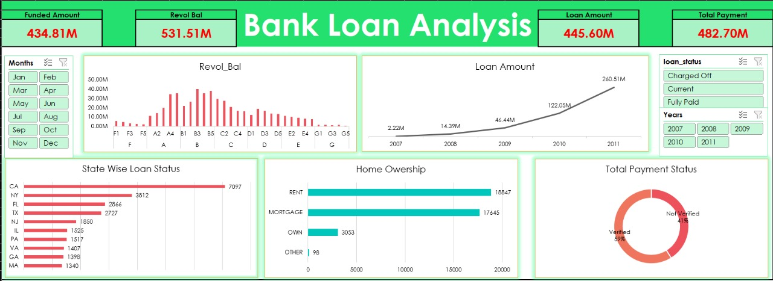
EXCEL DASHBOARD

Slide 7
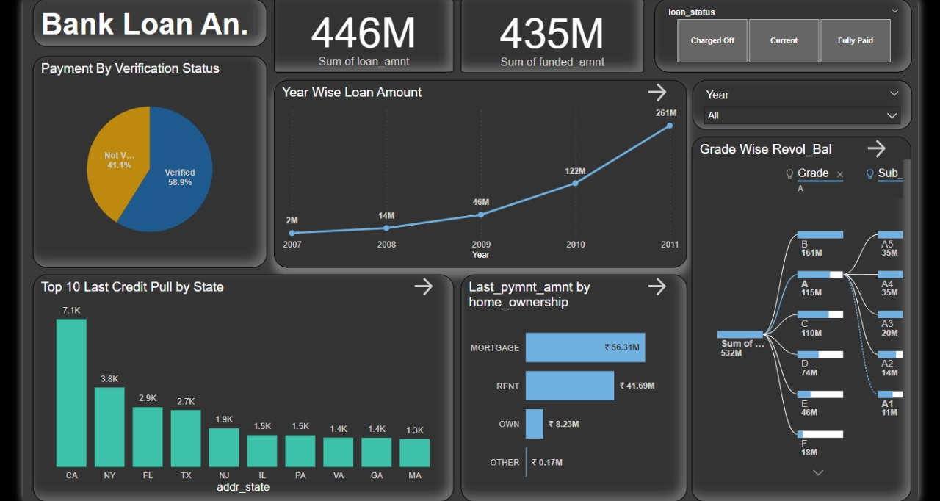
POWER BI DASHBOARD

Slide 8
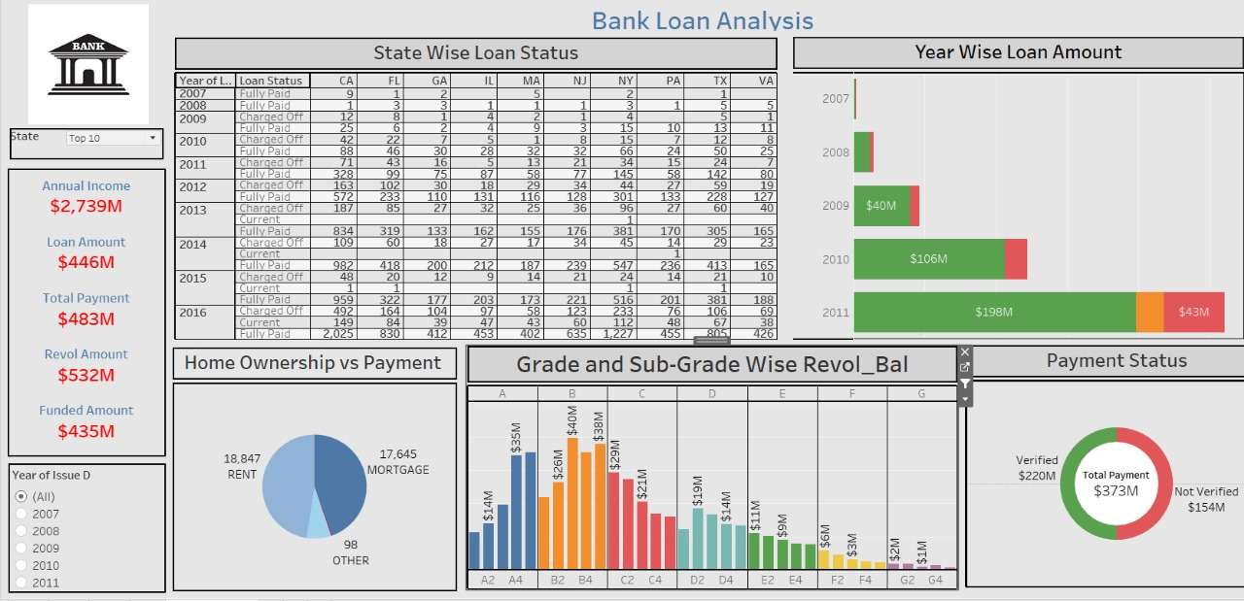
TABLEAU DASHBOARD

Slide 9
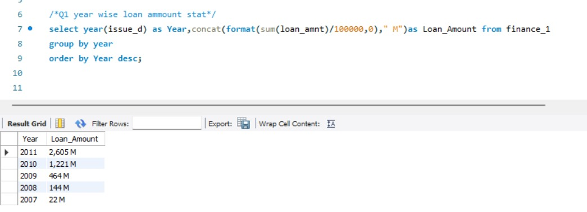
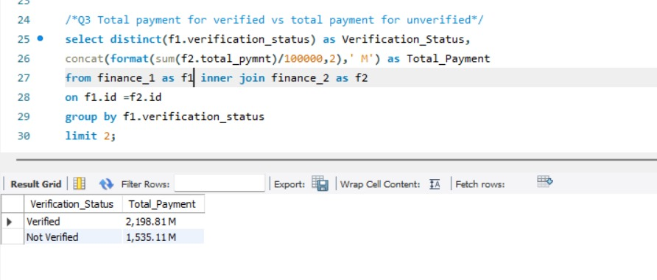
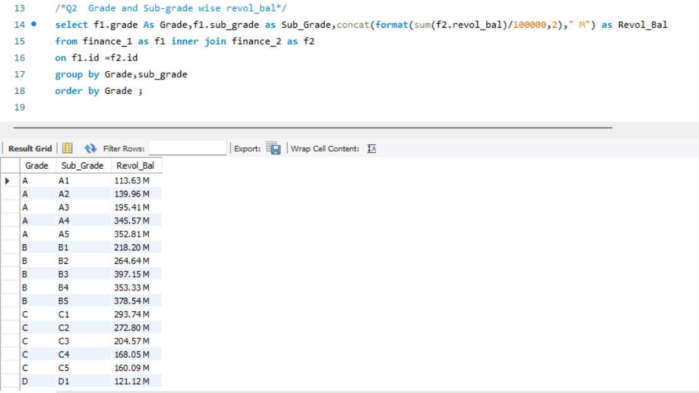
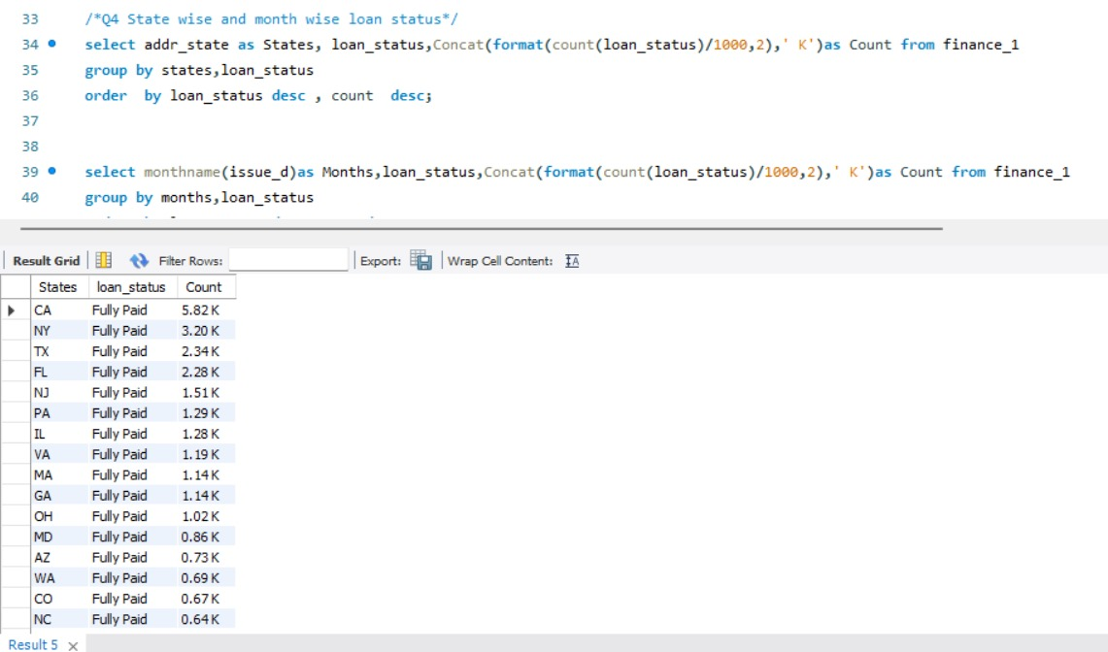
MySQL Queries

Slide 10
Understanding Loan Dashboard Analytics
.
Performance Monitoring: Loan dashboard analytics allows lenders to track and monitor key performance indicators
such as loan origination volume, delinquency rates, default rates, and profitability. This helps lenders identify underperforming loans, assess risk exposure, and take proactive measures to mitigate potential losses.
Trend Identification: By analyzing historical loan data, lenders can identify Trends and patterns that impact loan performance This includes factors such as borrower demographics, loan types, interest rates, and economic indicators. Understanding these trends enables lenders to adapt their lending strategies and optimize loan offerings.
Risk Assessment: Loan dashboard analytics provides lenders with insights into credit risk, allowing them to assess the creditworthiness of borrowers and make informed lending decisions. By analyzing credit scores, income levels, and other relevant data, lenders can identify high-risk borrowers and implement risk mitigation strategies.
Loan dashboard analytics help streamline loan processes, improve operational efficiency, and reduce costs. By identifying bottlenecks, inefficiencies, and areas of improvement, lenders can optimize loan origination, underwriting, and servicing processes, resulting in faster loan approvals and improved operational efficiency.

Slide 11
Summarize the key findings of the analysis:
Loan amounts have grown/shrank over the years.
Certain grades and sub-grades show higher risks based on revol_bal.
Verified customers make higher total payments.
Some states/months are more prone to certain loan statutes.
Homeownership affects the speed of loan repayments.
Actionable Insights:
Focus on riskier grades for better loan approval strategies.
Target states with higher default rates for focused outreach programs.
Encourage verified process to ensure higher repayments.

Slide 12
THANK YOU..

