Slide 1


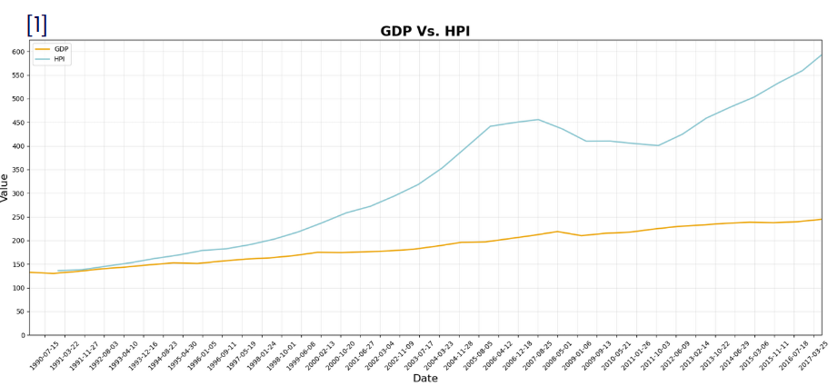
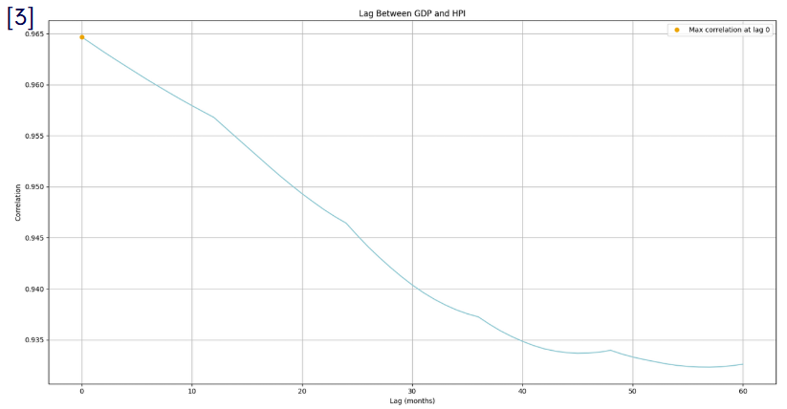
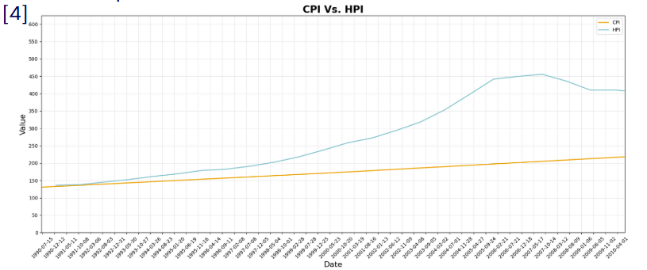
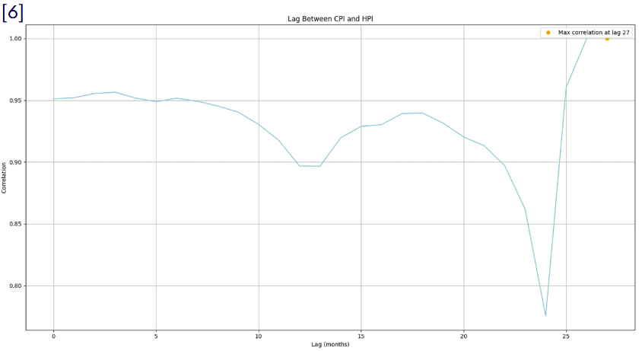
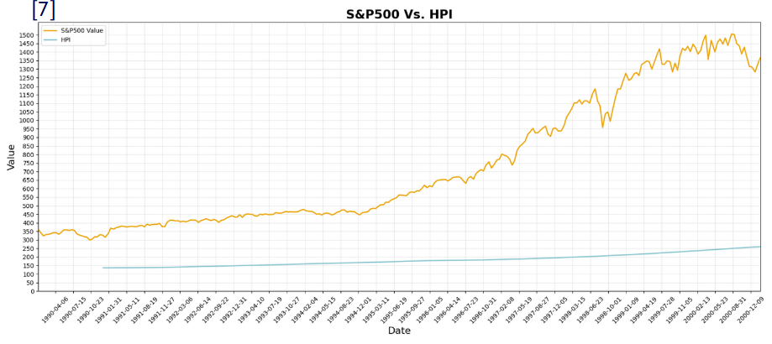
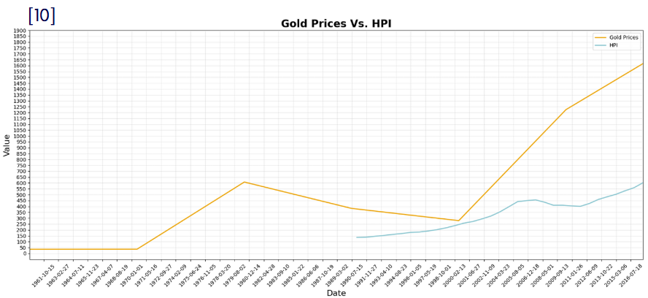

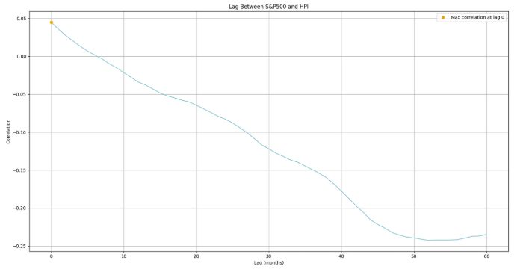

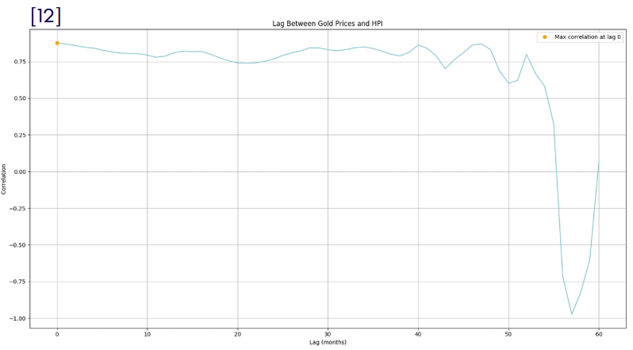
Leveraging Housing Prices To Predict
The Future Economy
Team IDs: 877494
Gulf Coast Regional Conference 2025
Introduction
Methods
Results
Conclusion
The U.S. housing market is closely tied to overall economic performance, with housing price fluctuations often signaling broader economic shifts. Studies, such as those by Robert Shiller, show that changes in housing prices can impact household wealth, consumption, and borrowing, influencing economic stability. By analyzing these relationships, researchers aim to better predict economic trends and improve decision-making for policymakers and investors.
Our research relied on secondary data collection and statistical simulations to analyze economic indicators. Secondary data was gathered from five sources: the SEC, FHFA, BLS, the World Bank Group, and the St. Louis Federal Bank. Data was selected based on the criteria of being recent (post-1990) to ensure relevance. The data was processed and cleaned to make it suitable for analysis.
HPI shows strong correlations with major economic indicators, confirming its effectiveness as an economic predictor. Its relationships with GDP, CPI, stock markets, and commodities provide actionable insights for managing inflation, adjusting fiscal policies, and investment decisions.
Results
Next Steps
HPI and GDP: Strong correlation (0.97) with immediate effects, reflecting HPI's reliability as a real-time economic indicator (Graph: HPI vs. GDP).
HPI and CPI: Positive relationship (0.97), with a predictive lag of 27 months, showing housing's role in inflation trends (Graph: HPI vs. CPI).
HPI and Stock Market: Correlation with S&P 500 (0.97), indicating synchronized trends (Graph: HPI vs. S&P 500).
HPI and Commodities: Short-term influence on gold prices (0.97 correlation), diminishing over longer timeframes (Graph: HPI vs. Gold).
Expand research to include other economies to test HPI’s universality
Develop machine learning models for more accurate forecasts
Conduct localized studies to assess regional impacts and disparities
Pilot test refined models at a local scale to inform policies
Create global frameworks to analyze economic conditions collaboratively
Purpose
The purpose of this research is to explore how housing price trends can predict broader economic shifts, aiding policymakers in adjusting fiscal and monetary policies and helping investors make more informed decisions. As Leamer (2007) emphasizes, housing markets are central to the business cycle and influence economic stability and growth. By comparing housing data with other economic datasets, this research aims to uncover how housing prices may signal upcoming economic trends, guiding decision-making during both periods of slowdown and growth.
References
Works Referenced
Leamer, E. E. (2007). Housing IS the Business Cycle (NBER Working Paper No. 13428). National Bureau of Economic Research. https://doi.org/10.3386/w13428
Shiller, R. J. (2008). The Subprime Solution: How today's global financial crisis happened, and what to do about it. Princeton University Press.
Iacoviello, S. (2005). Household debt and income inequality, 1963-2003. Federal Reserve Bank of Boston Working Paper, 05-13. https://doi.org/10.2139/ssrn.672973
Poterba, J. M. (1991). Household saving and the housing market: Evidence from micro data. Journal of Housing Economics, 1(1), 35-63. https://doi.org/10.1016/1051-1377(91)90004-T
Data Sources
U.S. Securities and Exchange Commission. "SP500." EDGAR, 2001, https://www.sec.gov/Archives/edgar/data/357298/000035729801500016/sp500.html.
Federal Housing Finance Agency. "Monthly Data." Housing Price Index (HPI) Datasets, https://www.fhfa.gov/data/hpi/datasets?tab=monthly-data.
Federal Reserve Economic Data. "USALORSGPNOSTSAM." FRED, https://fred.stlouisfed.org/series/USALORSGPNOSTSAM.
U.S. Bureau of Labor Statistics. "Historical CPI-U Data." Consumer Price Index - All Urban Consumers, 2017, https://www.bls.gov/cpi/tables/historical-cpi-u-201710.pdf.
The World Bank. "Commodity Markets." World Bank Research, https://www.worldbank.org/en/research/commodity-markets.
Notes:
1

