Slide 1
NAVIGATING THE FUTURE OF ONLINE SHOPPING
E-COMMERCE DATA ANALYSIS USING SQL & PYTHON
BY- GOURI SHARMA

Slide 2
ABOUT COMPANY
The dataset represents a multi-category e-commerce platform connecting customers and sellers across various regions. The platform facilitates online transactions, offering a wide range of products with multiple payment options including installments.
With increasing competition in the e-commerce space, understanding customer behavior, sales performance, and seller contribution is crucial for business growth

Slide 3
TOOLS
•SQL (MySQL) → Data extraction & querying
•Python (Pandas, Matplotlib) → Data analysis & visualization
•Google Colab → Implementation
•Structured workflow: Data Cleaning → Analysis → Visualization → Insights

Slide 4



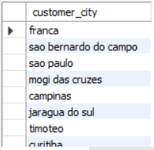
Q1. UNIQUE CITIES WHWRE CUSTOMERS ARE LOCATED
PYTHON CODE
SQL QUEREY
OUTPUT
OUTPUT

Slide 5
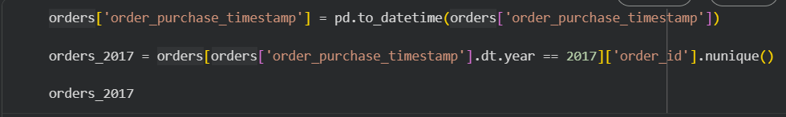


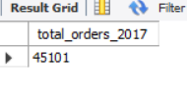
Q2. COUNT OF NO. OF ORDERS PLACED IN 2017
PYTHON CODE
SQL QUEREY
OUTPUT
OUTPUT

Slide 6
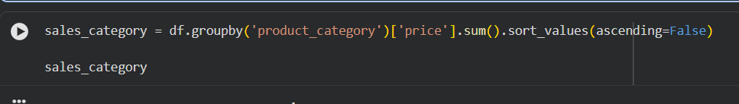
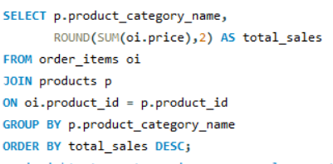
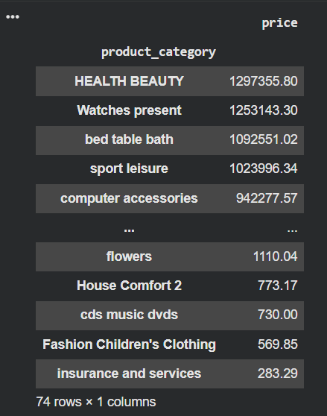
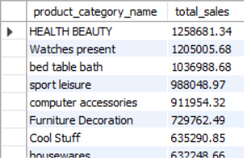
Q3. TOTAL SALES PER CATEGORY
PYTHON CODE
SQL QUEREY
OUTPUT
OUTPUT

Slide 7
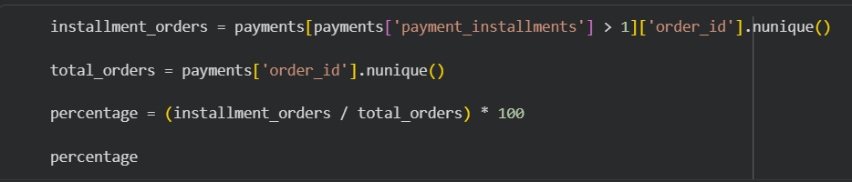
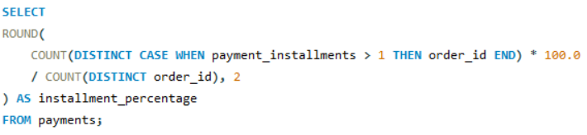


Q4. % OF ORDERS PLACED IN INSTALLMENTS
PYTHON CODE
SQL QUEREY
OUTPUT
OUTPUT

Slide 8
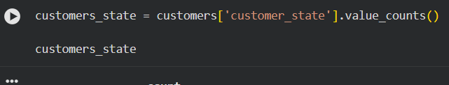
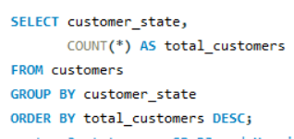
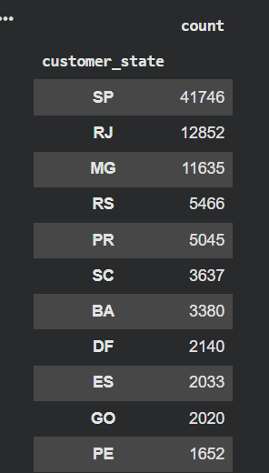
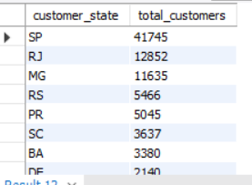
Q5. NO. OF CUSTOMERS FROM EACH STATE
PYTHON CODE
SQL QUEREY
OUTPUT
OUTPUT

Slide 9
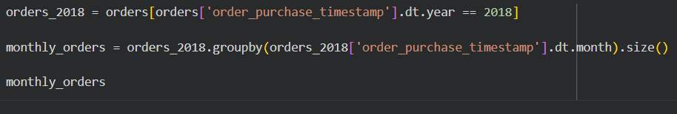
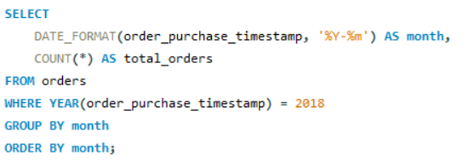
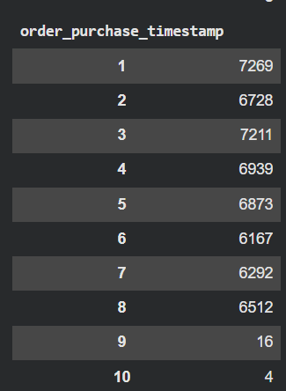
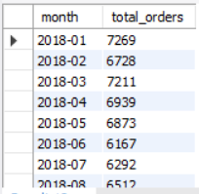
Q6. NO. OF ORDERS PLACED IN 2018
PYTHON CODE
SQL QUEREY
OUTPUT
OUTPUT

Slide 10
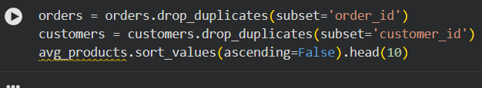
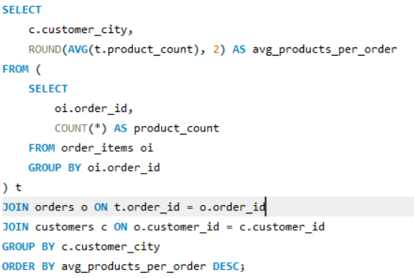
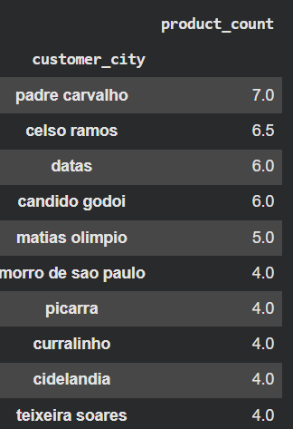
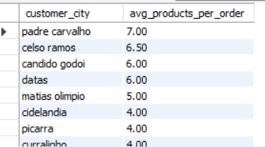
Q7. AVG NO. OF PRODUCTS PER ORDER BY CUSTOMER CITY
PYTHON CODE
SQL QUEREY
OUTPUT
OUTPUT

Slide 11
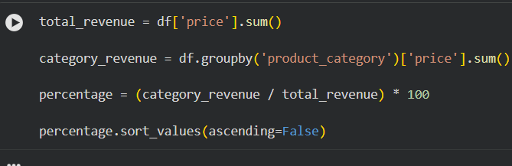
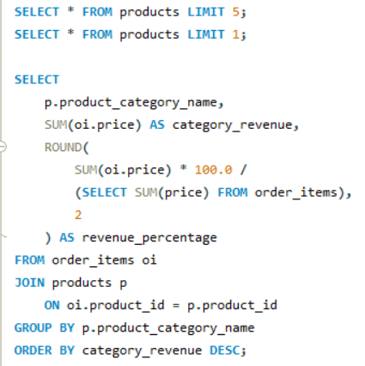
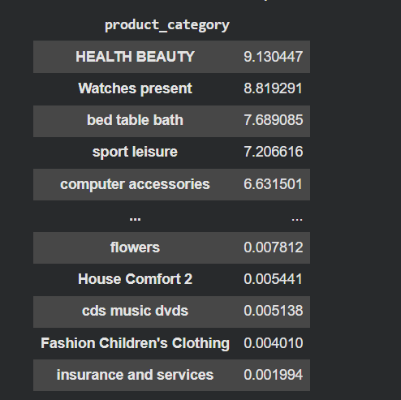
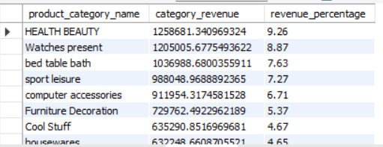
Q8. REVENUE CONTRIBUTION OF EACH CATEGORY
PYTHON CODE
SQL QUEREY
OUTPUT
OUTPUT

Slide 12
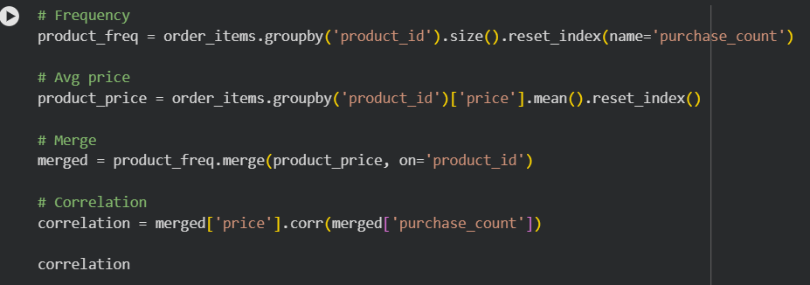
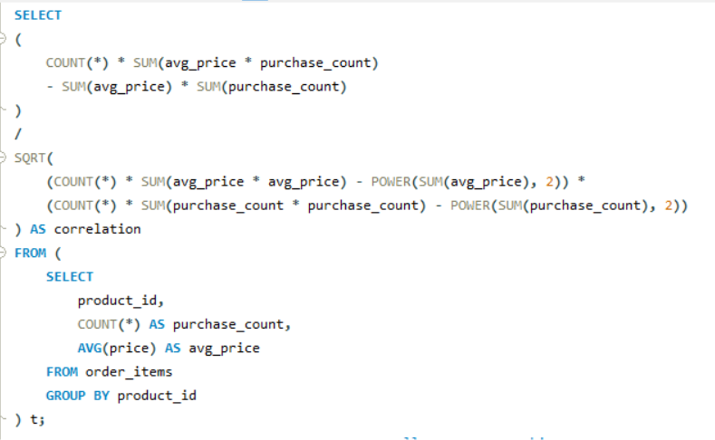


Q9. CORELATION : PRODUCT PRICE VS PURCHASE FREQUENCY
PYTHON CODE
SQL QUEREY
OUTPUT
OUTPUT

Slide 13
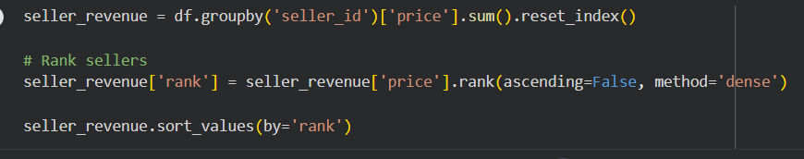
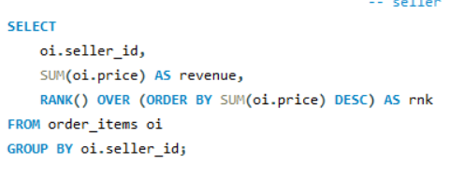
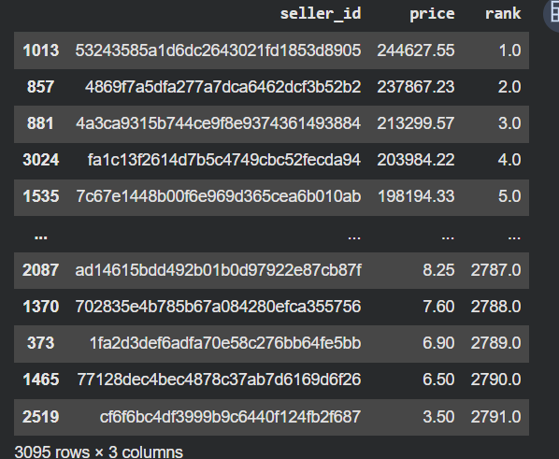
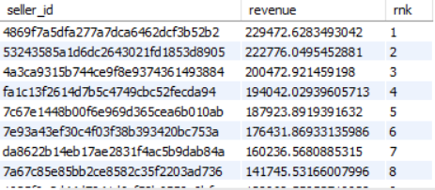
Q10. REVENUE BY SELLER AND RANKING
PYTHON CODE
SQL QUEREY
OUTPUT
OUTPUT

Slide 14
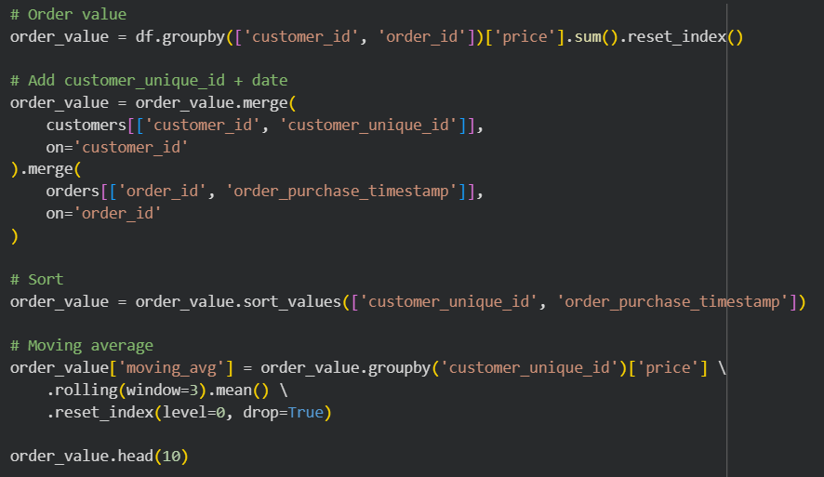
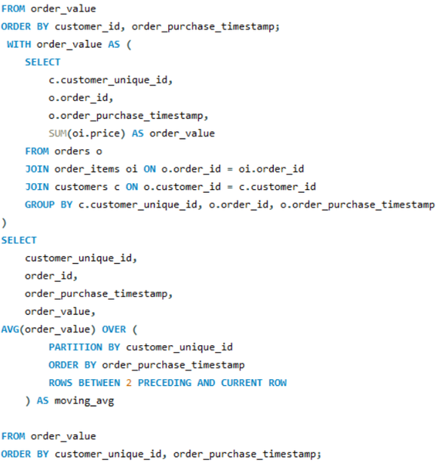
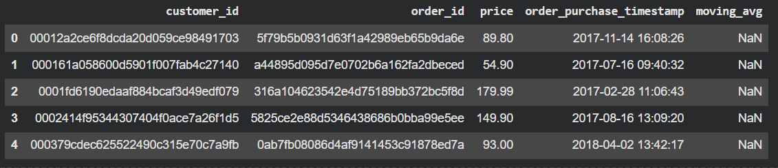
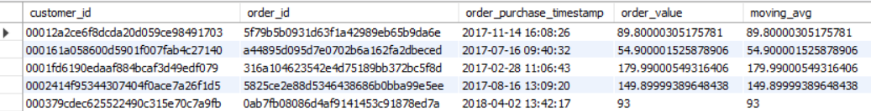
Q11.MOVING AVERAGE OF ORDER VALUES FOR EACH CUSTOMER OVER THEIR ORDER HISTORY.
PYTHON CODE
SQL QUEREY
OUTPUT
OUTPUT

Slide 15
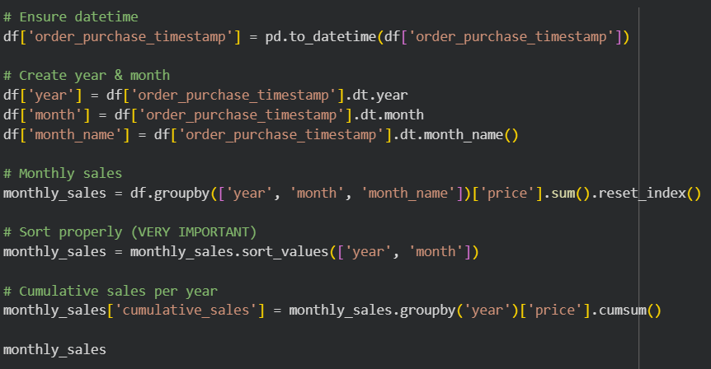
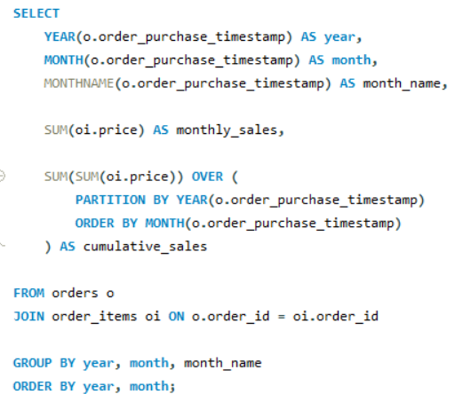
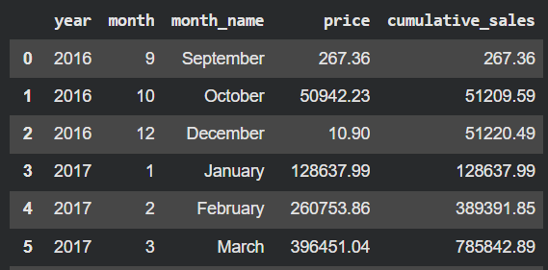
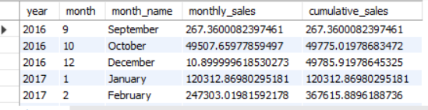
Q12. COMULATIVE SALES PER MONTH OF EACH YEAR
PYTHON CODE
SQL QUEREY
OUTPUT
OUTPUT

Slide 16
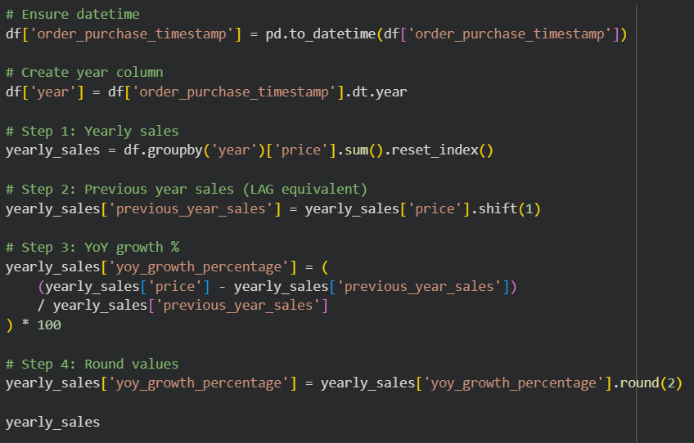
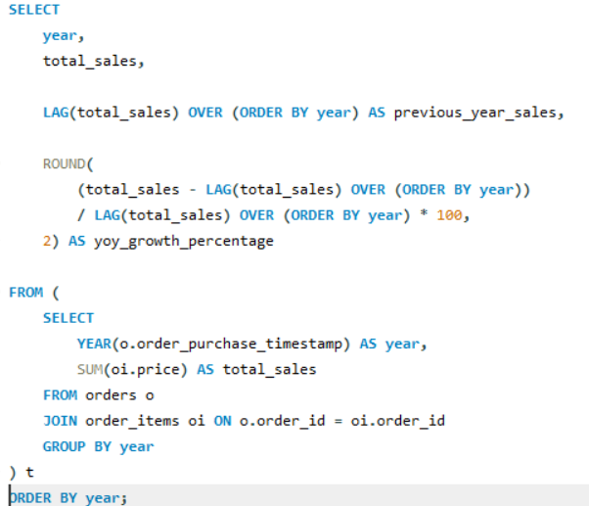
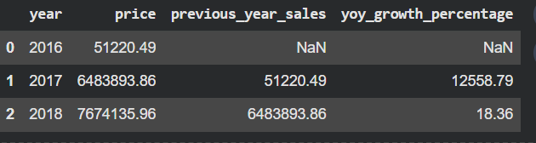
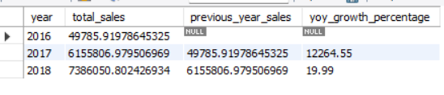
Q13 . YEAR ON YEAR GROWTH
PYTHON CODE
SQL QUEREY
OUTPUT
OUTPUT

Slide 17
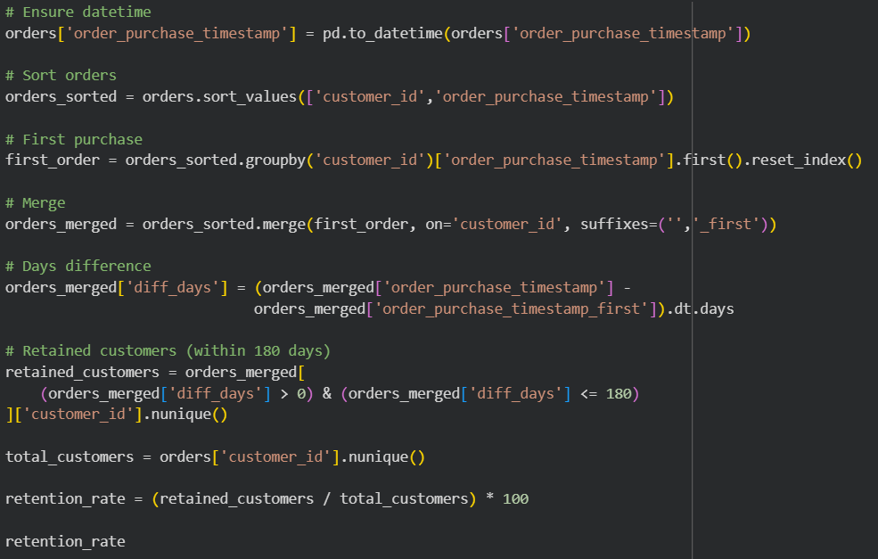
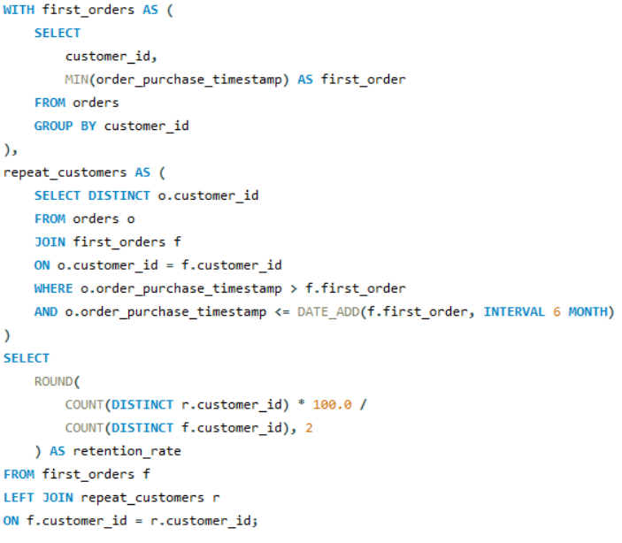


Q14. CUSTOMER RETENTION RATE
PYTHON CODE
SQL QUEREY
OUTPUT
OUTPUT

Slide 18
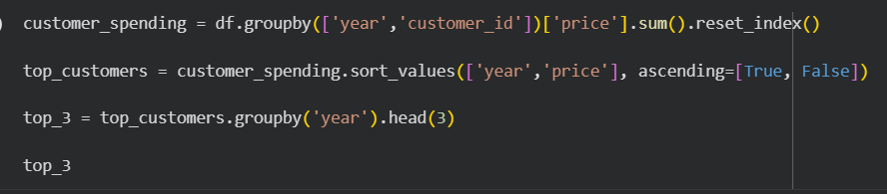
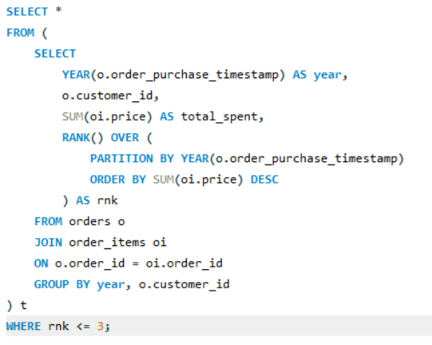
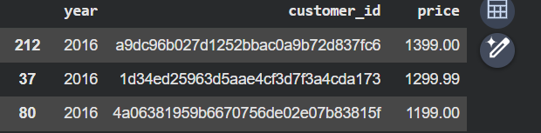

Q15. TOP 3 CUSTOMERS WHO SPENT THE MOST MONEY IN EACH YEAR.
PYTHON CODE
SQL QUEREY
OUTPUT
OUTPUT

Slide 19
THANK YOU

