Slide 1
Kaggle Case Study

Slide 2
A WALK THROUGH…
A large company named XYZ, employs, at any given point of time, around 4000 employees. However, every year, around 15% of its employees leave the company and need to be replaced with the talent pool available in the job market. The management believes that this level of attrition (employees leaving, either on their own or because they got fired) is bad for the company, because of the following reasons -
The former employees’ projects get delayed, which makes it difficult to meet timelines, resulting in a reputation loss among consumers and partners
A sizeable department has to be maintained, for the purposes of recruiting new talent
More often than not, the new employees have to be trained for the job and/or given time to acclimatize themselves to the company

Slide 3
Objective
Goal of the case study : You are required to model the probability of attrition
The results thus obtained will be used by the management to understand what changes they should make to their workplace, in order to get most of their employees to stay.

Slide 4
Why Logistic Regression?
It is the appropriate regression analysis to conduct when the dependent variable is dichotomous (binary).

Slide 5
Precautions to be taken :
The dependent variable should be dichotomous in nature (e.g., presence vs. absent).
There should be no outliers in the data, which can be assessed using Cook’s distance and/or capping.
There should be no high correlations (multicollinearity) among the predictors. This can be assessed by a correlation matrix among the predictors.

Slide 6
EXPLORATORY ANALYSIS
PROBLEM STATEMENT
BUSINESS UNDERSTANDING
CLUSTER ANALYSIS
OVERVIEW STUDY OF DATA PROVIDED
ANALYSE THE BASIC REQUIREMENTS

Slide 7
DATA PREPARATION
MODEL SELECTION
EXPLORATORY ANALYSIS
MODEL VALIDATION
MODEL REFINEMENT
MODEL DEPLOYMENT

Slide 8
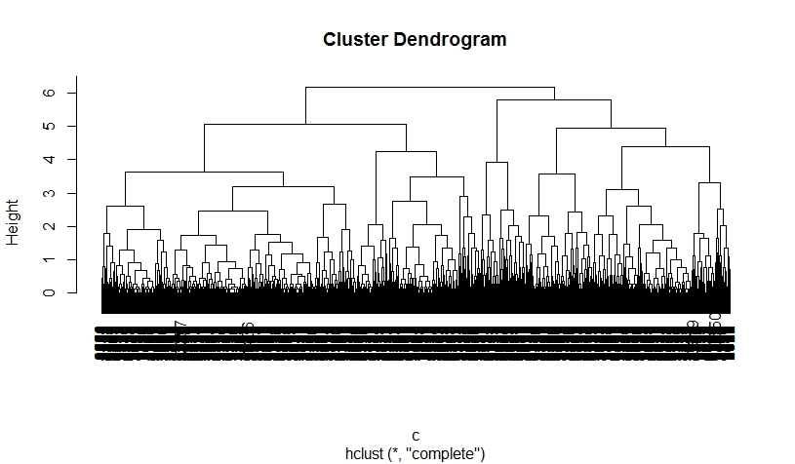
WHY NOT CLUSTER ANALYSIS?
CATEGORIC
NUMERIC
Whichever algorithm you use, it will have to merge all these objects at once, because they have the exact same similarity. In the worst case, your data might go from duplicates-only to everything-is-one-cluster because of this.
So in conclusion, I believe that categorical data does not cluster in the way clustering is commonly defined because the discrete nature yields too little discrimination/ranking of similarities. And how to combine these two is not obvious.

Slide 9
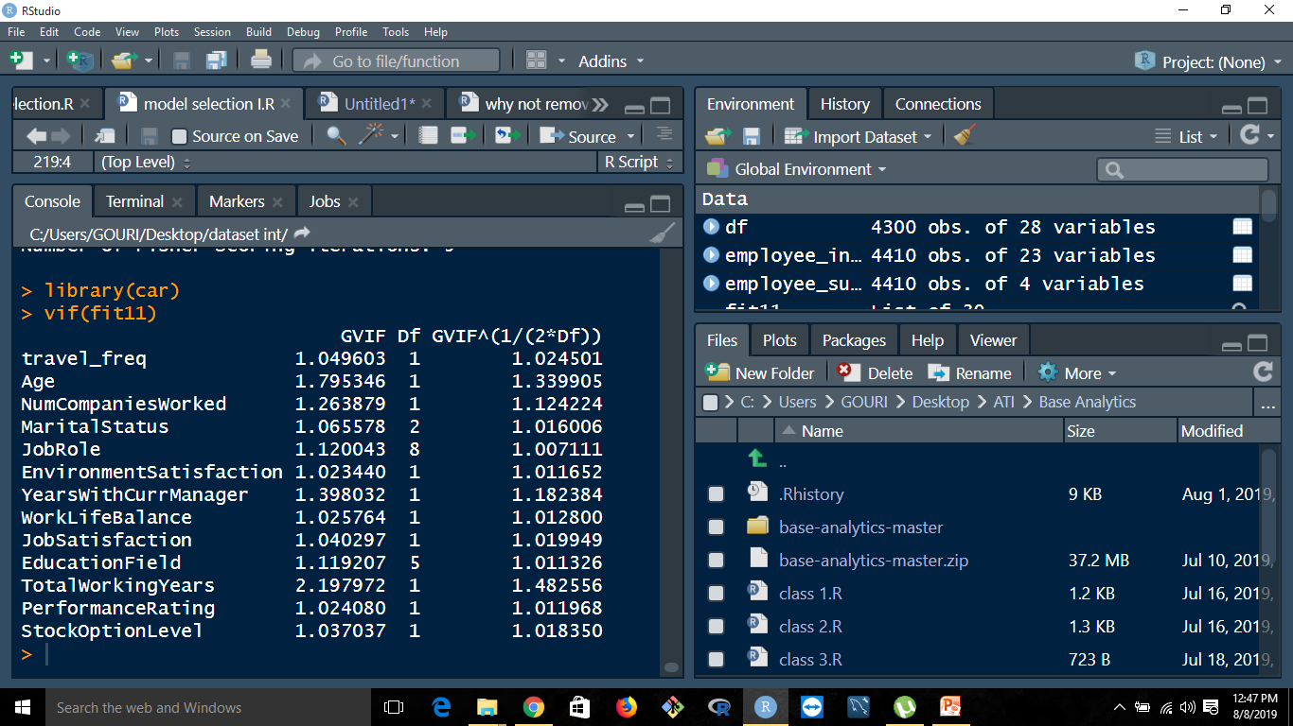
WHY IS MULTICOLLINEARITY ABSENT?

Slide 10
DATA PREPARATION
HYPOTHESIS TESTING
DEALING WITH MISSING VALUES
USING FEATURE ENGINEERING
CHECKING FOR MULTICOLLINEARITY
SPLITTING DATASET INTO TRAIN AND TEST

Slide 11
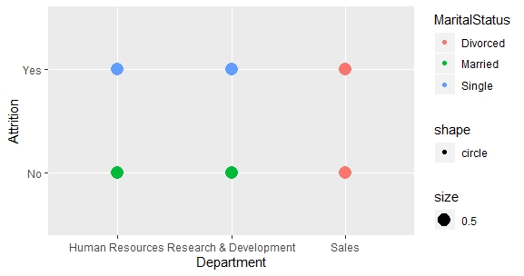

Slide 12
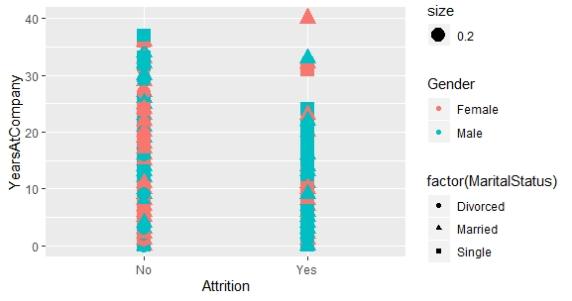

Slide 13
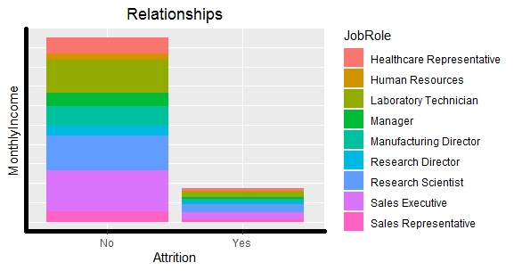

Slide 14
MODEL SELECTION
FACTORS INFLUENCING SELECTING A MODEL(for logistic regression) :
USING TRAIN DATA
Low AIC (Akaike Information Value)
Close to { |TN| = |TP| } (Sensitivity and Specificity)
High AUC (Area under Curve) (Receiver Operator Characteristic)
Calculation of Deviance (should decrease with better model)
Hosmer Lemeshow Test
Somer’s D Test
Beat AIC score obtained by STEPAIC()

Slide 15
MODEL VALIDATION
NECESSARY TESTS TO VALIDATE A MODEL :
Cross Validation :
Bootstrap
K-fold
Jack-knife
USING TEST DATA
Study histogram of residual (ideally normally distributed)
Homoscedastic graph without any visible bias
(Residual and predicted) graph should show no pattern

Slide 16
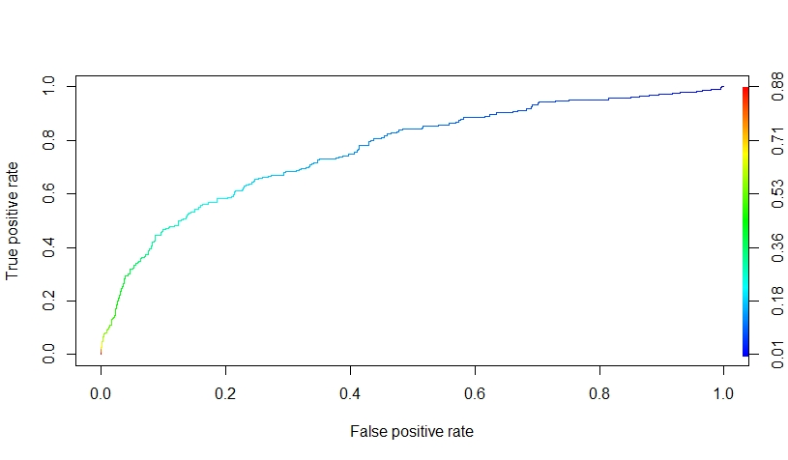
Fit 11 model
AIC : 2339.3
AUC : 0.7639201
travel_freq
Age
NumCompaniesWorked
MaritalStatus
JobRole
EnvironmentSatisfaction
YearsWithCurrManager
WorkLifeBalance
JobSatisfaction
EducationField
TotalWorkingYears
PerformanceRating
StockOptionLevel

Slide 17
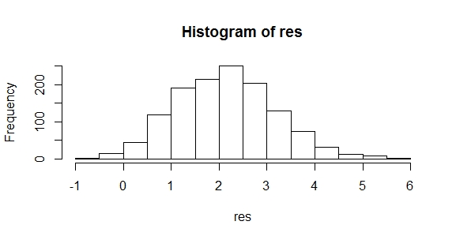

Slide 18
Necessary Links :
https://www.kaggle.com/vjchoudhary7/hr-analytics-case-study

Slide 19
THANK YOU !

