Slide 1

NIU CONNECT

Slide 2
FOUNDERS OF NIU CONNECT
Gouri Patil
Hita Kadam
Hitesh Reddy
Covenant Falana

Slide 3
NIU Connect
SOCIAL MEDIA PLATFORM
PHOTO and VIDEO Sharing App
ENGAGE PEOPLE ABOUT ONGOING EVENTS AND ACTIVITIES BY POSTING PICTURES, VIDEOS AND MUSIC.

Slide 4
ENTITIES
ACTIVITY
CALL
COMMENT
FOLLOW
FOLLOW_RECORD
HASHTAG
HASHTAG_RECORD
LIKE

Slide 5
ENTITIES
LOGIN_DATA
MEDIA
MEDIA_TYPE
MEDIA_UPDATE_RECORD
MEDIA_UPDATE_TYPE
MESSAGES
USER
USER_STATUS
VIEWS

Slide 6
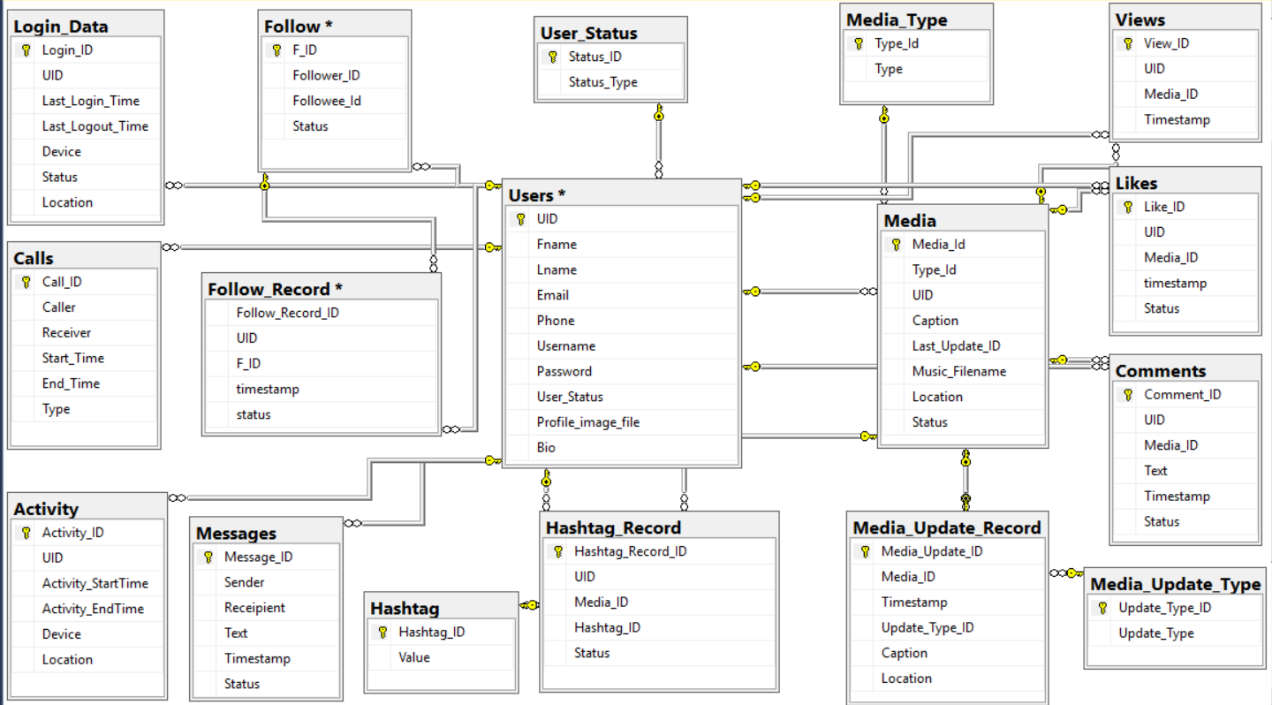

Slide 7
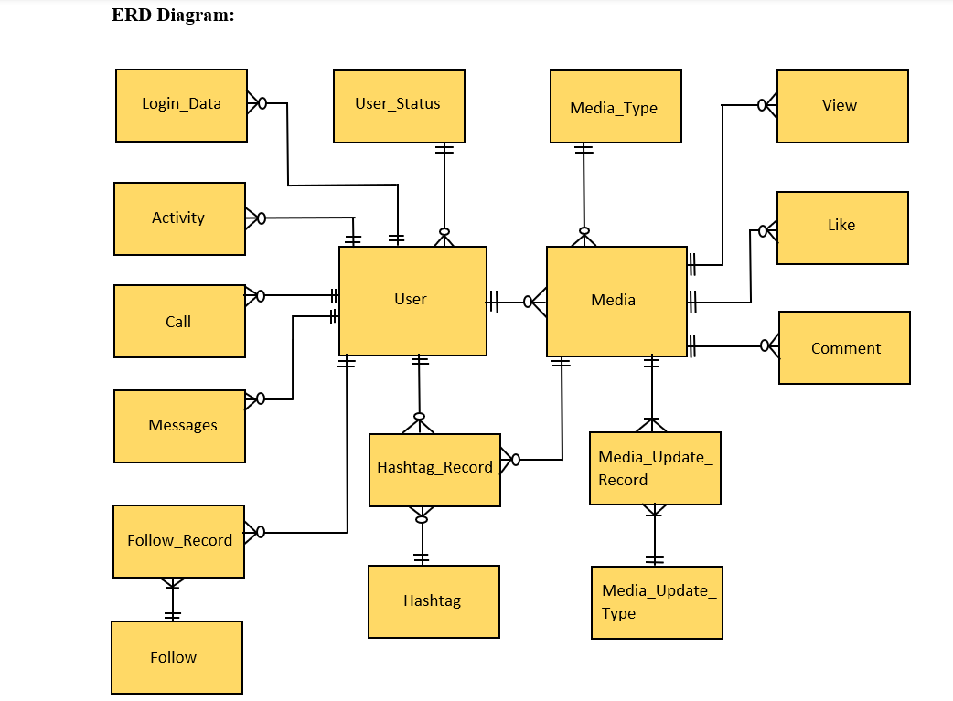

Slide 8
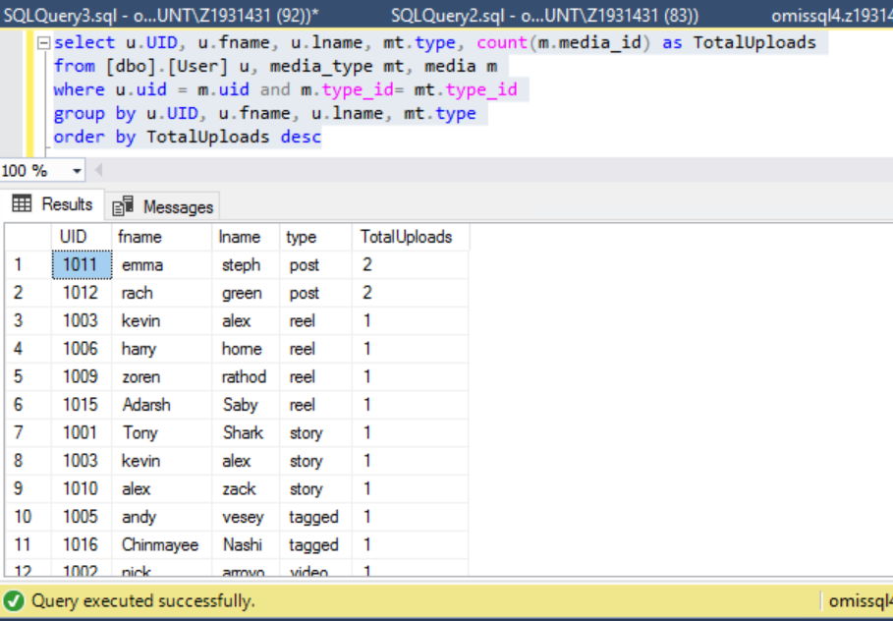
Displaying user details and count of each media type uploaded by that user.

Slide 9
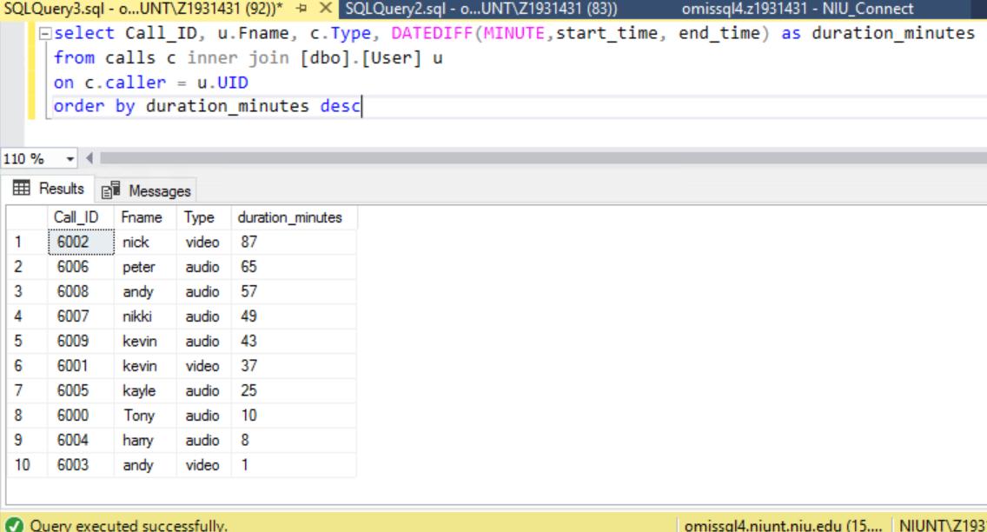
Display the call duration
for each call in desc order

Slide 10
Thank You

