Slide 1


Name of Project:
Plant disease detection system
for sustainable agriculture
AICTE_ID:
222G1A05A1

Slide 2

Learning Objectives
Understanding the significance of Plant Disease detection.
AI-Driven Disease Identification.
Enhancing Detection Accuracy with CNNs.
CNN :Convolutional Neural Networks
Real-Time , User-Friendly Platform.
Plant Disease Detection Methods.
Sustainable Plant Disease Management Practices.
Classification of the Plant Disease Detection Methods.
Early Detection
GOAL
Source :
www.freepik.com/

Slide 3
Tools and Technology used
TensorFlow (tf): For building and training machine learning models that recognize plant diseases from images.
Matplotlib & Seaborn: For visualizing data and results, creating plots to present diagnostic information clearly.
Pandas: For handling and processing datasets (e.g., images and labels) in a structured way.
Streamlit (st): For creating an interactive and user-friendly web interface for disease detection.
NumPy: For numerical computations and data manipulation to support the machine learning pipeline.
Image Preprocessing
Convolutional Neural Networks (CNNs)
Support Vector Machines (SVM)
Naive Bayes Classifier
Deep Neural Networks (DNNs) and Transfer Learning
Random Forests and Decision Trees

Slide 4
Methodology
Input Module
Step-Wise Approach:
Data-Collection - 38 classes
Data-Preprocessing - Rescale , Norm and Encoded Lab
Model Selection - CNN - checkpoint , CR
Model Training
Evaluation Loss / Recall
3. Output Module

Slide 5
Problem Statement:
Crop diseases represent a critical challenge in agriculture, causing significant losses in both yield and quality. Traditional methods of identifying plant diseases rely heavily on expert knowledge and manual inspection, which are often time-consuming, costly, and inaccessible to many farmers. These challenges highlight the necessity for an automated system capable of detecting and diagnosing plant diseases effectively and efficiently.
This AI-powered system helps farmers identify plant diseases early, enabling them to take timely action to prevent crop loss and improve agricultural productivity. The agricultural industry faces numerous challenges, and plant diseases are a significant threat to crop health.
This project leveraging cutting-edge technologies, we aim to reduce crop loss and promote sustainable farming practice uses AI to identify diseases in plants based on images, providing farmers with accurate, real-time diagnostics. By s.

Slide 6
Solution:
This project uses AI to identify diseases in plants based on images, providing farmers with accurate, real-time diagnostics. By leveraging cutting-edge technologies, we aim to reduce crop loss and promote sustainable farming practices.
By using CNN - DC – Classify 38 diseases.
Achieved an accuracy of 89%.
Cutting Edge Tech – Present the disease from the plants.

Slide 7
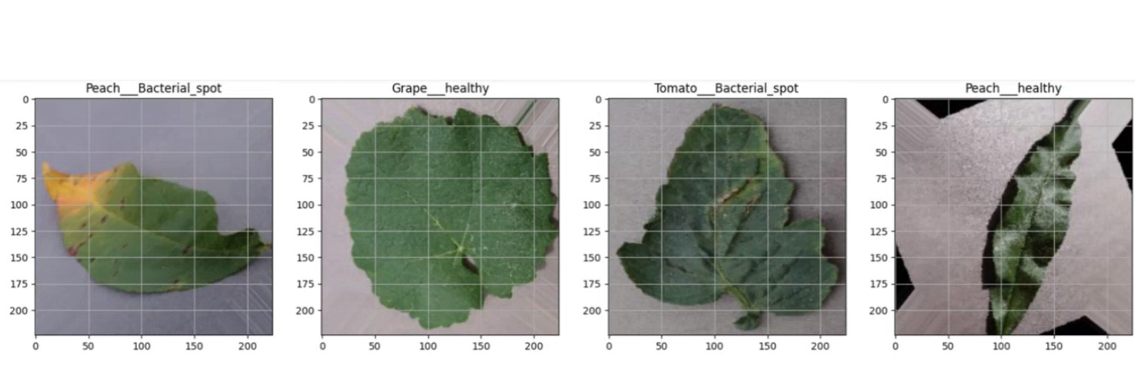
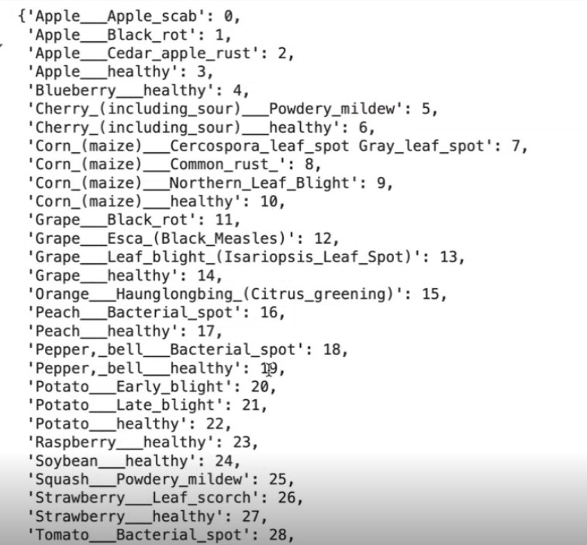
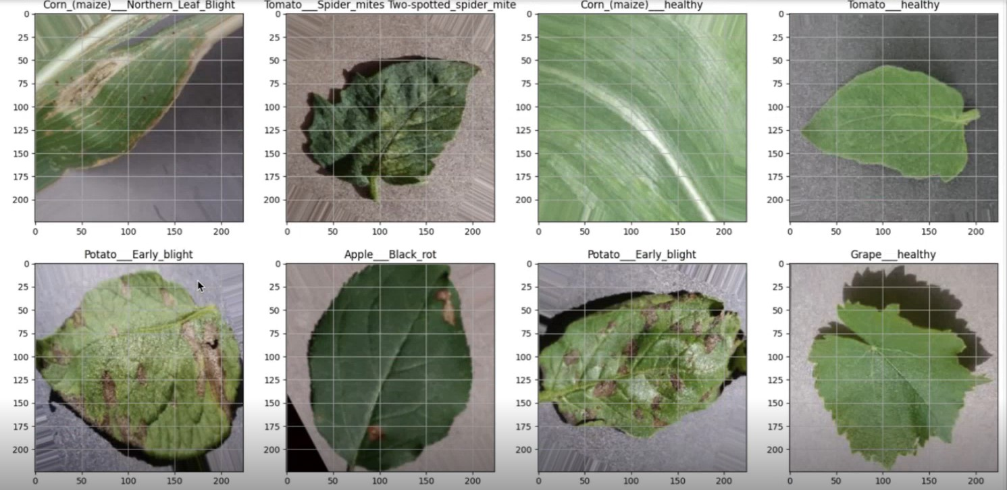
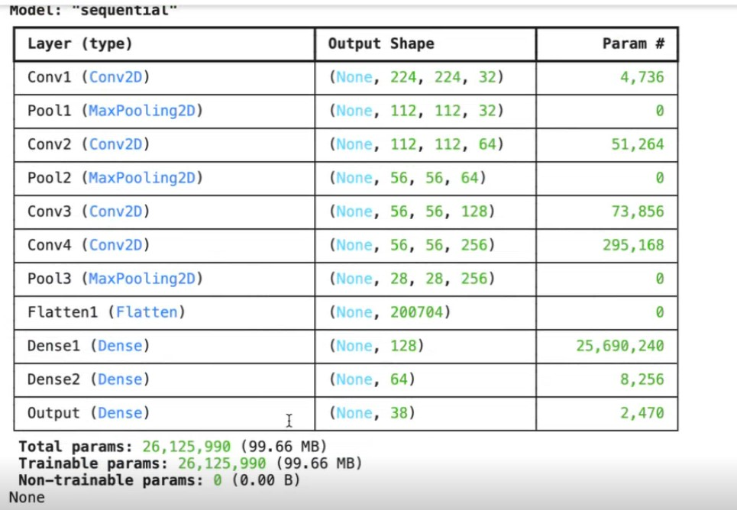
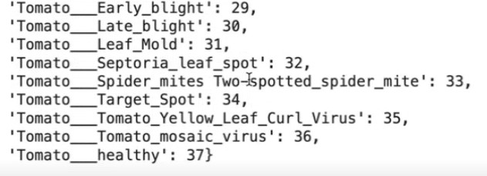
Screenshot of Output:

Slide 8
Conclusion:
In conclusion, this project demonstrates the transformative power of artificial intelligence in solving critical challenges faced by the agricultural industry. By using AI to detect early signs of plant diseases, the system offers farmers a proactive approach to managing crop health, enabling them to take timely action before diseases spread and cause significant losses. Early disease detection not only helps improve crop yields but also contributes to the overall sustainability of farming practices.
Furthermore, the system encourages sustainable agricultural practices by promoting efficient resource use, reducing waste, and minimizing the environmental impact of farming. The ability to address challenges like pest infestations and nutrient deficiencies would make the system even more comprehensive, improving both the quality and quantity of food production.
Ultimately, the project highlights the potential of integrating technology into traditional industries, especially in sectors like agriculture that are crucial for global food security. With further development and future enhancements, this system could become an essential tool in achieving food security, ensuring that we can meet the growing demands of a rapidly expanding global population while also preserving our planet’s resources.

