Slide 1
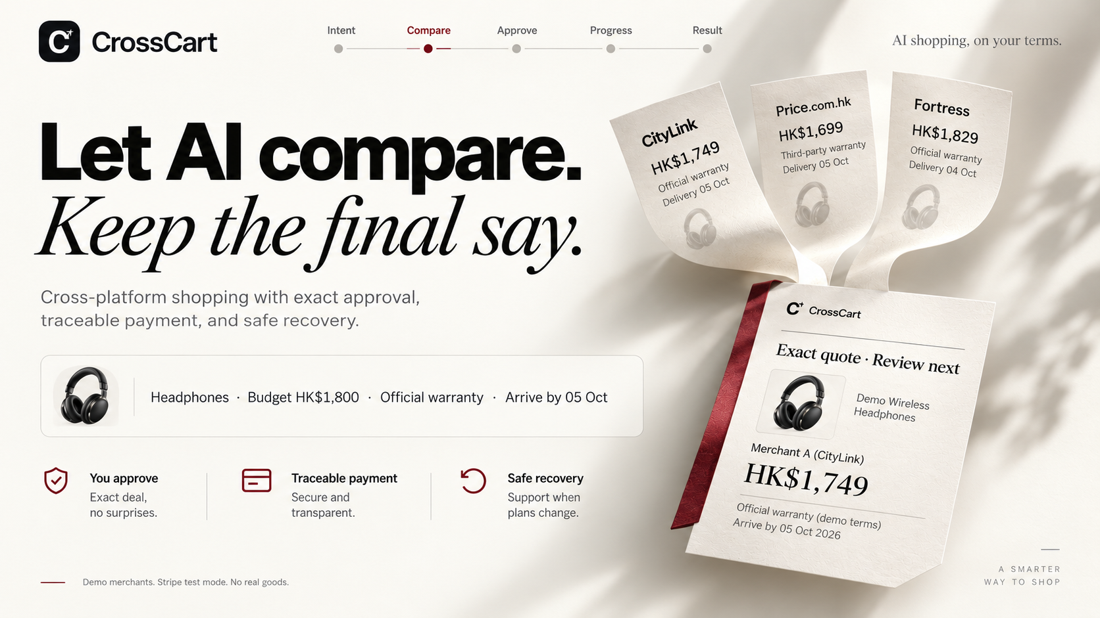
Notes:
User-provided ImageGen slide design, supplied 4 October 2026. Retailer names, references and imagery are illustrative. Actual demo uses three synthetic merchant adapters, one Stripe test payee and synthetic orders. No real goods, points payout or HKT/retailer integration is represented. Current validation and dated financial sources: https://github.com/Gout999/CrossCart/blob/main/docs/VALIDATION.md and https://crosscart.vercel.app/evidence. Current local browser checks: 18; offline: 114; actual public Stripe cases: 8 plus an independent signed HTTPS webhook/no-return case. Comparison-stage walkthrough: four versus one actions with the same offers and same choice; shared approval and Checkout excluded, not a human study. Provider refund success is not bank posting. Public demo: https://crosscart.vercel.app. Slide imagery is raster-based; only the corrected evidence text is native editable content.

Slide 2

Notes:
User-provided ImageGen slide design, supplied 4 October 2026. Retailer names, references and imagery are illustrative. Actual demo uses three synthetic merchant adapters, one Stripe test payee and synthetic orders. No real goods, points payout or HKT/retailer integration is represented. Current validation and dated financial sources: https://github.com/Gout999/CrossCart/blob/main/docs/VALIDATION.md and https://crosscart.vercel.app/evidence. Current local browser checks: 18; offline: 114; actual public Stripe cases: 8 plus an independent signed HTTPS webhook/no-return case. Comparison-stage walkthrough: four versus one actions with the same offers and same choice; shared approval and Checkout excluded, not a human study. Provider refund success is not bank posting. Public demo: https://crosscart.vercel.app. Slide imagery is raster-based; only the corrected evidence text is native editable content.

Slide 3
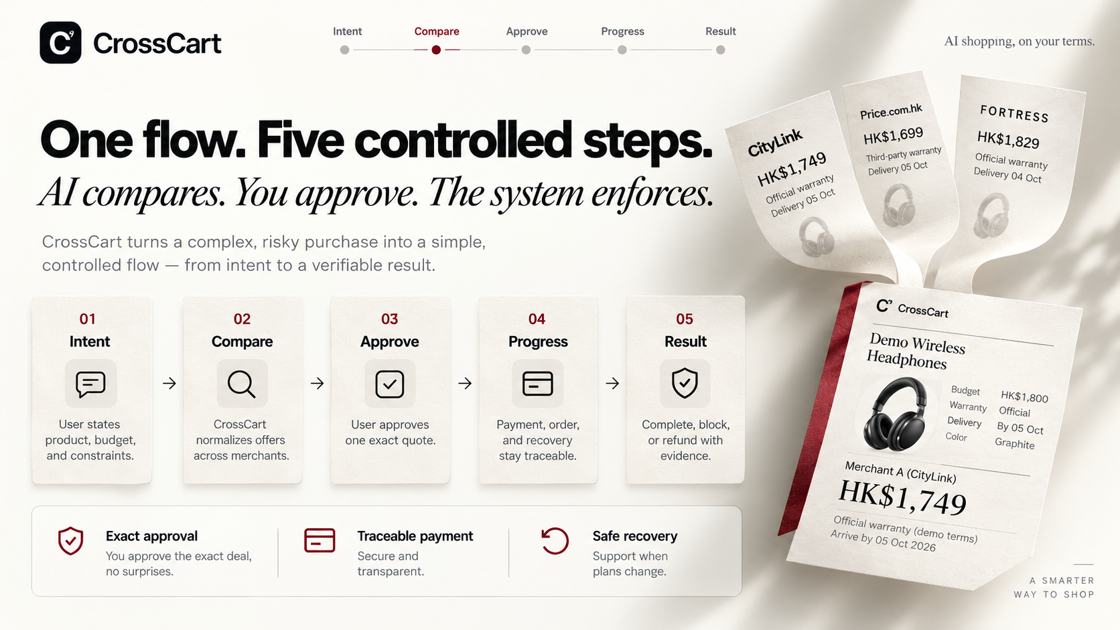
Notes:
User-provided ImageGen slide design, supplied 4 October 2026. Retailer names, references and imagery are illustrative. Actual demo uses three synthetic merchant adapters, one Stripe test payee and synthetic orders. No real goods, points payout or HKT/retailer integration is represented. Current validation and dated financial sources: https://github.com/Gout999/CrossCart/blob/main/docs/VALIDATION.md and https://crosscart.vercel.app/evidence. Current local browser checks: 18; offline: 114; actual public Stripe cases: 8 plus an independent signed HTTPS webhook/no-return case. Comparison-stage walkthrough: four versus one actions with the same offers and same choice; shared approval and Checkout excluded, not a human study. Provider refund success is not bank posting. Public demo: https://crosscart.vercel.app. Slide imagery is raster-based; only the corrected evidence text is native editable content.

Slide 4
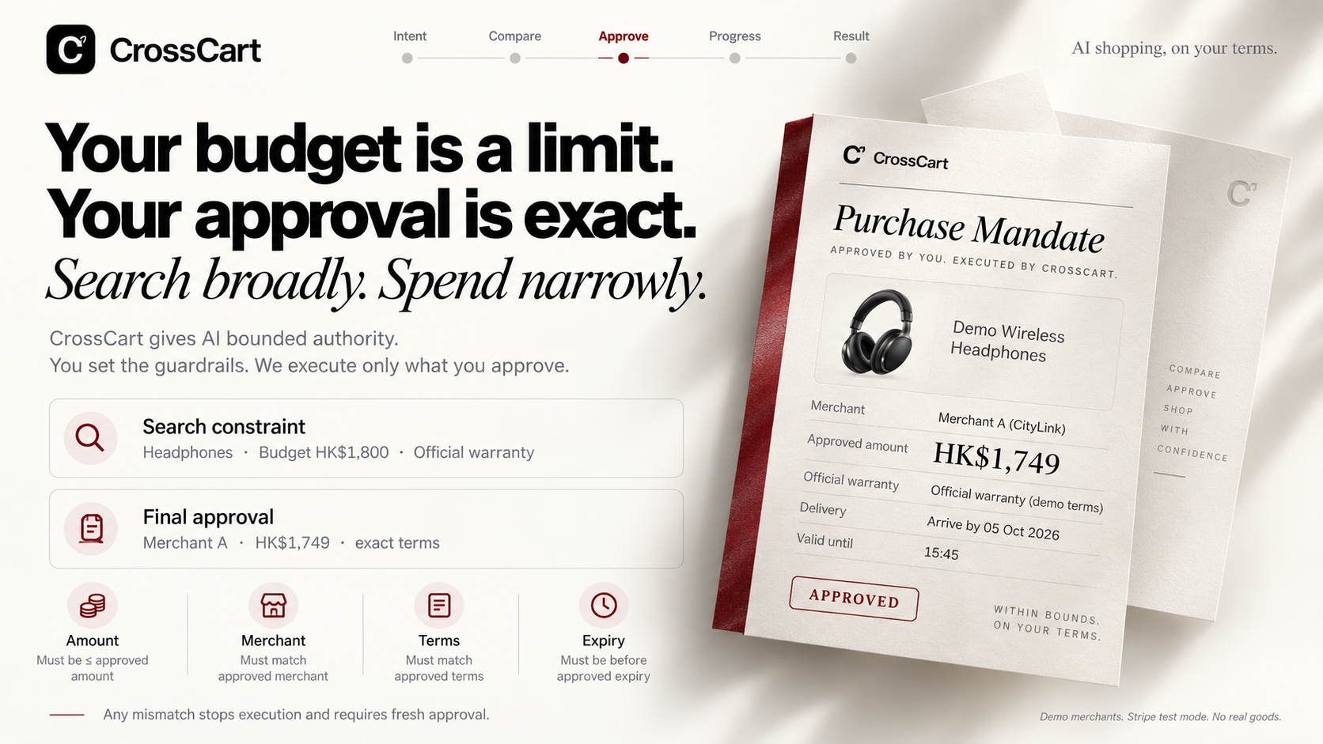
Notes:
User-provided ImageGen slide design, supplied 4 October 2026. Retailer names, references and imagery are illustrative. Actual demo uses three synthetic merchant adapters, one Stripe test payee and synthetic orders. No real goods, points payout or HKT/retailer integration is represented. Current validation and dated financial sources: https://github.com/Gout999/CrossCart/blob/main/docs/VALIDATION.md and https://crosscart.vercel.app/evidence. Current local browser checks: 18; offline: 114; actual public Stripe cases: 8 plus an independent signed HTTPS webhook/no-return case. Comparison-stage walkthrough: four versus one actions with the same offers and same choice; shared approval and Checkout excluded, not a human study. Provider refund success is not bank posting. Public demo: https://crosscart.vercel.app. Slide imagery is raster-based; only the corrected evidence text is native editable content.

Slide 5
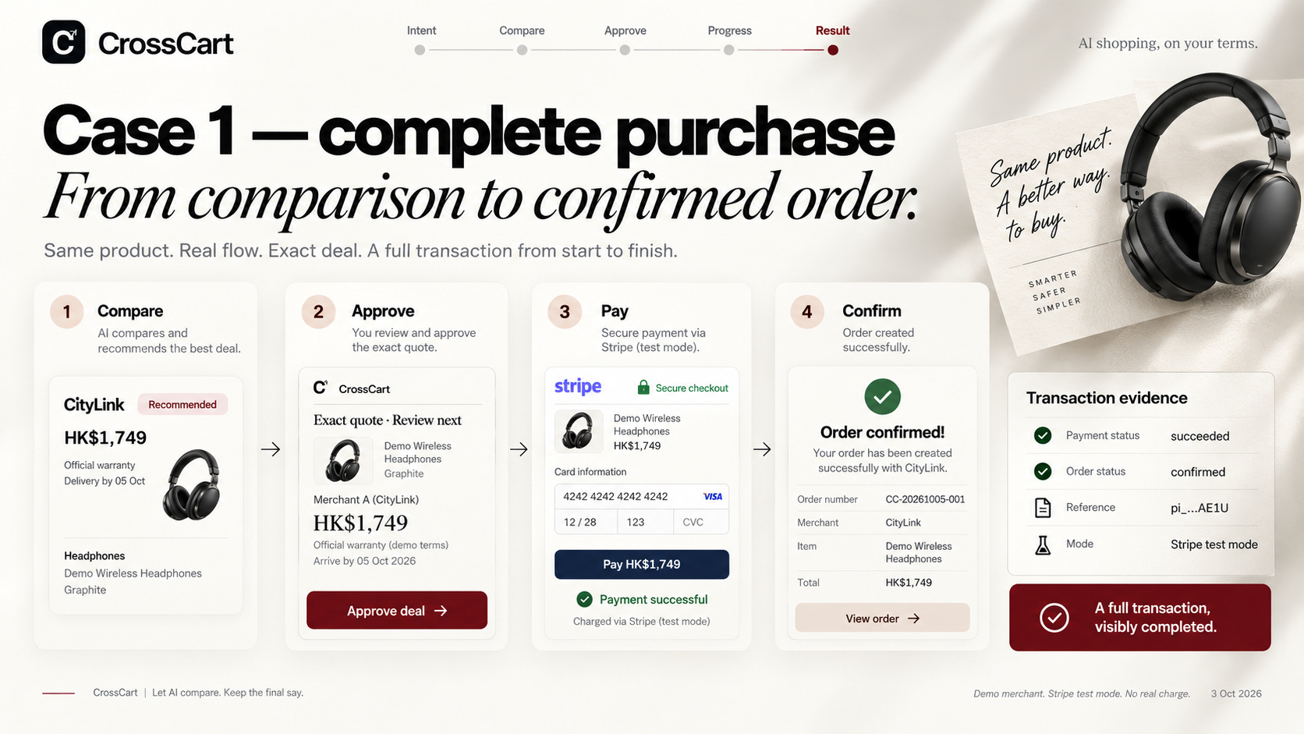
Notes:
User-provided ImageGen slide design, supplied 4 October 2026. Retailer names, references and imagery are illustrative. Actual demo uses three synthetic merchant adapters, one Stripe test payee and synthetic orders. No real goods, points payout or HKT/retailer integration is represented. Current validation and dated financial sources: https://github.com/Gout999/CrossCart/blob/main/docs/VALIDATION.md and https://crosscart.vercel.app/evidence. Current local browser checks: 18; offline: 114; actual public Stripe cases: 8 plus an independent signed HTTPS webhook/no-return case. Comparison-stage walkthrough: four versus one actions with the same offers and same choice; shared approval and Checkout excluded, not a human study. Provider refund success is not bank posting. Public demo: https://crosscart.vercel.app. Slide imagery is raster-based; only the corrected evidence text is native editable content.

Slide 6
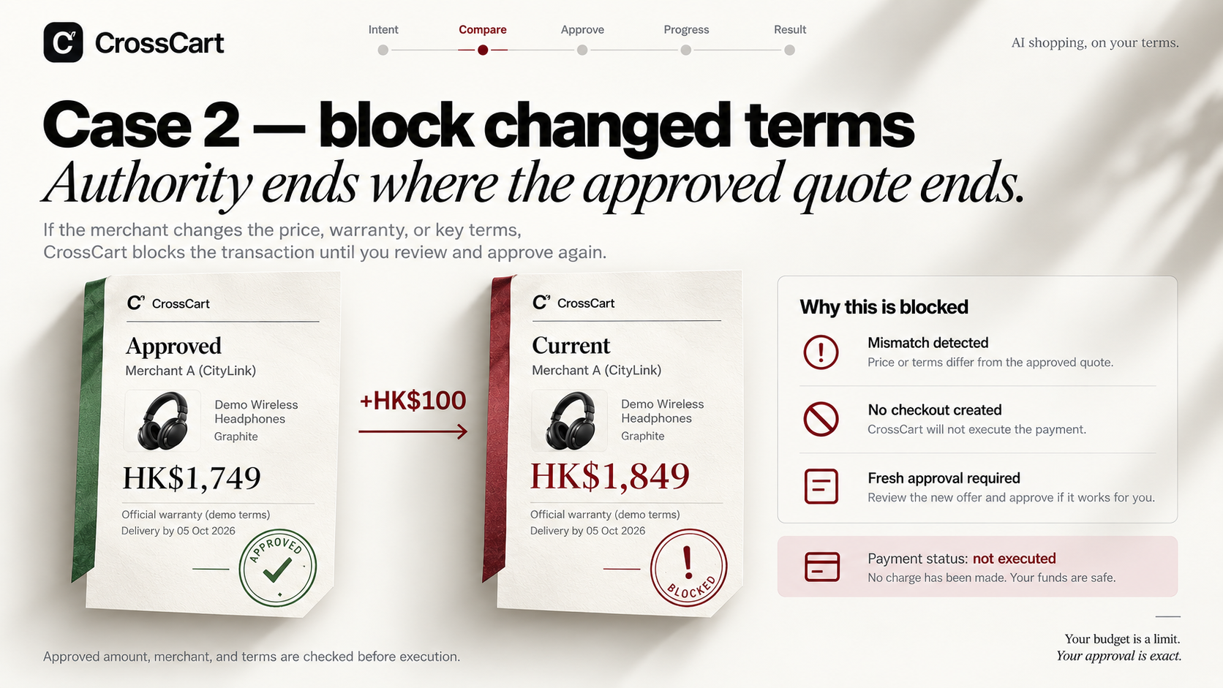
Notes:
User-provided ImageGen slide design, supplied 4 October 2026. Retailer names, references and imagery are illustrative. Actual demo uses three synthetic merchant adapters, one Stripe test payee and synthetic orders. No real goods, points payout or HKT/retailer integration is represented. Current validation and dated financial sources: https://github.com/Gout999/CrossCart/blob/main/docs/VALIDATION.md and https://crosscart.vercel.app/evidence. Current local browser checks: 18; offline: 114; actual public Stripe cases: 8 plus an independent signed HTTPS webhook/no-return case. Comparison-stage walkthrough: four versus one actions with the same offers and same choice; shared approval and Checkout excluded, not a human study. Provider refund success is not bank posting. Public demo: https://crosscart.vercel.app. Slide imagery is raster-based; only the corrected evidence text is native editable content.

Slide 7
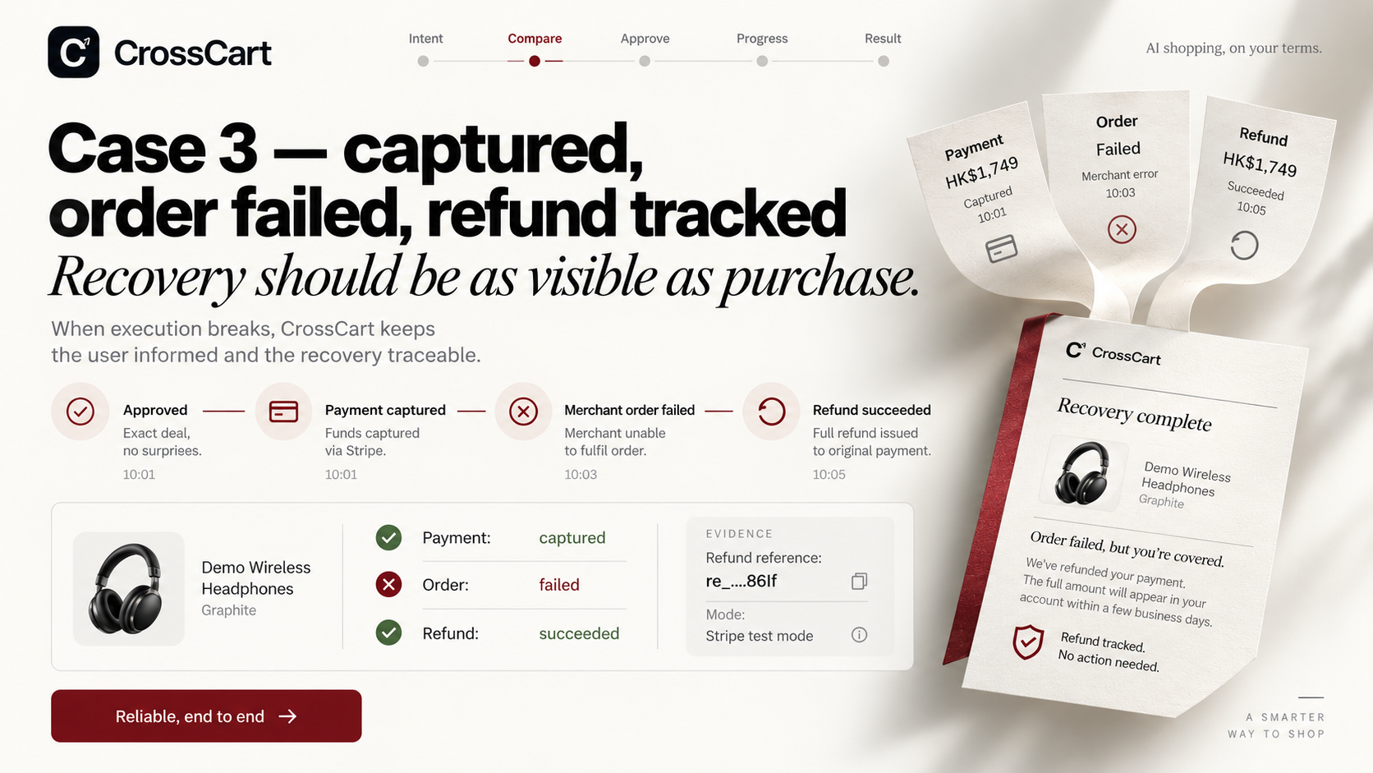
Notes:
User-provided ImageGen slide design, supplied 4 October 2026. Retailer names, references and imagery are illustrative. Actual demo uses three synthetic merchant adapters, one Stripe test payee and synthetic orders. No real goods, points payout or HKT/retailer integration is represented. Current validation and dated financial sources: https://github.com/Gout999/CrossCart/blob/main/docs/VALIDATION.md and https://crosscart.vercel.app/evidence. Current local browser checks: 18; offline: 114; actual public Stripe cases: 8 plus an independent signed HTTPS webhook/no-return case. Comparison-stage walkthrough: four versus one actions with the same offers and same choice; shared approval and Checkout excluded, not a human study. Provider refund success is not bank posting. Public demo: https://crosscart.vercel.app. Slide imagery is raster-based; only the corrected evidence text is native editable content.

Slide 8
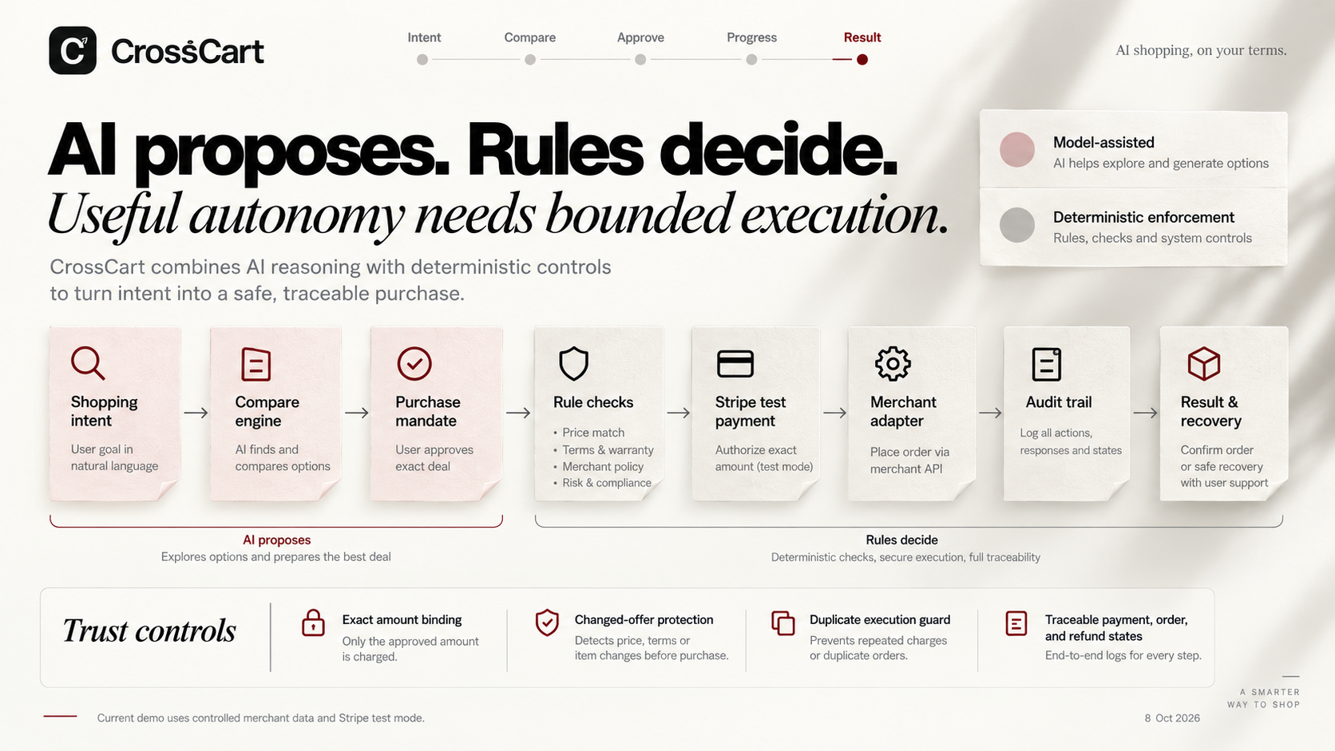
4 Oct 2026
Notes:
User-provided ImageGen slide design, supplied 4 October 2026. Retailer names, references and imagery are illustrative. Actual demo uses three synthetic merchant adapters, one Stripe test payee and synthetic orders. No real goods, points payout or HKT/retailer integration is represented. Current validation and dated financial sources: https://github.com/Gout999/CrossCart/blob/main/docs/VALIDATION.md and https://crosscart.vercel.app/evidence. Current local browser checks: 18; offline: 114; actual public Stripe cases: 8 plus an independent signed HTTPS webhook/no-return case. Comparison-stage walkthrough: four versus one actions with the same offers and same choice; shared approval and Checkout excluded, not a human study. Provider refund success is not bank posting. Public demo: https://crosscart.vercel.app. Slide imagery is raster-based; only the corrected evidence text is native editable content.

Slide 9
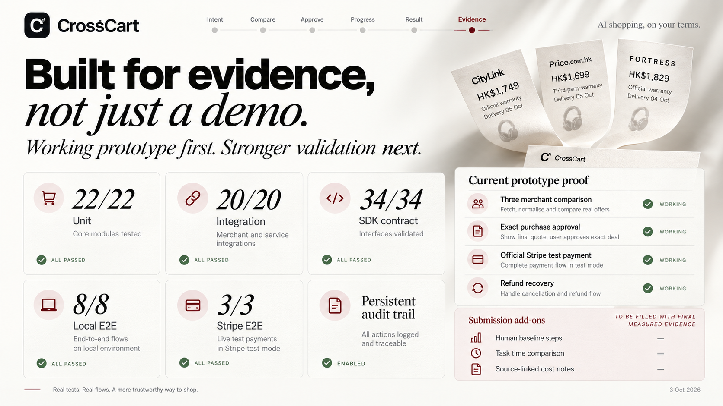
Compare controlled synthetic offers
18/18
8 + 1
Final submission evidence
Local browser
Public Stripe
4 vs 1 comparison actions
Same offers and outcome. Shared Checkout excluded.
Dated rates: crosscart.vercel.app/evidence
114 offline / 18 local browser / 8 + 1 public Stripe cases. Evidence observed 4 Oct 2026.
4 Oct 2026
Notes:
User-provided ImageGen slide design, supplied 4 October 2026. Retailer names, references and imagery are illustrative. Actual demo uses three synthetic merchant adapters, one Stripe test payee and synthetic orders. No real goods, points payout or HKT/retailer integration is represented. Current validation and dated financial sources: https://github.com/Gout999/CrossCart/blob/main/docs/VALIDATION.md and https://crosscart.vercel.app/evidence. Current local browser checks: 18; offline: 114; actual public Stripe cases: 8 plus an independent signed HTTPS webhook/no-return case. Comparison-stage walkthrough: four versus one actions with the same offers and same choice; shared approval and Checkout excluded, not a human study. Provider refund success is not bank posting. Public demo: https://crosscart.vercel.app. Slide imagery is raster-based; only the corrected evidence text is native editable content.

Slide 10

Live: crosscart.vercel.app / Source: github.com/Gout999/CrossCart
Notes:
User-provided ImageGen slide design, supplied 4 October 2026. Retailer names, references and imagery are illustrative. Actual demo uses three synthetic merchant adapters, one Stripe test payee and synthetic orders. No real goods, points payout or HKT/retailer integration is represented. Current validation and dated financial sources: https://github.com/Gout999/CrossCart/blob/main/docs/VALIDATION.md and https://crosscart.vercel.app/evidence. Current local browser checks: 18; offline: 114; actual public Stripe cases: 8 plus an independent signed HTTPS webhook/no-return case. Comparison-stage walkthrough: four versus one actions with the same offers and same choice; shared approval and Checkout excluded, not a human study. Provider refund success is not bank posting. Public demo: https://crosscart.vercel.app. Slide imagery is raster-based; only the corrected evidence text is native editable content.

