Slide 1

Using ML to Improve the Business of a Chain of Building Painting Works
Goutam Halder (26911005)
Aditya Sharma (26535002)
Soumyadeep Sen (26535031)
Ayush Katariya (26535006)
Satyam Shukla (26535025)
Indian Institute of Technology Roorkee
*Authors contributed equally
Presented by
Group 3 Team members

Slide 2
Group Members and Their Contributions
Name | Enrolment Number | Contribution
Goutam Halder | 26911005 | Dataset collection & understanding of the dataset, data preprocessing, plotting of the results, UI development and integration.
Aditya Sharma | 26535002 | Implementation and evaluation of the Linear Regression model.
Soumyadeep Sen | 26535031 | Implementation and evaluation of the Decision Tree model.
Ayush Katariya | 26535006 | Implementation and evaluation of the Support Vector Regression model.
Satyam Shukla | 26535025 | Result analysis, report preparation, readme file preparation.

Slide 3

Introduction
Painting Project Workflow
Site Visit and Requirement
(Measure Area, Check Condition)
Cost Estimation
(Material, Labour, Surface Area)
Submit Quotation
(To Customer)
Project Execution
(Painting Work)
Completed Project
Key Challenges
Underestimating Cost
Can reduce profit margin
May lead to financial loss
Overestimating Cost
Quotation may be higher than competitors
Lower chance of wining bids and retain customers

Slide 4
Problem Statement
Practical Difficulties
Manual estimates may vary between different estimators
Historical project information may not be used consistently and efficiently
A painting business needs estimates quickly when preparing the quotation
Incorrect estimation can affect profitability
Our Project Goal: Develop an ML model for painting cost estimation.

Slide 5

Proposed ML-Based Business Solution
Data Cleaning
&
Feature Preparation
Training Multiple Regression Model
Test the Models
Historical BOQ Records
The model predicts the painting cost according to the requirements
Integrate best model to Frontend UI
Estimator review the quotation

Slide 6
Dataset Source and Statistics
25645
Overall samples
1199
Usable sample
846
Training sample
353
Testing sample
7:3 ratio

Slide 7
Input Features and Target Variable
Features:
item_name (Ex: Interior emulsion paint (2 coats)
quantity (in sqm)
building_type (Ex: Residential - Independent House)
state (Ex: West Bengal)
city (Ex: Kolkata)
project_year (Year of project start)
project_month (Month of project start)
Targeting Variable:
amount_inr (Target painting cost)

Slide 8
Linear Model: Implementation
Why Linear Regression ?
Simple and easy to interpret.
Predicts continuous values like painting cost.
Provides a baseline to compare with other models.
1. Prepare the data
2. Preprocess features
Remove irrelevant features
Assign Target column - amount_inr
Drop rows where target is missing
Numeric missing values → median
Categorical missing values → most frequent
One-hot encode categorical features
3. Train / test split
70% training
30% testing
random_state = 42 for reproducibility

Slide 9
Linear Model: Implementation
Model Pipeline
Input Feature
Preprocessing
Linear Regression
Predicted
amount_inr
→
→
→
Evaluation matrices
1. MAE
2. RMSE
3. R² Score
Average absolute difference between actual and predicted costs. Lower MAE indicates
better prediction
Measures the difference between actual and predicted values, giving more penalty to larger errors..
Shows how well the model explains variations in the target cost. A value closer to 1 indicates a better fit.

Slide 10
Linear Model: Evaluation Result
Model performance
matrices | Linear Regression
MAE | 4,556,166
RMSE | 7,446,062
R² score | 0.9441

Slide 11
Decision Tree Regressor
MACHINE LEARNING PROJECT · MODEL EVALUATION
Implementation and evaluation for painting cost (amount in INR) prediction
Notes:
Cover.

Slide 12
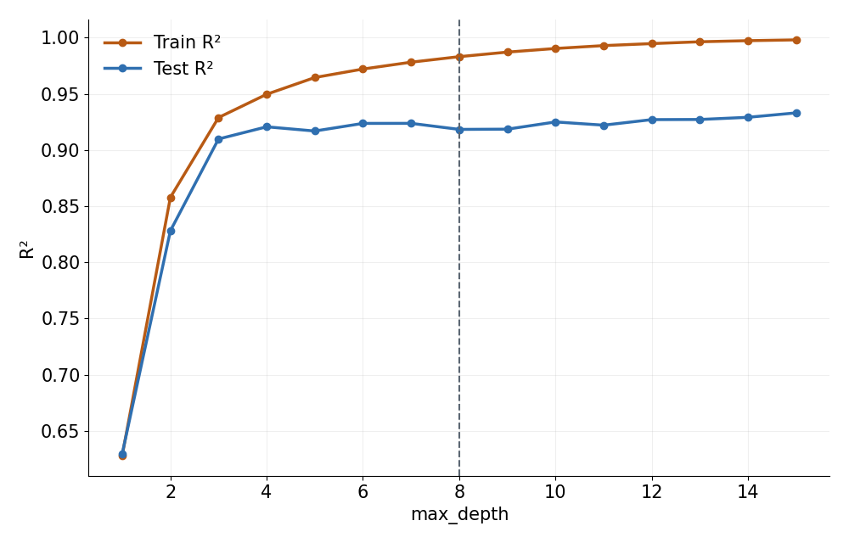
Effect of tree depth
Depth 8 is reasonable
Train R² keeps rising with depth while test R² levels off near 0.92 from depth 4.
On this split deeper trees reach 0.93, but gains are small and overfitting grows.
Decision Tree Regressor · Painting cost estimation
Notes:
Single 80/20 split; test R² by depth: 4 → 0.921, 8 → 0.918, 15 → 0.933.

Slide 13
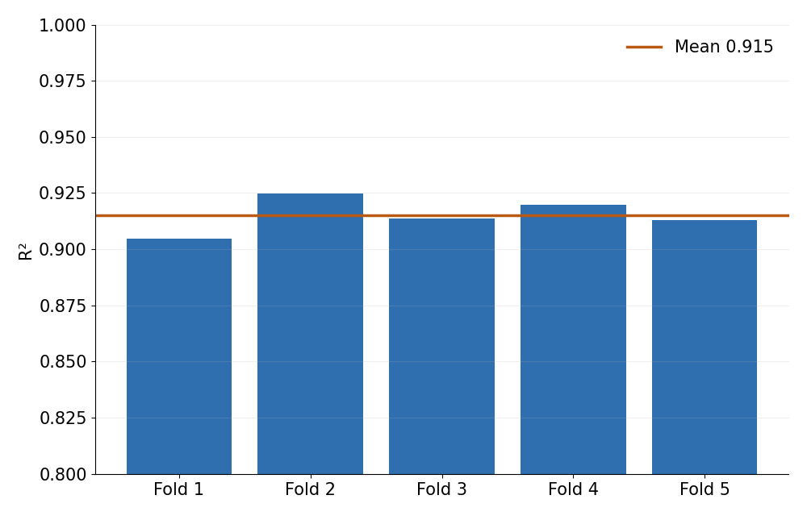
Generalization check
Metric | Train | Test
R² | 0.983 | 0.918
MAE | ₹2.06M | ₹4.69M
RMSE | ₹3.65M | ₹8.33M
5-fold CV R²: 0.915 ± 0.007
Stable across folds, so the test score is not a lucky split.
Decision Tree Regressor · Painting cost estimation
Notes:
Folds: 0.905, 0.925, 0.914, 0.920, 0.913. Mild overfitting remains.

Slide 14
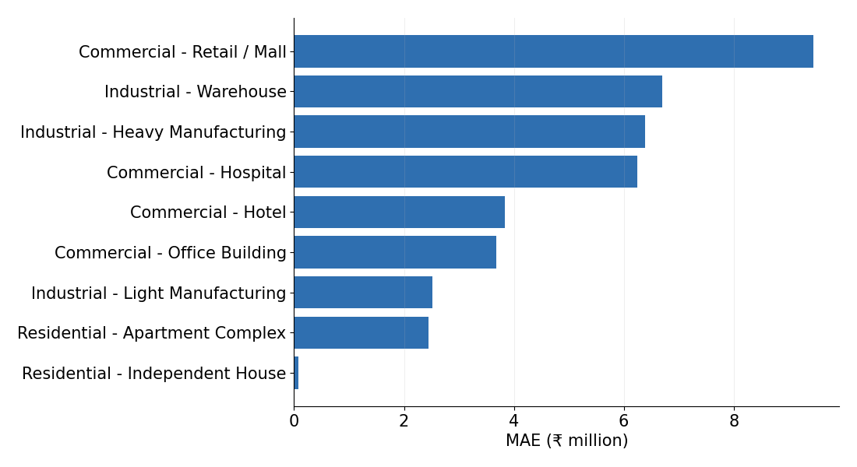
Error by building type
Larger projects, larger errors
Retail / Mall has the highest MAE (₹9.5M); Independent House the lowest.
Errors scale with project size, in line with the quantity-driven model.
Decision Tree Regressor · Painting cost estimation
Notes:
Mean absolute error on the test set grouped by building type.

Slide 15
SVR Model: Implementation
Why Support Vector Regression ?
SVR is a regression method that learns a function with a margin ( epsilon-tube) around predictions. With an RBF kernel, it can model non-linear relationships between project features and painting cost.
1. Prepare the data
2. Preprocess and train SVR
Dataset: painting-related BOQ records
Inputs : items,quantity(sqm),building types
Target: amount_inr
Encode categorical fields: scale numeric features
Fit a preprocessing + SVR pipeline
Start with the RBF kernel
3. Train / test split
70% training
30% testing

Slide 16
SVR Model: Evaluation Result
Model performance
matrices | Simple Vector Regression
MAE | 3228138
RMSE | 5511005
R² score | 0.9636

Slide 17
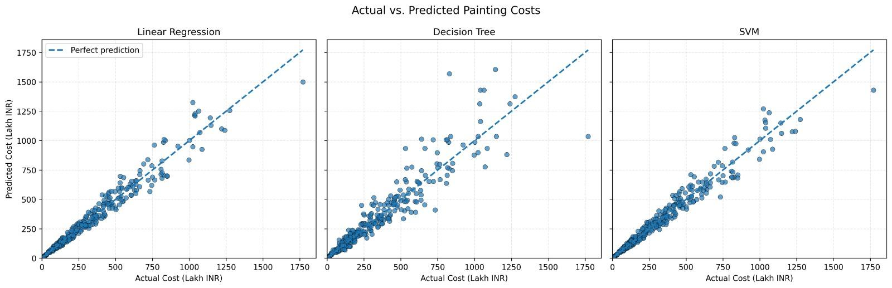
Actual vs. Predicted Painting Costs
The dashed diagonal represents perfect predictions. Points closer to the line indicate smaller prediction errors.
Linear Regression and SVM appear closer to the reference line overall; Decision Tree has more visible deviations, especially for higher-cost samples

Slide 18
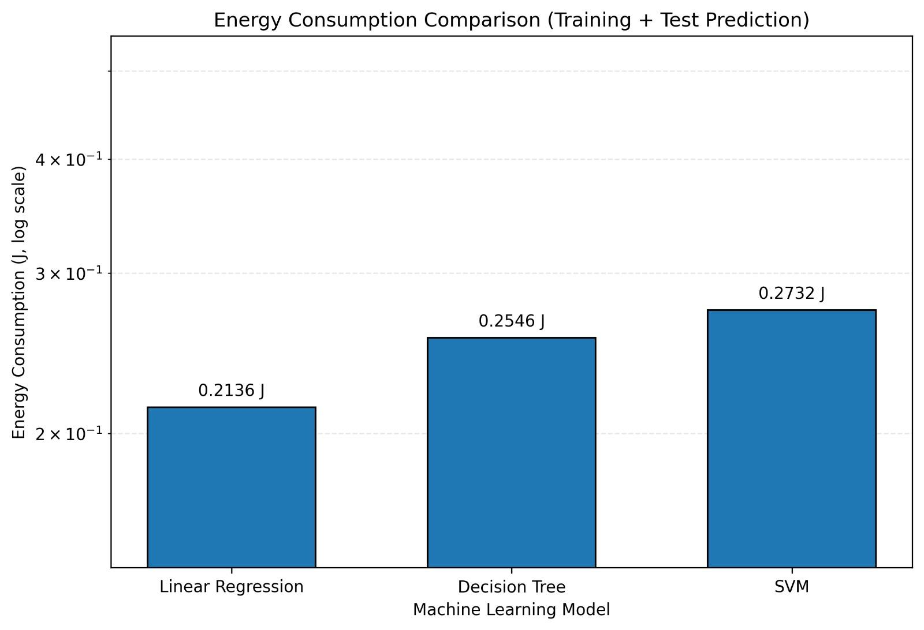
Energy Consumption Comparison
This chart compares energy used during training and test prediction. Lower energy consumption is preferable when model performance is comparable.
Linear Regression uses 0.2136 J, Decision Tree 0.2546 J, and SVM 0.2732 J. Linear Regression has the lowest reported energy use in this plot.

Slide 19
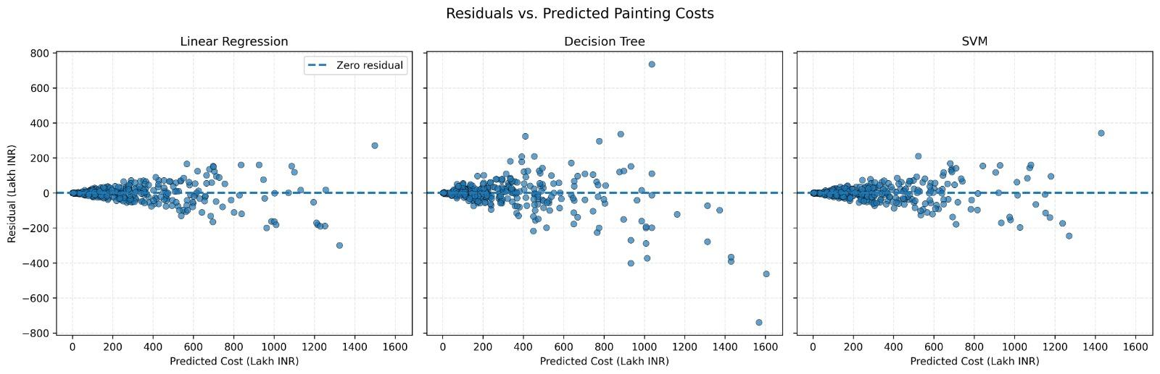
Residuals vs. Predicted Painting Costs
Residual = actual cost − predicted cost. The dashed horizontal line marks zero error; residuals around zero indicate closer predictions.
The spread grows for higher predicted costs, and Decision Tree shows several larger residuals. This suggests high-cost cases are harder to estimate consistently

Slide 20
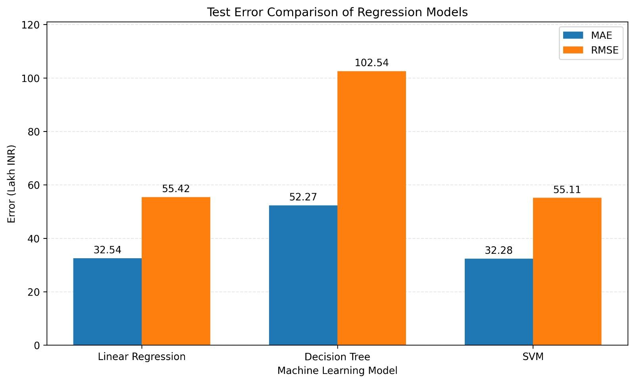
Test Error Comparison: MAE and RMSE
MAE is the average absolute prediction error; RMSE penalizes larger errors more strongly. Lower values indicate better performance.
Linear Regression and SVM have similar errors (MAE ≈ 32.5 and RMSE ≈ 55), while Decision Tree has higher errors (MAE 52.27, RMSE 102.54). Linear Regression has the lowest MAE; SVM has a marginally lower RMSE

Slide 21
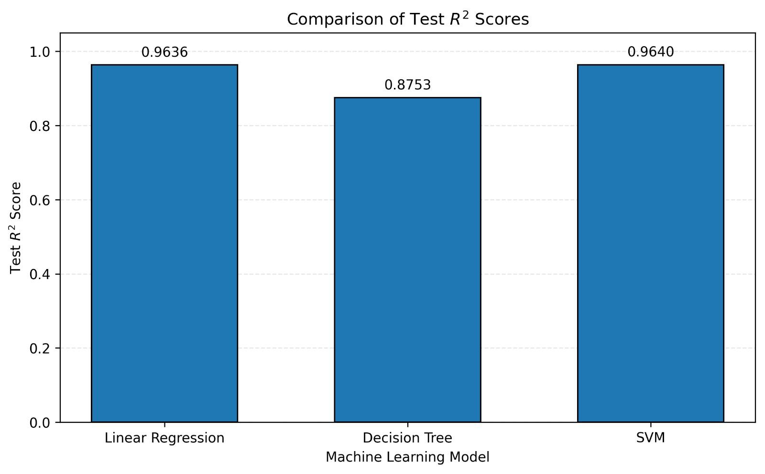
R² Score Comparison
R² score measures how well a model explains the variation in the target variable; values closer to 1 indicate better performance.
SVM (0.9640) and Linear Regression (0.9636) perform almost identically, while Decision Tree has a lower R² score (0.8753). SVM achieves the highest R² score, marginally outperforming Linear Regression.

Slide 22

Conclusion
Code
https://github.com/Goutam363/painting-cost-prediction
R² Score: > 0.96
Integrated with user friendly UI
Questions?
Deployed App
https://painting-cost-prediction.streamlit.app/
Thank You

